Slide 1
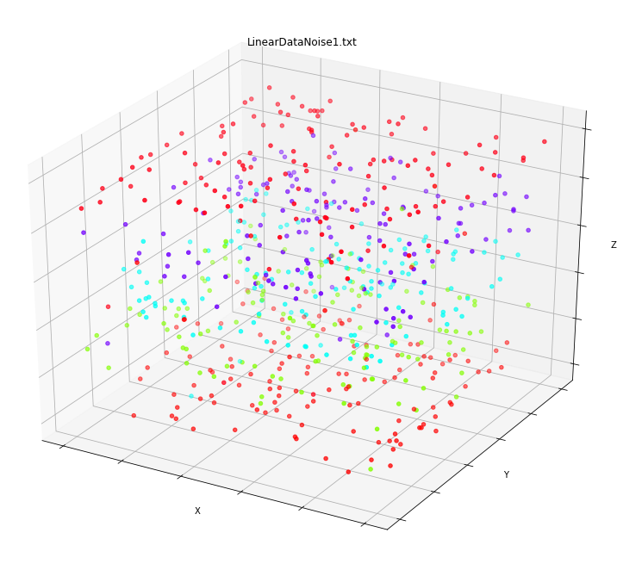
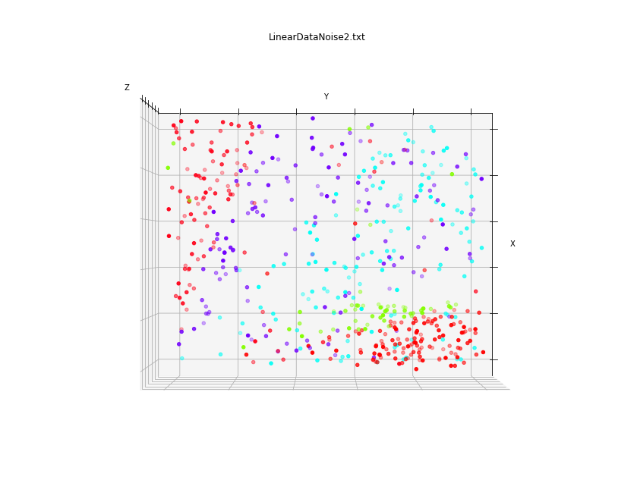
Linear Regression Modification to Perceptron Classifier
Camden Lambe, Ryan Neisess
Introduction:
Developed and tested a Linear Regression Perceptron Classifier (LRPC) vs a Multi Layered Perceptron (MLP)
Used the LRPC to classify based on continuous, discrete integer class values
Aimed to achieve accuracy as good as/better than similar methods (here, the MLP)
Used two subsets of UCI Heart Disease dataset as the initial test data
Created additional four datasets to ensure linearly separable data for further testing
Results:
Visuals:
Dataset | Accuracy (MLP) | Accuracy (LRPC)
Cleveland | 0.5625 | 0.5479
Cleveland + Hungarian | 0.6042 | 0.5869
LinearDataParallel | 0.9493 | 0.3983
LinearDataFanned | 0.6074 | 0.5000
LinearDataNoiseParallel | 0.8622 | 0.2939
LinearDataNoiseFanned | 0.5649 | 0.3480
Table 1: Accuracies of MLP vs LRPC over each dataset
 | 0 | 1 | 2 | 3 | 4
0 | 117 | 0 | 0 | 0 | 2
1 | 27 | 0 | 0 | 0 | 2
2 | 8 | 0 | 0 | 0 | 7
3 | 12 | 0 | 0 | 0 | 4
4 | 7 | 0 | 0 | 0 | 2
 | 0 | 1 | 2 | 3 | 4
0 | 18 | 23 | 0 | 1 | 0
1 | 2 | 12 | 6 | 0 | 3
2 | 1 | 6 | 16 | 18 | 4
3 | 1 | 3 | 11 | 12 | 12
4 | 0 | 1 | 2 | 5 | 25
Graphs 1 (left) and 2 (right): 3-D view of the 3-D linearly separable parallel data with noise (Graph 1) and 2-D view of the 3-D linearly separable fanned data with noise (Graph 2)
Method:
MLP Procedure:
Implemented with sklearn’s MLP
sklearn 2-fold cross validation
Hyperparameter testing (logistic, adam, .000001)
LRPC Procedure:
Basis in the traditional perceptron algorithm, coded from scratch
Custom n-fold (with n == 3) cross-validation
Implementation of max iterations, tolerance, and learning rate hyperparameters
Data Collection:
Average accuracy taken for each run
Confusion matrices computed for each dataset
Conclusion:
LRPC actualization is more difficult than anticipated, but shows some promise
The form of linearly separable data matters
Improved relative accuracy with LRPC on fanned data vs parallel data compared to decreased relative accuracy with MLP
Original dataset does not appear to be linearly separable, even with various forms of data processing, which poses problems
Further research should include both LRPC performance improvements and finding perfectly or nearly linearly separable datasets to train and test
Tables 2 (left) and 3 (right): Confusion matrices for LRPC over the Cleveland + Hungarian dataset (Table 2, single trial) and the LinearDataNosieFanned dataset (Table 3, single trial)
 | 0 | 1 | 2 | 3 | 4
0 | 30209 | 1177 | 569 | 634 | 111
1 | 5534 | 1143 | 1024 | 1176 | 123
2 | 2074 | 1016 | 1159 | 1215 | 436
3 | 1846 | 1203 | 1125 | 1466 | 360
4 | 757 | 480 | 653 | 811 | 99
Table 3: Confusion matrix for MLP over the Cleveland + Hungarian dataset, for ten trials of n == 2 cross-fold validation, yielding the average accuracy reported in Table 1

