Slide 1
Quartiles, Deciles and Percentiles
Prepared By: BCJTT

Slide 2

A. Quartiles for Ungrouped Data
$$Q_{k}=\frac{k(N+1)}{4}$$
Where: $Q_{k}=quartile$
$N=population$
$k=quartile location$

Slide 3
Example
1. Find the first, second, and third quartiles of the ages of 9 middle-management employees of a certain company. The ages are 53, 45, 59, 48, 54, 46, 51, 58, and 55.

Slide 4
Solution
Arrange the data in order.
Select the first, second , and third quartiles using the formula given.
Identify the first, second, and third quartiles in the data set.

Slide 5

Answer:
$Q_{1}=47 , Q_{2}=53 and Q_{3}=56.5$

Slide 6
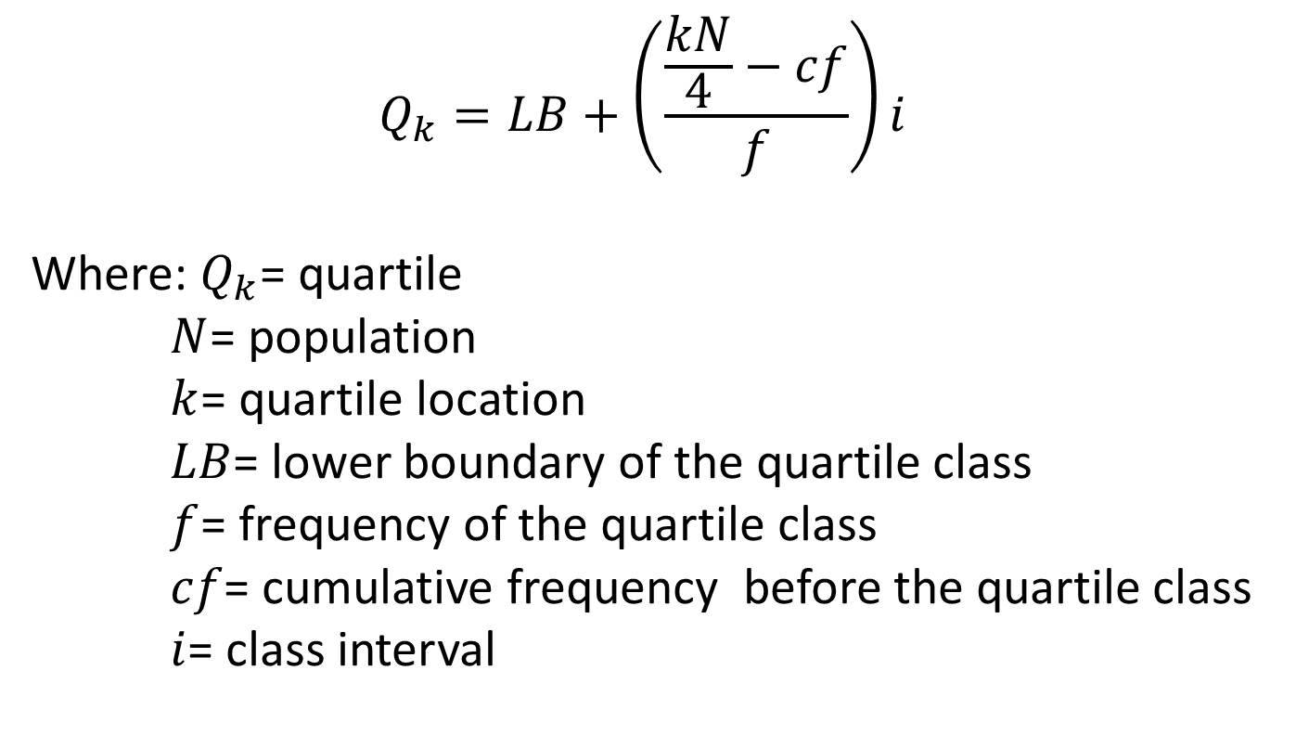
Quartiles for Grouped Data
$$Q_{k}=LB+\left(\frac{\frac{kN}{4}−cf}{f}\right)i$$
Where: $Q_{k}$= quartile
$N$= population
$k$= quartile location
$LB$= lower boundary of the quartile class
$f$= frequency of the quartile class
$cf$= cumulative frequency before the quartile class
$i$= class interval

Slide 7

Example
2. BCJ Travel Agency, a nationwide local travel agency, offers special rates on summer period. The owner wants additional information on the ages of those people taking travel tours. Determine the variance and standard deviation of the frequency distribution on the ages of 50 people taking travel tours.

Slide 8

Class Limits | Frequency
18-26 | 3
27-35 | 5
36-44 | 9
45-53 | 14
54-62 | 11
63-71 | 6
72-80 | 2

Slide 9
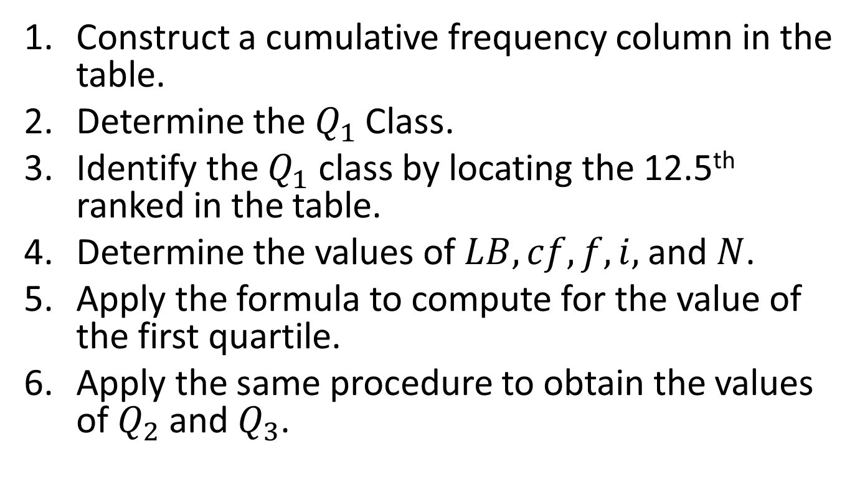
Solution
Construct a cumulative frequency column in the table.
Determine the $Q_{1}$Class.
Identify the $Q_{1}$ class by locating the 12.5th ranked in the table.
Determine the values of $LB, cf, f, i,$and $N$.
Apply the formula to compute for the value of the first quartile.
Apply the same procedure to obtain the values of $Q_{2}$ and $Q_{3}$.

Slide 10
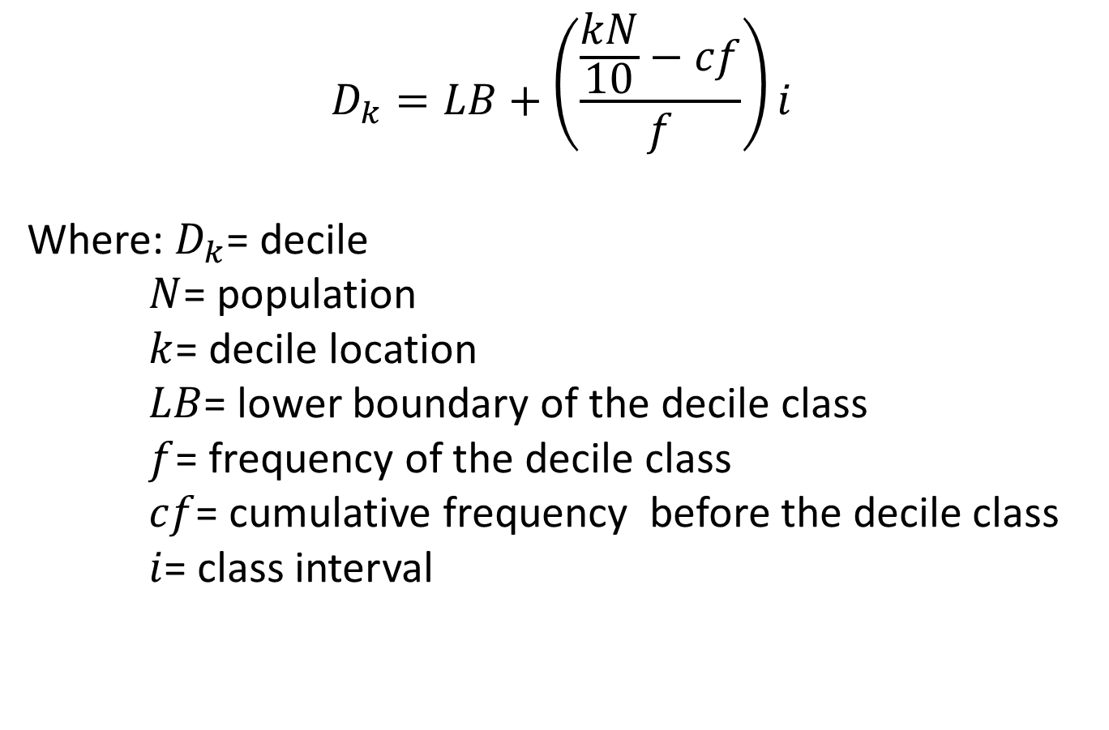
Deciles and Percentiles for Grouped Data
$$D_{k}=LB+\left(\frac{\frac{kN}{10}−cf}{f}\right)i$$
Where: $D_{k}$= decile
$N$= population
$k$= decile location
$LB$= lower boundary of the decile class
$f$= frequency of the decile class
$cf$= cumulative frequency before the decile class
$i$= class interval

Slide 11
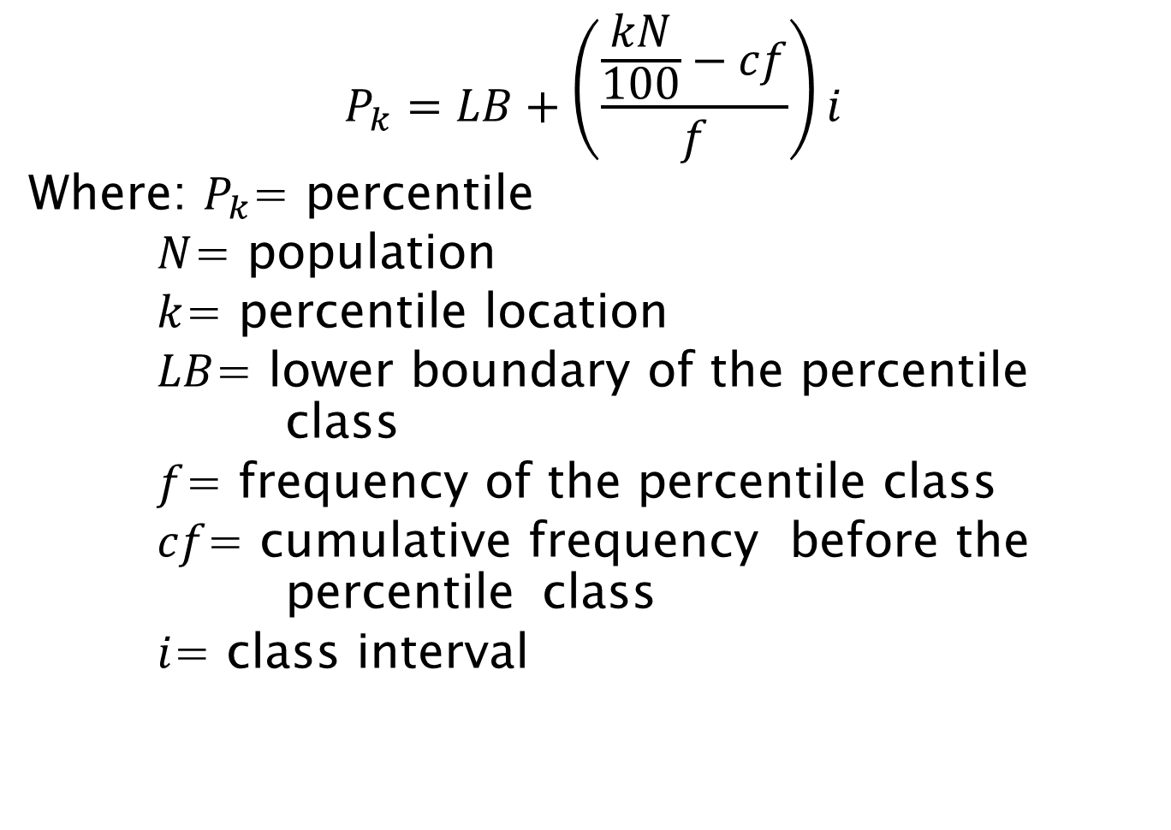
$$P_{k}=LB+\left(\frac{\frac{kN}{100}−cf}{f}\right)i$$
Where: $P_{k}$= percentile
$N$= population
$k$= percentile location
$LB$= lower boundary of the percentile class
$f$= frequency of the percentile class
$cf$= cumulative frequency before the percentile class
$i$= class interval

Slide 12

Example:
Using the example provided in the quartiles on BCJ Travel Agency. Determine the $D_{7}$ and $P_{22}$ of the frequency distribution on the ages of 50 people taking travel tours.

Slide 13
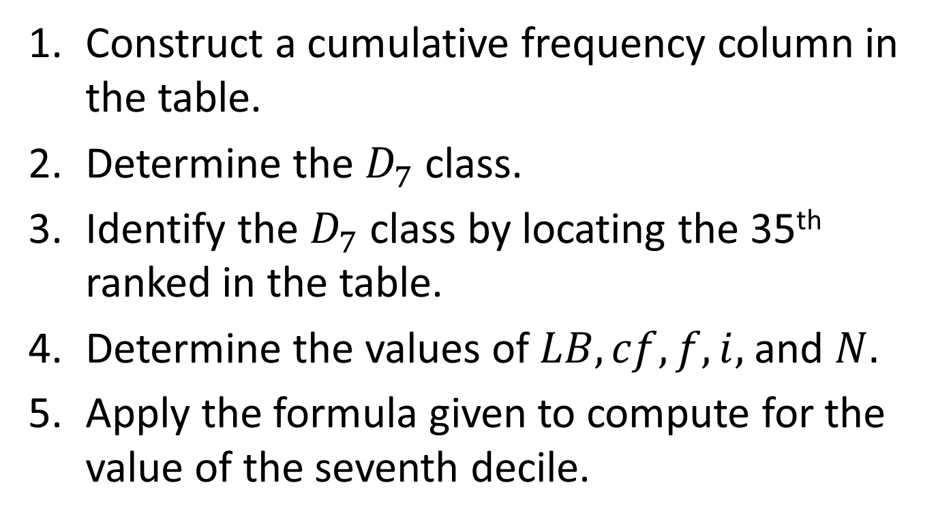
Solution
Construct a cumulative frequency column in the table.
Determine the $D_{7}$ class.
Identify the $D_{7}$ class by locating the 35th ranked in the table.
Determine the values of $LB, cf, f, i,$and $N.$
Apply the formula given to compute for the value of the seventh decile.

Slide 14
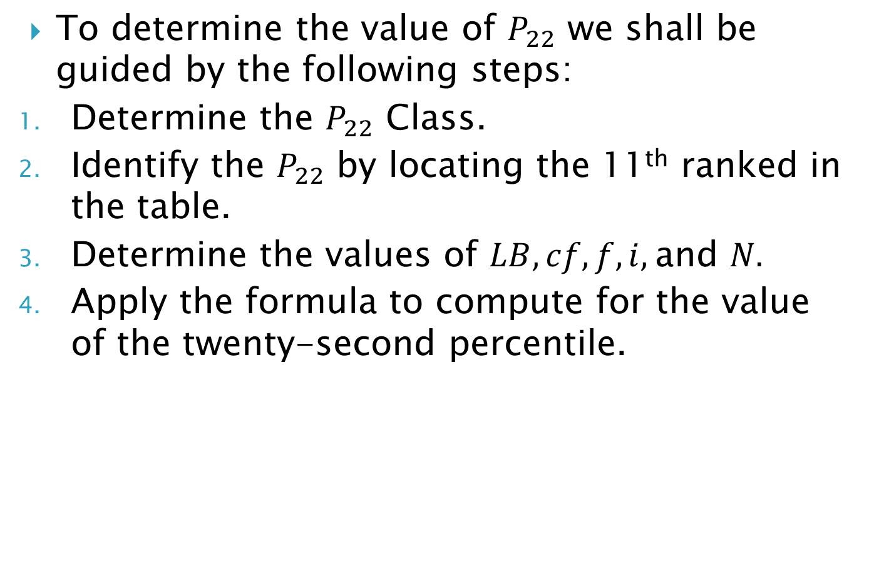
To determine the value of $P_{22}$ we shall be guided by the following steps:
Determine the $P_{22}$ Class.
Identify the $P_{22}$ by locating the 11th ranked in the table.
Determine the values of $LB, cf, f, i,$and $N.$
Apply the formula to compute for the value of the twenty-second percentile.

