Slide 1
HTML

Slide 2
Overview
HTML stands for Hyper Text Markup Language, which is the most widely used language on Web to develop web pages.
HTML was created by Tim Berners-Lee in late 1991 but "HTML 2.0" was the first standard HTML specification which was published in 1995.
HTML 4.01 was a major version of HTML and it was published in late 1999. Though HTML 4.01 version is widely used but currently we are having HTML-5 version which is an extension to HTML 4.01, and this version was published in 2012.

Slide 3
HTML stands for Hypertext Markup Language, and it is the most widely used language to write Web Pages.
Hypertext refers to the way in which Web pages (HTML documents) are linked together. Thus, the link available on a webpage is called Hypertext.
As its name suggests, HTML is a Markup Language which means you use HTML to simply "mark-up" a text document with tags that tell a Web browser how to structure it to display.

Slide 4
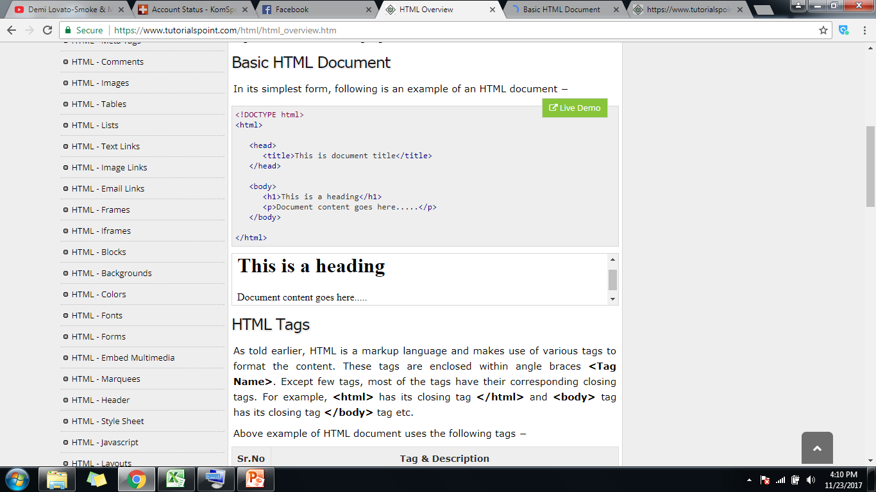
Basic HTML Document
<html>
<head>
<title>This is document title</title>
</head>
<body>
<h1>This is a heading</h1>
<p>Document content goes here.....</p>
</body>
</html>

Slide 5
HTML Tags
HTML is a markup language and makes use of various tags to format the content. These tags are enclosed within angle braces <Tag Name>. Except few tags, most of the tags have their corresponding closing tags. For example, <html> has its closing tag </html> and <body> tag has its closing tag </body> tag etc.

Slide 6
Sr.No | Tag & Description
1 | <html>This tag encloses the complete HTML document and mainly comprises of document header which is represented by <head>...</head> and document body which is represented by <body>...</body> tags.
2 | <head>This tag represents the document's header which can keep other HTML tags like <title>, <link> etc.
3 | <title>The <title> tag is used inside the <head> tag to mention the document title.
4 | <body>This tag represents the document's body which keeps other HTML tags like <h1>, <div>, <p> etc.
5 | <h1>This tag represents the heading.
6 | <p>This tag represents a paragraph.

Slide 7
Sr.No | Tag & Description
7 | HTML also has six levels of headings, which use the elements <h1>, <h2>, <h3>, <h4>, <h5>, and <h6>. While displaying any heading, browser adds one line before and one line after that heading.
8 | <br /> element, anything following it starts from the next line. This tag is an example of an empty element, where you do not need opening and closing tags, as there is nothing to go in between them.
9 | <center> tag to put any content in the center of the page or any table cell.
10 | <hr> tag creates a line from the current position in the document to the right margin and breaks the line accordingly.
11 | opening <pre> tag and the closing </pre> tag will preserve the formatting of the source document

Slide 8
HTML Elements
HTML element is defined by a starting tag. If the element contains other content, it ends with a closing tag, where the element name is preceded by a forward slash.
So here <p>....</p> is an HTML element, <h1>...</h1> is another HTML element. There are some HTML elements which don't need to be closed, such as <img.../>, <hr/> and <br/> elements. These are known as void elements.

Slide 9
HTML Tag vs. Element
An HTML element is defined by a starting tag. If the element contains other content, it ends with a closing tag.
For example, <p> is starting tag of a paragraph and </p> is closing tag of the same paragraph but <p>This is paragraph</p> is a paragraph element.

Slide 10
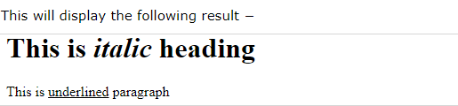
Nested HTML Elements
<html>
<head>
<title>Nested Elements Example</title> </head>
<body>
<h1>This is <i>italic</i> heading</h1> <p>This is <u>underlined</u> paragraph</p>
</body> </html>

Slide 11
HTML Attributes
An attribute is used to define the characteristics of an HTML element and is placed inside the element's opening tag. All attributes are made up of two parts: a name and a value:
The name is the property you want to set. For example, the paragraph element in the example carries an attribute whose name is align, which you can use to indicate the alignment of paragraph on the page.
The value is what you want the value of the property to be set and always put within quotations. The below example shows three possible values of align attribute: left, center and right.

Slide 12
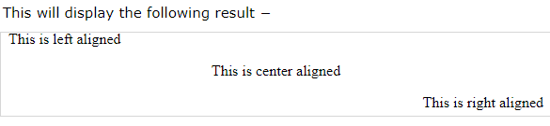
<html>
<head>
<title>Align Attribute Example</title>
</head>
<body>
<p align = "left">This is left aligned</p> <p align = "center">This is center aligned</p> <p align = "right">This is right aligned</p>
</body>
</html>

Slide 13
Core Attributes
The four core attributes that can be used on the majority of HTML elements (although not all) are −
Id - used to uniquely identify any element within an HTML page
Title - depend upon the element that carries it, although it is often displayed as a tooltip when cursor comes over the element or while the element is loading.
Class - used to associate an element with a style sheet, and specifies the class of element.
Style - allows you to specify Cascading Style Sheet (CSS) rules within the element.

Slide 14
Generic Attributes
Attribute | Options | Function
Align | Right,left,center | Horizontally aligns tag
Valign | Top, middle, bottom | Vertically align tags within an html element
Bgcolor | Numeric, hexadecimal, rgb vaues | Places a background color behind an element
Attribute | URL | Places a background image behind an element
ID | User Defined | Names an element for use with Cascading Style Sheets.
Class | User Defined | Classifies an element for use with Cascading Style Sheets.

Slide 15
HTML Tags
Document Elements
HTML | HTML | Tells browser that the included text is in HTML format | Element includes Head, Body, and other elements
 | <HTML> <HEAD></HEAD> <BODY> </BODY> </HTML>
HEAD | Header | Includes 'header', non-displaying information about the document, like the TITLE and other descriptive tags | Element can include Title, Meta, Base and other elements
 | <HEAD> <TITLE>Basic HTML Elements</TITLE> </HEAD>
TITLE | Document Title | Title that appears in Browser header and on bookmark lists. Should be concise and meaningful.
 | <TITLE>Basic HTML Elements</TITLE> | [see top of this page]
BODY | Document Body | Defines the content of the document. | BGCOLOR, BACKGROUND, TEXT, LINK, ALINK, VLINK
 | <BODY> </BODY> | See the background of this page

Slide 16
HTML Tags cont.
Body Elements
H1 H2 H3 H4 H5 H6 | Heading | Text of the Element is a section heading. Headings are numbered and displayed in order of decreasing importance. Headings are separate paragraphs. | ALIGN
 | <H1 ALIGN="CENTER">Page Name</H1> <H2>Section Heading</H2> | Page Name Section Heading
P | Paragraph | Defines paragraphs in the document. Usually paragraphs | ALIGN
 | <P>First paragraph, no content.</P> <P>Second paragraph, slightly more content here.</P> | First paragraph, no content. Second paragraph, slightly more content here.
BR | Break or Line Break | Puts a single break in the middle of a paragraph, list item, etc.
 | <P>First paragraph, <BR> no content.</P> | First paragraph, no content.

Slide 17
HTML Tags cont.
Body Elements
HR | Horizontal Rule | Runs a horizontal line across the page (or table cell) | SIZE WIDTH
 | <HR SIZE="10" WIDTH="50%">
DIV | Division | Defines a particular section of the document. Used to spread document attributes across a whole section. | ALIGN VALIGN, etc
 | <DIV ALIGN="RIGHT"> </DIV>
BLOCKQUOTE | Block Quote | Displays a block of text quoted from another document. Usually indented on all four sides.
 | <BLOCKQUOTE>Far off in a distant backwater of the unfashionable end of the western spiral arm of the galaxy....</BLOCKQUOTE> | Far off in a distant backwater of the unfashionable end of the western spiral arm of the galaxy...
PRE | Preformatted Text | Uses formatting (spacing, tabs, carriage returns, breaks, etc.) exactly as in the plain ASCII text of the document. Usually displays in a fixed font, such as Courier.
 | <PRE>User Services Begins Here</PRE> | User Services Begins Here

Slide 18
HTML Tags cont.
Style and Appearance Elements
STRONG | Strong emphasis | (logical formatting). Very important text. Generally displays as Bold.
 | <STRONG>Very Important</STRONG> | Very Important
EM | Emphasis | (logical formatting) Important text. Generally displays as Italic
 | <EM>Important information</EM> | Important information
CITE | Citation | Title of a cited work. Generally displays as Italic
 | <CITE>Huckleberry Finn,</CITE>, by Mark Twain. | Huckleberry Finn, by Mark Twain
CODE | Computer Code | Indicates computer code, such as programming languages, computer commands, etc. Usually displays in a fixed font.

Slide 19
HTML Tags cont.
Style and Appearance Elements
B | Bold | Displays text as bold.
 | <B>Bloody, bold and resolute</B> | Bloody, bold and resolute
I | Italic | Displays text as italic
 | <I>Caveat emptor</I>: let the buyer beware! | Caveat emptor: let the buyer beware!
U | Underline | Shows text as underlined (not supported by older versions of Netscape).
 | <U>Underlined Text</U> | Underlined Text
TT | Fixed font | Displays text in a 'fixed' font (in which each letter is the same size, such as Courier)-- similar to PRE , CODE, etc.
 | <TT>Fixed Text</TT> | Fixed Text
FONT | Font appearance. | Sets relative or absolute font size, font color. | SIZE COLOR
 | <FONT SIZE="+2" COLOR="#bb4732">Colored text</FONT> | Colored text

Slide 20
HTML Tags cont.
Anchor Element: Links and Named Targets
A HREF="URL" | Hypertext link (Special case of the Anchor element) | Allows the user to retrieve the document at the specified URL by clicking on the contents of the element. (Usually displayed as blue and underlined.) The URL may include a named target. | NAME, REL, REV URN,TITLE,TARGET
 | Go to <A HREF="htmlchart.html#named_target"> named anchor section</A> | Go to named anchor section.
A NAME="name" | Named Anchor, or target | Sets a 'target'/'anchor' which hypertext links can point to. | HREF, REL, REV URN,TITLE,TARGET
 | <A NAME="named_target">Named Target</A> | Named Target

Slide 21
HTML Tags cont.
Image Element
IMG | Image | Displays an 'inline' (embedded in the document) image in the document. Source (SRC="") gives the full or partial URL of the image file to use; ALT gives the alternative/caption text for the image | SOURCE, ALT, HEIGHT, WIDTH, BORDER
 | <IMG SRC="/icons/mthawk.gif" ALT="Lehigh mountain hawk">

Slide 22
HTML Tags cont.
List Elements
UL | Unordered List | Bullet List. Items in the list are LI elements. Lists can be nested. | TYPE
 | <UL> <LI>First Item <LI>Second Item </UL> | First Item Second Item
OL | Ordered List | Numberd (or lettered) list. Items in the list are LI elements. Lists can be nested. | TYPE
 | <OL TYPE="A"> <LI>First Item <LI>Second Item </OL> | First Item Second Item

Slide 23
HTML Tags cont.
List Elements
LI | List item | An item in a bullet or numbered list. List items can include other lists (nesting lists), line breaks, and other HTML tags. Close tags </LI> are optional.
 | <UL> <LI>List item One <UL> <LI>Niggle One <LI>Niggle Two </UL> <LI>List item Two </UL> | List item One Niggle One Niggle Two List item Two
DL | Descriptive List or Definition List | A list of terms with definitions or entries with annotations. Contains DT and DD elements. DT elements are the 'terms' or main entries DD elements are the definitions or annotations.
 | <DL> <DT>Hack <DD>To program skillfully. <DT>Crack <DD>To break into a computer system </DL> | Hack To program skillfully. Crack To break into a computer system.

Slide 24
HTML Tags cont.
List Elements
DT | Term in Definiton list | In an annotated list, the item or term being annotated
 | <DL> <DT>Hack <DD>To program skillfully </DL> | Hack To program skillfully.
DD | Definition in Definition list | In an annotated list, the annotation or definition
 | <DL><DT>Hack<DD> <OL> <LI>[v.]to program skillfully <LI>[n.,archaic]a makeshift, a kludge </OL></DD></DL> | Hack [v.] to program skillfully [n.,archaic] a makeshift, a kludge

Slide 25
HTML Tags cont.
Other Elements
<!-- --> | Comment | Inserts a 'comment' which does not display on the browser screen, but can be seen in the file itself when viewing the source or editing the HTML.
 | <!-- This is a comment -->

