Slide 1
ICPC Bootcamp Day 3
3.4 Greedy
3.5 Dynamic Programming
3.5.1 DP Illustration
3.5.2 Classical Examples
3.5.3 Non-Classical Examples

Slide 2
3.4 Greedy
The Core Concept:
  An algorithm that makes the locally optimal choice at each step with the hope that these local choices lead to a globally optimal solution.
When does it work? A problem must have two key ingredients:
  Greedy-Choice Property: A global optimum can be arrived at by selecting a local optimum.
  Optimal Substructure: An optimal solution to the problem contains optimal solutions to its subproblems.5
Greedy algorithms are infamous for providing solutions that look right but fail on edge cases.
If you cannot logically prove the greedy choice is always correct, consider Dynamic Programming instead
The Advantage: When a greedy strategy works, it is usually much faster and easier to code than Complete Search or Dynamic Programming.
Notes:
https://wiki.python.org/moin/TimeComplexity

Slide 3
Example: The Coin Change Problem
The Goal: Give a customer a specific amount of change using the absolute minimum number of coins.
The Greedy Strategy: Always pick the largest coin denomination that fits into the remaining balance.
When Greedy WORKS (Standard Currency):
  Denominations: Canadian coins: {1, 5, 10, 25, 100, 200} (in cents).
  Target: Make $2.87 (287 cents).
  Execution:
    Pick 200 (Remaining: 87)
    Pick 25 (Remaining: 62)
    Pick 25 (Remaining: 37)
    Pick 25 (Remaining: 12)
    Pick 10 (Remaining: 2)
    Pick 1 (Remaining: 1)
    Pick 1 (Remaining: 0)
  Result: 7 coins. For this specific set of denominations, Greedy is mathematically proven to always be optimal!
When Greedy FAILS (Custom Currency):
  Denominations: A fictional currency with coins {1, 3, 4}.
  Target: Make 6.
  Greedy Execution:
    Pick 4 (Remaining: 2)
    Pick 1 (Remaining: 1)
    Pick 1 (Remaining: 0)
  Result: 3 coins (4 + 1 + 1).
The Optimal Solution: Just use two 3 coins (3 + 3 = 6).
Greedy blindly took the biggest coin (4) and trapped itself into a sub-optimal path. When Greedy fails like this, you must use Dynamic Programming!
Notes:
https://wiki.python.org/moin/TimeComplexity

Slide 4
3.5 Dynamic Programming
The Core Concept:
  DP is essentially "smart recursion" or "exhaustive search with a memory."
How it works:
  It breaks a complex problem down into simpler subproblems, solves each subproblem just once, and stores their solutions.
When does it work?
  Optimal Substructure: Similar to greedy, the global optimal solution can be built from optimal sub-solutions.
  Overlapping Subproblems: The space of subproblems must be small, meaning the same subproblems are encountered repeatedly.
The Advantage: Transforms exponential time complexities (like 𝑂(2^{𝑁} )) into polynomial time complexities (like 𝑂(𝑁² )).
Primarily used in optimization problems and counting problems
  If you encounter a problem that says “minimize this” or “maximize that” or “count the ways to do that”, then there is a (high) chance that it is a DP problem
Notes:
Write these 3 rules down on the board

Slide 5
3.5 Dynamic Programming – Problem Study Wedding Shopping
Variation on the Knapsack problem
Given different options for each garment (e.g., 3 shirt models, 2 belt models, 4 shoe models, . . . )
Given a limited budget
Task: buy one model of each garment and spend the maximum possible amount
Input:
  Let M be the budget where 1 <= M <= 200
  Let C be the number of garment types where 1 <= C <= 20
  Let g be the set of garments i.e. g ∈ [0..C-1]
    Each garment in g has possible 1 to 20 (inclusive) models
Output: Integer of maximum amount of money we can spend, else print “no solution”
UVa 11450 - Wedding Shopping
https://onlinejudge.org/index.php?option=com_onlinejudge&Itemid=8&page=show_problem&problem=2445
https://onlinejudge.org/external/114/11450.pdf
https://github.com/stevenhalim/cpbook-code/tree/master/ch3/dp
Notes:
Copy input information to the board

Slide 6
3.5 Dynamic Programming – Example Test Cases
Ex: l
  Test case M=20, C=3
  Price of garments in g₀ → 6 4 8 // the prices are not sorted in the input
  Price of garments in g₁ → 5 10
  Price of garments in g₂ → 1 5 3 5
For this test case, the answer is 19, which may result from buying the underlined items (8+10+1). This is not unique, as solutions (6+10+3) and (4+10+5) are also optimal.
Ex: 2
  Test case M=9, C=3
  Price of garments in g₀ → 6 4 8
  Price of garments in g₁ → 5 10
  Price of garments in g₂ → 1 5 3 5
The answer is then “no solution” because even if we buy all the cheapest models for each garment, the total price (4+5+1) = 10 still exceeds our given budget M = 9.
Sources:
  Competitive Programming 4 Section 3.5
Notes:
Copy these 2 examples to the board
Ex: l
Test case M=20, C=3
Price of the 3 models of garment g = 0 → 6 4 8 // the prices are not sorted in the input
Price of the 2 models of garment g = 1 → 5 10
Price of the 4 models of garment g = 2 → 1 5 3 5
For this test case, the answer is 19, which may result from buying the underlined items (8+10+1).
This is not unique, as solutions (6+10+3) and (4+10+5) are also optimal.
Ex: 2
Test case M=9, C=3
Price of the 3 models of garment g = 0 → 6 4 8
Price of the 2 models of garment g = 1 → 5 10
Price of the 4 models of garment g = 2 → 1 5 3 5
The answer is then “no solution” because even if we buy all the cheapest models for each garment,
the total price (4+5+1) = 10 still exceeds our given budget M = 9.

Slide 7
3.5 Dynamic Programming – Greedy
One idea to maximize the budget is to take the most expensive model for each garment g which still fits in out budget!
This seems to work with example 1 and 2 but does not work with the following example
Ex: 3
  Test case M=12, C=3
  Price of garments in g₀ → 6 4 8
  Price of garments in g₁ → 5 10
  Price of garments in g₂ → 1 5 3 5
Greedy strategy selects garment in g₀ with price 8 (b = 12-8 = 4), causing us to not have enough budget to buy any model in garment g₁, thus incorrectly reporting “no solution”.
One optimal solution is 4+5+3 = 12, which uses up all our budget.
  The optimal solution is not unique as 6+5+1 = 12 also depletes the budget.
Notes:
Work through example 1 and 2 using greedy method and copy example 3 to the board
(one optimal is 4+5+3=12)
Ex: 3
Test case M=12, C=3
Price of the 3 models of garment g = 0 → 6 4 8
Price of the 2 models of garment g = 1 → 5 10
Price of the 4 models of garment g = 2 → 1 5 3 5

Slide 8
3.5 Dynamic Programming – Divide and Conquer
We can try.. but we will soon realize that it does not work why is that?
  This is because divide and conquer shines when each sub-problem are independent from each other
  This problem has sub-problems that are dependent on each other
Notes:
We can try.. but we will soon realise that it does not work why is that?
This is because divide and conquer shines when each sub-problem are independent from each other i.e.

Slide 9
3.5 Dynamic Programming – Complete Search
Recursive backtracking
Write a recursive function dp(g, b)
  g is the current garment g that we are dealing with
  b is the current (remaining) budget b that we have
  returns the required answer
Note that the pair (g, b) is the state of this problem
Idea:
  Start with g₀ (first garment) and b=M (initial budget) then try all possible models in garment g₀ and recurse
  Stop when we tried all the garments
  Prune when a solution is infeasible (b < 0)
  Pick solution with result that is the smallest non-negative b
Sources:
  Competitive Programming 4 Section 3.5

Slide 10
3.5 Dynamic Programming – Complete Search
Formally define Complete Search recurrences (transitions)
if b < 0 (i.e., the remaining budget goes negative),
  dp(g, b) = - ∞(in practice, we can just return a large negative value)
If a model from the last garment type has been bought, that is, g_{C}
  dp(g, b) = M-b (this is the actual budget that we spent)
In general case, for every garment in current garment type g_{i}
  dp(g, b) = max(dp(g_{i+1}, b-price[ g_{i} ][model]))
  We want to maximize this value (Recall that the invalid ones have large negative value)
Issue: Very very slow!!!!!!!
  There can be up to 20 garments each with up to 20 models, therefore there are 20²⁰ solutions that it could possibly check in the worst case
Sources:
  Competitive Programming 4 Section 3.5

Slide 11
3.5 Dynamic Programming Top-Down vs Bottom-UP DP
Top-Down (Memoization):
  Write a recursive Complete Search function.
  Save (memoize) the return value in a lookup table (array or hash map) based on the state parameters.
  If the state has been visited before, return the saved value instead of branching further.
  Pros: Natural translation from problem description; only computes necessary states.
  Cons: Can be slower than Bottom-Up
Bottom-Up (Tabulation):
  Build a table iteratively starting from the base cases up to the final answer.
  Determine the topological order of subproblem dependencies.
  Pros: Avoids recursive overhead; more cache-friendly memory access.
  Cons: Not as intuitive to reason through
Notes:
Write these 3 rules down on the board

Slide 12
3.5 Dynamic Programming – Top-Down
How many distinct problems?
  20 possible garments and 201 (0 to 200 inclusive) possible budget values therefore there are only 201x20 = 4020 distinct sub-problems! DP allows you to calculate each just once!
We can use a recursive backtracking complete search algorithm and turn it into a top-down DP by adding the following:
DP memo table so that we can access in O(1) past calculations
  Fill DP memo table with a dummy value that signifies that the calculation has not been made yet
At the start of recursive function, check if this state has been computed before
  If it has, return value from DP memo table (origin of word memoization)
  If it has not been computed before, perform computation and store in DP memo table
Notes:
Write these 2 rules on the board

Slide 13
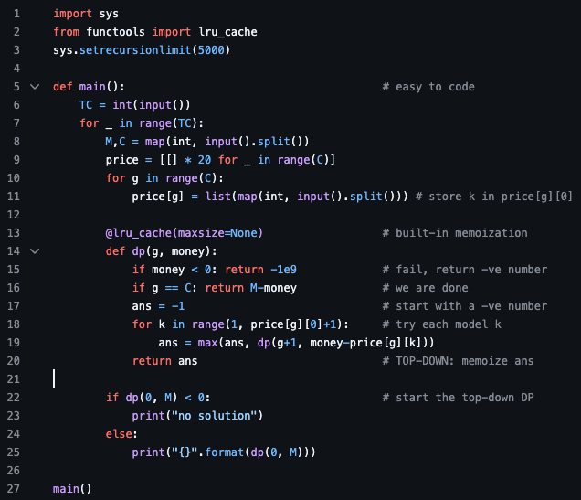
3.5 Dynamic Programming – Top-Down
Python has lru_cache (from functools library) that is a built-in memoization table
It will automatically save and then retrieve answers that are the same
Notes:
Write these 2 on the board

Slide 14
3.5 Dynamic Programming – Top-Down
Runtime analysis
If it has M distinct states, then it requires O(M) memory space
If computing one state (complexity of DP transition) requires O(k) step, then overall time complexity is O(Mk) as DP guarantees that each state is just computed once
This UVa 11450 problem has M = 20 x 201 = 4020 and k = 20 (as we must iterate through at most 20 models for each garment g).
Thus, the time complexity is at most 4020 x 20 = 80 400 operations per test case
Notes:
@functools.lru_cache(maxsize=128, typed=False)
Decorator to wrap a function with a memoizing callable that saves up to the maxsize most recent calls. It can save time when an expensive or I/O bound function is periodically called with the same arguments.

Slide 15
3.5 Dynamic Programming – Bottom-Up
Determine the required set of parameters that uniquely describe the problem (the state)
  Similar to recursive backtracking and top-down DP as shown earlier
If there are N parameters required to represent the states, create an N dimensional array (DP table), with one entry per state.
  Similar to the memo table in top-down DP; however, in bottom-up DP, we only need to initialize some cells of the DP table with known initial values (the base cases) rather than dummy values as in top-down DP.
With the base-case cells/states in the DP table already filled, determine the cells/states that can be filled next (the transitions)
  Repeat this process until the DP table is complete
  Usually accomplished through iterations, using loops
Notes:
Write these 3 rules down on the board

Slide 16
3.5 Dynamic Programming – Bottom-Up
We will use example A
Determine the required set of parameters that uniquely describe the problem (the state)
  Two parameters: the current garment g and the current budget left b (same as top-down)
Let g be the row indices
  Init 2D table (Boolean matrix) reachable[g][b] of size 20 x 201
Fill in the table row by row using previous rows
  Row 0: 12 (from 20-8), 14 (from 20-6), and 16 (from 20-4)
  Let p be the price of a model of current garment g. Loop through rest of the rows where if reachable[g-1][b] is true, then the next state reachable[g][b-p] is also reachable as long as b-p is not negative.
Answer is the the reachable state that is closest to 0 (as we want to have the least amount of money left)
  If there are no reachable states in the last row then there are no solutions
Let’s work it out!
Notes:
Work it out on the IPad

Slide 17
Bottom-Up Ex: 1, Step 1
Determine the required set of parameters that uniquely describe the problem (the state)
  Two parameters: the current garment g and the current budget left b (same as top-down)
Notes:
Write these 3 rules down on the board

Slide 18
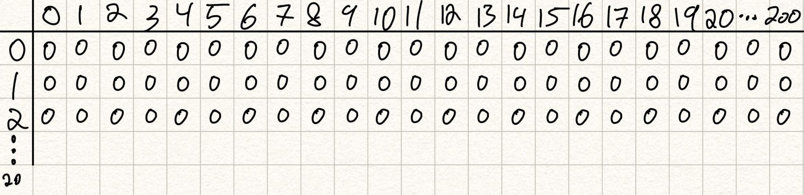
Bottom-Up Ex: 1, Step 2
Let g be the row indices
  Init 2D table (Boolean matrix) reachable[g][b] of size 20 x 201
Notes:
Write these 3 rules down on the board

Slide 19
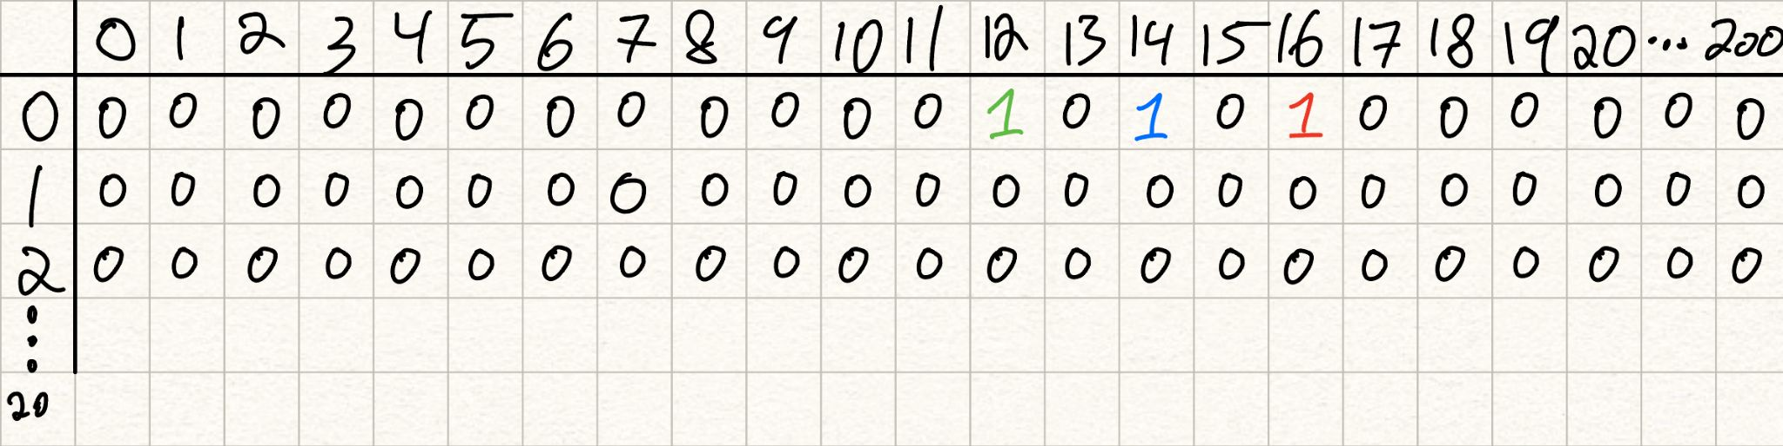
Bottom-Up Ex: 1, Step 3
Fill in the table row by row using previous rows
  Row 0: 12 (from 20-8), 14 (from 20-6), and 16 (from 20-4)
  Let p be the price of a model of current garment g. Loop through rest of the rows where if reachable[g-1][b] is true, then the next state reachable[g][b-p] is also reachable as long as b-p is not negative.
Notes:
Write these 3 rules down on the board

Slide 20
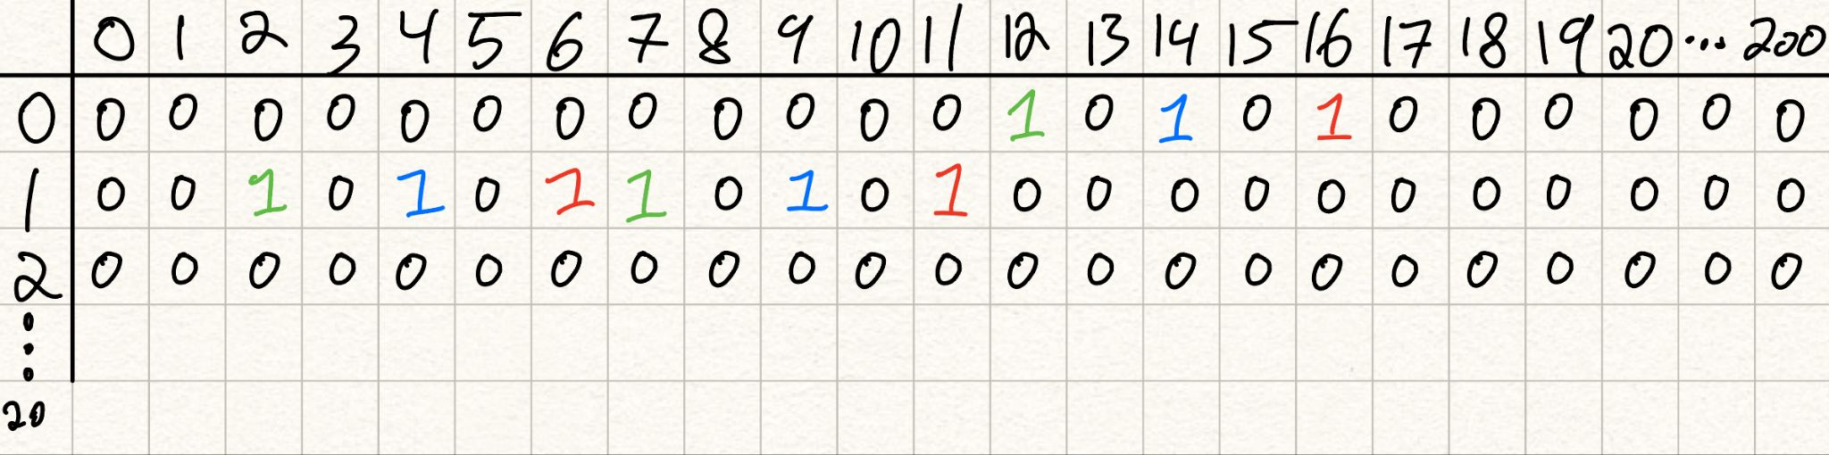
Bottom-Up Ex: 1, Step 3
Notes:
Write these 3 rules down on the board

Slide 21
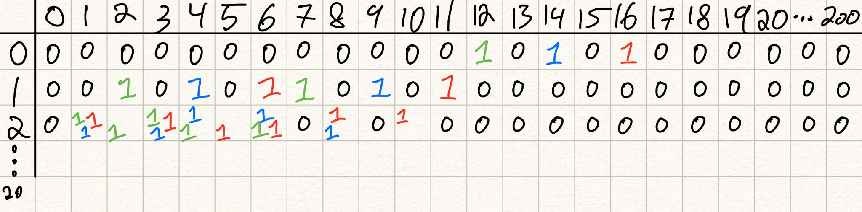
Bottom-Up Ex: 1, Step 3
Notes:
Write these 3 rules down on the board

Slide 22
Bottom-Up Ex: 1, Step 4
Answer is the the reachable state that is closest to 0 (as we want to have the least amount of money left)
  If there are no reachable states in the last row then there are no solutions
Here, the answer is 19! (20-1)
Notes:
Write these 3 rules down on the board

Slide 23
3.5 Dynamic Programming – Bottom-Up
For problems where we only need the last row of the DP table (the optimal answer and not the whole solution) you can optimize memory usage!
Note that we only need to store two rows, the current row we are processing and the previous row we have processed.
  To compute row 1, we only need to know the columns in row 0 that are set to true in reachable.
  To compute row 2, we only need to know the columns in row 1 that are set to true in reachable.
Instead of having a whole table, we can just init 2 rows, have one be a curr, the other be a prev and then swap the two rows as we compute!
For this problem it doesn’t save that much space, but for more complicated problems and larger datasets, it can be useful!
Notes:
Write these 3 rules down on the board

Slide 24
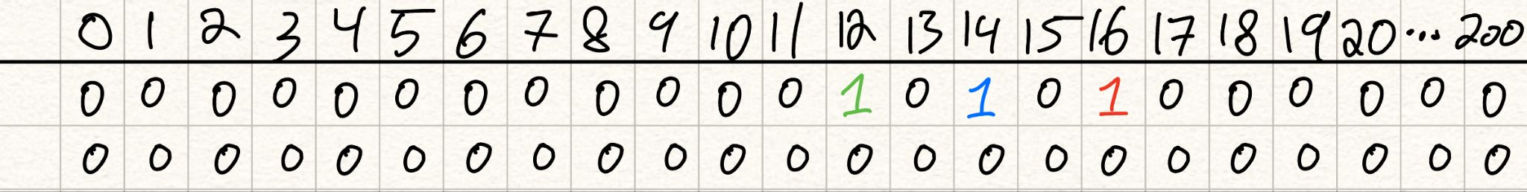
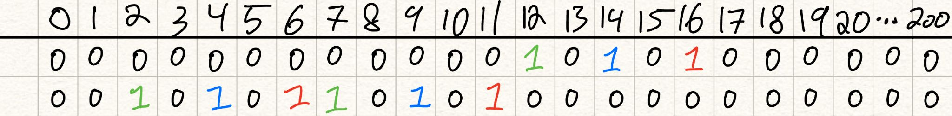
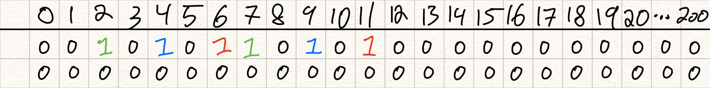
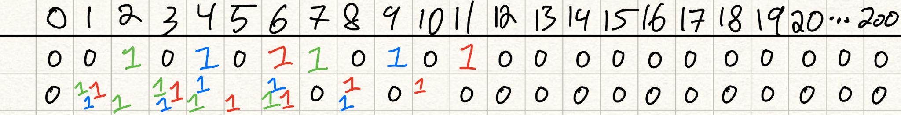
3.5 Dynamic Programming – Bottom-Up
Code:
  https://github.com/stevenhalim/cpbook-code/blob/master/ch3/dp/UVa11450_bu.py
Notes:
Write these 3 rules down on the board

Slide 25
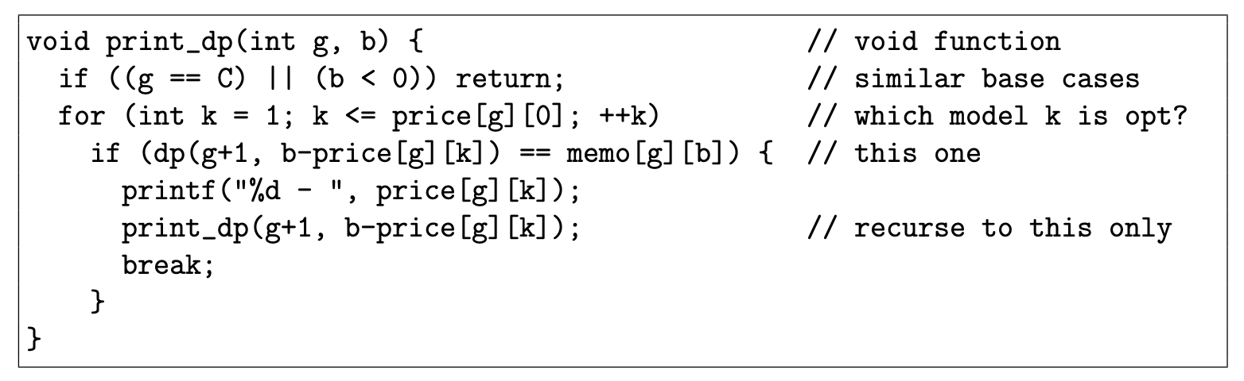
3.5 Dynamic Programming – Displaying the Optimal Solution
What if you have to print the optimal solution? All optimal solutions???
Approach 1, TD and BU DP:
  Store the predecessor information at each state, if more than 1 optimal, save them in a list
  Once final state is found, follow optimal transition at each state and print them all
    If problem asks for all solutions, use backtracking (unusual for problems)
Approach 2, TD DP:
  use recursion + memoization
  Add another recursive function void print dp(int g, int b) that uses values stored in memo table to reconstruct the solution
Notes:
Write these 3 rules down on the board

Slide 26
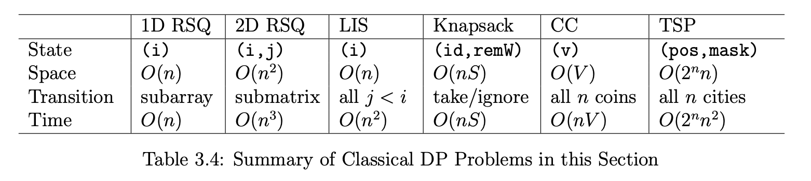
3.5 Dynamic Programming – Classic Examples
There are 6 “classical” examples of DP
In the textbook section 3.5.2 Classical Examples goes through each one in depth providing multiple algorithms in increasing effectiveness (in terms of runtime)
Highly suggest you read over this section!!!
The one problem of each of the 6 types are suggested as homework
RSQ (Range Search Query)
LIS (Longest Increasing Subsequence)
CC (Coin Change)
TSP (Travelling Salesman Problem)
Notes:
a1. Max 1D Range Sum
a2. Max 2D Range Sum
b. Longest Increasing Subsequence (LIS)
c. 0-1 Knapsack (Subset-Sum)
d. Coin-Change (CC) - The General Version
e. Traveling-Salesman-Problem (TSP)
DP level 1
UVa 10003 - Cutting Sticks

Slide 27
3.5 Dynamic Programming – Non-Classical Examples
In modern contests, you will rarely be asked a pure, undisguised classical DP problem.
Identifying the State:
  The hardest part of non-classical DP is defining the parameters that uniquely identify a "subproblem" state.
Adding Dimensions:
  You often need to add constraints directly into the state.
  Example: Instead of just dp(index), you might need dp(index, has_used_special_ability, remainder_modulo_K).
DP on Trees / Graphs: Combining DP with Depth First Search (DFS) where the subproblems are the subtrees of a graph.
Tip: Practice writing the brute-force recursive backtrack first. The parameters you pass to that recursive function are usually your DP state!
Check the textbook for more worked examples and practice problems!
Notes:
https://wiki.python.org/moin/TimeComplexity

Slide 28
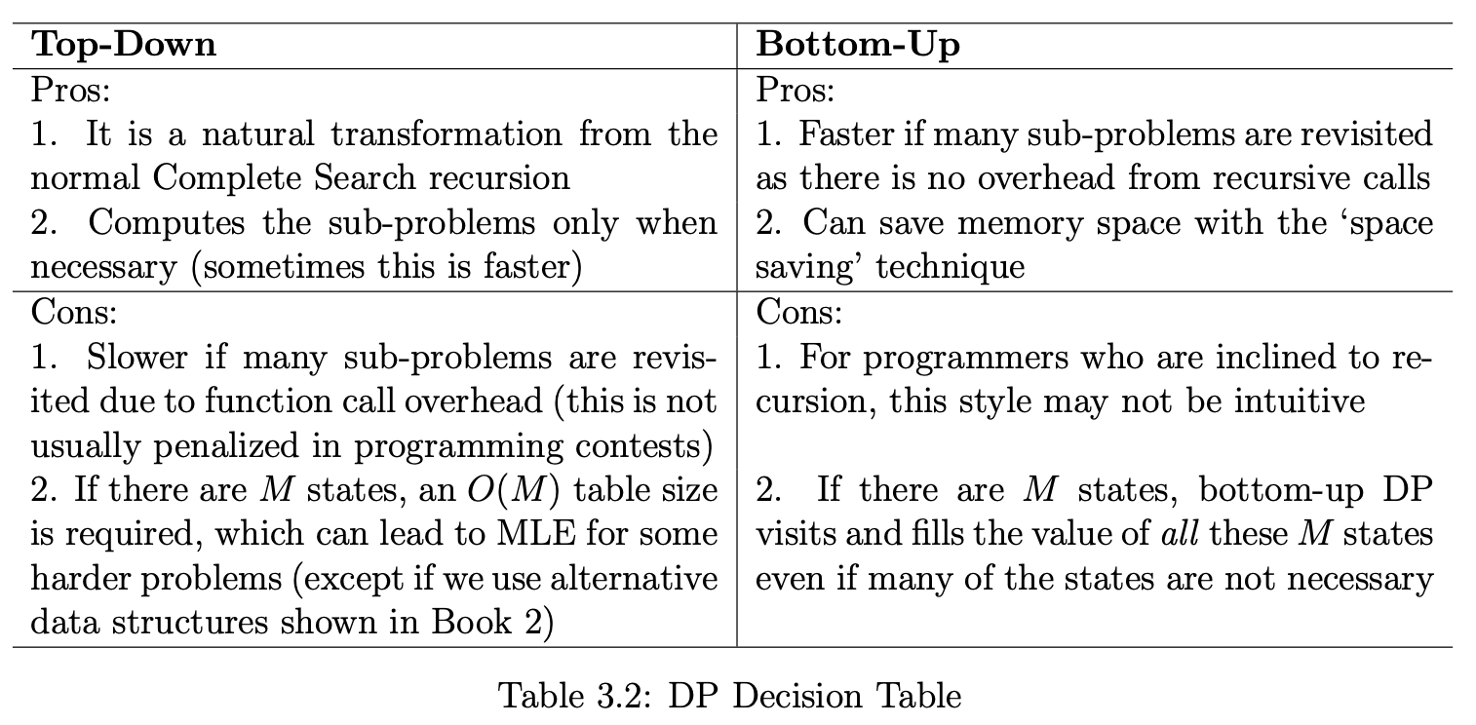
3.5 Dynamic Programming Top-Down vs Bottom-UP DP
In the top-down DP, the memo table entries are filled ‘as needed’ through the recursion itself.
In the bottom-up DP, we use a correct ‘DP table filling order’ to compute the values such that the previous values needed to process the current cell have already been obtained.
For most DP problems, these two styles are equally good and the decision to use a particular DP style is a matter of preference. However, for harder DP problems, one of the styles can be better than the other.
Notes:
Write these 3 rules down on the board

Slide 29
Template
Template
Notes:
https://wiki.python.org/moin/TimeComplexity

