Slide 1
ICPC Bootcamp Day 4
4.2 Graph Traversal (Introduction)
4.2.2 Depth First Search (DFS)
4.2.3 Breadth First Search (BFS)
DFS vs. BFS Comparison
4.2.5 Flood Fill (Implicit 2D Grid Graph)
4.3.1 MST (Minimum Spanning Tree) Overview and Motivation
4.3.2 Kruskal's Algorithm
Minimum Spanning Tree: Kruskal's vs. Prim's
4.4.1 SSSP (Single-Source Shortest Path) Overview and Motivation
4.4.3 On Weighted Graph: Dijkstra's

Slide 2
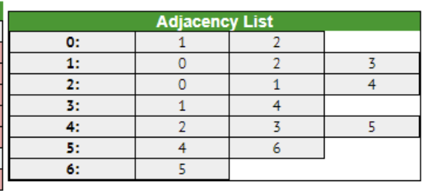
4.2 Graph Traversal (Introduction)
The Goal:
  Systematically visit the vertices (nodes) and edges of a graph to discover its properties or find specific information.
The Representation:
  Graphs are typically represented in code using an Adjacency List (an array of lists), where adj[u] contains all neighbors of vertex u.
There are many types of graphs, read online or from the textbook!
Notes:
https://wiki.python.org/moin/TimeComplexity
Quickly go through, can skip after the first 3 bullet points
Graph represents nodes and paths
Undirected/Directed
Directed Acyclic
Tree: pick any 2 points, there is only 1 path between them
Forest: a bunch of trees
Complete Graph: every point directly connects to every other point
Bipartite graph: you can split the vertices in such a way that they only connect to the other group
Multigraph: You can have an edge that starts and terminates on itself

Slide 3
4.2.2 Depth First Search (DFS)
The Concept:
  Plunge as deep as possible into the graph along one path before backtracking.
The Mechanism:
  Uses a visited nodes Stack (usually implemented implicitly via the function call stack/recursion).
Time Complexity: 𝑂(𝑉+𝐸) where 𝑉 is vertices and 𝐸 is edges.
Core Uses in CP:
  Reachability (Can I get from node A to node B?)
    Finds the first path available
    Takes less memory than BFS
  Finding Connected Components.
    Cross edge: connects two vertices where neither is an ancestor or descendant
    Back edge: connects a vertex to its ancestor in the DFS tree, creating a cycle
  Topological Sorting (for Directed Acyclic Graphs).
There is an iterative way and a recursive way to implement DFS, we will focus on the recursive way as it is shorter and easier to implement rapidly
Notes:
https://wiki.python.org/moin/TimeComplexity

Slide 4
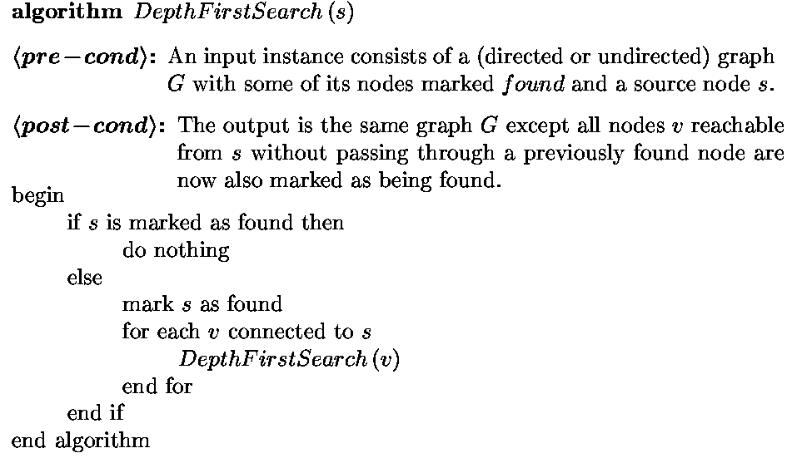
4.2.2 Depth First Search (DFS)
Pseudocode from slides created by Professor Jeff Edmonds
  https://www.eecs.yorku.ca/~jeff/courses/3101/
Notes:
https://wiki.python.org/moin/TimeComplexity

Slide 5
4.2.3 Breadth First Search (BFS)
The Concept:
  Explore the graph in layers. Visit all immediate neighbors of the starting node first, then all neighbors of those neighbors, and so on.
The Mechanism: Uses a Queue (First-In, First-Out).
Time Complexity: 𝑂(𝑉+𝐸).
BFS inherently finds the Shortest Path on Unweighted Graphs. The first time you reach a node, you are guaranteed it was via the shortest possible number of edges.
The following slides are from Jeff Edmonds
  https://www.eecs.yorku.ca/~jeff/courses/3101/
Notes:
https://wiki.python.org/moin/TimeComplexity

Slide 6
BFS
Found
Not Handled
Queue
s
b
a
d
e
g
c
f
j
i
h
m
k
l

Slide 7
BFS
Found
Not Handled
Queue
s
d=0
b
a
s
d=0
d
e
g
c
f
j
i
h
m
k
l

Slide 8
BFS
Found
Not Handled
Queue
s
d=0
d=1
b
a
d=0
e
a
d=1
d
d
g
c
g
f
b
j
i
h
m
k
l

Slide 9
BFS
Found
Not Handled
Queue
s
d=0
d=1
b
a
a
d=1
e
d
d
g
g
c
b
f
j
i
h
m
k
l

Slide 10
BFS
Found
Not Handled
Queue
s
d=0
d=1
b
a
d=1
e
d
d
g
g
c
b
f
c
d=2
j
f
d=2
i
h
m
k
l

Slide 11
BFS
Found
Not Handled
Queue
s
d=0
d=1
b
a
d=1
d
e
g
g
c
b
f
c
d=2
j
f
d=2
i
m
e
h
m
k
l

Slide 12
BFS
Found
Not Handled
Queue
s
d=0
d=1
b
a
d=1
d
e
g
c
b
f
c
d=2
j
f
d=2
i
m
e
h
j
m
k
l

Slide 13
BFS
Found
Not Handled
Queue
s
d=0
d=1
b
a
d=1
d
e
g
c
f
c
d=2
j
f
d=2
i
m
e
h
j
m
k
l

Slide 14
BFS
Found
Not Handled
Queue
s
d=0
d=1
b
a
c
d=2
d
e
f
g
m
c
e
f
j
j
d=2
i
h
m
k
l

Slide 15
BFS
Found
Not Handled
Queue
s
d=0
d=1
b
a
d=2
d
e
f
g
m
c
e
f
j
j
h
d=3
d=2
i
i
h
m
k
d=3
l

Slide 16
BFS
Found
Not Handled
Queue
s
d=0
d=1
b
a
d=2
d
e
g
m
c
e
f
j
j
h
d=3
d=2
i
i
h
m
k
d=3
l

Slide 17
BFS
Found
Not Handled
Queue
s
d=0
d=1
b
a
d=2
d
e
g
c
e
f
j
j
h
d=3
d=2
i
i
h
l
m
k
d=3
l

Slide 18
BFS
Found
Not Handled
Queue
s
d=0
d=1
b
a
d=2
d
e
g
c
f
j
j
h
d=3
d=2
i
i
h
l
m
k
d=3
l

Slide 19
BFS
Found
Not Handled
Queue
s
d=0
d=1
b
a
d=2
d
e
g
c
f
j
h
d=3
d=2
i
i
h
l
m
k
d=3
l

Slide 20
BFS
Found
Not Handled
Queue
s
d=0
d=1
b
a
h
d=3
e
i
d
l
g
c
f
j
d=2
i
h
m
k
d=3
l

Slide 21
BFS
Found
Not Handled
Queue
s
d=0
d=1
b
a
d=3
e
i
d
l
g
k
d=4
c
f
j
d=2
i
h
m
k
d=3
d=4
l

Slide 22
BFS
Found
Not Handled
Queue
s
d=0
d=1
b
a
d=3
d
e
l
g
k
d=4
c
f
j
d=2
i
h
m
k
d=3
d=4
l

Slide 23
BFS
Found
Not Handled
Queue
s
d=0
d=1
b
a
d=3
d
e
g
k
d=4
c
f
j
d=2
i
h
m
k
d=3
d=4
l

Slide 24
BFS
Found
Not Handled
Queue
s
d=0
d=1
b
a
k
d=4
d
e
g
c
f
j
d=2
i
h
m
k
d=3
d=4
l

Slide 25
BFS
Found
Not Handled
Queue
s
d=0
d=1
b
a
d=4
d
e
d=5
g
c
f
j
d=2
i
h
m
k
d=3
d=4
l

Slide 26
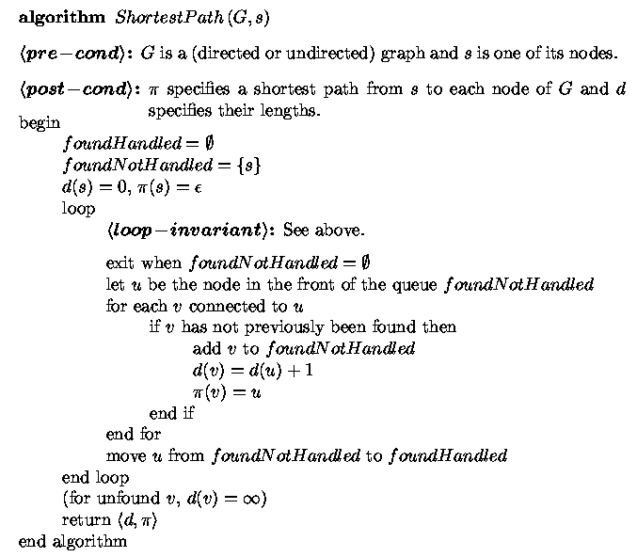

Slide 27
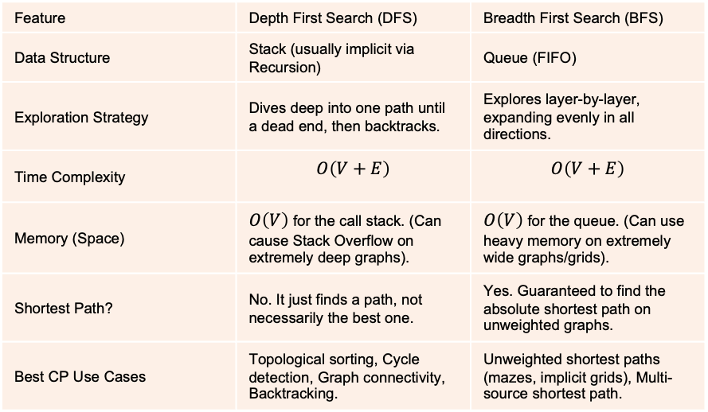
DFS vs. BFS Comparison
Feature | Depth First Search (DFS) | Breadth First Search (BFS)
Data Structure | Stack (usually implicit via Recursion) | Queue (FIFO)
Exploration Strategy | Dives deep into one path until a dead end, then backtracks. | Explores layer-by-layer, expanding evenly in all directions.
Time Complexity | $$O\left(V+E\right)$$ | $$O\left(V+E\right)$$
Memory (Space) | $O\left(V\right)$ for the call stack. (Can cause Stack Overflow on extremely deep graphs). | $O\left(V\right)$ for the queue. (Can use heavy memory on extremely wide graphs/grids).
Shortest Path? | No. It just finds a path, not necessarily the best one. | Yes. Guaranteed to find the absolute shortest path on unweighted graphs.
Best CP Use Cases | Topological sorting, Cycle detection, Graph connectivity, Backtracking. | Unweighted shortest paths (mazes, implicit grids), Multi-source shortest path.
The Rule of Thumb for Contests:
  If a problem asks for the shortest distance or minimum moves on an unweighted graph, you must use BFS.
  If you just need to know if two nodes are connected, count connected components, or detect cycles, DFS is typically faster and cleaner to type out.
Notes:
https://wiki.python.org/moin/TimeComplexity

Slide 28
4.2.5 Flood Fill
The Concept:
  Performing DFS or BFS on a 2D grid (like a maze or map) where the grid itself is the graph.
The Trick:
  Do not waste time/memory building a massive Adjacency List! The neighbors of cell left, right, top, bottom are mathematically predictable.
Direction Vectors:
  Use arrays and coordinates to cleanly loop through valid moves.
Always check boundary conditions (r < 0, r >= R, c < 0, c >= C) before moving to avoid indexing errors
Notes:
https://wiki.python.org/moin/TimeComplexity

Slide 29
Case Study – Lost Map
Let’s read the problem on Kattis: https://open.kattis.com/problems/lostmap
What have we understood?
  We are given N villages and a matrix containing the distance between every pair of villages.
  We need to output the roads that should be used to reconstruct the map.
  The roads must connect every village together while minimizing the total distance.
  This is an undirected weighted graph; the distance between village i and j is the edge weight.
  Because every pair of villages has a given distance, the input represents a complete graph.
  We have 1GB of memory and 8 seconds (800 Million Operations)
Somehow we need to create a tree that minimally connects each vertex
  A Minimum Spanning Tree!
Notes:
https://wiki.python.org/moin/TimeComplexity

Slide 30
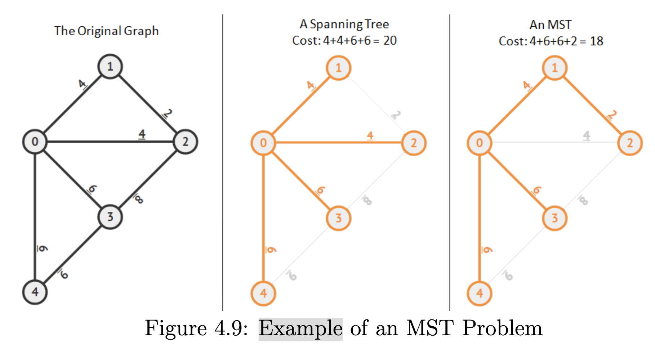
Minimum Spanning Tree (MST) - Overview
Given a connected, undirected, and weighted graph G = (V, E)
  Select a subset of edges E’ ⊆ E such that the graph G’ = (V, E’) is still connected and the total weight of the selected edges E’ is minimal.
I.E. Connect all vertices with the minimum cost of edge!
Notes:
https://wiki.python.org/moin/TimeComplexity

Slide 31
Minimum Spanning Tree (MST) - Kruskal’s Algorithm
First sorts E edges based on non-decreasing weight
  Done by sorting edges in an Edge List data structure
  Kruskal then greedily tries to add each edge into the MST if such addition does not form a cycle (checked by using Union-Find Disjoint Set)
  Greedily means that it tries to make the best choice given the current situation (in this case, the smallest edge)
O(E log V) runtime
  See textbook for breakdown on how this was calculated
Textbook implementation:
  https://github.com/stevenhalim/cpbook-code/tree/master/ch4/mst
Notes:
https://wiki.python.org/moin/TimeComplexity

Slide 32
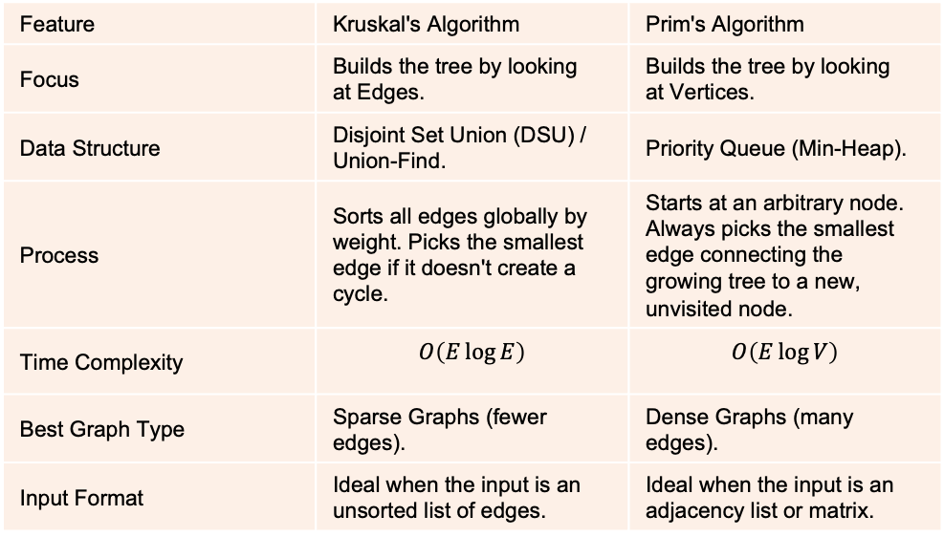
Minimum Spanning Tree: Kruskal's vs. Prim's
Both are Greedy algorithms that successfully find the Minimum Spanning Tree (MST) of a weighted, undirected graph
I suggest to look at the textbook for Prim’s algorithm
Feature | Kruskal's Algorithm | Prim's Algorithm
Focus | Builds the tree by looking at Edges. | Builds the tree by looking at Vertices.
Data Structure | Disjoint Set Union (DSU) / Union-Find. | Priority Queue (Min-Heap).
Process | Sorts all edges globally by weight. Picks the smallest edge if it doesn't create a cycle. | Starts at an arbitrary node. Always picks the smallest edge connecting the growing tree to a new, unvisited node.
Time Complexity | $$O\left(E\log{E}\right)$$ | $$O\left(E\log{V}\right)$$
Best Graph Type | Sparse Graphs (fewer edges). | Dense Graphs (many edges).
Input Format | Ideal when the input is an unsorted list of edges. | Ideal when the input is an adjacency list or matrix.
Notes:
https://wiki.python.org/moin/TimeComplexity

Slide 33
4.4.1 Single-Source Shortest Paths (Overview)
The Problem:
  Given a specific starting node (the source), find the shortest path to all other nodes in the graph.
Unweighted Graphs:
  Use BFS! (Every edge has a weight of 1).
Weighted Graphs:
  BFS fails because a path with 5 small edges might be "shorter" (lower total cost) than a path with 1 massive edge. We need smarter algorithms.
The Concept of "Relaxation":
  The core of all SSSP algorithms.
  If you find a new path to node v going through node u, check if: dist[u] + weight(u, v) < dist[v].
  If true, "relax" the edge by updating dist[v] to the new, better value.
Notes:
https://wiki.python.org/moin/TimeComplexity

Slide 34
4.4.3 Dijkstra's Algorithm
The Strategy:
  Another Greedy algorithm! Always process the unvisited node with the currently smallest known distance from the source.
The Mechanism:
  Uses a Priority Queue (Min-Heap) instead of a standard Queue.
  Push tuples of (current_distance, node) into the heap.
  Pop the node with the smallest distance, relax all its edges, and push any improved distances back into the heap.
Time Complexity:
  𝑂((𝑉+𝐸) log⁡𝑉 ) using a binary heap.
The Fatal Flaw:
  Dijkstra's algorithm cannot handle negative weight edges. Once a node is popped from the priority queue, Dijkstra assumes its shortest path is finalized. Negative edges break this assumption. (If negative edges exist, you must use the slower Bellman-Ford algorithm, which is 𝑂(𝑉×𝐸)).
The following slides are from Jeff Edmonds
  https://www.eecs.yorku.ca/~jeff/courses/3101/
Notes:
https://wiki.python.org/moin/TimeComplexity

Slide 35
Dijkstra's
d=0
s
10
1
b
a
d=∞
d=∞
30
30
40
2
3
3
1
2
d
c
d=∞
d=∞
e
d=∞
2
15
1
8
f
2
h
d=∞
1
g
6
d=∞
d=∞
i
3
j
d=∞
d=∞

Slide 36
Dijkstra's
d=0
s
10
1
b
c
d=10
d=1
a
30
30
40
2
3
3
1
2
d
c
d=40
d=30
e
d=∞
2
15
1
8
f
2
h
d=∞
1
g
6
d=∞
d=∞
i
3
j
d=∞
d=∞

Slide 37
Dijkstra's
d=0
s
10
1
b
c
d=10
d=1
a
30
30
40
2
3
3
1
2
d
c
d=31
d=30
e
d=∞
2
15
1
8
f
2
h
d=3
1
g
6
d=∞
d=∞
i
3
j
d=∞
d=∞

Slide 38
Dijkstra's
d=0
s
10
1
b
a
d=10
d=1
30
30
40
2
3
3
1
2
d
c
d=31
d=18
e
d=∞
2
15
1
8
f
2
h
d=3
1
g
6
d=∞
d=4
i
3
j
d=∞
d=∞

Slide 39
Dijkstra's
d=0
s
10
1
b
a
d=10
d=1
30
30
40
2
3
3
1
2
d
c
d=6
d=5
e
d=∞
2
1
8
15
1
f
h
d=3
1
g
6
d=10
d=4
i
3
j
d=∞
d=∞

Slide 40
Dijkstra's
d=0
s
10
1
b
a
d=10
d=1
30
30
40
2
3
3
1
2
d
c
d=6
d=5
e
d=∞
2
1
8
15
1
f
h
d=3
1
g
6
d=7
d=4
i
3
j
d=∞
d=∞

Slide 41
Dijkstra's
d=0
s
10
1
b
a
d=9
d=1
30
30
40
2
3
3
1
2
d
c
d=6
d=5
e
d=∞
2
1
8
15
1
f
h
d=3
1
g
6
d=7
d=4
i
3
j
d=∞
d=∞

Slide 42
Dijkstra's
d=0
s
10
1
b
a
d=8
d=1
30
30
40
2
3
3
1
2
d
c
d=6
d=5
e
d=15
2
1
8
15
1
f
h
d=3
1
g
6
d=7
d=4
i
3
j
d=∞
d=∞

Slide 43
Dijkstra's
d=0
s
10
1
b
a
d=8
d=1
30
30
40
2
3
3
1
2
d
c
d=6
d=5
e
d=10
2
1
8
15
1
f
h
d=3
1
g
6
d=7
d=4
i
3
j
d=∞
d=∞

Slide 44
Dijkstra's
d=0
s
10
1
b
a
d=8
d=1
30
30
40
2
3
3
1
2
d
c
d=6
d=5
e
d=10
2
1
8
15
1
f
h
d=3
1
g
6
d=7
d=4
i
3
j
d=∞
d=∞

Slide 45
Dijkstra's
d=0
s
10
1
b
a
d=8
d=1
30
30
40
2
3
3
1
2
d
c
d=6
d=5
e
d=10
2
1
8
15
1
f
h
d=3
1
g
6
d=7
d=4
i
3
j
d=∞
d=∞

Slide 46
Dijkstra's
d=0
s
10
1
b
a
d=8
d=1
30
30
40
2
3
3
1
2
d
c
d=6
d=5
e
d=10
2
1
8
15
1
f
h
d=3
1
g
6
d=7
d=4
DONE
i
3
j
d=∞
d=∞

Slide 47
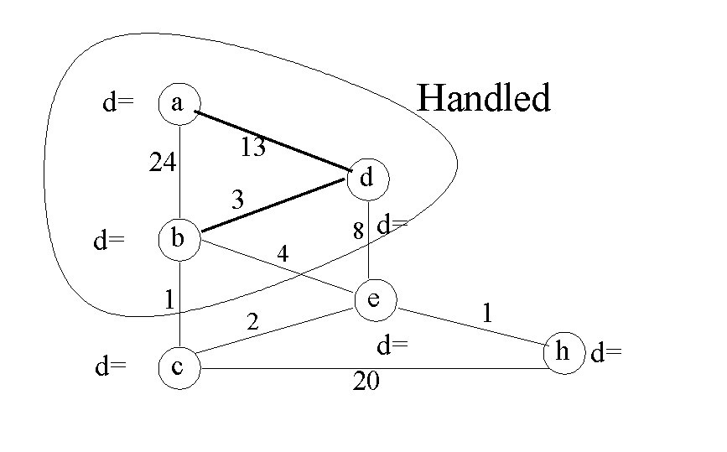
4.4.3 Dijkstra's Algorithm
Notes:
https://wiki.python.org/moin/TimeComplexity

Slide 48
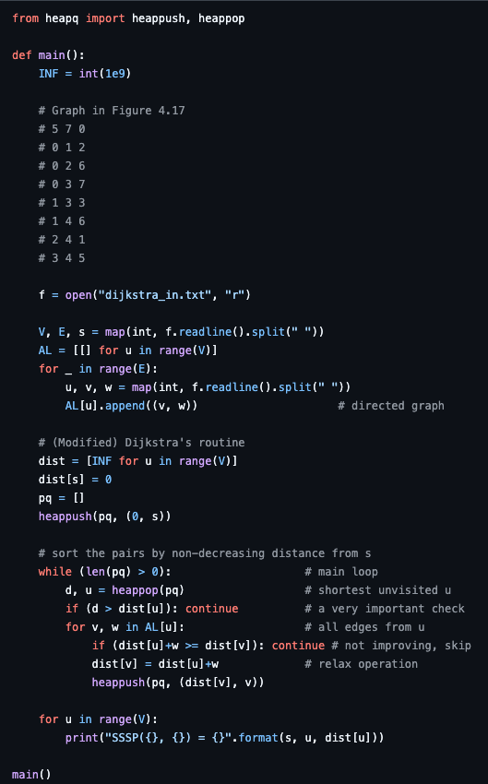
4.4.3 Dijkstra's Algorithm
Notes:
https://wiki.python.org/moin/TimeComplexity

Slide 49
Template
Template
Notes:
https://wiki.python.org/moin/TimeComplexity

