Slide 1
ICPC Bootcamp
Introduction
What is ICPC?
Format of this Bootcamp
Roadmap of this Bootcamp
How to be successful in ICPC
Let’s get to know each other!

Slide 2
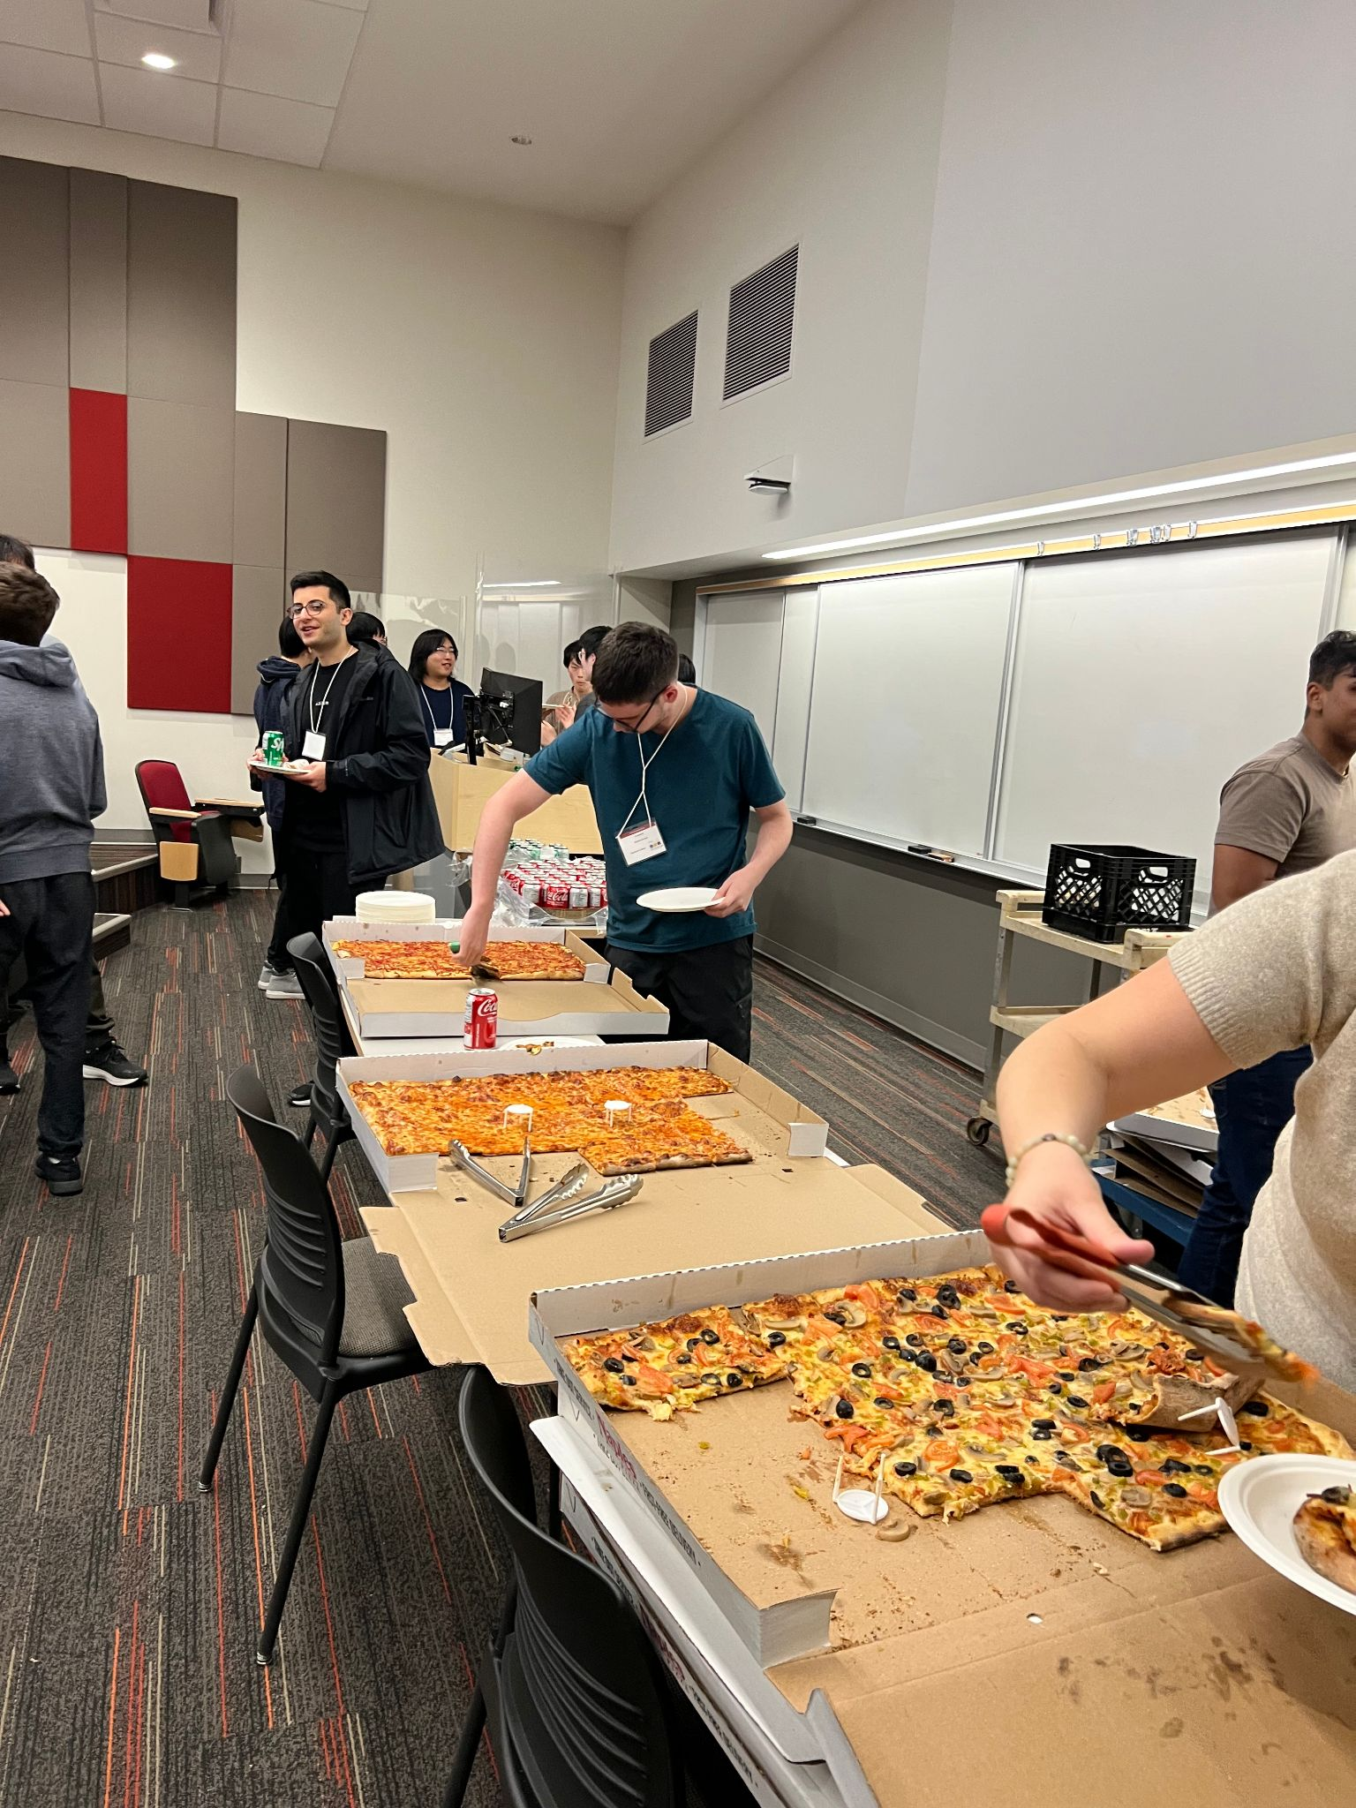
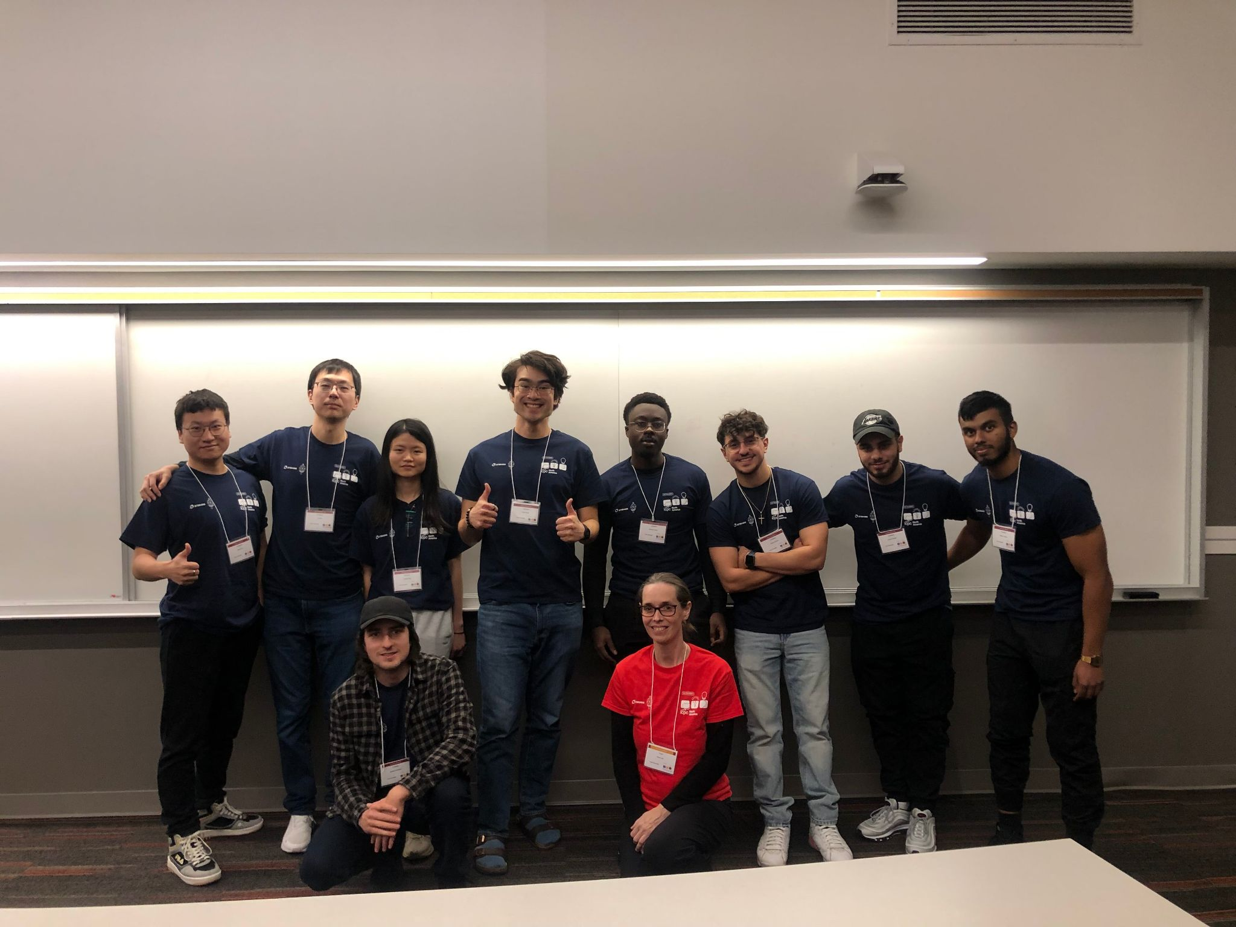
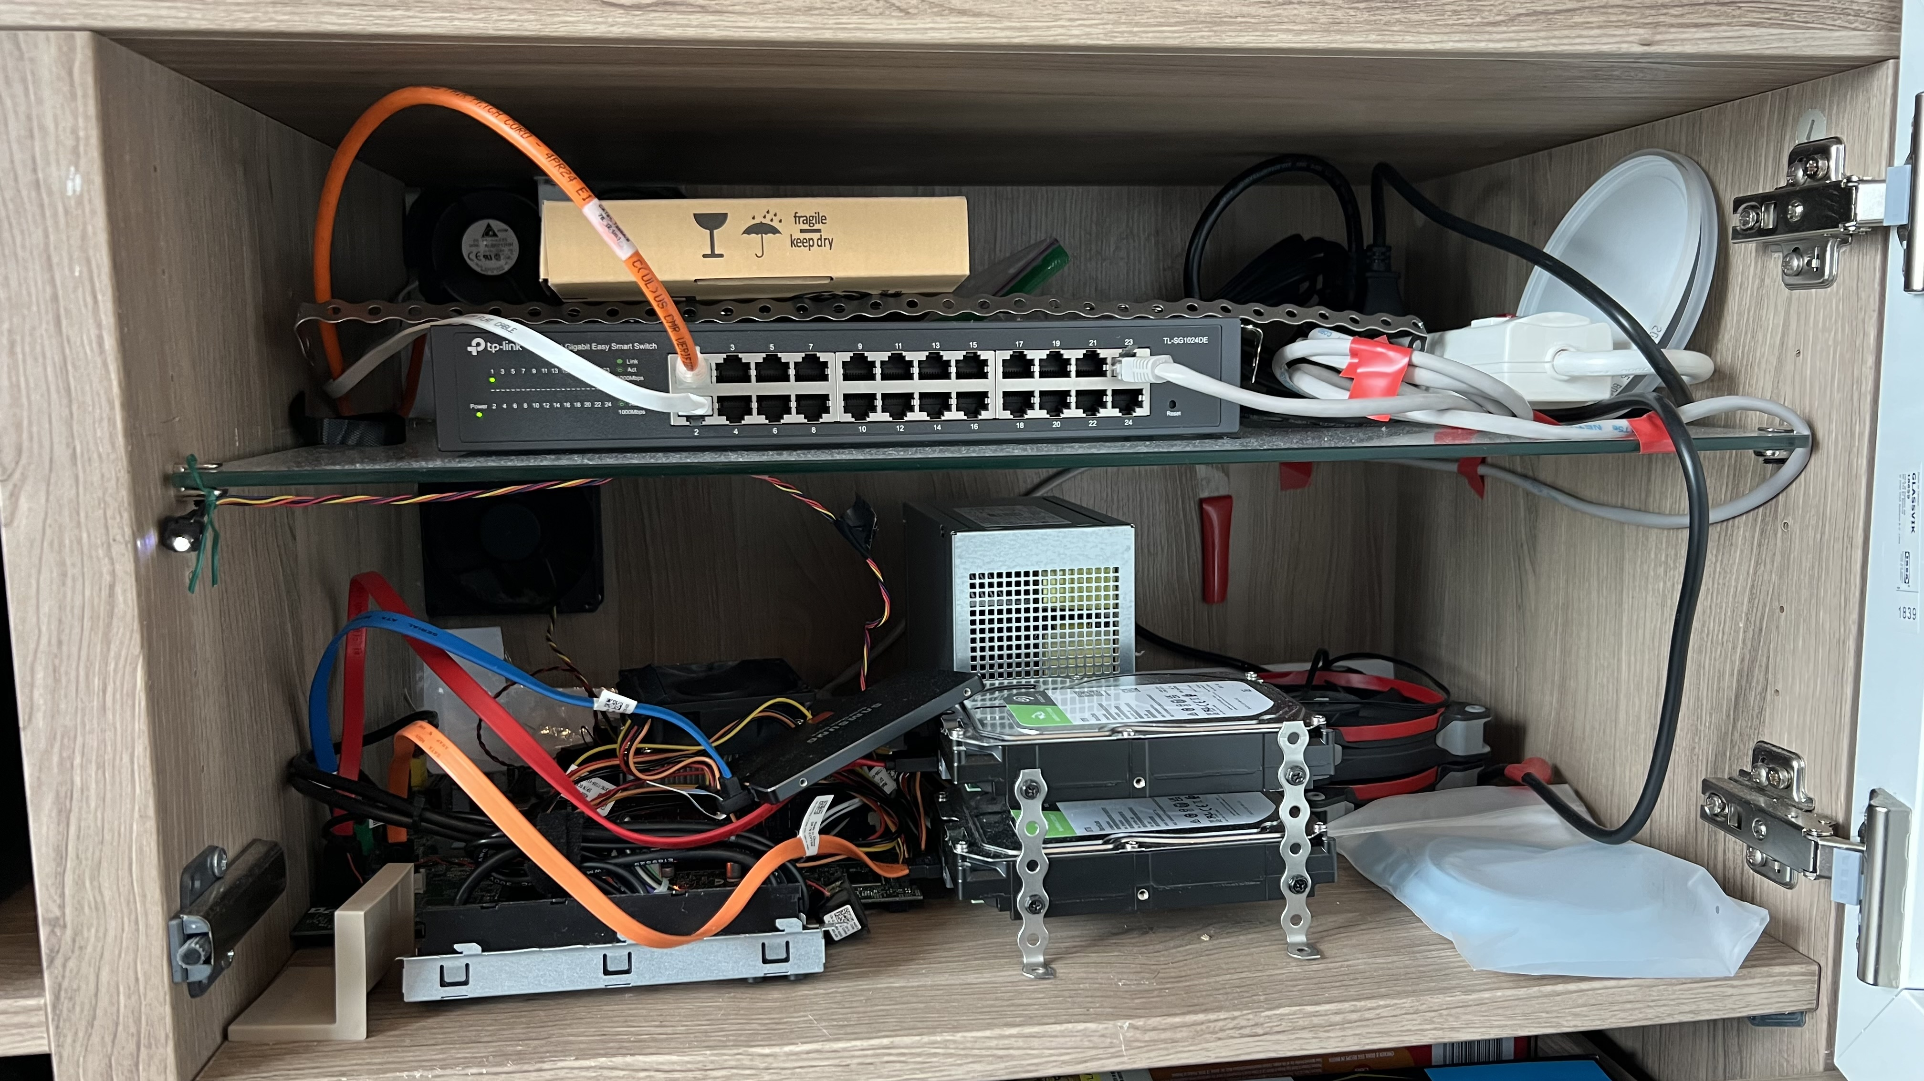
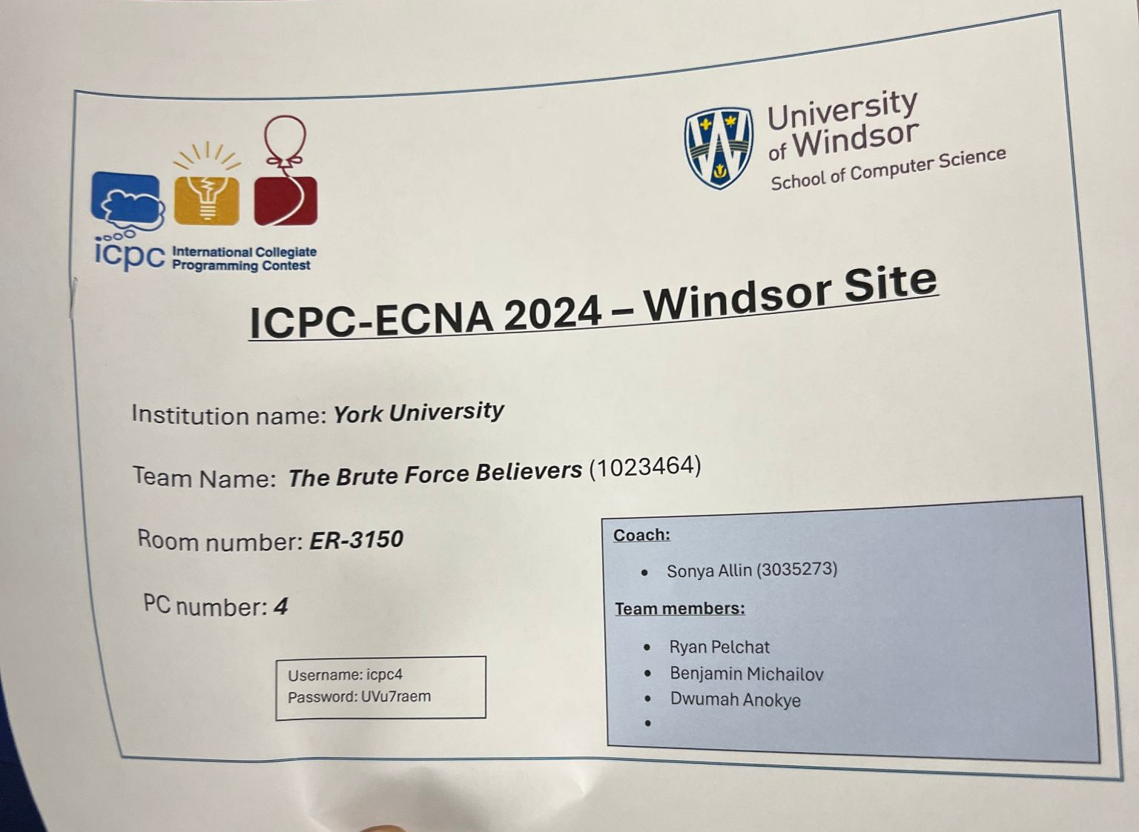

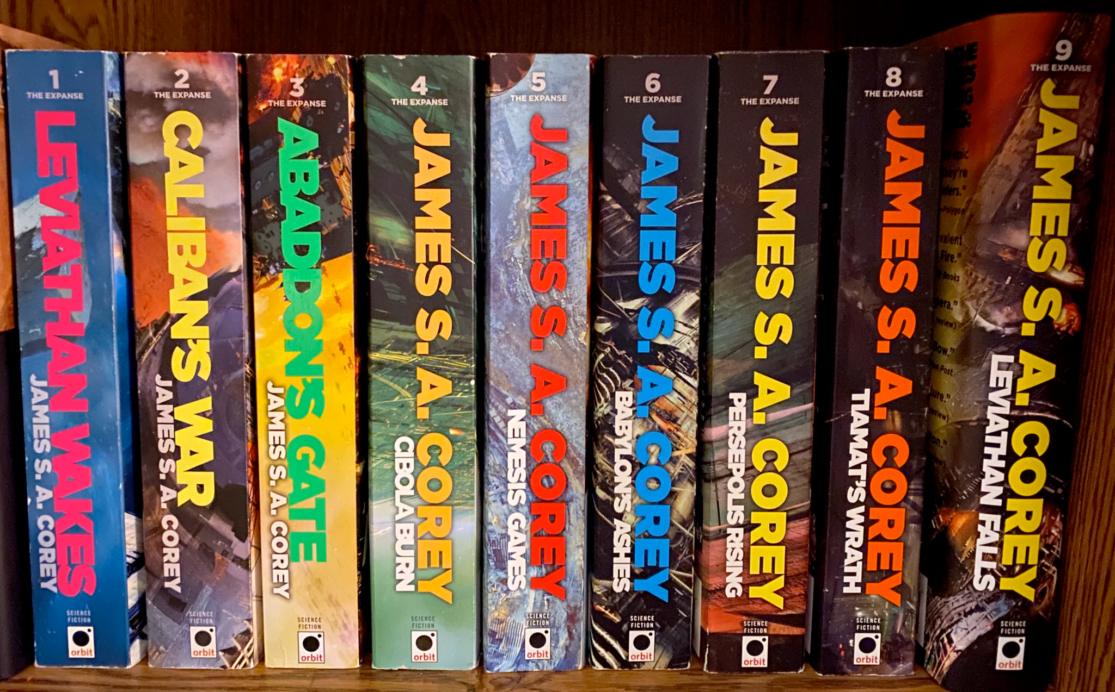
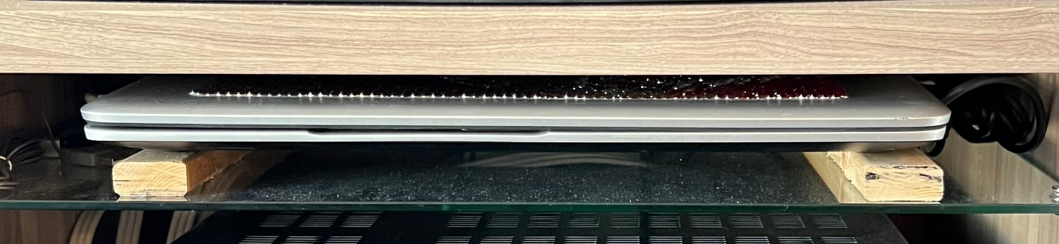
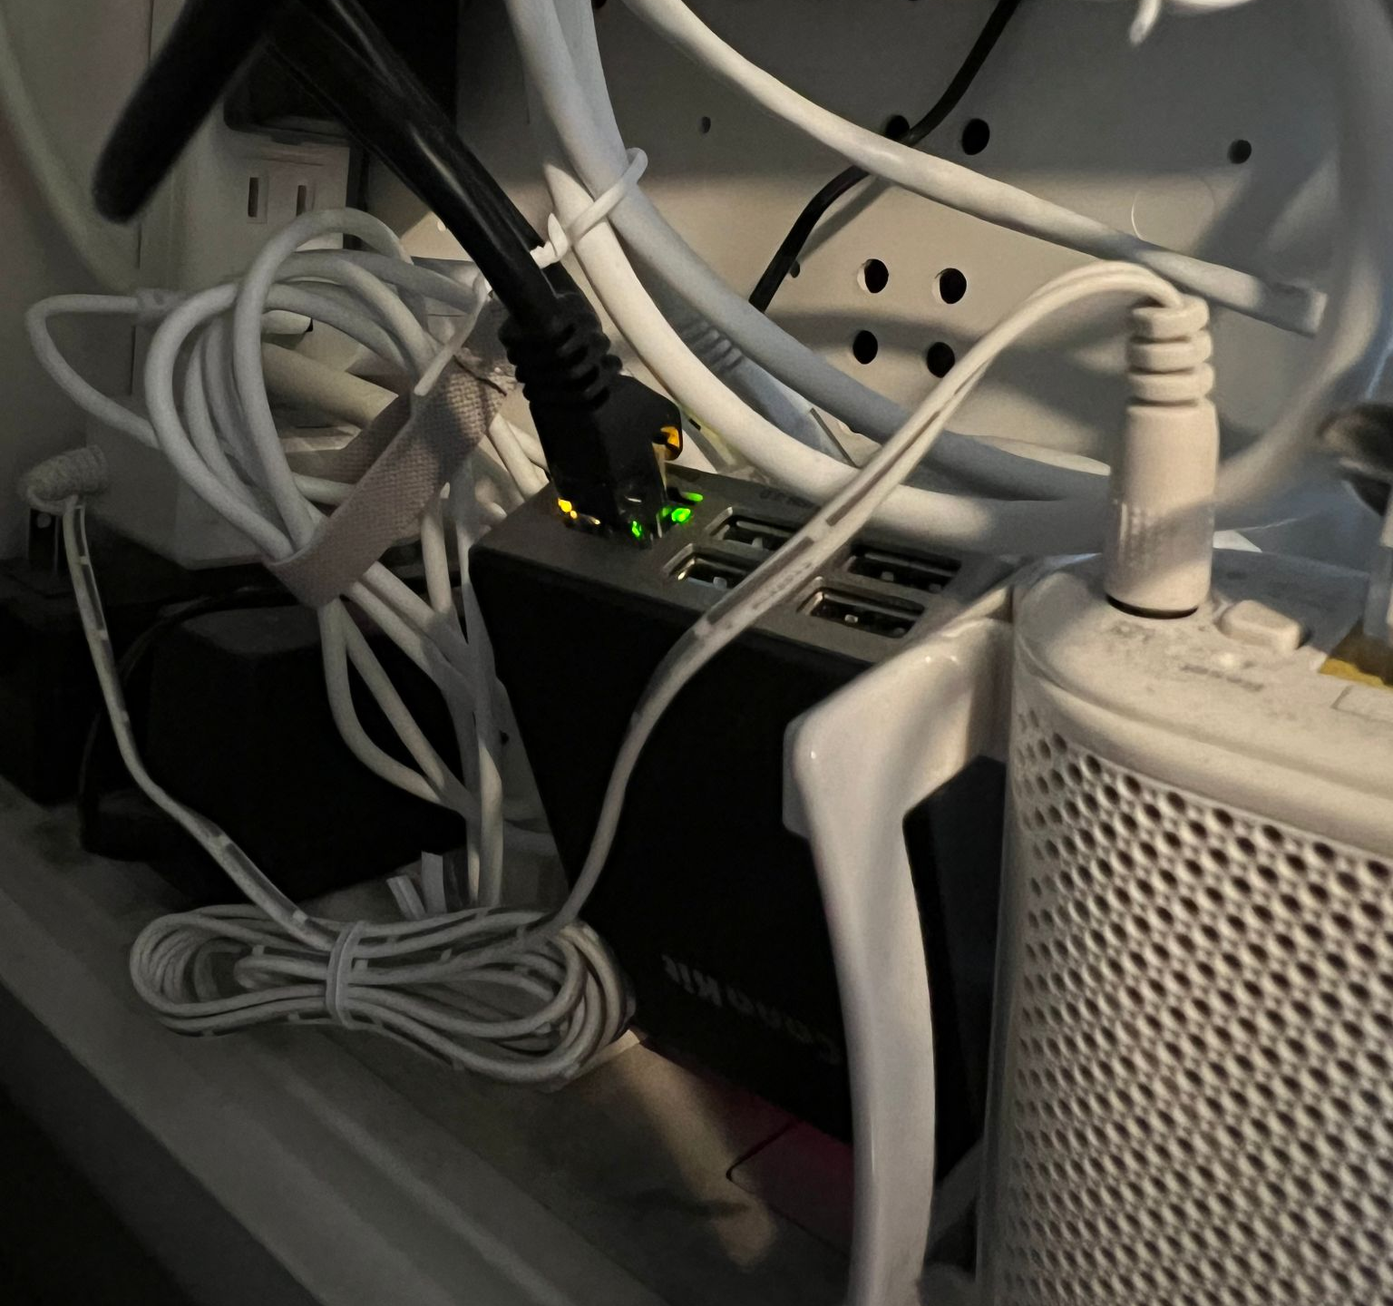

Ryan Pelchat
Notes:
I am Ryan Pelchat
4th year Computer Science Student with a Specialization in Software Development
I am taking EECS 4070 which is a self directed course. The direction that I chose is to conduct a workshops on competitive programming
Last year I was on the ICPC team and we competed at the University of Windsor, it was a lot of fun! Challenging problems, a fun train ride, and free food.
In my free time I like to read and tinker with software and hardware.
I host a Jellyfin server on an old laptop on my local network and I remote access it using a Wireguard VPN that I host on a raspberry pi
I am on the 6th book of The Expanse series.

Slide 3

What is ICPC
ICPC is the International Collegiate Programming Competition
Teams of 3 have 5 hours to solve 13 problems and 1 computer
All the paper that you can bring, no internet allowed
Secret tests, time penalty if you submit a wrong solution
Covers wide breadth of Computer Science
  Requires: Teamwork, Knowledge, and Practice
Why?
  Greater mastery of programming and Computer Science
  Help you with coding based interviews
  It’s fun!
Notes:
https://wiki.python.org/moin/TimeComplexity

Slide 4
Format
Time | Duration | Activities
10:00 | 1h30min | Discussion of previous day’s contest
11:30 | 1h30min | Instruction
13:00 | 30min | Lunch
13:30 | 3h | Practice Contest
16:30 |  | End!
We will be using Kattis
  Sign up for Kattis (https://open.kattis.com/)
We will be using eclass,
  please upload your solutions after the practice contest
  Readings for the next day
If you have a question, raise your hand anytime!
Notes:
Problem Reviews with Ben
Workshop with me
Focused on theory, most of the code libraries will be up to you (I will give tips from time to time)
Suggested practice problems relating to the workshop given
If you have a question, raise your hand anytime!

Slide 5
Roadmap for this Week Day 1
Day 1
  1.3.3 Introduction to Algorithm Analysis
  2.2 Linear DS with Built-in Libraries
    2.2.1 Array
    2.2.3 Bitmask
    2.2.5 Linked Data Structures
  2.3 Non-Linear DS with Built-in Libraries
    2.3.1 Binary Heap (Priority Queue)
    2.3.2 Hash Table
    2.3.3 Balanced Binary Search Tree (bBST)
  2.4 DS with Our Own Libraries
    2.4.1 Graph
    2.4.2 Union-Find Disjoint Sets
    2.4.3 Fenwick (Binary Indexed) Tree
Notes:
https://wiki.python.org/moin/TimeComplexity

Slide 6
Roadmap for this Week Day 2
Day 2
  3.2 Complete Search
    3.2.1 Iterative Complete Search
    3.2.2 Recursive Complete Search
    3.2.3 Complete Search Tips
  3.3 Divide and Conquer
    3.3.2 Ternary Search
Notes:
https://wiki.python.org/moin/TimeComplexity

Slide 7
Roadmap for this Week Day 3
Day 3
  3.4 Greedy
    3.4.1 Examples
  3.5 Dynamic Programming
    3.5.1 DP Illustration
    3.5.2 Classical Examples
    3.5.3 Non-Classical Examples
Notes:
https://wiki.python.org/moin/TimeComplexity

Slide 8
Roadmap for this Week Day 4
Day 4
  4.2 Graph Traversal
    4.2.2 Depth First Search (DFS)
    4.2.3 Breadth First Search (BFS)
    4.2.5 Flood Fill (Implicit 2D Grid Graph)
  4.3 Minimum Spanning Tree
    4.3.1 Overview and Motivation
    4.3.2 Kruskal’s Algorithm
  4.4 Single-Source Shortest Paths (SSSP)
    4.4.1 Overview and Motivation
    4.4.3 On Weighted Graph: Dijkstra’s
Notes:
https://wiki.python.org/moin/TimeComplexity

Slide 9
Roadmap for this Week Day 5
Day 5
  5.3 Number Theory
    5.3.1 Prime Numbers
    5.3.3 Finding Prime Factors with Optimized Trial Divisions
    5.3.6 Greatest Common Divisor & Least Common Multiple
    5.3.9 Modular Arithmetic
  7.2 Basic Geometry Objects with Libraries
    7.2.1 0D Objects: Points
    7.2.2 1D Objects: Lines
    7.2.3 2D Objects: Circles
    7.2.4 2D Objects: Triangles
    7.2.5 2D Objects: Quadrilaterals
  7.3 Algorithms on Polygon with Libraries
    7.3.1 Polygon Representation
    7.3.3 Area of a Polygon
    7.3.4 Checking if a Polygon is Convex
    7.3.5 Checking if a Point is Inside a Polygon
    7.3.6 Cutting Polygon with a Straight Line
Notes:
https://wiki.python.org/moin/TimeComplexity

Slide 10
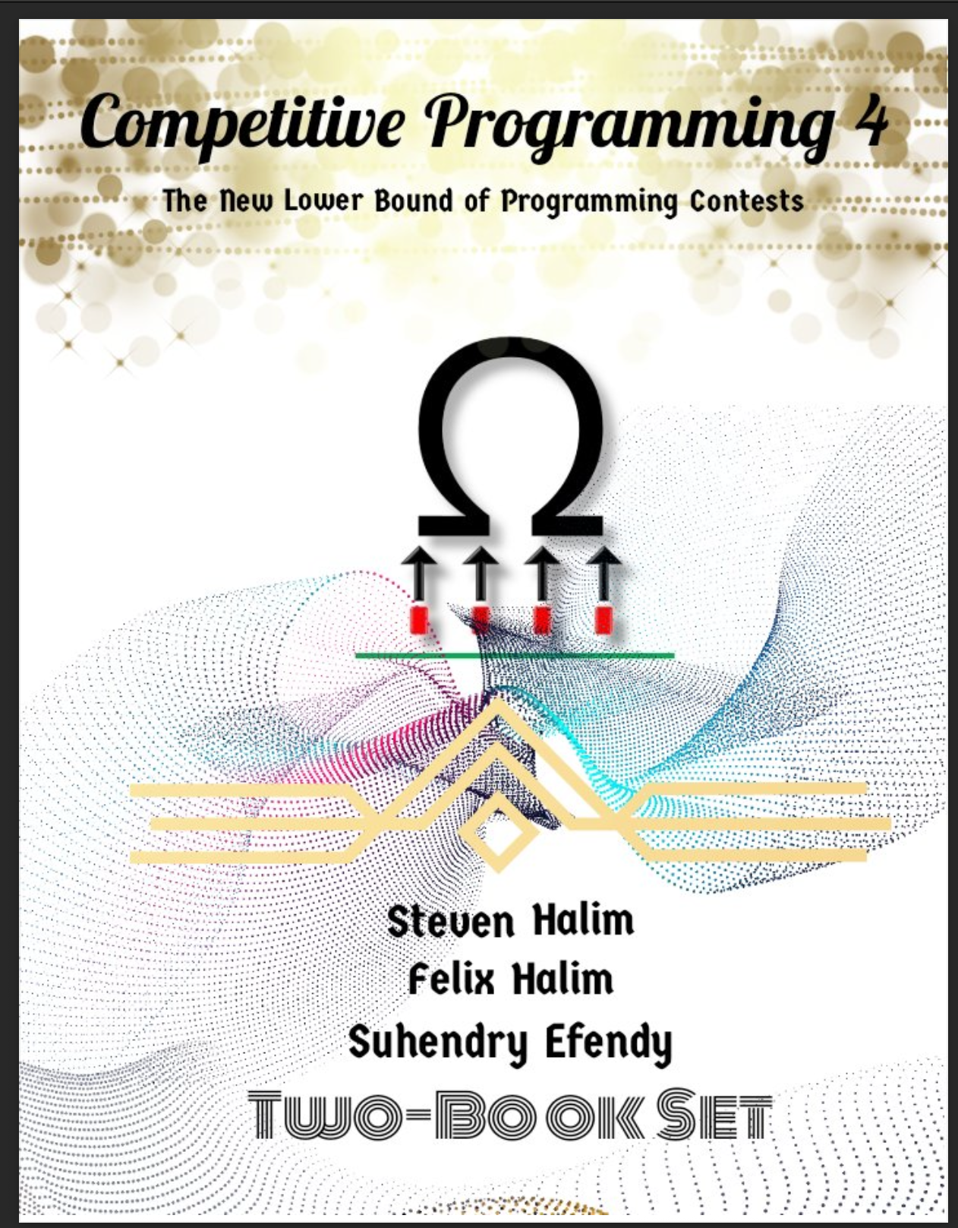
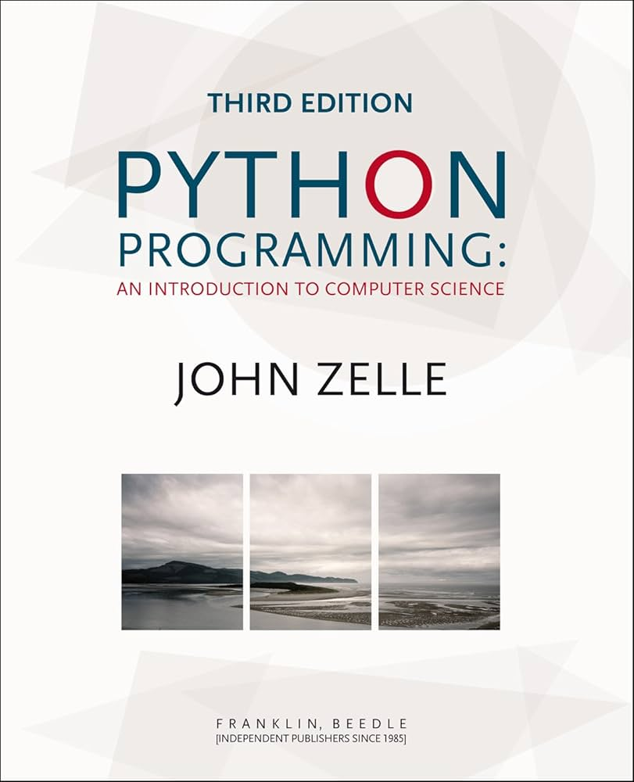
Resources
Competitive Programming, 1 & 2, 4th Edition Steven Halim, Felix Halim, Suhendry Effendy
Zelle J. - Python Programming An Introduction to Computer Science, 3rd Edition - 2017
Eclass
CSC148 from UofT https://www.teach.cs.toronto.edu/~csc148h/notes/index.html

Slide 11
How to be successful in ICPC
Theory
  Use CP4 textbook as a roadmap of the skills required in ICPC
  Use many resources to learn!
    Data Structures, Algorithms textbooks
    Lectures from other universities
Practice!
  Do problems in CP4
  Leetcode helps
  Codeforces,
  UVa (https://onlinejudge.org/)
  Kattis
Teamwork!
  Split the work
  Practice together
  Strategize
  Pair programming
Notes:
https://wiki.python.org/moin/TimeComplexity

Slide 12
Example Strategy
Start:
  Every member reads different problems
  Rank each problem, Easy, Medium, Hard
    Easy -> confident can solve on your own
    Medium -> somewhat confident, need someone to talk it through, maybe pair program
    Hard -> might need all 3 members, unsure, keep for last
  Classify the problem type
    Dynamic Programming, Minimum Spanning Tree, Binary Search, etc…
    This is to be able to refer problems to each other
  Interrupt:
    While reading, if a member ranks an easy, attempt to solve it right away
Computer Usage
  First solve on paper to verify your solution, unless it is an easy and no one is at the computer
  Have 2 signs
    “quick test/print” for tasks under 1 minute
    “ready to code” for longer coding tasks
  This allows the person at the computer to dictate when they stop
    For a quick second or if they are not making progress (debugging and back to paper solving)
Notes:
https://wiki.python.org/moin/TimeComplexity

Slide 13
Let’s get to know each other!
Notes:
https://wiki.python.org/moin/TimeComplexity

Slide 14
Template
Template
Notes:
https://wiki.python.org/moin/TimeComplexity

Slide 15
Template
Template
Notes:
https://wiki.python.org/moin/TimeComplexity

