Slide 1
ICPC Bootcamp Day 2
Understanding the Search Space
The Monotonic Search Space
3.2.1 Iterative Complete Search
2.2.3 Bitmask – Iterating Through Subsets with Bitmasks
Recursion Review
3.2.2 Recursive Complete Search
Code Example: 8-Queens (Python)
3.2.3 Complete Search Tip 1 Filtering versus Generating
3.2.3 Complete Search Tip 2 Prune Infeasible/Inferior Search Space Early
3.2.3 Complete Search Tip 3 Utilize Symmetries
3.2.3 Complete Search Tip 4 Pre-Computation a.k.a Pre-Calculation
3.2.3 Complete Search Tip 5 Try Solving the Problem Backwards
3.2.3 Complete Search Tip 6 Data Compression
3.2.3 Complete Search Tip 7 Optimizing Your Source Code
3.3.1 Interesting Usages of Binary Search
Unimodal Functions in CP
3.3.2 Ternary Search
foolingaround, Kattis Problem

Slide 2
Understanding the Search Space
Definition:
  The complete set of all possible candidate solutions to a given problem.
Discrete vs. Continuous:
  Discrete: A finite set of options, such as all possible arrangements of an array, or all subsets of a bitmask.
  Continuous: An infinite range of real numbers, such as finding the exact time a projectile hits the ground.
Navigation Strategies:
  Complete Search: Exploring the entire search space one by one (or pruning bad branches early).
  Divide and Conquer: Using algorithms to skip massive chunks of the search space at once (e.g., eliminating half the options per step).
The Goal: To define the search space clearly and find the fastest algorithm to navigate it without triggering a Time Limit Exceeded (TLE) verdict.
Notes:
https://wiki.python.org/moin/TimeComplexity

Slide 3
The Monotonic Search Space
What does "Monotonic" mean?
  In computer science, a monotonic condition is one that transitions exactly once across a sorted search space.
  Example: A boolean function isValid(x) that returns [False, False, False, True, True, True].
Requirement for Binary Search:
  You cannot use Binary Search unless your search space is monotonic relative to the question you are asking.
Why it matters:
  If the space is [False, True, False, True], checking the middle element tells you absolutely nothing about where to look next.
  If the space is monotonic, finding a True guarantees that everything to the right is also True (or vice versa). You can safely discard half of the search space in a single 𝑂(log⁡𝑁 ) operation.
Notes:
https://wiki.python.org/moin/TimeComplexity

Slide 4
3.2.1 Iterative Complete Search
Iterative Complete Search
  Nested Loops
    Try em’ all
  Loops + Pruning
    use if statements and short circuiting to skip loops
      bool expressions (X and Y) if X is False then Y isn’t checked
      bool expressions (X or Y) if X is True then Y isn’t checked
    use break/continue to stop/skip loops
  Permutations
    Python use itertools very powerful combination library!
  Subsets
    use bitmasks
Section 3.2.1 Works through an example for each of the above concepts, take a look!
Notes:
https://wiki.python.org/moin/TimeComplexity

Slide 5

Template
2.2.3 Bitmask – Iterating Through Subsets with Bitmasks
The Concept:
  We can represent a subset of items using an integer (a bitmask). The i-th bit is 1 if the item is included, and 0 if it is not.
  For a set of N items, simply iterating from 0 to 2^N - 1 generates all possible global subsets.
The Submask Problem:
  What if you only want to find all subsets of an already existing subset (a submask)?
  Iterating through all 2^N possibilities and filtering them is too slow.
The Bitwise Solution:
  subset = (mask & (subset - 1)) is the core logic.
  Subtracting 1 from subset flips its lowest set bit to 0 and turns all lower 0s into 1s.
  The bitwise & with the original mask acts as a filter, instantly turning off any newly created 1s that don't belong to the parent mask.
  Result: It generates every valid submask in strictly decreasing order (e.g., for mask = 18 or 10010, it perfectly yields 18, 16, 2, and 0) without wasting cycles on invalid states.
mask = 10 = 0b1010
subset -1 | mask & (subset -1)
0b1010 | 1000
0b0111 | 0010
Notes:
https://wiki.python.org/moin/TimeComplexity

Slide 6
3.2.2 Recursive Complete Search
Also known as Backtracking. It models the search space as a tree and traverses it recursively.
When to use it:
  When the number of nested loops is not known in advance, making iterative approaches impossible.
Key Components:
  Base Case: The condition where a partial solution becomes a full solution. Encapsulates the condition of the smallest problem instance.
  Recursive Step: The loop that tries all possible candidates for the current state and makes recursive calls to go deeper.
Filtering vs Generating: Backtracking generates solutions and stops exploring a branch the moment it becomes invalid, which is much faster than generating all possibilities and then filtering out the invalid solutions.
Notes:
https://wiki.python.org/moin/TimeComplexity

Slide 7
Code Example: 8-Queens (Python)
The Goal: Place 8 queens on an 8×8 board without them attacking each other.
Try all possibilities, enumerate all combinations of 8 different cells out of the 8x8=64 possible cells!
  64C8 about 4B possibilities
Prune the column? (queens can’t occupy same column)
  8^8 about 17M possibilities
Prune column and row?
  8! About 40k possibilities
Prune column, row and diagonals? Yes!
  Sub-8! Possibilities
Notes:
https://wiki.python.org/moin/TimeComplexity

Slide 8
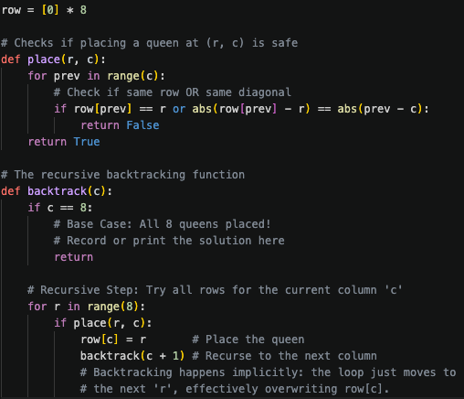
Code Example: 8-Queens (Python)
The Goal: Place 8 queens on an 8×8 board without them attacking each other.
The Recursive State: place_queen(column_index)
The Logic:
  Base Case: If column_index == 8, all queens are placed. We found a valid arrangement! Record it and return.
  Recursive Step:
    Loop through rows 0 to 7.
    Check if placing a queen at (row, column_index) is safe.
    If safe, place the queen and recursively call place_queen(column_index + 1).
    Backtrack: Remove the queen we just placed to try the next row in the loop.
Notes:
https://wiki.python.org/moin/TimeComplexity

Slide 9
3.2.3 Complete Search Tips – Tip 1
Filtering versus Generating
Filters:
  Programs that examine lots of (if not all) candidate solutions and choose the ones that are correct (or remove the incorrect ones)
  Usually iterative algorithms
  Usually easier to code, but run slower due to difficulty in pruning more of the search space
  ex. The naïve 8-Queen solution is to generate all combinations ₆₄C₈ (8⁸)
Generators:
  Gradually build the solutions and immediately prune invalid partial solutions
  Usually recursive algorithms
  ex. The recursing 8-Queen solution that prunes as it generates solutions
Notes:
https://wiki.python.org/moin/TimeComplexity

Slide 10
3.2.3 Complete Search Tips – Tip 2
Prune Infeasible/Inferior Search Space Early
When generating solutions using recursive backtracking (see tip above), we may encounter a partial solution that will never lead to a full solution
  Prune the search there and explore other parts of the search space
  Ex. In the queens problem, as soon as you find 2 queens “attacking” each other, you don’t have to explore that solution further (2 queens in same column, row, or diagonal)
Rule of thumb, the earlier you can prune the search space, the better
In other problems, we may be able to compute the ‘potential worth’ of a partial (and still valid) solution.
  If the potential worth is inferior to the worth of the current best found valid solution so far, we can prune the search there.
Notes:
https://wiki.python.org/moin/TimeComplexity

Slide 11
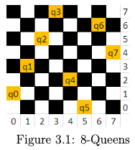
3.2.3 Complete Search Tips – Tip 3
Utilize Symmetries
Some problems have symmetries that can be exploited to reduce execution time.
8-Queens example:
  Total solutions = 92
  Unique (fundamental) solutions = 12 (due to rotational and reflection symmetries)
  Strategy:
    Generate only the 12 unique solutions.
    Derive the full 92 by applying rotations/reflections.
Caution:
  Considering symmetries may complicate code.
  In competitive programming, shorter/cleaner code is usually better (fewer bugs).
  If symmetry handling doesn’t give significant benefit, it’s best to ignore it.
Notes:
https://wiki.python.org/moin/TimeComplexity

Slide 12
3.2.3 Complete Search Tips – Tip 4
Pre-Computation a.k.a Pre-Calculation
Pre-computation:
  Generate tables/data structures before execution to speed up lookups.
  Trades memory/space for time.
Example (8-Queens problem):
  Only 92 valid solutions exist.
  Store them in a 2D array solution[92][8].
    Use a generator program to pre-fill this array.
  Later, another program can quickly retrieve solutions from it.
Limitations:
  Rarely applicable in modern programming contests.
  Not useful for most Complete Search problems.
  Some exercises (at the end of section 2.2) can still benefit from it.
Notes:
https://wiki.python.org/moin/TimeComplexity

Slide 13
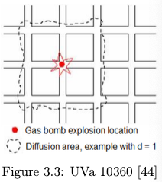
3.2.3 Complete Search Tips – Tip 5
Try Solving the Problem Backwards
Some problems are easier when solved “backwards” (unconventional angle) instead of the obvious way.
Ex: UVa 10360 – Rat Attack:
  Descriptions:
    1025x1025 grid where there are n <= 20’000 rats across the cells
    Find which cell (x, y) should be gas-bombed so that the number of rats killed in a square box (x-d, y-d) to (x+d, y+d) is maximized
    d is power of gas-bomb (d <= 50)
  Naïve approach (frontal attack):
    Let’s bomb every cell and count the kills with a O(1025^2 * d²) scan (each cell in the bombing radius)
    Worse case: 1025²x50² = ~2626 million or ~2.6 billions operations TLE!
  Backward approach
    Create array int killed[1025][1025]
    For each rat at (x, y) add 1 to killed[i][j] where |i - x| <= d and |j - y| <= d
      O(n x d²)
    Find coordinate of highest entry in array killed in 1025² operations
    Total is 20’000x50²+1025²=51Million operations for (n=20’000, d=50)
  Instead of iterating through all cells, you iterate through all rats.
    Since not every cell have rats

Slide 14
3.2.3 Complete Search Tips – Tip 6
Data Compression
Some problems disguise input constraints to look too big for Complete Search.
Careful reading can reveal remarks that shrink the search space.
Ex:
  Given a multiset S of M = 100K integers, we want to know how many different integers that we can form if we pick two (not necessarily distinct) integers from S and sum them.
  The content of multiset S is prime numbers not more than 20K.
Direct Method:
  Try all possible O(M²) pairs of integers and insert their sums into a hash table (O(1) per insertion)
  Get TLE as M = 100K integers (100’000² = 1 Trillion operations)
Key Observation:
  S contains only prime numbers under 20K.
  In Book 2 of the textbook we find that π(20’000) = 2262 (prime counting function)
Optimized Approach
  There are only 2262 distinct prime numbers under 20K.
  Do one O(M) data compression pass to ensure that each integer only has at most 2 copies
    i.e. N ≤ 2x2262
  Do O(N²) complete search as before but now is ~ 20.5M operations
Notes:
https://wiki.python.org/moin/TimeComplexity

Slide 15
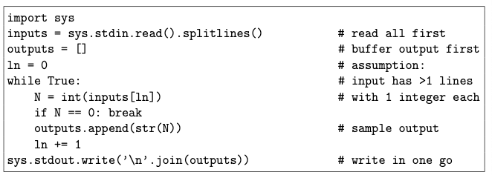
3.2.3 Complete Search Tips – Tip 7
Optimizing Your Source Code Pt 1
By understanding your hardware and how it is organized, especially the I/O, memory, and cache behaviour, you can design better code
Book is biased towards C++ because C++ > Java > Python in terms of speed
  Some contests give Java/Python extra time to account for this but it is never 100% fair
Use bit manipulation!
  Much more efficient than index manipulation in an array of Booleans
For Python, read all input first upfront before processing them in-memory and buffer output first before writing them out in one go, especially if the I/O is big.
Access a 2D array in a row-major fashion (row by row) rather than in a column-major fashion as multidimensional arrays are stored in a row-major order in memory. This will increase the probability of cache hit.
Notes:
https://wiki.python.org/moin/TimeComplexity

Slide 16
3.2.3 Complete Search Tips – Tip 7
Optimizing Your Source Code Pt 2
Use lower level data structures/types at all times if you do not need the extra functionality in the higher level (or larger) ones.
When you have the option to write your code either iteratively or recursively, choose the iterative version
Array access in (nested) loops can be slow
  If you frequently need A[i] (without changing it) in (nested) loops, you can use a local variable temp = A[i] and work with temp instead
Careful with String manipulation as they are immutable (For a new string, it must be recreated from scratch)
  Better to use Python list (and join the list afterwards) if you require lots of modifications
Browse the Internet or relevant books to find more information on how to speed up your code!
  Practice by choosing harder problems in UVa or Kattis where the best solution is not 0.000s. Submit variants and check runtime differences
  Adopt hacking modifications that consistently give you faster runtime.
Use better data structures and algorithms!
  They will always outperform any micro optimizations.
If you are sure that you have written your fastest Complete Search code, but it is still judged as TLE, perhaps explore other non-Complete search solutions.
For more information and tips relating to other languages, refer to the textbook
Notes:
https://wiki.python.org/moin/TimeComplexity

Slide 17
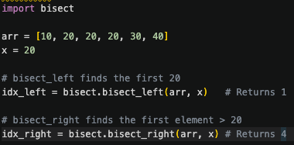
3.3.1 Interesting Usages of Binary Search
Used when a problem asks to find the "minimum possible maximum" or "maximum possible minimum" (e.g., minimizing the longest distance).
The Prerequisite: The search space must be monotonic. If an answer 𝑥 is valid, then all values greater than 𝑥 (or less than 𝑥, depending on the problem) must also be valid.
The Strategy: Instead of computing the exact answer directly, guess an answer 𝑚𝑖𝑑. Write a can(mid) function to check if 𝑚𝑖𝑑 is feasible (often using a greedy algorithm). Adjust the binary search bounds based on the result.
Built-in Library Functions:
Avoid writing manual binary search loops for standard array lookups to prevent off-by-one errors.
  Python: Use bisect library
  bisect_left(arr, x): Returns the index of the first element that is greater than or equal to x. (If x is in the list, it returns the index of its first occurrence).
  bisect_right(arr, x): Returns the index of the first element that is strictly greater than x. (If x is in the list, it returns the index right after its last occurrence).
Notes:
https://wiki.python.org/moin/TimeComplexity

Slide 18
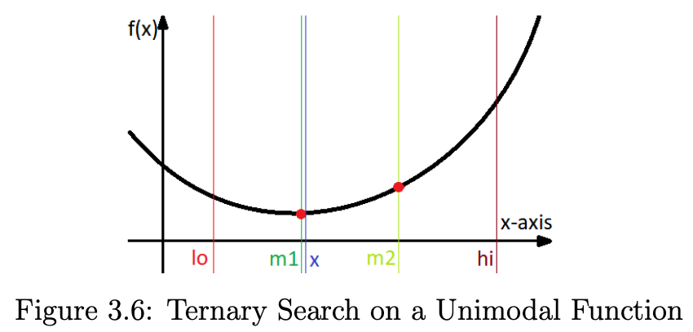
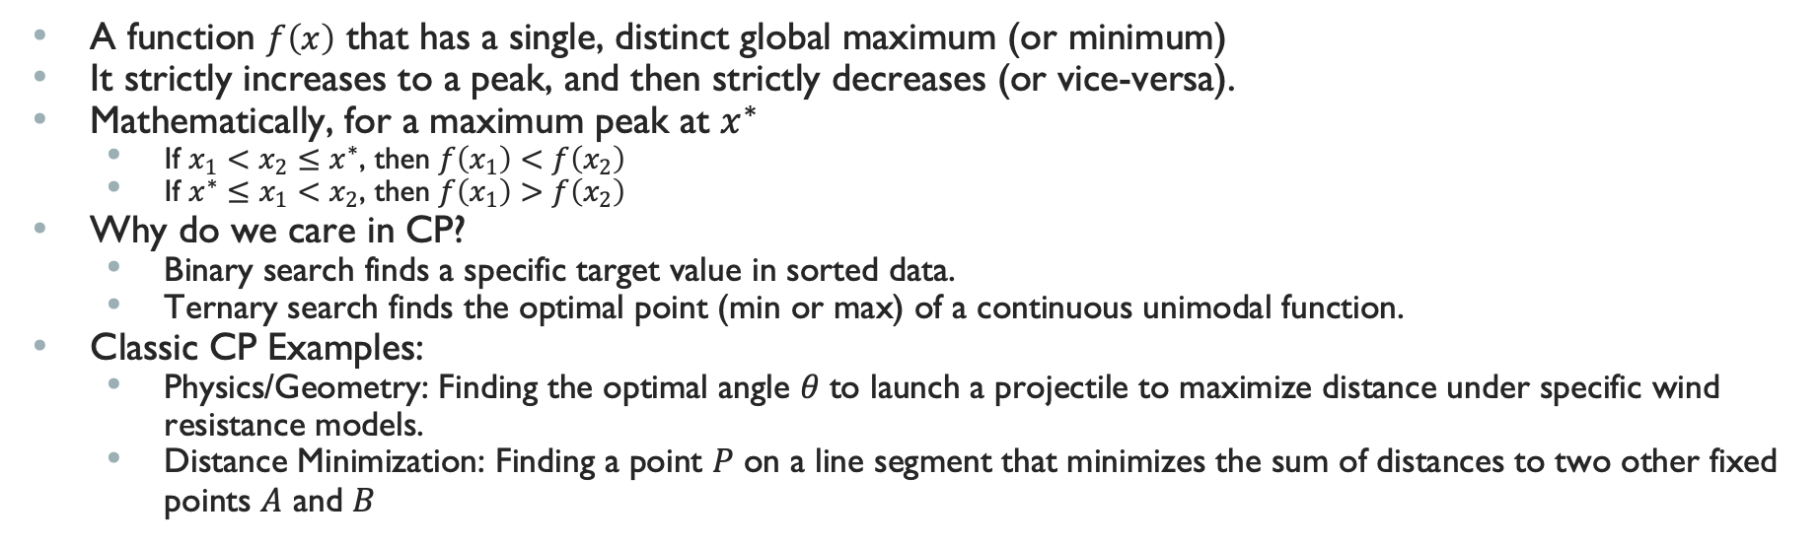
Unimodal Functions in CP
A function $f\left(x\right)$ that has a single, distinct global maximum (or minimum)
It strictly increases to a peak, and then strictly decreases (or vice-versa).
Mathematically, for a maximum peak at $x^{∗}$
  If $x_{1}<x_{2}≤x^{∗}$, then $f\left(x_{1}\right)<f\left(x_{2}\right)$
  If $x^{∗}≤x_{1}<x_{2}$, then $f\left(x_{1}\right)>f\left(x_{2}\right)$
Why do we care in CP?
  Binary search finds a specific target value in sorted data.
  Ternary search finds the optimal point (min or max) of a continuous unimodal function.
Classic CP Examples:
  Physics/Geometry: Finding the optimal angle 𝜃 to launch a projectile to maximize distance under specific wind resistance models.
  Distance Minimization: Finding a point 𝑃 on a line segment that minimizes the sum of distances to two other fixed points 𝐴 and 𝐵
Notes:
https://wiki.python.org/moin/TimeComplexity

Slide 19
3.3.2 Ternary Search
A Divide and Conquer algorithm similar to Binary Search, but instead of splitting the search space into two parts, it splits it into three parts.
The Midpoints:
  Splitting the space requires two midpoints instead of one:
  mid1 = low + (high - low) / 3
  mid2 = high - (high - low) / 3
The Logic (Finding a Maximum):
  If f(mid1) < f(mid2): The maximum cannot be in the left-most third. We discard the left third by setting low = mid1.
  If f(mid1) > f(mid2): The maximum cannot be in the right-most third. We discard the right third by setting high = mid2.
  If f(mid1) == f(mid2): We can safely discard both the left-most and right-most thirds.
Complexity:
  The search space is reduced by 1/3 each step.
  Time Complexity: O(log₃ N).
Notes:
https://wiki.python.org/moin/TimeComplexity

Slide 20
Template
Template
Notes:
https://wiki.python.org/moin/TimeComplexity

