Slide 1
ICPC Bootcamp Day 5
5.3.1 Prime
5.3.3 Finding Prime Factors with Optimized Trial Divisions
5.3.6 Greatest Common Divisor & Least Common Multiple
5.3.9 Modular Arithmetic
7.2.1 0D Objects: Points
7.2.2 1D Objects: Lines
7.2.3 2D Objects: Circles
7.2.4 2D Objects: Triangles
7.2.5 2D Objects: Quadrilaterals
7.3.1 Polygon Representation
7.3.2 Perimeter of a Polygon
7.3.3 Area of a Polygon
7.3.4 Checking if a Polygon is Convex
7.3.5 Checking if a Point is Inside a Polygon
7.3.6 Cutting Polygon with a Straight Line
7.3.7 Finding the Convex Hull of a Set of Points

Slide 2
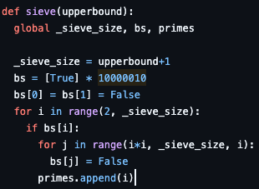
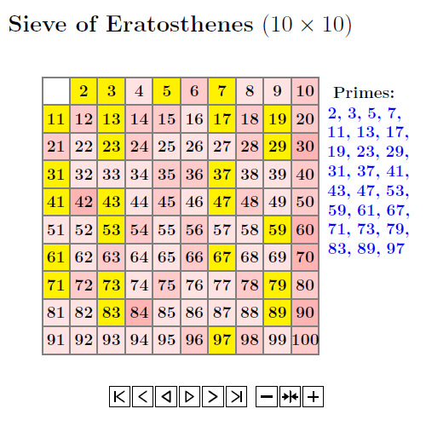
5.3.1 Prime Numbers
Primality Testing (𝑂(√𝑁)):
  To check if 𝑁 is prime, you only need to test divisibility up to √𝑁. If 𝑁 is divisible by a number 𝑝>√𝑁, it must also be divisible by a number 𝑞<√𝑁.
Generating Primes (Sieve of Eratosthenes):
  The most efficient way to generate all primes up to an upper bound 𝑀 (usually up to 10^7).
  Algorithm: Create a boolean array of size 𝑀 set to True. (You can use a binary string as seen in day 1) Starting from 𝑝=2, if 𝑝 is true, mark all multiples of 𝑝 (2𝑝,3𝑝,5𝑝…) as False. Then p=3, p=4, etc…
  Time Complexity: 𝑂(𝑀loglog𝑀), which is close to linear time 𝑂(𝑀).
Code from: https://github.com/stevenhalim/cpbook-code/blob/master/ch5/primes.py
Notes:
https://wiki.python.org/moin/TimeComplexity

Slide 3
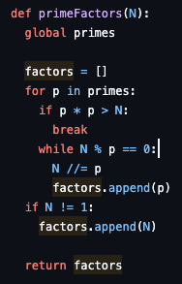
5.3.3 Finding Prime Factors with Optimized Trial Divisions
The Naïve Way:
  Testing every number up to 𝑁 to find its factors is too slow.
The Optimized Way (𝑂(√𝑁/ln⁡√𝑁 )):
  First, generate a list of prime numbers using the Sieve of Eratosthenes up to √𝑁.
  Iterate only through these prime numbers. If a prime 𝑝 divides 𝑁, divide 𝑁 by 𝑝 as many times as possible while recording 𝑝 as a factor.
  After the loop finishes, if the remaining 𝑁 is greater than 1, then that remaining 𝑁 is itself a prime factor!
  Code from: https://github.com/stevenhalim/cpbook-code/blob/master/ch5/primes.py
Notes:
https://wiki.python.org/moin/TimeComplexity

Slide 4
5.3.6 Greatest Common Divisor & Least Common Multiple
Greatest Common Divisor (GCD):
  The largest integer that divides both 𝐴 and 𝐵 without leaving a remainder.
  Libraries: math.gcd(a, b) in Python.
Least Common Multiple (LCM):
  The smallest integer that is a multiple of both 𝐴 and 𝐵.
Formula: lcm(𝐴,𝐵)=𝐴*(𝐵/gcd(𝐴,𝐵))
Notes:
https://wiki.python.org/moin/TimeComplexity

Slide 5
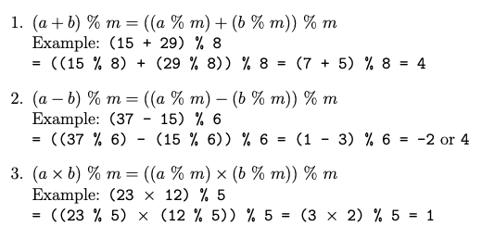
5.3.9 Modular Arithmetic
Many problems are only interested in the modulo of large numbers that fit into built-in types
Ex: You have binary digits of up to 2¹⁰⁰-1 long, output if the number is divisible by 131071
  Answer: convert binary to decimal digit by digit while performing % 131071 to the intermediate result
  If result is 0, then actual number is divisible by 131071
Note:
  Modulo can behave differently depending on the language used
  Python: -10%4=4
  C++/Java: -10%4=-3
  To be safer, you can find a non-negative number using ((a % m) + m) % m
    Ex: ((-10 % 7) + 7) % 7 = (3 + 7) % 7 = 4 % 7 = 4.
Notes:
Top teams in ICPC have extensive pre-written libraries for Geometry

Slide 6
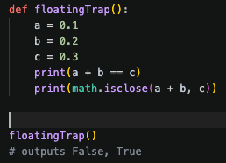
7 Geometry
There are many pitfalls in working with geometry problems, tips:
Avoid floating point operations
If you have to use floating points:
  Do floating point equality test this way: fabs(a-b) < EPS where EPS is a small number like 1e-9 (i.e., 109 or 0.000000001) instead of testing if a == b.
  Python, use math.isclose()
  Check if a floating point number x >= 0.0 by using x > -EPS (similarly to check if x <= 0.0, we use x < EPS)
  Use double-precision data type by default instead of single-precision data type.
  Defer the floating point operation(s) as late as possible to reduce the effect of compounding errors.
  Reduce the number of such floating point operation(s) as much as we can,
    Ex: instead of computing a/b/c (two floating poin point divisions), we compute a/(b*c) instead (only one floating point division)
Notes:
https://wiki.python.org/moin/TimeComplexity

Slide 7
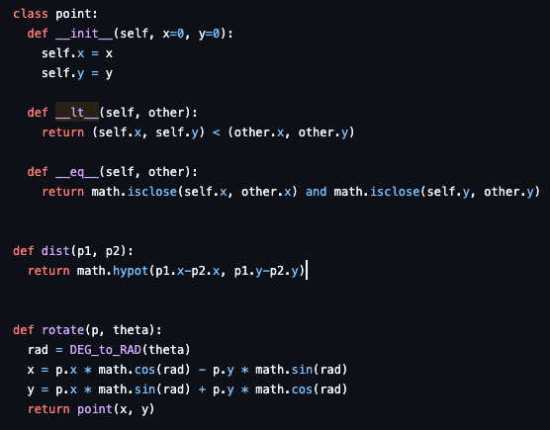
7.2.1 0D Objects: Points
A point is the basic building block of higher dimensional geometry objects.
Create a point class and add methods to help yourself
Implement
  __lt__
  __eq__
  distance
  rotations
Notes:
__lt__ is for the comparison operator <

Slide 8
7.2.2 1D Objects: Lines
Create classes!
Use a𝑥+b𝑦+c=0 because it can handle vertical lines (when b=0)
Implement:
  Compute line equation given 2 points
  Compute line equation given 1 point and a slope
  Test whether 2 lines are parallel (if all coefficients are the same)
  Compute the intersection of 2 non-parallel lines
  Vectors (line segment with x, y as magnitudes of the vector)
  Vector translations
  Compute the angle between 2 points
  Given three points p, q, and r, determine whether point p, q, and then r, in that order, makes a left (counterclockwise) or a right (clockwise turn); or whether the three points p, q, and r are collinear
  Given a point p and a line l (described by two points a and b), compute the minimum distance from p to l
  Given a line segment instead (defined by two end points a and b), compute the minimum distance from point p to line segment ab
Look at code on https://github.com/stevenhalim/cpbook-code/blob/master/ch7/points_lines.py for implementation
Look at textbook for detailed implementation notes
Notes:
Collinear means are the points on the same line

Slide 9
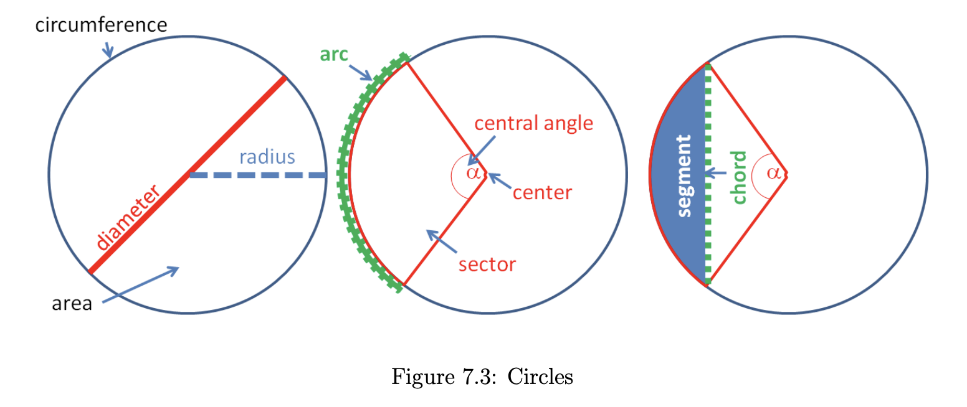
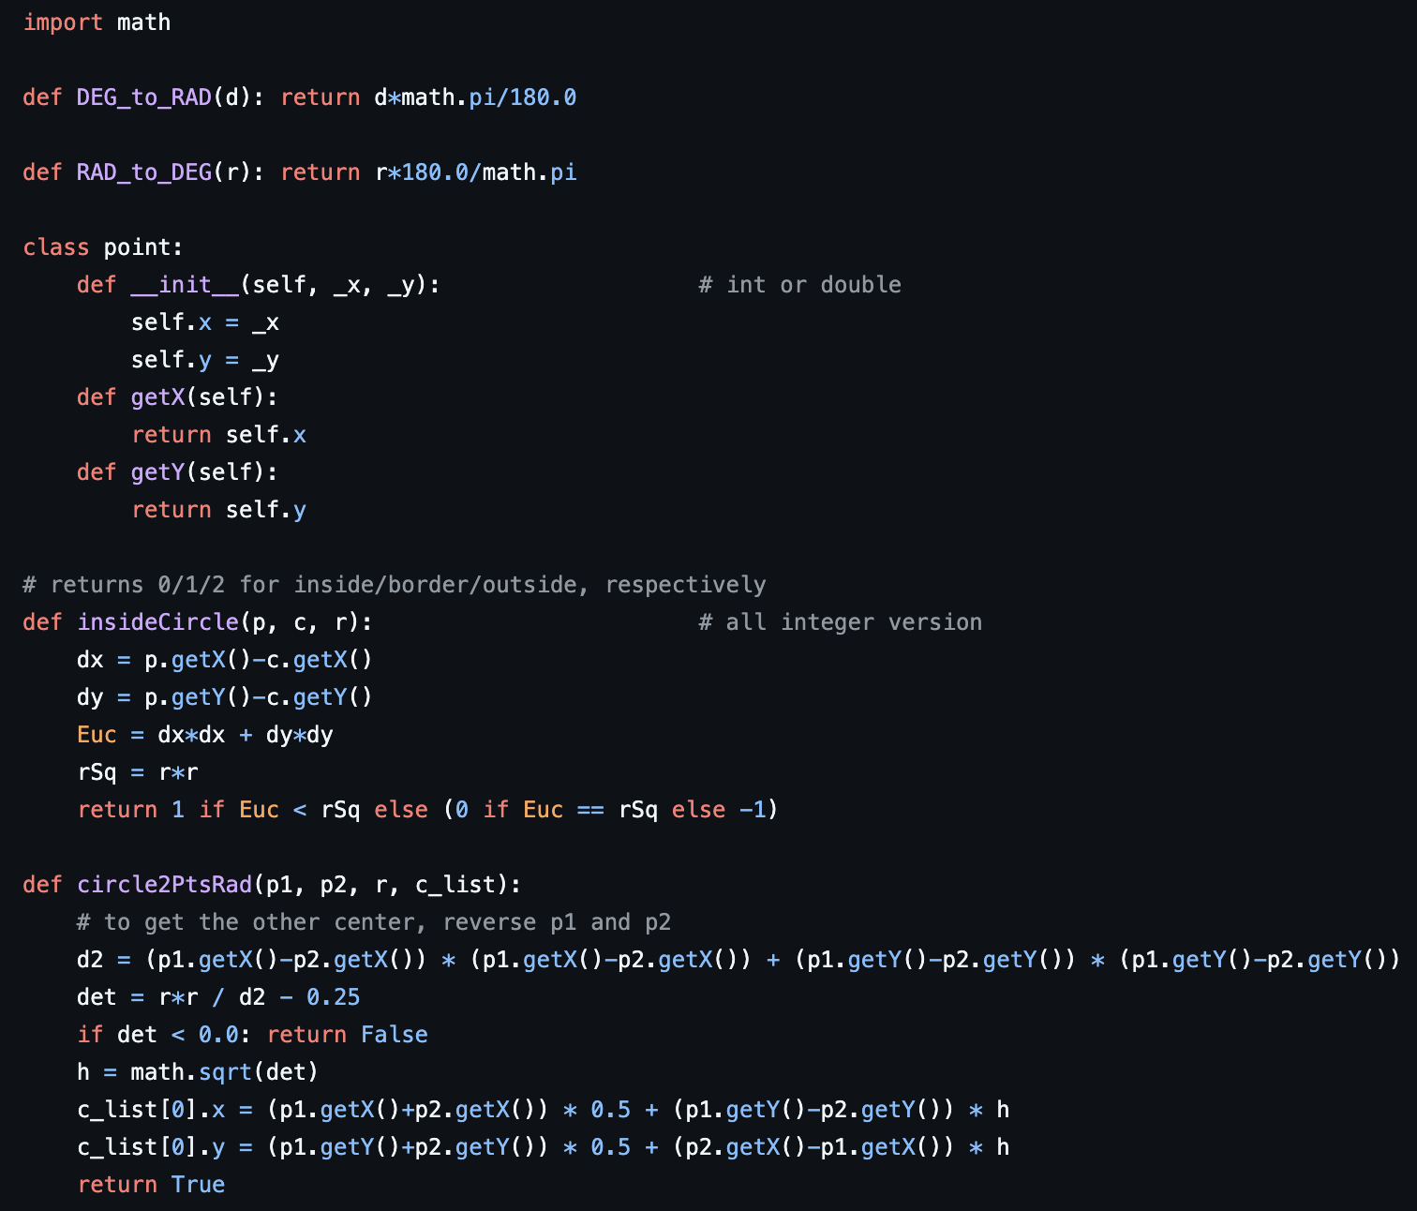
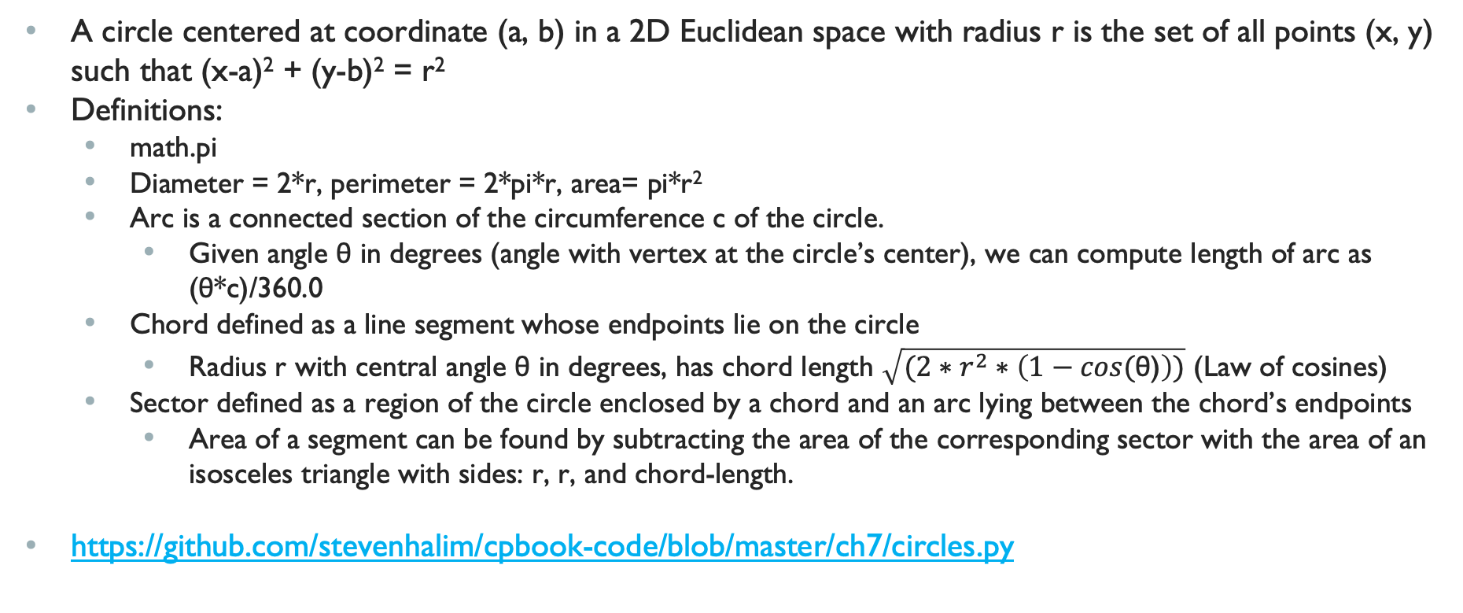
7.2.2 2D Objects: Circles
A circle centered at coordinate (a, b) in a 2D Euclidean space with radius r is the set of all points (x, y) such that (x-a)² + (y-b)² = r²
Definitions:
  math.pi
  Diameter = 2*r, perimeter = 2*pi*r, area= pi*r²
  Arc is a connected section of the circumference c of the circle.
    Given angle θ in degrees (angle with vertex at the circle’s center), we can compute length of arc as (θ*c)/360.0
  Chord defined as a line segment whose endpoints lie on the circle
    Radius r with central angle θ in degrees, has chord length $\sqrt{(2∗r^{2}∗\left(1−cos\text{(}\text{θ}\text{)}\right))}$ (Law of cosines)
  Sector defined as a region of the circle enclosed by a chord and an arc lying between the chord’s endpoints
    Area of a segment can be found by subtracting the area of the corresponding sector with the area of an isosceles triangle with sides: r, r, and chord-length.
https://github.com/stevenhalim/cpbook-code/blob/master/ch7/circles.py
Notes:
https://wiki.python.org/moin/TimeComplexity

Slide 10
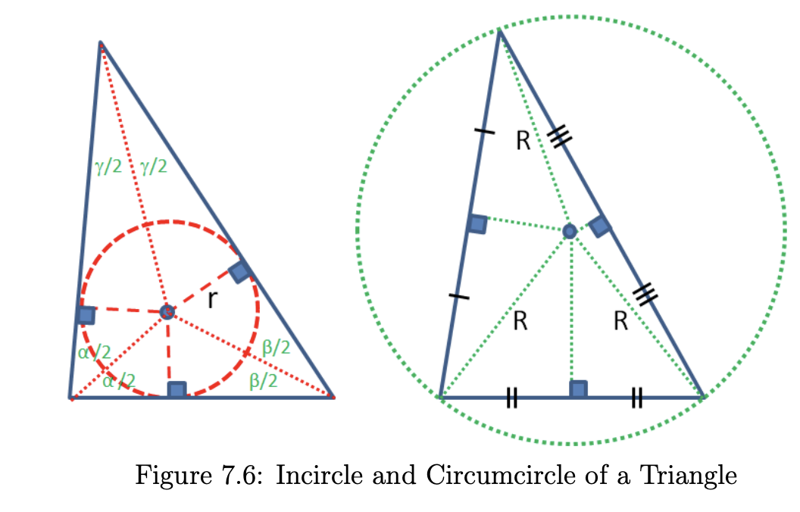
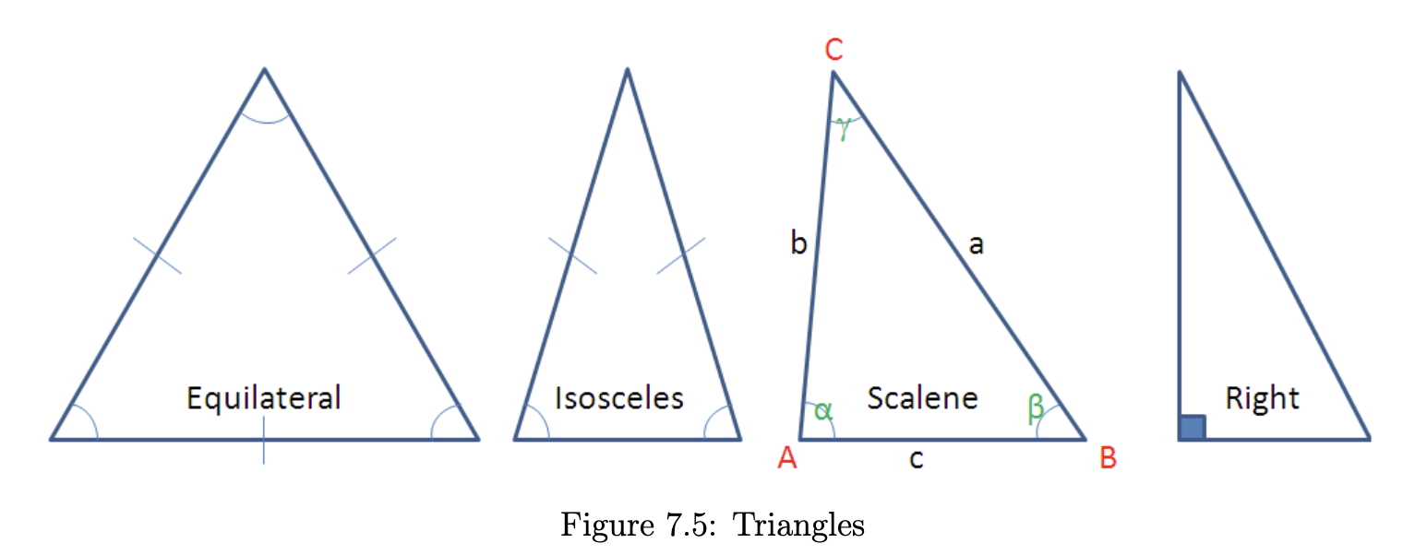
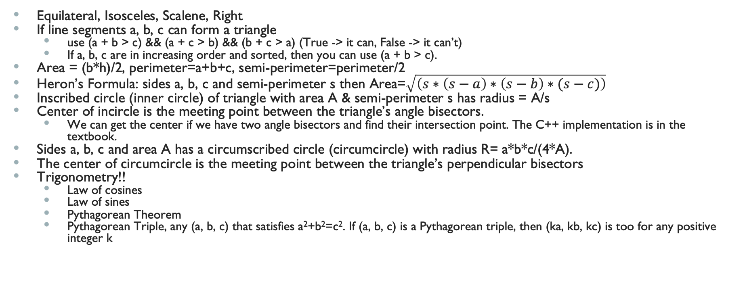
7.2.4 2D Objects: Triangles
Equilateral, Isosceles, Scalene, Right
If line segments a, b, c can form a triangle
  use (a + b > c) && (a + c > b) && (b + c > a) (True -> it can, False -> it can’t)
  If a, b, c are in increasing order and sorted, then you can use (a + b > c).
Area = (b*h)/2, perimeter=a+b+c, semi-perimeter=perimeter/2
Heron’s Formula: sides a, b, c and semi-perimeter s then Area=$\sqrt{\left(s∗\left(s−a\right)∗\left(s−b\right)∗(s−c)\right)}$
Inscribed circle (inner circle) of triangle with area A & semi-perimeter s has radius = A/s
Center of incircle is the meeting point between the triangle’s angle bisectors.
  We can get the center if we have two angle bisectors and find their intersection point. The C++ implementation is in the textbook.
Sides a, b, c and area A has a circumscribed circle (circumcircle) with radius R= a*b*c/(4*A).
The center of circumcircle is the meeting point between the triangle’s perpendicular bisectors
Trigonometry!!
  Law of cosines
  Law of sines
  Pythagorean Theorem
  Pythagorean Triple, any (a, b, c) that satisfies a²+b²=c². If (a, b, c) is a Pythagorean triple, then (ka, kb, kc) is too for any positive integer k
Notes:
https://wiki.python.org/moin/TimeComplexity

Slide 11
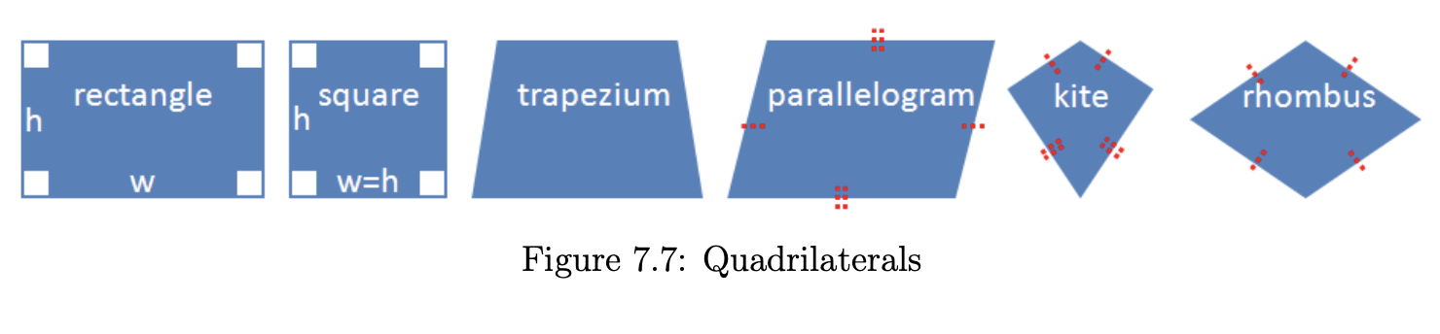
2D Objects: Quadrilaterals
Polygon: 4 edges and 4 vertices
Rectangle: 4 edges and 4 vertices and 4 right angles
Area=w*h, perimeter=2*(2+h)
Trapezium: a polygon with 4 vertices, 4 edges, and 1 pair of parallel edges among these four edges.
  If the two non-parallel sides have the same length, we have an Isosceles Trapezium.
  Area=0.5*(w1 + w2) * h
Parallelogram: polygon with 4 edges, 4 vertices, opposite sides must be parallel
Kite: quadrilateral that has 2 pairs of sides of the same length that are adjacent to each other
  Area: diagonal1 * diagonal2/2 (diagonal is from one internal vertex to another)
Rhombus: special parallelogram where every side has equal length, also special case of kite
Notes:
https://wiki.python.org/moin/TimeComplexity

Slide 12
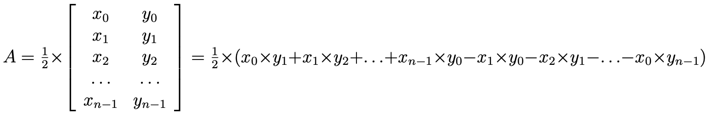
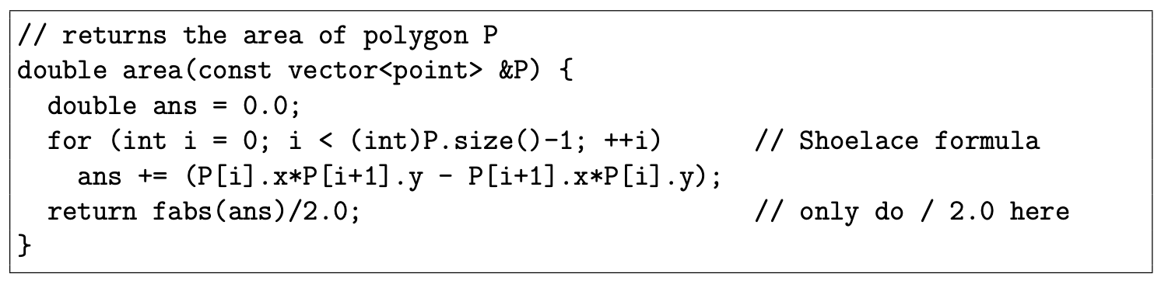
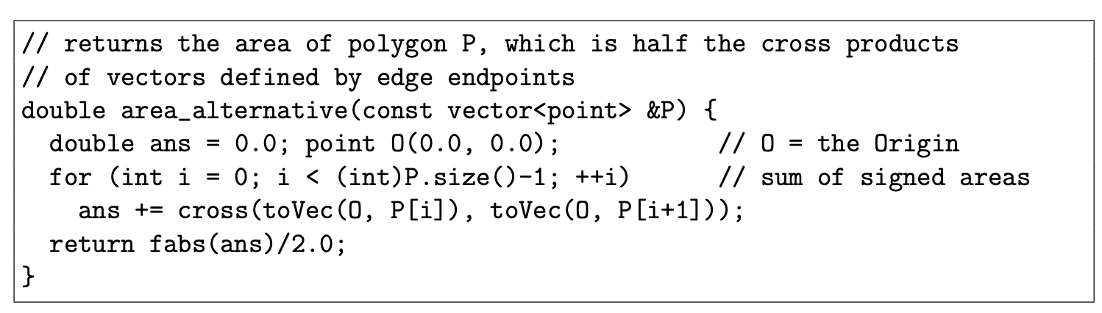
7.3.1, 7.3.2, 7.3.3 Polygon Representation, Perimeter
Simple polygon: at least 3 edges & no crossing edges
Enumerate vertices either clockwise or counterclockwise where end==start
Perimeter=add all edge lengths using Euclidian distance
Area: use Shoelace Formula, compute using the cross multiplication of coordinates in the matrix ex.
  Code using vector operations in textbook
  Works by doing successive sums triangles defined by the origin
Notes:
https://wiki.python.org/moin/TimeComplexity

Slide 13
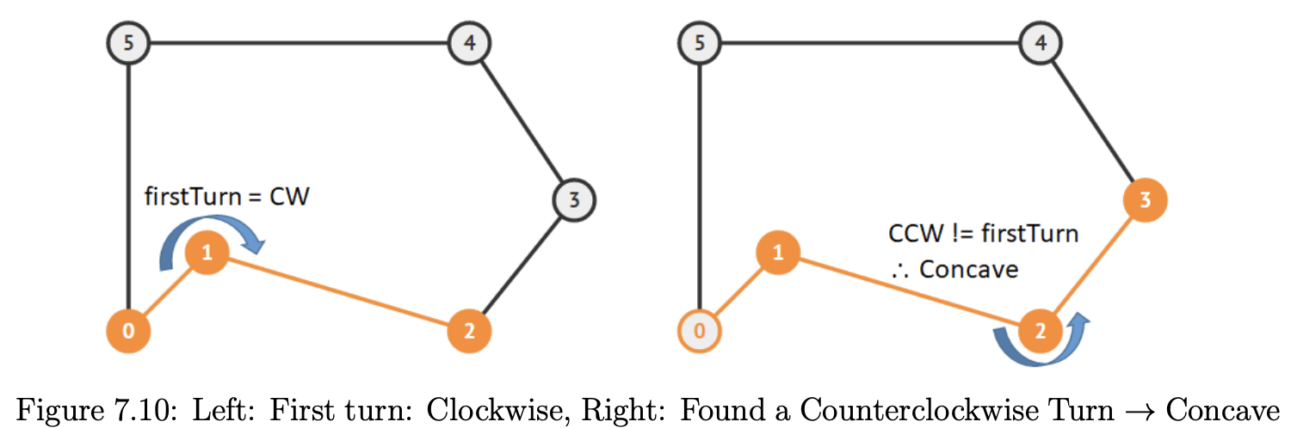
7.3.4 Checking if a Polygon is Convex
If any line segment drawn inside the polygon does not intersect any edge of the polygon. Otherwise, the polygon is called Concave.
  Check whether all three consecutive vertices of the polygon form the same turns (all left turns/ccw if the vertices are listed in counterclockwise order or all right turns/cw if the vertices are listed in clockwise order). If we can find at least one triple where this is false, then the polygon is concave.
Notes:
https://wiki.python.org/moin/TimeComplexity

Slide 14
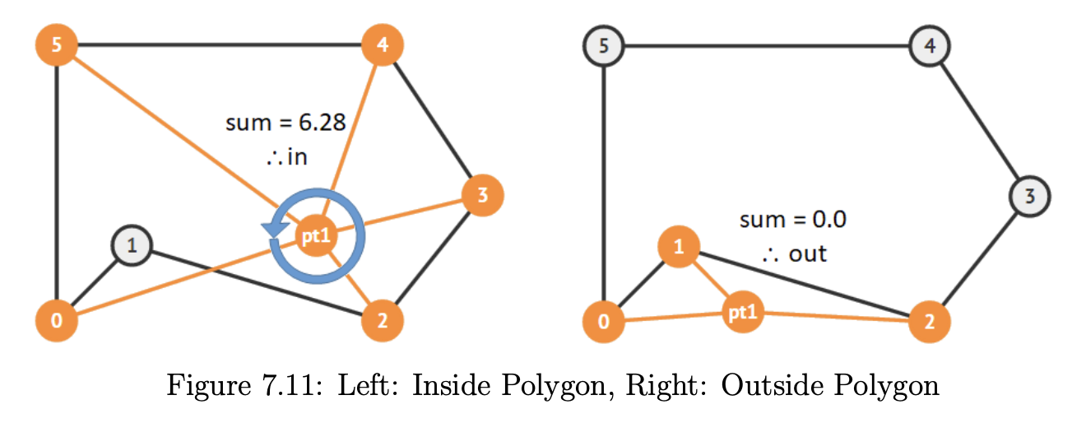
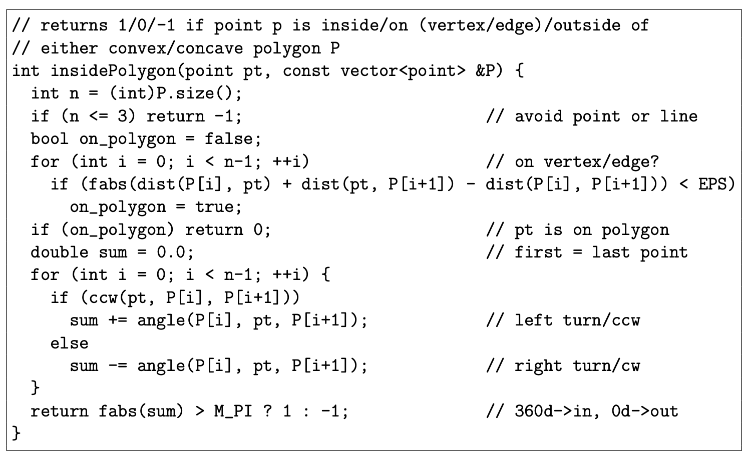
7.3.5 Checking if a Point is Inside a Polygon
Winding Number Algorithm:
  Compute the signed sum of angles between three points: {P[i], pt, P[i + 1]} where (P[i], P[i + 1]) are consecutive edges of polygon P, taking care of ccw/left turns (add the angle) and cw/right turns (subtract the angle) respectively.
  If the final sum is 2*pi (360 degrees), then pt is inside polygon P. Otherwise (if the final sum 0 degree), pt is outside polygon P
Notes:
https://wiki.python.org/moin/TimeComplexity

Slide 15
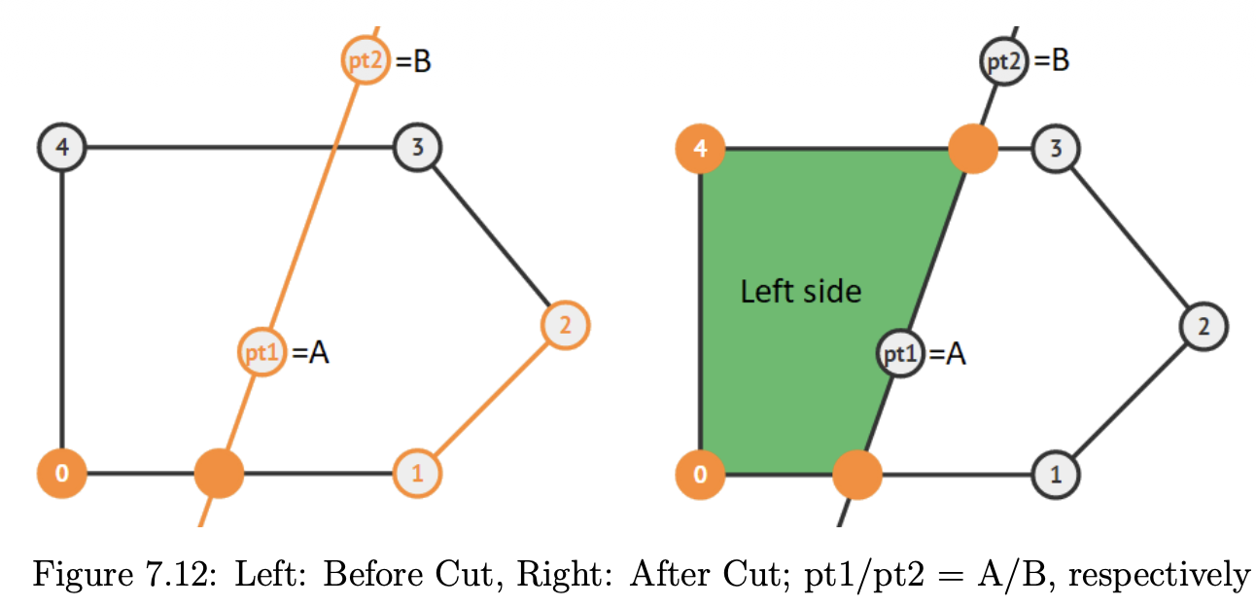
7.3.6 Cutting Polygon with a Straight Line
The Problem: Given a convex polygon and an infinite straight line, "slice" the polygon and return the smaller resulting polygon (e.g., the part on the left side of the line).
Algorithm:
  Iterate through all edges of polygon
    If point A, point B, and polygon vertex v form a left turn (implies that v is on the left side of the line AB (order matters)),
      put v inside the new polygon P
  Once we find a polygon edge that intersects with the line AB, use that intersection point as part of the new polygon P (in figure, new vertex between edge (0-1)).
  Skip the next few vertices of Q that are located on the right side of line AB (in figure left, vertices 1, 2, and later 3).
  We will revisit another polygon edge that intersects with line AB again and we also use that intersection point as part of the new polygon P (in figure right, the new vertex between edge (3-4)).
  Then, we continue appending vertices of Q into P again because we are now on the left side of line AB again.
  Stop when we have returned to the starting vertex and return the resulting polygon P (see the shaded area in figure right).
Notes:
https://wiki.python.org/moin/TimeComplexity

Slide 16
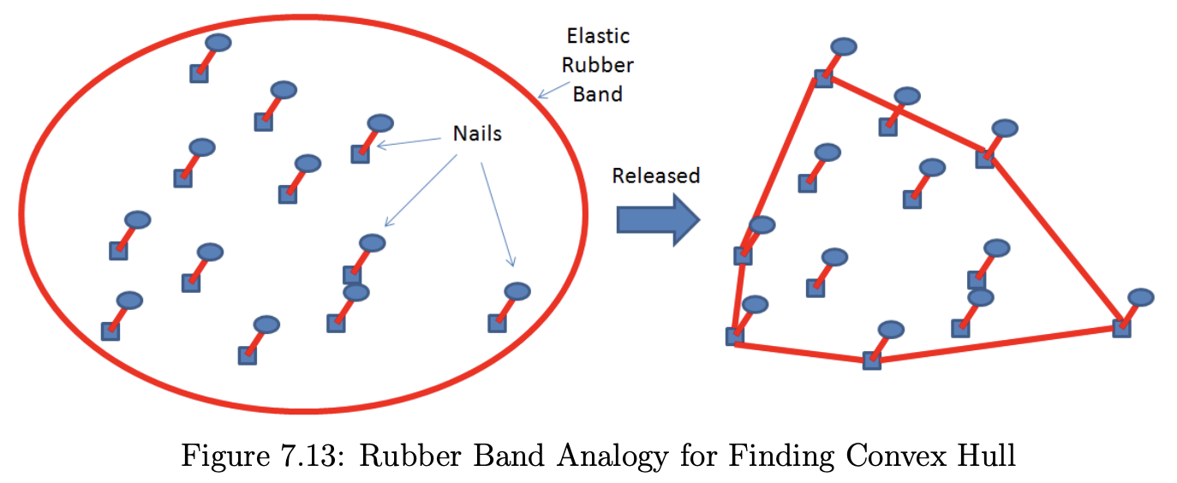
7.3.7 Finding the Convex Hull of a Set of Points
Convex Hull of a set of points Pts is the smallest convex polygon CH(Pts) for which each point in Pts is either on the boundary of CH(Pts) or in its interior.
Natural applications in packing problems and can be used as pre-processing step for more complex computational geometry problems.
Problem is to choose which vertex is part of convex hull
  Ronald Graham’s Scan O(nlogn)
  Andrew’s Monotone Chain Algorithm O(nlogn) (faster and preferred)
Notes:
As every vertex in CH(P ts) is a vertex in the set of points P ts itself, the algorithm for finding
convex hull is essentially an algorithm to decide21 which points in P ts should be chosen as
part of the convex hull. There are several ecient convex hull finding algorithms available.
In this section, we present two of them: the O(n log n) Ronald Graham’s Scan algorithm
(for historical purpose) followed by the more ecient O(n log n) Andrew’s Monotone Chain
algorithm (our default).

Slide 17
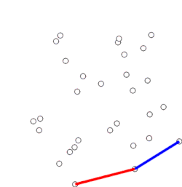
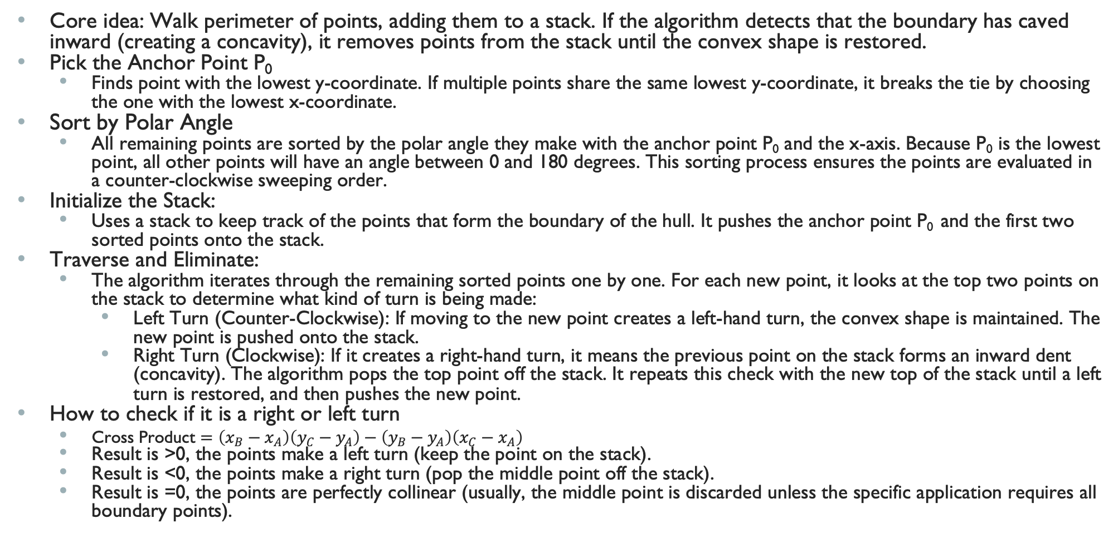
Graham scan
Core idea: Walk perimeter of points, adding them to a stack. If the algorithm detects that the boundary has caved inward (creating a concavity), it removes points from the stack until the convex shape is restored.
Pick the Anchor Point P₀
  Finds point with the lowest y-coordinate. If multiple points share the same lowest y-coordinate, it breaks the tie by choosing the one with the lowest x-coordinate.
Sort by Polar Angle
  All remaining points are sorted by the polar angle they make with the anchor point P₀ and the x-axis. Because P₀ is the lowest point, all other points will have an angle between 0 and 180 degrees. This sorting process ensures the points are evaluated in a counter-clockwise sweeping order.
Initialize the Stack:
  Uses a stack to keep track of the points that form the boundary of the hull. It pushes the anchor point P₀ and the first two sorted points onto the stack.
Traverse and Eliminate:
  The algorithm iterates through the remaining sorted points one by one. For each new point, it looks at the top two points on the stack to determine what kind of turn is being made:
    Left Turn (Counter-Clockwise): If moving to the new point creates a left-hand turn, the convex shape is maintained. The new point is pushed onto the stack.
    Right Turn (Clockwise): If it creates a right-hand turn, it means the previous point on the stack forms an inward dent (concavity). The algorithm pops the top point off the stack. It repeats this check with the new top of the stack until a left turn is restored, and then pushes the new point.
How to check if it is a right or left turn
  $\text{Cross Product}=\left(x_{B}−x_{A}\right)\left(y_{C}−y_{A}\right)−\left(y_{B}−y_{A}\right)\left(x_{C}−x_{A}\right)$
  Result is >0, the points make a left turn (keep the point on the stack).
  Result is <0, the points make a right turn (pop the middle point off the stack).
  Result is =0, the points are perfectly collinear (usually, the middle point is discarded unless the specific application requires all boundary points).
Notes:
As every vertex in CH(P ts) is a vertex in the set of points P ts itself, the algorithm for finding
convex hull is essentially an algorithm to decide21 which points in P ts should be chosen as
part of the convex hull. There are several ecient convex hull finding algorithms available.
In this section, we present two of them: the O(n log n) Ronald Graham’s Scan algorithm
(for historical purpose) followed by the more ecient O(n log n) Andrew’s Monotone Chain
algorithm (our default).
LOOK AT VISUALGO

Slide 18
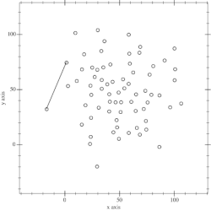
Andrew’s Monotone Chain
Instead of sorting by polar angle, it sorts points lexicographically by their X-coordinate.
  If two points have the same X-coordinate, it breaks the tie using their Y-coordinate.
  No more floating points, use built-in libraries
  Because the points are sorted strictly left-to-right, the algorithm sweeps across the plane twice.
Sort Lexicographically
  Sort the array of points by X, then by Y.
  The very first point in the sorted array (leftmost) and the very last point (rightmost) are guaranteed to be on the convex hull
Build the Lower Hull
  Creates an empty stack, iterate through the sorted points from left to right (index 0 to n-1).
  Just like Graham scan, for each new point, check the top two points on the stack.
    If the new point creates a "right turn" (a concavity), it pops the top point off the stack. It repeats this until it makes a valid "left turn," then pushes the new point. By the time it reaches the rightmost point, the stack contains the bottom half of the convex hull.
Build the Upper Hull:
  Without emptying the stack, the algorithm now iterates through the points from right to left (index n-2 down to 0). It applies the exact same right-turn elimination logic. Because it's moving backwards, checking for a "left turn" naturally outlines the top boundary of the points.
Combine:
  Once the backward sweep reaches the original leftmost point, the upper hull is complete. The last point of the upper hull is the same as the first point of the lower hull, so that duplicate is removed. The stack now contains the complete convex hull in counter-clockwise order.
Notes:
LOOK AT VISUALGO

Slide 19
Graham’s Scan VS Andrew’s Monotone Chain
Feature | Graham Scan | Andrew's Monotone Chain
Sorting Method | Polar angle from an anchor point | Lexicographical (X, then Y)
Sweep Style | Single circular sweep | Left-to-right, then right-to-left
Math Complexity | Higher (requires custom polar comparators) | Lower (standard sorting, just needs cross-product)
Precision Issues | Prone to floating-point errors during sorting | Extremely robust

