Slide 1
ICPC Bootcamp Day 1
1.3.3 Do Algorithm Analysis
Some Abstract Data Types
2.3.3 Balanced Binary Search Tree (bBST)
Linked-List
2.3.1 Binary Heap (Priority Queue)
2.3.2 Hash Table
2.4.1 Graph
2.2.3 Bitmask
2.4.2 Union-Find Disjoint Set
2.4.3 Fenwick (Binary Indexed Tree)

Slide 2

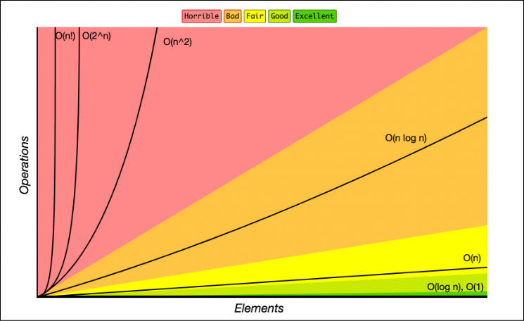



1.3.3 Do Algorithm Analysis
What is time complexity?
  Denoted by the Big-Oh, ex: O(n), O(n^2), O(nlogn) etc…
  Time complexity measures how the number of operations grows with input size as n→∞.
What is space complexity?
  Space complexity measures how the memory required grows with input size as n→∞
Need this to not TLE or MLE (Time Limit Exceeded) (Memory Limit Exceeded)
A computer can perform about 10^8 operations per second
Notes:
https://www.freecodecamp.org/news/big-o-cheat-sheet-time-complexity-chart/

Slide 3
Some Abstract Data Types
Set
  Data: a collection of unique elements
  Ops: add, remove, contains, union, intersect
List
  Data: an ordered sequence of elements
  Ops: insert, remove, get, size
Map
  Data: a collection of key-value pairs, where each key is unique and associated with a single value
  Ops: put(key, value), get(key), remove(key)
Graph
  Data: non-linear structure of vertices and edges
  Ops: add_vertex, add_edge, get_neighbors
Queue
  Data: linear collection operating on FIFO principle
  Ops: enqueue, dequeue, is_empty
Priority Queue
  Data: linear collection where order is preserved according to element weight
  Ops: insert, extract_min, extract_max, peek
Stack
  Data: linear collection operating on LIFO priciple
  Ops: put(key, value), get(key), remove(key)
Double-ended queue (Dequeue)
  Data: Same as queue but you can enqueue and dequeue from both ends
  Ops: enqueueLeft, enqueueRight, dequeueLeft, dequeueRight
Notes:
https://wiki.python.org/moin/TimeComplexity

Slide 4
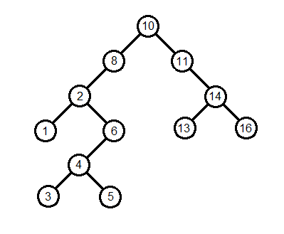
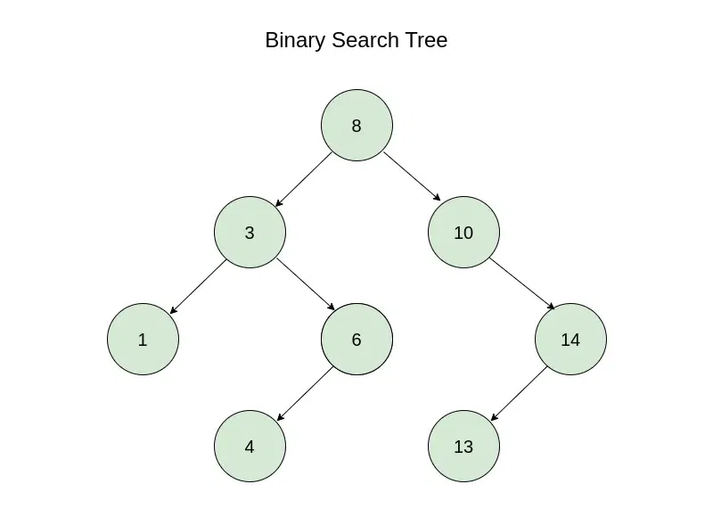
Binary Search Tree (BST)
Implements many ADTs
  Ex: Binary heap, Sets
For any given node:
  all values in its left subtree are smaller
  All values in its right subtree are larger
Balanced
  If height of left and right subtree of every node differ by no more than 1
Complete Binary Tree
  All levels are fully filled except possibly the last, which is filled from left to right
Notes:
https://wiki.python.org/moin/TimeComplexity

Slide 5
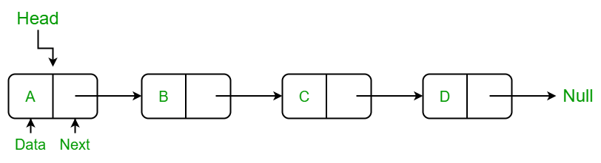
Linked-List
Implementation of the List ADT
  List is represented by the Head
  Each node points to the next node
  Too slow to practically use as a list implementation with certain rare exceptions
    Ex. To access the end of the list, you would have to cycle through the whole list
Notes:
https://wiki.python.org/moin/TimeComplexity

Slide 6
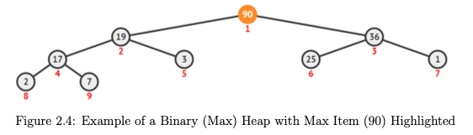
2.3.1 Binary Heap (Priority Queue)
Implementation of the Priority Queue ADT
  Complete binary tree
  min-heap, each parent is less than or equal to its children → the smallest element is always at the root.
  max-heap, each parent is greater than or equal to its children → the largest element is always at the root.
Library: heapq, implements a min-heap
Method | Runtime
heapify(x) | O(n)
heappush(heap, item) | O(log n)
heappop(heap) | O(log n)
Notes:
https://wiki.python.org/moin/TimeComplexity

Slide 7
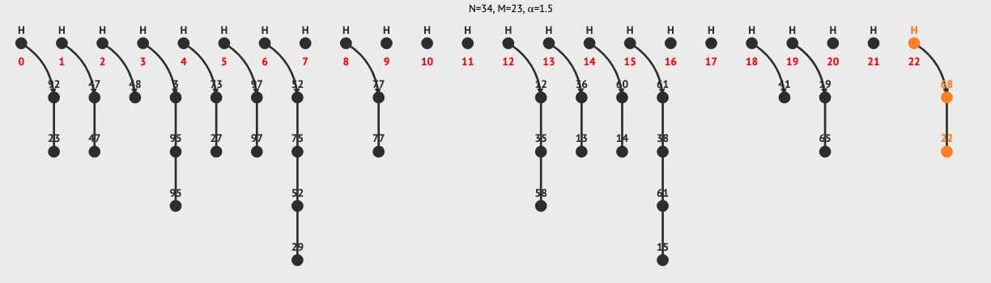
2.3.2 Hash Table
Implementation of the Map ADT
  Stores key-value pairs in an array by running each key through a hash function (turning it into an index), then places the value at that index
  If there is a collision, then it uses a linked-list (implementation of a list ADT) to store collisions at the same key
Library: dictionaries and sets
  Runtime for methods are on average/amortized O(1) with a worst case of O(n)
Notes:
https://wiki.python.org/moin/TimeComplexity

Slide 8
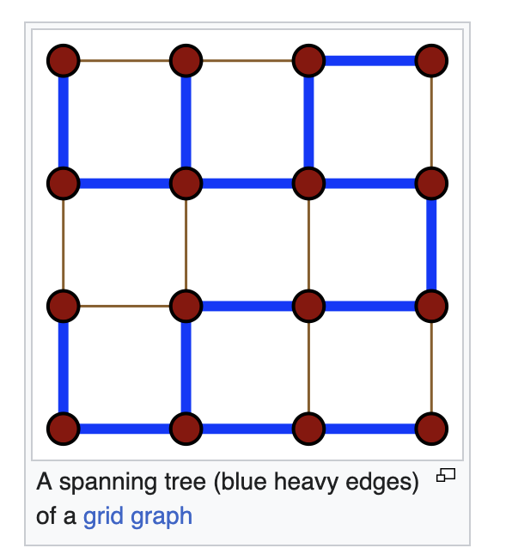
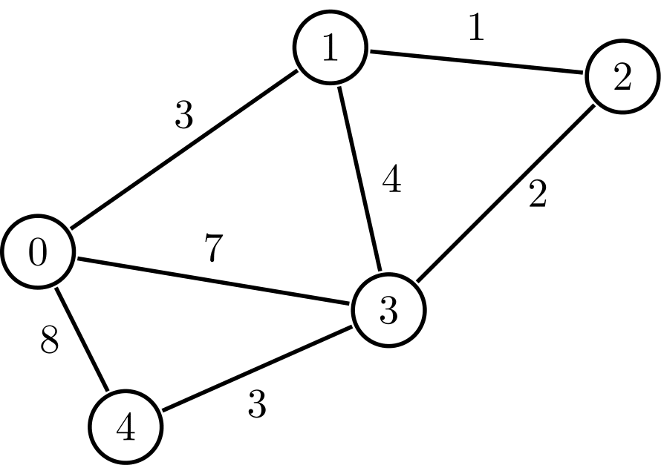
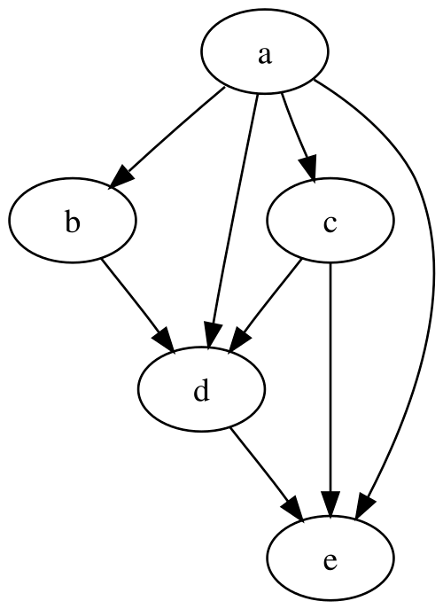
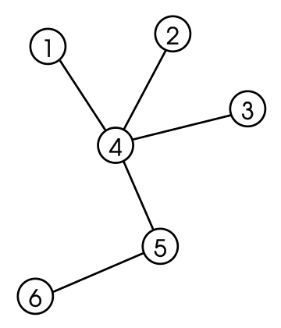
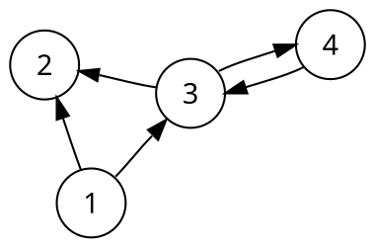
2.4.1 Graph
A graph G = (V, E) is a set of vertices (V) and edges (E)
  Edges store connectivity information between vertices in V
    Can be in the form of weight and/or direction
Undirected/Directed Graph
  A graph that is made up of a set of vertices connected by undirected/directed edges respectively
Spanning Tree
  The subgraph of a graph that contains the minimum number of edges to connect all vertices
  Used for Minimum Spanning Tree
Notes:
Quickly go through, can skip after the first 3 bullet points
Graph represents nodes and paths
Undirected/Directed
Directed Acyclic
Tree: pick any 2 points, there is only 1 path between them
Forest: a bunch of trees
Complete Graph: every point directly connects to every other point
Bipartite graph: you can split the vertices in such a way that they only connect to the other group
Multigraph: You can have an edge that starts and terminates on itself

Slide 9
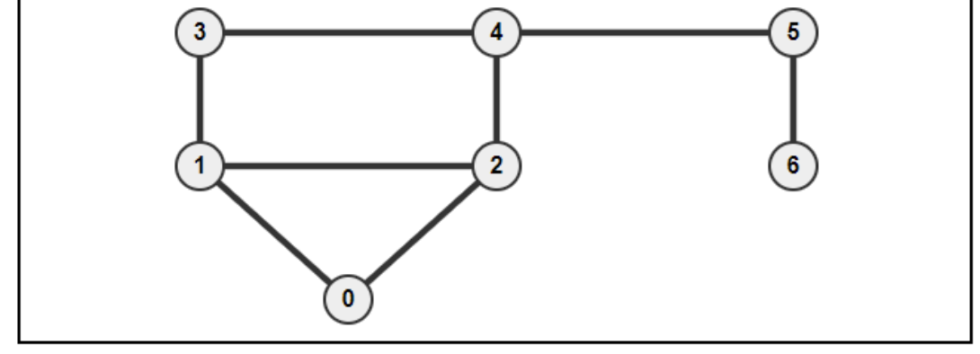
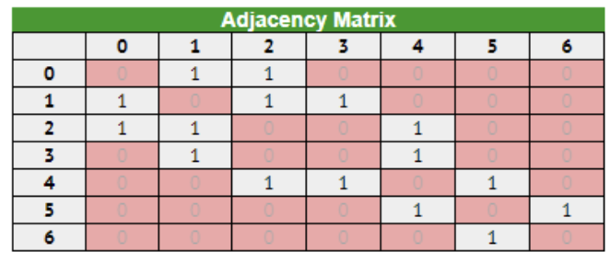
2.4.1 Graph - Adjacency Matrix
A 2D array storing the connectivity information between 2 vertices
  AM[u][v] can store the weight and direction
Python use list of lists
Good to know:
  Only use if number of vertices V is small enough (under ~ 5000)
  Use if you need to access the connectivity between two vertices in a small dense graph is frequently required
  Cannot store a multigraph
O(V²) space
O(V) to enumerate list of neighbors of a vertex u
Notes:
https://wiki.python.org/moin/TimeComplexity

Slide 10
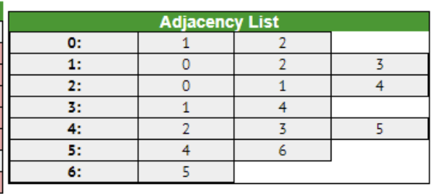
2.4.1 Graph - Adjacency List
Is a vector of vector of pairs storing the list of neighbors of each vertex u as ‘edge information pairs’
  Each pair is: (index of neighbouring vertex, weight of the edge)
  If graph is unweighted, you can leave it empty or just don’t implement it
Python: AL = defaultdict(list), the values in list are grouped by pairs
Good to know:
  More space-efficient than Adjacency Matrices
  Can easily enumerate the list of neighbors of a vertex v efficiently
    if v has k neighbors, it will take O(k) time
  Very common to use this model to store graphs
O(V + E) Space complexity
Notes:
https://wiki.python.org/moin/TimeComplexity

Slide 11
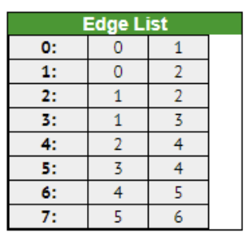
2.4.1 Graph - Edge List
Is a vector of triples
  Store a list of all E edges, usually in some sorted order
  For directed graphs, we store a bidirectional edge twice, one for each direction
  The edges are tuples usually (w, u, v), (weight w plus the two endpoints u and v)
    If the graph is unweighted, you can drop the w
Python: List of list or Tuples
Good to know:
  Good for Kruskal’s algorithm for MST where the collection of undirected edges need to be sorted
  Complicates algorithms that require the enumeration of edges incident to a vertex
O(E) Space complexity
Take a look at: https://visualgo.net/en/graphds
Notes:
https://wiki.python.org/moin/TimeComplexity

Slide 12
2.2.3 Bitmask – Why?
All bitwise operations are constant time! O(1)!!!
  This is because they are implemented closer to the hardware level
Can represent a set, or as a parameter in recursive/dynamic programming algorithms!
Faster multiplication!!
  (With some programming languages, not Python though due to arbitrary precision)
Used in many data structures and algorithms to speed things up!
Sources:
  Competitive Programming 4 Section 2.2.3
Notes:
https://wiki.python.org/moin/TimeComplexity

Slide 13
2.2.3 Bitmask – Representation in Python
Base 2
  0000, 0001, 0010, 0011…
  Each position is a power of 2, just like in base 10, they are powers of 10
Integer with arbitrary precision in base 2 (i.e. it is whatever you need, max is your system’s memory)
Two's Complement Number: Representing Negative Numbers
  Negative numbers are written with a leading one instead of a leading zero(splits possible bits in 2!)
    8 bits, "00000000" to "01111111" means 0 to 127
    8 bits, "10000000" to “00000000” means -128 to 0
    reserve "1xxxxxxx" for writing negative numbers.
  -x = ~(x - 1)
  ex: -1 is ~(1 - 1) = ~(0) = "11111111"
  ex: -10 is ~(10 - 1) = ~(9) = ~("00001001") = "11110110"
Notes:
https://wiki.python.org/moin/TimeComplexity

Slide 14
2.2.3 Bitmask – Python Syntax
x << y
  Returns x with the bits shifted to the left by y places. (new bits on the right-hand-side are zeros)
  Same as multiplying x by 2^{y}
x >> y
  Returns x with the bits shifted to the right by y places
  Same as floor division of x by 2^{y}
x & y
  Bitwise AND
x | y
  Bitwise OR
~ x
  Bitwise NOT
x ^ y
  Bitwise XOR
Notes:
In class, show example of each on the board
IF Class is new to bit operations, draw Truth Tables on the board!

Slide 15

2.2.3 Bitmask – Multiplication/Division
Easy!
  Shift left to multiply by 2, shift right to divide by 2!
  NOTE: shift left does the floor division! (see 17/2 = 8 in last line)
Notes:
https://wiki.python.org/moin/TimeComplexity

Slide 16

2.2.3 Bitmask – Set/Turn on j-th Item (0-based indexing)
When using as a set, you can use the bitwise OR operation to set/turn on bits!
  S |= (1 << j)
Notes:
https://wiki.python.org/moin/TimeComplexity

Slide 17
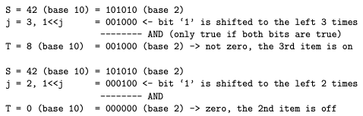
2.2.3 Bitmask – Check if j-th Item of the Set is on
Use bitwise AND operation T = S & (1 << j)
  if T = 0, then j-th item of the set is off
  if T != 0, (specifically, T=(1<<j)) then the j-th item of the set is on
Notes:
https://wiki.python.org/moin/TimeComplexity

Slide 18

2.2.3 Bitmask – Clear/Turn off the j-th Item of the Set
Bitwise AND operation S &= ~(1<<j)
  Don’t forget to use parentheses to avoid accidental bugs due to operator precedence
In example, we find the NOT of 1 shifted by 1
  000001
  000010
  111101
Notes:
https://wiki.python.org/moin/TimeComplexity

Slide 19
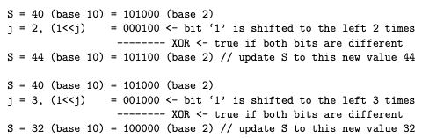
2.2.3 Bitmask – Toggle (flip status of) j-th Item of the Set
Use bitwise operation XOR S ^= (1<<j)
Notes:
https://wiki.python.org/moin/TimeComplexity

Slide 20
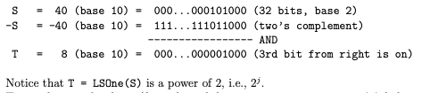
2.2.3 Bitmask – Get the Value of Least Significant Bit of S
T = ((S) & -(S))
Operation is often abbreviated as LSOne(S)
Notes:
https://wiki.python.org/moin/TimeComplexity

Slide 21

2.2.3 Bitmask – Turn on All Bits in a Set of Size n
S = (1 << n) - 1
Notes:
https://wiki.python.org/moin/TimeComplexity

Slide 22
2.4.2 Union-Find Disjoint Sets (UFDS)
Data structure to model a collection of disjoint
Is used to efficiently answer the question “Are these two items part of the same set?”
Space complexity is O(n)
Operations:
Initialize(n) O(n)
  Creates n items and form n disjoint sets with these n items
FindSet(i) O(1)
  Calls findSet(p[i]) recursively to find the representative item
IsSameSet(i, j) O(1)
  Calls findSet(i) and findSet(j) and returns equivalency
UnionSet(i, j) O(1)
  Unite 2 disjoint U, V where i ∈ U and j ∈ V
Optional operations:
  numDisjointSets() O(1)
    returns the number of disjoint sets currently in the UFDS data structure
  sizeOfSet(i) O(1)
    returns the number of items (including item i) that the set that contains item i has
Notes:
Disjoint sets (sets with no items in common)

Slide 23
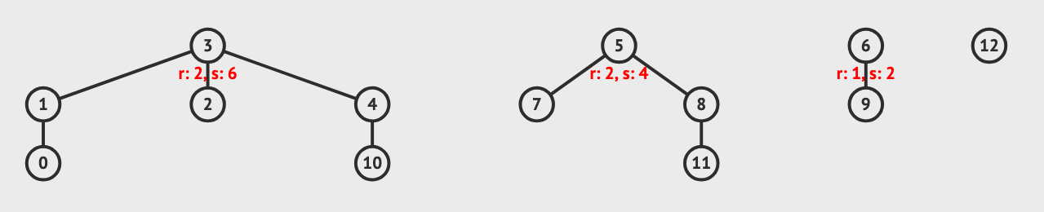
2.4.2 Union-Find Disjoint Sets (UFDS) – Basic Idea
What if each disjoint set can be represented by one unique item?
Then determining if 2 items belong to the same set is easy!
Each tree represents a disjoint set, and the root of the tree is the representative item of this disjoint set.
Notes:
https://wiki.python.org/moin/TimeComplexity

Slide 24
2.4.2 Union-Find Disjoint Sets (UFDS) - Storing Data P1
Use an array p of size N
  p[i] is the parent of item i
  if p[i] == i
    i is the root of the tree
    i is the representative item of the set that contains item i
Draw the array for the following UFDS!
  p = [1, 3, 3, 3, 3, 5, 6, 5, 5, 6, 4, 8,12] of size N = 13 ranging from p[0] to p[12].
Notes:
https://wiki.python.org/moin/TimeComplexity

Slide 25
2.4.2 Union-Find Disjoint Sets (UFDS) - Storing Data P2
Use array rank of size N
rank[i] is the upper-bound of the height of subtree rooted at vertex i that we will be used as guiding heuristic for UnionSet(i,j) operation
What numbers have rank 0?
  {0, 10, 11, 9, 12}
What numbers have rank 1?
  {1,4,6,8}
What numbers have rank 2?
  {3,5}
Notes:
https://wiki.python.org/moin/TimeComplexity

Slide 26
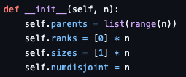
2.4.2 Union-Find Disjoint Sets (UFDS) - Initialize(n)
Creates n items and form n disjoint sets with these n items
Time complexity is O(n)
Sources:
  https://github.com/stevenhalim/cpbook-code/blob/master/ch2/ourown/unionfind_ds.py
Notes:
https://wiki.python.org/moin/TimeComplexity

Slide 27
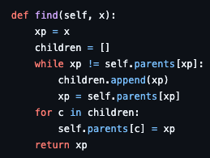
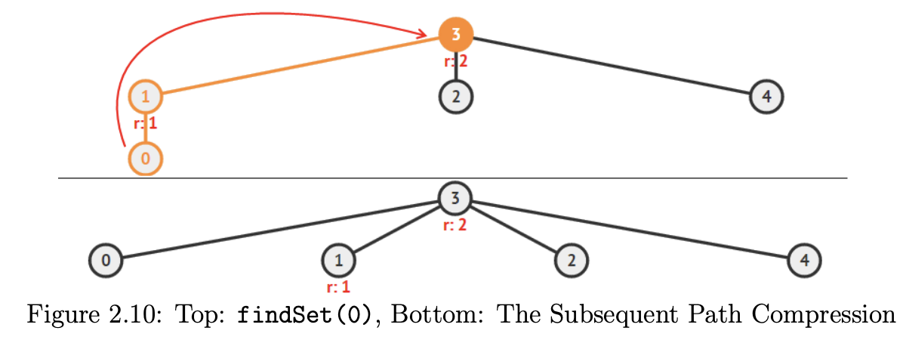
2.4.2 Union-Find Disjoint Sets (UFDS) - FindSet(i)
findSet(i) calls findSet(p[i]) recursively to find the representative item of a set
  returning findSet(p[i]) if p[i] != i and i otherwise
To speed things up, we use path compression!
  When findSet traverses an element on the way to find the parent, it links it directly to the parent
Won’t path compression mess with our rank values?
  Yes! Rank is only a “guiding heuristic” for unionSet(i, j) and updating it is too costly
Runtime isn’t always O(1), but for our purposes, we will treat it as so
Notes:
https://wiki.python.org/moin/TimeComplexity

Slide 28
2.4.2 Union-Find Disjoint Sets (UFDS) - IsSameSet(i, j)
Check if FindSet(i) == FindSet(j)
Notice that it implicitly uses the path-compression as FindSet() is used
Used extensively in Kruskal’s MST (Minimum Spanning Tree) algorithm
We assume that it also runs in O(1)
Notes:
https://wiki.python.org/moin/TimeComplexity

Slide 29
2.4.2 Union-Find Disjoint Sets (UFDS) - UnionSet(i, j)
Unite 2 disjoint U, V where i ∈ U and j ∈ V
Check ranks to make shortest tree possible, we want to link the shorter disjoint set to the representative item of the taller disjoint set.
  if rank[i] > rank[j]
    swap i and j
  if rank[i] < rank[j]
    Set representative item of shorter tree to be child of representative item of taller tree
    Note that the rank is preserved
  if rank[i] == rank[y]
    Choose either to be the new parent, then add 1 to the rank
We assume that it runs in O(1)
Notes:
https://wiki.python.org/moin/TimeComplexity

Slide 30
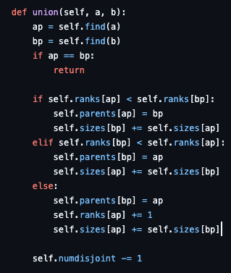
2.4.2 Union-Find Disjoint Sets (UFDS) - UnionSet(i, j)
Notes:
https://wiki.python.org/moin/TimeComplexity

Slide 31

2.4.2 Union-Find Disjoint Sets (UFDS) - NumDisjointSets()
Returns the number of disjoint sets currently in the UFDS data structure
Add one more internal counter variable numSets
  numSets is initially set to N
  Reduce numSets by one every time a successful unionSet(i, j) is performed
Return numSets when called
Notes:
https://wiki.python.org/moin/TimeComplexity

Slide 32

2.4.2 Union-Find Disjoint Sets (UFDS) - SizeOfSet(i)
Returns the number of items (including item i) that the set that contains item i has
Create additional integer array setSize of size N
  Initialize all disjoint sets to have size 1 initially.
  Whenever a successful unionSet(i, j) is performed, sum the two sizes of the sets and store the information in the representative item of the combined set.
Return setSize[findSet(i)]
Notes:
https://wiki.python.org/moin/TimeComplexity

Slide 33
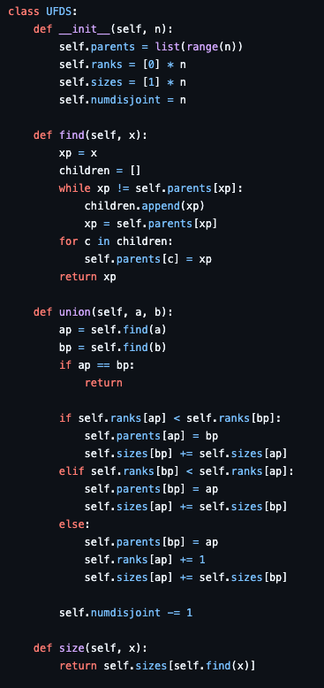
2.4.2 Union-Find Disjoint Sets (UFDS) – Basic Implementation
Sources:
  https://github.com/stevenhalim/cpbook-code/blob/master/ch2/ourown/unionfind_ds.py
Notes:
https://wiki.python.org/moin/TimeComplexity

Slide 34
Fenwick Tree (or Binary Indexed Tree BIT) Motivation
Supposed we have 11 scores for 11 students for a course. Scores range from 1 to 10,
  s = [2, 4, 5, 6, 5, 6, 8, 6, 7, 9, 7]
We want to know how many students got 8, how many got between 1 and 6, between 4 and 6? What if we update the scores?
This is called a Range Search Query class of problems
Typically we use a prefix sum!
Naive Implementation
  Initialization → O(n)
  update(i,x): a[i] += x → O(1)
  prefix_sum(i): loop from 1..i and add → O(n)
  sum(i, j): prefix_sum(j) - prefix_sum(i-1).) → O(n)
  Space complexity O(n)
Fenwick Tree
  Initialization → O(n)
  update(i,x) → O(log n)
  prefix_sum(i) → O(log n)
  sum(i, j): prefix_sum(j) - prefix_sum(i-1) → O(log n)
  Space complexity O(n)
https://github.com/stevenhalim/cpbook-code/blob/master/ch2/ourown/fenwicktree_ds.py
Notes:
https://wiki.python.org/moin/TimeComplexity

Slide 35

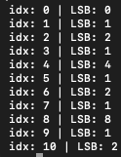
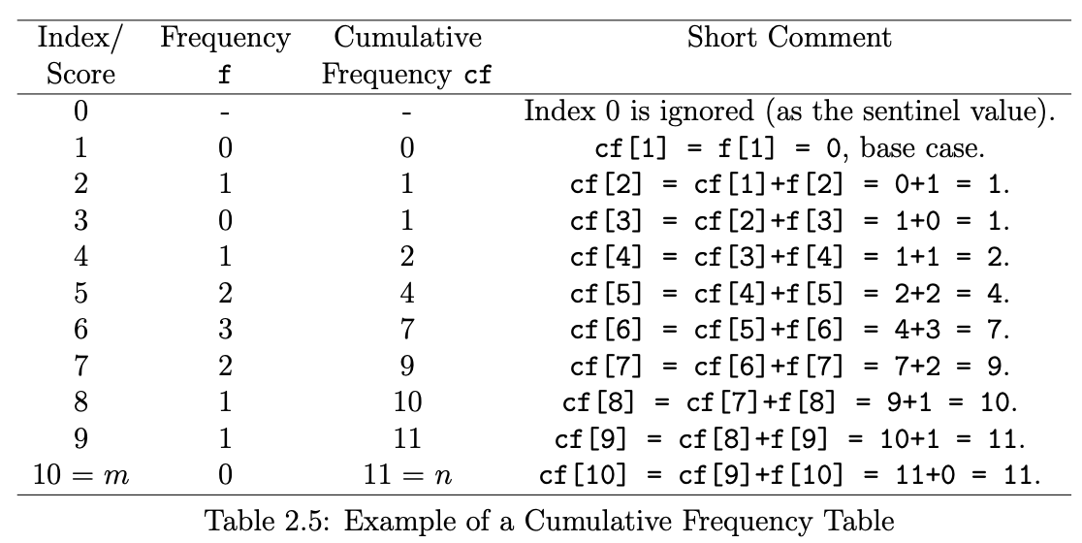
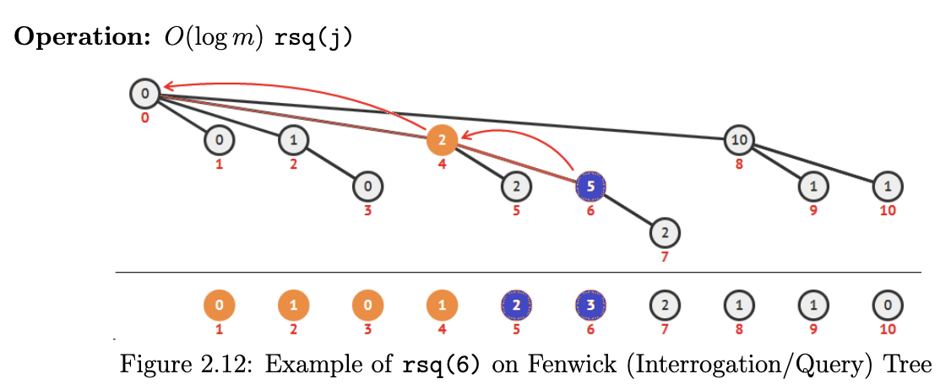
Fenwick Tree Structure
First remember LSOne(x: int)
  returns the least significant bit of a number by using ((S) & -(S))
We keep a separate array ft[1..n] where each position i stores the sum of a range of the original array ending at i.
Uses the properties of LSB (Lowest Set Bit) to split an array in powers of 2 to speed up calculations
The idea is that we “split” the summed chunks across the array, better than the naive way where each “chunk” is the previous element!
Notes:
https://wiki.python.org/moin/TimeComplexity

Slide 36
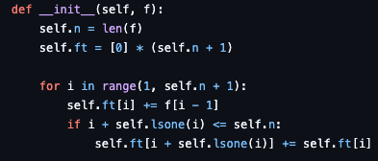
Fenwick Tree – build
During one linear O(n) pass to create an array of frequencies with m keys/integer indices
  Create a cumulative sum
    self.ft[i] += f[i - 1]
  Check if its parent in the updating tree of Fenwick Tree is still within range. If it is, we update its parent too
    self.ft[i + self.lsone(i)] += self.ft[i]
Notes:
https://wiki.python.org/moin/TimeComplexity

Slide 37
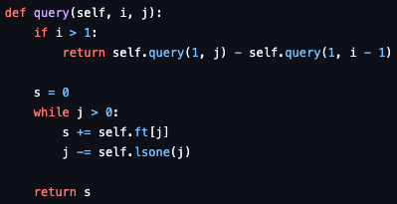
Fenwick Tree – RQS
A Range Query Sum is the sum of all elements within a specified range
RQS(i, j) is the sum of all occurrences between i and j
  RSQ(1, 8) = 10
  RSQ(4, 6) = RSQ(1, 6) – RSQ(1, 3) = 7-1 = 6
Notes:
Let’s introduce the Range Query Sum!

Slide 38

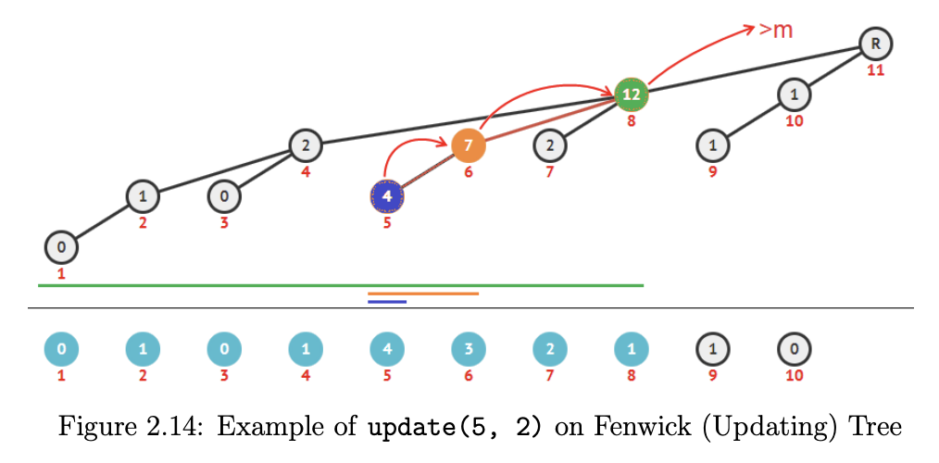

Fenwick Tree – update
Traverse the affected “chunks” and update their values
Notes:
Let’s introduce the Range Query Sum!

Slide 39
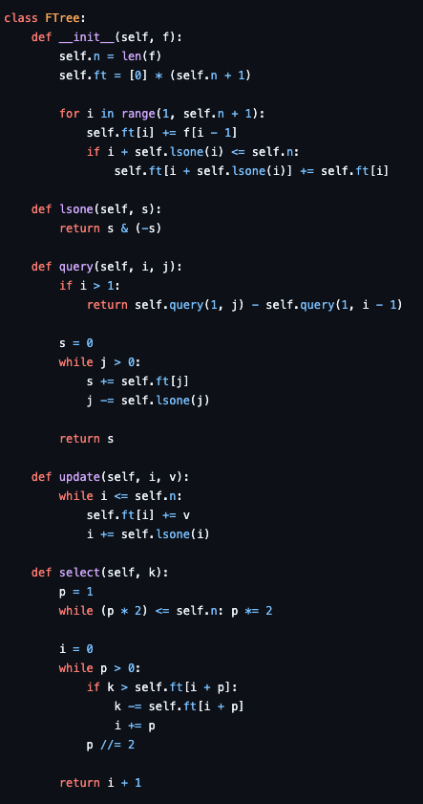
Fenwick Tree – Basic Implementation
Sources:
  https://github.com/stevenhalim/cpbook-code/blob/master/ch2/ourown/fenwicktree_ds.py
Notes:
https://wiki.python.org/moin/TimeComplexity

Slide 40
Template
Template
Notes:
https://wiki.python.org/moin/TimeComplexity

