Slide 1
WORKSHOP 8
3.5 Dynamic Programming Part 2
4.3 Minimum Spanning Tree (MST)
4.3.4 Other Applications
4.3.5 MST in Programming Contests
Suggested Homework

Slide 2
3.5 Dynamic Programming

Slide 3
3.5 Dynamic Programming – Introduction
Skills to be good at DP:
Familiar with recursions and recurrence relations
Ability to track the problem states and to determine the relationships or transitions between the current problem and its sub-problems
Primarily used in optimization problems and counting problems
If you encounter a problem that says “minimize this” or “maximize that” or “count the ways to do that”, then there is a (high) chance that it is a DP problem
Sources:
Competitive Programming 4 Section 3.5

Slide 4
3.5 Dynamic Programming – Problem Study Wedding Shopping
Variation on the Knapsack problem
Given different options for each garment (e.g., 3 shirt models, 2 belt models, 4 shoe models, . . . )
Given a limited budget
Task: buy one model of each garment and spend the maximum possible amount
Input:
Let M be the budget where 1 ≤ M ≤ 200
Let C be the number of garment types where 1 ≤ C ≤ 20
Let g be the set of garments i.e. g ∈ [0..C-1]
Each garment in g has possible 1 to 20 (inclusive) models
Output: Integer of maximum amount of money we can spend, else print “no solution”
UVa 11450 - Wedding Shopping
https://onlinejudge.org/index.php?option=com_onlinejudge&Itemid=8&page=show_problem&problem=2445
https://onlinejudge.org/external/114/11450.pdf
https://github.com/stevenhalim/cpbook-code/tree/master/ch3/dp
Sources:
Competitive Programming 4 Section 3.5
Notes:
Copy input information to the board

Slide 5
3.5 Dynamic Programming – Example Test Cases
Ex: l
Test case M=20, C=3
Price of the 3 models of garment g = 0 → 6 4 8 // the prices are not sorted in the input
Price of the 2 models of garment g = 1 → 5 10
Price of the 4 models of garment g = 2 → 1 5 3 5
For this test case, the answer is 19, which may result from buying the underlined items (8+10+1). This is not unique, as solutions (6+10+3) and (4+10+5) are also optimal.
Ex: 2
Test case M=9, C=3
Price of the 3 models of garment g = 0 → 6 4 8
Price of the 2 models of garment g = 1 → 5 10
Price of the 4 models of garment g = 2 → 1 5 3 5
The answer is then “no solution” because even if we buy all the cheapest models for each garment, the total price (4+5+1) = 10 still exceeds our given budget M = 9.
Sources:
Competitive Programming 4 Section 3.5
Notes:
Copy these 2 examples to the board
Ex: l
Test case M=20, C=3
Price of the 3 models of garment g = 0 → 6 4 8 // the prices are not sorted in the input
Price of the 2 models of garment g = 1 → 5 10
Price of the 4 models of garment g = 2 → 1 5 3 5
For this test case, the answer is 19, which may result from buying the underlined items (8+10+1).
This is not unique, as solutions (6+10+3) and (4+10+5) are also optimal.
Ex: 2
Test case M=9, C=3
Price of the 3 models of garment g = 0 → 6 4 8
Price of the 2 models of garment g = 1 → 5 10
Price of the 4 models of garment g = 2 → 1 5 3 5
The answer is then “no solution” because even if we buy all the cheapest models for each garment,
the total price (4+5+1) = 10 still exceeds our given budget M = 9.

Slide 6
3.5 Dynamic Programming – Greedy
One idea to maximize the budget is the take the most expensive model for each garment g which still fits in out budget!
This seems to work with example 1 and 2 but does not work with the following example
Ex: 3
Test case M=12, C=3
Price of the 3 models of garment g = 0 → 6 4 8
Price of the 2 models of garment g = 1 → 5 10
Price of the 4 models of garment g = 2 → 1 5 3 5
Greedy strategy selects model 3 of garment g = 0 with price 8 (b = 12-8 = 4), causing us to not have enough budget to buy any model in garment g = 1, thus incorrectly reporting “no solution”.
One optimal solution is 4+5+3 = 12, which uses up all of our budget.
The optimal solution is not unique as 6+5+1 = 12 also depletes the budget.
Sources:
Competitive Programming 4 Section 3.5
Notes:
Work through example 1 and 2 using greedy method and copy example 3 to the board
(one optimal is 4+5+3=12)
Ex: 3
Test case M=12, C=3
Price of the 3 models of garment g = 0 → 6 4 8
Price of the 2 models of garment g = 1 → 5 10
Price of the 4 models of garment g = 2 → 1 5 3 5

Slide 7
3.5 Dynamic Programming – Divide and Conquer
We can try.. but we will soon realise that it does not work why is that?
This is because divide and conquer shines when each sub-problem are independent from each other
This problem has sub-problems that are dependent on each other
Sources:
Competitive Programming 4 Section 3.5
Notes:
We can try.. but we will soon realise that it does not work why is that?
This is because divide and conquer shines when each sub-problem are independent from each other i.e.

Slide 8
3.5 Dynamic Programming – Complete Search
Recursive backtracking
Write a recursive function dp(g, b)
g is the current garment g that we are dealing with
b is the current (remaining) budget b that we have
returns the required answer
Note that the pair (g, b) is the state of this problem
Idea:
Start with g=0 (first garment) and b=M (initial budget) then try all possible models in garment g=0 and recurse
Stop when we tried all the garments
Prune when a solution is infeasible (b < 0)
Pick solution with result that is the smallest non-negative b
Sources:
Competitive Programming 4 Section 3.5

Slide 9
3.5 Dynamic Programming – Complete Search
Formally define Complete Search recurrences (transitions)
if b < 0 (i.e., the remaining budget goes negative),
dp(g, b) = - ∞(in practice, we can just return a large negative value)
If a model from the last garment has been bought, that is, g = C,
dp(g, b) = M-b (this is the actual budget that we spent)
In general case, ∀ model 2 [1..k] of current garment g,
dp(g, b) = max(dp(g+1, b-price[g][model]))
We want to maximize this value (Recall that the invalid ones have large negative value)
Issue: Very very slow!!!!!!!
There can be up to 20 garments each with up to 20 models, therefore there are 20²⁰ solutions that it could possible check in the worst case
Sources:
Competitive Programming 4 Section 3.5

Slide 10
3.5 Dynamic Programming – Top-Down
Prerequisites:
This problem has optimal sub-structures
It means the best overall solution is built from best solutions to its parts (i.e. best solution at every level)
if we select model i for garment g = 0, for our final selection to be optimal, our choice for garments g = 1 and above must also be the optimal choice
Problem has overlapping sub-problems
Key characteristic of DP, the search space is smaller than it appears because many of the sub-problems are overlapping
ex: Suppose that there are 2 models in a certain garment g with the same price p. Then, a Complete Search will move to the same sub-problem dp(g+1, b-p) after picking either model!
Sources:
Competitive Programming 4 Section 3.5
Notes:
Write these 2 on the board

Slide 11
3.5 Dynamic Programming – Top-Down
How many distinct problems?
20 possible garments and 201 (0 to 200 inclusive) possible budget values therefore there are only 201x20 = 4020 distinct sub-problems! DP allows you to calculate each just once!
We can adapt our recursive backtracking complete search algorithm into a top-down DP by adding the following:
DP memo table so that we can access in O(1) past calculations
Fill DP memo table with a dummy value that signifies that the calculation has not been made yet
At the start of recursive function, check if this state has been computed before
If it has, return value from DP memo table (origin of word memoization)
If it has not been computed before, perform computation and store in DP memo table
Sources:
Competitive Programming 4 Section 3.5
Notes:
Write these 2 rules on the board

Slide 12
3.5 Dynamic Programming – Top-Down
Runtime analysis
If it has M distinct states, then it requires O(M) memory space
If computing one state (complexity of DP transition) requires O(k) step, then overall time complexity is O(Mk) as DP guarantees that each state is just computed once
This UVa 11450 problem has M = 20 x 201 = 4020 and k = 20 (as we have to iterate through at most 20 models for each garment g).
Thus, the time complexity is at most 4020 x 20 = 80 400 operations per test case
We will look at the code now:
https://github.com/stevenhalim/cpbook-code/blob/master/ch3/dp/UVa11450_td.py
https://docs.python.org/3/library/functools.html#functools.lru_cache
Sources:
Competitive Programming 4 Section 3.5
Notes:
@functools.lru_cache(maxsize=128, typed=False)
Decorator to wrap a function with a memoizing callable that saves up to the maxsize most recent calls. It can save time when an expensive or I/O bound function is periodically called with the same arguments.

Slide 13
3.5 Dynamic Programming – Bottom-Up
Determine the required set of parameters that uniquely describe the problem (the state)
Similar to recursive backtracking and top-down DP as shown earlier
If there are N parameters required to represent the states, create an N dimensional array (DP table), with one entry per state.
Similar to the memo table in top-down DP; however, in bottom-up DP, we only need to initialize some cells of the DP table with known initial values (the base cases) rather than dummy values as in top-down DP.
With the base-case cells/states in the DP table already filled, determine the cells/states that can be filled next (the transitions)
Repeat this process until the DP table is complete
Usually accomplished through iterations, using loops
Sources:
Competitive Programming 4 Section 3.5
Notes:
Write these 3 rules down on the board

Slide 14
3.5 Dynamic Programming – Bottom-Up
We will use example A
Determine the required set of parameters that uniquely describe the problem (the state)
Two parameters: the current garment g and the current budget left b (same as top-down)
Let g be the row indices
Init 2D table (Boolean matrix) reachable[g][b] of size 20 x 201
Fill in the table row by row using previous rows
Row 0: 12 (from 20-8), 14 (from 20-6), and 16 (from 20-4)
Let p be the price of a model of current garment g. Loop through rest of the rows where if reachable[g-1][b] is true, then the next state reachable[g][b-p] is also reachable as long as b-p is not negative.
Answer is the the reachable state that is closest to 0 (as we want to have the least amount of money left)
If there are no reachable states in the last row then there are no solutions
Let’s work it out!
Sources:
Competitive Programming 4 Section 3.5
Notes:
Work it out on the IPad

Slide 15
Bottom-Up Ex: 1, Step 1
Determine the required set of parameters that uniquely describe the problem (the state)
Two parameters: the current garment g and the current budget left b (same as top-down)
Sources:
Competitive Programming 4 Section 3.5
Notes:
Write these 3 rules down on the board

Slide 16
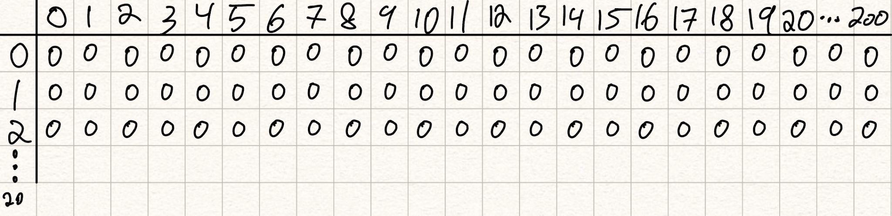
Bottom-Up Ex: 1, Step 2
Let g be the row indices
Init 2D table (Boolean matrix) reachable[g][b] of size 20 x 201
Sources:
Competitive Programming 4 Section 3.5
Notes:
Write these 3 rules down on the board

Slide 17
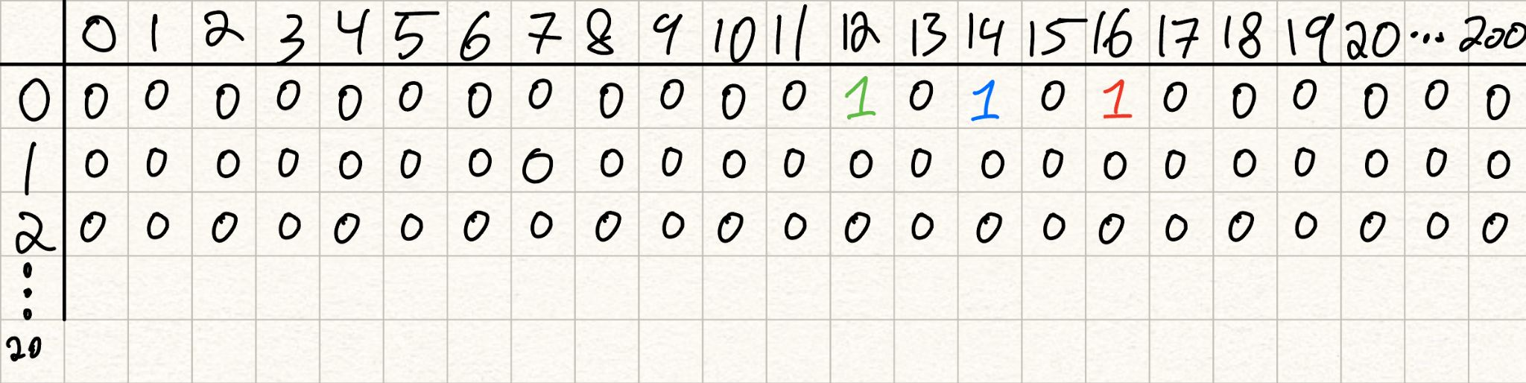
Bottom-Up Ex: 1, Step 3
Fill in the table row by row using previous rows
Row 0: 12 (from 20-8), 14 (from 20-6), and 16 (from 20-4)
Let p be the price of a model of current garment g. Loop through rest of the rows where if reachable[g-1][b] is true, then the next state reachable[g][b-p] is also reachable as long as b-p is not negative.
Sources:
Competitive Programming 4 Section 3.5
Notes:
Write these 3 rules down on the board

Slide 18
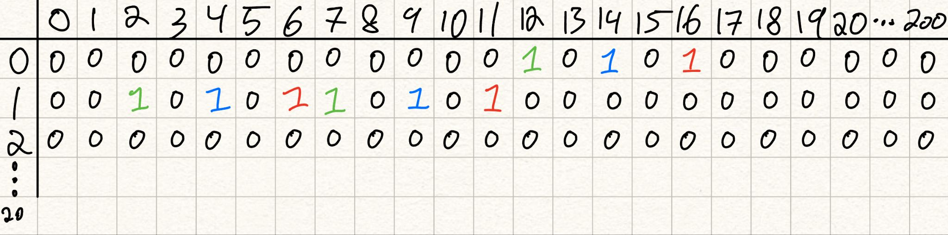
Bottom-Up Ex: 1, Step 3
Sources:
Competitive Programming 4 Section 3.5
Notes:
Write these 3 rules down on the board

Slide 19
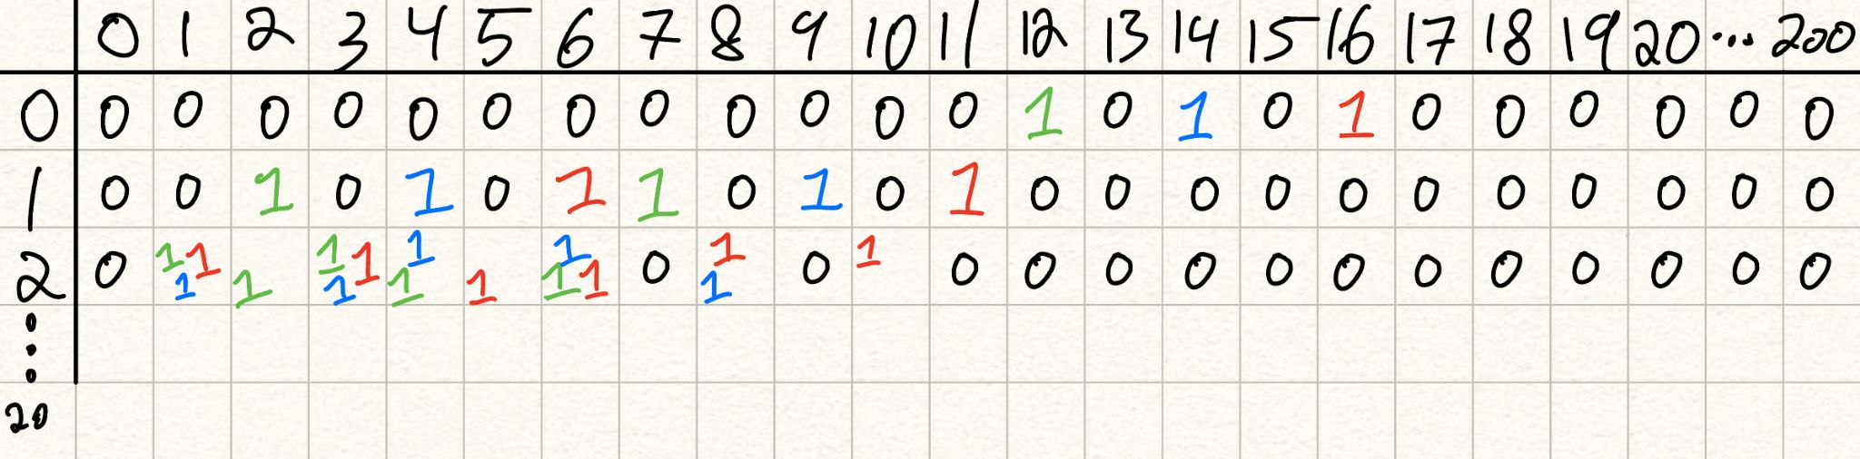
Bottom-Up Ex: 1, Step 3
Sources:
Competitive Programming 4 Section 3.5
Notes:
Write these 3 rules down on the board

Slide 20
Bottom-Up Ex: 1, Step 4
Answer is the the reachable state that is closest to 0 (as we want to have the least amount of money left)
If there are no reachable states in the last row then there are no solutions
Here, the answer is 19! (20-1)
Sources:
Competitive Programming 4 Section 3.5
Notes:
Write these 3 rules down on the board

Slide 21
3.5 Dynamic Programming – Bottom-Up
For problems where we only need the last row of the DP table (the optimal answer and not the whole solution) you can optimize memory usage!
Note that we only need to store two rows, the current row we are processing and the previous row we have processed.
To compute row 1, we only need to know the columns in row 0 that are set to true in reachable.
To compute row 2, we only need to know the columns in row 1 that are set to true in reachable.
Instead of having a whole table, we can just init 2 rows, have one be a curr, the other be a prev and then swap the two rows as we compute!
For this problem it doesn’t save that much space, but for more complicated problems and larger datasets, it can be useful!
Sources:
Competitive Programming 4 Section 3.5
Notes:
Write these 3 rules down on the board

Slide 22
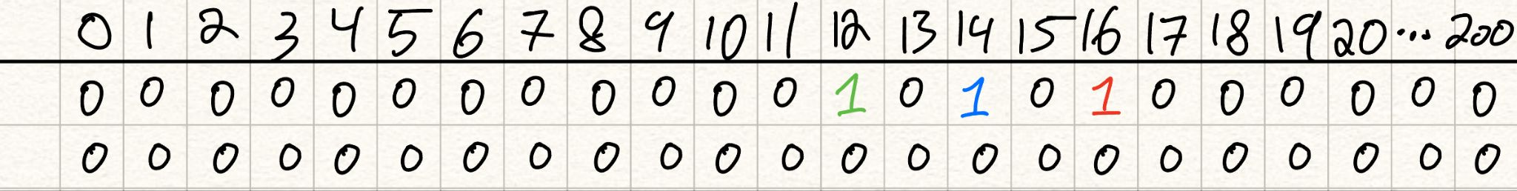
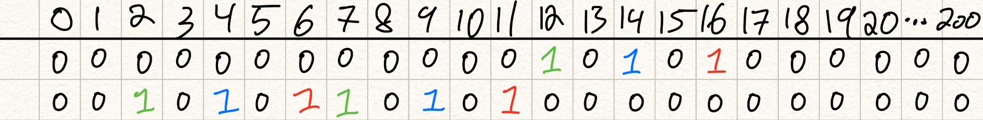
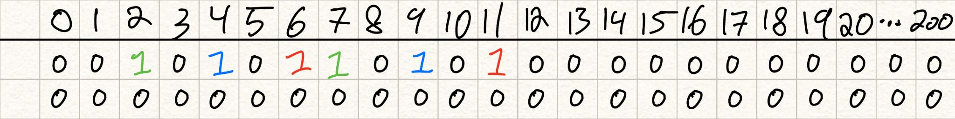
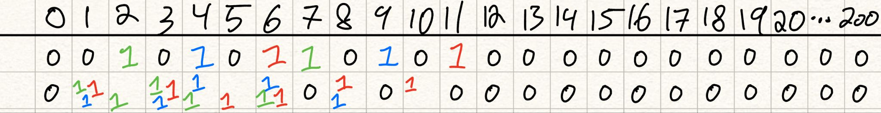
3.5 Dynamic Programming – Bottom-Up
Sources:
Competitive Programming 4 Section 3.5
Notes:
Write these 3 rules down on the board

Slide 23
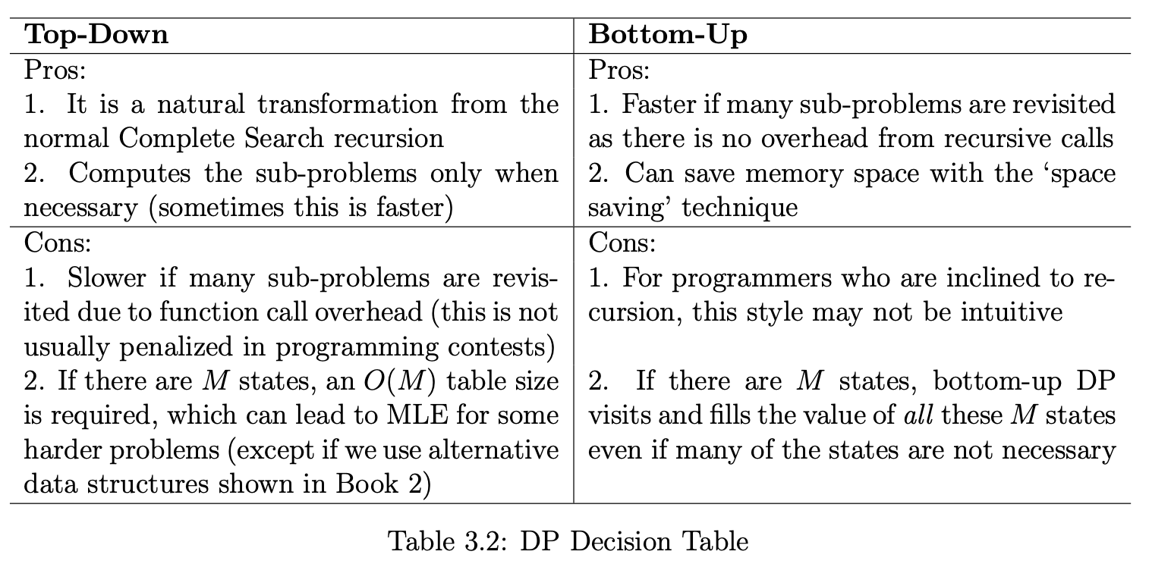
3.5 Dynamic Programming Top-Down vs Bottom-UP DP
In the top-down DP, the memo table entries are filled ‘as needed’ through the recursion itself.
In the bottom-up DP, we use a correct ‘DP table filling order’ to compute the values such that the previous values needed to process the current cell have already been obtained.
For most DP problems, these two styles are equally good and the decision to use a particular DP style is a matter of preference. However, for harder DP problems, one of the styles can be better than the other.
Sources:
Competitive Programming 4 Section 3.5
Notes:
Write these 3 rules down on the board

Slide 24
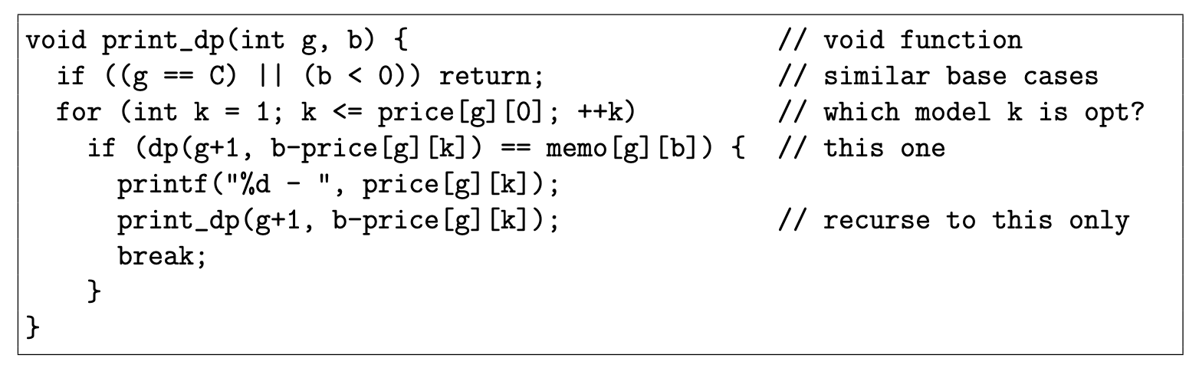
3.5 Dynamic Programming – Displaying the Optimal Solution
What if you have to print the optimal solution? All optimal solutions???
Approach 1, TD and BU DP:
Store the predecessor information at each state, if more than 1 optimal, save them in a list
Once final state is found, follow optimal transition at each state and print them all
If problem asks for all solutions, use backtracking (unusual for problems)
Approach 2, TD DP:
use recursion + memoization
Add another recursive function void print dp(int g, int b) that uses values stored in memo table to reconstruct the solution
Sources:
Competitive Programming 4 Section 3.5
Notes:
Write these 3 rules down on the board

Slide 25
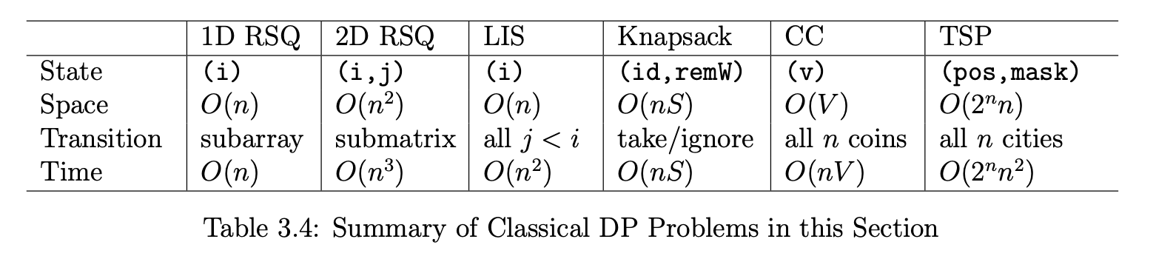
3.5 Dynamic Programming – Classic Examples
There are 6 “classical” examples of DP
In the textbook section 3.5.2 Classical Examples goes through each one in depth providing multiple algorithms in increasing effectiveness (in terms of runtime)
Highly suggest you read over this section!!!
The one problem of each of the 6 types are suggested as homework
Sources:
Competitive Programming 4 Section
Notes:
a1. Max 1D Range Sum
a2. Max 2D Range Sum
b. Longest Increasing Subsequence (LIS)
c. 0-1 Knapsack (Subset-Sum)
d. Coin-Change (CC) - The General Version
e. Traveling-Salesman-Problem (TSP)
DP level 1
UVa 10003 - Cutting Sticks

Slide 26
3.5 Dynamic Programming – Non-Classical Examples
DP problems in competitions are very common, but it is uncommon that pure classical DP problems will appear in competitions.
In section 3.5.3 Non-Classical Examples, the textbook goes in depth into 2 different DP problems and I highly recommend to read and take a look
Sources:
Competitive Programming 4 Section
Notes:
https://wiki.python.org/moin/TimeComplexity

Slide 27
Coin-Change (CC) - The General Version
Let’s work it out!
https://onlinejudge.org/index.php?option=com_onlinejudge&Itemid=8&page=show_problem&category=0&problem=615&mosmsg=Submission+received+with+ID+30777735
Will update these slides with worked solution that we did in the workshop
Sources:
Competitive Programming 4 Section
Notes:
1: what is the

Slide 28
Suggested Homework

Slide 29
Suggested Homework
a1. Max 1D Range Sum
UVa 00507 - Jill Rides Again
https://onlinejudge.org/index.php?option=com_onlinejudge&Itemid=8&page=show_problem&problem=448
a2. Max 2D Range Sum
UVa 00108 - Maximum Sum
https://onlinejudge.org/index.php?option=onlinejudge&page=show_problem&problem=44
b. Longest Increasing Subsequence (LIS)
UVa 00481 - What Goes Up?
https://onlinejudge.org/index.php?option=com_onlinejudge&Itemid=8&page=show_problem&problem=422
c. 0-1 Knapsack (Subset-Sum)
UVa 10130 - SuperSale
https://onlinejudge.org/index.php?option=onlinejudge&page=show_problem&problem=1071
d. Coin-Change (CC) - The General Version
UVa 00674 - Coin Change
https://onlinejudge.org/index.php?option=com_onlinejudge&Itemid=8&page=show_problem&problem=615
e. Traveling-Salesman-Problem (TSP)
Kattis - beepers
https://open.kattis.com/problems/beepers
DP level 1
UVa 10003 - Cutting Sticks
https://onlinejudge.org/index.php?option=com_onlinejudge&Itemid=8&page=show_problem&problem=944

Slide 30
Template
Template
Sources:
Competitive Programming 4 Section
Notes:
https://wiki.python.org/moin/TimeComplexity

