Slide 1
WORKSHOP 3
Questions?
Contest Acronyms
Suggested Homework Review
2.4.2 Union-Find Disjoint Sets
3.2.1 Iterative Complete Search
3.2.3 Complete Search Tips
Suggested Homework

Slide 2
Questions?
Notes:
https://wiki.python.org/moin/TimeComplexity

Slide 3
Contest Acronyms

Slide 4
Contest Acronyms
WA – Wrong Answer
TLE – Time Limit Exceeded
MLE – Memory Limit Exceeded
RE – Runtime Error
CE – Compilation Error
Notes:
https://wiki.python.org/moin/TimeComplexity

Slide 5
Suggested Homework Review

Slide 6
Baloni
Each balloon has a height; an arrow shot from a balloon continues at height−1 after popping it.
Goal: Find the minimum number of arrows needed to pop all balloons.
Strategy:
Track how many arrows are currently “in flight” at each height.
When a balloon of height h is seen:
If there is an arrow at h+1, reuse it: decrement arrows at h+1 and increment arrows at h.
Otherwise, start a new arrow at h.
At the end, the total arrows in all heights is the answer.
Time Complexity: O(n) (each balloon checked once).
Space Complexity: O(H), where H is max balloon height (~1e6).
Sources:
Competitive Programming 4 Section 2.2 a. 1D Array Manipulation, Medium
Notes:
https://wiki.python.org/moin/TimeComplexity

Slide 7
greedilyincreasing
Given a sequence of integers, construct the greedy increasing subsequence:
Scan the sequence from left to right.
Keep the first number, then keep the next number if it is strictly larger than the last chosen.
Continue until the end of the sequence.
Output:
The length of the subsequence.
The subsequence itself.
Strategy:
Track the last chosen number (previousNumber).
Append numbers to the subsequence only if they are greater than previousNumber.
Time Complexity: O(n), since each element is checked once.
Space Complexity: O(n), to store the subsequence.
Sources:
Competitive Programming 4 Section 2.2 a. 1D Array Manipulation, Medium
Notes:
https://wiki.python.org/moin/TimeComplexity

Slide 8
2048
Problem: Implement one move in the game 2048 on a 4×4 grid.
Input:
The grid (4 rows of 4 numbers).
A direction (0 = left, 1 = up, 2 = right, 3 = down).
Goal: After applying the move, print the resulting grid.
Strategy:
Implement smash left (merge numbers to the left, respecting 2048’s merging rules).
For other directions (up, right, down), rotate the grid so the operation becomes “left,” apply the left merge, then rotate back.
Time Complexity: O(n²) (process each grid cell once; here n=4 so it’s constant time in practice).
Space Complexity: O(n²) (store a new 4x4 grid).
Sources:
Competitive Programming 4 Section 2.2 d. 2D Array Manipulation, Harder
Notes:
https://wiki.python.org/moin/TimeComplexity

Slide 9
restaurant
Problem: Simulate plate distribution in a restaurant with two stacks.
Plates are dropped off with DROP x.
Customers take plates with TAKE x.
Plates are stored in two stacks (stack1, stack2).
Strategy:
Always DROP plates into stack2.
Always TAKE from stack1 if possible.
If stack1 doesn’t have enough:
Take what’s left in stack1.
Move all plates from stack2 to stack1.
Then continue taking the remaining plates from stack1.
Greedy approach: minimize moves by only transferring from stack2 to stack1 when necessary.
Time Complexity: O(n) (each operation processed once).
Space Complexity: O(n) (for the output log).
Sources:
Competitive Programming 4 Section 2.2 j. Stack
Notes:
https://wiki.python.org/moin/TimeComplexity

Slide 10
teque
Problem: Implement a custom deque-like structure (Teque) that supports:
push_back x → insert at the end.
push_front x → insert at the front.
push_middle x → insert in the middle.
get i → retrieve element at index i.
Strategy:
Maintain two deques (q1, q2) to represent the left and right halves of the sequence.
Invariant: always keep len(q1) == len(q2) or len(q1) == len(q2) + 1.
Ensures middle is always well-defined.
After each push operation, rebalance the two deques to maintain the invariant.
For get i:
If i < len(q1), the element is in q1.
Otherwise, the element is in q2 at index i - len(q1).
Time Complexity:
push:
O(1) amortized.
get:
O(n) in the middle (though fast enough for Kattis).
Space Complexity: O(n) for storing the elements.
Sources:
Competitive Programming 4 Section 2.2 l. List/Queue/Deque
https://docs.python.org/3/library/collections.html#collections.deque
Notes:
https://wiki.python.org/moin/TimeComplexity

Slide 11
alehouse
Problem: Each person has an entry time and exit time.
You want the maximum number of people simultaneously in the bar, given everyone can stay at most k milliseconds.
Strategy:
Maintain two heaps:
Entry heap → sorted by entry times.
Exit heap → active people’s exit times.
Sweep over time:
Add all people whose entry ≤ current time into the exit heap.
Remove expired people whose exit < current_time − k.
The size of the exit heap = number of people present.
Track the maximum over all times.
Invariant: Exit heap always contains the end times of all currently valid intervals intersecting [R−k, R].
Time Complexity: O(n log n) (heap operations dominate).
Space Complexity: O(n) (to store intervals in heaps).
Sources:
Competitive Programming 4 Section 2.3 a. Priority Queue
Notes:
https://wiki.python.org/moin/TimeComplexity

Slide 12
grandpabernie
Problem: Grandpa Bernie has traveled to various destinations in specific years.
Input: a list of trips (destination year) and a set of queries (destination k).
Output: for each query, the k-th earliest trip year for that destination.
Strategy:
Group all years for each destination into a list.
Sort the list of years for each destination.
Store the sorted list in a map (hash table) with the key being the destination and value being the list
For each query, directly index into the sorted list to get the answer.
Time Complexity: O(n log n) (sorting trips per destination).
Space Complexity: O(n) (store all trips).
Sources:
Competitive Programming 4 Section 2.3 e. Hash Table (map), Easier
Notes:
https://wiki.python.org/moin/TimeComplexity

Slide 13
2.4.2 Union-Find Disjoint Sets

Slide 14
2.4.2 Union-Find Disjoint Sets (UFDS)
Data structure to model a collection of disjoint sets with the ability to do the following in about O(1)
Determine which set an item belongs to
Test whether 2 items belong to the same set
Unite 2 disjoint sets into one larger set
Why?
The above operations are not efficiently supported by the C++ STL set, Java TreeSet, Python set, they are not designed for this purpose
Ex: help to find connected components in an undirected graph (section 4.2.4, 4.3.2)
Init vertex into separate disjoint set
Enumerate edges + union the corresponding vertices/sets
Now you can test if 2 vertices belong to the same component/set easily
Now you can track number of lone vertices/disjoint sets
Now you can track number of connected components of the undirected graph
Sources:
Competitive Programming 4 Section 2.4.2
Notes:
Disjoint sets (sets with no items in common)

Slide 15
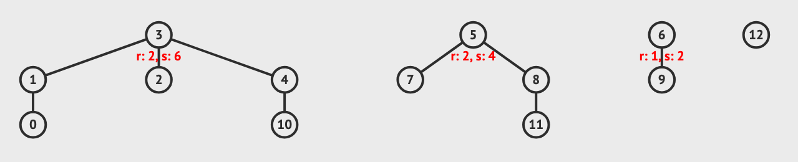
2.4.2 Union-Find Disjoint Sets (UFDS) – Basic Idea
What if each disjoint set can be represented by one unique item?
Then determining if 2 items belong to the same set is easy!
Each tree represents a disjoint set (thus a collection of disjoint sets form a forest of trees) and the root of the tree is the representative item of this disjoint set.
Sources:
Competitive Programming 4 Section 2.4.2
https://visualgo.net/en/ufds/print
https://visualgo.net/en/ufds
Notes:
https://wiki.python.org/moin/TimeComplexity

Slide 16
2.4.2 Union-Find Disjoint Sets (UFDS) – Visualization
How many items (N) are there overall?
N=13
How many disjoint sets are there?
4 disjoint sets
What are the members of each disjoint set?
{0,1,2,3,4,10}, {5,7,8,11}, {6,9}, {12}
What is the representative item of each disjoint set?
{0,1,2,3,4,10}, {5,7,8,11}, {6,9}, {12}
Sources:
Competitive Programming 4 Section 2.4.2
https://visualgo.net/en/ufds/print
https://visualgo.net/en/ufds
Notes:
https://wiki.python.org/moin/TimeComplexity

Slide 17
2.4.2 Union-Find Disjoint Sets (UFDS) - Storing Data P1
Use an array p of size N
p[i] is the parent of item i
if p[i] == i
i is the root of the tree
i is the representative item of the set that contains item i
Draw the array for the following UFDS!
p = [1, 3, 3, 3, 3, 5, 6, 5, 5, 6, 4, 8,12] of size N = 13 ranging from p[0] to p[12].
Sources:
Competitive Programming 4 Section 2.4.2
https://visualgo.net/en/ufds/print
https://visualgo.net/en/ufds
Notes:
https://wiki.python.org/moin/TimeComplexity

Slide 18
2.4.2 Union-Find Disjoint Sets (UFDS) - Storing Data P2
Use array rank of size N
rank[i] is the upper-bound of the height of subtree rooted at vertex i that we will be used as guiding heuristic for UnionSet(i,j) operation
What numbers have rank 0?
What numbers have rank 1?
What numbers have rank 2?
{1,4,6,8} have rank 1 and {3,5} have rank 2, with the rest having rank 0
Sources:
Competitive Programming 4 Section 2.4.2
https://visualgo.net/en/ufds/print
https://visualgo.net/en/ufds
Notes:
https://wiki.python.org/moin/TimeComplexity

Slide 19
2.4.2 Union-Find Disjoint Sets (UFDS) - Operations
Initialize(N, M)
Creates N items and form M disjoint sets with these N items
FindSet(i)
Finds the representative item of a set (finds which set i belongs to)
IsSameSet(i, j)
Returns True or False if i and j belong to the same set or not
UnionSet(i, j)
Unite a disjoint set that contains item i with a different disjoint set that contains item j
Optional operations:
numDisjointSets()
returns the number of disjoint sets currently in the UFDS data structure
sizeOfSet(i)
returns the number of items (including item i) that the set that contains item i has
Sources:
Competitive Programming 4 Section 2.4.2
https://visualgo.net/en/ufds/print
https://visualgo.net/en/ufds
Notes:
https://wiki.python.org/moin/TimeComplexity

Slide 20
2.4.2 Union-Find Disjoint Sets (UFDS) - Initialize(N, M)
Creates N items and form M disjoint sets with these N items
Randomly pick 2 disjoint sets and merge them until we have M random disjoint sets
Due to union-by-rank heuristics (we will see this in a few slides) + randomness, it is unlikely that this will create a tall tree
Usual default values:
M = N (i.e. Initialize(N, N))
p[i] = i
rank[i] = 0
Time complexity is O(N)
Sources:
Competitive Programming 4 Section 2.4.2
https://visualgo.net/en/ufds/print
https://visualgo.net/en/ufds
Notes:
https://wiki.python.org/moin/TimeComplexity

Slide 21
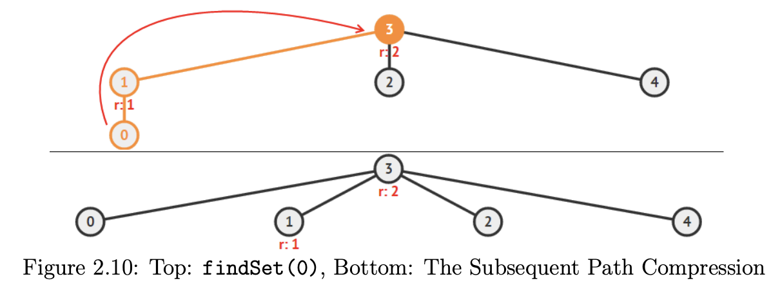
2.4.2 Union-Find Disjoint Sets (UFDS) - FindSet(i)
findSet(i) calls findSet(p[i]) recursively to find the representative item of a set
returning findSet(p[i]) if p[i] != i and i otherwise
To speed things up, we use path compression!
When we find the representative (root) item of a disjoint set by following the chain of ‘parent’ edges from a given item, we can set the parent of all items traversed to point directly to the root
Won’t path compression mess with our rank values?
Yes! Hence why we defined rank as reflecting only the upper bound of the actual height of the tree
We don’t update ranks because it is too costly and only used for ‘guiding heuristic’ during unionSet(i, j) operations
There are some cases where the time complexity is not O(1) BUT for competitive programming where n < 1M, then we can treat it as O(1)
See textbook Section 2.4.2 on UFDS Operation: O(1) findSet(i) for more detailed information about time complexity
Sources:
Competitive Programming 4 Section 2.4.2
https://visualgo.net/en/ufds/print
https://visualgo.net/en/ufds
Notes:
https://wiki.python.org/moin/TimeComplexity

Slide 22
2.4.2 Union-Find Disjoint Sets (UFDS) - FindSet(i) Example
Let’s watch it in action! (example “4 sets” on visualgo UFDS)
https://visualgo.net/en/ufds
Try:
FindSet(12)
get vertex 12
FindSet(9)
get vertex 6 after 1 stop
FindSet(0)
UFDS will modify structure due to path-compression
Now if you try again, it’ll be a lot faster!
Notice that the rank is wrong now and we don’t bother to change it (too costly and not enough benefit)
Try “1 tree of rank 4” example and do FindSet(0)!
You’ll see path-compression in action!
Sources:
Competitive Programming 4 Section 2.4.2
https://visualgo.net/en/ufds/print
https://visualgo.net/en/ufds
Notes:
https://wiki.python.org/moin/TimeComplexity

Slide 23
2.4.2 Union-Find Disjoint Sets (UFDS) - IsSameSet(i, j)
Easy!
Check if FindSet(i) == FindSet(j) or not!
Notice that it implicitly uses the path-compression as FindSet() is used
Used extensively in Kruskal’s MST (Minimum Spanning Tree) algorithm (We will cover that in a future workshop!)
We assume that it also runs in O(1)
Let’s see it in action using example “4 sets”!
https://visualgo.net/en/ufds
Try IsSameSet(3, 5)
We get False
Try IsSameSet(0, 11)
We see path compression and we get False as well!
Sources:
Competitive Programming 4 Section 2.4.2
https://visualgo.net/en/ufds/print
https://visualgo.net/en/ufds
Notes:
https://wiki.python.org/moin/TimeComplexity

Slide 24
2.4.2 Union-Find Disjoint Sets (UFDS) - UnionSet(i, j)
Unite a disjoint set that contains item i with a different disjoint set that contains item j
i.e. let x = findSet(i), y = findSet(j), and x != y
Check ranks to make shortest tree possible, we want to link the shorter disjoint set to the representative item of the taller disjoint set.
if rank[x] > rank[y]
swap x and y
if rank[x] < rank[y]
Set representative item of shorter tree to be child of representative item of taller tree
Note that the rank is preserved
if rank[x] == rank[y]
Choose either to be the new parent, then add 1 to the rank
We assume that it runs in O(1)
Note that this also uses FindSet() and hence path-compression
Sources:
Competitive Programming 4 Section 2.4.2
https://visualgo.net/en/ufds/print
https://visualgo.net/en/ufds
Notes:
https://wiki.python.org/moin/TimeComplexity

Slide 25
2.4.2 Union-Find Disjoint Sets (UFDS) - UnionSet(i, j) Example
Let’s see it in action using example “4 sets”!
https://visualgo.net/en/ufds
Try UnionSet(9, 12)
Shorter disjoint set {12} is slotter under vertex 6 without increasing height of combined tree
Try UnionSet(0, 11)
Notice ranks that the of vertex 3 and vertex 5 are the same (rank[3] = rank[5] = 2)
We can then choose either to be the new parent
The resulting height of the combined tree will increase by 1
Notice the indirect path-compression in action!
Sources:
Competitive Programming 4 Section 2.4.2
https://visualgo.net/en/ufds/print
https://visualgo.net/en/ufds
Notes:
https://wiki.python.org/moin/TimeComplexity

Slide 26
2.4.2 Union-Find Disjoint Sets (UFDS) - Code
You can get the textbook’s implementation for Java, C++, Python, and ml at the following link:
https://github.com/stevenhalim/cpbook-code/tree/master/ch2/ourown
Sources:
Competitive Programming 4 Section 2.4.2
https://visualgo.net/en/ufds/print
https://visualgo.net/en/ufds
Notes:
https://wiki.python.org/moin/TimeComplexity

Slide 27
2.4.2 Union-Find Disjoint Sets (UFDS) - NumDisjointSets()
Returns the number of disjoint sets currently in the UFDS data structure
Add one more internal counter variable numSets
numSets is initially set to N
Reduce numSets by one every time a successful unionSet(i, j) is performed
Return numSets when called
Sources:
Competitive Programming 4 Section 2.4.2
Notes:
https://wiki.python.org/moin/TimeComplexity

Slide 28
2.4.2 Union-Find Disjoint Sets (UFDS) - SizeOfSet(i)
Returns the number of items (including item i) that the set that contains item i has
Create additional integer array setSize of size N
Initialize all disjoint sets to have size 1 initially.
Whenever a successful unionSet(i, j) is performed, sum the two sizes of the sets and store the information in the representative item of the combined set.
Return setSize[findSet(i)]
Sources:
Competitive Programming 4 Section 2.4.2
Notes:
https://wiki.python.org/moin/TimeComplexity

Slide 29
3.2.1 Iterative Complete Search

Slide 30
3.2.1 Iterative Complete Search
Iterative Complete Search
Nested Loops
Try em’ all
Loops + Pruning
use if statements and short circuiting to skip loops
bool expressions (X and Y) if X is False then Y isn’t checked
bool expressions (X or Y) if X is True then Y isn’t checked
use break/continue to stop/skip loops
Permutations
C++ use next_permutations
Python use itertools
Subsets
use bitmasks
Section 3.2.1 Works through an example for each of the above concepts, take a look!
Sources:
Competitive Programming 4 section 3.2.1
Notes:
https://wiki.python.org/moin/TimeComplexity

Slide 31
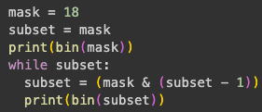

2.2.3 Bitmask – Enumerate all Proper Subsets of a Given Bitmask
A proper subset of a mask is all the subsets with set bits (including bit 0) that is strictly smaller than the mask
e.g. mask = (11)₁₀ = (1011)₂ or {0, 1, 3}
Base 10 | Base 2 | Subset
0 | 0000 | {0}
1 | 0001 | {1}
2 | 0010 | {0, 1}
3 | 0011 | {3}
8 | 1000 | {3}
9 | 1001 | {0, 3}
10 | 1010 | {1, 3}
Python
Mask | Element | In Mask?
0001 | 0 | Yes
0010 | 1 | Yes
0100 | 2 | No
1000 | 3 | Yes
C/C++
Let’s take a look at the Google Collab file to see more detail on what’s going on…
Sources:
Competitive Programming 4 Section 2.2.3
Notes:
https://wiki.python.org/moin/TimeComplexity

Slide 32
3.2.3 Complete Search Tips

Slide 33
8-Queens Chess Reference Problem
We will dive more in depth into the solution of this problem next week when we cover recursion
In standard chess (with an 8 x 8 board), it is possible to place 8-Queens on the board such that no two Queens attack each other.
Determine all such possible arrangements given the position of one of the Queens (i.e., coordinate (a, b) must contain a Queen).
Output the possibilities in lexicographical (sorted) order.
Sources:
Competitive Programming 4 Section
Notes:
https://wiki.python.org/moin/TimeComplexity

Slide 34
3.2.3 Complete Search Tips – Tip 1
Filtering versus Generating
Filters:
Programs that examine lots of (if not all) candidate solutions and choose the ones that are correct (or remove the incorrect ones)
Usually iterative algorithms
Usually easier to code, but run slower due to difficulty in pruning more of the search space
ex. The naïve 8-Queen solution is to generate all combinations ₆₄C₈ (8⁸)
Generators:
Gradually build the solutions and immediately prune invalid partial solutions
Usually recursive algorithms
ex. The recursing 8-Queen solution that prunes as it generates solutions
Sources:
Competitive Programming 4 Section 3.2.3
Notes:
https://wiki.python.org/moin/TimeComplexity

Slide 35
3.2.3 Complete Search Tips – Tip 2
Prune Infeasible/Inferior Search Space Early
Note: We will do a review on recursion next week…
When generating solutions using recursive backtracking (see tip above), we may encounter a partial solution that will never lead to a full solution
Prune the search there and explore other parts of the search space
Ex. In the queens problem, as soon as you find 2 queens “attacking” each other, you don’t have to explore that solution further
Rule of thumb, the earlier you can prune the search space, the better
In other problems, we may be able to compute the ‘potential worth’ of a partial (and still valid) solution.
If the potential worth is inferior to the worth of the current best found valid solution so far, we can prune the search there.
Sources:
Competitive Programming 4 Section 3.2.3
Notes:
https://wiki.python.org/moin/TimeComplexity

Slide 36
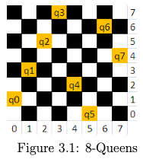
3.2.3 Complete Search Tips – Tip 3
Utilize Symmetries
Some problems have symmetries that can be exploited to reduce execution time.
8-Queens example:
Total solutions = 92
Unique (fundamental) solutions = 12 (due to rotational and reflection symmetries)
Strategy:
Generate only the 12 unique solutions.
Derive the full 92 by applying rotations/reflections.
Caution:
Considering symmetries may complicate code.
In competitive programming, shorter/cleaner code is usually better (fewer bugs).
If symmetry handling doesn’t give significant benefit, it’s best to ignore it.
Sources:
Competitive Programming 4 Section 3.2.3
Notes:
https://wiki.python.org/moin/TimeComplexity

Slide 37
3.2.3 Complete Search Tips – Tip 4
Pre-Computation a.k.a Pre-Calculation
Pre-computation:
Generate tables/data structures before execution to speed up lookups.
Trades memory/space for time.
Example (8-Queens problem):
Only 92 valid solutions exist.
Store them in a 2D array solution[92][8].
Use a generator program to pre-fill this array.
Later, another program can quickly retrieve solutions from it.
Limitations:
Rarely applicable in modern programming contests.
Not useful for most Complete Search problems.
Some exercises (at the end of section 2.2) can still benefit from it.
Sources:
Competitive Programming 4 Section 3.2.3
Notes:
https://wiki.python.org/moin/TimeComplexity

Slide 38
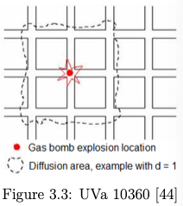
3.2.3 Complete Search Tips – Tip 5
Try Solving the Problem Backwards
Some problems are easier when solved “backwards” (unconventional angle) instead of the obvious way.
Ex: UVa 10360 – Rat Attack:
Descriptions:
1025x1025 grid where there are n ≤ 20’000 rats across the cells
Find which cell (x, y) should be gas-bombed so that the number of rats killed in a square box (x-d, y-d) to (x+d, y+d) is maximized
d is power of gas-bomb (d ≤ 50)
Naïve approach (frontal attack):
Let’s bomb every cell and count the kills with a O(d²) scan (each cell in the bombing radius)
Worse case: 1025²x50² = ~2626 million or ~2.6 billions operations TLE!
Backward approach
Create array int killed[1025][1025]
For each rat at (x, y) add 1 to killed[i][j] where |i - x| ≤ d and |j - y| ≤ d
O(n x d²)
Find coordinate of highest entry in array killed in 1025² operations
Total is 20’000x50²+1025²=51Million operations for (n=20’000, d=50)
Sources:
Competitive Programming 4 Section 3.2.3

Slide 39
3.2.3 Complete Search Tips – Tip 6
Data Compression
Some problems disguise input constraints to look too big for Complete Search.
Careful reading can reveal remarks that shrink the search space.
Ex:
Given a multiset S of M = 100K integers, we want to know how many different integers that we can form if we pick two (not necessarily distinct) integers from S and sum them.
The content of multiset S is prime numbers not more than 20K.
Direct Method:
Try all possible O(M²) pairs of integers and insert their sums into a hash table (O(1) per insertion)
Get TLE as M = 100K integers (100’000² = 1 Trillion operations)
Key Observation:
S contains only prime numbers under 20K.
In Book 2 of the textbook we find that π(20’000) = 2262 (prime counting function)
Optimized Approach
There are only 2262 distinct prime numbers under 20K.
Do one O(M) data compression pass to ensure that each integer only has at most 2 copies
i.e. N ≤ 2x2262
Do O(N²) complete search as before but now is ~ 20.5M operations
Sources:
Competitive Programming 4 Section 3.2.3
https://en.wikipedia.org/wiki/Prime-counting_function
Notes:
https://wiki.python.org/moin/TimeComplexity

Slide 40
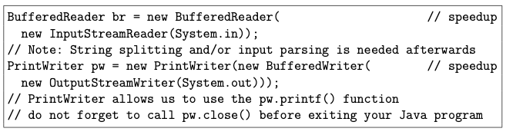
3.2.3 Complete Search Tips – Tip 7
Optimizing Your Source Code Pt 1
By understanding your hardware and how it is organized, especially the I/O, memory, and cache behaviour, you can design better code
Book is biased towards C++ because C++ > Java > Python in terms of speed
Some contests give Java/Python extra time to account for this but it is never 100% fair
Use bit manipulation!
Much more efficient than index manipulation in an array of booleans
For C/C++ use scanf/printf rather than cin/cout (or at least set ios::sync with stdio(false); cin.tie(NULL); albeit still slower than scanf/printf).
For Java users, use the faster BufferedReader/BufferedWriter classes as follows:
Sources:
Competitive Programming 4 Section 3.2.3
Notes:
https://wiki.python.org/moin/TimeComplexity

Slide 41
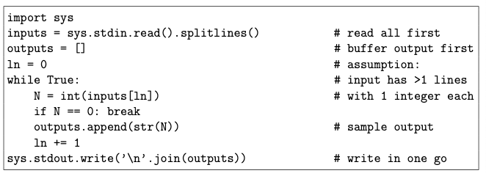
3.2.3 Complete Search Tips – Tip 7
Optimizing Your Source Code Pt 2
For Python users, read all input first upfront before processing them in-memory and buffer output first before writing them out in one go, especially if the I/O is big.
For C++, use the expected O(n log n) but cache-friendly quicksort in C++ STL algorithm::sort (part of ‘introsort’) rather than the true O(n log n) but non cache-friendly heapsort (its root-to-leaf/leaf-to-root operations span a wide range of indices—lots of cache misses).
Access a 2D array in a row-major fashion (row by row) rather than in a column-major fashion as multidimensional arrays are stored in a row-major order in memory. This will increase the probability of cache hit.
Sources:
Competitive Programming 4 Section 3.2.3
Notes:
https://wiki.python.org/moin/TimeComplexity

Slide 42
3.2.3 Complete Search Tips – Tip 7
Optimizing Your Source Code Pt 3
Use lower level data structures/types at all times if you do not need the extra functionality in the higher level (or larger) ones.
ex. use an array with a slightly larger size than the maximum size of input instead of using resizable vectors
use 32-bit ints instead of 64-bit long longs as the 32-bit int is faster in most 32-bit online judge systems
For Java, use the faster ArrayList (and StringBuilder) rather than Vector (and StringBuffer).
Java Vectors and StringBuffers are thread safe but this feature is not needed in competitive programming.
Sources:
Competitive Programming 4 Section 3.2.3
Notes:
https://wiki.python.org/moin/TimeComplexity

Slide 43
3.2.3 Complete Search Tips – Tip 7
Optimizing Your Source Code Pt 5
Declare most data structures (especially the bulky ones, e.g., large arrays) once by placing them in global scope
Allocate enough memory to deal with the largest input of the problem
This way, we do not have to pass (or worse, copy) the data structures around as function arguments
For problems with multiple test cases, simply clear/reset the contents of the data structure before dealing with each test case
When you have the option to write your code either iteratively or recursively, choose the iterative version
Ex: (check on your own time) the iterative C++ STL next permutation and iterative subset generation techniques using bitmask shown in Section 3.2.1 are (far) faster than if you write similar routines recursively and when early pruning is not possible.
Sources:
Competitive Programming 4 Section 3.2.3
Notes:
https://wiki.python.org/moin/TimeComplexity

Slide 44
3.2.3 Complete Search Tips – Tip 7
Optimizing Your Source Code Pt 6
Array access in (nested) loops can be slow
If you frequently need A[i] (without changing it) in (nested) loops, you can use a local variable temp = A[i] and work with temp instead
For C++, using C-style character arrays will yield faster execution than when using the C++ STL string
For Java/Python/OCaml users
Careful with String manipulation as they are immutable (For a new string, it has to be recreated from scratch)
Better to use Java StringBuilder or Python list (and join the list afterwards)
Browse the Internet or relevant books to find more information on how to speed up your code!
Practice by choosing harder problems in UVa or Kattis where the best solution is not 0.000s. Submit variants and check runtime differences
Adopt hacking modifications that consistently give you faster runtime.
Sources:
Competitive Programming 4 Section 3.2.3
Notes:
https://wiki.python.org/moin/TimeComplexity

Slide 45
3.2.3 Complete Search Tips – Tip 8
Use Better Data Structures & Algorithms
Use better data structures and algorithms!
They will always outperform any micro optimizations.
If you are sure that you have written your fastest Complete Search code, but it is still judged as TLE, perhaps explore other non-Complete search solutions.
Sources:
Competitive Programming 4 Section 3.2.3
Notes:
https://wiki.python.org/moin/TimeComplexity

Slide 46
Suggested Homework

Slide 47
Suggested Homework
Implement YOUR Union-Find Disjoint Set!
https://open.kattis.com/problems/unionfind
https://open.kattis.com/problems/almostunionfind
https://open.kattis.com/problems/blackfriday
https://open.kattis.com/problems/veci
https://open.kattis.com/problems/tautology
https://open.kattis.com/problems/geppetto
https://open.kattis.com/problems/thanosthehero

Slide 48
Template
Template
Sources:
Competitive Programming 4 Section
Notes:
https://wiki.python.org/moin/TimeComplexity

