Slide 1
WORKSHOP 1
Introduction
Workshop Format
Resources
1.3.3 Introduction to Algorithm Analysis
2.2.1 Array
2.2.5 Linked Data Structures (overview)
2.2.6 Special Stack-based Problems
2.3.1 Binary Heap (Priority Queue)
2.3.2 Hash Table

Slide 2
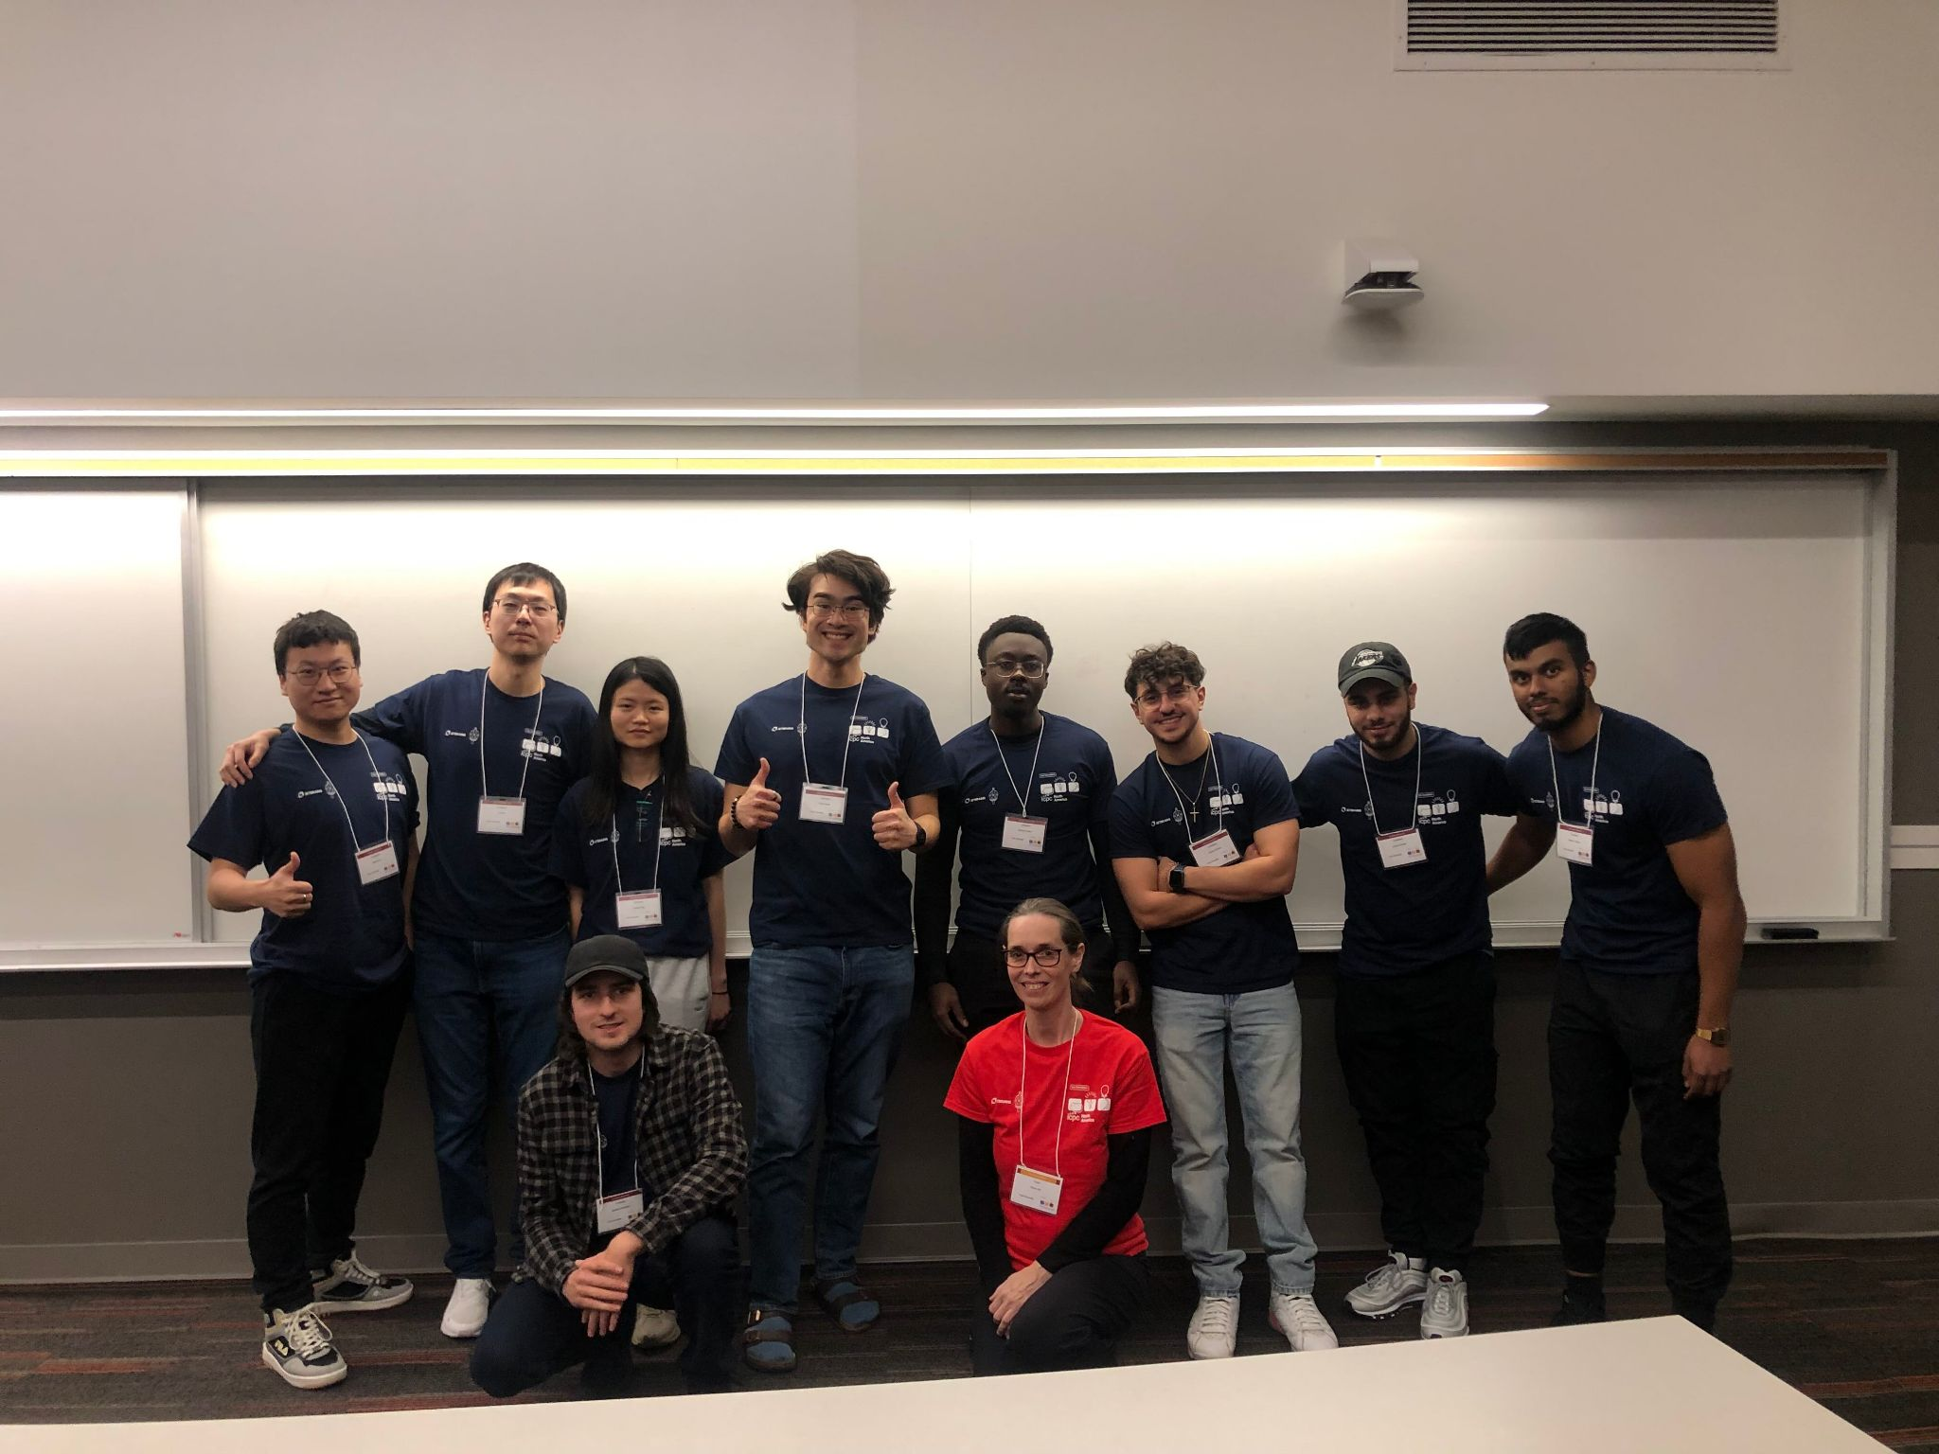
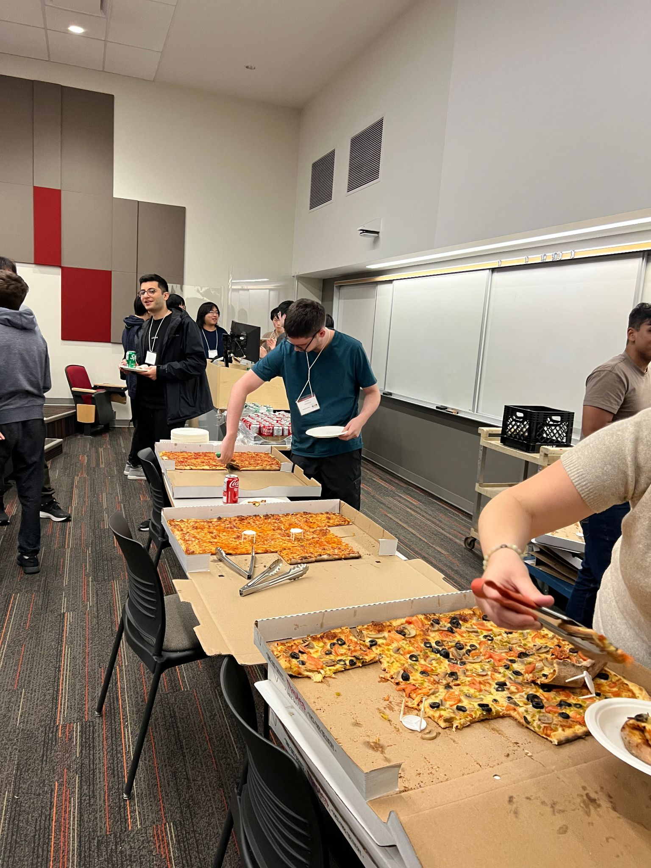






Ryan Pelchat
Notes:
I am Ryan Pelchat
4th year Computer Science Student with a Specialization in Software Development
I am taking EECS 4070 which is a self directed course. The direction that I chose is to conduct a workshops on competitive programming
Last year I was on the ICPC team and we competed at the University of Windsor, it was a lot of fun! Challenging problems, a fun train ride, and free food.
In my free time I like to read and tinker with software and hardware.
I host a Jellyfin server on an old laptop on my local network and I remote access it using a Wireguard VPN that I host on a raspberry pi
I am on the 6th book of The Expanse series.

Slide 3

FORMAT
Problem Reviews with Ben
Workshop with me
Focused on theory using Python, most of the code libraries will be up to you (I will give tips from time to time)
Suggested practice problems relating to the workshop given
Next week Ben will review the solution to one of the problems
Next week I will release my personal solutions to the problems
All course files will be at this link:
https://github.com/ryan-pelchat/competitive-programming-workshop
We will be using Kattis and UVa
Sign up for Kattis (https://open.kattis.com/)
Sign up for UVa online judge (https://onlinejudge.org/)
If you have a question, raise your hand anytime!
Notes:
Problem Reviews with Ben
Workshop with me
Focused on theory, most of the code libraries will be up to you (I will give tips from time to time)
Suggested practice problems relating to the workshop given
If you have a question, raise your hand anytime!

Slide 4
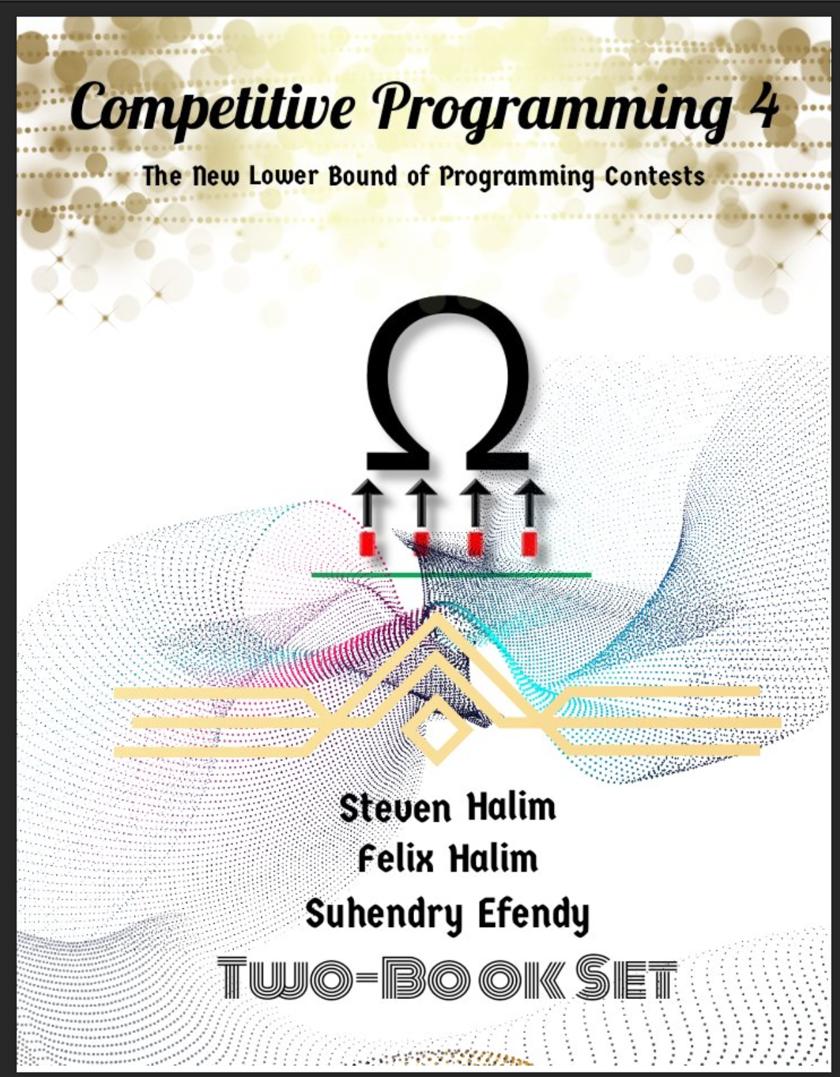
Resources
Competitive Programming 4 -- Steven Halim, Felix Halim, Suhendry Effendy -- Competitive Programming, 1 & 2, 4th Edition

Slide 5
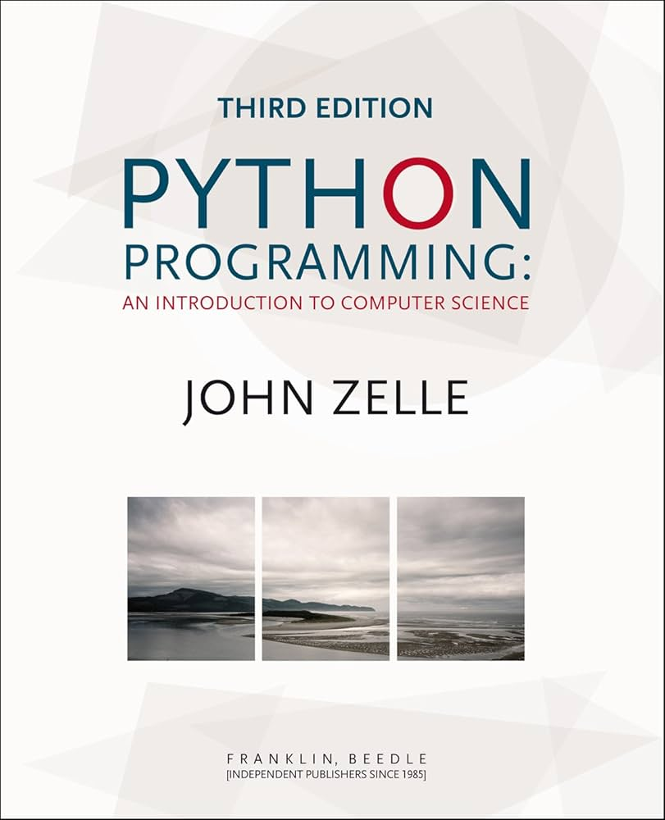
Resources
Zelle J. - Python Programming An Introduction to Computer Science, 3rd Edition - 2017

Slide 6
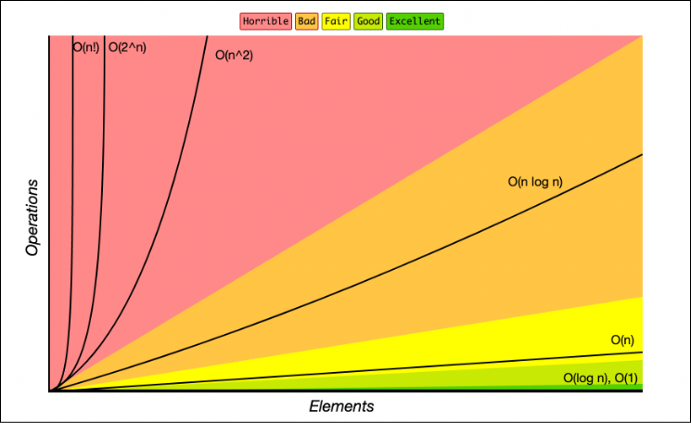
1.3.3 Introduction to Algorithm Analysis
What is time complexity?
Denoted by the Big-Oh, ex: O(n), O(n^2), O(nlogn) etc…
Time complexity measures how the number of operations grows with input size as n→∞.
What is space complexity?
Big-Oh notation
Space complexity measures how the memory required grows with input size as n→∞.
bit level chapter?
Sources:
https://www.freecodecamp.org/news/big-o-cheat-sheet-time-complexity-chart/
Notes:
https://www.freecodecamp.org/news/big-o-cheat-sheet-time-complexity-chart/

Slide 7
1.3.3 Introduction to Algorithm Analysis
Why is time and space complexity important?
Understanding complexity helps you quickly decide whether an approach will run fast enough and fit in memory, so you don’t waste submissions and time.
What makes the best solution?
Meets the constraints for time and space complexity
Simple for you to implement
Notes:
https://wiki.python.org/moin/TimeComplexity

Slide 8
1.3.3 Introduction to Algorithm Analysis
Activity!
A “simple operation” can be considered something done in constant time
When we say ‘simple operation’ = O(1), we’re ignoring real-world machine details and just focusing on asymptotic growth.
Disk I/O not always constant time
Hash table lookup is expected O(1), but worst-case O(n)
A modern computer can calculate about 10^8 or 100 Million operations per second
Gives you a rule of thumb when estimating if you will fit the constraints
Just like time complexity measures how runtime grows with input size, space complexity measures how memory usage grows
Keep in mind how many objects/data structures you create and how large they become
Try to re-use structures instead of making new ones
Keep track of how large your stack frame and associated objects inside becomes when you use a recursive solution
Every recursive call stores local variables on the stack, too much recursion can blow your memory cap even if each call is cheap
I will expand on recursion in a later workshop
Sources:
https://wiki.python.org/moin/TimeComplexity
Competitive Programming 4 section 1.3.3
Notes:
https://wiki.python.org/moin/TimeComplexity

Slide 9
2.2.1 Array
What is an array?
Is a collection of homogenous sequential data to be stored and later accessed using their indices
Native support in C/C++ and Java.
No built-in support for static array in Python.
Not resizeable
Dynamic (Resizeable) Array
C++ STL vector.
Java ArrayList (preferred in Competitive Programming, as it is faster) or Vector.
Python list
Resizable, the computer will take care of increasing or decreasing the size of the array for you.
Sorting
Python: O(nlogn)
Searching
Python Unsorted Array: O(n)
Python Sorted Array: O(logn) using binary search
https://visualgo.net/en/array
Sources:
https://wiki.python.org/moin/TimeComplexity
Competitive Programming 4 section 2.2.1
Notes:
https://wiki.python.org/moin/TimeComplexity

Slide 10
2.2.5 Linked Data Structures (overview)
What is a Linked List?
A linked list is a linear data structure where each element (node) stores a value and a pointer to the next node, forming a chain of connected elements.
Inefficient, we won’t be using this in the competition.
What is a Stack?
A stack is a linear data structure that stores elements in a last-in, first-out (LIFO) order, where insertions and removals occur only at the top.
What is a Queue?
A queue is a linear data structure that stores elements in a first-in, first-out (FIFO) order, where insertions happen at the rear and removals happen at the front.
What happens if you need to add to the front of a queue as well as the back?
Double-ended Queue (Deque)
Is a linear data structure that allows insertions and removals from both the front and the rear.
But even looking at the middle is slow, and adding to or removing from the middle is slower still.
Sources:
https://wiki.python.org/moin/TimeComplexity
Competitive Programming 4 section 2.2.5
https://visualgo.net/en/list
Notes:
https://wiki.python.org/moin/TimeComplexity

Slide 11
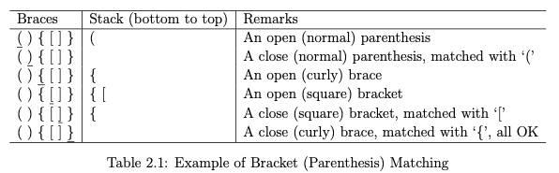
2.2.6 Special Stack-based Problems
Parentheses Matching
Given a string containing brackets, return True if all the parentheses inside the string are properly closed, False otherwise.
How can we solve this? What can we use?
We can use a stack! Using the LIFO strategy!
Push open brackets, pop matching closing ones.
If at the end of the string, the stack is empty then it is all okay! If not, then it is not okay.
What is the runtime?
O(n)
Sources:
Competitive Programming 4 section 2.2.6
Notes:
https://wiki.python.org/moin/TimeComplexity

Slide 12
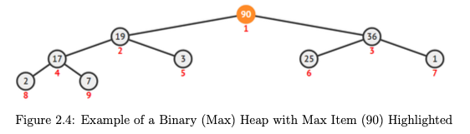
2.3.1 Binary Heap (Priority Queue)
What is a heap?
Data structure that satisfies 2 properties
Shape property: it is a complete binary tree (all levels are fully filled except possibly the last, which is filled from left to right).
Heap property: every parent node compares in a consistent way with its children
In a min-heap, each parent is less than or equal to its children → the smallest element is always at the root.
In a max-heap, each parent is greater than or equal to its children → the largest element is always at the root.
Binary Heap is what heapq in Python uses and it is a specific implementation of a Heap
Why is this useful?
Binary Heap (Priority Queues) Lets you always grab the largest/smallest item in O(logn) time instead of inserting and sorting which can be O(nlogn) time
You have a problem with incoming tasks with various levels of priority, you can always get the most important one any time
Sources:
Competitive Programming 4 section 2.3.1
https://visualgo.net/en/heap
Notes:
https://wiki.python.org/moin/TimeComplexity

Slide 13
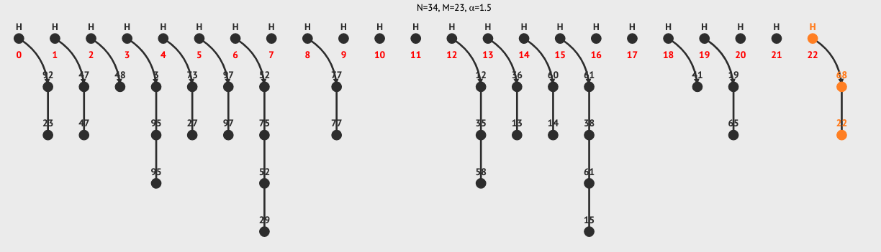
2.3.2 Hash Table
What are Hash Tables?
Hash Table is a non-linear data structure that requires very fast (expected) O(1) insertion, search/retrieval/update, or removal of keys if the keys do not have to be sorted.
A hash table stores key–value pairs in an array by running each key through a hash function (turns it into an index), then places the value at that index.
If two keys land on the same index (collision), the table resolves it by a few ways but a common way is by using linked lists.
Worst case can be O(n), but is O(1) on average.
In python they are dict/set
Why is this useful?
Near instant lookup tool! Insertion, search/retrieval/update is super duper fast
Good for ex:
Frequency counting (how many times does a number/letter appear?).
Membership tests (has this state/word/number been seen before?).
Mapping (store extra info keyed by a string or ID).
Sources:
Competitive Programming 4 section 2.3.2
https://visualgo.net/en/hashtable
https://wiki.python.org/moin/TimeComplexity
Notes:
https://wiki.python.org/moin/TimeComplexity

Slide 14
Suggested Homework
2.2
a. 1D Array Manipulation, Medium
https://open.kattis.com/problems/jollyjumpers
b. 2D Array Manipulation, Easier
https://open.kattis.com/problems/epigdanceoff
j. Stack
https://open.kattis.com/problems/pairingsocks
l. List/Queue/Deque
https://open.kattis.com/problems/integerlists
2.3
a Priority Queue
https://open.kattis.com/problems/stockprices
d. Hash Table (set)
https://open.kattis.com/problems/esej
https://open.kattis.com/problems/shiritori
e. Hash Table (map), Easier
https://open.kattis.com/problems/recount
Other Special Stack-Based Problem
https://open.kattis.com/problems/bracketmatching

Slide 15
Template
Template
Notes:
https://wiki.python.org/moin/TimeComplexity

