Slide 1
WORKSHOP 9
2.2.3 Bitmask
2.4.1 Graph Representation Review
2.4.3 Fenwick (Binary Indexed) Tree

Slide 2
2.2.3 Bitmask

Slide 3
2.2.3 Bitmask – Why?
All bitwise operations are constant time! O(1)!!!
This is because they are implemented closer to the hardware level
Can represent a set, or as a parameter in recursive or dynamic programming algorithms!
Faster multiplication!!
(With some programming languages, not Python though due to arbitrary precision)
We are stripping everything but exactly we need to do the job!
Used in many data structures and algorithms to speed things up!
Sources:
Competitive Programming 4 Section 2.2.3
Notes:
https://wiki.python.org/moin/TimeComplexity

Slide 4
2.2.3 Bitmask – Representation in Python
Base 2
0000, 0001, 0010, 0011…
Each position is a power of 2, just like in base 10, they are powers of 10
Integer with arbitrary precision in base 2 (i.e. it is whatever you need, max is your system’s memory)
Two's Complement Number: Representing Negative Numbers
Negative numbers are written with a leading one instead of a leading zero(splits possible bits in 2!)
8 bits, "00000000" to "01111111" means 0 to 127
8 bits, "10000000" to “00000000” means -128 to 0
reserve "1xxxxxxx" for writing negative numbers.
-x = ~(x - 1) i.e. -x = NOT(x - 1)
ex: -1 is ~(1 - 1) = ~(0) = "11111111"
ex: -10 is ~(10 - 1) = ~(9) = ~("00001001") = "11110110"
Sources:
Competitive Programming 4 Section 2.2.3
https://wiki.python.org/moin/BitwiseOperators
https://en.wikipedia.org/wiki/Arbitrary-precision_arithmetic
Notes:
https://wiki.python.org/moin/TimeComplexity

Slide 5
2.2.3 Bitmask – Python Syntax
x << y
Returns x with the bits shifted to the left by y places. (new bits on the right-hand-side are zeros)
Same as multiplying x by 2^{y}
x >> y
Returns x with the bits shifted to the right by y places
Same as floor division of x by 2^{y}
x & y
Bitwise AND
x | y
Bitwise OR
~ x
Bitwise NOT
x ^ y
Bitwise XOR
Sources:
Competitive Programming 4 Section 2.2.3
https://wiki.python.org/moin/BitwiseOperators
Notes:
In class, show example of each on the board
IF Class is new to bit operations, draw Truth Tables on the board!

Slide 6

2.2.3 Bitmask – Multiplication/Division
Easy!
Shift left to multiply by 2, shift right to divide by 2!
NOTE: shift left does the floor division! (see 17/2 = 8 in last line)
Sources:
Competitive Programming 4 Section 2.2.3
Notes:
https://wiki.python.org/moin/TimeComplexity

Slide 7

2.2.3 Bitmask – Set/Turn on j-th Item (0-based indexing)
When using as a set, you can use the bitwise OR operation to set/turn on bits!
S |= (1 << j)
Sources:
Competitive Programming 4 Section
https://visualgo.net/en/bitmask
Notes:
https://wiki.python.org/moin/TimeComplexity

Slide 8
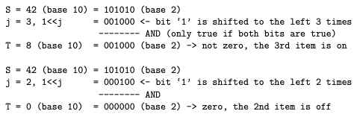
2.2.3 Bitmask – Check if j-th Item of the Set is on
Use bitwise AND operation T = S & (1 << j)
if T = 0, then j-th item of the set is off
if T != 0, (specifically, T=(1<<j)) then the j-th item of the set is on
Sources:
Competitive Programming 4 Section 2.2.3
Notes:
https://wiki.python.org/moin/TimeComplexity

Slide 9

2.2.3 Bitmask – Clear/Turn off the j-th Item of the Set
Bitwise AND operation S &= ~(1<<j)
Don’t forget to use parentheses to avoid accidental bugs due to operator precedence
In example, we find the NOT of 1 shifted by 1
000001
000010
111101
Sources:
Competitive Programming 4 Section 2.2.3
Notes:
https://wiki.python.org/moin/TimeComplexity

Slide 10
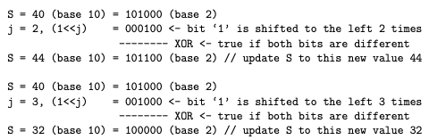
2.2.3 Bitmask – Toggle (flip status of) j-th Item of the Set
Use bitwise operation XOR S ^= (1<<j)
Sources:
Competitive Programming 4 Section 2.2.3
Notes:
https://wiki.python.org/moin/TimeComplexity

Slide 11
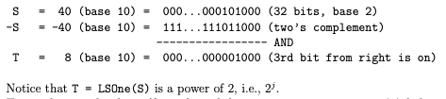
2.2.3 Bitmask – Get the Value of Least Significant Bit of S
T = ((S) & -(S))
Operation is often abbreviated as LSOne(S)
Remember!
Sources:
Competitive Programming 4 Section 2.2.3
Notes:
https://wiki.python.org/moin/TimeComplexity

Slide 12

2.2.3 Bitmask – Turn on All Bits in a Set of Size n
S = (1 << n) - 1
Sources:
Competitive Programming 4 Section 2.2.3
Notes:
https://wiki.python.org/moin/TimeComplexity

Slide 13
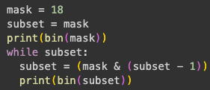

2.2.3 Bitmask – Enumerate all Proper Subsets of a Given Bitmask
A proper subset of a mask is all the subsets with set bits (including bit 0) that is strictly smaller than the mask
e.g. mask = (11)₁₀ = (1011)₂ or {0, 1, 3}
Base 10 | Base 2 | Subset
0 | 0000 | {0}
1 | 0001 | {1}
2 | 0010 | {0, 1}
3 | 0011 | {3}
8 | 1000 | {3}
9 | 1001 | {0, 3}
10 | 1010 | {1, 3}
Python
Mask | Element | In Mask?
0001 | 0 | Yes
0010 | 1 | Yes
0100 | 2 | No
1000 | 3 | Yes
C/C++
There will be a Jupyter Notebook on Github with a printout of what’s happening
Sources:
Competitive Programming 4 Section 2.2.3
Notes:
https://wiki.python.org/moin/TimeComplexity

Slide 14
2.4.1 Graph

Slide 15
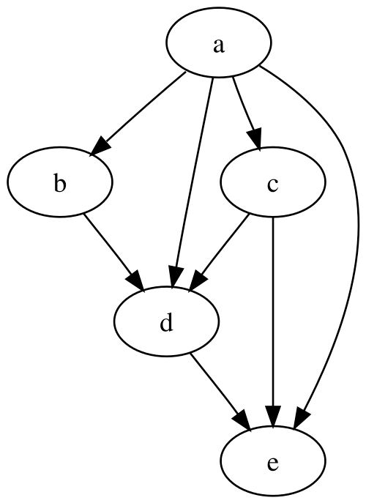
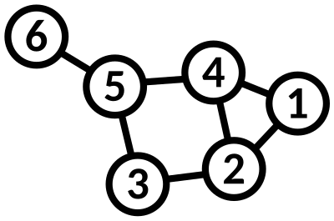
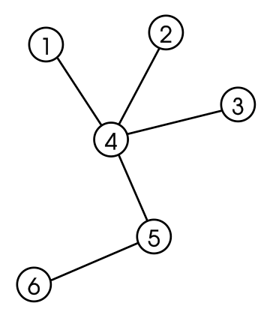
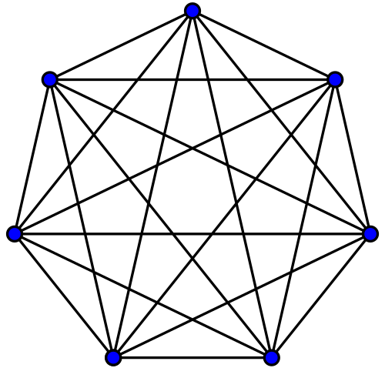
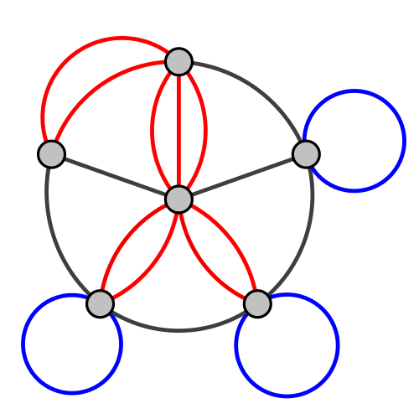
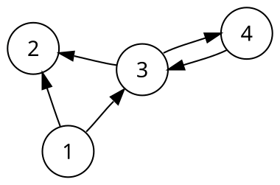
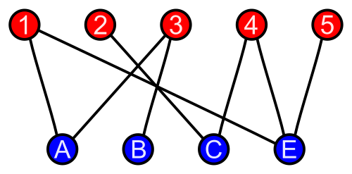
2.4.1 Graph – Quick Review Terminology Info Dump
A graph G = (V, E) is a set of vertices (V) and edges (E)
Edges store connectivity information between vertices in V
Can be in the form of weight or direction
Undirected/Directed Graph
A graph that is made up of a set of vertices connected by undirected/directed edges respectively
Directed Acyclic Graph (DAG)
Is a directed graph with no directed cycles (no loop arounds!)
Tree
An undirected graph in which every pair of distinct vertices is connected by exactly one path
Forest
A forest is collection of trees, i.e. an undirected graph where any two vertices are connected by exactly one path
Acyclic, and doesn’t need to connected
Complete Graph
An undirected graph in which every pair of distinct vertices is connected by a unique edge
Bipartite Graph
A graph whose vertices can be divided into two disjoint and independent sets U and V, that is, every edge connects a vertex in U to one in V
Multigraph
A graph which is permitted to have multiple edges, that is, edges that have the same end nodes
Sources:
Competitive Programming 4 Section 2.4.1
https://en.wikipedia.org/wiki/Tree_(graph_theory)
https://en.wikipedia.org/wiki/Complete_graph
https://en.wikipedia.org/wiki/Bipartite_graph
https://en.wikipedia.org/wiki/Directed_graph
https://en.wikipedia.org/wiki/Directed_acyclic_graph
https://en.wikipedia.org/wiki/Multigraph
Notes:
Quickly go through, can skip after the first 3 bullet points Graph represents nodes and paths
Undirected/Directed
Directed Acyclic
Tree: pick any 2 points, there is only 1 path between them
Forest: a bunch of trees
Complete Graph: every point directly connects to every other point
Bipartite graph: you can split the vertices in such a way that they only connect to the other group
Multigraph: You can have an edge that starts and terminates on itself

Slide 16
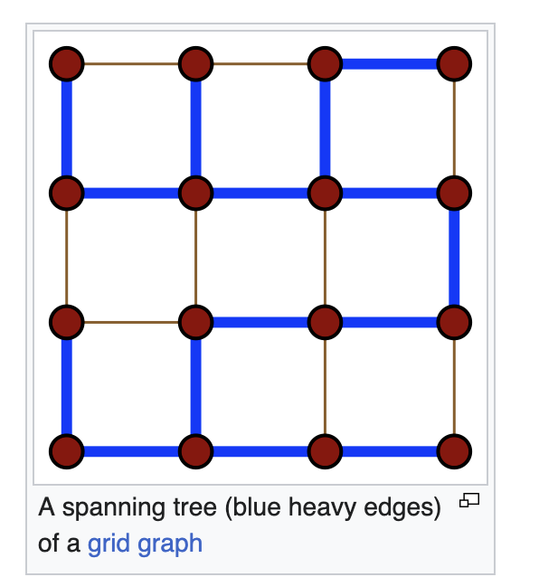
Spanning Trees
“Spanning tree T of an undirected graph G is a subgraph of a tree which includes all of the vertices of G”
I.E. a tree that has V-1 edges and where all the edges connect all the vertices
There are many possible kinds spanning trees given an undirected graph
Minimum Spanning Tree
Depth First Search Spanning Tree
Breadth First Search Spanning Tree
SSSP (Single-Source Shortest Paths) Spanning Tree
and more!
Sources:
Competitive Programming 4 Section 4.3
https://en.wikipedia.org/wiki/Spanning_tree
Notes:
Skip this slide Spanning Tree: The minimum amount of edges such that every vertex is connected to each other, in a way, a ”minimum” tree

Slide 17
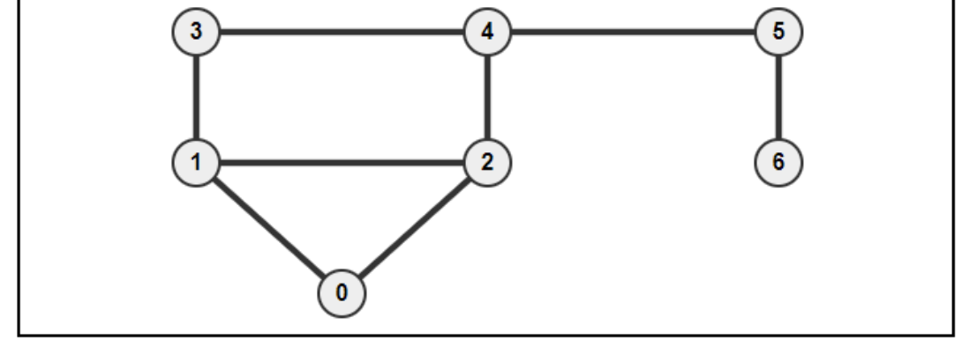
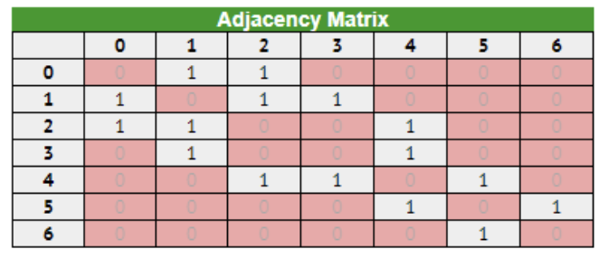
2.4.1 Graph - Adjacency Matrix
A 2D array storing the connectivity information between 2 vertices
AM[u][v] can store the weight and direction
Languages
Native support in C++ STL and Java API
Python use list of lists
Good to know:
Only use if number of vertices V is small enough (under ~ 5000)
Use if you need to access the connectivity between two vertices in a small dense graph is frequently required
Cannot store a multigraph
O(V²) space
O(V) to enumerate list of neighbors of a vertex u
Sources:
Competitive Programming 4 Section 2.4.1
Notes:
https://wiki.python.org/moin/TimeComplexity

Slide 18
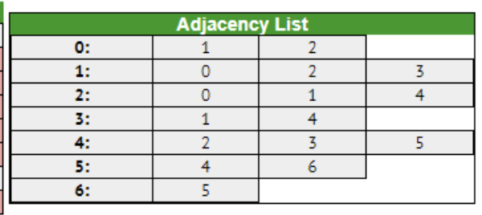
2.4.1 Graph - Adjacency List
Is a vector of vector of pairs storing the list of neighbors of each vertex u as ‘edge information pairs’
Each pair is: (index of neighbouring vertex, weight of the edge)
If graph is unweighted, you can leave it empty or just don’t implement it
Languages
C++ STL: vector<vii> AL, with vii defined as in: typedef pair<int, int> ii; typedef vector<ii> vii;
Using the Java API: ArrayList<ArrayList<IntegerPair>> AL
IntegerPair is a simple Java class that contains a pair of integers like pair<int, int>
Python: AL = defaultdict(list), the values in list are grouped by pairs
Good to know:
More space-efficient than Adjacency Matrices
Can store a multigraph
Can easily enumerate the list of neighbors of a vertex v efficiently
if v has k neighbors, it will take O(k) time
Very common to use this model to store graphs
O(V + E) Space complexity
Sources:
Competitive Programming 4 Section 2.4.1
Notes:
https://wiki.python.org/moin/TimeComplexity

Slide 19
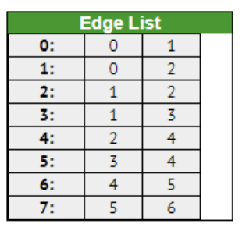
2.4.1 Graph - Edge List
Is a vector of triples
Store a list of all E edges, usually in some sorted order
For directed graphs, we store a bidirectional edge twice, one for each direction
The edges are tuples usually (w, u, v), (weight w plus the two endpoints u and v)
If the graph is unweighted, you can drop the w
Languages
C++ STL: vector<tuple<int, int, int>> EL
Java API: Vector<IntegerTriple> EL
IntegerTriple is a class that contains a triple of integers like tuple<int, int, int>
Python: EL = []
Good to know:
Good for Kruskal’s algorithm for MST where the collection of undirected edges need to be sorted
Complicates algorithms that require the enumeration of edges incident to a vertex
O(E) Space complexity
Take a look at: https://visualgo.net/en/graphds
Sources:
Competitive Programming 4 Section 2.4.1
Notes:
https://wiki.python.org/moin/TimeComplexity

Slide 20
2.4.3 Fenwick (Binary Indexed) Tree

Slide 21
Fenwick Tree (or Binary Indexed Tree BIT) Motivation
Supposed we have 11 scores for 11 students for a course. Scores range from 1 to 10,
s = [2, 4, 5, 6, 5, 6, 8, 6, 7, 9, 7]
We want to know how many students got 8, how many got between 1 and 6, between 4 and 6?
We also have to update these constantly during the semester!
Ideas?
Naive Implementation
update(i,x): a[i] += x → O(1)
prefix_sum(i): loop from 1..i and add → O(n)
sum(i, j): prefix_sum(j) - prefix_sum(i-1).) → O(n)
Fenwick Tree
update(i,x) → O(log n)
prefix_sum(i) → O(log n)
sum(i, j): prefix_sum(j) - prefix_sum(i-1) → O(log n)
Sources:
Competitive Programming 4 Section 2.4
Notes:
https://wiki.python.org/moin/TimeComplexity

Slide 22
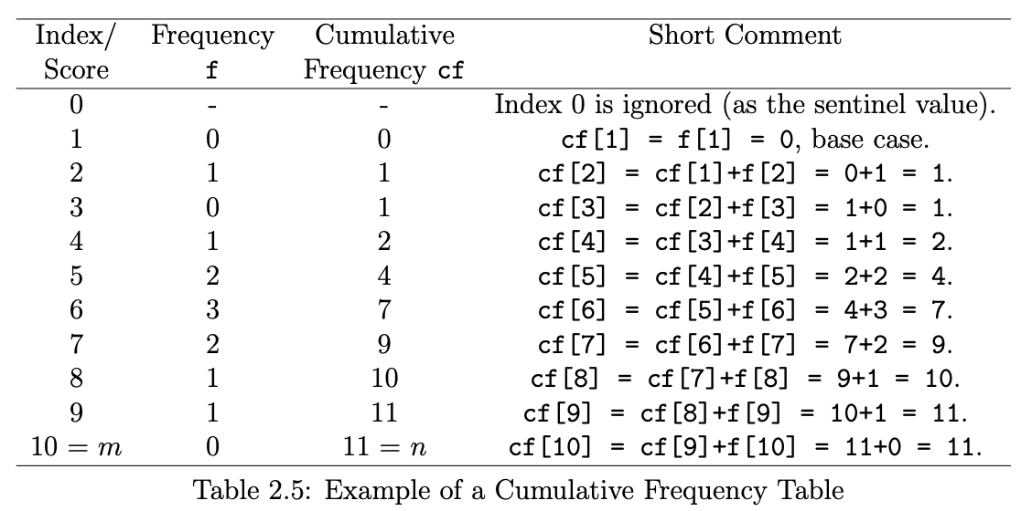
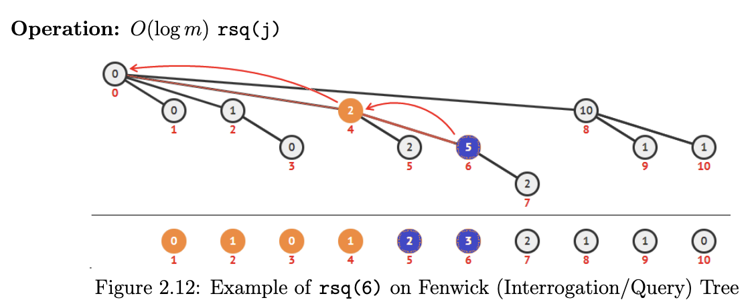
Fenwick Tree What is it?
First remember LSOne(x: int)
returns the least significant bit of a number by using ((S) & -(S))
We keep an separate array ft[1..n] where each position i stores the sum of a range of the original array ending at i.
ft[i] = sum of elements/frequencies of items {i-LSOne(i)+1, i-LSOne(i)+2, i-LSOne(i)+3, .., i}
ft[4] = 2 is responsible for range [(4-4+1)..4] = [1..4] of f
ft[6] = 5 is responsible for range [(6-2+1)..6] = [5..6] of f
ft[7] = 2 is responsible for range [(7-1+1)..7] = [7..7] of f
The idea is that we “split” the sumed chunks across the array, better than the naive way where each “chunk” is the previous element!
Sources:
Competitive Programming 4 Section 2.4
Notes:
https://wiki.python.org/moin/TimeComplexity

Slide 23
Fenwick Tree – RQS
A Range Query Sum is the sum of all elements within a specified range
RQS(i, j) is the sum of all occurrences between i and j
RSQ(1, 8) = 10
RSQ(4, 6) = RSQ(1, 6) – RSQ(1, 3) = 7-1 = 6
By using the inclusion-exclusion principle
Let’s trace an example! what is rsq(6)?
Remember, the “key” idea is that we find the “chunk”, then we find the previous “chunk” until we hit 0
let’s see on Google Collab!
Sources:
Competitive Programming 4 Section 2.4
Notes:
Let’s introduce the Range Query Sum!

Slide 24
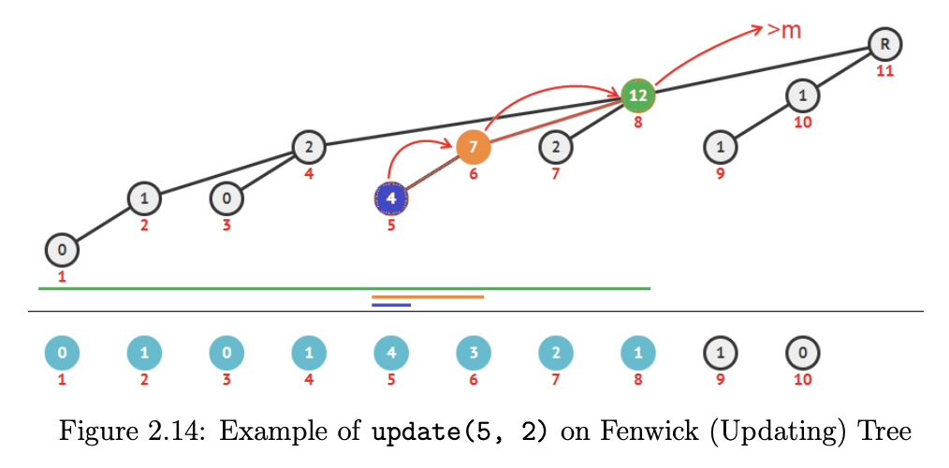

Fenwick Tree – update
Ideas on how we should update the values?
We traverse the affected “chunks” and update their values!
Let’s see this in Google Collab
Sources:
Competitive Programming 4 Section 2.4
Notes:
Let’s introduce the Range Query Sum!

Slide 25
Fenwick Tree – build
How do we build the sum/frequency array?
Ideas?
One Idea
Do one linear O(n) pass to create an array of frequencies with m keys/integer indices
Call update(i, f[i]) for every m
O(n + m log m)
Better Idea
During one linear O(n) pass to create an array of frequencies with m keys/integer indices
Create a cumulative sum
self.ft[i] += f[i - 1]
Check if its parent in the updating tree of Fenwick Tree is still within range. If it is, we update its parent too
self.ft[i + self.lsone(i)] += self.ft[i]
Let’s see on Google Colab!
Sources:
Competitive Programming 4 Section 2.4
Notes:
https://wiki.python.org/moin/TimeComplexity

Slide 26
Fenwick Tree – Basic Implementation
Let’s see on Google Colab!
Sources:
Competitive Programming 4 Section 2.4
Notes:
https://wiki.python.org/moin/TimeComplexity

Slide 27
Fenwick Tree – More!
We haven’t seen select(rank k) (O(log2 m))
find the smallest index/key i so that the cumulative frequency in the range [1..i] ≥ k.
Range Update Point Query (RUPQ)
Updating the values within a given range [lo..hi] by the same +v value
If you guys like Fenwick Trees, we’ll see this in the next session!
Sources:
Competitive Programming 4 Section 2.4
Notes:
https://wiki.python.org/moin/TimeComplexity

Slide 28
Suggested Homework

Slide 29
Suggested Homework
Implement YOUR Basic Fenwick Tree!
c1. Tree-related Data Structures
Kattis – fenwick
https://open.kattis.com/problems/fenwick

Slide 30
Template
temp
Sources:
Competitive Programming 4 Section 2.4
Notes:
https://wiki.python.org/moin/TimeComplexity

