Slide 1
WORKSHOP 4
2.4.1 Graph
4.3 Minimum Spanning Tree (MST)
4.3.4 Other Applications
Questions + Suggested Homework Solution Review
Suggested Homework
4.3 Minimum Spanning Tree (MST)
4.3.4 Other Applications
4.3.5 MST in Programming Contests
Suggested Homework

Slide 2
2.4.1 Graph

Slide 3
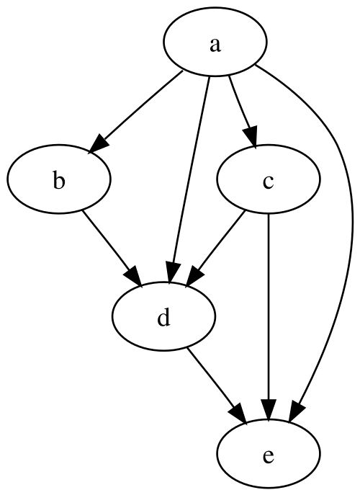
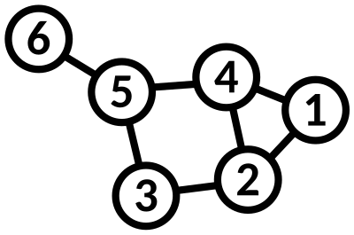
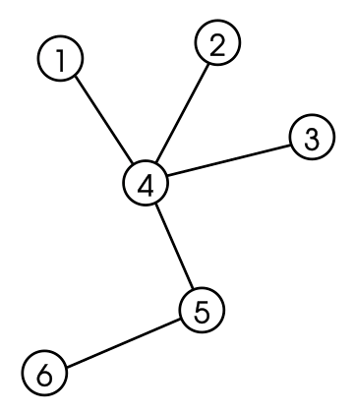
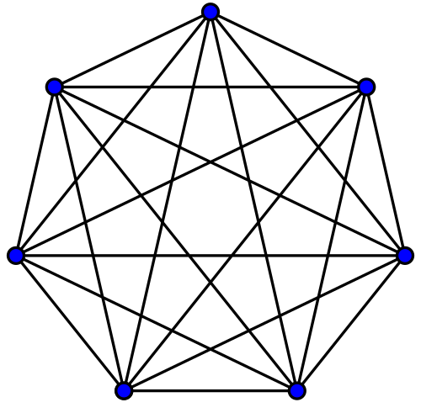
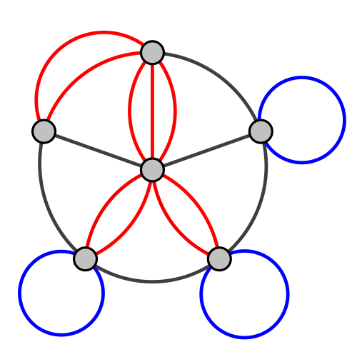
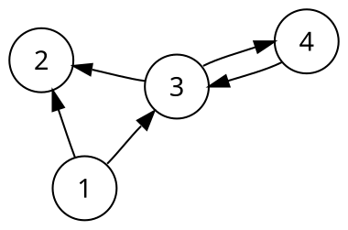
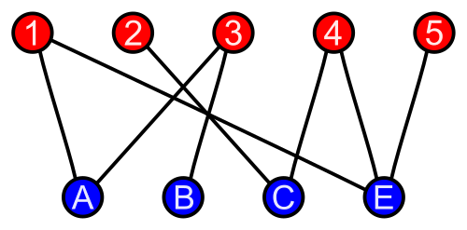
2.4.1 Graph – Quick Review Terminology Info Dump
A graph G = (V, E) is a set of vertices (V) and edges (E)
Edges store connectivity information between vertices in V
Can be in the form of weight or direction
Undirected/Directed Graph
A graph that is made up of a set of vertices connected by undirected/directed edges respectively
Directed Acyclic Graph (DAG)
Is a directed graph with no directed cycles (no loop arounds!)
Tree
An undirected graph in which every pair of distinct vertices is connected by exactly one path
Forest
A forest is collection of trees, i.e. an undirected graph where any two vertices are connected by exactly one path
Acyclic, and doesn’t need to connected
Complete Graph
An undirected graph in which every pair of distinct vertices is connected by a unique edge
Bipartite Graph
A graph whose vertices can be divided into two disjoint and independent sets U and V, that is, every edge connects a vertex in U to one in V
Multigraph
A graph which is permitted to have multiple edges, that is, edges that have the same end nodes
Sources:
Competitive Programming 4 Section 2.4.1
https://en.wikipedia.org/wiki/Tree_(graph_theory)
https://en.wikipedia.org/wiki/Complete_graph
https://en.wikipedia.org/wiki/Bipartite_graph
https://en.wikipedia.org/wiki/Directed_graph
https://en.wikipedia.org/wiki/Directed_acyclic_graph
https://en.wikipedia.org/wiki/Multigraph
Notes:
https://wiki.python.org/moin/TimeComplexity

Slide 4
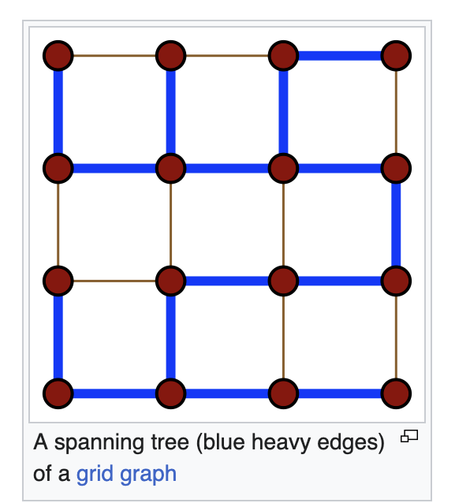
Spanning Trees
“Spanning tree T of an undirected graph G is a subgraph of a tree which includes all of the vertices of G”
I.E. a tree that has V-1 edges and where all the edges connect all the vertices
There are many possible kinds spanning trees given an undirected graph
Minimum Spanning Tree
Depth First Search Spanning Tree
Breadth First Search Spanning Tree
SSSP (Single-Source Shortest Paths) Spanning Tree
and more!
Sources:
Competitive Programming 4 Section 4.3
https://en.wikipedia.org/wiki/Spanning_tree
Notes:
https://wiki.python.org/moin/TimeComplexity

Slide 5
Graph Representation in Code
How do we represent graphs in code? Any ideas?
Notes:
Adjacency Matrix
Adjacency List
Edge List

Slide 6
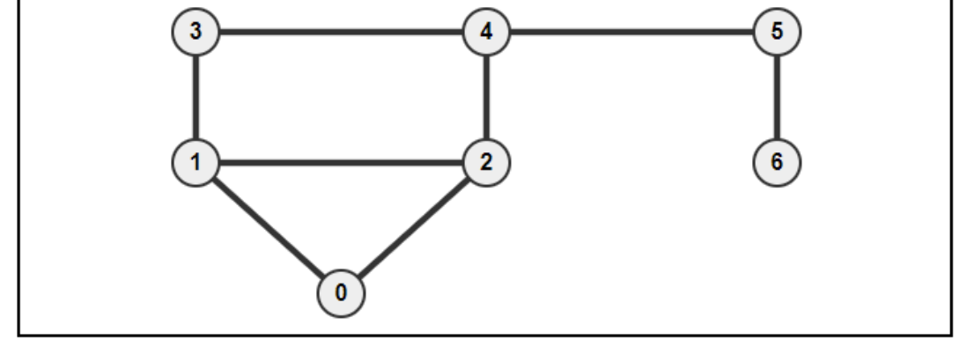
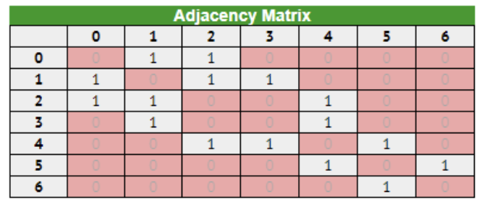
2.4.1 Graph - Adjacency Matrix
A 2D array storing the connectivity information between 2 vertices
AM[u][v] can store the weight and direction
Languages
Native support in C++ STL and Java API
Python use list of lists
Good to know:
Only use if number of vertices V is small enough (under ~ 5000)
Use if you need to access the connectivity between two vertices in a small dense graph is frequently required
Cannot store a multigraph
O(V²) space
O(V) to enumerate list of neighbors of a vertex u
Sources:
Competitive Programming 4 Section 2.4.1
Notes:
https://wiki.python.org/moin/TimeComplexity

Slide 7
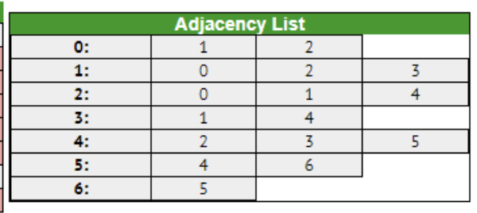
2.4.1 Graph - Adjacency List
Is a vector of vector of pairs storing the list of neighbors of each vertex u as ‘edge information pairs’
Each pair is: (index of neighbouring vertex, weight of the edge)
If graph is unweighted, you can leave it empty or just don’t implement it
Languages
C++ STL: vector<vii> AL, with vii defined as in: typedef pair<int, int> ii; typedef vector<ii> vii;
Using the Java API: ArrayList<ArrayList<IntegerPair>> AL
IntegerPair is a simple Java class that contains a pair of integers like pair<int, int>
Python: AL = defaultdict(list), the values in list are grouped by pairs
Good to know:
More space-efficient than Adjacency Matrices
Can store a multigraph
Can easily enumerate the list of neighbors of a vertex v efficiently
if v has k neighbors, it will take O(k) time
Very common to use this model to store graphs
O(V + E) Space complexity
Sources:
Competitive Programming 4 Section 2.4.1
Notes:
https://wiki.python.org/moin/TimeComplexity

Slide 8
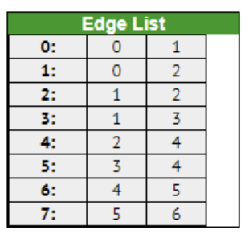
2.4.1 Graph - Edge List
Is a vector of triples
Store a list of all E edges, usually in some sorted order
For directed graphs, we store a bidirectional edge twice, one for each direction
The edges are tuples usually (w, u, v), (weight w plus the two endpoints u and v)
If the graph is unweighted, you can drop the w
Languages
C++ STL: vector<tuple<int, int, int>> EL
Java API: Vector<IntegerTriple> EL
IntegerTriple is a class that contains a triple of integers like tuple<int, int, int>
Python: EL = []
Good to know:
Good for Kruskal’s algorithm for MST where the collection of undirected edges need to be sorted
Complicates algorithms that require the enumeration of edges incident to a vertex
O(E) Space complexity
Take a look at: https://visualgo.net/en/graphds
Sources:
Competitive Programming 4 Section 2.4.1
Notes:
https://wiki.python.org/moin/TimeComplexity

Slide 9
4.3 Minimum Spanning Tree (MST)

Slide 10
Case Study - Island Hopping
Let’s read the problem on Kattis: https://open.kattis.com/problems/islandhopping
What have we understood?
We have a max of 10 test cases, each with a max of 750 islands
We need to return the smallest length of bridge that needs to be built
This is an undirected weighted tree
We have 1GB of memory and 3 seconds (300 Million Operations)
How, ideas?
Somehow we need to create a tree that minimally connects each vertex
A Minimum Spanning Tree!
Sources:
https://open.kattis.com/problems/islandhopping
Notes:
https://wiki.python.org/moin/TimeComplexity

Slide 11
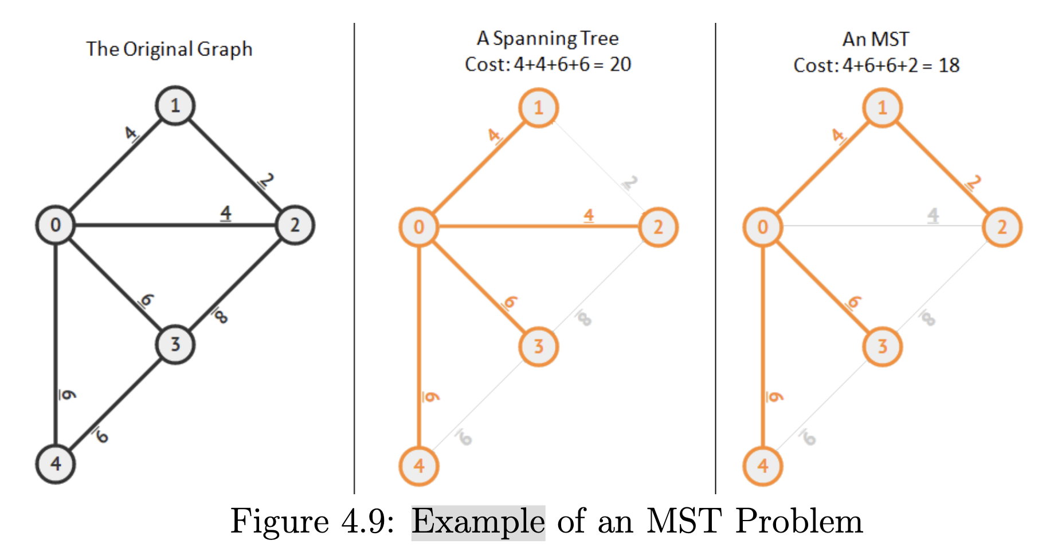
Minimum Spanning Tree (MST) - Overview
Given a connected, undirected, and weighted graph G = (V, E)
Select a subset of edges E’ ⊆ E such that the graph G’ = (V, E’) is still connected and the total weight of the selected edges E’ is minimal.
I.E. Connect all vertices with the minimum cost of edge!
Sources:
Competitive Programming 4 Section 4.3
Notes:
https://wiki.python.org/moin/TimeComplexity

Slide 12
Minimum Spanning Tree (MST) - Kruskal’s Algorithm
First sorts E edges based on non-decreasing weight
Done by sorting edges in an Edge List data structure
Kruskal then greedily tries to add each edge into the MST as long as such addition does not form a cycle (checked by using Union-Find Disjoint Set)
Greedily means that it tries to make the best choice given the current situation (in this case, the smallest edge)
O(E log V) runtime
See textbook for breakdown on how this was calculated
Textbook implementation:
https://github.com/stevenhalim/cpbook-code/tree/master/ch4/mst
Let’s watch it in action!
https://visualgo.net/en/mst
Sources:
Competitive Programming 4 Section Section 4.3
Notes:
https://wiki.python.org/moin/TimeComplexity

Slide 13
4.3.4 Other Applications

Slide 14
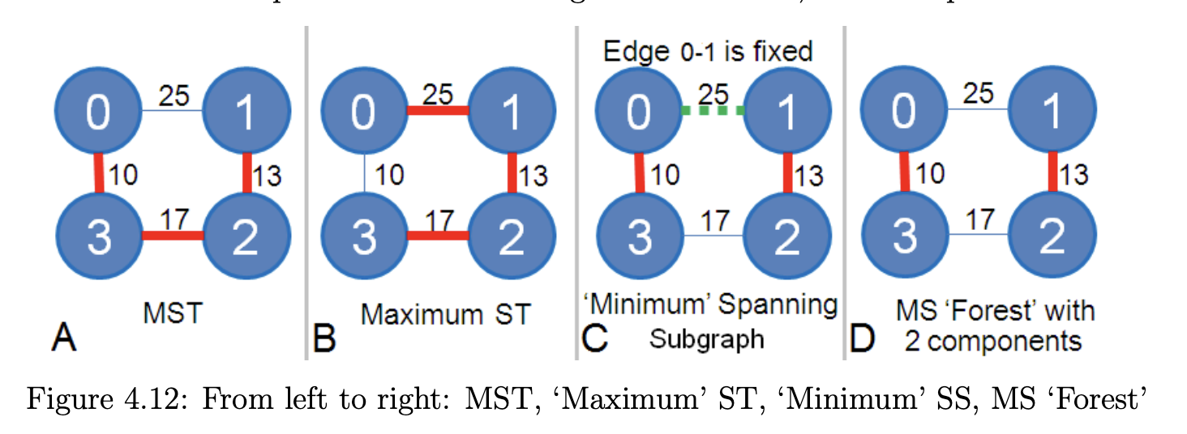
4.3.4 Other Applications – Variants of basic MST
These variations are more rare, the trend is to hide that the problem is actually an MST problem
e.g., UVa 01013, 01216, 01234, 01235, 01265, 10457, Kattis - lostmap
Maximum Spanning Tree
We want the maximum instead of the minimum
Instead of sorting in a non-decreasing way, sort in a non-increasing way
e.g., UVa 01234, 10842
‘Minimum’ Spanning Subgraph
Some edges in the given graph have already been fixed and must be taken as part of the solution
First take into account the fixed edges, then continue using Kruskal
Result might not be a tree or even an MST, hence ‘Minimum’ in quotes and Subgraph instead of tree
e.g. UVa 10147, 10397
Minimum Spanning Forest
Form a forest of K connected components (K subtrees) in the least cost way where K is given beforehand
In Kruskal we run as normal BUT as soon as the number of connected components equal to the desired pre-determined K, we can terminate the algorithm
e.g. Kattis - arcticnetwork
Sources:
Competitive Programming 4 Section 4.3
Notes:
https://wiki.python.org/moin/TimeComplexity

Slide 15
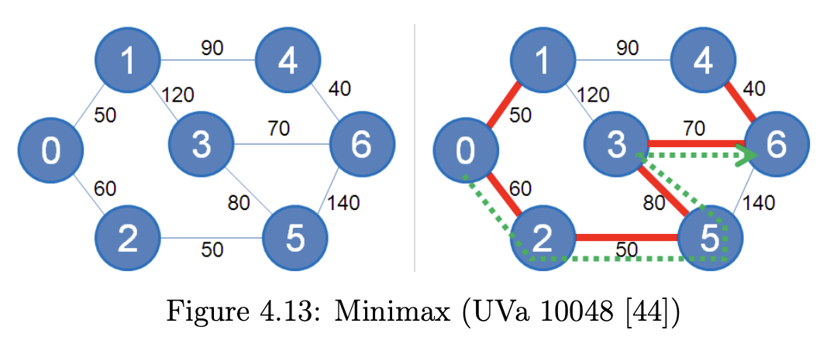
4.3.4 Other Applications – Variants of basic MST
MiniMax (and MaxiMin)
Find the minimum of maximum edge weight among all possible paths between two vertices i to j
Cost for a path from i to j is determined by the maximum edge weight along this path
Among all these possible paths from i to j, pick the one with the minimum max-edge-weight
i.e. you can have a longer path if your max-edge-weight is lower
An MST creates a connected graph with the minimum weight between every vertex
Therefore an MST contains the lowest weight path between any 2 vertex
Therefore, find the biggest weight along path i to j in the MST and that is your answer
e.g. UVa 10048, 00534, 00544, 10048, 10099, Kattis - millionairemadness, muddyhike
O(E log V)
Calculations in the textbook
Sources:
Competitive Programming 4 Section 4.3
Notes:
https://wiki.python.org/moin/TimeComplexity

Slide 16
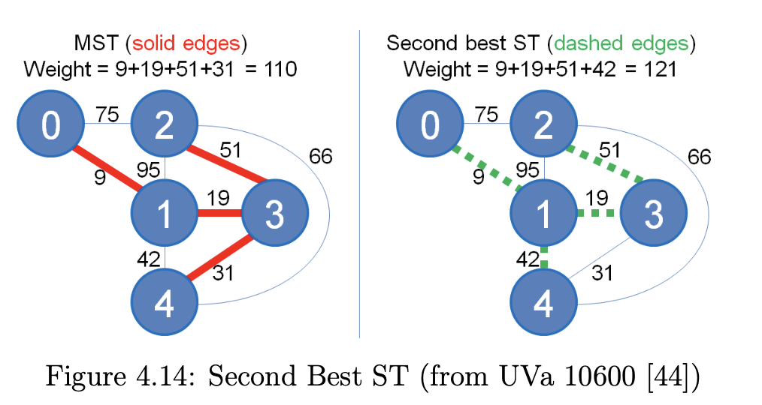
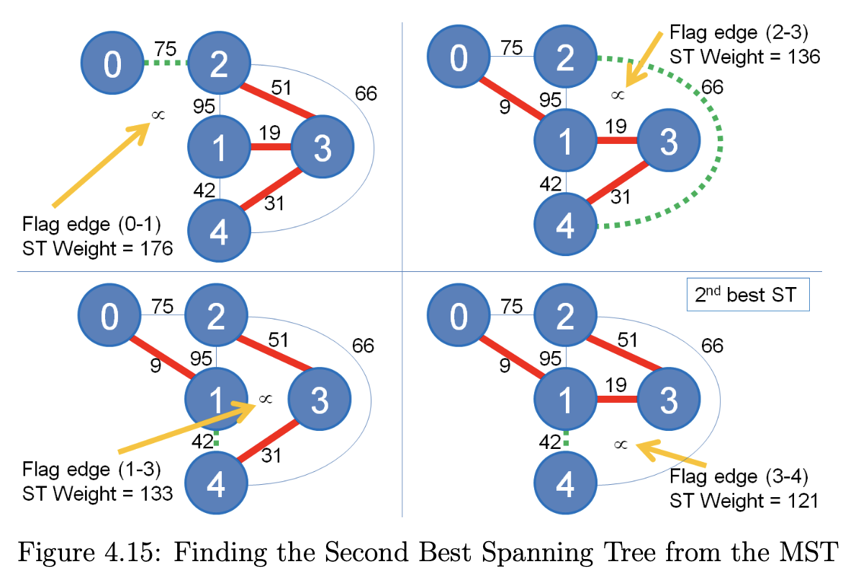
4.3.4 Other Applications – Variants of basic MST
Second Best Spanning Tree
Chord is an edge is defined as an edge in graph G that is not selected in the MST of G
Goal: You have replace an edge with a chord, but which one?
Solution:
Sort the edges O(E log V)
Find the MST O(E)
For each edge in MST, “freeze” that edge and recreate the MST excluding that “frozen” edge (note that you don’t need to re-sort the edges)
The best spanning tree after that is the answer
e.g. UVa 10600 – ACM contest and blackout
O(VE)
Calculations in the textbook
Sources:
Competitive Programming 4 Section 4.3
Notes:
https://wiki.python.org/moin/TimeComplexity

Slide 17
Questions + Suggested Homework Solution Review

Slide 18
Suggested Homework

Slide 19
Suggested Homework
Implement YOUR Kruskal!
https://open.kattis.com/problems/islandhopping
https://open.kattis.com/problems/millionairemadness
https://open.kattis.com/problems/lostmap
https://open.kattis.com/problems/svemir

Slide 20
Template
Template
Sources:
Competitive Programming 4 Section 4.3
Notes:
https://wiki.python.org/moin/TimeComplexity

Slide 21
Template
Template
Sources:
Competitive Programming 4 Section
Notes:
https://wiki.python.org/moin/TimeComplexity

