Slide 1
PREDICTION & ANALYSIS OF:
STUDENT GRADES
LING 460
By Ryan Presnell

Slide 2
RESEARCH QUESTION
RATIONALE
Can I consistently predict an accurate grade range for students based on factors such as parental education levels, absences, and previous exam scores?
Students with better exam scores usually get into better colleges and consequently have an easier time landing a job. Identifying factors that play a role in exam scores may help students such as myself perform better on future exams.

Slide 3
DATA SOURCE
I found the data on Kaggle. It contains student demographic information as well as data such as the students’ family structure, study habits, and past exam grades.

Slide 4
EXPLORATORY DATA ANALYSIS

Slide 5
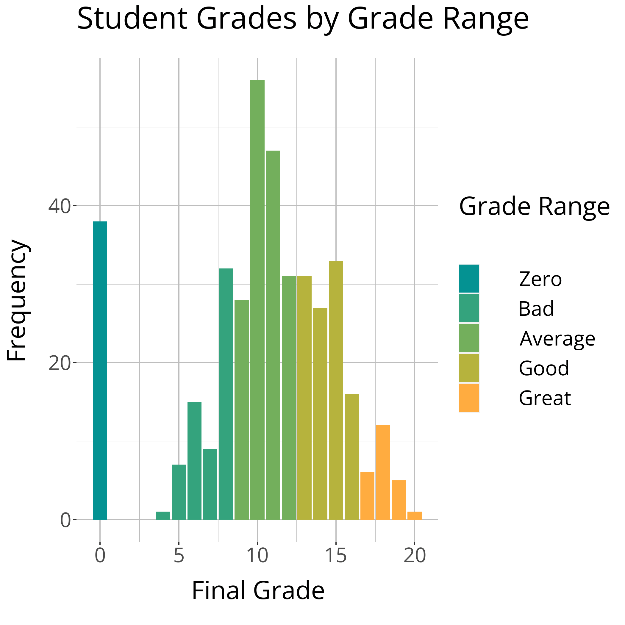
GRADE DISTRIBUTION
The exam grades appear to be relatively normally distributed except for many students who received a score of zero.

Slide 6
HYPOTHESIS TESTING

Slide 7
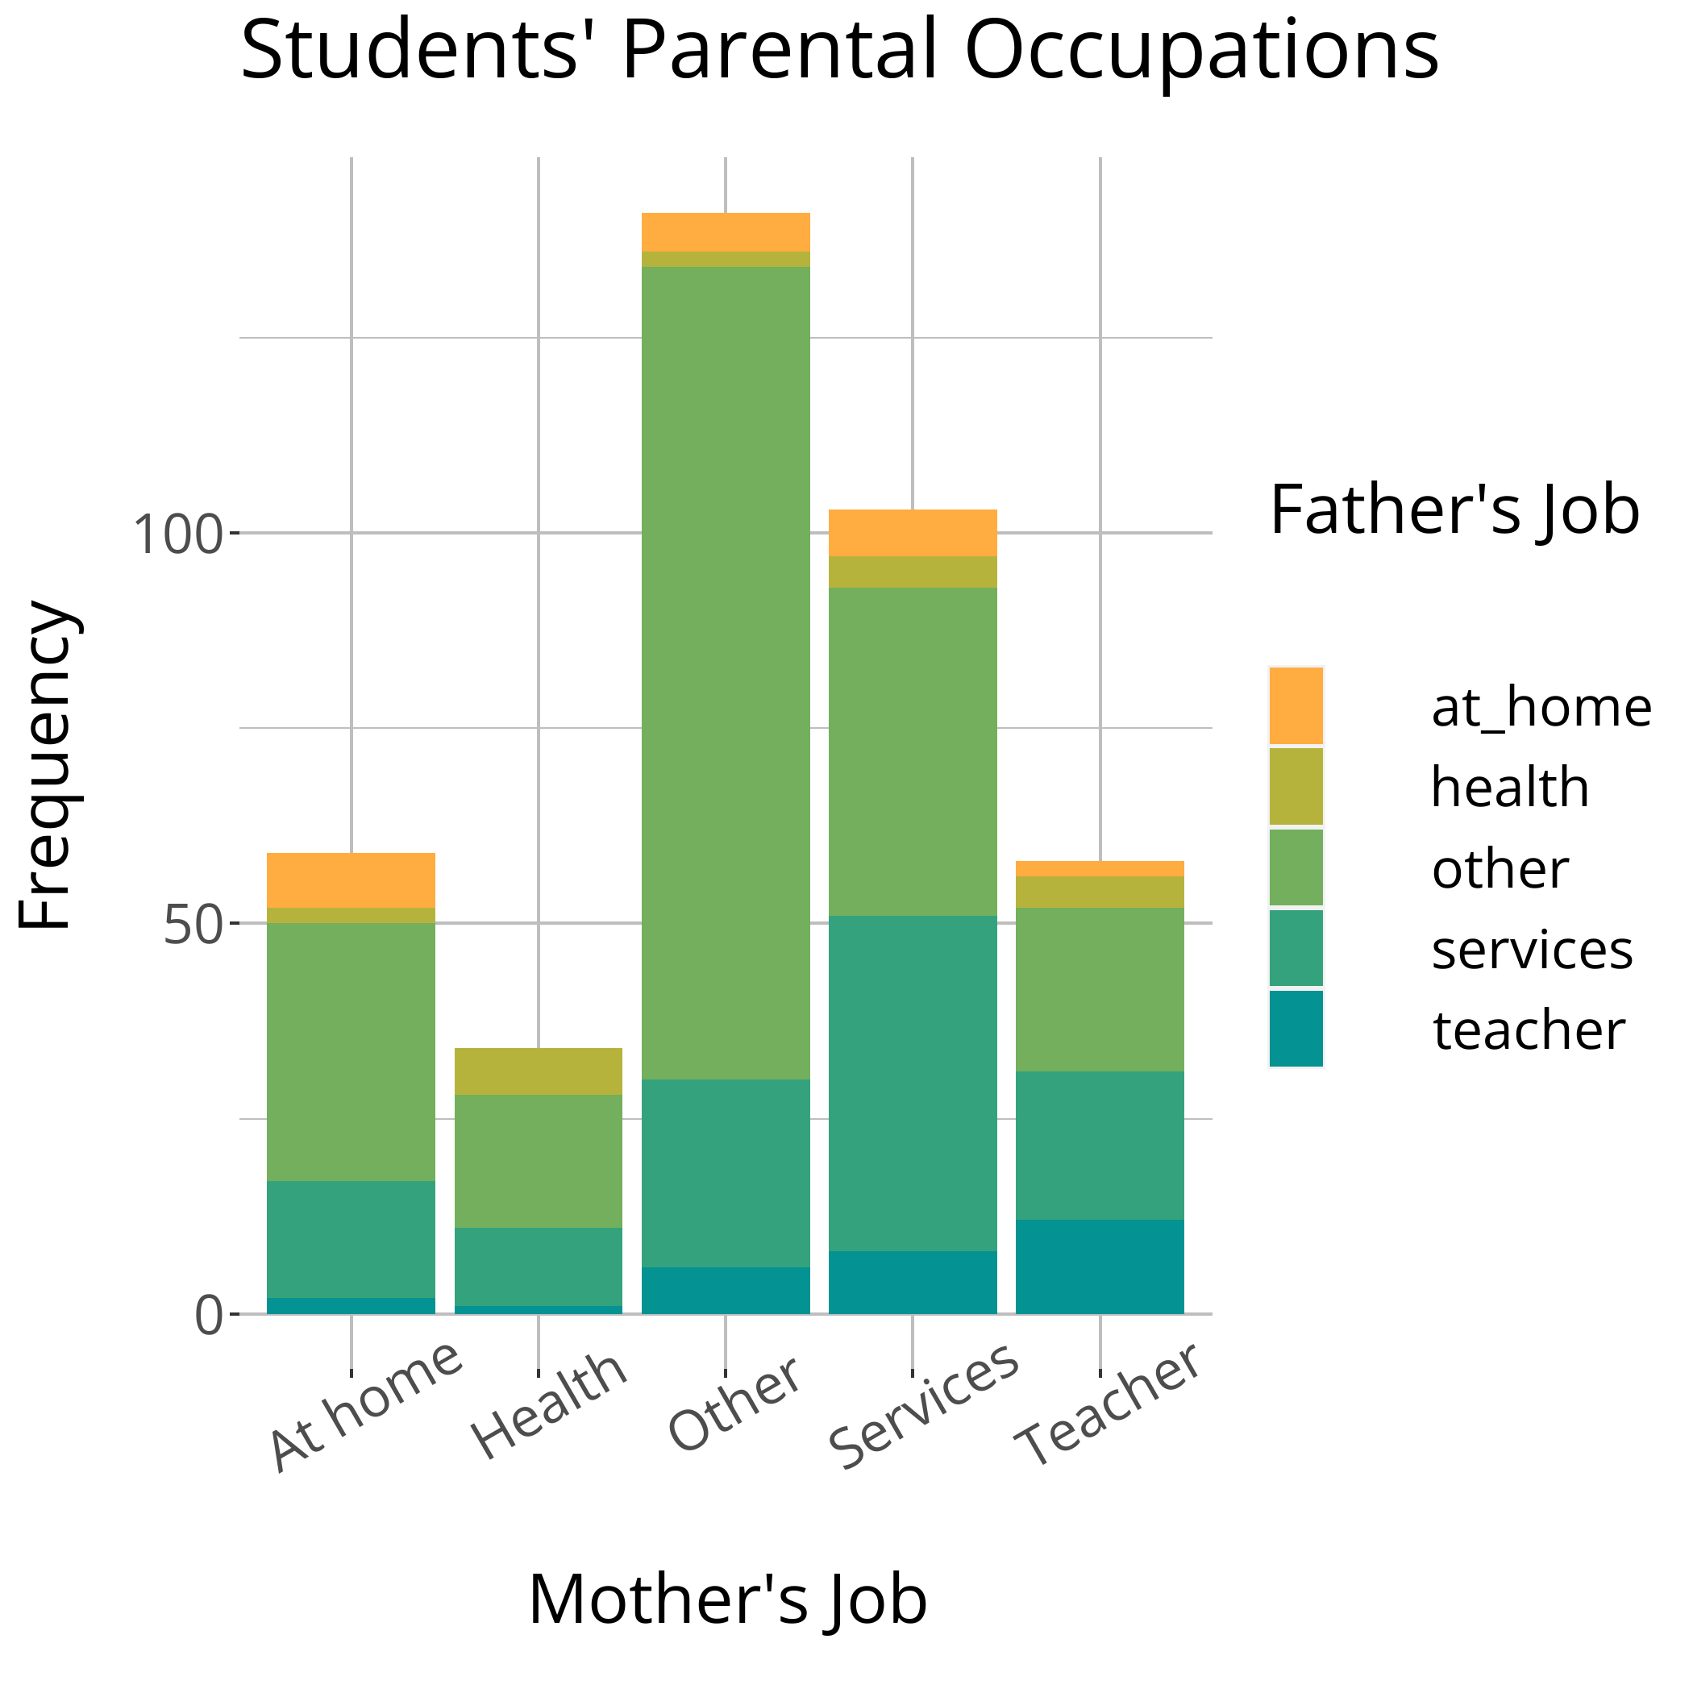
PARENTAL OCCUPATIONS
ANOVA
I found that there was an association at the 0.05 significance level between final grades and the mother’s job
(p = 0.005), but not between final grades and the father’s job
(p = 0.268).

Slide 8
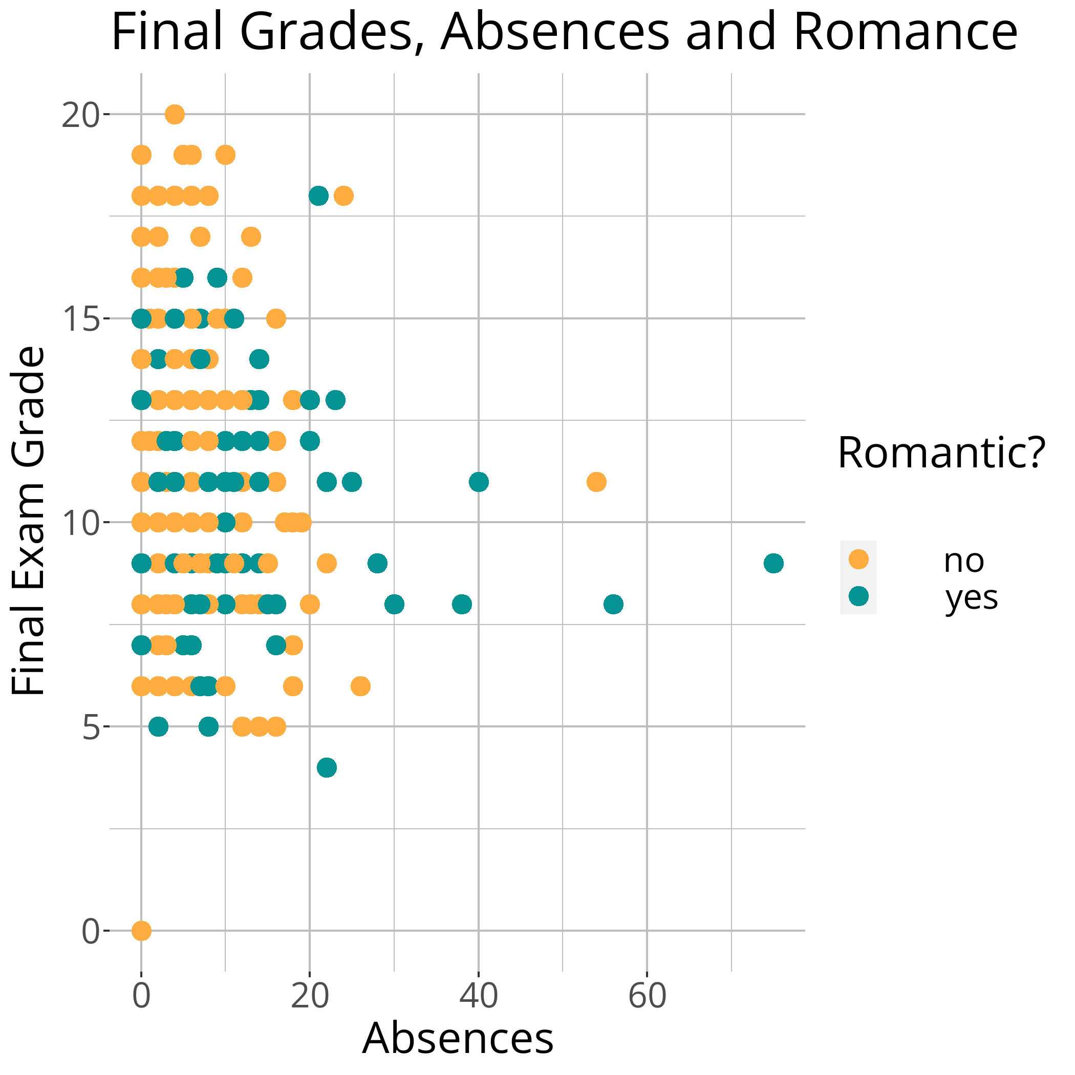
ABSENCES AND ROMANTIC RELATIONSHIPS
ROMANCE
ABSENCES
No statistically significant difference at the 0.05 significance level in mean exam grades for students with and without romantic relationships
(p = 0.070).
No statistically significant difference at the 0.05 significance level in mean exam grades for students with greater than/equal to and less than 20 absences
(p = 0.567).
In both cases, at least one sample was not normally distributed, so a Wilcox test was used for both romantic relationships and absences.

Slide 9
FAMILY RELATIONSHIPS
ANOVA
After conducting an ANOVA test on the data, I was unable to reject the null hypothesis of no association between final exam scores and quality of family relationships
(p = 0.309).
*If graph is not working, put the PowerPoint in slideshow mode.

Slide 10
PREDICTION

Slide 11
MODELING & PREDICTION PROCESS
01
ALL SUBSETS
02
SELECT MODELS
03
PREDICTIONS
04
CLASSIFICATION
I first tested every possible subset of predictors using the regsubsets function.
The two models (4 and 5 predictors) with the best Cp & BIC values were chosen to prevent overfitting.
I then used the two models to predict the exam scores of the students in the test data.
Then, I assigned each test observation a class based on its predicted exam score.

Slide 12
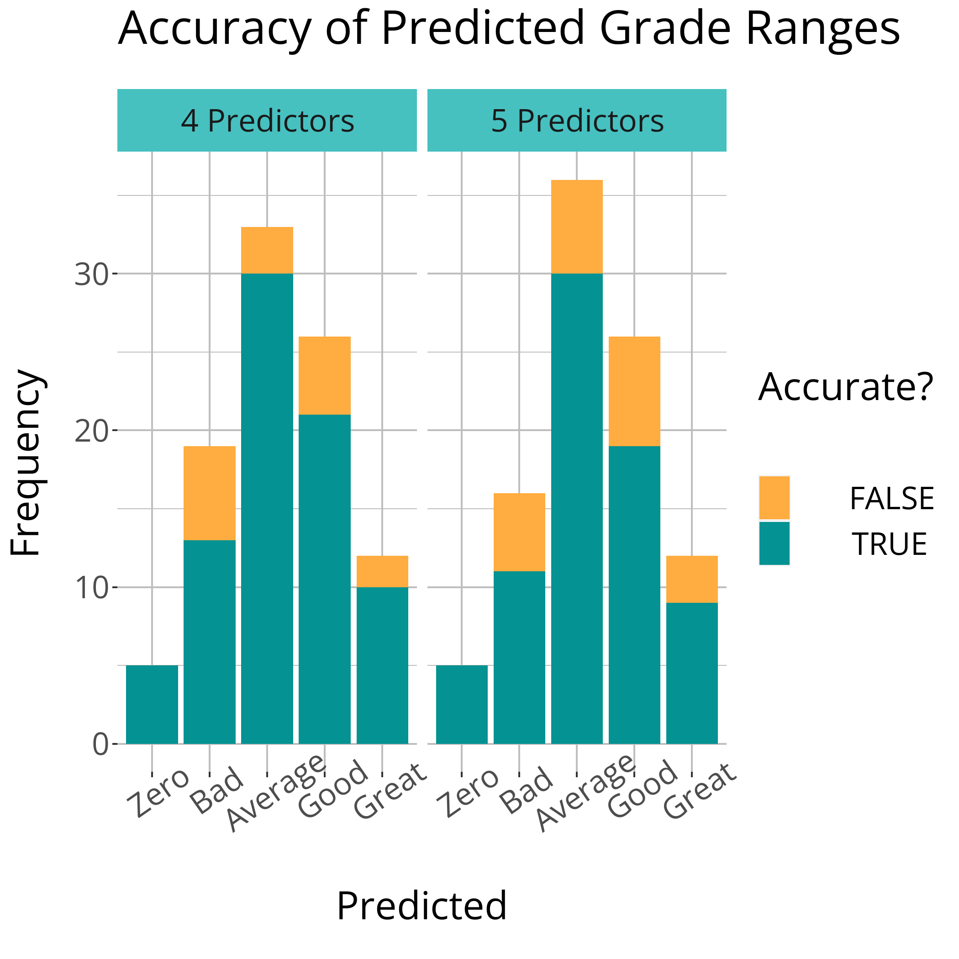
LINEAR MODEL PERFORMANCE
ACCURACY
ACCURACY
The 4-predictor model was 83.2% accurate.
The 5-predictor model was 77.9% accurate.
FEATURES
FEATURES
The student’s age, number of absences and previous (2) exam scores
Same as the other model but includes quality of family relationships

Slide 13
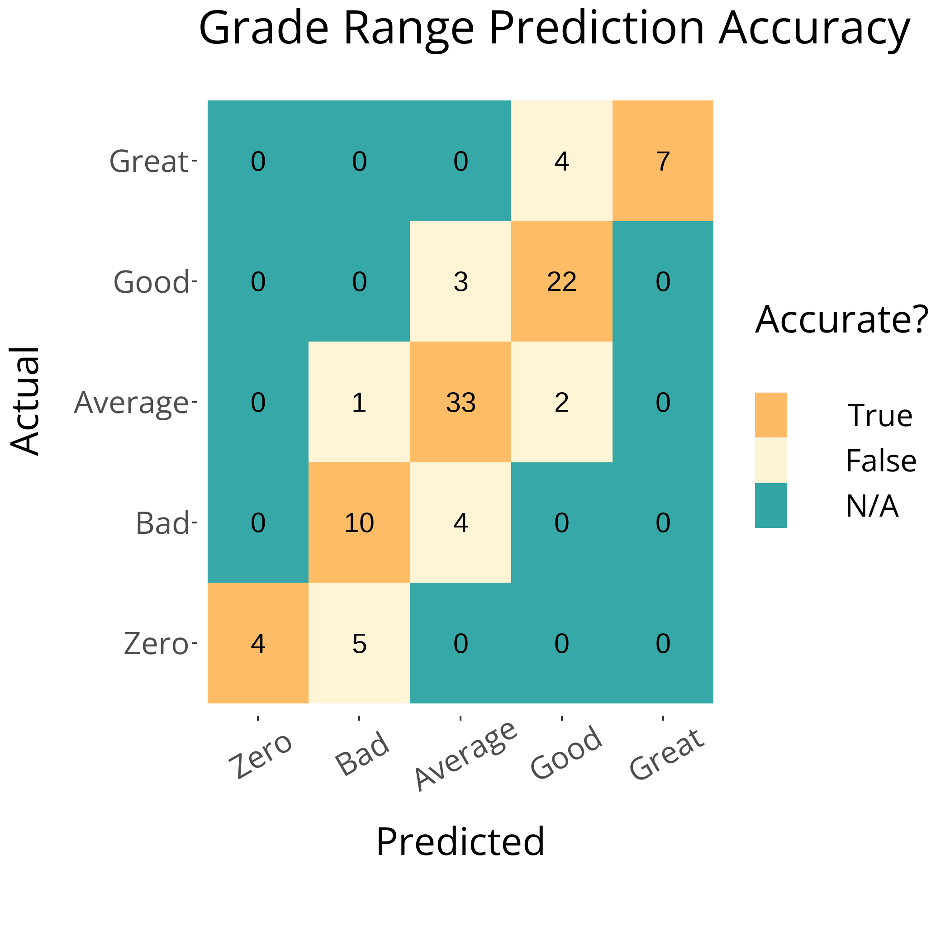
K-NEAREST NEIGHBORS
I also used a k-nearest neighbors algorithm with optimal k = 5 found by using leave-one-out cross validation. This resulted in 80% accuracy when predicting on the test data. All predictions were accurate to within one grade range.

Slide 14
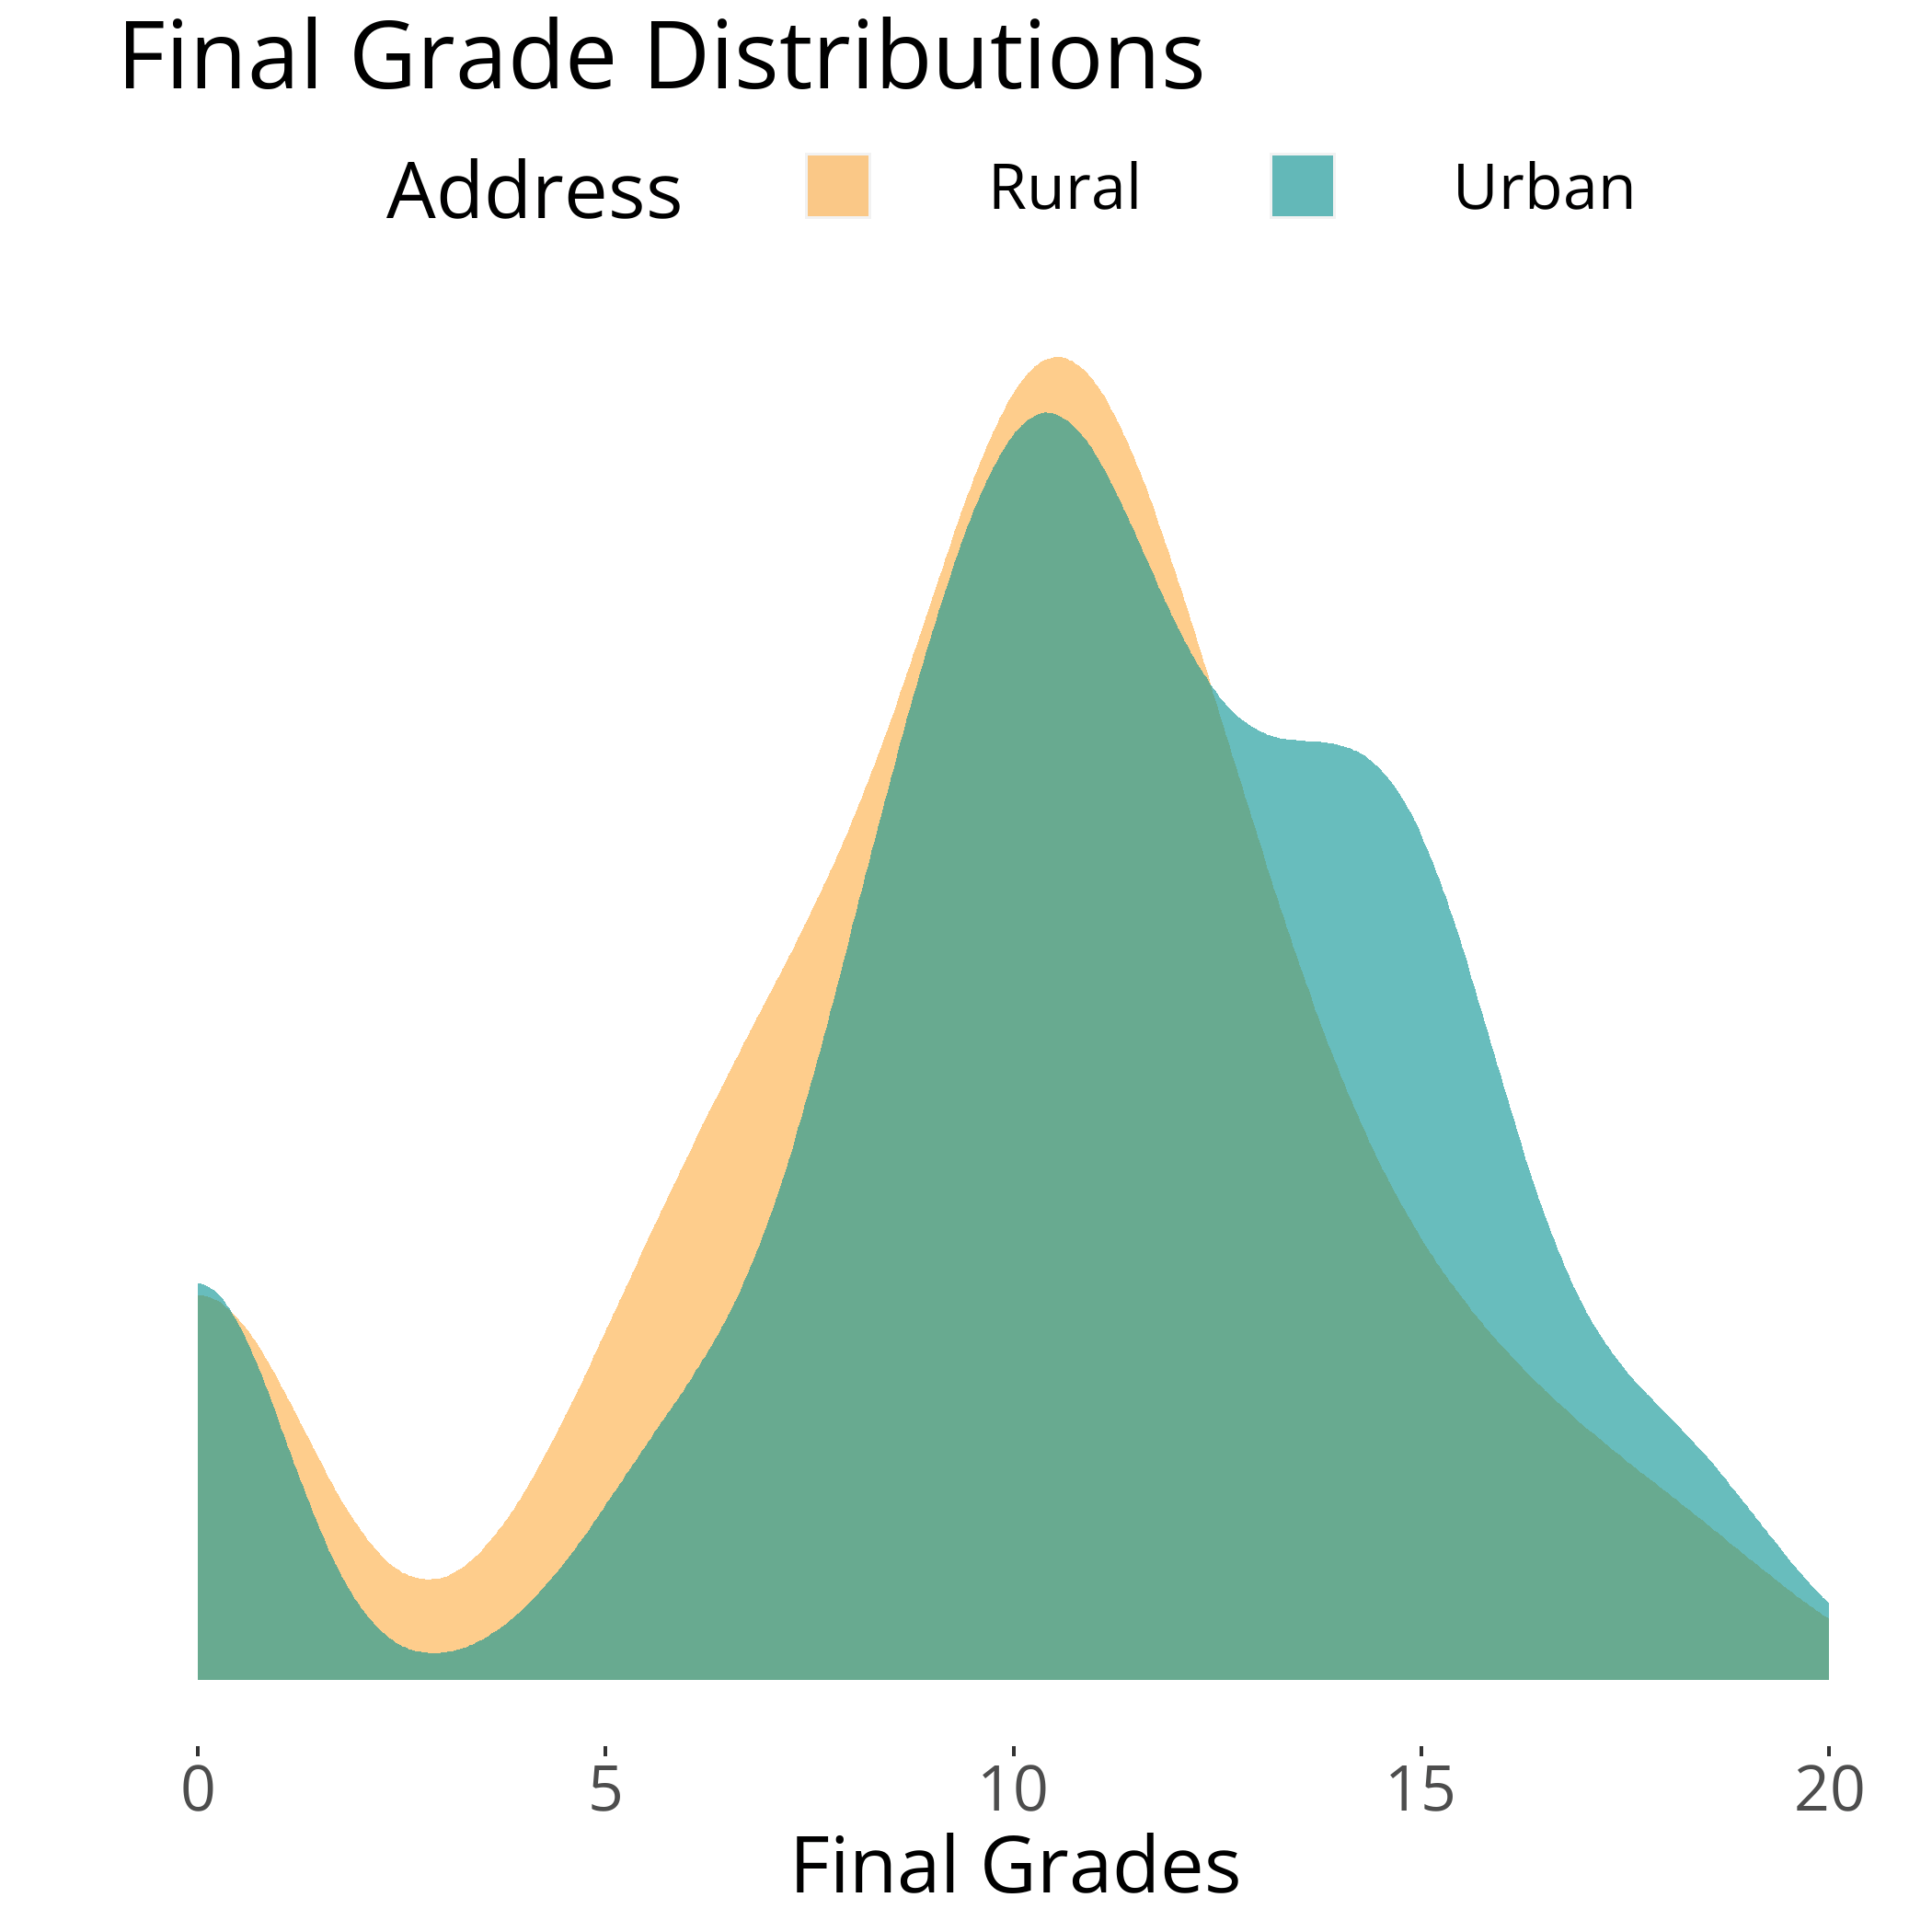
MODELING LIMITATIONS
Although the models were relatively successful, there are some inherent obstacles in trying to predict test scores:
Everyone has a different level of test-taking ability and work ethic, so even if two people grew up in similar environments, they may have radically different test scores.
People can change how much effort they put in. For example, one student scored a 12 on the first exam, but had zeros for the second and third (final) exam.
The distribution of final grades led to some linear model assumption violations, which may have resulted in less accurate predictions on the test data.

Slide 15

ABOUT ME
RYAN PRESNELL
Junior at UNC Chapel Hill
Anticipated Graduation – 2023
Statistics Major
Data Science Minor

Slide 16
THANKS!
Please keep this slide for attribution

