Slide 1
Predicting Credit Card Eligibility
Ryan Presnell

Slide 2
Data Source
I found the main data set, containing data such as family structure and debt levels, and its accompanying credit history data set on Kaggle. I also introduced some extra features, such as a variable indicating whether a person had an overdue credit card/loan payment for more than five months.

Slide 3
Exploratory Data Analysis

Slide 4
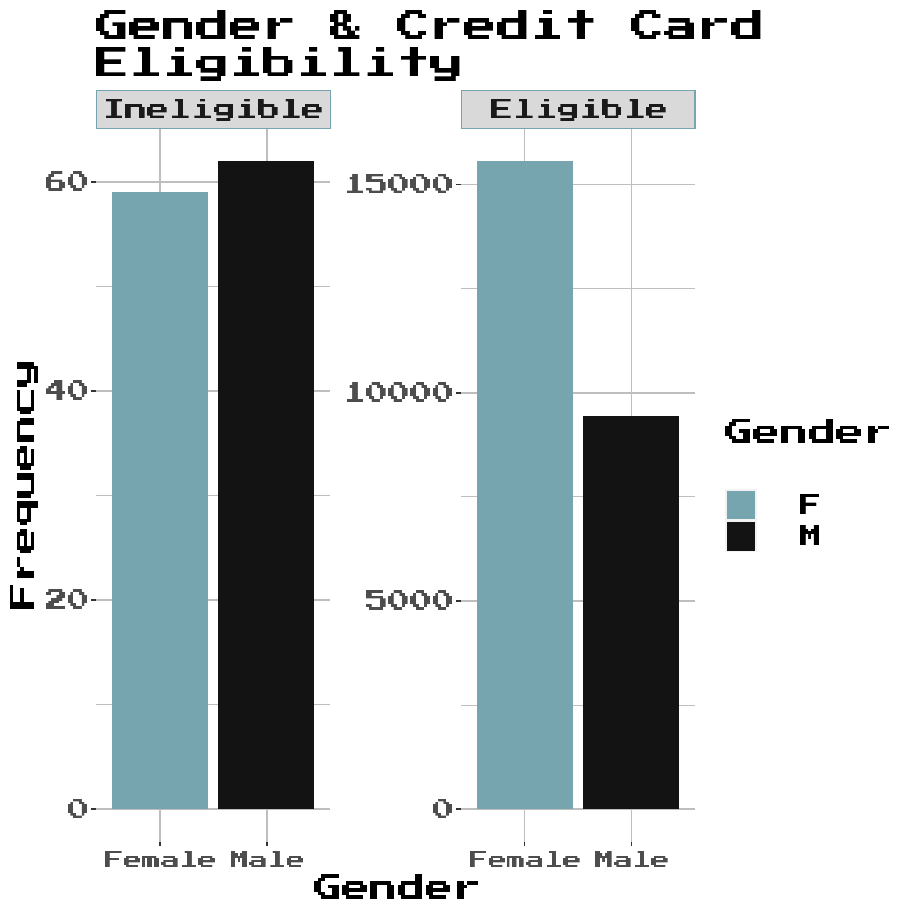
Gender Distribution
Men seem to have a much higher rate of credit card ineligibility than women in this data set.

Slide 5
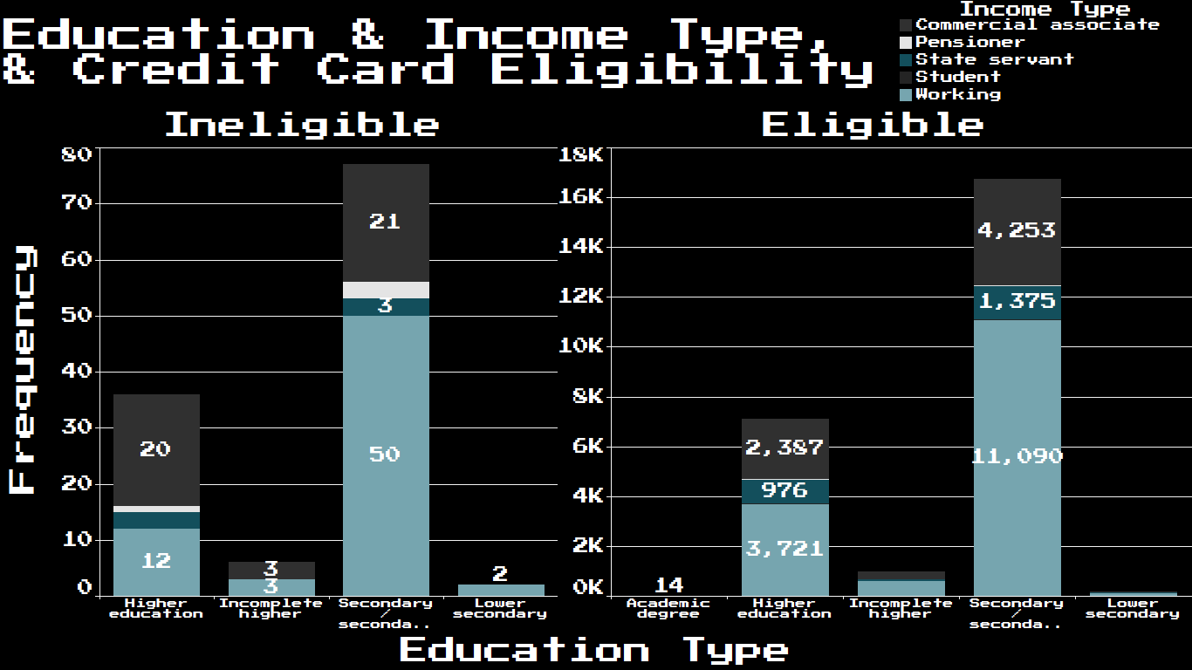
Education & Income Type
The distributions of education and income type are extremely similar between the two groups, so education and income type likely do not play a significant role in determining if a person will be eligible for a credit card.

Slide 6
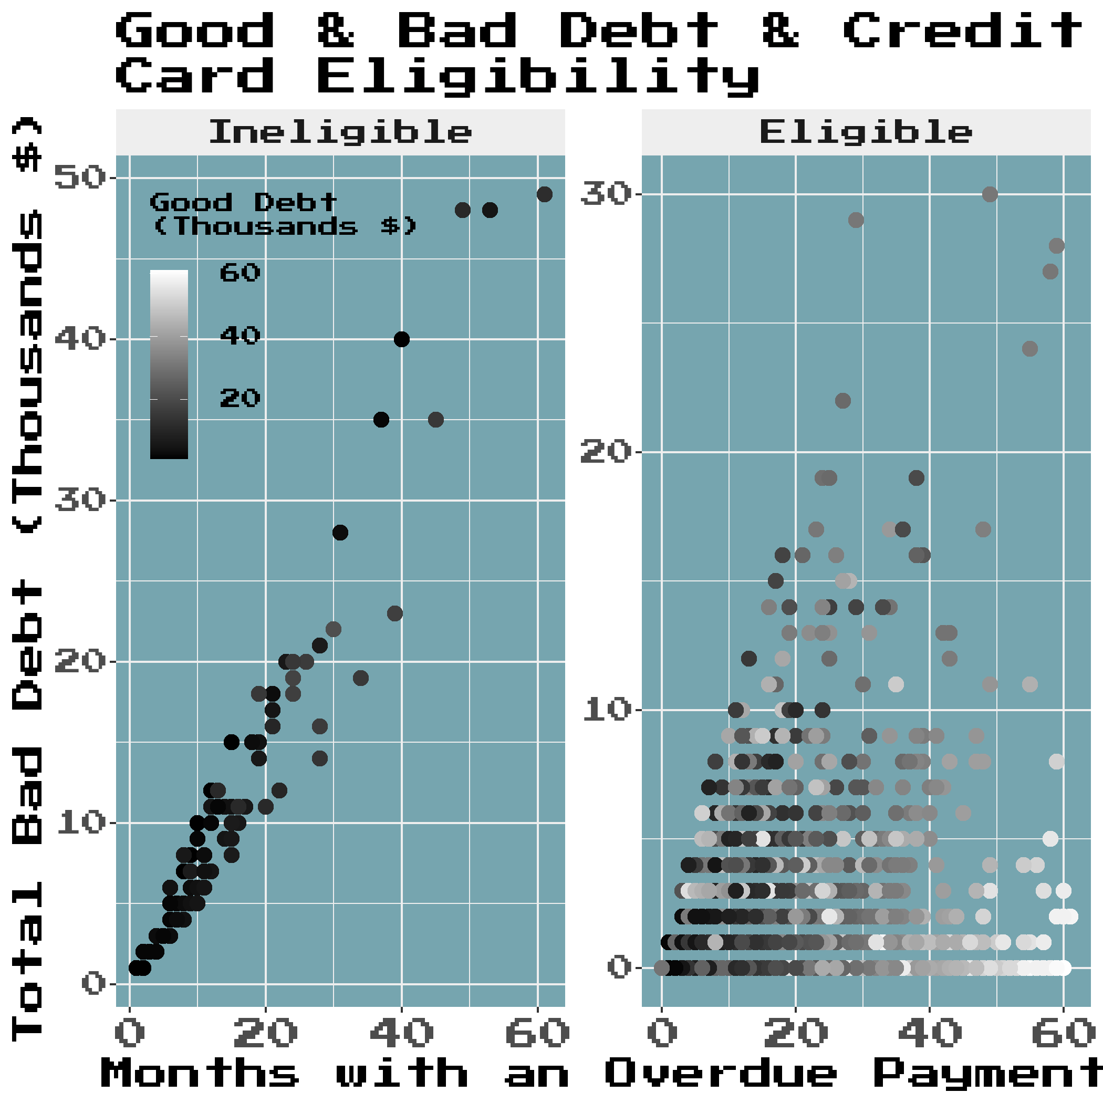
Good & Bad Debt
People who were ineligible for a credit card tended to have much less good debt, and their bad debt tended to skyrocket when they didn’t make payments on time.

Slide 7
Predicting Eligibility

Slide 8
Other Predictions

Slide 9
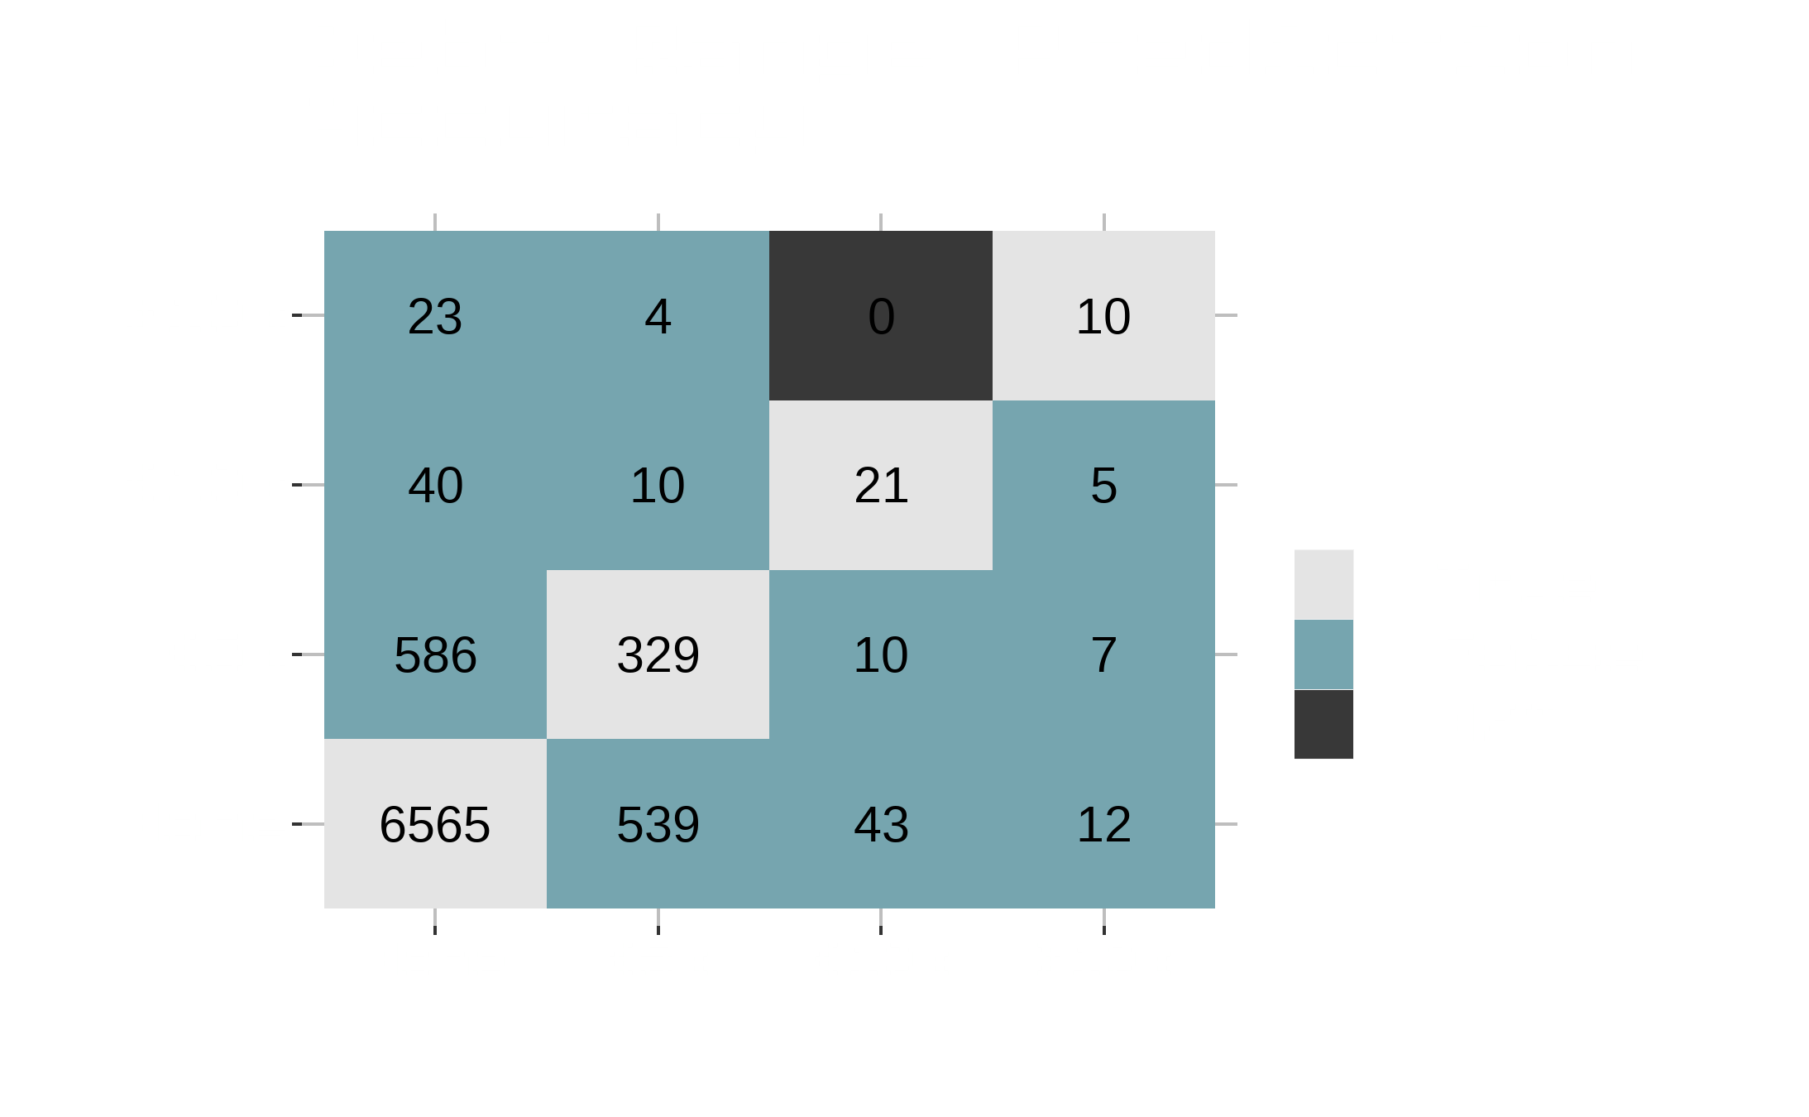

Slide 10
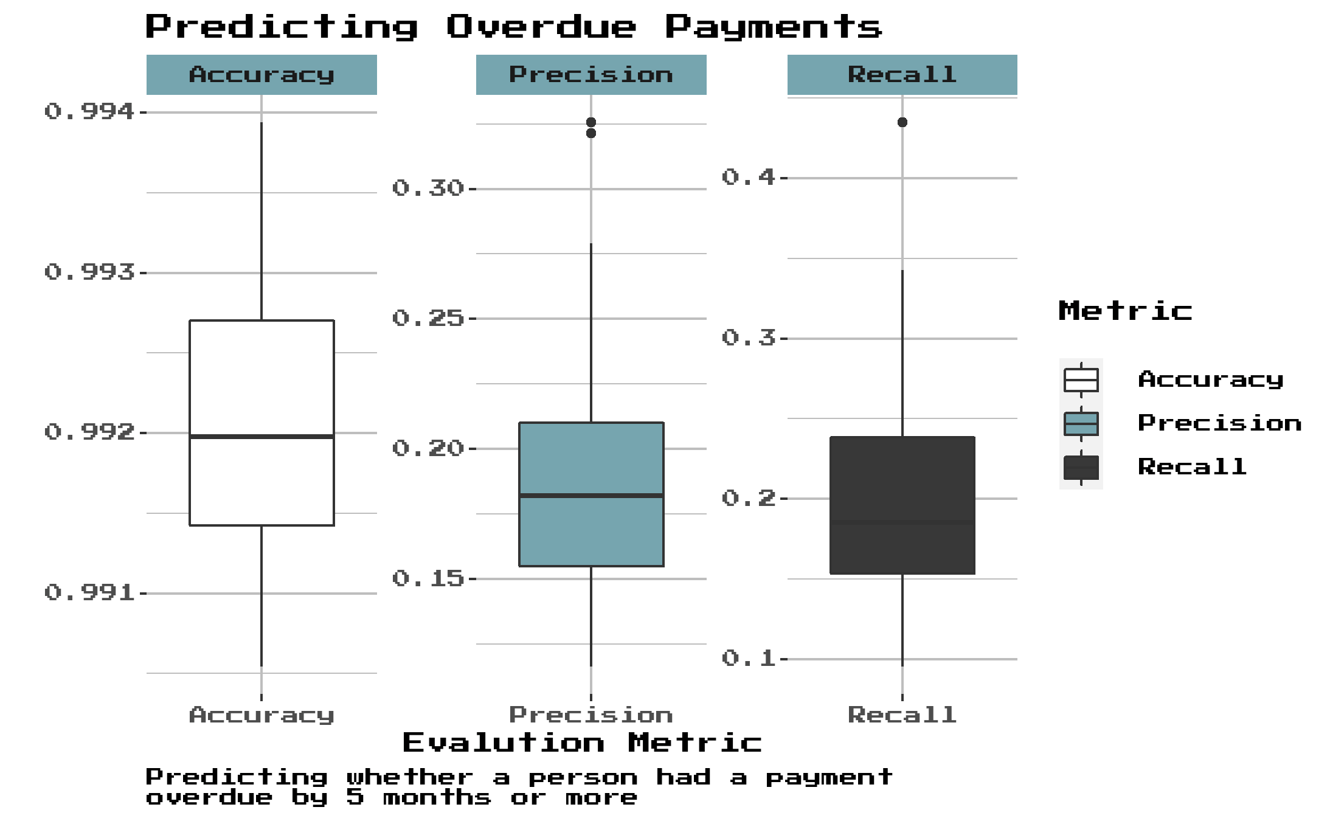
Credit reports typically stop showing delinquencies after about 7 years
Possibly act as a “red flag” for applicants without an extensive credit history?
Used KNN (Optimal k = 1 found by LOOCV)
Naïve Bayes, Logistic Regression, and Decision Trees predicted all zeroes
Doesn’t seem to work very well

Slide 11

NAME:RYAN PRESNELL
SCHOOL: UNIVERSITY OF NORTH CAROLINA AT CHAPEL HILL
EXPECTED GRADUATION: MAY 2023
MAJOR: STATISTICS & ANALYTICS
MINOR: DATA SCIENCE
ABOUT ME

Slide 12
Thank you!

Slide 13
Credits
Presentation Template: SlidesMania
Images: Unsplash
Please keep this slide or mention us and the other resources used in the footer of a slide.

