Slide 1
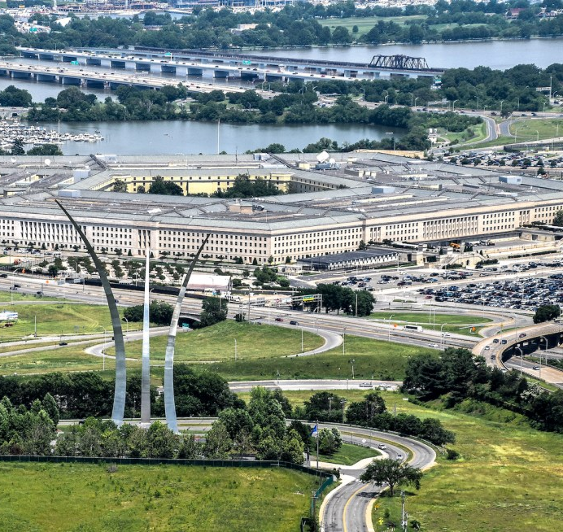
DLA Contract Quality Review
The UiPath word mark, logos, and robots are registered trademarks owned by UiPath, Inc. and its affiliates. UiPath (R) is a registered trademark in the United States and several countries across the globe. See TMEP 906. ©2025 UiPath. All rights reserved.
Notes:
Pat
[Sources] - User-provided reference deck: Master_Preso_DLA_EBC_July29_2026.pptx (visual template and title image). [/Sources]

Slide 2

Contract quality review Manual workflow
Contract Quality Review
Contract package
Human
Collect contract package
Human
Extract contract evidence
Human
Apply business rules
Human
Review findings
Human
Record outcome
Review complete
Human
Verify required forms
Human
Read DD2579 and both SF1449 records
Human
Compare NAICS, PSC, and size
Human
Resolve missing or conflicting evidence
Human
Write reviewer notes
Human
Locate optional SAAD
Human
Calculate SAM timing
Human
Determine pass or flag
Human
Assemble audit evidence
Human
Capture dates, codes, and CLIN data
Human
Locate D&F when needed
Human
Agent
Robot
2
Notes:
[Sources] - Local project business rules and UiPath solution artifacts in C:/Users/ryan.sikand/DLA_Vibronyx_POC. - User-provided reference deck: Master_Preso_DLA_EBC_July29_2026.pptx (process-map layout). [/Sources]

Slide 3
Contract quality review UiPath agentic workflow
Maestro Orchestration
Document upload
Robot
Document intake
Robot
Document Understanding
Agent
Consolidate evidence
Agent
Validate contract quality
Robot
Publish results
Results available
Robot
Validate package inputs
Robot
Extract DD2579, two SF1449s, SAAD, and D&F
Agent
Combine file-level JSON
Agent
Run five grounded checks
Robot
Create one-sheet Excel report
Robot
Stage source files
Agent
Use Data Fabric as fallback
Human
Review pass / flag findings
Robot
Save to SharePoint and storage
Robot
Upsert records by filename
Robot
Start Maestro process
Human
Agent
Robot
3
Notes:
[Sources] - Local DLA Contract Quality Review UiPath solution: Maestro BPMN, Modern Document Understanding workflows, Contract Validation Agent, Data Fabric integration, and Excel export workflow. - User-provided reference deck: Master_Preso_DLA_EBC_July29_2026.pptx (upgraded process-map layout). [/Sources]

Slide 4
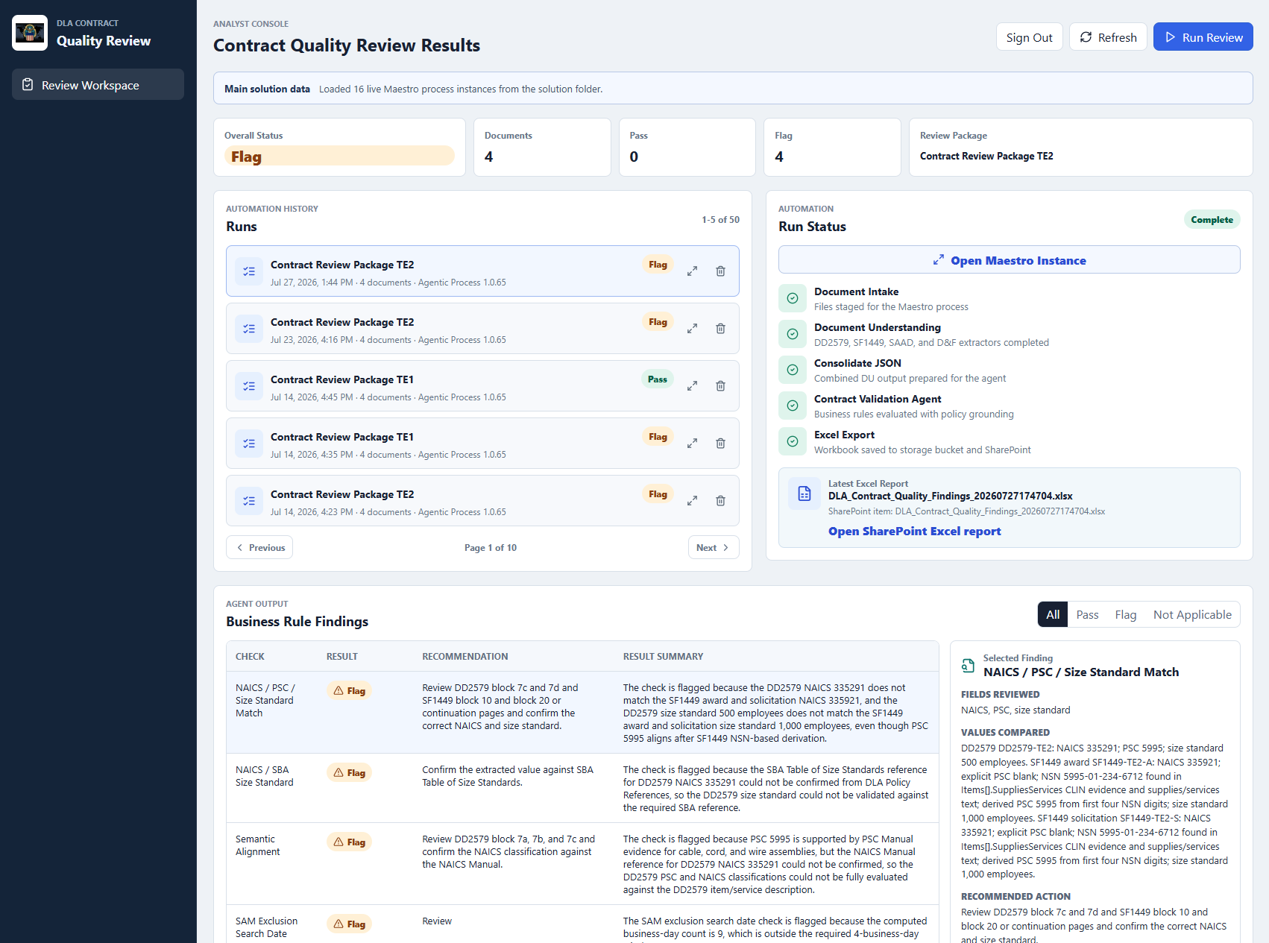
Quality Review
DLA Contract
Single-package document intake
Five repeatable, grounded quality checks
Live Maestro status and run history
Explainable findings with Excel evidence
Notes:
Pat
[Sources] - User-provided DLA Contract Quality Review app screenshot: codex-clipboard-d784dbba-fdde-42f8-b7da-e96e087c3e52.png. - Local DLA Contract Quality Review UiPath solution for workflow and outcome descriptions. - User-provided reference deck: Master_Preso_DLA_EBC_July29_2026.pptx (product outcome layout). [/Sources]

