Slide 1
HIPAAChecker: Automating Compliance in Mobile Health Applications
COSC6998: Professional Project
By: Ryan Ramirez
Advisor: Sheikh Ahamed Iqbal

Slide 2
Project Introduction & Objective
Goal: To analyze and validate HIPAAChecker as a static analysis tool for automating HIPAA compliance verification
Scope: Evaluate the framework’s effectiveness across a curated dataset of mobile and web applications
Purpose: Demonstrate HIPAAChecker’s viability as an accessible, developer-focused solution to reduce the burden of security validation

Slide 3
The Problem: A Gap in Compliance
Over 300,000 health-related apps are now available, the majority of them are not built by large institutions.
(Source: ORCHA Health, 2025)
Many mHealth applications are deployed without proper validation against HIPAA’s technical safeguards
Traditional compliance audits are time-consuming, and often too costly for small to mid-sized teams.
This creates a vulnerability gap between regulation requirements and the practical tools available to developers.

Slide 4
Prior Research & Market Need
Studies of 200 Android and 200 Laravel apps found widespread non-compliance, with over 86% failing to meet minimum HIPAA expectations.
Common failures included weak encryption, lack of access control, and insecure data transmission.
Enterprise-level tools like IBM Guardium and Secureframe exist but are not designed for in-development implementation, and are often inaccessible due to cost.

Slide 5
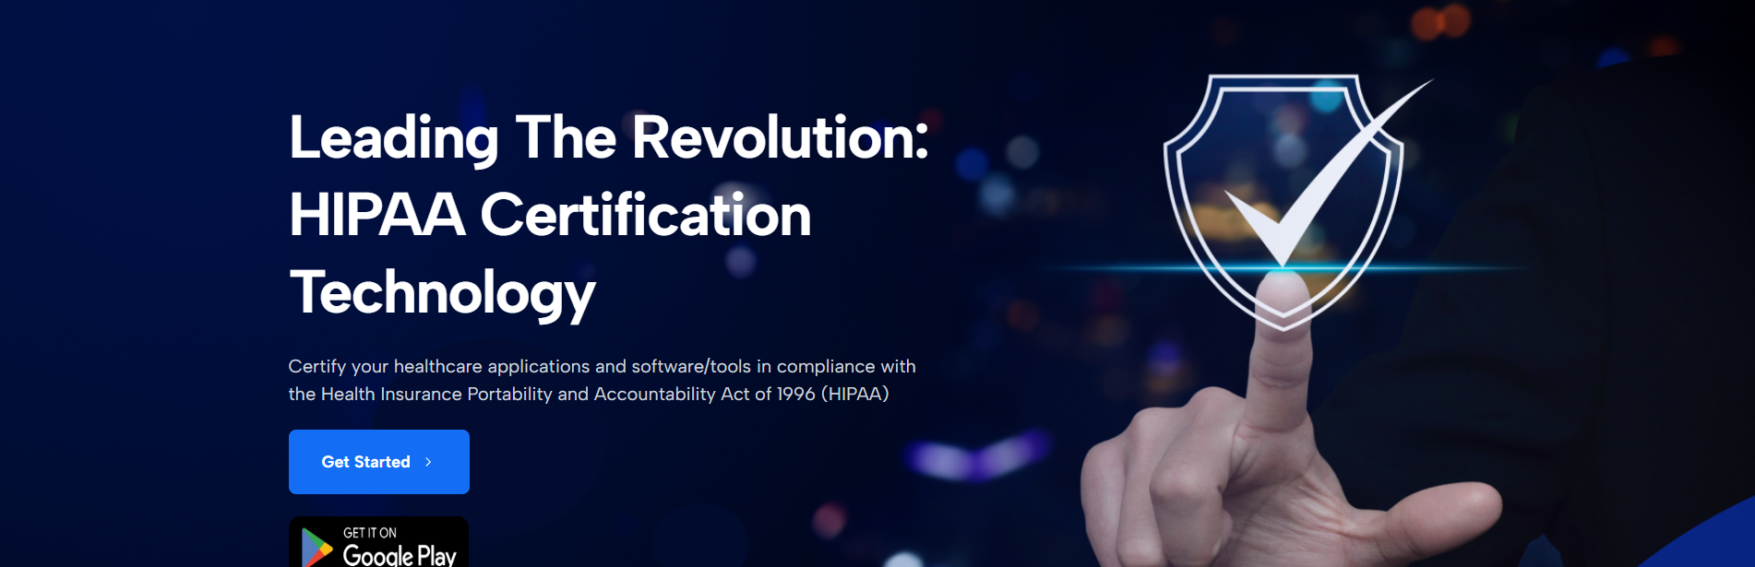
The Solution: Introducing HIPAAChecker
Automated & Efficient
Developer-Focused
Accessible
Actionable Feedback

Slide 6
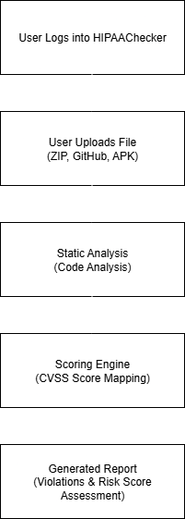
Methodology: How HIPAAChecker Works
UPLOAD: User uploads a project (GitHub link, ZIP file, or installed Android APK)
ANALYZE: A rule-based engine performs static analysis on the code without executing it.
CVSS SCORE: Implementation patterns are mapped to12 technical safeguard checks and assigned a severity score using the Common Vulnerability Scoring System (CVSS)
REPORT: A report is generated with flagged violations and plain-language descriptions

Slide 7





Key Features & Platform Support
Web Portal: Browser-based interface for easy uploading and report viewing
On-Device Android Scanning: Scans installed mHealth apps directly from device, without needing the source code
Cross-Platform Support: Analyzes mobile apps for Android, as well as web applications build on numerous frameworks: Laravel, Django, and .NET

Slide 8
Common Safeguard Violations
Safeguard Category | Implementation Flaw
Access Control | Lack of role enforcement, missing authorization middleware
Authentication | Use of weak or hardcoded credentials
Transmission Security | Incomplete HTTPS/TLS implementation
Data-at-rest Encryption | Storage of sensitive data as plain text
Audit Controls | Lack of audit logging
Session Management | Improper session handling

Slide 9
Overall Risk Scores
App ID | App Name | Platform | Overall Risk Score | Risk Level
PYTHON001 | Ehr-Django | Python-Django | 25.7/100 | Medium
LARAVEL001 | Lhr-ehr-laravel | Laravel | 41.4/100 | Medium
DOTNET001 | Hospital-Mgmt system | .NET | 43.7/100 | Medium
JAVA001 | Healthcare Mgmt | Spring Boot | 63.8/100 | High

Slide 10
Risk Breakdown Per Category
App Name | Insufficient Authorization | Inadequate Data Security | Insecure Network Comm. | Inconsistent Audit Trail
Ehr- Django | 16.8% | 15.3% | 30.0% | 44.4%
Lh-ehr-laravel | 10.0% | 0.0% | 75.0% | 100%
Hospital-Mgmt | 22.6% | 36.6% | 13.3% | 100%
Healthcare Mgmt. | 10.4% | 66.8% | 82.8% | 100%
3 out of 4 apps scored 100% Risk for ‘Inconsistent Audit Trail’

Slide 11

Discussions & Implications
HIPAAChecker successfully distinguishes security posture variations across a variety of different platforms
Even applications with “Medium” risk scores often had significant failures in one or more categories, such as a complete lack of audit trails
This validates that most compliance gaps stem from an oversight in implementing available security features, not just framework limitations.

Slide 12
Limitations
Application Loading Failures: The tool would occasionally fail to load or extract certain non-listed applications.
Usability Issues: During testing, the user session would sometimes reset unexpectedly. Additionally, generated reports cannot be exported.
Lack of Report Synchronization: The web portal and on-device Android scanner do not sync reports, requiring manual cross-referencing.

Slide 13
Conclusions & Future Work
HIPAAChecker is a viable and efficient platform that successfully lowers the barrier to HIPAA compliance for developers
Contribution: The project validates the tool’s ability to provide actionable insights into common vulnerabilities, promoting more secure application design
Future work: Completing iOS version, dynamic analysis in scanning engine, secured funding to commercialize platform.

Slide 14

Thank You

