Slide 1
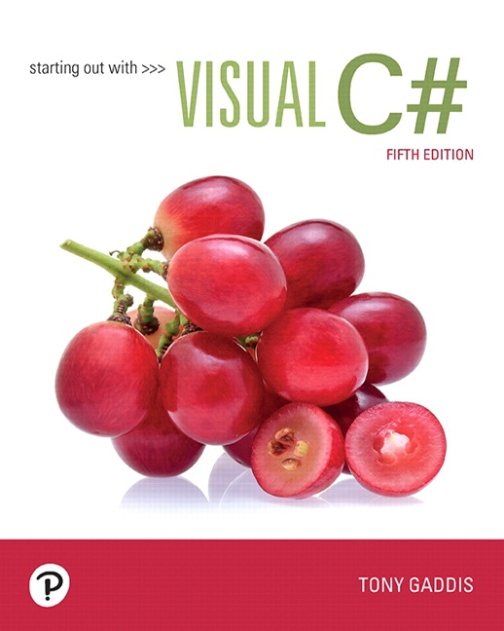
Starting out with Visual
Fifth Edition
Chapter 1
Introduction to Computers and Programming
Notes:
If this PowerPoint presentation contains mathematical equations, you may need to check that your computer has the following installed:
1) MathType Plugin
2) Math Player (free versions available)
3) NVDA Reader (free versions available)

Slide 2
Topics
1.1 Introduction
1.2 Hardware and Software
1.3 How Computers Store Data
1.4 How a Program Works
1.5 Graphical User Interfaces
1.6 Objects
1.7 The Program Development Process
1.8 Getting Started with the Visual Studio Environment

Slide 3
1.1 Introduction
A program is a set of instructions that a computer follows to perform a task
Programs are commonly referred to as software
Without software, computers cannot do anything
Programmers, or software developers, create software
They are people with the training and skills necessary to design, create, and test programs
This book introduces fundamental programming concepts using

Slide 4
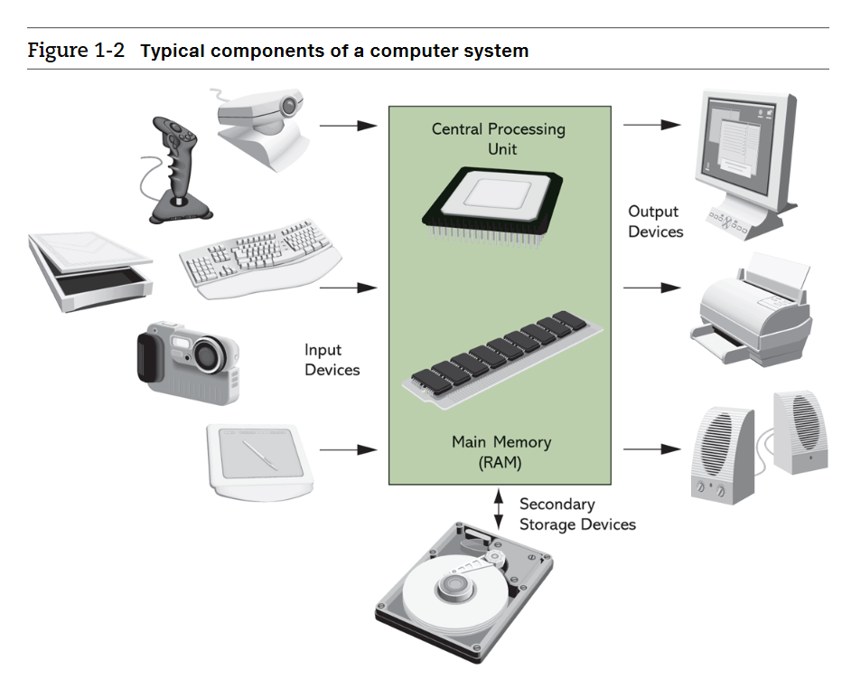
1.2 Hardware and Software
Hardware refers to all physical devices
A computer consists of many pieces of hardware that all work together
Each piece of hardware does its own work
A typical computer system contains:
The CPU
Main memory
Secondary storage
Input devices
Output devices

Slide 5
The C P U
The central processing unit is the part that actually runs programs
The most important part of a computer
Today CPUs are microprocessor
Commonly used CPU vendors are Intel and AMD

Slide 6
Main Memory
The computer’s work area
Where the computer loads instructions of programs and data for processing
Commonly known as RAM, random-access memory
Designed for C P U s to quickly access data stored at any random location in the RAM
They are a volatile type of memory
When the computer is powered off, the contents in RAM are erased

Slide 7
Secondary Storage Devices
Devices that can hold data for long periods of time, even when the power is off
Where important data and system files are stored
Most commonly used is the disk drive which stores data by magnetically encoding it onto a circular disk
Solid state drives have no moving parts, and operate faster than a traditional disk drive.
Optical devices such as D V D-ROMs and C D-ROM sare also popular
U S B drives and S D memory cards are small devices that plug into a port

Slide 8
Input Devices
Input is any data the computer collects from people and devices
Devices that collect the data and send them to the computer are called input devices
Commonly used input devices are touch screens, keyboards, mouses, scanners, microphones, and digital cameras

Slide 9
Output Devices
Output is any data the computer produces for people or devices
The device that generates output for a computer is called an output device
Commonly used output devices are screens, speakers, and printers

Slide 10
Software
Categorized mainly into system software and application software
System software are programs that control and manage the basic operations of a computer. Subcategories are:
Operating systems
Utility programs
Software development tools
Application software are programs that perform special tasks

Slide 11
1.3 How Computers Store Data
All data stored in a computer is converted to sequence of 0s and 1s; each sequence is called a bit
A computer’s memory is divided into tiny storage locations called bytes
Eight bits make a byte
Combinations of bits, 0s and 1s, are used to represent characters. For example,
The character ‘A’ is 65 in A S C I I code, which is converted to binary format 1000001
When you press ‘A’, 1000001 will be stored in computer’s memory

Slide 12
Digital Data
“Digital” refers to anything that can only have two possible values
Digital data is the data that is stored in binary.
Digital devices are devices that work with binary data
Computers are digital devices

Slide 13
1.4 How a Program Works
C P U reads instructions written in machine language called instruction set
A program will be copied into memory for C P U to execute
CPU uses the “fetch-decode-execute” cycle for processing
Fetch: Reads instructions from memory
Decode: Decodes the instructions that were just read to determine how to perform operations
Execute: Actually performs the operations

Slide 14
Programming Languages
Machine languages: sequences of 0s and 1s
Assembly languages: use short words known as “mnemonics” to write program
Must be translated by assembler
Still considered low-level languages
High-level languages: more human readable languages that allow programmers to create programs without knowing how C P U works.
Modern languages are high-level

Slide 15
Keywords, Operators, and Syntax
High level languages use keywords that have special meaning and cannot be used for any purpose other than to write programs
Operators are keywords that represent special program functions such as addition, subtraction, and multiplication
Syntax is a set of rules that must be strictly followed to write computer-understandable instructions
Syntax error is a mistake or violation of these rules
Each instruction in a program is called a statement

Slide 16
Compilers and Interpreters
A compiler translates a high-level language program to a separate machine program for CPU to read and execute
Source code: the statements a programmer writes in a high-level language
Compilation: translates a text-based source code to binary codes
Interpreter reads, translates, and executes the instructions of a high-level language program
Examples are PHP, Perl, Python, and ASP.NET

Slide 17
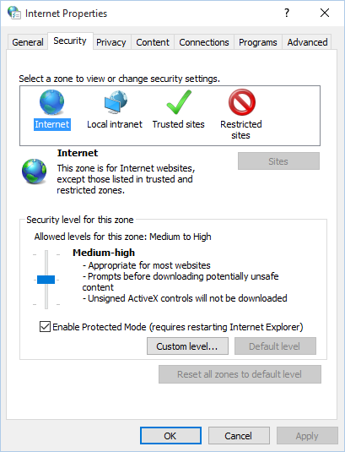
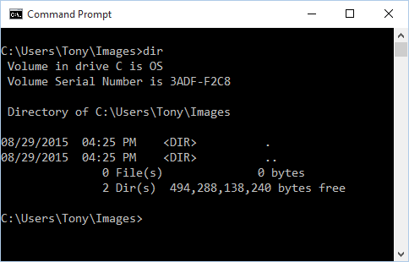
1.5 Graphical User Interface
User interfaces allow users to interact with the computer. Categories are:
Command line interface (aka console interface)
Graphical user interface (GUI)- now the most commonly used

Slide 18
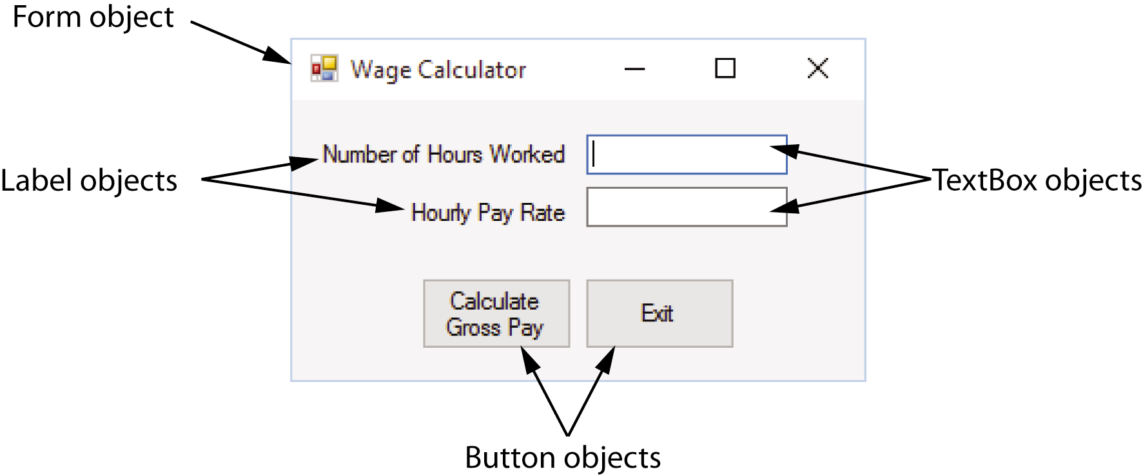
1.6 Objects
Most programming languages use object-oriented programming in which a program component is called an “object”
Program objects have properties (or fields) and methods
Properties – data stored in an object
Methods – the operations an object can perform

Slide 19
Controls
Objects that are visible in a program GUI are known as controls
Commonly used controls are Labels, Buttons, and TextBoxes
They enhance the functionality of your programs
There are invisible objects in a GUI such as Timers, and OpenFileDialog
A class is code that describes a particular type of object

Slide 20
The .NET Framework
The .NET Framework is a collection of classes and other codes that can be used to create programs for Windows operating system is a language supported by the .NET Framework
Controls are defined by specialized classes provided by the .NET Framework
You can also write your own class to perform a special task

Slide 21
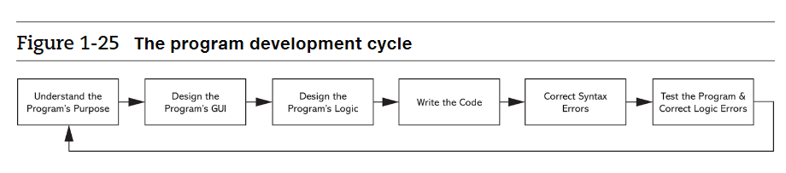
1.7 The Program Development Process
The process of creating a program is known as the programming development cycle
It has six phases:

Slide 22
Understand the program’s purpose
When beginning a new programming project, it is essential that you understand what the program is supposed to do.
Most programs perform the following three-step process:
Step 1. Input is received.
Step 2. Some process is performed on the input.
Step 3. Output is produced.

Slide 23
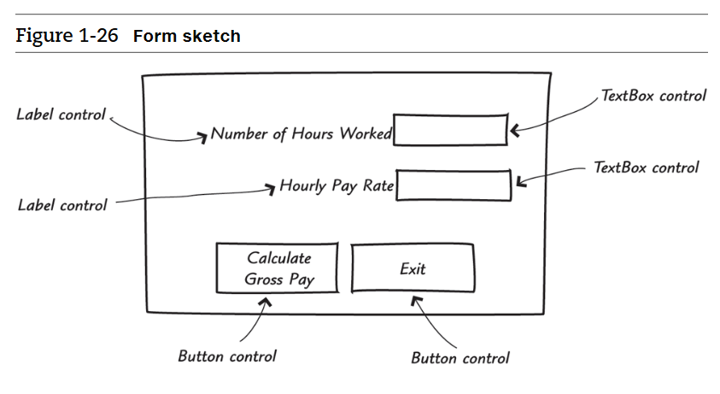
Design the GUI
Once you clearly understand what the program is supposed to do, you can begin designing its GUI.
Often, you will find it helpful to draw a sketch of each form that the program displays.

Slide 24
Design the Program’s Logic
In this phase you break down each task that the program must perform into a series of logical steps. Example:
Step 1. Get the number of hours worked from the appropriate TextBox.
Step 2. Get the hourly pay rate from the appropriate TextBox.
Step 3. Calculate the gross pay as the number of hours worked times the hourly pay rate.
Step 4. Display the gross pay in a pop-up window.
This is an example of an algorithm, which is a set of well-defined, logical steps that must be taken to perform a task. An algorithm that is written out in this manner, in plain English statements, is called pseudocode.

Slide 25
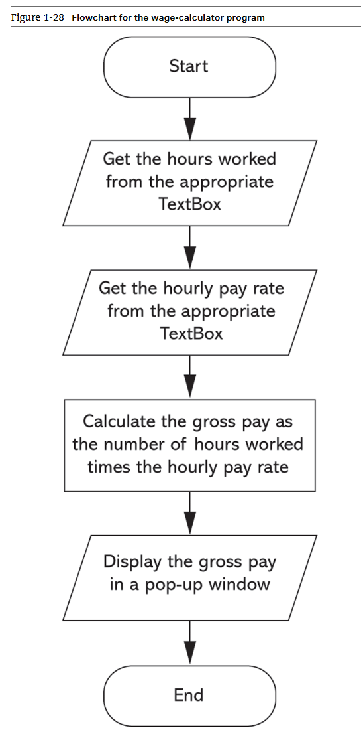
Design the Program’s Logic

Slide 26
Final Steps
Write the Code
Once you have created a program’s GUI and designed algorithms for the program’s tasks, you are ready to start writing code. During this process, you will refer to the pseudocode or flowcharts that you created
Correct Syntax Errors
Test the Program and Correct Logic Errors

Slide 27
Algorithm, Pseudocode, Flowchart
An algorithm is a set of well-defined, logical steps that must be taken to perform a task
An algorithm that is written out in plain English is called pseudocode
A flowchart is a diagram that graphically depicts the steps of an algorithm

Slide 28
1.8 Getting Started with the Visual Studio Environment (1 of 5)
Visual Studio 2017 is a professional integrated development environment (IDE)
The Visual Studio Environment includes:
Designer Window
Solution Explorer Window
Properties Window

Slide 29
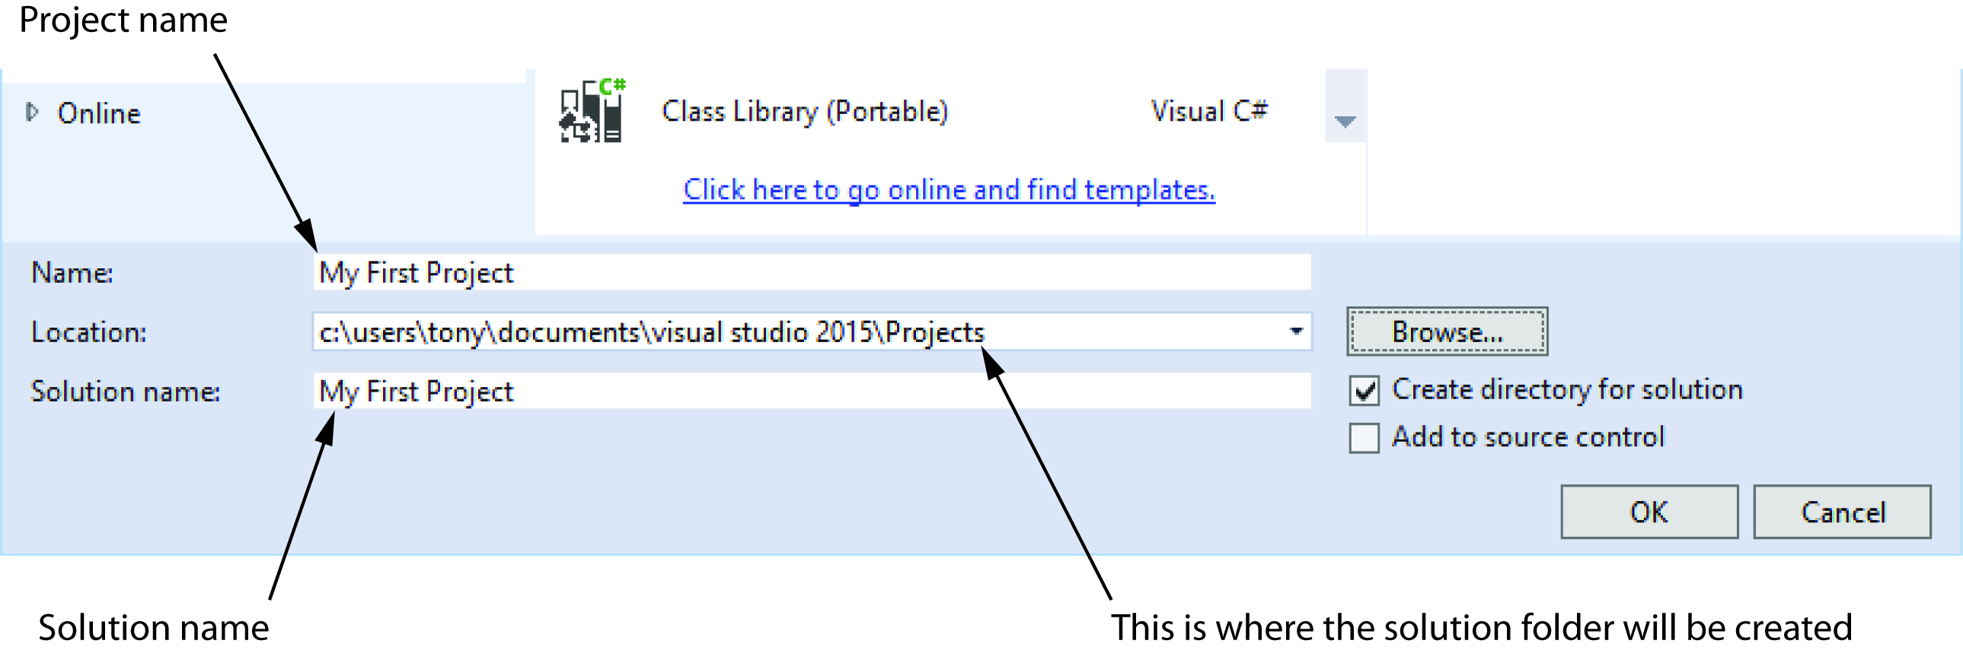
Specifying the Project Name
You can specify the project name the first time you save the project.
CRITICAL: Always know where you are storing your program. See the (Location) section in the below image.

Slide 30
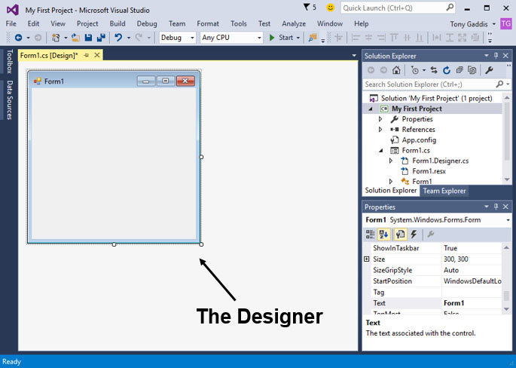
1.8 Getting Started with the Visual Studio Environment (2 of 5)

Slide 31
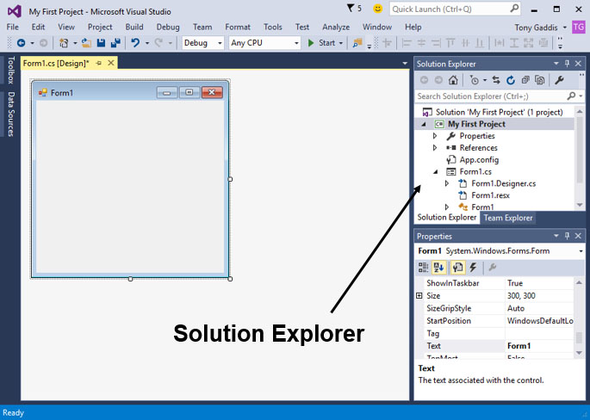
1.8 Getting Started with the Visual Studio Environment (3 of 5)

Slide 32
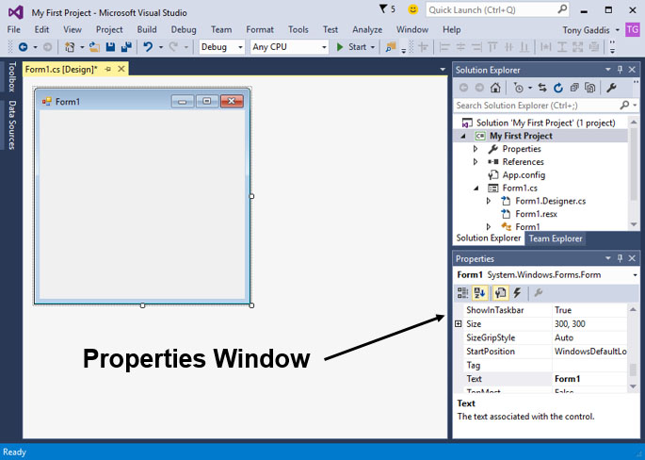
1.8 Getting Started with the Visual Studio Environment (4 of 5)

Slide 33
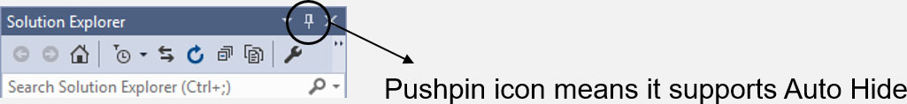
1.8 Getting Started with the Visual Studio Environment (5 of 5)
Auto Hide allows a window to display only as a tab of the edges

Slide 34
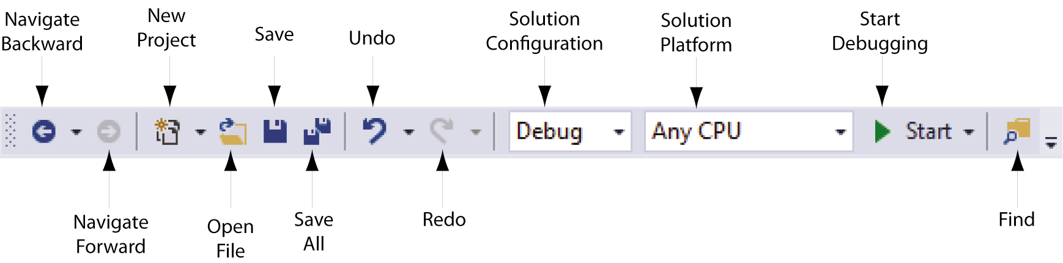
Menu Bar and Standard Toolbar
Menu bar provides menus such as File, Edit, View, Project, etc.
Standard toolbar contains buttons that execute frequently used commands

Slide 35
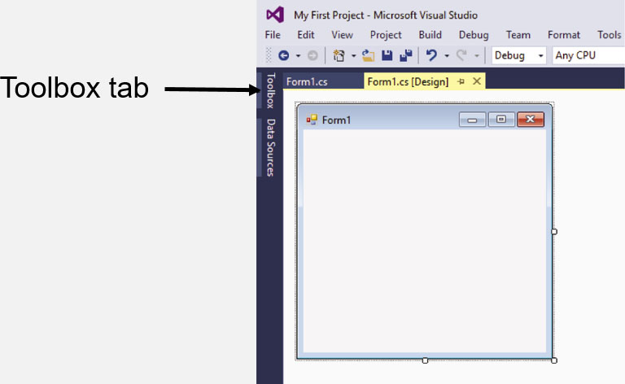
The Toolbox (1 of 2)
Toolbox is a window for selecting controls to use in an application
Typically appears on the left side of Visual Studio environment
Usually in Auto Hide mode

Slide 36
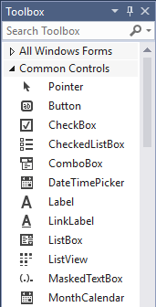
The Toolbox (2 of 2)
Toolbox is a window for selecting controls to use in an application
Divided into sections such as “All Windows Forms” and “Common Controls”

Slide 37
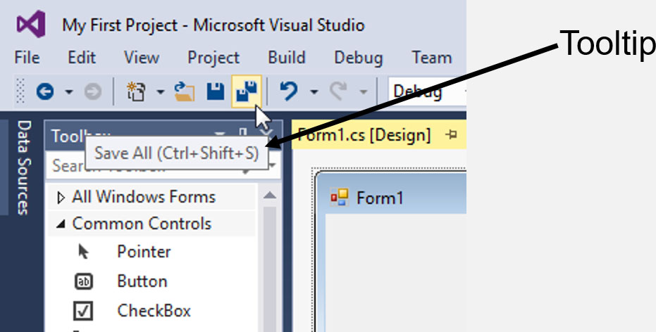
Tooltips
A Tooltip is a small box that pops up when you hover the mouse pointer over an item on the toolbar or toolbox.

Slide 38
Docked and Floating Windows
When a window such as Solution Explorer is docked, it is attached to one of the edges of the Visual Studio environment
When a window is floating, you can click and drag it around the screen
A window cannot float if it is in Auto Hide mode
Right click a window’s title bar and select Float or Dock to change between them

Slide 39
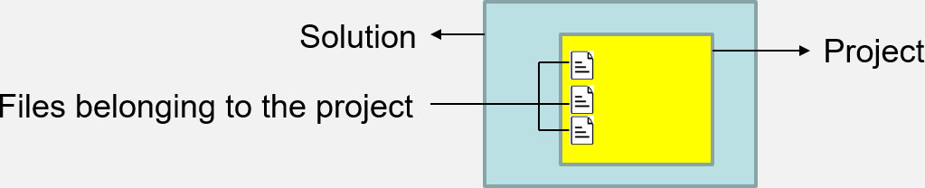
Projects and Solutions
You will create is a project
A project contains several files.
Typically they are Form1.cs, Program.cs, etc.
A solution is a container that can hold one or more Visual Studio applications
projects
Each project, however, is saved in its own solution

Slide 40
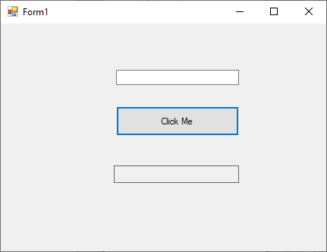
Hello World
TextBox control Name: txtHello
Button control Name: btnDisplay Text: Click Me
Label control Name: lblDisplay
Project Name: HelloWorld
After you rename all of the controls first double click on the Button and add this line of code
private void btnDisplay_Click(object sender, EventArgs e)
{
//Add this line of code
lblDisplay.Text = txtHello.Text;
}

