Slide 1
Chapter 1
Section 1.1
An Overview of Statistics

Slide 2
Statistics Overview…
Everywhere, We’re Surrounded
  Surveys, polls, registration cards, data collection
    “…stay on the line for a survey”,
    “…your call may be monitored for Quality Assurance purposes”.
  Huge databases exist to store consumer info and conduct statistical analysis (privacy issues)
    Shopper Loyalty Cards – more sophistication coming
    Web Site and Browsing Tracking – Google, Amazon, etc.
    Credit Scores
    Credit Card Purchasing trends

Slide 3
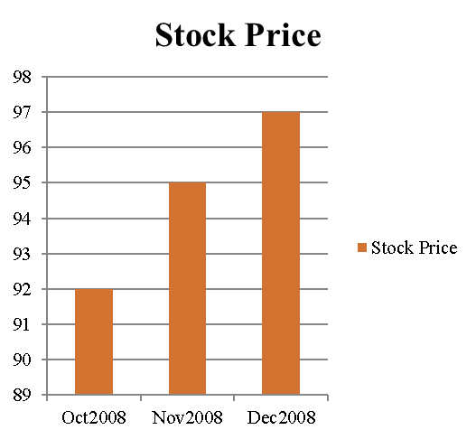
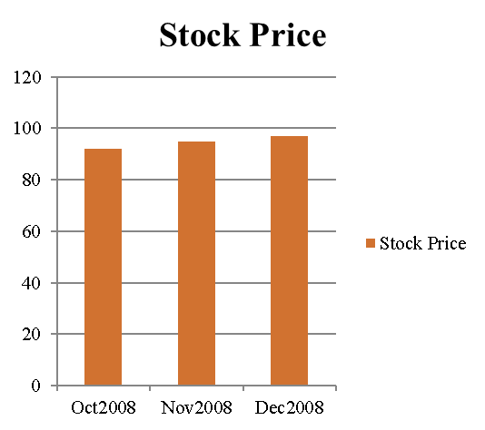
Statistics – Abuse and Misuse!!!
Misleading Charts and Graphs !!!
  Changing scales on charts can affect reader interpretation!
Selective Analysis or Selective presentation of data to support one’s position.
  One-sided excerpts are published from other studies…
  Please read and comment on Journal Article entitled:
    “Public Policy Case for Taxes on Sugared Beverages” published in New England Journal of Medicince

Slide 4
Statistics – Abuse and Misuse!!!
When a study is published, who is the sponsor of the research?
  TV Commericals for “Benefits of Corn Syrup”, of course produced by Corn Syrup Association of America.
Small sample sizes can produce misleading results.
Biased samples can produce misleading results.
  1936 Presidential Election:
  Literary Digest poll, which was based on 10 million questionnaires mailed to readers and potential readers; over two million were returned. The Literary Digest, announced that Alf Landon was winner over FDR.
  In reality, FDR won the election in landslide win.
  What went wrong with the prediction? Biased sampling: more Republicans subscribed to the Literary Digest than Democrats, and were thus more likely to vote for Landon than Roosevelt.
  Side note: This mistake by the Literary Digest proved to be devastating to the magazine's credibility, and in fact the magazine went out of existence within a few months of the election.

Slide 5
Statistics – Abuse and Misuse!!! (cont’d)
Wording on Survey Questions can influence results:
  Do you agree with following statements:
    19% agreed : “Too little money is being spent on welfare”
    63% agreed: “Too little money is being spent on assistance to the poor”
  Another Survey :
    97% yes: “Should the President have the line item veto to eliminate waste?”
    57% yes: “Should the President have the line item veto, or not?”
  Another example of how wording can affect Survey Results:
    “Have you ever used illegal drugs?“
    “Have you ever driven a motor vehicle while intoxicated?"
Part of this course: Develop “Statistical Skepticism”
  What was sample size, what was sample make-up, who is sponsor, how was the data collected, etc.

Slide 6
Data Collection can be expensive
U.S. Government Accountability Office predicted that the 2010 census will be "the most expensive census in the nation's history, even after adjusting for inflation." (See reference below).
  Total cost of the 2010 census: $14 billion.
  Projected costs of 2020 census: $16 billion
Typically, too expensive to collect data from the entire population of interest.
  More efficient to sample, but…
    How large should the sample size be?, How to ensure random sample?
    Sample selection is crucial,
      How about using home phone numbers to select respondents for a survey in Allentown?
      Note: Some Local courts use driver license records for sample pool for jury duty.
      How about sampling from driver licenses for a survey in New York City?
Reference: http://www.computerworld.com/action/article.do?command=viewArticleBasic&articleId=9129157&source=NLT_PM.

Slide 7
Statistics / Data
Statistics
The science of collecting, organizing, analyzing, and interpreting data in order to make decisions.
Data
Consist of information coming from observations, counts, measurements, or responses.
Data may be numeric (pulse rate of 78.3)
Data may be non-numeric (eye color of blue)

Slide 8
Data Sets
Population
The collection of all outcomes, responses, measurements, or counts that are of interest.
Sample
A subset of the population.

Slide 9

Example: Identifying Data Sets
In a recent survey, 1708 adults in the United States were asked if they think global warming is a problem that requires immediate government action. Nine hundred thirty-nine of the adults said yes. Identify the population and the sample. Describe the data set. (Adapted from: Pew Research Center)

Slide 10
Solution: Identifying Data Sets
The population consists of the responses of all adults in the U.S.
The sample consists of the responses of the 1708 adults in the U.S. in the survey.
The sample is a subset of the responses of all adults in the U.S.
The data set consists of 939 yes’s and 769 no’s.
Responses of adults in the U.S. (population)
Responses of adults in survey (sample)

Slide 11




MyMathLab Example

Slide 12
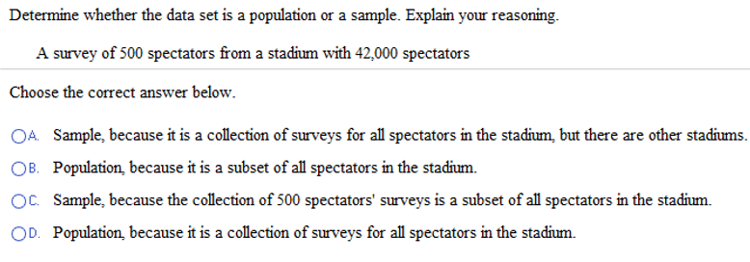
MyMathLab Example

Slide 13
Parameter and Statistic
Parameter
A number that describes a population characteristic.
Average age of all people in the United States
Statistic
A number that describes a sample characteristic.
Average age of people from a sample of three states

Slide 14

Example: Distinguish Parameter and Statistic
Decide whether the numerical value describes a population parameter or a sample statistic.
A recent survey of a sample of MBAs reported that the average salary for an MBA is more than $82,000. (Source: The Wall Street Journal)
Solution:
Sample statistic (the average of $82,000 is based on a subset of the population)
Starting salaries for the 667 MBA graduates from the University of Chicago Graduate School of Business increased 8.5% from the previous year.
Solution:
Population parameter (the percent increase of 8.5% is based on all 667 graduates’ starting salaries)

Slide 15
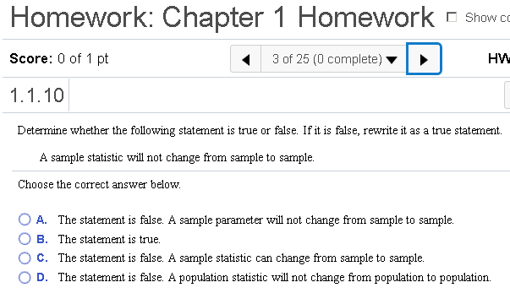
MyMathLab Examples

Slide 16
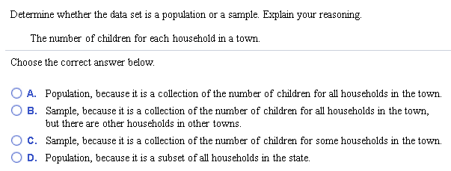
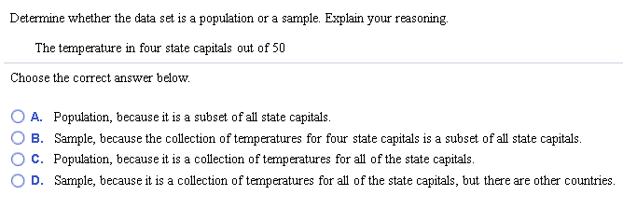
MyMathLab Examples

Slide 17
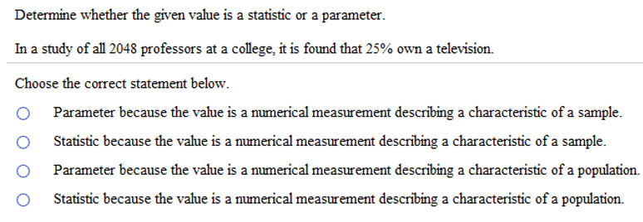
MyMathLab Example

Slide 18

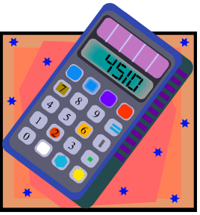
Branches of Statistics
Descriptive Statistics Involves organizing, summarizing, and displaying data.
e.g. Tables, charts, averages
Inferential Statistics Involves using sample data to draw conclusions about a population.

Slide 19
Section 1.2 – Data Classification
Variables
Variable: a characteristic or attribute about each subject of a population or sample that can assume different values.
For example, if we measured the height of 10 subjects, then height will be a variable.
More examples:
  Measure each patients weight in hospital
    Variable is weight.
  Record students age when they register at College
    Variable is age.
  Check each household and record number of kids
    Variable is Number of kids per household

Slide 20
Types of Data
Qualitative Data
Consists of attributes, labels, or nonnumerical entries, or numerical data where math operations do not make sense
Blood Type
Place of birth
Eye color Zip Code
Quantitative data
Numerical measurements or counts, where math operations make sense.

Slide 21
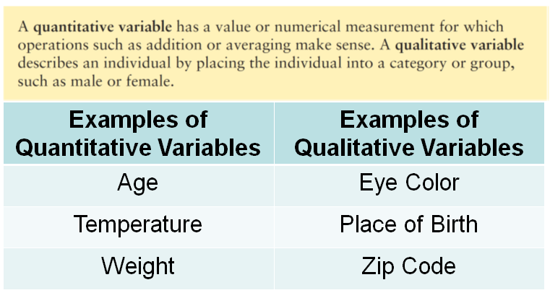
Quantitative vs. Qualitative Variable

Slide 22
Quantitative vs. Qualitative Variable
Examples of Variables | Qualitative or Quantitative?
1. Names of Honda Cars: such as Civic, Accord
2. Base Prices for Honda Cars
3. Social Security Numbers
4. Body Temp of Patients
5. Player Numbers on the back of Football Jerseys
6. Education Level
7. Household Income
8. Gender
9. Number of children in a family

Slide 23
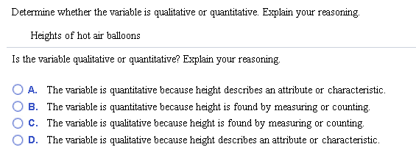
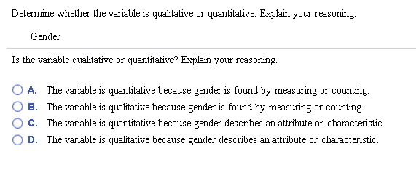
MyMathLab Examples

Slide 24
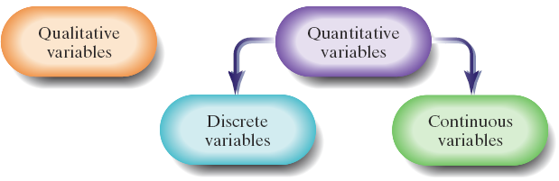
Quantitative Data
Quantitative data can be divided into two categories:
Discrete:
  Countable, finite number of values, no values exist between two categories.
  Examples:
    Number of cars in parking lot.
    Number of children in family.
    Number of tennis balls manufactured on production line.
Continuous:
  Can take on infinite number of values.
  Can be measured to any desired degree of accuracy
  Examples:
    Body weight
    Time to finish race
    Measurement of resistance between two points in electrical circuit.
Note: The distinction between discrete and continuous random variables is important because of the different mathematical techniques associated with the two kinds of random variables that we will examine later in the course.

Slide 25
Discrete Random Variables
In most cases we will consider, a discrete random variable will be the result of a count.
The number of students in a statistics class is a discrete random variable.
Values such as 15, 25, 50, and 250 are all possible.
However, 25.7 students is not a possible value for the number of students.

Slide 26
Continuous Random Variables
Most of the continuous random variables we will see will occur as the result of a measurement on a continuous scale.
For example, the air pressure in an automobile tire represents a continuous random variable. The air pressure could, in theory, take on any value from 0 lb/in² (psi) to the bursting pressure of the tire.
  Values such as 20.126 psi, 20.12678 psi, and so forth are possible.

Slide 27
Discrete vs. Continuous
Classify each of these variables as either discrete or continuous:
Example | Variable | Discrete or Continuous ?
A | Shoe Size such as 6 ½ , 7, 7 ½, etc.
B | Length of Fish caught at a lake
C | Available engine options on a new car, such as 3.0 Liter, 3.5 Liter, 4.0 Liter, etc.
D | Number of children per family in a neighborhood
E | Height of adult males in US
F | Elapsed Time to complete MyMathLab HW #5
G | Number of successful knee surgeries during a certain day at a hospital
H | Number of cars through McDonald’s Drive-Through from 12pm to 1pm
I | Daily intake of whole grains (measured in grams per day)

Slide 28
Coming Attractions
Discrete Random Variable
Continuous Random Variable
Chapter 4
Binomial Distribution
Poisson Distribution
Others we will not discuss:
Geometric Distribution
Multinomial Distribution
Etc.
Chapter 5
Normal Distribution
Chapter 10
Chi Square Distribution
Others we will not discuss:
Exponential Distribution
Weibull Distribution
Etc.

Slide 29
Section 1.3 – Experimental Design
Designing a Statistical Study
Identify the variable(s) of interest (the focus) and the population of the study.
Develop a detailed plan for collecting data. If you use a sample, make sure the sample is representative of the population.
Collect the data.
Describe the data using descriptive statistics techniques.
Interpret the data and make decisions about the population using inferential statistics.
Identify any possible errors.

Slide 30
Data Collection
Observational study
A researcher observes and measures characteristics of interest of part of a population.
Researchers observed and recorded the mouthing behavior on nonfood objects of children up to three years old. (Source: Pediatric Magazine)

Slide 31
Data Collection
Experiment
A treatment is applied to part of a population and responses are observed.
An experiment was performed in which diabetics took cinnamon extract daily while a control group took none. After 40 days, the diabetics who had the cinnamon reduced their risk of heart disease while the control group experienced no change. (Source: Diabetes Care)

Slide 32
Data Collection
Simulation
Uses a mathematical or physical model to reproduce the conditions of a situation or process.
Often involves the use of computers.
Automobile manufacturers use simulations with dummies to study the effects of crashes on humans.

Slide 33
Data Collection
Survey
An investigation of one or more characteristics of a population.
Commonly done by interview, mail, or telephone on a sample of the population.
A survey is conducted on a sample of female physicians to determine whether the primary reason for their career choice is financial stability.

Slide 34
Key Elements of Experimental Design: Control
Control for effects other than the one being measured.
Confounding variables
  Occurs when an experimenter cannot tell the difference between the effects of different factors on a variable.
    A coffee shop owner remodels her shop at the same time a nearby mall has its grand opening. If business at the coffee shop increases, it cannot be determined whether it is because of the remodeling or the new mall.

Slide 35
Key Elements of Experimental Design: Control
Placebo effect
  A subject reacts favorably to a placebo when in fact he or she has been given no medical treatment at all.
  Blinding is a technique where the subject does not know whether he or she is receiving a treatment or a placebo.
  Double-blind experiment neither the subject nor the experimenter knows if the subject is receiving a treatment or a placebo.

Slide 36
Sampling Techniques
Simple Random Sample
Every possible sample of the same size has the same chance of being selected.
Every member of the population has an equally likely chance to be selected in the sample
x
x
x
x
x
x
x
x
x
x
x
x
x
x
x
x
x
x
x
x
x
x
x
x
x
x
x
x
x
x
x
x
x
x
x
x
x
x
x
x
x
x
x
x
x
x
x
x
x
x
x
x
x
x
x
x
x
x
x
x
x
x
x
x
x
x
x
x
x
x
x
x
x
x
x
x
x
x
x
x
x
x
x
x
x
x
x
x
x
x
x
x
x
x
x
x
x
x
x
x
x
x
x
x
x
x
x
x
x

Slide 37
Simple Random Sample
Random numbers can be generated by a random number table, a software program or a calculator.
Assign a number to each member of the population.
Members of the population that correspond to these numbers become members of the sample.

Slide 38
Using Random Number Table
Identify the population. Imagine numbering each person or item in the population with numbers 1, 2, 3, 4, etc. up to the total number in the population. Note the number of digits in the population size.
  Example: the population of interest are the 35 students in STAT200. Number each student from 1 to 35. Note there are 2 digits in the pop. size of “35”.
Identify the sample size.
  Example: Say we want a sample of 10 students to fill out a survey.
Use a random number generator or table to generate random numbers. Group the random numbers in groups of digits corresponding to number of digits in the population size. Choose any arbitrary starting point in the table.
  Example: Since we have two digits in the population size, we group random numbers in groups of two digits.
Members of the population that correspond to the random numbers selected from the random number table are then included in the sample.
  Any two digit random numbers between 01 and 35 are used to select these students for the sample.
  Note: If we encounter a two digit random number greater than 35, discard and move onto the next random number

Slide 39
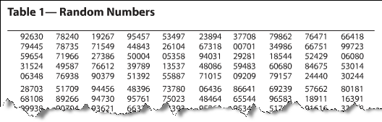
Example: Simple Random Sample
There are 731 students currently enrolled in statistics at your school. You wish to form a sample of eight students to answer some survey questions. Select the students who will belong to the simple random sample.
Assign numbers 1 to 731 to each student taking statistics.
On the table of random numbers, choose a starting place at random (suppose you start in the third row, second column.)

Slide 40
Solution: Simple Random Sample
Read the digits in groups of three
Ignore numbers greater than 731
The students assigned numbers 719, 662, 650, 4, 53, 589, 403, and 129 would make up the sample.

Slide 41
Example to Try
There are 4,352 students at the College.
You want to select a random sample of 3 students as winners of a raffle.
Use the Random Number Table in the Text and start at the upper left corner of the table.
Which four students would you select as winners?

Slide 42
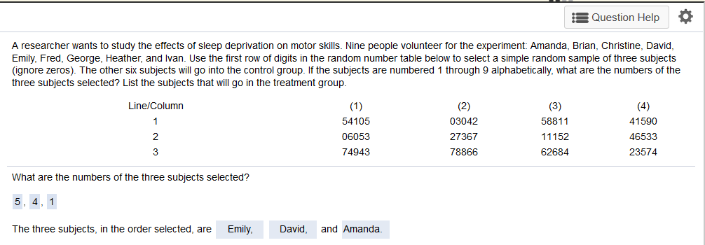
MyMathLab Example

Slide 43
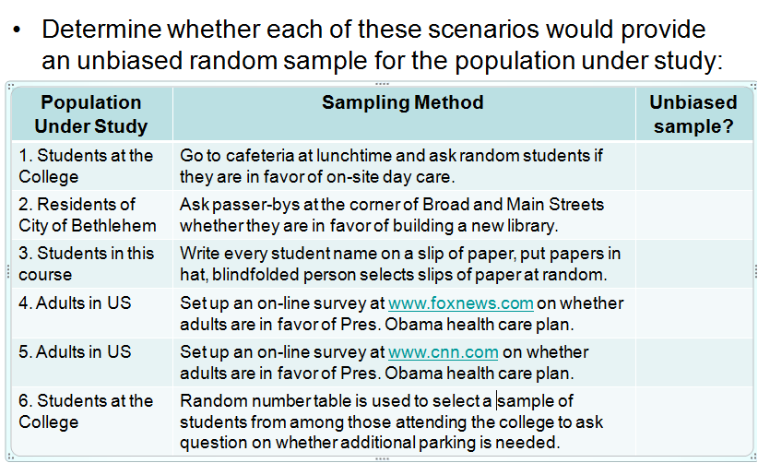
Random Sampling Examples

Slide 44
Other Sampling Methods
Sampling Method | Description | Example
Random | Every member of the population has an equally likely chance to be included in the sample | Use a random number generator to select 10 students from a class of 35 students
Stratified | When you want members from each segment of the population included in the sample -- Divide the population into categories such as income level, gender, etc. (called strata). Then select random samples from each category. | Separate high school students according to freshman, sophomore, junior, senior then select random samples from each grade level.
Systematic | Number all items in population, then pick a random starting point and select every k^{th} member for the sample. | At a DUI checkpoint, police offers selects every 10th car for a sobriety check.
Cluster | Divide population into segments or clusters (typically done on geographic basis). Randomly select clusters and then include every member from that cluster in the sample. | After a tornado, a disaster area is divided into 200 grids, then a sample of grids is selected and all residents in that grid are surveyed.
Convenience | Select sample according to sample that is most readily and easily available – usually results in a biased sample! | To survey customers, Best Buy asks 100 customers leaving the store on Wed morning if they were satisfied with product selection in the store.
Although we will assume throughout this text that random samples are used, other methods of sampling are also widely used.
Other Sampling methods:
  Stratified Sampling
  Systematic Sampling
  Cluster Sampling
  Convenience Sampling

