Slide 1
Welcome to STAT200
Calendar
"Every American should have above average income, and my Administration is going to see they get it."
(Bill Clinton on the campaign trail)
Conclusion:
  Bill Clinton never took STAT200

Slide 2
STAT200 – Elementary Statistics
Summer2, 2022
Time/Room: Fully Online Course (no class meetings)
Midterm exam taken in proctored format
Final exam taken in proctored format
Course Dates: June 29 to Aug 10
Length: 6 weeks (plus Final Exam)
Instructor: Larry Musolino
Email: lsm7@psu.edu
Phone: 610-285-5032 (office) 610-217-5843 (cell)
Office: Room 217I
Office Hours: Fridays at 11am via Zoom
or by appointment
Notes:
Larson/Farber 4th ed
Chapter 1

Slide 3
Key Concepts for STAT200
Descriptive statistics,
Frequency distributions,
Measures of Central Tendency and Dispersion
Detecting Outliers,
Probability,
Binomial and normal distributions,
Statistical inference,
Linear regression, and correlation
Confidence intervals
Hypothesis Testing
Test for Independence, ANOVA
Chapters 1 to 10

Slide 4
MATERIALS For Course
1. Textbook:
Elementary Statistics: Picturing the World Plus MyMathLab -- Access Card Package, 6/E
6th Edition by Larson and Farber, Pearson Publishing,
ISBN-10: 0321911210 , ISBN-13: 978-0321911216
2. MyMathLab access is required.
You do not need to purchase the hardcopy of the text, since the text is available as an ebook which is included with MyMathLab access.
To Register in MyMathLab, use Course code: musolino01992
Note: We will be using StatCrunch as a statistical analysis tool which is included as part of MyMathLab access.
3. A Scientific Calculator is recommended, examples:
      TI 30XIIS (~$13)
      TI 30XS Multiview (~$14)
      TI 83 Plus, TI 84 Graphing Calculators (~$120)
14 day FREE ACCESS for MyMathLab, Cost is $80

Slide 5
Note: MyMathLab Access is Required !!
Option | Approx Cost | What you get | Where to purchase
A | $80 | MyMathLab Access (includes access to the online version of the textbook) | Purchase online at www.MyMathLab.com using a credit card
B | $130 | MyMathLab Access (includes access to the online version of the textbook) | Penn State Bookstore
C | $88 | Three ring loose-leaf version of textbook (does not include MyMathLab access) | Purchase online at www.MyMathLab.com using a credit card
B | $270 | MyMathLab Access Hardcopy version of textbook | Penn State Bookstore
C | $200 | MyMathLab Access Used Hardcopy version of textbook | Purchase Access online at www.MyMathLab.com using a credit card Then, Purchase used textbook at amazon.com, half.com, etc.
Lowest Cost

Slide 6
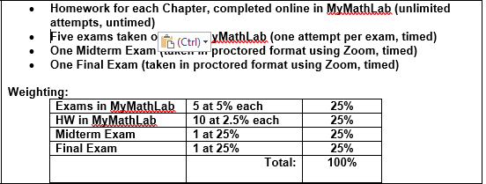

Course Grading

Slide 7
Keys to Success in STAT200
Keep up with Homework Assignments, work these carefully and completely.
  Online Tests are based on Homework Problems.
  Midterm Exam is based on Homework Problems
  Final Exam is based on Homework Problems.
Don’t wait until the last minute !!
  Homework will take multiple hours to complete.
  Don’t start the HW at 10:45pm on the due date
Learn to use StatCrunch
  This will be a major timesaver especially for more complicated topics in the 2nd half of the course.

Slide 8
Is there any Extra Credit available?
Please make note:
There is no EXTRA CREDIT AVAILABLE in this STAT200 course.
The Homeworks are designed so you can go back and improve your scores and redo incorrect problems (and theoretically achieve 100% on Homework).

Slide 9
Academic Integrity
The University defines academic integrity as the pursuit of scholarly activity in an open, honest and responsible manner. All students should act with personal integrity, respect other students' dignity, rights and property, and help create and maintain an environment in which all can succeed through the fruits of their efforts (refer to Senate Policy 49-20).
Dishonesty of any kind will not be tolerated in this course. Dishonesty includes, but is not limited to, cheating, plagiarizing, fabricating information or citations, facilitating acts of academic dishonesty by others, having unauthorized possession of examinations, submitting work of another person or work previously used without informing the instructor, or tampering with the academic work of other students.
Students who are found to be dishonest will receive academic sanctions and will be reported to the University's Office of Student Conduct for possible further disciplinary sanctions
Any student who uses outside help of any kind when completing online HWs or online exams will automatically receive a grade of “F” for the course

Slide 10
Late Policy
Out of fairness to all students, no late work is permitted for Homework, Tests.
  Please do not request extensions for any graded activities in STAT200
The only exception is for documented absences such as hospitalization, urgent family matters, etc.
  In these circumstances, documented evidence is required (hospital release form, doctor note, etc).

Slide 11
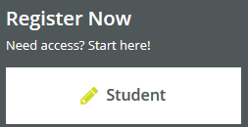
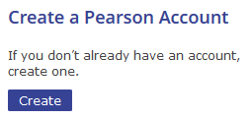
Registering for MyMathLab
Go to www.MyMathLab.com
Click on REGISTER, as a STUDENT
Enter Course ID of musolino01992
Click on “CREATE” to create a pearson account
Then select Either “Access Code” or “Use Credit Card”
Or you can select “PAY LATER for 14 day temp access
See Next Slide

Slide 12
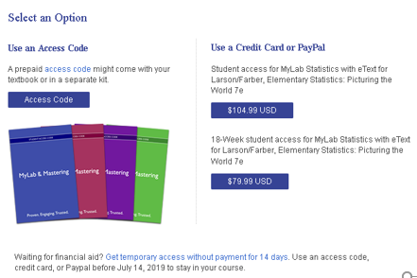
Registering for MyMathLab
When Registering for MyMatlLab:
Then select Either “Access Code” or “Use Credit Card”
Or you can select “PAY LATER for 14 day temp access
DO NOT CLICK HERE
Click here to purchase access for $80
Click here for 14 day FREE ACCESS

Slide 13
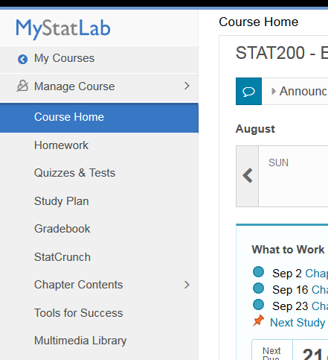
Using MyMathLab in STAT200
MyMathLab (MML) includes many videos which provide step by step worked out examples
Also MML provides other supplemental resources such as animations, interactive figures, podcasts and powerpoint files.
  Note: All video lectures and worked out examples can also be downloaded for viewing as podcasts. You must have iTunes installed on your computer to view these videos.
These resources are available under the MULTIMEDIA LIBRARY section within MyMathLab. (click on MULTIMEDIA LIBRARY link on the left hand side of the MyMathLab Course Home page).

Slide 14
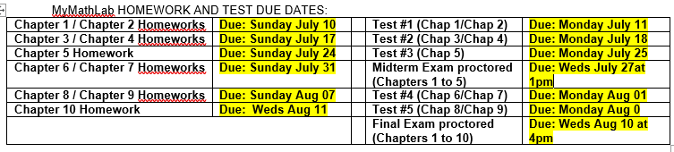
Due Dates for HWs and Exams
Due Dates are on SUNDAYS for:
  Online Homeworks taken in MyMathLab
Due Dates are on MONDAYS for:
  Online Exams taken in MyMathLab

Slide 15
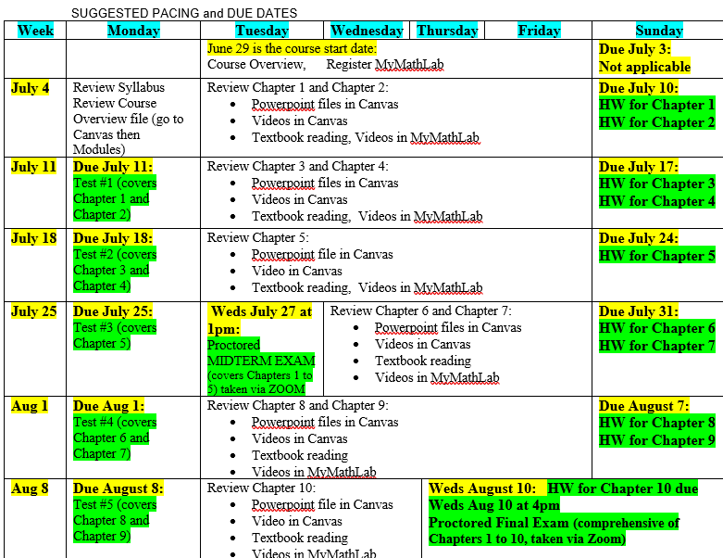

Slide 16
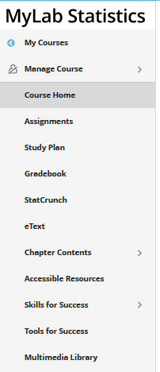
Course Administration
CANVAS will be used as a location for posting lecture notes, videos, syllabus, gradebook, etc.
A Chapter Summary of key concepts and key formulas from each chapter will be provided.
  Keep these handy as you work through any HW’s and Tests
  Chapter summaries will be provided to you for use during Midterm and Final Exams
We will use StatCrunch as a statistical analysis tool
  Access is included as part of MyMathLab

Slide 17
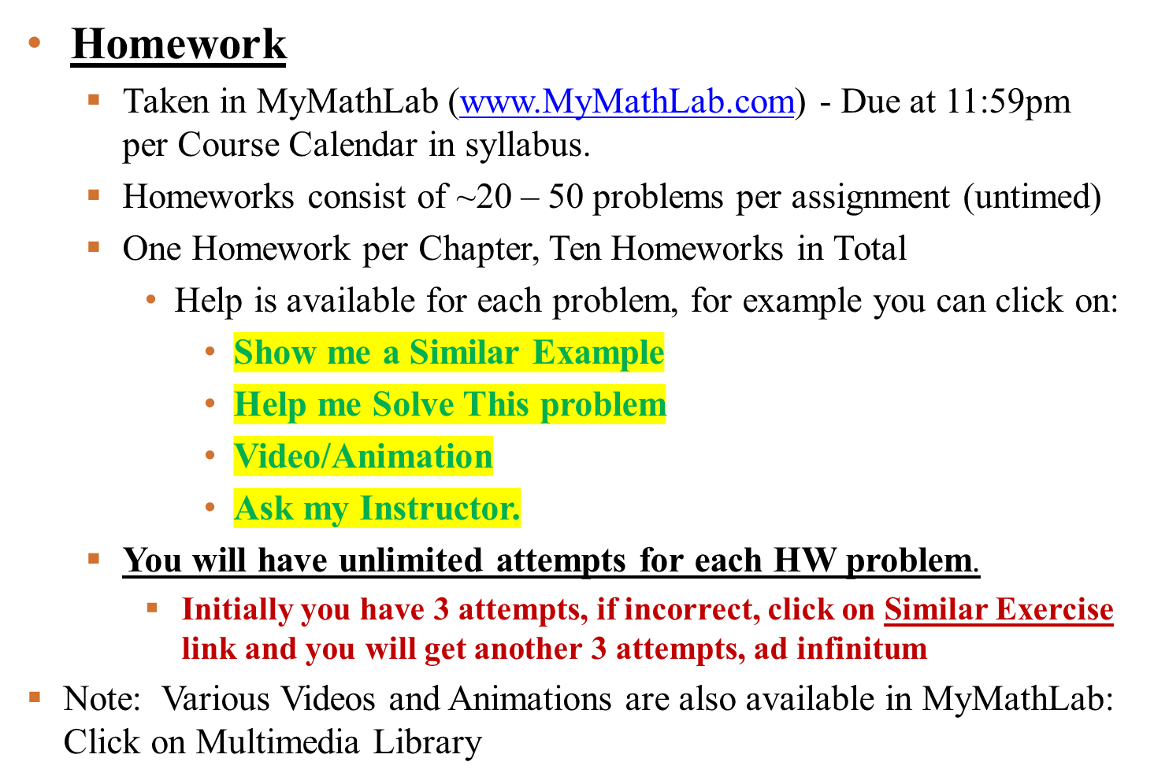
More Details on Assessments

Slide 18
Tests are taken in MyMathLab
Tests online in MyMathLab (5 Tests)
  Taken online in MyMathLab out of class (at home)– will be representative of worked examples from class and MyMathLab HW problems (includes access to StatCrunch)
  20 problems per Test. 2 hours to complete.
    Open book/Open Notes/Use of StatCrunch/Use of Calculator all OK.
  Problems on the Tests are taken from same pool of questions as used on the Homeworks !! (No Help Resources available)
  Review for tests will be held in class before each test.
    Test #1 – Covers Chapters 1 and 2
    Test #2 – Covers Chapters 3 and 4
    Test #3 – Covers Chapter 5
    Test #4 – Covers Chapter 6 and 7
    Test #5 – Covers Chapters 8 and 9
    Note: Chapter 10 material will be included on the Final Exam
  Refer to Course Calendar in syllabus for specific due dates.

Slide 19
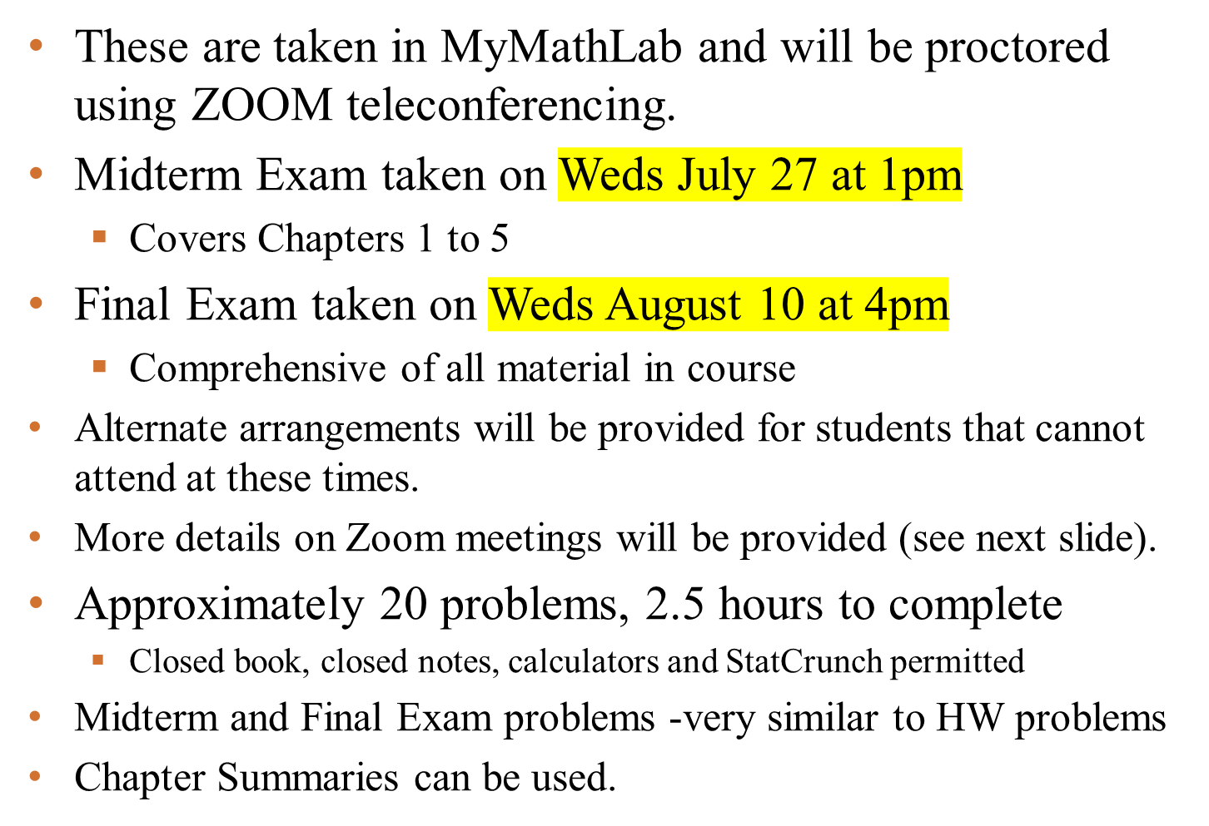
Midterm and Final Exam in STAT200

Slide 20
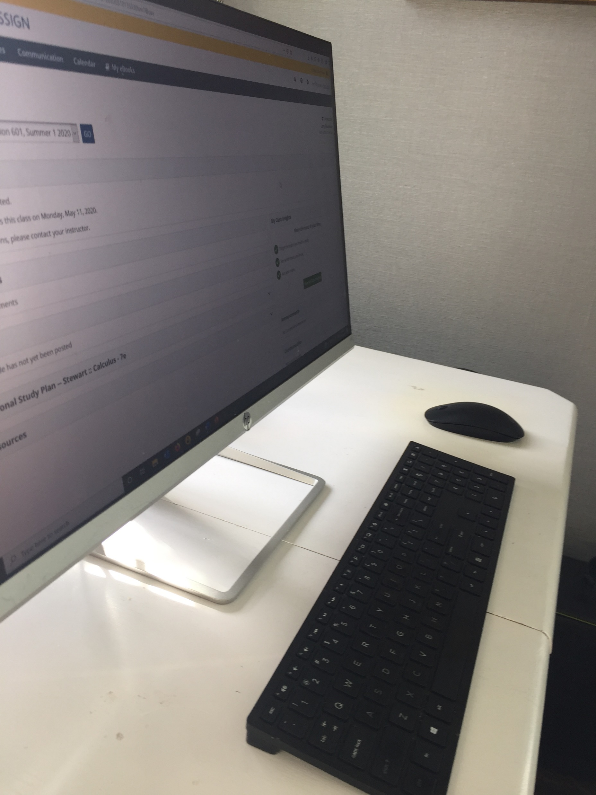
Setup for Midterm and Final Exams
Steps to take the Midterm or Final Exam
Use your smartphone to log into CANVAS and select ZOOM from left hand menu.
Click on the Zoom Meeting Link
Enable video and point your smartphone camera at your desktop and computer screen as shown in the image
Use your laptop/desktop to access MyMathLab and click on the link for the exam
The password for the exam will be provided during the meeting.
Do not bring up any other websites on your computer except MyMathLab and StatCrunch
  MyMathLab monitors your IP address and will alert the instructor if you navigate to another website.
Do not get any outside help from anyone else while taking the exam
You can use scrap paper
You can use calculator
You can use StatCrunch
You can use Chapter summaries
During the exam, point your smartphone camera at your desktop and computer screen

Slide 21
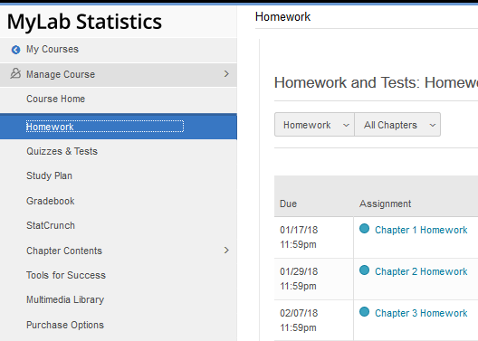
MyMathLab Homeworks
How to Access MyMathLab Homeworks:
  Click on Homeworks on Left Side of MyMathLab course page
  Then click on any specific HW assignment

Slide 22
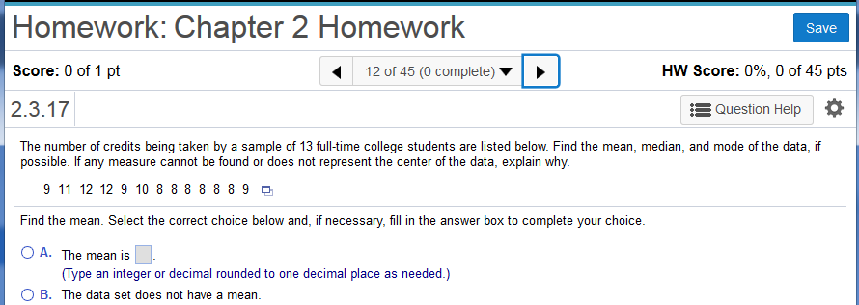
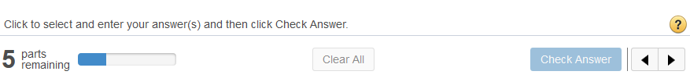
MyMathLab Example
Click SAVE to record your results
Click on these arrows to move from one problem to another
Notice this problem is from Section 2.3 in text
Help is Available !!!
Answer box
Click Check Answer after entering your response

Slide 23
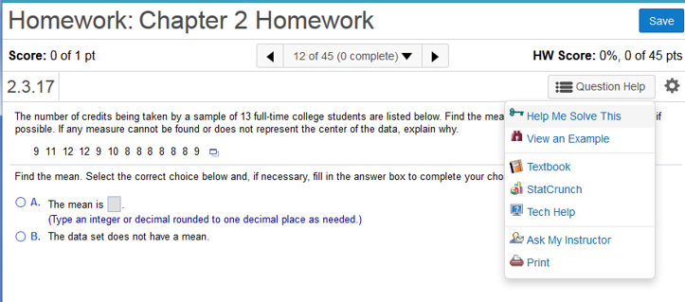
Help Within MyMathLab
Make sure to use these HELP RESOURCES !!!

Slide 24
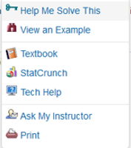
Help Within MyMathLab HW
Built in Help Resources Available for HW :
  Help Me Solve This
    Solves the given problem for you in step by step manner, then generates a new and similar problem
  View an Example
    Solves a similar problem for you in step by step manner
  Videos/Animation
    Brings up short video or animation explaining the concepts
  Textbook
    Opens up electronic textbook to the specific page where the concept is reviewed
  StatCrunch
    Opens StatCrunch statistical analysis tool. You can also copy datasets directly into StatCrunch
  Ask My Instructor
    Sends an email to instructor with link to problem

Slide 25
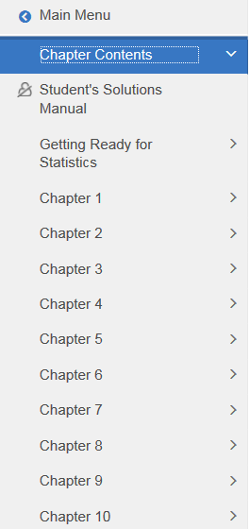
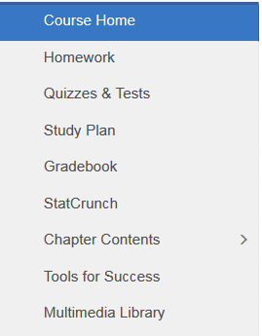
More on MyMathLab
Textbook available in MyMathLab:
  Click on Chapter Contents to access Textbook
  Then select any Chapter from Navigation Menu

Slide 26
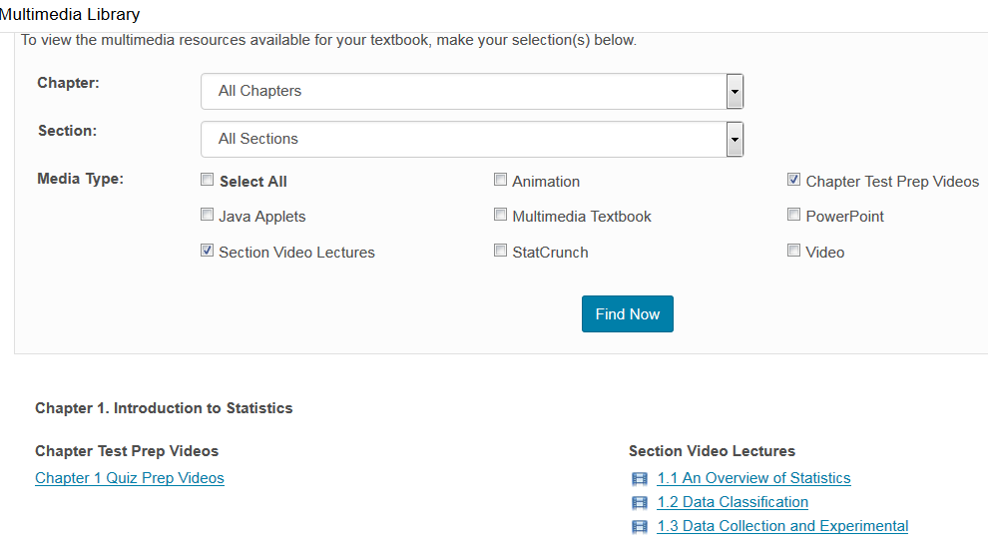
More on MyMathLab
Videos available in MyMathLab:
  Click on Multimedia Library
  Then select Videos and Click “Find Now”

Slide 27
CHALLENGES IN STAT200
We will be covering many different concepts and formulas.
  How will you know when to use which formula and which concept to solve any given problem ??
  How will you know what numbers to plug into a given formula ??
WORK THROUGH EXAMPLES !!!!
  MyMathLab Homework Problems
  Worked out Examples in TEXTBOOK
    Exercises in Textbook at end of each section
  In-class Worked out examples

Slide 28
Additional Support
I will hold a drop-in office hour each Friday at 11am using ZOOM conferencing. (If you cannot attend, feel free to send questions ahead of time)
Use “Ask My Instructor” link in MyMathLab Homeworks (under Question Help)
Videos in MyMathLab: Click on Multimedia Library
Videos in CANVAS: Instructor provided videos for each Chapter (go to CANVAS then MODULES
Penn State Tutoring (fill out tutor request form)
https://lehighvalley.psu.edu/tutor-request-form
You will need to give the tutors 2 business days to receive a response and start setting up an appointment.
OnLine Tutoring Help using Tutor.com:
  Click on TUTOR.COM link on left hand menu in CANVAS
OnLine Penn State Notes and Lessons for STAT200:
  https://onlinecourses.science.psu.edu/stat200/
iStudy Tutorials: http://tutorials.istudy.psu.edu/basicstatistics/

Slide 29
Additional Support (continued)
Many Excellent Statistical Videos: www.khanacademy.org
Getting Started in StatCrunch: https://youtu.be/pKzFcW-66XM
StatCrunch Help Guide with Examples: https://www.statcrunch.com/5.0/example.php
StatCrunch YouTube Channel (Video Tutorials):
https://www.youtube.com/view_play_list?p=BE055F65E43B4973

