Slide 1
Section 2.1
Frequency Distributions
and Their Graphs
© 2012 Pearson Education, Inc. All rights reserved.
1

Slide 2
Frequency Distributions and Histograms
The goal is to organize large amounts of data to be able to visualize patterns or trends in the data, and thus come to some conclusions or actions based on the dataset.
So we would like to organize data into a table to record how frequently different data values occur.
A frequency distribution table shows how the frequencies for the dataset is distributed.
Then, a histogram provides a VISUAL picture of the frequency distribution table.

Slide 3
Frequency Distribution
Frequency Distribution
A table that shows classes or intervals of data with a count of the number of entries in each class.
The frequency, f, of a class is the number of data entries in the class.
Class | Frequency, f
1–5 | 5
6–10 | 8
11–15 | 6
16–20 | 8
21–25 | 5
26–30 | 4
Class width 6 – 1 = 5
Lower class
limits
Upper class
limits
NOTE: CLASS refers to ROWs
© 2012 Pearson Education, Inc. All rights reserved.
3

Slide 4
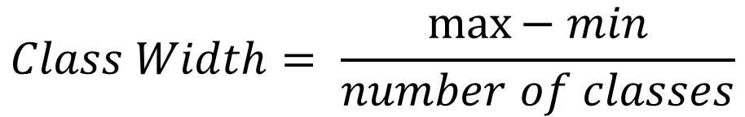
STEPS in Constructing a Frequency Distribution (For Integer Data)
Decide on the number of classes (i.e. rows).
Usually between 5 and 20; otherwise, it may be difficult to detect any patterns.
Find the class width.
Determine the range of the data (max – min)
Divide the range by the number of classes.
Round up to the next whole number.
© 2012 Pearson Education, Inc. All rights reserved.
4

Slide 5
Constructing a Frequency Distribution
Find the Lower and Upper Class limits.
You can use the minimum data entry as the lower limit of the first class.
Find the remaining lower class limits (add the class width to the lower class limit of the preceding row).
Find the upper limit of the first row. Remember that classes cannot overlap.
Find the remaining upper class limits (add the class width to the upper class limit of the preceding class).
© 2012 Pearson Education, Inc. All rights reserved.
5

Slide 6
Constructing a Frequency Distribution
Make a tally mark for each data entry in the row of the appropriate class.
Count the tally marks to find the total frequency f for each class.
Note: It’s helpful to rank order the data from smallest to largest to help with setting up the frequency distribution table.
© 2012 Pearson Education, Inc. All rights reserved.
6

Slide 7

Example: Constructing a Frequency Distribution
The following sample data set lists the prices (in dollars) of 30 portable global positioning system (GPS). Construct a frequency distribution that has seven classes (rows).
This is Example #1 on page 41
© 2012 Pearson Education, Inc. All rights reserved.
7

Slide 8
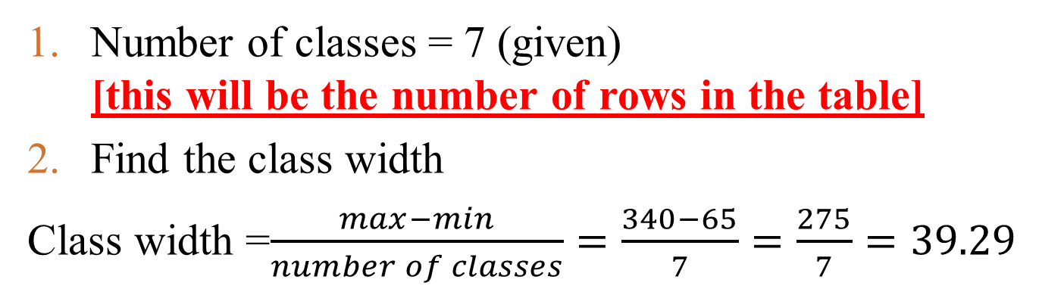
Solution: Constructing a Frequency Distribution
min
max
Round up to 40
© 2012 Pearson Education, Inc. All rights reserved.
8

Slide 9
Solution: Constructing a Frequency Distribution
Use 65 (minimum value) as first lower limit. Add the class width of 40 to get the lower limit of the next class.
65 + 40 = 105
Find the remaining lower limits by adding 40.
Lower limit | Upper limit
65
105
145
185
225
265
305
min
Add Class width = 40
© 2012 Pearson Education, Inc. All rights reserved.
9

Slide 10
Solution: Constructing a Frequency Distribution
The upper limit of the first class is 104 (one less than the lower limit of the second class).
Add the class width of 40 to get the upper limit of the next class.
104 + 40 = 144
Find the remaining upper limits in the same way.
Lower limit | Upper limit
65 | 104
105 | 144
145 | 184
185 | 224
225 | 264
265 | 304
305 | 344
Class width = 40
© 2012 Pearson Education, Inc. All rights reserved.
10

Slide 11
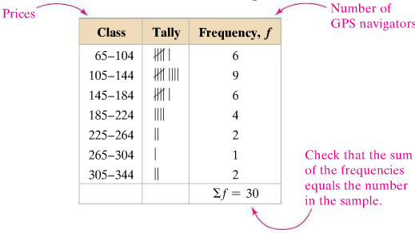
Solution: Constructing a Frequency Distribution
Make a tally mark for each data entry in each row.
Count the tally marks to find the total frequency f for each row.
© 2012 Pearson Education, Inc. All rights reserved.
11

Slide 12
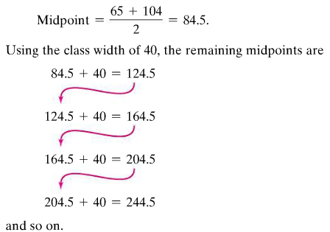
Determining the Midpoint for each Row
Midpoint of a class:
Class width = 40
© 2012 Pearson Education, Inc. All rights reserved.
12

Slide 13
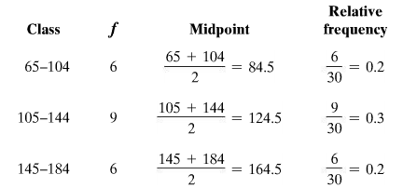
Determining the Relative Frequency
Relative Frequency of a class
Portion or percentage of the data that falls in a particular class.
© 2012 Pearson Education, Inc. All rights reserved.
13

Slide 14
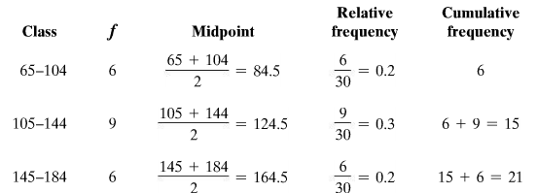
Determining the Cumulative Frequency
Cumulative frequency of a class
The sum of the frequencies for that class and all previous classes.
© 2012 Pearson Education, Inc. All rights reserved.
14

Slide 15
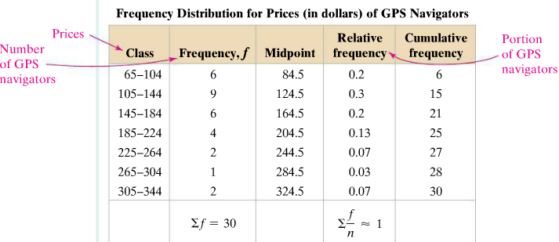
Expanded Frequency Distribution
© 2012 Pearson Education, Inc. All rights reserved.
15

Slide 16
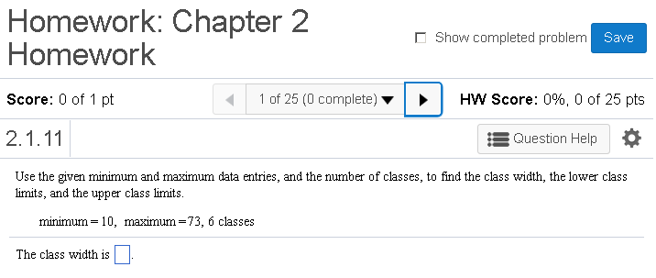
MyMathLab Example

Slide 17
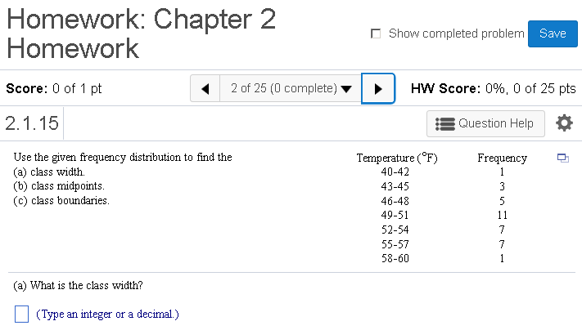
MyMathLab Example

Slide 18
Graphs of Frequency Distributions
Frequency Histogram
A bar graph that represents the frequency distribution.
The horizontal scale is quantitative and measures the data values.
The vertical scale measures the frequencies of the classes.
Consecutive bars must touch.
frequency
data values
© 2012 Pearson Education, Inc. All rights reserved.
18

Slide 19
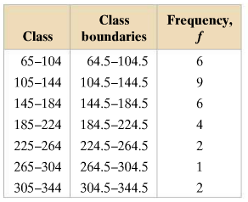
Class Boundaries
Class boundaries
The numbers that separate classes without forming gaps between them.
For integer data: Lower Class Boundary = Lower Class Limit – 0.5
For integer data: Upper Class Boundary = Upper Class Limit + 0.5
First class lower boundary = 65 – 0.5 = 64.5
First class upper boundary = 104 + 0.5 = 104.5
© 2012 Pearson Education, Inc. All rights reserved.
19

Slide 20
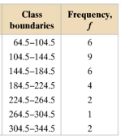
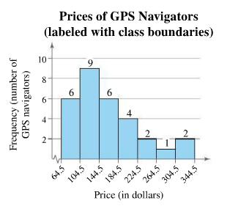
Solution: Frequency Histogram (using class boundaries)
© 2012 Pearson Education, Inc. All rights reserved.
20

Slide 21
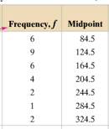
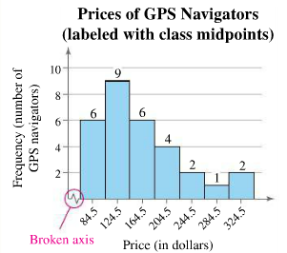
Solution: Frequency Histogram (using Midpoints)
© 2012 Pearson Education, Inc. All rights reserved.
21

Slide 22
Graphs of Frequency Distributions
Relative Frequency Histogram
Has the same shape and the same horizontal scale as the corresponding frequency histogram.
The vertical scale measures the relative frequencies, not frequencies.
relative frequency
data values
© 2012 Pearson Education, Inc. All rights reserved.
22

Slide 23
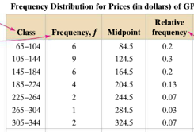
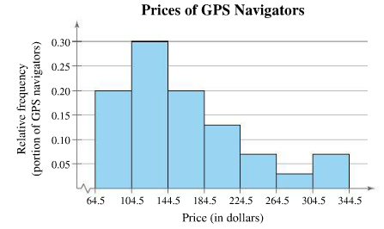
Solution: Relative Frequency Histogram
Notice the height of each bar is its relative frequency
© 2012 Pearson Education, Inc. All rights reserved.

Slide 24
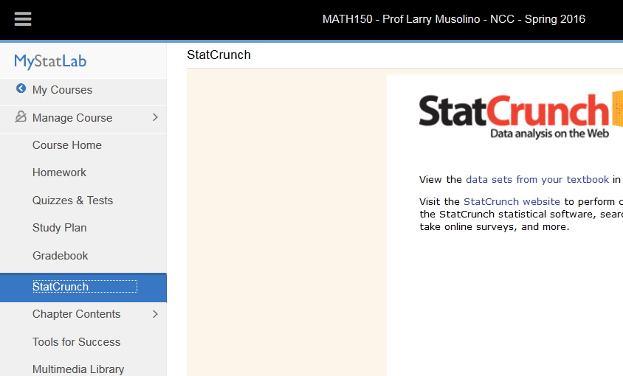
Using StatCrunch to Generate Histograms
Login to MyStatLab - Start up StatCrunch

Slide 25
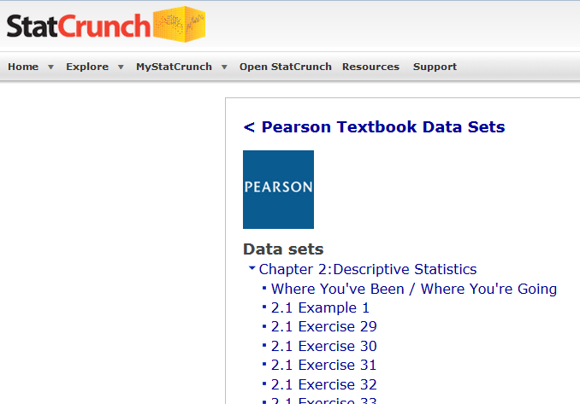
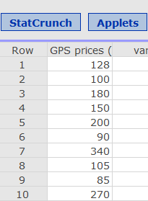
Select Chapter 2, then 2.1 Example 1

Slide 26
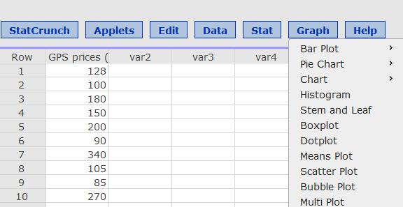
Using StatCrunch to Generate Histograms
Click on Graph
Then select Histogram

Slide 27
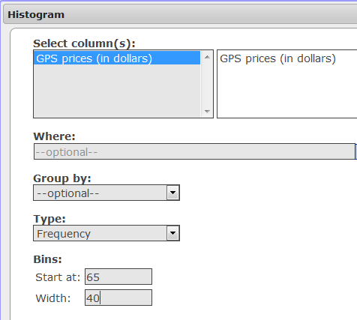
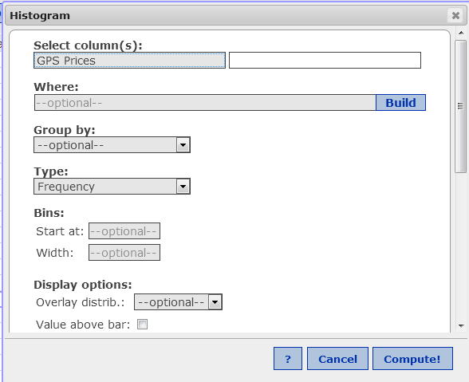
Using StatCrunch to Generate Histograms
Click on Column Name (GPS Prices) to select
Enter Start at: 65, Enter Width : 40,
Check box for Value above Bar,
Scroll down, if desired, enter labels for x-axis, y-axis and title. (see next slide)
Then Click Compute

Slide 28
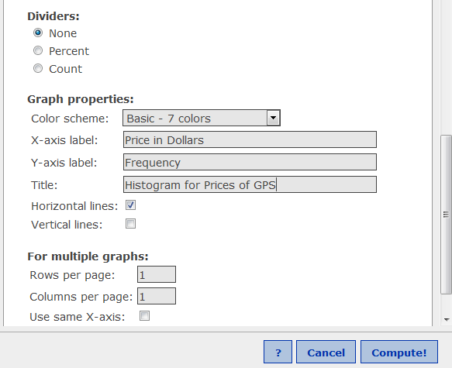
Using StatCrunch to Generate Histograms
If desired, enter labels for x-axis, y-axis and title.
Click Compute!

Slide 29
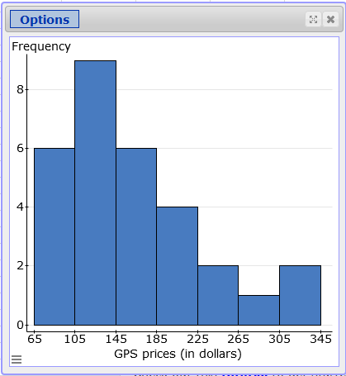
Using StatCrunch to Generate Histograms

Slide 30

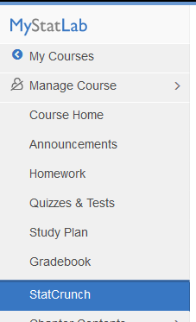
Example to Try – Section 2.1 Exercise 31
The dataset represents sales figures for the 22 salespeople in your company during a certain month.
Construct a frequency histogram using seven classes.
You are the Sales Manager, What conclusions do you derive from the histogram?
As the Sales Manager, What actions would you take based on the histogram?
2114 3981
2468 1643
7119 1858
1876 1500
4105 4608
3183 1000
1932 2478
1355 1697
4278 1512
1030 5835
2000 1077
Calculate the class width
Click on StatCrunch
Click on “Datasets from text”
Click on Chapter 2
Select 2.1 Exercise 31
Click on Graph then Histogram
For “Start At”, use 1000
For “Width”, use the class width calculated from Step 1
Click COMPUTE!

Slide 31
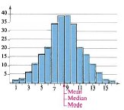
The Shape of Distributions
Symmetric Distribution
A vertical line can be drawn through the middle of a graph of the distribution and the resulting halves are approximately mirror images.
© 2012 Pearson Education, Inc. All rights reserved.
31

Slide 32
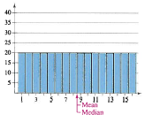
The Shape of Distributions
Uniform Distribution (rectangular)
All entries or classes in the distribution have equal or approximately equal frequencies.
Symmetric.
© 2012 Pearson Education, Inc. All rights reserved.
32

Slide 33
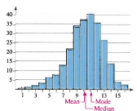
The Shape of Distributions
Skewed Left Distribution (negatively skewed)
The “tail” of the graph elongates more to the left.
The mean is to the left of the median.
© 2012 Pearson Education, Inc. All rights reserved.
33

Slide 34
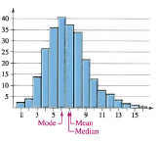
The Shape of Distributions
Skewed Right Distribution (positively skewed)
The “tail” of the graph elongates more to the right.
The mean is to the right of the median.
© 2012 Pearson Education, Inc. All rights reserved.
34

Slide 35
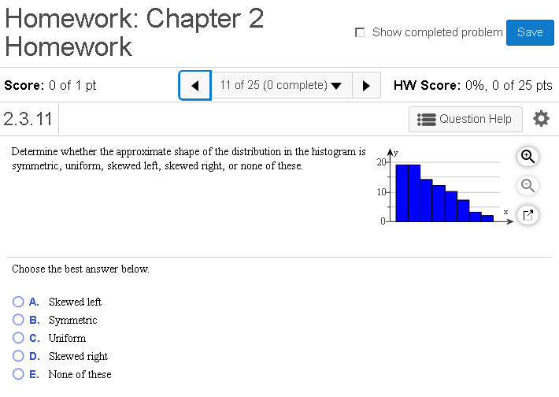
MyMathLab Example

Slide 36
Section 2.2
More Graphs and Displays
© 2012 Pearson Education, Inc. All rights reserved.
36

Slide 37
Graphing Quantitative Data Sets
Stem-and-leaf plot
Each number is separated into a stem and a leaf.
Similar to a histogram.
Still contains original data values.
26
Data: 21, 25, 25, 26, 27, 28, 30, 36, 36, 45
2
1 5 5 6 7 8
3
0 6 6
4
5
© 2012 Pearson Education, Inc. All rights reserved.
37

Slide 38
Example: Constructing a Stem-and-Leaf Plot
The following are the numbers of text messages sent last week by the cellular phone users on one floor of a college dormitory. Display the data in a stem-and-leaf plot.
159 144 129 105 145 126 116 130 114 122 112 112 142 126
118 108 122 121 109 140 126 119 113 117 118 109 109 119
139 122 78 133 126 123 145 121 134 124 119 132 133 124
129 112 126 148 147
© 2012 Pearson Education, Inc. All rights reserved.
38

Slide 39
Solution: Constructing a Stem-and-Leaf Plot
159 144 129 105 145 126 116 130 114 122 112 112 142 126
118 108 122 121 109 140 126 119 113 117 118 109 109 119
139 122 78 133 126 123 145 121 134 124 119 132 133 124
129 112 126 148 147
The data entries go from a low of 78 to a high of 159.
Use the rightmost digit as the leaf.
For instance,
78 = 7 | 8 and 159 = 15 | 9
List the stems, 7 to 15, to the left of a vertical line.
For each data entry, list a leaf to the right of its stem.
© 2012 Pearson Education, Inc. All rights reserved.
39

Slide 40
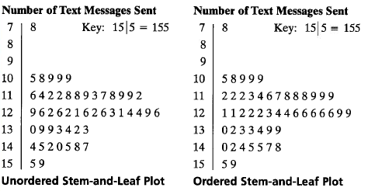
Solution: Constructing a Stem-and-Leaf Plot
Include a key to identify the values of the data.
From the display, you can conclude that more than 50% of the cellular phone users sent between 110 and 130 text messages.
© 2012 Pearson Education, Inc. All rights reserved.
40

Slide 41
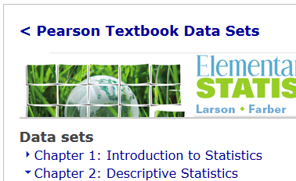
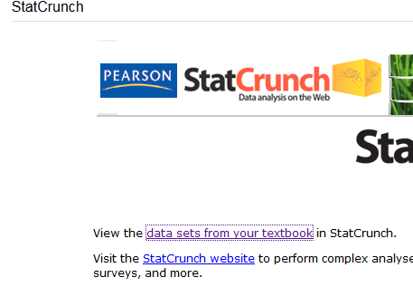
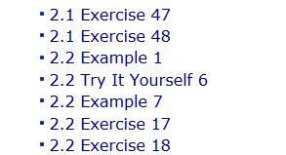
Using StatCrunch for Stem and Leaf Plot
Start up StatCrunch,
Click on “Data sets from your text”
Click on Chapter 2
Click on 2.2 Example 1 to load in dataset for Text Messages

Slide 42
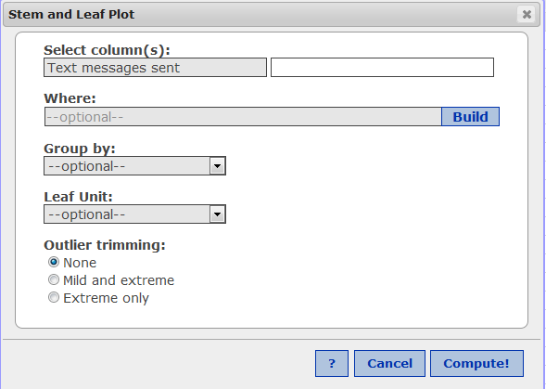
Using StatCrunch for Stem and Leaf Plot
Click on Graph, then select Stem and Leaf
Select Column Name “Text Messages Sent”
Click Next
For Outlier trimming, select None
Click Compute!

Slide 43
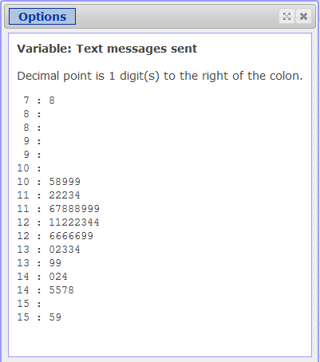
Stem and Leaf Plot

Slide 44
Graphing Quantitative Data Sets
Dot plot
Each data entry is plotted, using a point, above a horizontal axis.
Data: 21, 25, 25, 26, 27, 28, 30, 36, 36, 45
26
20 21 22 23 24 25 26 27 28 29 30 31 32 33 34 35 36 37 38 39 40 41 42 43 44 45
© 2012 Pearson Education, Inc. All rights reserved.
44

Slide 45
Example: Constructing a Dot Plot
Use a dot plot organize the text messaging data.
159 144 129 105 145 126 116 130 114 122 112 112 142 126
118 108 122 121 109 140 126 119 113 117 118 109 109 119
139 122 78 133 126 123 145 121 134 124 119 132 133 124
129 112 126 148 147
So that each data entry is included in the dot plot, the horizontal axis should include numbers between 70 and 160.
To represent a data entry, plot a point above the entry's position on the axis.
If an entry is repeated, plot another point above the previous point.
© 2012 Pearson Education, Inc. All rights reserved.
45

Slide 46
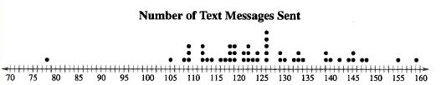
Solution: Constructing a Dot Plot
159 144 129 105 145 126 116 130 114 122 112 112 142 126
118 108 122 121 109 140 126 119 113 117 118 109 109 119
139 122 78 133 126 123 145 121 134 124 119 132 133 124
129 112 126 148 147
From the dot plot, you can see that most values cluster between 105 and 148 and the value that occurs the most is 126. You can also see that 78 is an unusual data value.
© 2012 Pearson Education, Inc. All rights reserved.
46

Slide 47
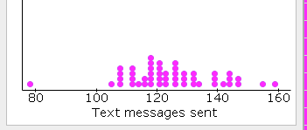
Using StatCrunch for Dot Plot
Click on Graphics, then select Dot Plot
Select Column Name “Text Messages Sent”
Click Compute!

Slide 48
Graphing Qualitative Data Sets
Pie Chart
A circle is divided into sectors that represent categories.
The area of each sector is proportional to the frequency of each category.
© 2012 Pearson Education, Inc. All rights reserved.
48

Slide 49
Example: Constructing a Pie Chart
The numbers of earned degrees conferred (in thousands) in 2007 are shown in the table. Use a pie chart to organize the data. (Source: U.S. National Center for Educational Statistics)
Type of degree | Number (thousands)
Associate’s | 728
Bachelor’s | 1525
Master’s | 604
First professional | 90
Doctoral | 60
© 2012 Pearson Education, Inc. All rights reserved.
49

Slide 50
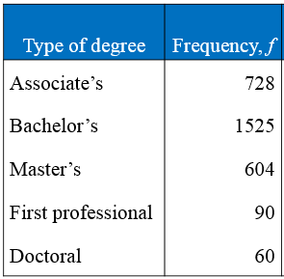
Using StatCrunch for Pie Chart
Start up StatCrunch
Enter the following data in the 1st two columns of StatCrunch
Note: To enter a label at the top of the column, click your mouse in the top cell and type over the existing var1, var2 labels

Slide 51
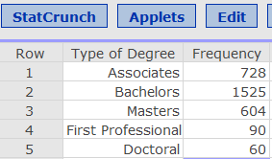
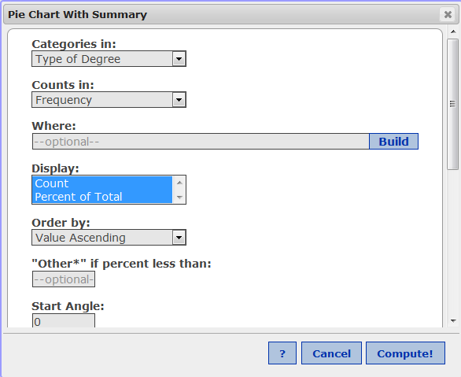
Using StatCrunch for Pie Chart
Select Graphs then Pie Chart then With Summary
Categories in: Select Type of Degree
Counts in: Select Frequency

Slide 52
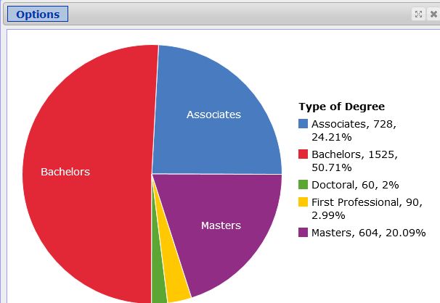
Using StatCrunch for Pie Chart

Slide 53
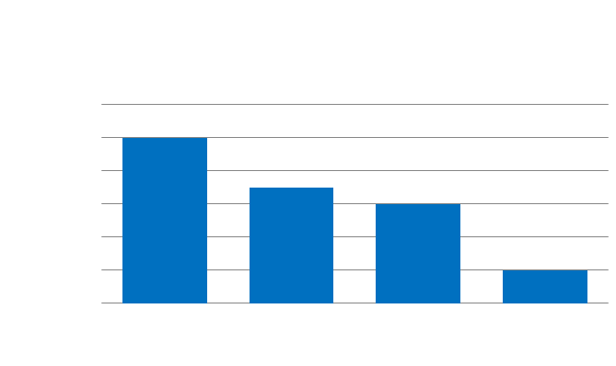
Graphing Qualitative Data Sets
Pareto Chart
A vertical bar graph in which the height of each bar represents frequency or relative frequency.
The bars are positioned in order of decreasing height, with the tallest bar positioned at the left.
Frequency
Categories
© 2012 Pearson Education, Inc. All rights reserved.
53

Slide 54
Example: Constructing a Pareto Chart
In a recent year, the retail industry lost $36.5 billion in inventory shrinkage. Inventory shrinkage is the loss of inventory through breakage, pilferage, shoplifting, and so on. The causes of the inventory shrinkage are administrative error ($5.4 billion), employee theft ($15.9 billion), shoplifting ($12.7 billion), and vendor fraud ($1.4 billion). Use a Pareto chart to organize this data. (Source: National Retail Federation and Center for Retailing Education, University of Florida)
© 2012 Pearson Education, Inc. All rights reserved.
54

Slide 55
Solution: Constructing a Pareto Chart
Cause | $ (billion)
Admin. error | 5.4
Employee theft | 15.9
Shoplifting | 12.7
Vendor fraud | 1.4
From the graph, it is easy to see that the causes of inventory shrinkage that should be addressed first are employee theft and shoplifting.
© 2012 Pearson Education, Inc. All rights reserved.
55

Slide 56
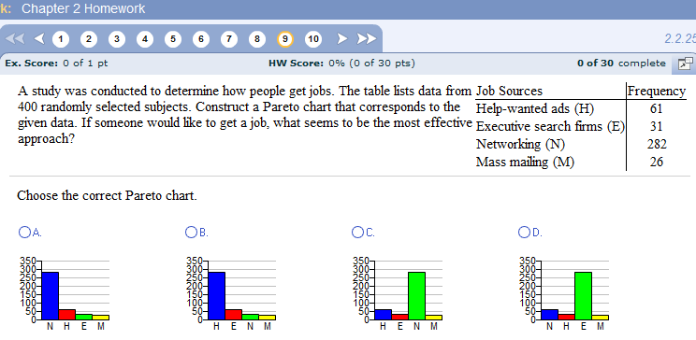
MyStatLab Example

Slide 57
Graphing Paired Data Sets
Paired Data Sets
Each entry in one data set corresponds to one entry in a second data set.
Graph using a scatter plot.
The ordered pairs are graphed as points in a coordinate plane.
Used to show the relationship between two quantitative variables.
Examples:
Salary vs. years experience
Age of car vs. value of car
y
x

Slide 58
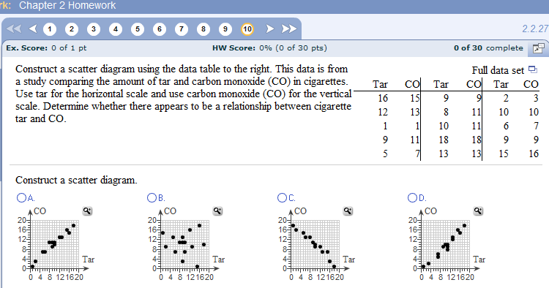
MyStatLab Example

Slide 59
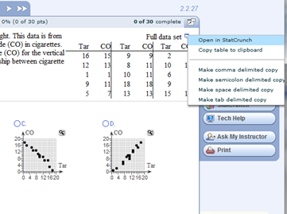
MyStatLab Example – Open in StatCrunch
By clicking on the icon in upper right corner of dataset you can copy the data directly into StatCrunch

Slide 60
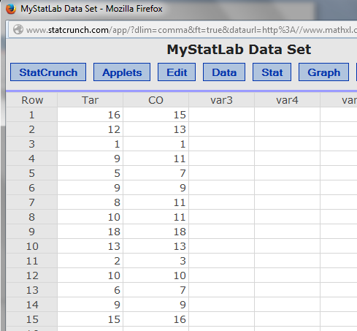
MyStatLab Example – Data is copied into StatCrunch

Slide 61
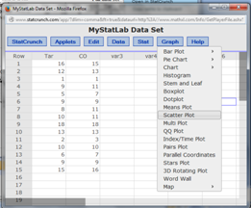
MyStatLab Example – Select Graph then ScatterPlot

Slide 62
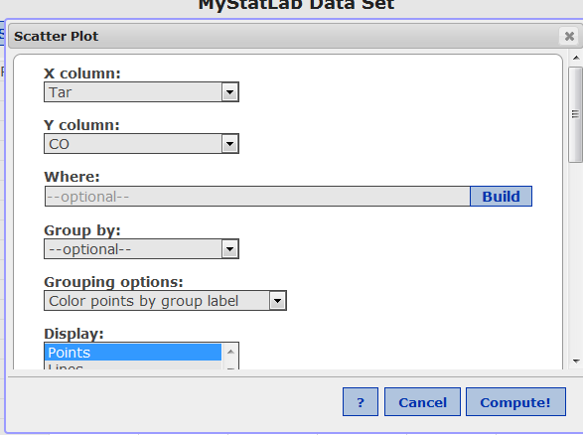
MyStatLab Example
Select X Column as TAR, Select Y Column as CO
Click Compute!

Slide 63
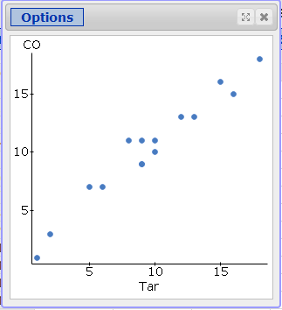
MyStatLab Example
ScatterPlot Output

