Slide 1
Section 2.3
Measures of Central Tendency
© 2012 Pearson Education, Inc. All rights reserved.

Slide 2
Measures of Central Tendency
Measure of central tendency
A value that represents a typical, or central, entry of a data set.
Most common measures of central tendency:
Mean
Median
Mode
© 2012 Pearson Education, Inc. All rights reserved.

Slide 3
Measure of Central Tendency: Mean
Mean (average)
The sum of all the data entries divided by the number of entries.
Sigma notation: Σx = add all of the data entries (x) in the data set.
Population mean:
Sample mean:
© 2012 Pearson Education, Inc. All rights reserved.

Slide 4
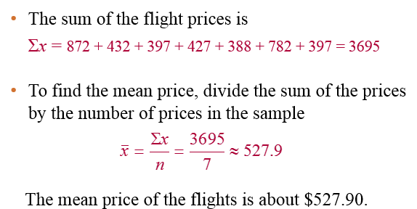
Example: Finding a Sample Mean
The prices (in dollars) for a sample of round-trip flights from Chicago, Illinois to Cancun, Mexico are listed. What is the mean price of the flights?
872 432 397 427 388 782 397

Slide 5
Measure of Central Tendency: Median
Median
The value that lies in the middle of the data when the data set is ordered.
Measures the center of an ordered data set by dividing it into two equal parts.
If the data set has an
odd number of entries: median is the middle data entry.
even number of entries: median is the mean of the two middle data entries.
© 2012 Pearson Education, Inc. All rights reserved.

Slide 6
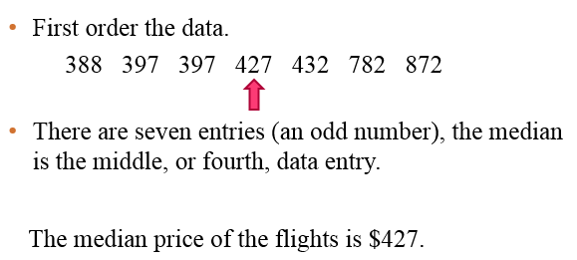
Example: Finding the Median
The prices (in dollars) for a sample of roundtrip flights from Chicago, Illinois to Cancun, Mexico are listed. Find the median of the flight prices.
872 432 397 782 427 388 397

Slide 7
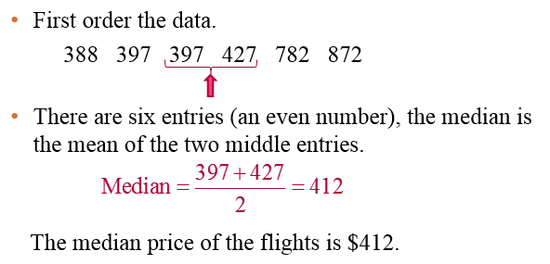
Example: Finding the Median
The flight priced at $432 is no longer available. What is the median price of the remaining flights?
872 397 427 388 782 397

Slide 8
Example
(A) Find the median of the following dataset:
10, 3, -4, 75, 420, 39, 6, 8
(B) Find the median of the following dataset:
28, 19, 13, 19, 17, 1, 279

Slide 9
Example - Solution
(A) Find the median of the following dataset:
10, 3, -4, 75, 420, 39, 6, 8
Solution: Note there are eight datapoints.
Order the data: -4, 3, 6, 8, 10, 39, 75, 420
Median = (8+10)/2 = 18/2 = 9
(B) Find the median of the following dataset:
28, 19, 13, 19, 17, 1, 279
Solution: Note there are seven datapoints.
Order the data: 1, 13, 17, 19, 19, 28, 279
Median = 19

Slide 10
Measure of Central Tendency: Mode
Mode
The data entry that occurs with the greatest frequency.
A data set can have one mode, more than one mode, or no mode.
If no entry is repeated the data set has no mode.
If two entries occur with the same greatest frequency, each entry is a mode (bimodal).

Slide 11
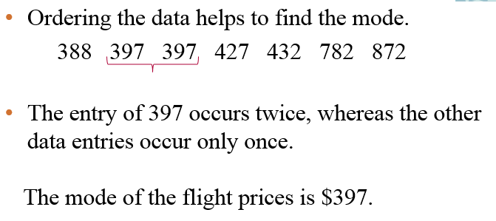
Example: Finding the Mode
The prices (in dollars) for a sample of roundtrip flights from Chicago, Illinois to Cancun, Mexico are listed. Find the mode of the flight prices.
872 432 397 427 388 782 397

Slide 12
Comparing the Mean and Median
All three measures describe a typical entry of a data set.
Advantage of using the mean:
The mean is a reliable measure because it takes into account every entry of a data set.
Disadvantage of using the mean:
Greatly affected by outliers (a data entry that is far removed from the other entries in the data set).
Notice that the median uses the position rather than the specific value of each data entry.
Thus, The median is less sensitive to outliers vs. the mean.
This is why the median is often used as the central measure for salaries or for housing prices (where outliers might be present)

Slide 13
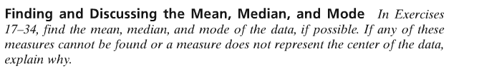
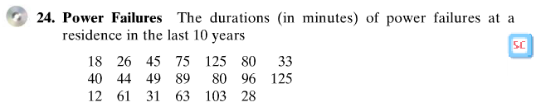
Using StatCrunch for Mean, Median
Example: Section 2.3 Exercise 24
To find mean, median and mode, we will let StatCrunch do the work

Slide 14
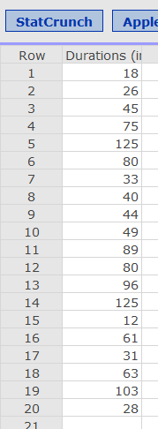

Using StatCrunch for Mean, Median
Start up StatCrunch, Select 2.3 Exercise 24

Slide 15
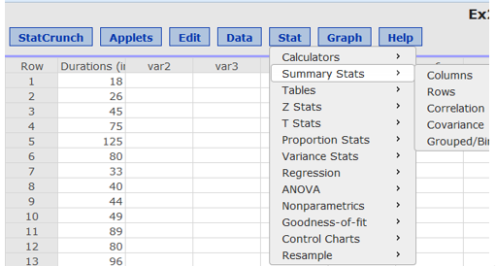
Using StatCrunch for Mean, Median
Click on Stat, then Summary Stats, then Column

Slide 16
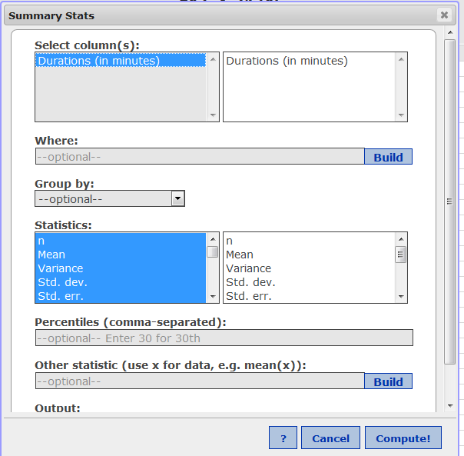
Using StatCrunch for Mean, Median
Click on Column Name to select
Duration (in minutes)

Slide 17
Using StatCrunch for Mean, Median
Under Statistics Box, we can select from choices: n, mean, Variance, etc.
Note that StatCrunch has already pre-selected the most common measurements.
Click on the right side to de-select any measurements.
Then click Compute

Slide 18
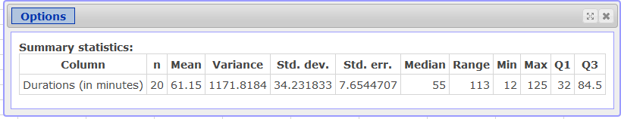
Using StatCrunch for Mean, Median
StatCrunch shows output table with calculated results

Slide 19
Weighted Mean
Weighted Mean
The mean of a data set whose entries have varying weights.
where w is the weight of each entry x
x stands for the measurements such as scores
w stands for the weightings (use decimal format in the equation)

Slide 20
Example: Finding a Weighted Mean
You are taking a class in which your grade is based on:
50% from your test mean, 15% from your midterm, 20% from your final exam, 10% from your computer lab work, and 5% from your homework.
Your scores are:
86 (test mean), 96 (midterm), 82 (final exam), 98 (computer lab), and 100 (homework).
What is the weighted mean of your scores? If the minimum average for an A is 90, did you get an A?

Slide 21
Solution: Finding a Weighted Mean
Source | Score, x | Weight, w | x∙w
Test Mean | 86 | 0.50 | 86(0.50)= 43.0
Midterm | 96 | 0.15 | 96(0.15) = 14.4
Final Exam | 82 | 0.20 | 82(0.20) = 16.4
Computer Lab | 98 | 0.10 | 98(0.10) = 9.8
Homework | 100 | 0.05 | 100(0.05) = 5.0
 |  | Σw = 1 | Σ(x∙w) = 88.6
Your weighted mean for the course is 88.6.
PS - You did not get an A (bummer).

Slide 22
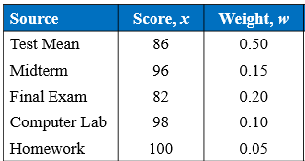
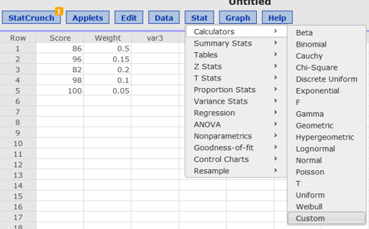
Using StatCrunch to Find Weighted Mean
Enter scores and weights into 1st two columns
Select Stat → Calculators → Custom

Slide 23
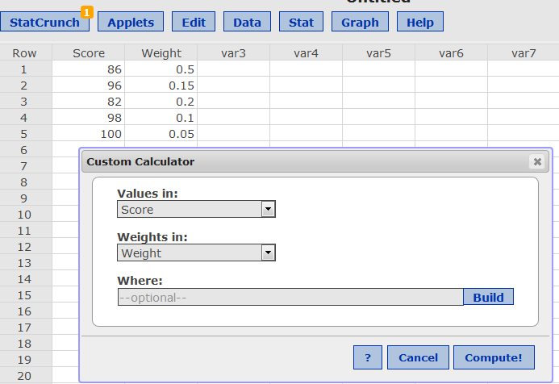
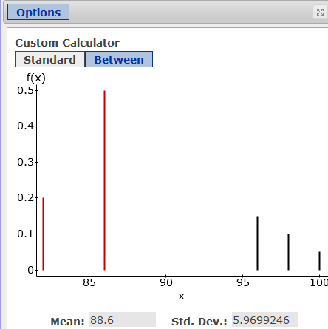
Using StatCrunch to Find Weighted Mean
Then , for Values, specify the column “Score”
Then , for Weights, specify the column “Weight”
Click “Compute” → Mean is shown as 88.6

Slide 24
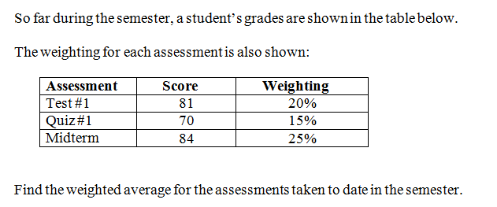
Example to Try: Weighted Mean

Slide 25
Section 2.4
Measures of Variation

Slide 26
Example to Try
For each of the two datasets shown below:
Create a dotplot for each dataset
Find the mean for each dataset
Dataset A: 47 48 49 51 52 53
Dataset B: 1 2 3 97 98 99

Slide 27
Variation
The mean of the following two datasets are both 50.
Dataset A: 47 48 49 51 52 53
Dataset B: 1 2 3 97 98 99
However notice from the dotplots that the datasets are very different in terms of the spread of the data.
The mean is often not enough to characterize a dataset.
We need a statistical measurement for the spread of the data.
The range and standard deviation are measures of the spread or variance of the dataset

Slide 28
Range
Range
The difference between the maximum and minimum data entries in the set.
The data must be quantitative.
Range = (Max. data entry) – (Min. data entry)
Example:
A corporation hired 10 graduates. The starting salaries for each graduate are shown. Find the range of the starting salaries.
Starting salaries (1000s of dollars)
41 38 39 45 47 41 44 41 37 42

Slide 29
Solution: Finding the Range
Ordering the data helps to find the least and greatest salaries.
37 38 39 41 41 41 42 44 45 47
Range = (Max. salary) – (Min. salary)
= 47 – 37 = 10
The range of starting salaries is 10 or $10,000.
Note: Although the range provides the difference between max and min, the range does not take into account the variation of all the data values.
minimum
maximum
© 2012 Pearson Education, Inc. All rights reserved.

Slide 30
Deviation, Variance, and Standard Deviation for Sample Data
Deviation
The difference between the data entry, x, and the mean of the data set.
Sample data set:
Deviation of
Sample Variance
Sample Standard Deviation

Slide 31
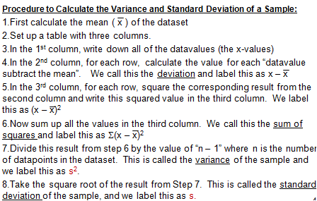
Step by Step Procedure: Variance and Standard Deviation for a Sample
StatCrunch will do this

Slide 32
Example: Finding the Sample Standard Deviation
The starting salaries are for the Chicago branches of a corporation. The corporation has several other branches, and you plan to use the starting salaries of the Chicago branches to estimate the starting salaries for the larger population. Find the sample standard deviation of the starting salaries.
Sample of Starting salaries (1000s of dollars)
41 38 39 45 47 41 44 41 37 42

Slide 33
Finding the Sample Standard Deviation
Take each Datavalue and subtract the mean
Table with 3 columns:
Salary, x | Deviation: x – x | Squares: (x – x)²
41 | 41 – 41.5 = –0.5 | (–0.5)² = 0.25
38 | 38 – 41.5 = –3.5 | (–3.5)² = 12.25
39 | 39 – 41.5 = –2.5 | (–2.5)² = 6.25
45 | 45 – 41.5 = 3.5 | (3.5)² = 12.25
47 | 47 – 41.5 = 5.5 | (5.5)² = 30.25
41 | 41 – 41.5 = –0.5 | (–0.5)² = 0.25
44 | 44 – 41.5 = 2.5 | (2.5)² = 6.25
41 | 41 – 41.5 = –0.5 | (–0.5)² = 0.25
37 | 37 – 41.5 = –4.5 | (–4.5)² = 20.25
42 | 42 – 41.5 = 0.5 | (0.5)² = 0.25
Square the result from the second column
Datavalues (called the x-values)
Add up the values from the 3rd column
Σ(x – x) = 0
SS_{x} = 88.5

Slide 34
Solution: Finding the Sample Standard Deviation
This is the sum of the 3rd column
Sample Variance
Sample Standard Deviation
n = 10, since there are 10 datavalues
The sample standard deviation is about 3.1, or $3100.
© 2012 Pearson Education, Inc. All rights reserved.

Slide 35
Meaning of Standard Deviation
What does the standard deviation measure, anyway ??
The standard deviation is a measure of how far the typical data value is away from the mean.
From the formula you can see that the standard deviation:
Subtracts the mean from each datavalue,
Divides by the number of datavalues
Note: The standard deviation is always positive.

Slide 36
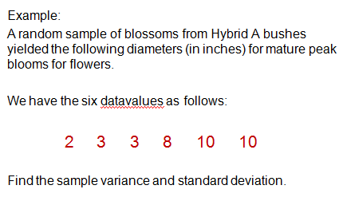
Example #1 to Try

Slide 37
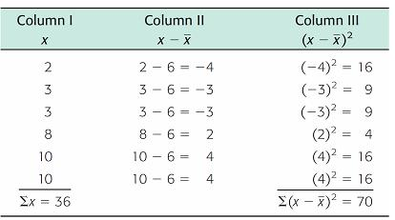
Example #1 – Solution
Step 1: Find the mean. we take the sum of the entries and divide by the number of datavalues:
Steps 2 to 6:
1st Column – Write down the data values themselves
2nd Column – Calculate the value of x – x
3rd Column – Calculate the value of (x – x )²
Note the sum of this column is 0

Slide 38
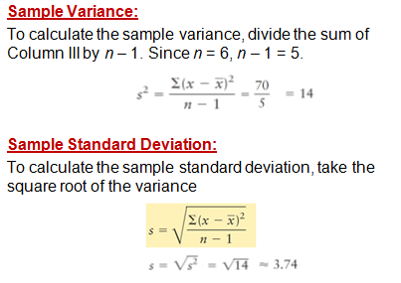
Example - Solution

Slide 39
Using StatCrunch for Sample Standard Deviation
Enter data in first column
Click on STAT then Summary Stats then Columns
Select the column of interest, Click Next
Select measurements of interest such as mean, median, variance, standard deviation, etc. Click Calculate
Note: StatCrunch will preselect typical measurements for you.

Slide 40
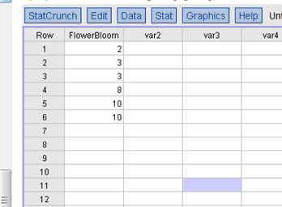
Using StatCrunch to find Sample Standard Deviation
Enter data in 1st column

Slide 41
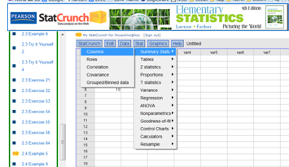
Using StatCrunch to find Sample Standard Deviation
Click on STAT then Summary Stats then Columns

Slide 42
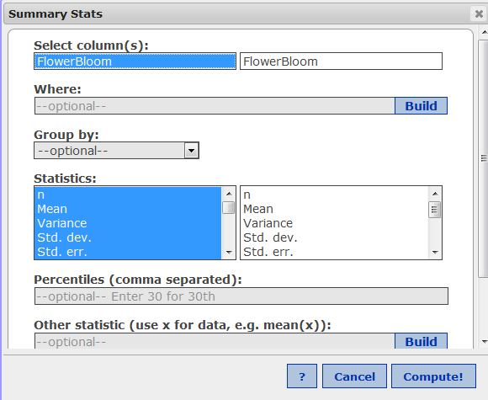
Using StatCrunch to find Sample Standard Deviation
Select Column of Interest, Click Compute!

Slide 43
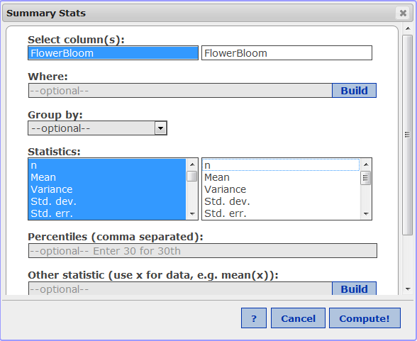
Using StatCrunch to find Sample Standard Deviation
Notice that measurements of interest such as mean, variance, standard deviation, are pre-selected

Slide 44
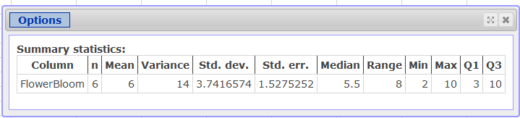
Using StatCrunch to find Sample Standard Deviation
Output Table is displayed
Note: In StatCrunch, Std. dev. refers to the sample standard deviation
For the population standard deviation , select “UNADJUSTED STANDARD DEVIATION”

Slide 45
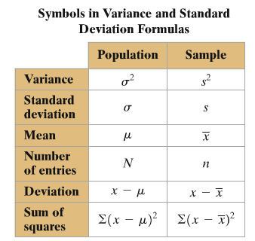

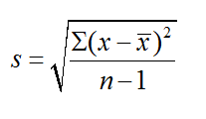
Notation
Formula for Population Standard Deviation:
Formula for Sample Standard Deviation:

Slide 46
Interpreting Standard Deviation: Empirical Rule (68 – 95 – 99.7 Rule)
For data with a (symmetric) bell-shaped distribution, the standard deviation has the following characteristics:
About 68% of the data lie within one standard deviation of the mean.
About 95% of the data lie within two standard deviations of the mean.
About 99.7% of the data lie within three standard deviations of the mean.

Slide 47
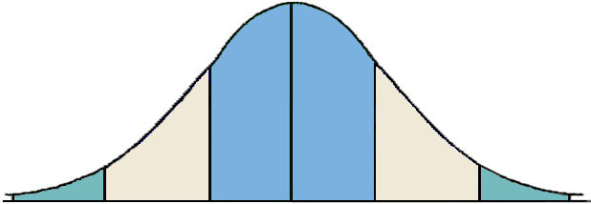
Interpreting Standard Deviation: Empirical Rule (68 – 95 – 99.7 Rule)
Note: Total area under curve is 100%
99.7% within 3 standard deviations
95% within 2 standard deviations
68% within 1 standard deviation
34%
34%
2.35%
2.35%
0.15%
13.5%
13.5%
0.15%

Slide 48
Example: Using the Empirical Rule
In a survey conducted by the National Center for Health Statistics, the sample mean height of women in the United States (ages 20-29) was 64.3 inches, with a sample standard deviation of 2.62 inches. Estimate the percent of the women whose heights are between 59.06 inches and 64.3 inches.

Slide 49
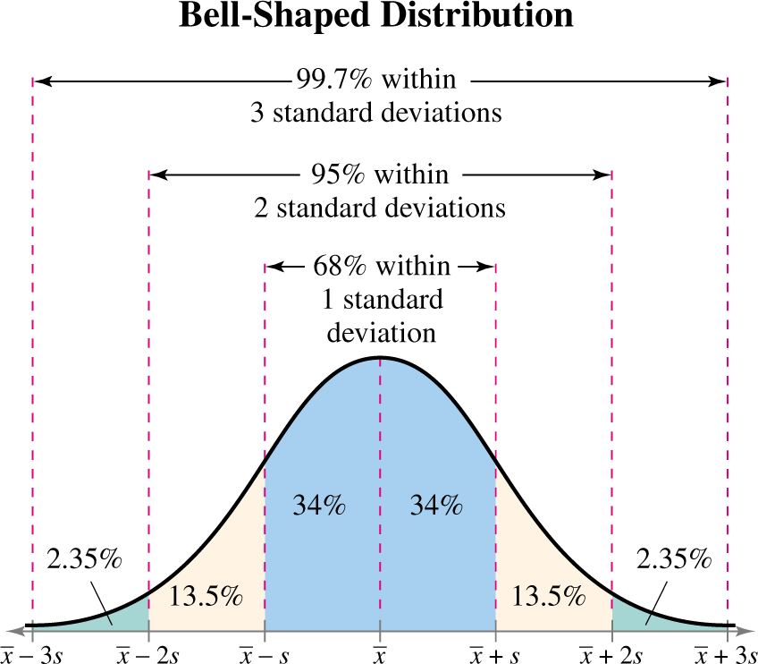
Solution: Using the Empirical Rule
Because the distribution is bell-shaped, you can use the Empirical Rule.
34% + 13.5% = 47.5% of women are between 59.06 and 64.3 inches tall.
© 2012 Pearson Education, Inc. All rights reserved.

Slide 50
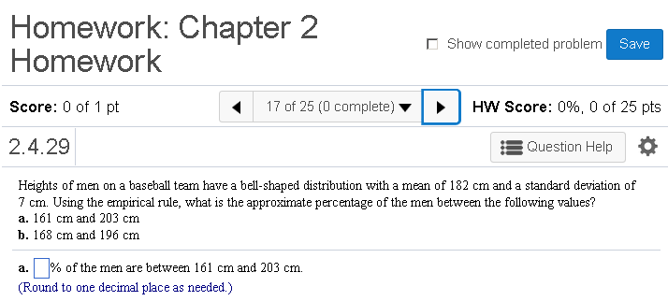
MyMathLab Example

Slide 51
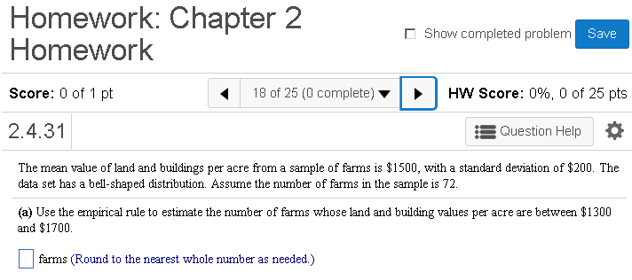
MyMathLab Example

Slide 52
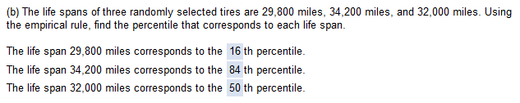
MyMathLab Example
Note: Percentiles refer to the area under the curve to the LEFT of a given x-value
To find Percentiles: Use the Empirical rule and add up the areas under the normal curve to the left of the given value

Slide 53
Section 2.5
Measures of Position

Slide 54
Quartiles
Fractiles are numbers that partition (divide) an ordered data set into equal parts.
Quartiles approximately divide an ordered data set into four equal parts.
First quartile, Q₁: About one quarter of the data fall on or below Q₁.
Second quartile, Q₂: About one half of the data fall on or below Q₂ (median).
Third quartile, Q₃: About three quarters of the data fall on or below Q₃.
© 2012 Pearson Education, Inc. All rights reserved.

Slide 55
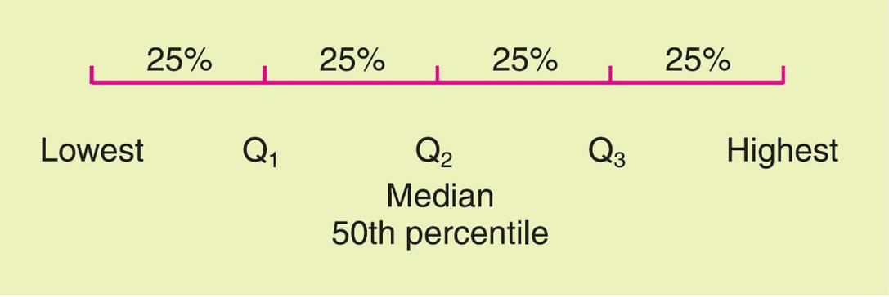
Quartiles
How to Calculate Quartiles of a Dataset:
Order the data from smallest to largest.
Find the middle value (the median). This is the 2nd quartile, called Q₂
Now, look only at all the datavalues less than the median. Find the median of this lower half of the data. This value is called the 1st Quartile (Q₁)
Now, look only at all the datavalues more than the median. Find the median of this upper half of the data. This value is called the 3rd Quartile (Q₃)

Slide 56
Quartiles
First quartile Q₁ is the 25th percentile
Second quartile Q₂ is the 50th percentile, also called MEDIAN
Third quartile Q₃ is the 75th percentile.
Applications of Quartiles:
We can use Quartiles as one method to identify outliers in a dataset
Another application: we can use quartiles to create box and whisker plots which is a graphical representation of dataset

Slide 57
Interpretation of Quartiles
Example: Suppose we collect the ages of all students in this class and determine the quartiles.
Example:
Quartile | Interpretation
Q₁ = 21 years old | 25% of students are less than 21 years old
Q₂ = 23 years old | 50% of students (half of the class) are less than 23 years old
Q₃ = 26 years old | 75% of students are less than 26 years old

Slide 58
Example: Finding Quartiles
The number of nuclear power plants in the top 15 nuclear power-producing countries in the world are listed. Find the first, second, and third quartiles of the data set.
7 18 11 6 59 17 18 54 104 20 31 8 10 15 19
Solution:
Q₂ divides the data set into two halves.
6 7 8 10 11 15 17 18 18 19 20 31 54 59 104
Lower half
Upper half
Q₂
© 2012 Pearson Education, Inc. All rights reserved.

Slide 59
Solution: Finding Quartiles
The first and third quartiles are the medians of the lower and upper halves of the data set.
6 7 8 10 11 15 17 18 18 19 20 31 54 59 104
Lower half
Upper half
Q₁
Q₂
Q₃
About one fourth of the countries have 10 or fewer nuclear power plants; about one half have 18 or fewer; and about three fourths have 31 or fewer.
© 2012 Pearson Education, Inc. All rights reserved.

Slide 60
Interquartile Range
Interquartile Range (IQR)
The difference between the third and first quartiles.
IQR = Q₃ – Q₁
© 2012 Pearson Education, Inc. All rights reserved.

Slide 61
Example: Finding the Interquartile Range
Find the interquartile range of the data set.
7 18 11 6 59 17 18 54 104 20 31 8 10 15 19
Recall Q₁ = 10, Q₂ = 18, and Q₃ = 31
Solution:
IQR = Q₃ – Q₁ = 31 – 10 = 21
The number of power plants in the middle portion of the data set vary by at most 21.
© 2012 Pearson Education, Inc. All rights reserved.

Slide 62

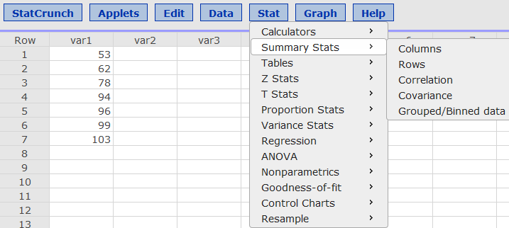
Using StatCrunch to find Quartiles and IQR
Enter data in 1st column
Select STAT → Summary Stats → Columns

Slide 63
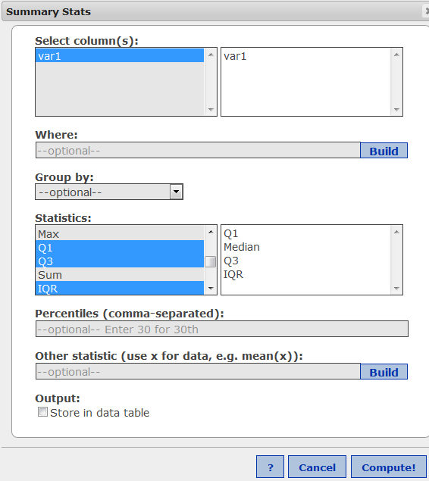
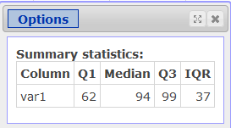
Using StatCrunch to find Quartiles and IQR
Select Q1, Median, Q3, IQR
Click Compute

Slide 64
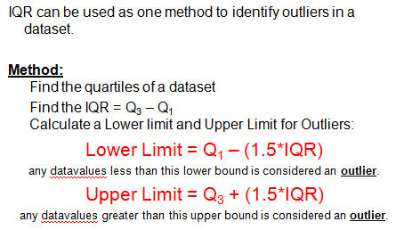
Using IQR to identify Outliers

Slide 65
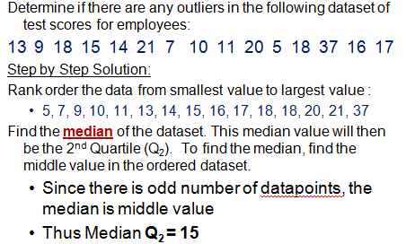
Example – Using IQR to detect Outliers

Slide 66
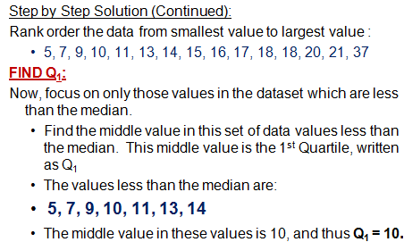
Example – Using IQR to detect Outliers

Slide 67
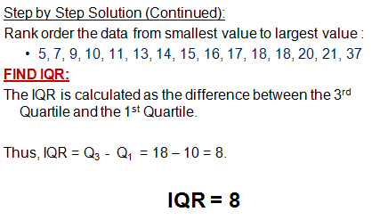
Example – Using IQR to detect Outliers

Slide 68
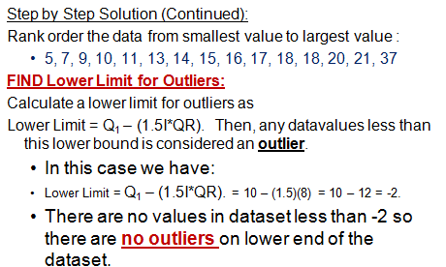
Example – Using IQR to detect Outliers

Slide 69
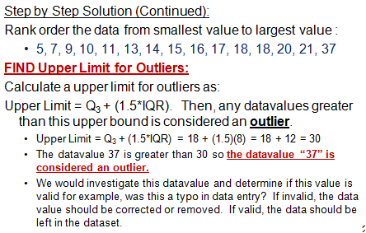
Example – Using IQR to detect Outliers

Slide 70
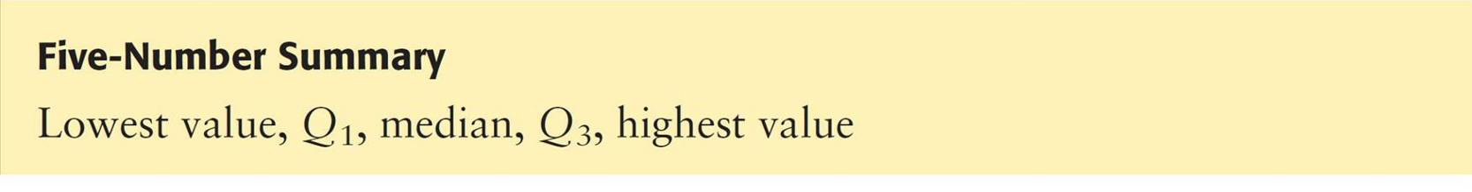
Box-and-Whisker Plot
Box-and-whisker plot
Exploratory data analysis tool.
Requires (five-number summary):
Minimum entry
First quartile Q₁
Median Q₂
Third quartile Q₃
Maximum entry
© 2012 Pearson Education, Inc. All rights reserved.

Slide 71
Drawing a Box-and-Whisker Plot
Find the five-number summary of the data set.
Construct a horizontal scale that spans the range of the data.
Plot the five numbers above the horizontal scale.
Draw a box above the horizontal scale from Q₁ to Q₃ and draw a vertical line in the box at Q₂.
Draw whiskers from the box to the minimum and maximum entries.
Box
Whisker
Whisker
Minimum entry
Maximum entry
Q₁
Median, Q₂
Q₃
© 2012 Pearson Education, Inc. All rights reserved.

Slide 72
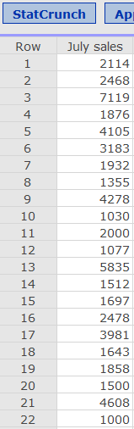
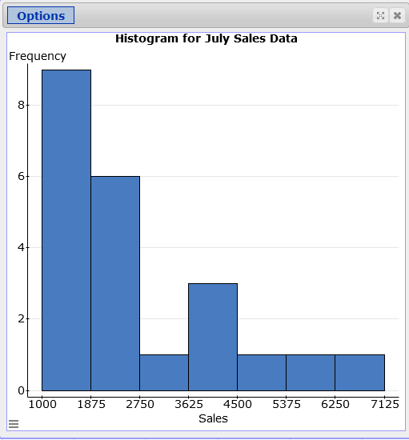
Using StatCrunch for Box and Whisker Plot
Section 2.1 Exercise 31
July Sales data for 21 salespeople
Recall the histogram looked like this:

Slide 73
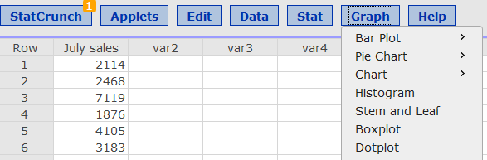
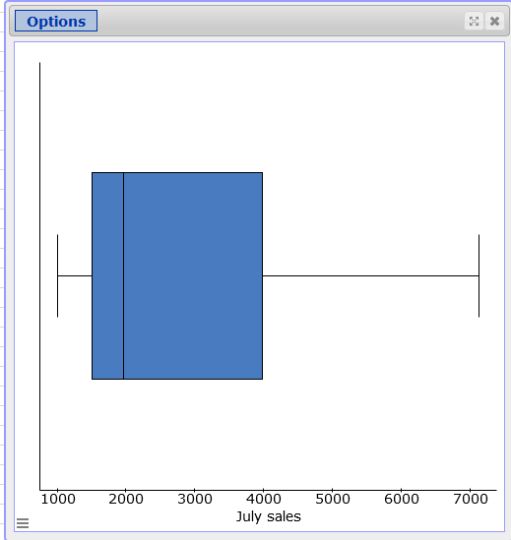
Using StatCrunch for Box and Whisker Plot
For Box and Whisker Plot in StatCrunch
GRAPH → BOX PLOT
Note: You can select to draw the boxplot either vertically or horizontally

Slide 74
The Standard Score
Standard Score (z-score)
Represents the number of standard deviations a given datavalue x falls from the mean μ.
© 2012 Pearson Education, Inc. All rights reserved.

Slide 75
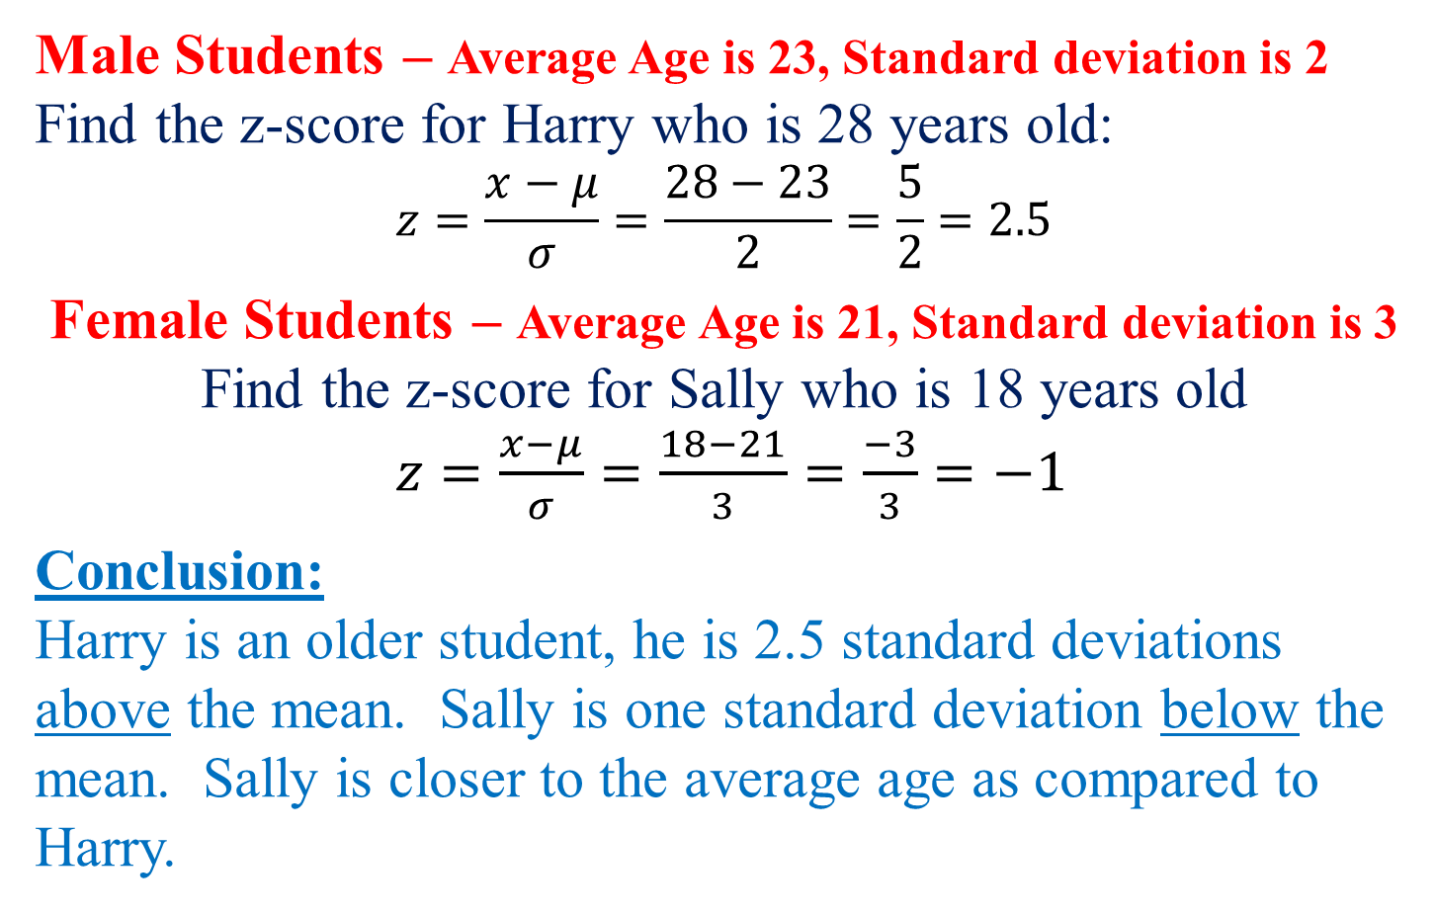
Example: Comparing z-Scores from Different Data Sets

Slide 76
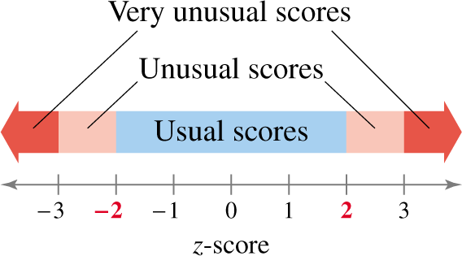

Solution: Comparing z-Scores from Different Data Sets
Harry’s age was 28, and he had a z-score of 2.5
His age would be considered as “unusual”
Sally’s age was 18, and she had a z-score of -1
Her age would be considered as “usual”
© 2012 Pearson Education, Inc. All rights reserved.

Slide 77
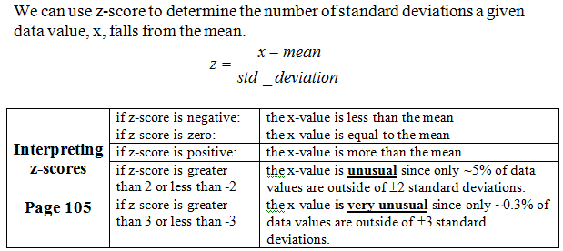
Z-score Summary

Slide 78
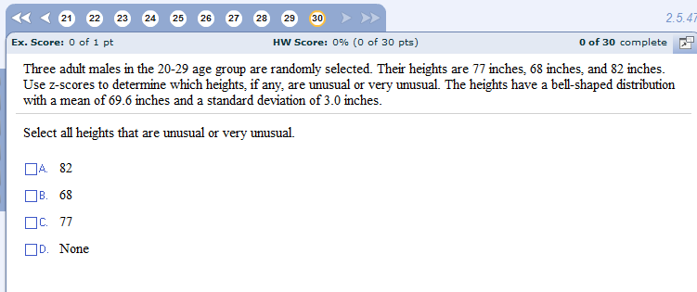
MyStatLab Example

Slide 79

MyStatLab Example

