Slide 1
HKN ECE 110 Exam 2
Review Session
Steven Kolaczkowski
Kanad Sarkar
Joseph Ravichandran

Slide 2
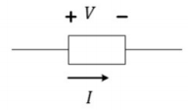
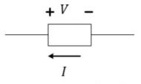

Standard VS Non-Standard Labeling
Standard Labeling: Current Flows from + to -
  $V=IR$
  $P=IV$
Non-Standard Labeling: Current Flows from – to +
  $V=−IR$
  $P=−IV$
If $P>0$ the element is absorbing power
  Resistors will always have positive power
If $P<0$ the element is supplying power

Slide 3
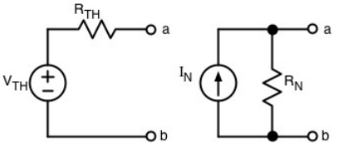

Thevenin, Norton, and IV Relationships
We can express and linear circuit as a simple circuit involving one source and one resistance
  More on this in ECE 210!
Want find $V_{oc}$ (V intercept of IV plot), $I_{sc}$ (I Intercept of IV plot), and $R_{eff}$ (inverse of the slope of IV plot)
If current is defined as standard: $I=−\frac{I_{sc}}{V_{oc}}V+I_{sc}$
If current is defined as non-standard: $I=\frac{I_{sc}}{V_{oc}}V−I_{sc}$
$V_{T}=V_{oc}$ $I_{N}=I_{sc}$ $R_{eff}=R_{N}=R_{T}$
$V_{oc}=I_{sc}R_{eff}$

Slide 4

Root Mean Square
A way to assign a meaningful voltage value to time varying signals
$V_{rms}=\sqrt{\frac{\int_{0}^{T}{{\left(v\left(t\right)\right)}^{2}dt }}{T}}$
  Square all voltage values
  Find area under one complete period
  Divide by the period
  Square root
$V_{rms}\left(Square Wave\right)=V_{peak−peak}\sqrt{Duty Cycle}=V_{peak−peak}\sqrt{\frac{t_{high}}{T}}$
$V_{rms}\left(sinusoid\right)=\frac{A}{\sqrt{2}}$
$P\left(t\right)=\frac{{\left(V\left(t\right)\right)}^{2}}{R}$ $P_{avg}=\frac{V_{rms}^{2}}{R}$

Slide 5

Node Voltage Method
We want to write KCL in terms of node voltages using Ohm’s Law.
Pick a ground node that touches as many sources as possible
Label the nodes that tough ground through a voltage source
Pick a node where you need to find the node voltage. Write KCL at that node.
Express the currents using Ohm’s Law and the node voltages $\left( I=\frac{V_{start}−V_{end}}{R} \right)$
Solve! (If there are more than one unknown and unrelated node, may need a system of equations)

Slide 6
Exam Advice
Do not spend too much time on questions you cannot answer
Spend your time showing what you know
Look at past exams
Take time to relax before your exam

Slide 7
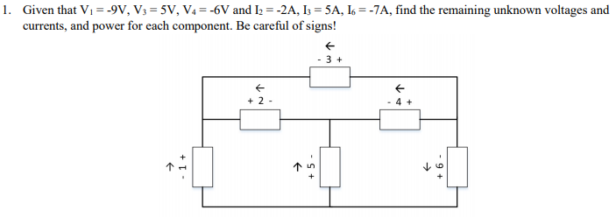

Slide 8
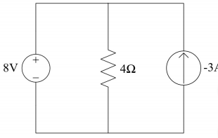

If $I_{s}=100mA$ and $V_{s}=8V$what is the power for each component?
If the $P_{I_{s}}=300mW$ and $I_{s}=100mA$ find power for $R$ and the value of $V_{s}$

Slide 9
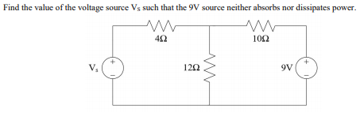

Slide 10

Consider a voltage signal $v\left(t\right)=\left\{\begin{aligned}5V for 0≤t<16sec \\ 0V for 16≤t<25sec\end{aligned}\right.$
What is $V_{rms}$ of this signal
This signal delivers an average of .25W to an unknow resistor. What is this resistor’s resistance?
Suppose we want to generate a sinusoidal waveform that provides the same average power to the resistor. What should the amplitude of this sinusoid be?

Slide 11
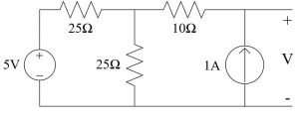

Find $V_{T}, I_{N}, R_{N},$and $R_{T}$

Slide 12
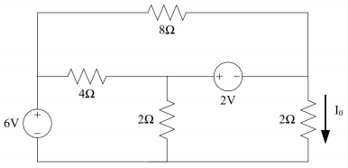

Find the labeled current $I_{0}$ in the following circuit

Slide 13
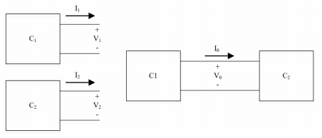

The two following subcircuits $C_{1}$ and $C_{2}$ have the following IV characteristics. Find the operation point $I_{0}$ and $V_{0}$.
$I_{1}=−\frac{V_{1}}{3}+4$ $I_{2}=−\frac{V_{2}}{15}+2$

