Slide 1











Vibe Coding
101​

Slide 2
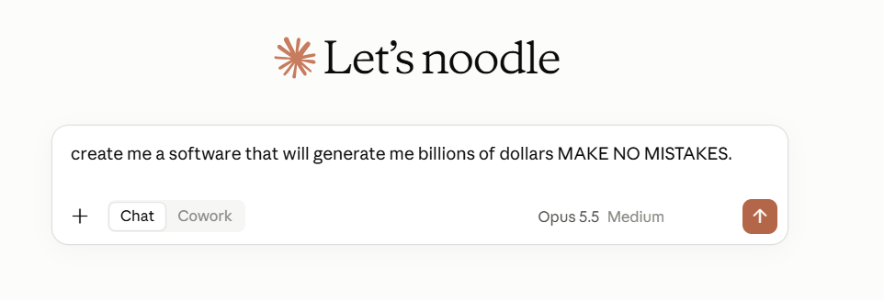
What "vibe coding" actually means​
-You describe what you want in plain language. An AI agent reads your project, plans a change, edits the files, and runs commands to check its own work. You steer, it drives.​
-The risk isn't that the AI writes bad code. It's that nobody wrote down a plan, and nobody checked the output before it shipped. Everything after this slide is about closing those two gaps

Slide 3
An agent is a loop. A model is who's thinking.
Agent
Uses a model and tools to pursue a goal, take actions, check results, and adjust its next step.
LM/ LLM
A language model interprets prompts and generates responses or code. It needs surrounding software to execute actions.
Harness
Software around the model that manages tools, context, permissions, and the loop that keeps work moving.
Most mainstream companies offer all 3 in one system like chat gpt.

Slide 4

GITHUB
Where your code (and your agent) lives
repository
a project's folder, tracked by git, hosted on GitHub
fork
your own copy of someone else's repo, linked back to it
# "Use this template" on GitHub, then:
git clone https://github.com/<you>/vibe-coding-101.git
cd vibe-coding-101
git add -A
git commit -m "add the thing"
git push
template
your own copy with a clean history, no link back
clone
pulling a repo down to your own computer to work on

Slide 5
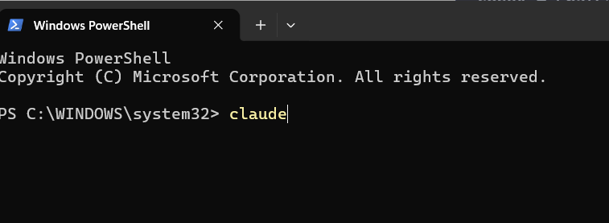
cd vibe-coding-101
# whichever tool you've got:
claude # Claude Code
copilot # GitHub Copilot CLI
codex # ChatGPT / Codex CLI
agy # Google Antigravity
> "add a login page with email + password"
THE CLI ( command_line_interface )
The terminal is where the agent actually works
A terminal just runs programs by name instead of by clicking icons. Point it at your project folder, and an agent command starts it right there, reading and editing real files instead of pasting code in and out of a chat window.

Slide 6
02 . THE CLI, CONTINUED
This meeting doesn't require a specific tool
The instructions live in AGENTS.md, a cross-tool standard now read natively by Copilot, Cursor, Codex, Windsurf, Aider, Zed, and Claude Code. Use whatever you've already got.
FREE
FREE (BETA)
GitHub Copilot
Google Antigravity
Free tier for everyone. Free Copilot Pro for students via the GitHub Student Developer Pack.
Free in public beta for personal use. An agentic IDE built around Gemini models.
Have Claude Code, Cursor, or something else through school or work? Use it. Nothing here depends on a specific tool. Full comparison in docs/tooling.md.

Slide 7
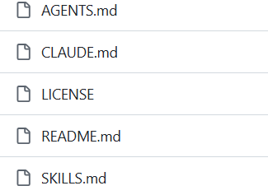
04 . SKILLS and .MD
Teaching the agent your workflow, once
A skill is a small file, usually SKILL.md, that tells the agent how to behave in a specific situation: a rule, a persona, a checklist. Install it once instead of re-explaining it every session.
Skills provided in next slides

Slide 8
04 . SKILLS, CONTINUED
Good prompt, bad prompt
An agent fills gaps you leave with guesses. A good prompt names where, states the constraint, and states how you'll know it worked.
BAD
GOOD
"make the login work"
Add email + password login...
No file, no validation rule, no definition of done. The agent guesses all three.
Add email+password login to src/auth. Reuse the Form component. Inline error under 8 chars or bad email. Write a test for the happy path and both errors.
If the vague part is your own idea, not a missing detail, that's what grill-me is for, next.

Slide 9
06 . BUILDING EFFICIENTLY
Two skills that make the agent stop overdoing it
CAVEMAN
PONYTAIL
Talk less, spend less
Don't write what doesn't need writing
Strips the agent's chatter down to blunt, terse language: code and results, not paragraphs of narration.
A decision ladder before any new code: does it need to exist? already in the codebase? one line? Then write minimal code.
~65% fewer tokens
~54% less code
Neither skill makes the agent smarter. Both stop it from doing more than the job requires.

Slide 10

07 . TESTING
TEST DRIVEN DEVELOPMENT !
The one slide to actually remember
Agent-written code can look right, run without errors, and still be wrong, because "looks right" was never checked. Without a test, the first person to find the bug is whoever's using it.
tests/test_calc.py
class TestAddScenarioCombiningTwoPrices:
def test_case_typical_prices(self):
assert add(2, 3) == 5
CI fails your pull request if tests don't pass. Don't turn that check off to get a change through. Fix the change instead.

Slide 11
07 . BEFORE YOU START
What's actually automatic here, and what isn't
Using the template does not make an agent follow BMAD, ask to be grilled, or write minimal code on its own. Those are things you have to do or ask for, every session.
1
AGENTS.md is auto-loaded into context by supporting tools. Loaded is not the same as obeyed; a long session can still drift from it.
2
The four Claude Code skills need a manual install, and most need manual invocation each time. grill-me in particular refuses to trigger itself.
3
CI reruns tests on every push, and fails a PR if src/ changed with no matching change in tests/. It catches "no test at all," not "bad test."
The template lowers the friction and sets the default. It doesn't replace the discipline of actually doing the steps.

Slide 12
08 . YOUR TURN
Use the template and start building
1
Use the template wadeburton/vibe-coding-101, clone your copy. Any AI tool works, see docs/tooling.md.
2
On Claude Code, run the setup in SKILLS.md: installs grill-me, tdd, ponytail, caveman.
3
Clarify your idea, then say "grill me on this" before writing code.
4
Plan it in docs/planning/.
5
Build it. Every change to src/ gets a test in tests/.
6
Ship, then log what you'd do differently next time.

