Slide 1
Virtualization and the Cloud
Chapter 7
Tanenbaum & Bo, Modern Operating Systems:4th ed., (c) 2013 Prentice-Hall, Inc. All rights reserved.

Slide 2
Requirements for Virtualization
Hypervisors should score well in three dimensions:
Safety: hypervisor should have full control of virtualized resources.
Fidelity: behavior of a program on a virtual machine should be identical to same program running on bare hardware.
Efficiency: much of code in virtual machine should run without intervention by hypervisor.
Tanenbaum & Bo, Modern Operating Systems:4th ed., (c) 2013 Prentice-Hall, Inc. All rights reserved.

Slide 3
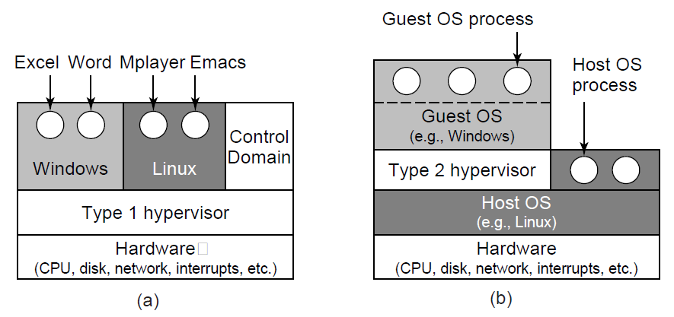
Type 1 and Type 2 Hypervisors (1)
Figure 7-1. Location of type 1 and type 2 hypervisors.
Tanenbaum & Bo, Modern Operating Systems:4th ed., (c) 2013 Prentice-Hall, Inc. All rights reserved.

Slide 4
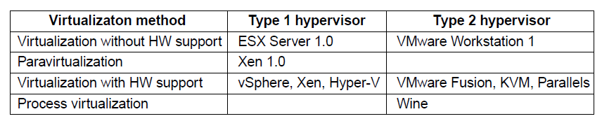
Type 1 and Type 2 Hypervisors (2)
Figure 7-2. Examples of the various combinations of virtualization type and hypervisor. Type 1 hypervisors always run on the bare metal whereas type 2 hypervisors use the services of an existing host operating system.
Tanenbaum & Bo, Modern Operating Systems:4th ed., (c) 2013 Prentice-Hall, Inc. All rights reserved.

Slide 5
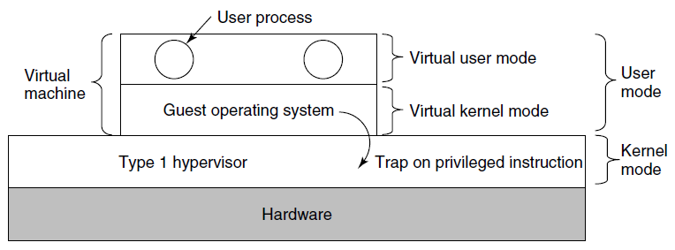
Techniques for Efficient Virtualization
Figure 7-3. When the operating system in a virtual machine executes a kernel only instruction, it traps to the hypervisor if virtualization technology is present.
Tanenbaum & Bo, Modern Operating Systems:4th ed., (c) 2013 Prentice-Hall, Inc. All rights reserved.

Slide 6
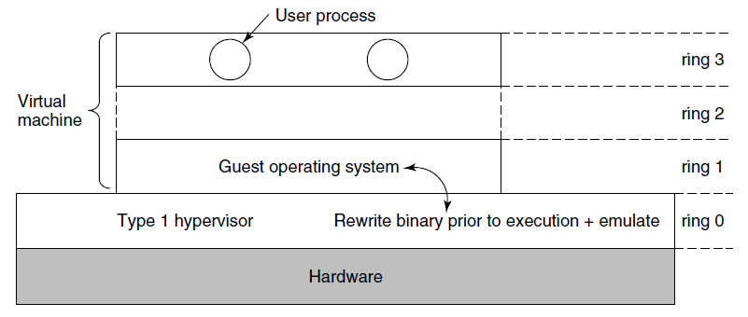
Virtualizing the Unvirtualizable
Figure 7-4. The binary translates rewrites the guest operating system running in ring 1, while the hypervisor runs in ring 0
Tanenbaum & Bo, Modern Operating Systems:4th ed., (c) 2013 Prentice-Hall, Inc. All rights reserved.

Slide 7
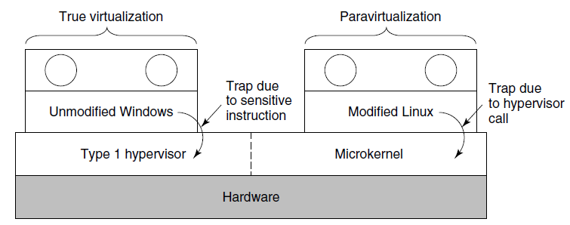
Are Hypervisors Microkernels
Done Right? (1)
Figure 7-5. True virtualization and paravirtualization
Tanenbaum & Bo, Modern Operating Systems:4th ed., (c) 2013 Prentice-Hall, Inc. All rights reserved.

Slide 8
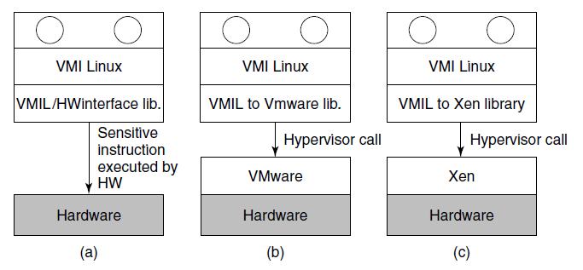
Are Hypervisors Microkernels
Done Right?
Figure 7-6. VMI Linux running on (a) the bare hardware
(b) VMware (c) Xen.
Tanenbaum & Bo, Modern Operating Systems:4th ed., (c) 2013 Prentice-Hall, Inc. All rights reserved.

Slide 9
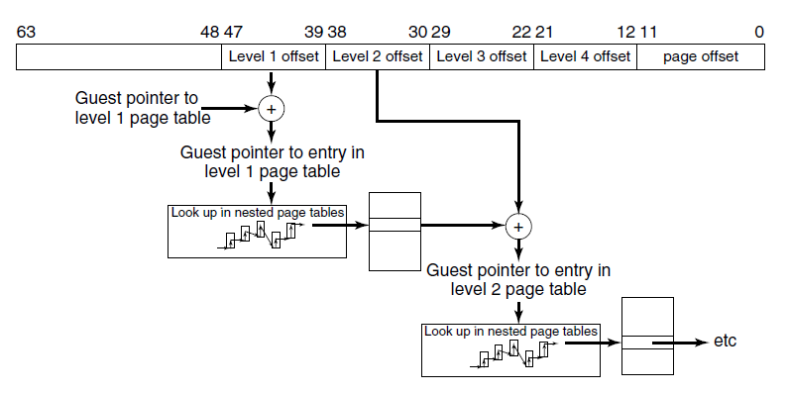
Hardware Support For
Nested Page Tables
Figure 7-7. Extended/nested page tables are walked every time a guest physical address is accessed—including the accesses for each level of the guest’s page tables.
Tanenbaum & Bo, Modern Operating Systems:4th ed., (c) 2013 Prentice-Hall, Inc. All rights reserved.

Slide 10
Clouds
National Institute of Standards and Technology defines characteristics of “cloud”
On-demand self-service
Broad network access
Resource pooling
Rapid elasticity
Measured service
Tanenbaum & Bo, Modern Operating Systems:4th ed., (c) 2013 Prentice-Hall, Inc. All rights reserved.

Slide 11
Challenges in Bringing Virtualization to the x86 (1)
Core attributes of a virtual machine to
x86-based target platform:
Compatibility
Performance
Isolation
Tanenbaum & Bo, Modern Operating Systems:4th ed., (c) 2013 Prentice-Hall, Inc. All rights reserved.

Slide 12
Challenges in Bringing Virtualization to the x86 (2)
Major Challenges:
The x86 architecture was not virtualizable
The x86 architecture was of daunting complexity
x86 machines had diverse peripherals
Need for a simple user experience
Tanenbaum & Bo, Modern Operating Systems:4th ed., (c) 2013 Prentice-Hall, Inc. All rights reserved.

Slide 13
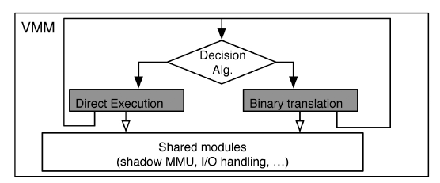
Virtualizing the x86 Architecture (1)
Figure 7-8. High-level components of the VMware virtual machine monitor (in the absence of hardware support).
Tanenbaum & Bo, Modern Operating Systems:4th ed., (c) 2013 Prentice-Hall, Inc. All rights reserved.

Slide 14
Virtualizing the x86 Architecture (2)
Binary translation must be used if any of the following is true:
Virtual machine is currently running in kernel mode
Virtual machine can disable interrupts and issue I/O instruction
Virtual machine is currently running in real mode
Tanenbaum & Bo, Modern Operating Systems:4th ed., (c) 2013 Prentice-Hall, Inc. All rights reserved.

Slide 15
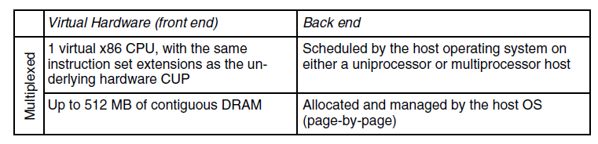
Virtual Hardware Platform (1)
Figure 7-9 Virtual hardware configuration options
of the early VMware Workstation, ca. 2000.
Tanenbaum & Bo, Modern Operating Systems:4th ed., (c) 2013 Prentice-Hall, Inc. All rights reserved.

Slide 16
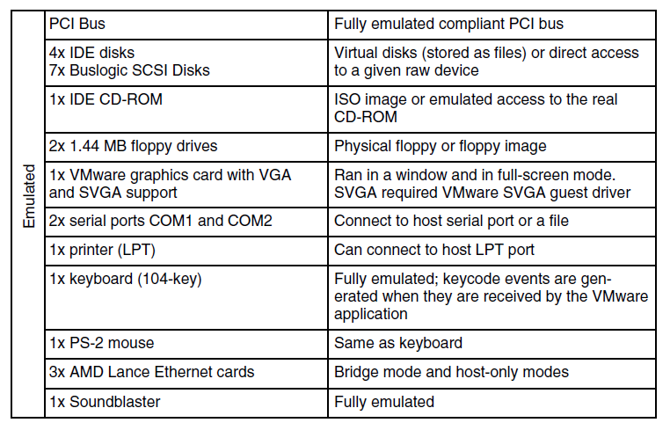
Virtual Hardware Platform (2)
Figure 7-9 Virtual hardware configuration options
of the early VMware Workstation, ca. 2000.
Tanenbaum & Bo, Modern Operating Systems:4th ed., (c) 2013 Prentice-Hall, Inc. All rights reserved.

Slide 17
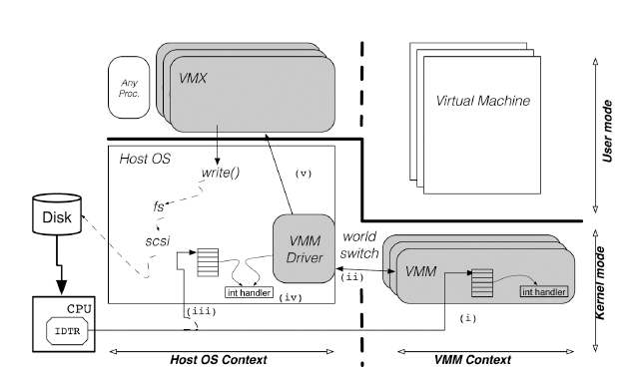
Role of the Host Operating System (1)
Figure 7-10. The VMware Hosted Architecture and its three components: VMX, VMM driver and VMM.
Tanenbaum & Bo, Modern Operating Systems:4th ed., (c) 2013 Prentice-Hall, Inc. All rights reserved.

Slide 18
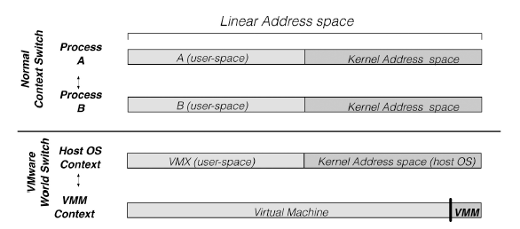
Role of the Host Operating System (2)
Figure 7-11. Difference between a normal context
switch and a world switch.
Tanenbaum & Bo, Modern Operating Systems:4th ed., (c) 2013 Prentice-Hall, Inc. All rights reserved.

Slide 19
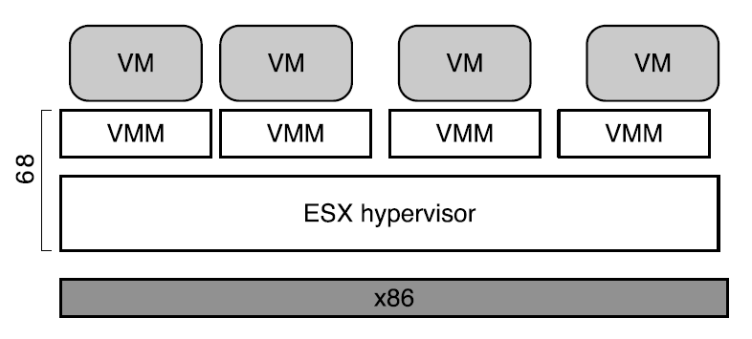
ESX Server: VMware’s type-1 Hypervisor (1)
Figure 7-11. ESX Server: VMware’s type-1 Hypervisor
Tanenbaum & Bo, Modern Operating Systems:4th ed., (c) 2013 Prentice-Hall, Inc. All rights reserved.

Slide 20
ESX Server: VMware’s type-1 Hypervisor (2)
ESX Server architecture provides substantial benefits
CPU scheduler ensures that each virtual machine gets a fair share of the CPU
Memory manager is optimized for scalability
I/O subsystem is optimized for performance
Back ends also typically relied on abstractions provided by host operating system.
ESX Server made it easy to introduce new capabilities
Tanenbaum & Bo, Modern Operating Systems:4th ed., (c) 2013 Prentice-Hall, Inc. All rights reserved.

Slide 21
End
Chapter 7
Tanenbaum & Bo, Modern Operating Systems:4th ed., (c) 2013 Prentice-Hall, Inc. All rights reserved.

