Slide 1
Database System Concepts
数据库系统概念
主讲：康辉
kanghui@jlu.edu.cn

Slide 2
引 言
课程目标
  数据库应用系统的开发能力
  数据库管理系统软件的研究与开发能力
先行课程
  C语言、数据结构、操作系统
形式：线上+课堂教学
网络资源
  www.itpub.net

Slide 3
引 言
现状
  数据库已经与操作系统、应用服务器一起成为IT基础设施的重要组成部分。
应用领域广泛
  数据仓库, 文本管理, 海量存储, 备份, 报表, 商业智能business intelligence, ERP, CRM等
  云计算、大数据
大量的相关的行业
  银行、电信、制造等几乎每个行业的数据都是存储在关系数据库中。

Slide 4
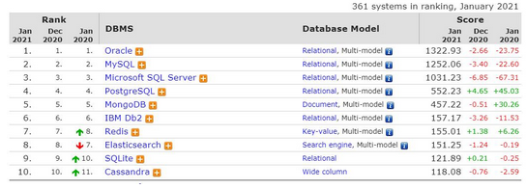
2021全球数据库排名

Slide 5
主流数据库产品 DB2
能够适合范围广泛的系统
技术先进.
侧重关键应用，电子商务、商务智能（IBM DB2 Intelligent Miner）和信息集成（IBM DB2 Warehouse Manager ）等核心应用
和Oracle一样，拥有多个应用系统

Slide 6
主流数据库产品 Oracle
1979年6月12日，全球第一个商用SQL关系数据库Oracle V2由RSI（Relational Software Inc.）公司正式推出。

Slide 7
主流数据库产品 SQL Server
小型的桌面机(关系数据库中70%的功能未被使用)
安装方便
价格低廉
Enterprise Edition中作为标准功能包含了联机分析处理（OLAP，Online analytical processing）以及数据挖掘（Data Mining）
可管理性方面，自优化、自管理等功能更完美，以便在运行数据库时无需进行更多的优化工作
售后服务完备
安全性不高
  容易受到病毒攻击

Slide 8
主流数据库产品 Adaptive Server Enterprise (ASE) - Sybase
Sybase公司是1984年成立的，属于后起之秀。
  推出支持企业范围的“客户/服务器体系结构”的数据库。
  1987年推出Sybase SQL Server，称为大学版INGRES的第三代产品。
Sybase System 11.5是其最新产品, 支持企业内部各种数据库应用需求, 如数据仓库、联机事务处理、决策支持系统和小平台应用, 具有丰富的开发工具等。
和Oracle,DB2相比，价格低廉
华尔街一半的交易都使用了Sybase公司的数据库软件
移动数据管理

Slide 9
开放源码数据库 MySQL
开放源码系统
应用广泛，主要应用于网站后台
遵循GPL协议.
  GNU Public License的缩写，最早是自由软件基金会为了促进开放源代码的发展，而搞出来的一种版权协议。
4.0不支持存储过程、外码和嵌套查询，没有视图，不是实时数据库和集群数据库，不支持嵌套子查询

Slide 10
开放源码数据库 PostgreSQL
开放源码数据库DBMS
California Berkeley开发
全球志愿者开发
版权协议是BSD,便于商业开发
PostgreSQL 拥有大型商用 DBMS 里大多数特性：
  事务，子查询，触发器，视图和复杂的锁定等。
  用户定义类型，继承，规则和多版本并行控制以减少锁的争用等。

Slide 11
工作前景
数据库DBA管理员
数据库程序开发人员
数据分析人员
  DBMiner
数据库用户

Slide 12
研究前景
国际会议
  SIGMOD, PODS,VLDB, ICDE, ICDT, EDBT, ER……
研究机构
  IBM Watson, Almaden研究中心
  AT&T实验室
  Microsoft
大学
  Stanford, Berkeley, Duke, Washington, Cornell, Pennsylvanian, Maryland, Wisconsin, Michigan

Slide 13
Chapter 1: Introduction

Slide 14
Outline
The Need for Databases
Data Models
Relational Databases
Database Design
Storage Manager
Query Processing
Transaction Manager

Slide 15
Database Management System (DBMS)
DBMS contains information about a particular enterprise
  Collection of interrelated data
  Set of programs to access the data
  An environment that is both convenient and efficient to use
Database Applications:
  Banking: transactions
  Airlines: reservations, schedules
  Universities: registration, grades
  Sales: customers, products, purchases
  Online retailers: order tracking, customized recommendations
  Manufacturing: production, inventory, orders, supply chain
  Human resources: employee records, salaries, tax deductions
Databases can be very large.
Databases touch all aspects of our lives

Slide 16
University Database Example
Application program examples
  Add new students, instructors, and courses
  Register students for courses, and generate class rosters
  Assign grades to students, compute grade point averages (GPA) and generate transcripts
In the early days, database applications were built directly on top of file systems

Slide 17
Drawbacks of using file systems to store data
Data redundancy and inconsistency
  Multiple file formats, duplication of information in different files
Difficulty in accessing data
  Need to write a new program to carry out each new task
Data isolation
  Multiple files and formats
Integrity problems
  Integrity constraints (e.g., account balance > 0) become “buried” in program code rather than being stated explicitly
  Hard to add new constraints or change existing ones

Slide 18
Drawbacks of using file systems to store data (Cont.)
Atomicity of updates
  Failures may leave database in an inconsistent state with partial updates carried out
  Example: Transfer of funds from one account to another should either complete or not happen at all
Concurrent access by multiple users
  Concurrent access needed for performance
  Uncontrolled concurrent accesses can lead to inconsistencies
    Example: Two people reading a balance (say 100) and updating it by withdrawing money (say 50 each) at the same time
Security problems
  Hard to provide user access to some, but not all, data
Database systems offer solutions to all the above problems

Slide 19

文件系统阶段
劳资科
学号
姓名
系别
补贴
学籍科
学号
姓名
系别
学分
学位
房产科
学号
姓名
系别
性别
住址
人事科
学号
姓名
系别
性别
学位
年龄
出身

Slide 20
数据库系统的特点
人事科
劳资科
系别
年龄
补贴
学位
学号
姓名
住址
学分
学籍科
性别
出身
房产科

Slide 21
Levels of Abstraction
Physical level: describes how a record (e.g., instructor) is stored.
Logical level: describes data stored in database, and the relationships among the data.
  type instructor = record
  ID : string;
  name : string;
  dept_name : string;
  salary : integer;
        end;
View level: application programs hide details of data types. Views can also hide information (such as an employee’s salary) for security purposes.

Slide 22
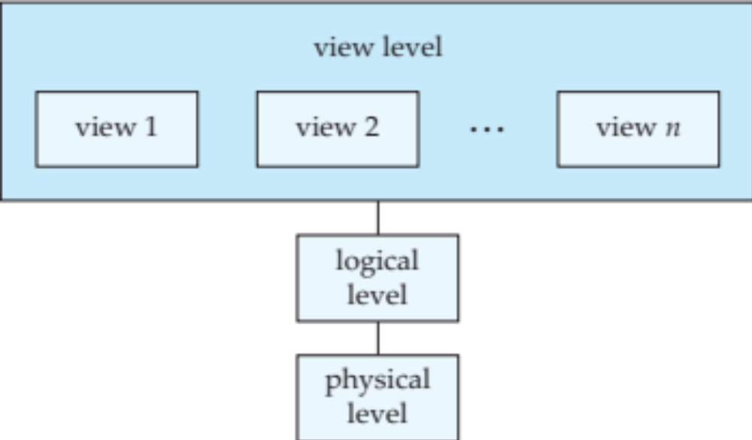
View of Data
An architecture for a database system

Slide 23
Instances and Schemas
Similar to types and variables in programming languages
Logical Schema – the overall logical structure of the database
  Example: The database consists of information about a set of customers and accounts in a bank and the relationship between them
    Analogous to type information of a variable in a program
Physical schema– the overall physical structure of the database
Instance – the actual content of the database at a particular point in time
  Analogous to the value of a variable
Physical Data Independence – the ability to modify the physical schema without changing the logical schema
  Applications depend on the logical schema
  In general, the interfaces between the various levels and components should be well defined so that changes in some parts do not seriously influence others.

Slide 24
Data Models
A collection of tools for describing
  Data
  Data relationships
  Data semantics
  Data constraints
Relational model
Entity-Relationship data model (mainly for database design)
Object-based data models (Object-oriented and Object-relational)
Semistructured data model (XML)
Other older models:
  Network model
  Hierarchical model

Slide 25

Relational Model
All the data is stored in various tables.
Example of tabular data in the relational model
Columns
Rows

Slide 26
A Sample Relational Database

Slide 27
Data Definition Language (DDL)
Specification notation for defining the database schema
  Example: create table instructor (
  ID char(5),
  name varchar(20),
  dept_name varchar(20),
  salary numeric(8,2))
DDL compiler generates a set of table templates stored in a data dictionary
Data dictionary contains metadata (i.e., data about data)
  Database schema
  Integrity constraints
    Primary key (ID uniquely identifies instructors)
  Authorization
    Who can access what

Slide 28
Data Manipulation Language (DML)
Language for accessing and manipulating the data organized by the appropriate data model
  DML also known as query language
Two classes of languages
  Pure – used for proving properties about computational power and for optimization
    Relational Algebra
    Tuple relational calculus
    Domain relational calculus
  Commercial – used in commercial systems
    SQL is the most widely used commercial language

Slide 29
SQL
The most widely used commercial language
SQL is NOT a Turing machine equivalent language
To be able to compute complex functions SQL is usually embedded in some higher-level language
Application programs generally access databases through one of
  Language extensions to allow embedded SQL
  Application program interface (e.g., ODBC/JDBC) which allow SQL queries to be sent to a database

Slide 30
Database Design
The process of designing the general structure of the database:
Logical Design – Deciding on the database schema. Database design requires that we find a “good” collection of relation schemas.
  Business decision – What attributes should we record in the database?
  Computer Science decision – What relation schemas should we have and how should the attributes be distributed among the various relation schemas?
Physical Design – Deciding on the physical layout of the database

Slide 31

Database Design (Cont.)
Is there any problem with this relation?

Slide 32
Design Approaches
Need to come up with a methodology to ensure that each of the relations in the database is “good”
Two ways of doing so:
  Entity Relationship Model (Chapter 7)
    Models an enterprise as a collection of entities and relationships
    Represented diagrammatically by an entity-relationship diagram:
  Normalization Theory (Chapter 8)
    Formalize what designs are bad, and test for them

Slide 33
Object-Relational Data Models
Relational model: flat, “atomic” values
Object Relational Data Models
  Extend the relational data model by including object orientation and constructs to deal with added data types.
  Allow attributes of tuples to have complex types, including non-atomic values such as nested relations.
  Preserve relational foundations, in particular the declarative access to data, while extending modeling power.
  Provide upward compatibility with existing relational languages.

Slide 34
XML: Extensible Markup Language
Defined by the WWW Consortium (W3C)
Originally intended as a document markup language not a database language
The ability to specify new tags, and to create nested tag structures made XML a great way to exchange data, not just documents
XML has become the basis for all new generation data interchange formats.
A wide variety of tools is available for parsing, browsing and querying XML documents/data

Slide 35
Database Engine
Storage manager
Query processing
Transaction manager

Slide 36
Storage Management
Storage manager is a program module that provides the interface between the low-level data stored in the database and the application programs and queries submitted to the system.
The storage manager is responsible to the following tasks:
  Interaction with the OS file manager
  Efficient storing, retrieving and updating of data
Issues:
  Storage access
  File organization
  Indexing and hashing

Slide 37

Query Processing
1. Parsing and translation
2. Optimization
3. Evaluation

Slide 38
Query Processing (Cont.)
Alternative ways of evaluating a given query
  Equivalent expressions
  Different algorithms for each operation
Cost difference between a good and a bad way of evaluating a query can be enormous
Need to estimate the cost of operations
  Depends critically on statistical information about relations which the database must maintain
  Need to estimate statistics for intermediate results to compute cost of complex expressions

Slide 39
Transaction Management
What if the system fails?
What if more than one user is concurrently updating the same data?
A transaction is a collection of operations that performs a single logical function in a database application
Transaction-management component ensures that the database remains in a consistent (correct) state despite system failures (e.g., power failures and operating system crashes) and transaction failures.
Concurrency-control manager controls the interaction among the concurrent transactions, to ensure the consistency of the database.

Slide 40

Database Users and Administrators
Database

Slide 41
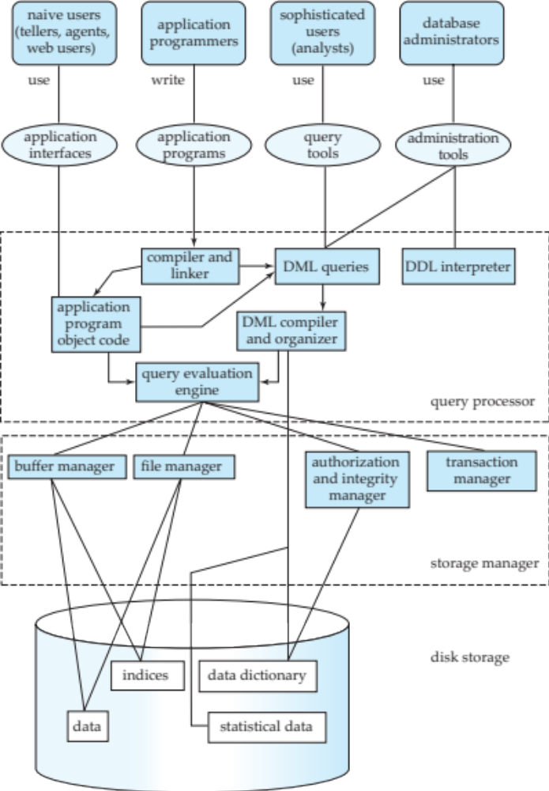
Database System Internals

Slide 42
Database Architecture
The architecture of a database systems is greatly influenced by
the underlying computer system on which the database is running:
Centralized
Client-server
Parallel (multi-processor)
Distributed

Slide 43
History of Database Systems
1950s and early 1960s:
  Data processing using magnetic tapes for storage
    Tapes provided only sequential access
  Punched cards for input
Late 1960s and 1970s:
  Hard disks allowed direct access to data
  Network and hierarchical data models in widespread use
  Ted Codd defines the relational data model
    Would win the ACM Turing Award for this work
    IBM Research begins System R prototype
    UC Berkeley begins Ingres prototype
  High-performance (for the era) transaction processing

Slide 44
History (cont.)
1980s:
  Research relational prototypes evolve into commercial systems
    SQL becomes industrial standard
  Parallel and distributed database systems
  Object-oriented database systems
1990s:
  Large decision support and data-mining applications
  Large multi-terabyte data warehouses
  Emergence of Web commerce
Early 2000s:
  XML and XQuery standards
  Automated database administration
Later 2000s:
  Giant data storage systems
    Google BigTable, Yahoo PNuts, Amazon, ..

Slide 45
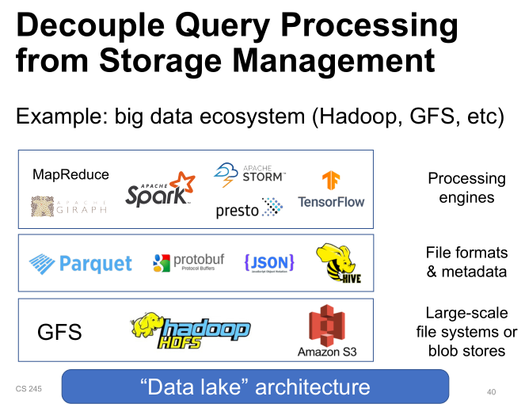

Slide 46
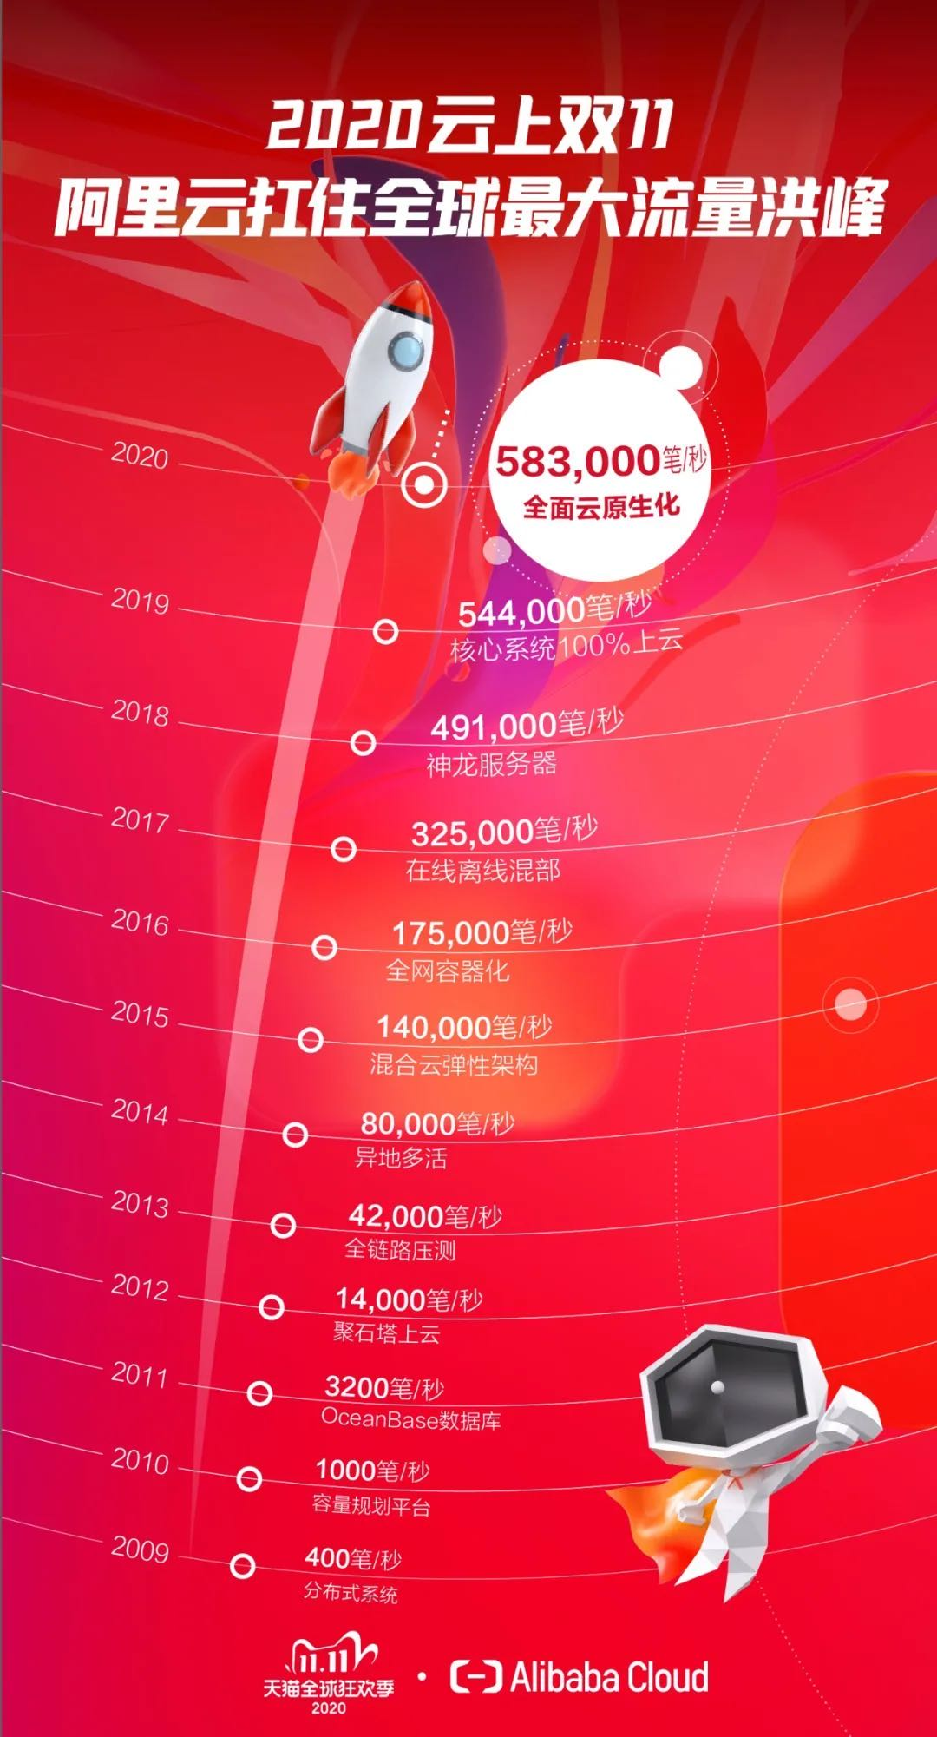

Slide 48
End of Chapter 1

