Slide 1
统一建模语言及工具 车海燕 chehy@jlu.edu.cn

Slide 2
Agenda
Chapter 1 Why we modeling and What is UML
Chapter 2 A Practice of Visual Modeling with UML
Chapter 3 Use case Modeling
Chapter 4 Use case Analysis Technique

Slide 3
Chapter 1 Why we modeling and What is UML

Slide 4
Contents
1.1Why We Modeling
1.2 Software Modeling
1.3 Introducing the UML
1.4 An example of UML modeling

Slide 5
1.1 Why We Modeling
What is a model?
What is Modeling?
What is Software Models?

Slide 6
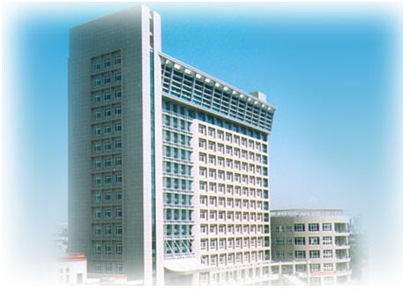
What is a model?
Architectural model

Slide 7
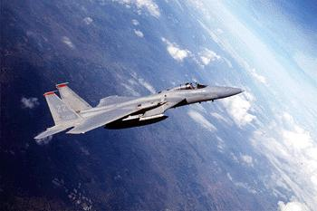
What Is a Model?
A model is a simplification of reality.
Notes:
According to Grady Booch, IBM Fellow, a model provides the blueprints of a system. Models may encompass detailed plans, as well as more general plans that give a 30,000-foot view of the system under construction. A good model includes those elements that are not relevant to the given level of abstraction. Every system may be described from different aspects using different models, and each model is therefore a semantically closed abstraction of the system. A model may be structural, emphasizing the organization of the system, or it may be behavioral, emphasizing the dynamics of the system.
Define what is meant by the term “model.”

Slide 8
What is Modeling?
客观世界
主观世界
认识世界
世界是什么样的呢?
改造世界
建模就是认识现实世界的过程
Notes:
8

Slide 9
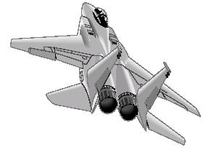
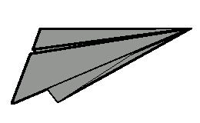
The Importance of Modeling
Less Important
More Important
Paper Airplane
Fighter Jet

Slide 10
What is Software Models?
软件模型的概念
软件模型在软件开发中的作用
软件模型的内容

Slide 11
软件模型的概念
软件模型
通过一定的形式和方法来描述软件的模型。
软件建模
建立软件模型的过程被称为软件建模。

Slide 12
软件模型的内容
描述软件向用户所能够提供的
外在特性，包括软件的目标、
功能、性能等。
需求模型

Slide 13
软件模型的内容
需求模型
立足于系统的抽象逻辑建模。
分析模型

Slide 14
软件模型的内容
需求模型
分析模型
软件设计方案的规范化描述。
包括软件的架构、详细设计、
界面设计、数据库设计等模型。
设计模型

Slide 15
软件模型的内容
需求模型
分析模型
设计模型
测试软件的方案描述。
测试模型

Slide 16
Four Principles of Modeling
The model you create influences how the problem is attacked.
Every model may be expressed at different levels of precision.
The best models are connected to reality.
No single model is sufficient.
Notes:
Modeling has a rich history in all the engineering disciplines.
The four basic principles of modeling are derived from this history.
The models you create profoundly influence how a problem is attacked and how a solution is shaped.
Every model may be expressed at different levels of precision.
The best models are connected to reality.
No single model is sufficient. Every non-trivial system is best approached through a small set of nearly independent models.
Demonstrate that there are guiding principles for visual modeling. It is not chaotic activity.
The four modeling principles are described in detail on the next four slides.
See the “UML User Guide” for a more detailed discussion on these four principles.

Slide 17
Principle 1: The Choice of Model is Important
The models you create profoundly influence how a problem is attacked and how a solution is shaped.
In software, the models you choose greatly affect your world view.
Each world view leads to a different kind of system.
Notes:
The right models illuminate the most difficult development problems, offering insight that you could not gain otherwise. The wrong models mislead you, causing you to focus on irrelevant issues.
In software, the models you choose can greatly affect your world view. If you build a system through the eyes of a database developer, you’ll likely end up with entity-relationship models that push behavior into stored procedures and triggers. If you build a system through the eyes of an object-oriented developer, you’ll end up with a system that has its architecture centered around many classes and patterns of interaction that direct how those classes work together.
Each world view leads to a different kind of system with different costs and benefits. (The Unified Modeling Language User Guide, Booch, 1999.)
Remind students that each model should reflect the problem that they are trying to solve.
The model of a system comprises many different views of that system.
Refer students to the “Architectural Blueprints -The 4+1 View of Software Architecture” by Phillipe Kruchten. You can find the white paper at http://www-306.ibm.com/software/rational/info/literature/design.jsp.
Discuss the views later in this module.
Supplement this slide with the following example. To build a home, you would use different models to resolve structural and electrical problems.

Slide 18
Principle 2: Levels of Precision May Differ
Every model may be expressed at different levels of precision.
The best kinds of models let you choose your degree of detail, depending on:
Who is viewing the model.
Why they need to view it.
View for Customers
View for Designers
Notes:
If you are building computer chips, sometimes you need a 30,000-foot view. For example, you need your investors to visualize the end product. Other times, you need to get down to the level of the circuits.
When developing a GUI system, a quick and dirty executable model of the user interface may be all you need to communicate your intentions. Other times, when you are dealing with cross-system interfaces of network bottlenecks, you need to model down to the bit level. In either case, the best models are those that let you choose your degree of detail, depending on who is doing the viewing and why they need to view it. (The Unified Modeling Language User Guide, Booch, 1999.)
Remember, there are many different ways to view a model of a solution.
Again, point out that there is no one mega-model that displays everything about a system.
Additional examples from building a home may include examples that the homebuyer may be interested only in the elevation and the floor plan.
Obviously, the construction foreman is going to need a more detailed view of the home.

Slide 19
Principle 3: The Best Models Are Connected to Reality
All models simplify reality.
A good model reflects potentially fatal characteristics.
Notes:
A physical model of a building that doesn’t respond the same way as the real materials has limited value. It’s best to have models that have a clear connection to reality. Where that connection is weak, you need to know exactly how those models are divorced from the real world.
All models simplify reality. The trick is to be sure that your simplifications don’t mask any important details. A good model reveals any potentially fatal flaws in design. (The Unified Modeling Language User Guide, Booch, 1999.)
A model should accurately reflect the real world.

Slide 20
Principle 4: No Single Model Is Sufficient
No single model is sufficient. Every non-trivial system is best approached through a small set of nearly independent models.
Create models that can be built and studied separately, but are still interrelated.
Logical View
Implementation View
Analysts/Designers
Programmers
Structure
Software management
Use-Case View
End-user
Functionality
Process View
Deployment View
System integrators
System engineering
Performance, scalability, throughput
System topology, delivery,
installation, communication
Notes:
The key phrase is “nearly independent,” meaning that models can be built and studied separately, but are still interrelated.
To understand the architecture of object-oriented systems, you need several complementary and interlocking views. An architectural view can be defined as a simplified description (an abstraction) of a system from a particular perspective or vantage point, covering particular concerns, and omitting entities that are not relevant to this perspective. Views are “slices” of models.
Each of the views below may have structural and behavioral aspects. Together, they represent the blueprints of a software system.
Use-case view exposing the requirements of the system
Logical view capturing the vocabulary of the problem space and the solution space
Process view modeling the distribution of the system’s processes and threads
Implementation view addressing the physical realization of the system
Deployment view focusing on system engineering issues
To address these different needs, Rational has defined the “4+1 view” architecture model.
Remember that not all systems require all views. The number of views is dependent on the system you’re building. For example, a single processor does not require a deployment view or a small program does not require an implementation view and so on.
Many interrelated models are needed to accurately describe a system.
Introduce the 4+1 views of architecture first.
It’s important that they understand from the beginning that the models created/read represent a specific view of the system.

Slide 21
Contents
1.1 Why We Modeling
1.2 Software Modeling
1.2.1 Software modeling Elements
1.2.2 Object oriented Software Modeling
1.2.3 Software modeling Process
1.2.4 Software modeling Tools
1.3 Introducing the UML
1.4 An example of UML modeling

Slide 22
1.2.1 Software modeling elements
面向对象的建模方法
建模方法
建模过程
支持UML的建模工具
UML
建模语言
建模工具

Slide 23
1.2.2 Object oriented software modeling
含义:
在软件开发中，采用与人的思维方式相一致的、直接面向客观事物、面向所要解决的需求问题，并用一套对象、类、继承、消息等机制开发软件的系统化软件建模方法。
特点:
对象是软件建模的重心；
包括需求、设计、实现等多种模型；

Slide 24
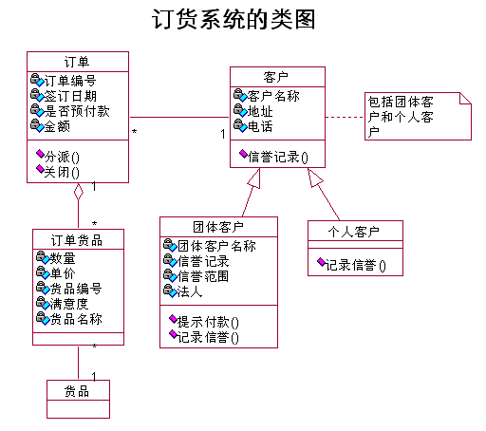
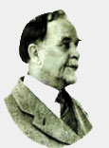
客观空间
事物
软件空间
概念
对象
主观空间
扳手
软盘
显微镜
汽车
图片
吊车
-24-

Slide 25
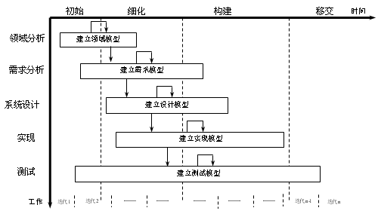
1.2.3 Software modeling process
根据软件开发的需要，进行业务建模、需求建模、分析建模、设计建模和测试建模的过程。

Slide 26
1.2.4 Software modeling tools
Rational Rose2003
Enterprise Architect
Microsoft Visio
IBM Rational Software Architect

Slide 27

Rational Rose2003:
美国Raitonal公司推出，是一个强大的UML建模工具，但从2003版之后，并入IBM整体开发平台，称之为IBM rational software architect。

Slide 28
Rational Software Architect:
Rational Software Architect（RSA）是由IBM公司的Rational Software部门开发的产品。RSA是一个基于UML 2.1的可视化建模和架构设计工具。RSA构建在Eclipse开源框架之上，它具备了可视化建模和模型驱动开发（Model-Driven Development）的能力。无论是普通的分布式应用还是Web Services，这个工具都是适用的。
2002年IBM收购了Rational公司，将所有的Rational软件产品进行整合，形成了IBM Rational软件交付平台（IBM Rational Delivery Platform），包括如下子工具：
（1）Rational Software Architect
（2）Rational Systems Developer
（3）Rational Application Developer

Slide 29
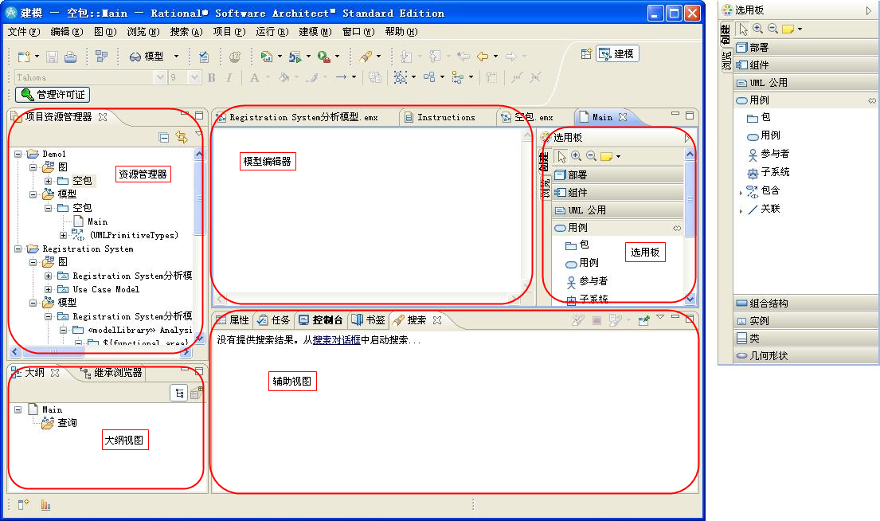
Rational Software Architect:

Slide 30
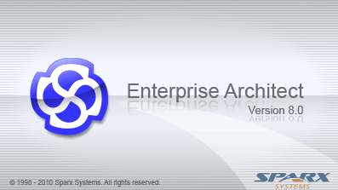
Enterprise Architect:
澳大利亚Sparx公司推出，被业界广泛接受。
https://sparxsystems.com/

Slide 31
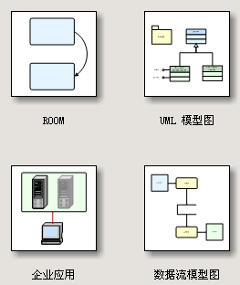
Microsoft Visio:

Slide 32
Contents
1.1 Why We Modeling
1.2 Software Modeling
1.3 Introducing the UML
1.3.1 What is UML
1.3.2 The history of UML
1.3.3 The essence of UML
1.4 An example of UML modeling

Slide 33
What is UML?
UML → “Unified Modeling Language”
Unified: UML has become a world standard
Modeling: Describing a software system at a high level of abstraction
Language: More comprehensible, ready-to-use, expressive, and visualing.
https://www.uml.org

Slide 34
Unified Modeling Language（统一建模语言）是对象管理组织（OMG）制定的一个通用的、可视化的建模语言标准，可以用来可视化（visualize） 、描述（specify）、构造（construct）和文档化（document）软件密集型系统的各种工件（artifacts，又译制品）

Slide 35
The UML Is a Language for Visualizing
Communicating conceptual models to others is prone to error unless everyone involved speaks the same language.
There are things about a software system you can’t understand unless you build models.
An explicit model facilitates communication.
Notes:
Typically, projects and organizations develop their own language for modeling systems, making it difficult for outsiders and new team members to understand what is going on.
Communicating these conceptual models to others is prone to error unless everyone involved speaks the same language. The UML offers a set of symbols that represents well-defined semantics. One developer can write a model in the UML, and another developer can interpret that model unambiguously.
There are things about a software system you can’t understand unless you build models that transcend the textual programming language. For example, the meaning of a class hierarchy can be inferred, but not directly grasped, by staring at the code for all the classes in the hierarchy. The UML is a graphical language that addresses this problem.
If the developer who cut the code never wrote down the models, the information would be lost forever. At best, the information would only be partially recoverable from the implementation after the developer has moved on. Writing models in the UML addresses this issue. An explicit model facilitates communication. (The Unified Modeling Language User Guide, Booch, 1999.)
Stress how the UML is designed to promote communication using pictures rather than text.
Using the UML allows the “light bulb” to go on in the minds of many people. Rather than trying to interpret a textual description of a system design, the UML offers a graphical representation of that same description.
In this case, a picture is truly worth a thousand words.

Slide 36
The UML Is a Language for Specifying
The UML builds models that are precise, unambiguous, and complete.
Notes:
In this context, specifying means to build models that are precise, unambiguous, and complete. In particular, the UML addresses the specification of all the important analysis, design, and implementation decisions that must be made to develop and deploy software-intensive systems. (The Unified Modeling Language User Guide, Booch, 1999.)
The UML can be used to specify detailed or general models.
Anyone who has worked on a project where miscommunication occurred appreciates this feature of the UML.
The UML allows the modeler to specify their intentions in a clear, unmistakable manner.

Slide 37
The UML Is a Language for Constructing
UML models can be directly connected to a variety of programming languages.
Maps to Java, C++, Visual Basic, and so on
Tables in a RDBMS or persistent store in an OODBMS
Permits forward engineering
Permits reverse engineering
Notes:
The UML is not a visual programming language. However, models using the UML can be directly connected to a variety of programming languages, making it possible to map from a model in the UML to a programming language or even to a database.
If it is best expressed graphically, it is done graphically in the UML. If it is best expressed textually, it is done in the programming language.
This mapping permits forward engineering: the generation of code from a UML model to a programming language. Reverse engineering is also possible: the reconstruction of a model from implementation back into the UML.
The UML was designed with forward and reverse engineering in mind.
Rational has partners who provide round-trip engineering for other languages.

Slide 38
The UML Is a Language for Documenting
The UML addresses documentation of system architecture, requirements, tests, project planning, and release management.
Use Case Diagram
Deployment Diagram
- À©µµ¿ì 95 : Å¬¶óÀÌ¾ðÆ®
ºÐ»ê È¯°æÀÇ ÇÏµå¿þ¾î¹× ³×Æ®¿÷À¸·ÎÀÇ Á¤º¸ ½Ã½ºÅÛ ¿¬°á ¸ðµ¨
- À©µµ¿ì NT: ÀÀ¿ë¼­¹ö
- À¯´Ð½º ¸Ó½Å: ÀÀ¿ë ¼­¹ö ¹× µ¥ÀÌÅ¸ ¼­¹ö, Åë½Å ¼­¹ö
- IBM ¸ÞÀÎÇÁ·¹ÀÓ: µ¥ÀÌÅ¸ ¼­¹ö, Åë½Å ¼­¹ö
Use Case 1
Window95
Windows95
Windows95
¹®¼­°ü¸®
Å¬¶óÀÌ¾ðÆ®.EXE
Windows
¹®¼­°ü¸® ¾ÖÇÃ¸´
Actor A
Use Case 2
Actor B
NT
Solaris
¹®¼­°ü¸® ¿£Áø.EXE
Alpha
Windows
ÀÀ¿ë¼­¹ö.EXE
UNIX
Use Case 3
NT
IBM
Mainframe
µ¥ÀÌÅ¸º£ÀÌ½º¼­¹ö
mainWnd
fileMgr :
document :
gFile
repository
FileMgr
DocumentList
Document
user
FileMgr
Document
add( )
name : int
fetchDoc( )
delete( )
docid : int
Æ¯Á¤¹®¼­¿¡ ´ëÇÑ º¸±â¸¦
1: Doc view request ( )
sortByName( )
get( )
numField : int
read() fill the
»ç¿ëÀÚ°¡ ¿äÃ»ÇÑ´Ù.
open( )
code..
2: fetchDoc( )
close( )
FileList
fList
read( )
sortFileList( )
3: create ( )
add( )
create( )
fillDocument( )
delete( )
1
4: create ( )
5: readDoc ( )
1
È­ÀÏ°ü¸®ÀÚ´Â ÀÐ¾î¿Â
6: fillDocument ( )
¹®¼­ÀÇ Á¤º¸¸¦ ÇØ´ç ¹®¼­
°´Ã¼¿¡ ¼³Á¤À» ¿äÃ»ÇÑ´Ù.
7: readFile ( )
Repository
rep
File
È­¸é °´Ã¼´Â ÀÐ¾îµéÀÎ
8: fillFile ( )
(from Persistence)
read( )
GrpFile
°´Ã¼µé¿¡ ´ëÇØ ÀÌ¸§º°·Î
9: sortByName ( )
name : char * = 0
Á¤·ÄÀ» ½ÃÄÑ È­¸é¿¡
read( )
º¸¿©ÁØ´Ù.
readDoc( )
open( )
readFile( )
create( )
fillFile( )
Sequence Diagram
Class Diagram
Notes:
Project artifacts are critical in controlling, measuring, and communicating about a system during its development and after its deployment.
The UML addresses the documentation of a system’s architecture and all of its details. The UML also provides a language for expressing requirements and for tests. Finally, the UML provides a language for modeling the activities of project planning and release management. (The Unified Modeling Language User Guide, Booch, 1999.)
This slide does not represent all the diagrams defined in the UML specification. For example, there is no graphic presented here for a composite structure diagram or a timing diagram. Composite structure is a more advanced modeling concept that is not covered in this course. The timing diagram is new to UML2 and will be introduced in a later module.
UML diagrams should be treated as formal project artifacts.
Each diagram created by a project team should be treated as an artifact.
The UML can help alleviate some of the paper crunch that many software teams experience.

Slide 39
History of UML
History of UML
Object-Oriented modeling languages began to appear between mid-1970 and the late 1980s ;
Identified modeling languages: <10 → >50 (1989-1994 )
Necessity and development

Slide 40
In 1994 the UML effort officially began as a collaborative effort between Booch and Rumbaugh. Jacobson was soon after included in the effort.
The goal of UML is to be a comprehensive modeling language (all things to all people) that will facilitate communication between all members of the development effort.

Slide 41



UML的创建人:
Rumbaugh Booch Jacobson
OMT方法 Booch方法 OOSE方法
UML

Slide 42

Year Version
2017: UML2.5.1
2005: UML 2.0
2001: UML 1.4
2000: UML 1.3
UML
Partners’
Expertise
1997: UML 1.0, 1.1
1996: UML 0.9 & 0.91
1995: Unified Method 0.8
Public
Feedback
OOSE
Booch ‘93
OMT - 2
Other methods
Booch ‘91
OMT - 1
began in late 1994(unifying the Booch and OMT (Object Modeling Technique) methods )

Slide 43

Inputs to the UML
Rumbaugh
Booch
Jacobson
Meyer
Fusion
Before and after conditions
Operation descriptions, message numbering
Harel
Embley
State charts
Singleton classes, High-level view
Gamma, et.al
Wirfs-Brock
Frameworks, patterns, notes
Responsibilities
Shlaer- Mellor
Selic, Gullekson, Ward
Odell
Object lifecycles
ROOM (Real-Time Object-Oriented Modeling)
Classification
Notes:
UML development included incorporating ideas from numerous other methodologists. The main challenge was to construct an approach that was simple, yet allowed the modeling of a broad range of systems. The conceptual framework was established quickly, but the notational semantics took more time.
Active collaboration with other industry leaders has brought unique expertise and experience into the UML effort. The UML effort was supported by a cross-section of the industry. Partners in the UML effort included HP, ICON Computing, IBM, I-Logix, Intellicorp, MCI Systemhouse, Microsoft, ObjecTime, Oracle, Platinum Technology, Ptech, Reich Technologies, Softeam, Sterling Software, Taskon, and Unisys. These partners provided contributors, reviewers, and advocates for the standardization efforts.
In the end, a modeling language was created that has already withstood the test of widespread use in the industry and the scrutiny of international standardization efforts.
Demonstrate that UML was developed as an industry standard with many influences. The UML is not owned and written by Rational.
Do not spend a lot of time on this slide. Simply point out one or two contributors of special interest to your audience.
For example, for a telephony audience, you might point out Harel and his state charts.

Slide 44
1.3.3 The essence of UML
UML和程序设计语言的关系
UML和软件过程的关系

Slide 45
UML和程序设计语言的关系
Java、C++ 等程序设计语言用来编码实现一个软件系统。
UML用于对一个软件系统建立模型。

Slide 46


UML和软件过程的关系
软件过程规定软件开发的阶段、步骤和工作。
UML是语言，用来描述软件模型。
A Language Is Not Enough to Build a System
Team
-
Based
Development
Modeling
Unified
Language
Process

Slide 47
Contents
1.1 Why We Modeling
1.2 Software Modeling
1.3 Introducing the UML
1.4 An example of UML modeling
1.4.1 Problem Analysis
1.4.2 Understanding things with the view of Object Oriented
1.4.3 UML based Analysis

Slide 48
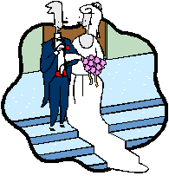
1.4.1 Problem Analysis
昨天我的一个朋友结婚了

Slide 49
Problem Analysis -1
A. 这里面有什么东东？
月老，小伙，姑娘，恋人，玫瑰花
B. 每个东东看上去是什么样的？
月老，看上去有些年纪了，挺热心的
小伙，看上去很强壮，很诚实的
姑娘，看上去好漂亮，还很温柔
恋人，看上去很亲密，当然就结婚了
玫瑰花，火红火红的，难怪姑娘动情了

Slide 50
Problem Analysis -2
C. 每个东东能做点什么用？
月老：牵线搭桥，介绍认识
小伙：追求献花，表达爱意
姑娘：仰慕倾情，以身相许
恋人：拍拖，…，结婚
玫瑰花：传情示爱

Slide 51
Problem Analysis -3
D. 这些东东都呆在什么地方？
月老：婚介所，交友网站
小伙：软件园，住唐家
姑娘：人民医院，住新香洲
恋人：情侣路，电影院， …
玫瑰花：花店里，小伙手中，姑娘手中

Slide 52
Problem Analysis -4
E. 这些东东之间有什么关系？
关系 | 月老 | 小伙 | 姑娘 | 恋人 | 玫瑰
月老 |  | 干妈 | 舅妈 | 撮合者 | 没关系
小伙 | 干儿子 |  | 男友&老公 | 男主角 | 买送主
姑娘 | 外甥女 | 女友&太太 |  | 女主角 | 受主
恋人 | 作品 | 组合 | 组合 |  | 使用者
玫瑰 | 没关系 | 准备的礼物 | 受物心意 | 礼物

Slide 53
Problem Analysis -5
F. 这些东东是怎么成事的？
月老牵线搭桥，介绍小伙和姑娘认识
姑娘和小伙一见钟情，成为一对恋人
一对恋人开始拍拖
小伙追求献花，表达对姑娘的爱意
姑娘收到999火红玫瑰
小伙真心求婚，姑娘以身相许
一对恋人终于走入婚姻殿堂

Slide 54
1.4.2 Understanding things with the view of Object Oriented

Slide 55
The view of Object Oriented
A.这里面有什么东东？ 类与对象
B.每个东东看上去是什么样的？ 类的属性
C.每个东东能做点什么用？ 类的方法
D.这些东东都呆在什么地方？ 类的行为、状态、部署
E.这些东东之间有什么关系？ 类间的关联
F.这些东东是怎么成事的？ 类间的交互
B
C
E
F
A
D

Slide 56
我的一个朋友结婚了-A
A.这里面有什么东东？
Object → Class
我 — 本剧与我无关
我的朋友 小伙
我朋友的妻子 姑娘
月老
恋人
玫瑰
……
B
C
E
F
A
D

Slide 57
我的一个朋友结婚了-B
B.每个东东看上去是什么样的？
每个事物看上去都有自己的属性，在每个属性上都有一个特征值
小伙：体格，特征值：强壮
姑娘：性情，特征值：温柔
月老：年纪，特征值：较大
恋人：关系，特征值：亲密
玫瑰：颜色，特征值：火红
B
C
E
F
A
D

Slide 58
我的一个朋友结婚了-C
C.每个东东能做点什么用？
每个事物都具备某种能力
小伙：追求、送花、娶亲
姑娘：爱慕、相许、出嫁
月老：牵线搭桥
玫瑰：示爱
B
C
E
F
A
D

Slide 59
我的一个朋友结婚了-D
D.这些东东都呆在什么地方？
每个事物都会有它合理的或者必须的空间位置和逻辑位置。尤其当这些位置对事物的行为造成重要影响的时候，表明他们的位置极其重要
本剧列出的位置对故事主要情节没有太大的影响，系统中不予考虑
B
C
E
F
A
D

Slide 60
我的一个朋友结婚了-E
E.这些东东之间有什么关系？
事物之间的关系非常多，面向对象的观点一般分为主要的三类：
整体-部分关系（组合和聚合），甲是乙的一个组成部分：如恋人和小伙，恋人和姑娘的关系
抽象-具体关系（泛化），甲是乙的一个特例：如人和小伙，人和月老，人和姑娘的关系
合作关系（关联），甲会对乙做点什么：如月老和小伙、姑娘，小伙和玫瑰，小伙和姑娘的关系
B
C
E
F
A
D

Slide 61
我的一个朋友结婚了-F
F.这些东东是怎么成事的？
每个事物都会尽量利用伙伴的能力
整体事物的能力依靠部分事物的能力
抽象事物的属性和能力就是具体事物的属性和能力；此外，具体事物还可以有自己特殊的属性和能力
事物分工协作，互通信息，共同完成整体的目标
B
C
E
F
A
D

Slide 62
俗语和术语间的对应
俗语 | 术语 | 例子
出了什么事？ | 用例 | 我的一个朋友结了婚。
具体事物 | 对象 | 我的一个朋友,他未婚妻…
事物类型 | 类 | 小伙,姑娘,玫瑰,月老…
属性 | 属性 | 年龄,体格,性情…
能力 | 方法 | 牵线,追求,结婚…
位置 | 部署 | 软件园,情侣路…
整-部关系 | 聚集关系 | 恋人-小伙,恋人-姑娘
抽-具关系 | 继承关系 | 人-小伙,人-姑娘
合作关系 | 关联关系 | 小伙-姑娘,小伙-玫瑰
成事过程 | 用例实现 | 相识,相恋,结婚

Slide 63
1.4.3 UML based Analysis
静态类图
活动图
顺序图
协作图
状态图

Slide 64
完整故事情节的静态模型

Slide 65
搞清过程的活动图

Slide 66
拍拖过程活动图
……

Slide 67
复述情节的顺序图(2-1)
初次见面顺序图

Slide 68
复述情节的顺序图(2-2)
求婚过程顺序图

Slide 69
理清头绪的协作图

Slide 70
定点观察的状态图
初步交往阶段
确定恋爱关系
热恋阶段
热恋阶段
关系不稳定阶段
拜见双方父母
订婚阶段
关系稳定阶段

Slide 71
作业
安装相关建模工具：
Enterprise Architect
RSA
Rose

