Slide 1

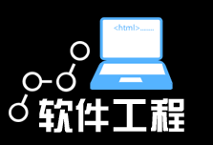

软件过程（3）

Slide 2
RUP ( Rational Unified Process)
What is RUP
Process Framework and a detailed prescriptive process model
Meta Process / Must customize
Software engineering knowledge base
Covers almost all activities of software development
Well defined structure for object-oriented design and development
Based on OO and UML
Like a software product, the Rational Unified Process is designed and documented using the Unified Modeling Language (UML)
Well documented

Slide 3
RUP ( Rational Unified Process)
开发经验（最佳实践）
迭代式开发：容纳需求变更/减少风险
管理需求：使用用例和脚本
使用基于构件的体系结构
可视化建模
验证软件质量：质量评估内建在贯穿于整个开发过程的、由全体成员参与的所有活动中
控制软件变更

Slide 4
1. Develop Software Iteratively
An initial design will likely be flawed with respect to its key requirements
Late-phase discovery of design defects results in costly over-runs and/or project cancellation
The time and money spent implementing a faulty design
are not recoverable

Slide 5
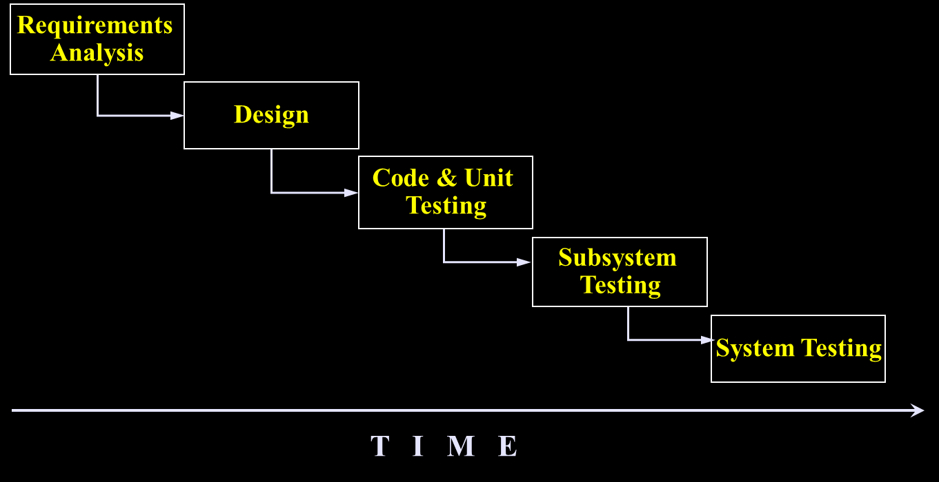
Waterfall Development

Slide 6
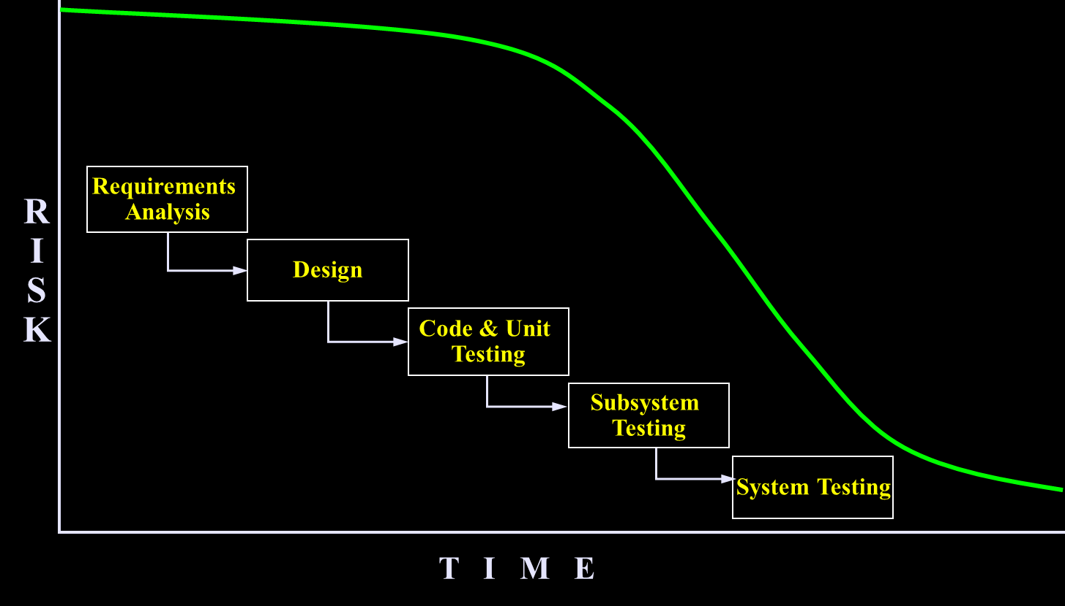
Waterfall Development: Risk vs. Time

Slide 7
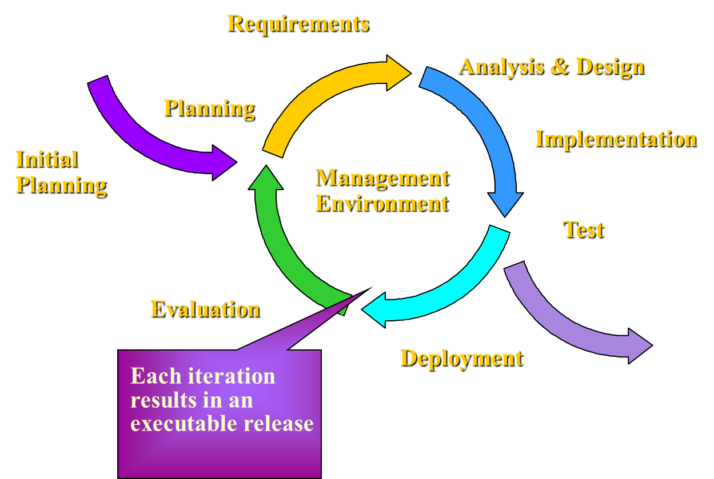
Iterative Development

Slide 8
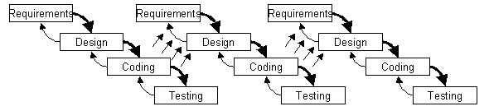
An Iterative Development Lifecycle

Slide 9
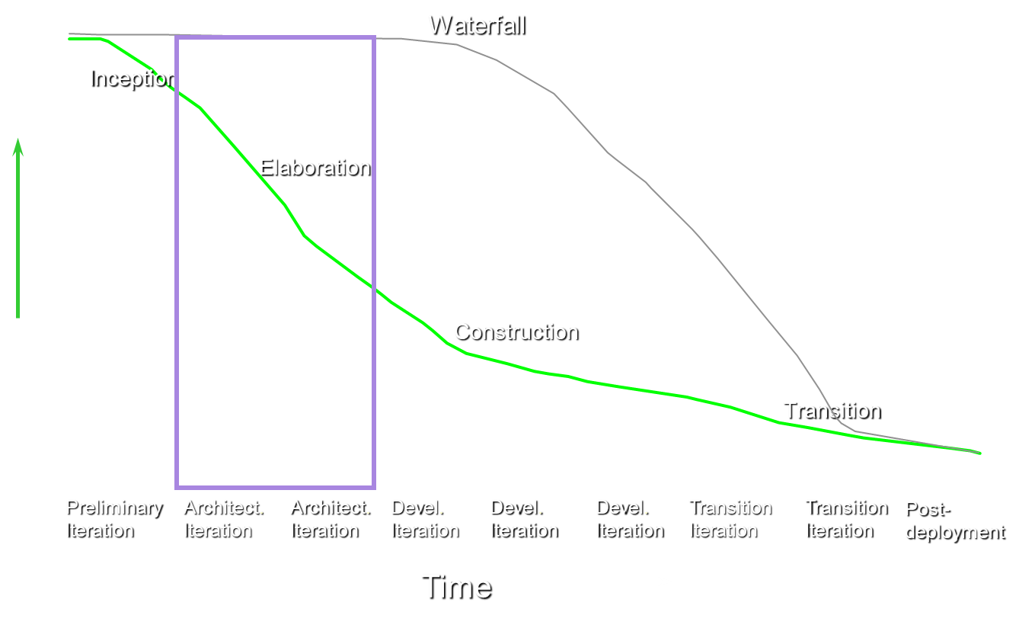
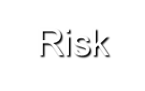
Risk Profile of an Iterative Development
Risks - process, technology, teamwork, customer, business domain

Slide 10
Iterative Development Characteristics
Critical risks are resolved before making large investments
Initial iterations enable early user feedback
Testing and integration are continuous
Objective milestones provide short-term focus
Progress is measured by assessing implementations
Partial implementations can be deployed

Slide 11
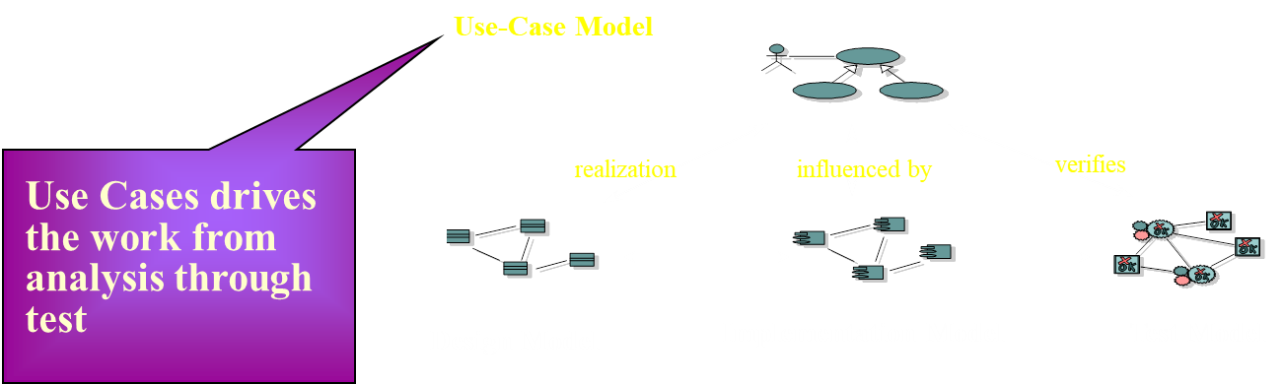
2. Manage Your Requirements
Elicit, organize, and document required functionality and constraints
Track and document tradeoffs and decisions
Business requirements are easily captured and communicated through use cases
Use cases are important planning instruments

Slide 12
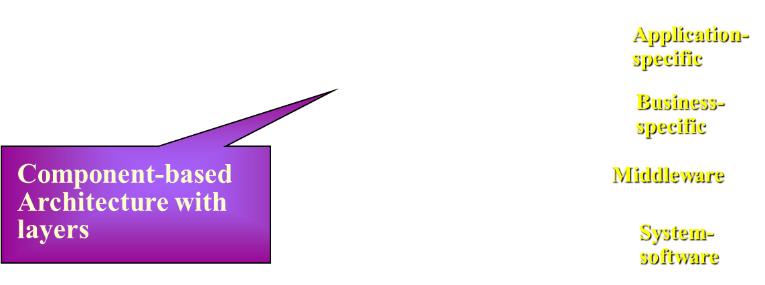
3. Employ Component-based Architecture
Design, implement and test your architecture up-front!
A systematic approach to define a “good” architecture
resilient to change by using well-defined interfaces
by using and reverse engineering components
derived from top rank use cases
intuitively understandable

Slide 13
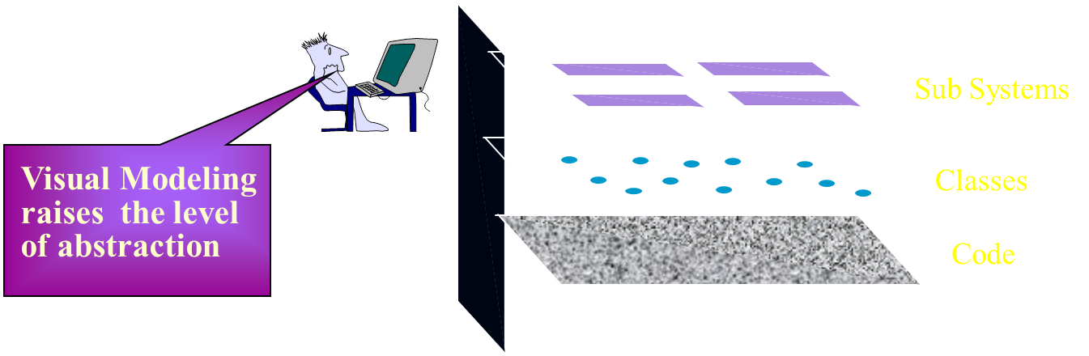
4. Model Software Visually
Capture the structure and behavior of architectures and components
Show how the elements of the system fit together
Maintain consistency between a design and its implementation
Promote unambiguous communication

Slide 14
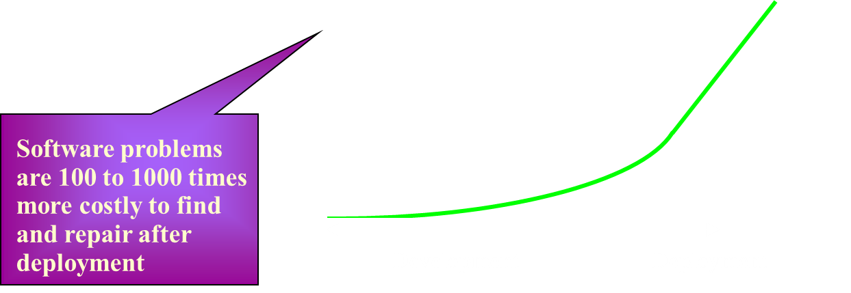
5. Verify Software Quality
Create tests for each key scenario to ensure that all requirements are properly implemented
Unacceptable application performance hurts as much as unacceptable reliability
Verify software reliability - memory leaks, bottle necks
Test every iteration - automate test!

Slide 15
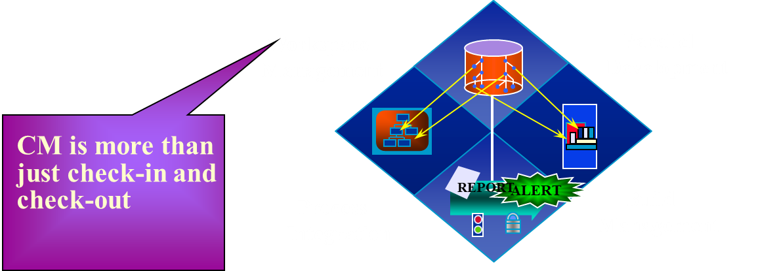
6. Control Changes to Software
Control, track and monitor changes to enable iterative development
Establish secure workspaces for each developer
Provide isolation from changes made in other workspaces
Control all software artifacts - models, code, docs, etc.
Automate integration and build management

Slide 16
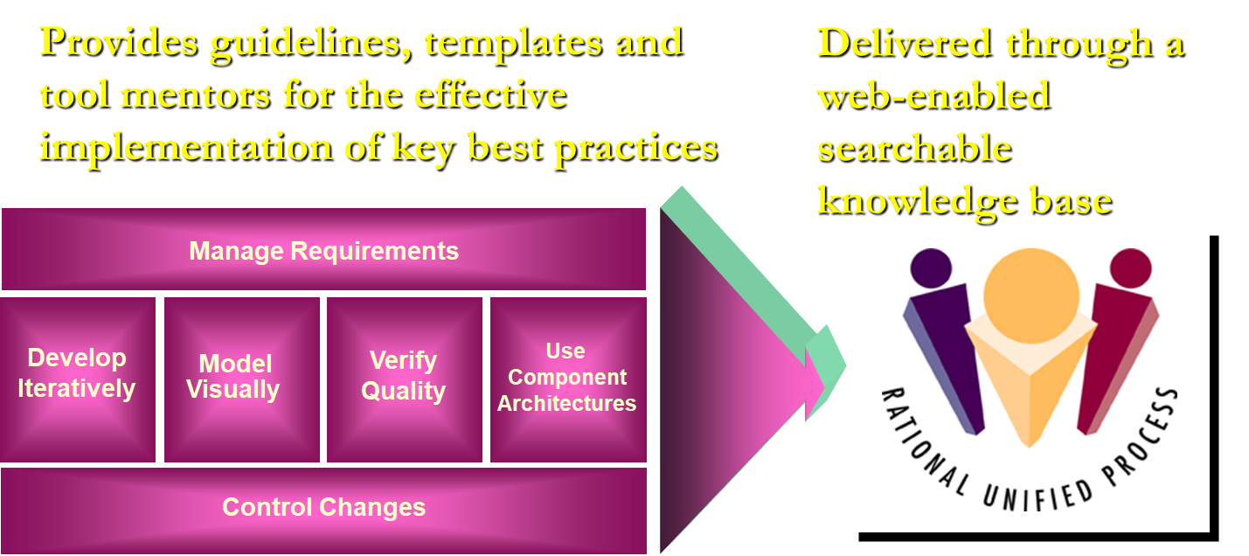
Rational Unified Process

Slide 17
RUP术语(RUP Terminology)
Worker
a Role played by individuals on a project
some people have many roles
Activity
a unit of work with a clear purpose, broken down into steps
small, definable, reusable tasks that can be allocated to a single worker
Artifact
a work product produced as a result of an activity
usually process deliverables, like: use cases, code, plans, test cases, test results
Workflow
The sequence of activities performed in a business that produces a result of observable value to an individual actor of the business.

Slide 18
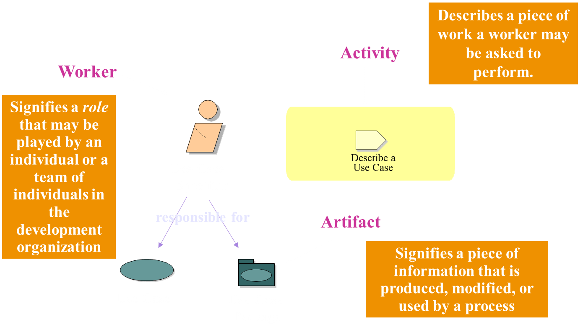
Process Notation

Slide 19
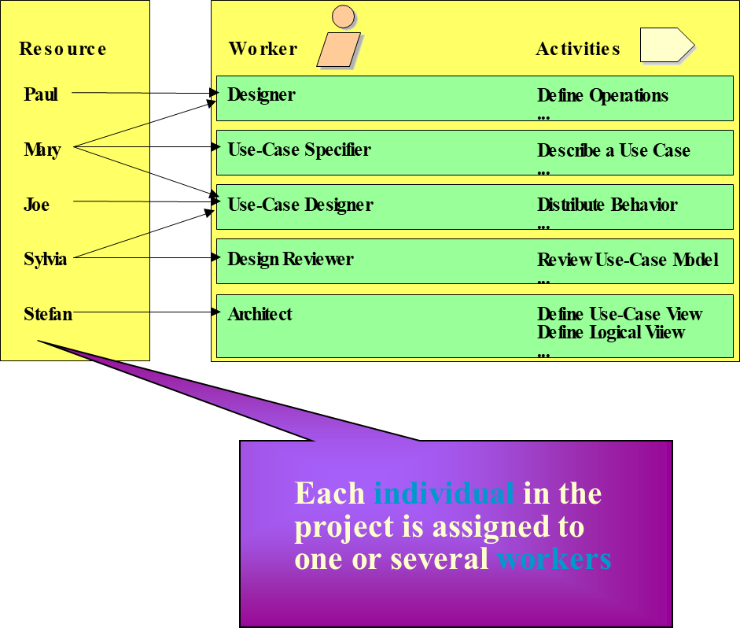
Workers Are Used for Resource Planning

Slide 20
RUP软件开发生命周期
阶段
工作流
初始
精化
构建
移交
业务建模
需求
分析与设计
实现
测试
部署
配置与变更管理
项目管理
环境
初始
精化1
精化2
构建1
构建2
构建3
移交1
移交2

Slide 21
RUP软件开发生命周期的静态结构
核心工作流
业务建模
需求
分析与设计
实现
测试
部署：生成目标系统的可运行版本，移交给用户
配置与变更管理：跟踪维护开发过程中Artifacts的完整性和一致性
项目管理：提供项目管理框架，为软件开发项目制定计划、人员配备、执行和监控等方面的使用准则，并为风险管理提供框架
环境：软件开发环境，包括过程管理和工具支持

Slide 26
RUP软件开发生命周期的动态结构
工作阶段
Inception（先启）：生命周期目标里程碑
建立业务模型，定义最终产品视图，确定项目的范围
Elaboration（精化）：生命周期架构里程碑
设计并确定系统的体系结构，制定项目计划，确定资源需求
Construction（构建）：初始可操作性能里程碑
开发所有构件和程序，集成为客户需要的产品，测试所有功能
Transition（移交）：产品发布里程碑
把开发出的产品提交给用户使用

Slide 27
RUP迭代式开发
整个项目开发过程由多个迭代过程组成。
每次迭代只考虑一部分系统需求。
每个迭代都是风险驱动的。
每个迭代都可以看作是一个“小型的瀑布模型”过程。
以一个交付版本结束
其结果是一个增量，增加一些新的功能
每次迭代以不同的重点和强度访问核心工作流。

Slide 28
Inception
Elaboration
Construction
Transition
Iteration 1
Iteration 2
Iteration 3
“Mini-Waterfall” Process
Iteration Planning
Rqmts Capture
Analysis & Design
Implementation
Test
Prepare Release

Slide 29
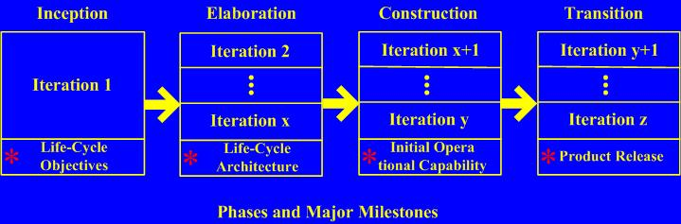

Slide 30
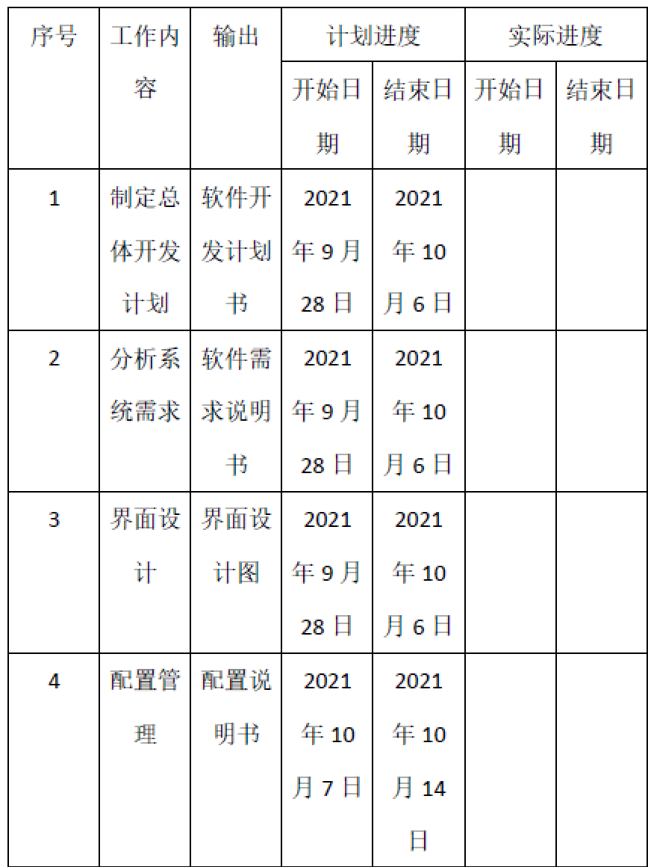
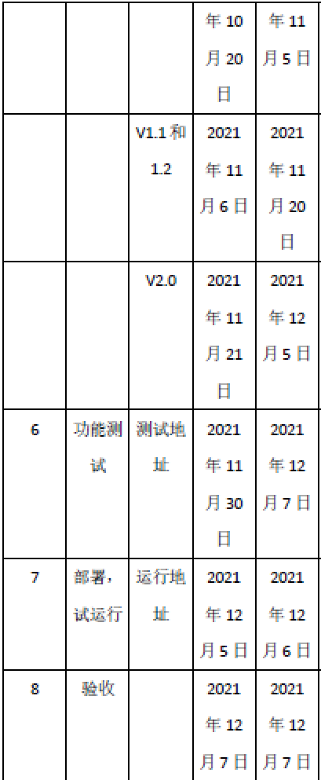
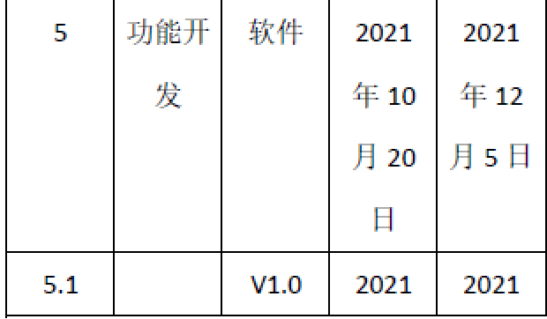

Slide 31
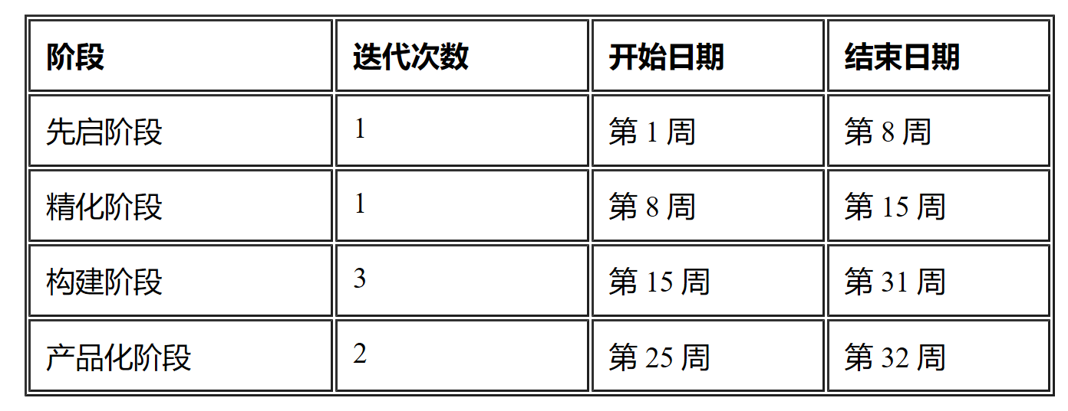

Slide 32
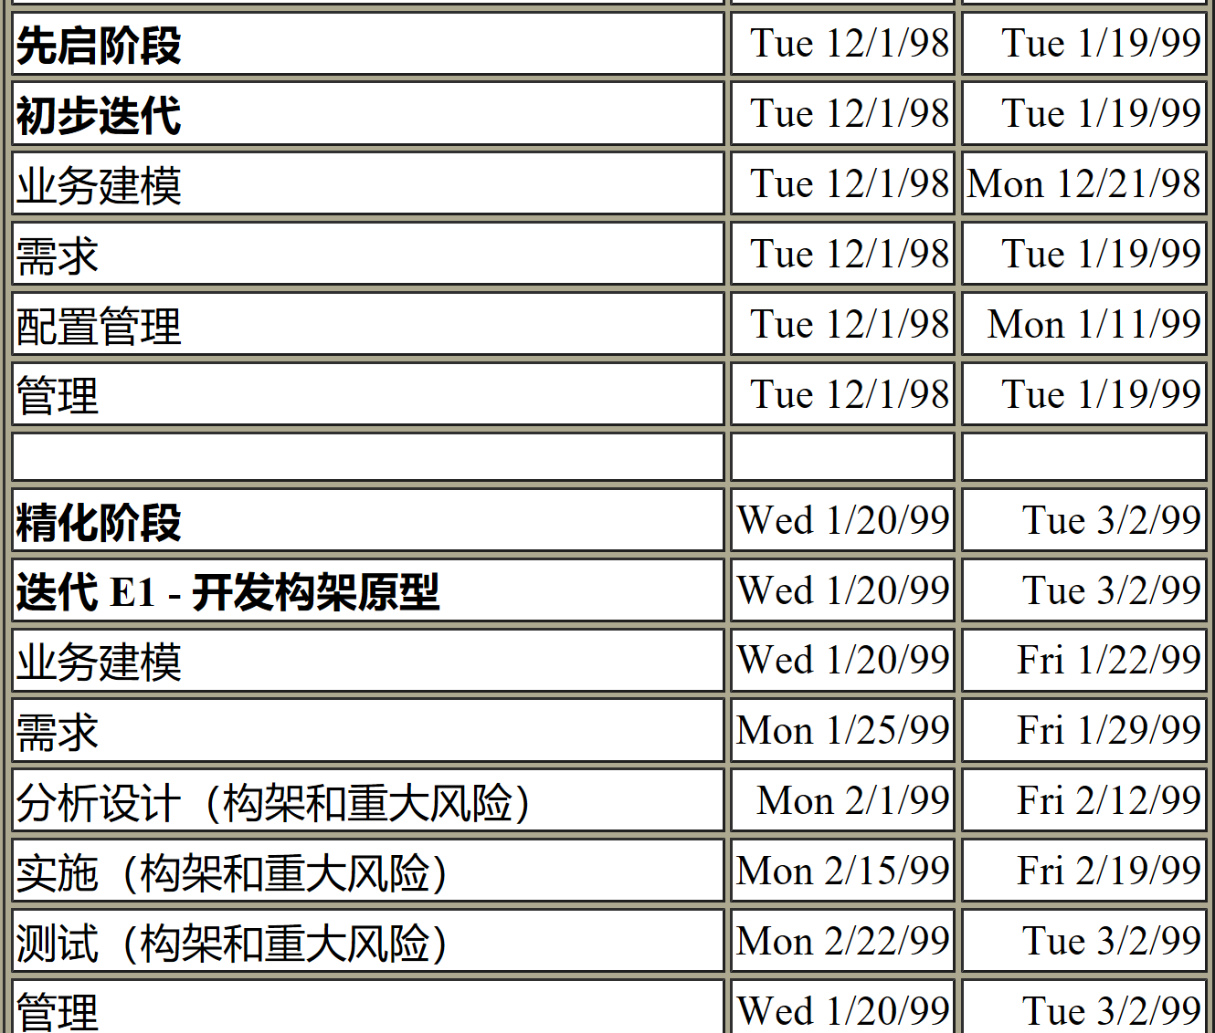
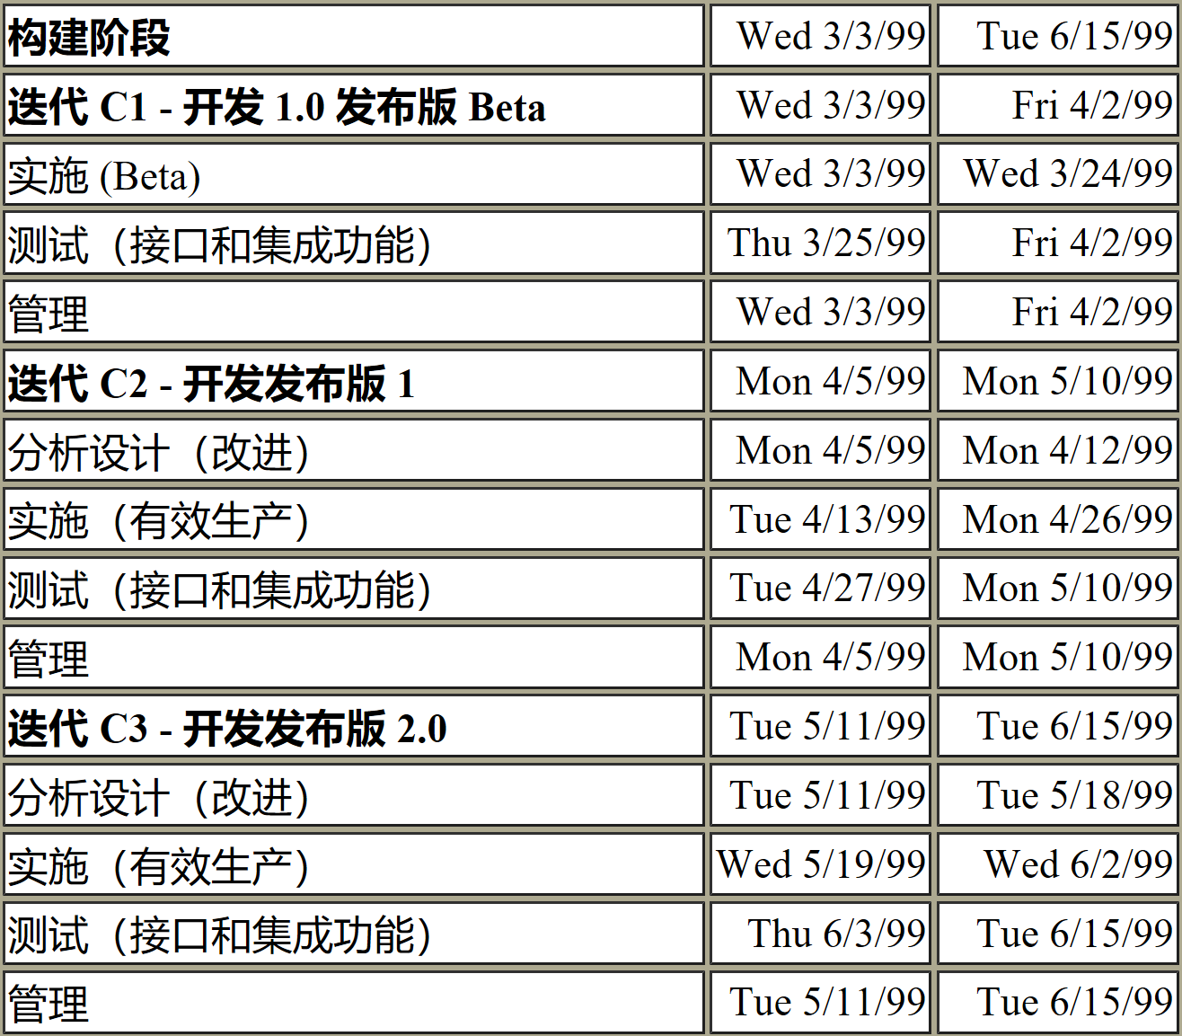
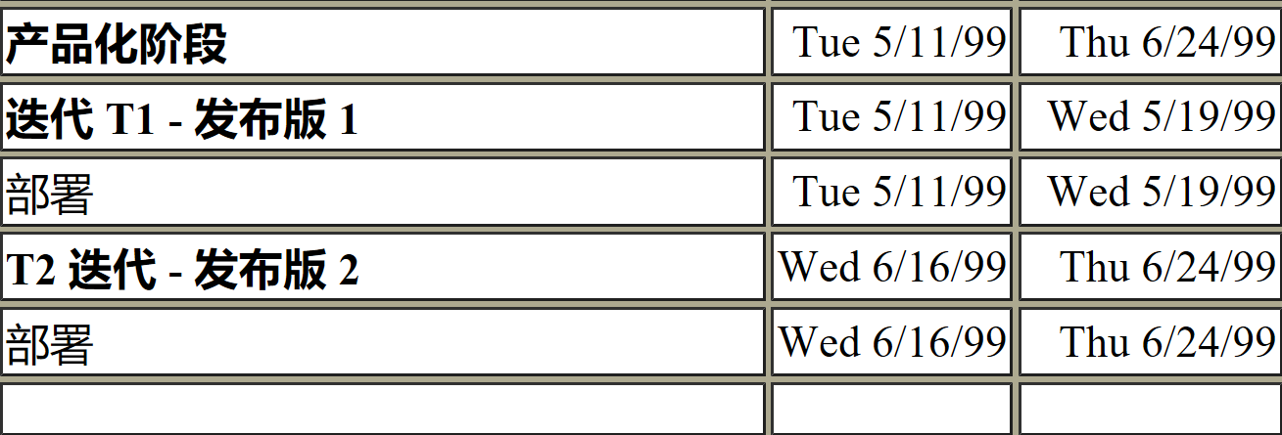

Slide 33
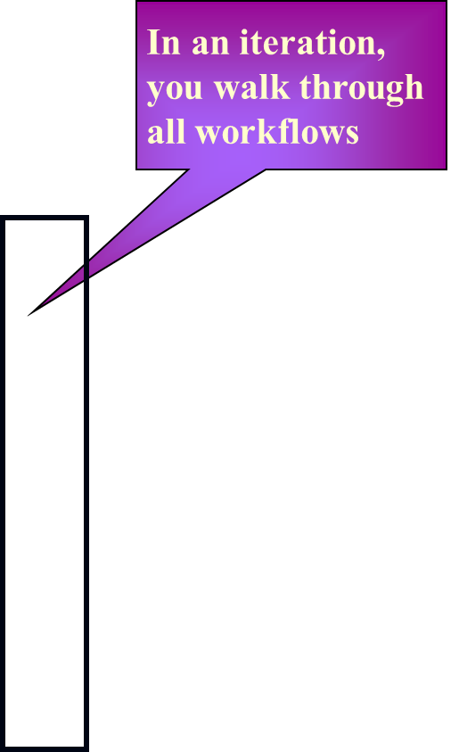
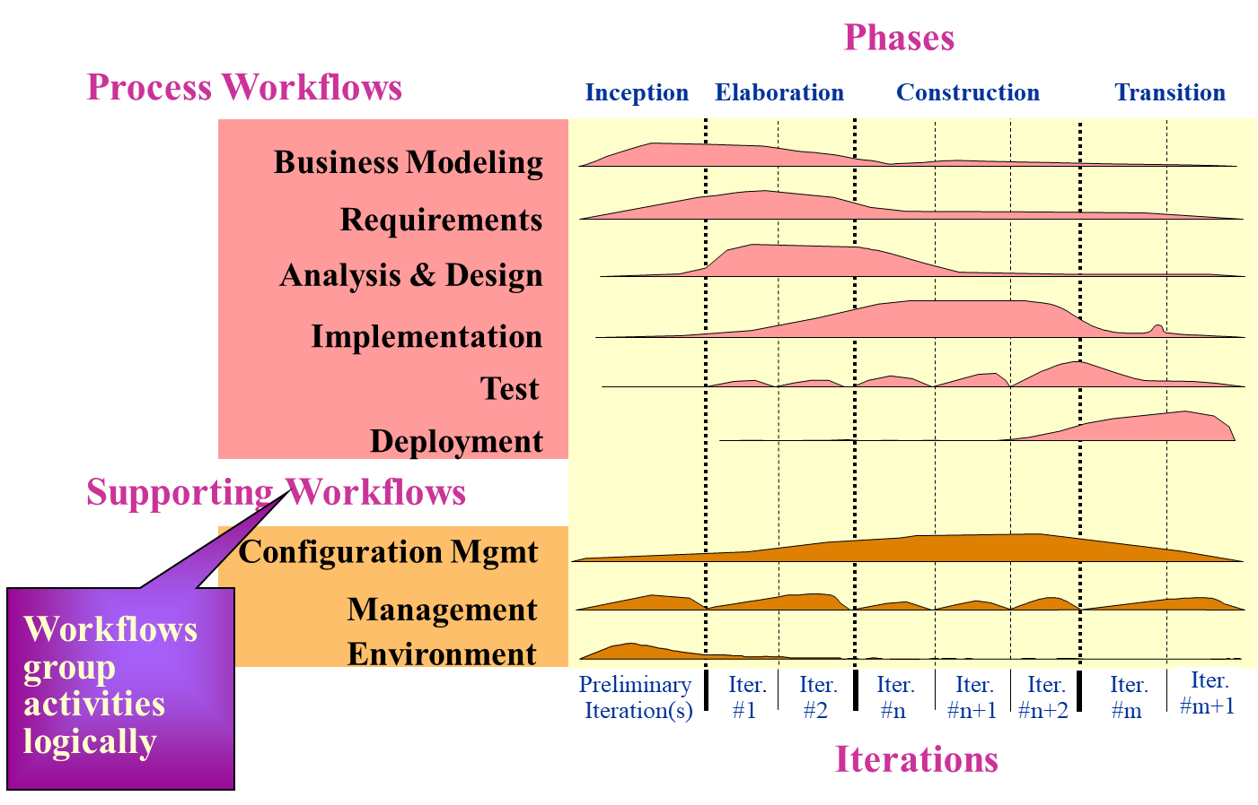
Bringing It All Together...

Slide 34
Tailoring and Implementing RUP
4 Phases
9 Core Workflows
31 Roles/Workers
103 Artifacts
136 Activities
15 Tool Mentors
14 Work Guidelines
43 Word/HTML Templates
8 Project Plan Templates
…

Slide 35
RUP生命周期的特点
与螺旋模型相比
相似：重复一系列组成系统生命周期的循环
差异：
RUP给出了每个阶段内的若干次迭代过程完成后交付的增量的具体要求，即四个阶段的里程碑
RUP详细阐述了不同阶段的不同迭代过程经历的九大核心工作流程中活动内容的重点和强度不同
RUP提供了对每次迭代过程中不同核心工作流程活动的并行化支持
优点：用于指导需求不明确、不稳定的项目开发时具有更强的可操
作性。

Slide 36
RUP生命周期的特点
与瀑布模型相比
优点：
RUP将成本风险进一步降低为获得一次增量所需的费用
RUP进一步降低了产品不能按计划投放市场的风险
RUP使项目开发更能适应项目需求的变化

Slide 37
RUP的人员——角色及其活动
角色的划分及相关活动
RUP定义了五大类角色集：分析员、开发人员、测试员、经理、其他角色。每一类角色集又包括多个角色，并给出了每个角色对应的活动。
角色的意义
将角色和个体区分开来，有效提高了项目中人力资源的利用率。
角色方面的缺陷
未给出角色的组织管理方式、角色间的相互地位关系和交互方式。

Slide 38
RUP的方法——方法和工具
方法：
用例及用例驱动
用例是捕获需求的有效方法
用例驱动整个RUP过程
以架构为中心
在面向对象的分析设计中采用UML进行可视化建模
面向对象的设计与构件实现
工具：
Rational Solutions

Slide 39
RUP的特点
优点：
用例驱动、以架构为中心、迭代和增量的；
具有二维迭代性，有利于降低风险、适应需求变化；
是可配置的，具有通用性；
缺点：
是在理想的项目开发环境下软件过程的一种完美模式；
未给出具体的剪裁、扩充等配置实施的方法准则。

