Slide 1

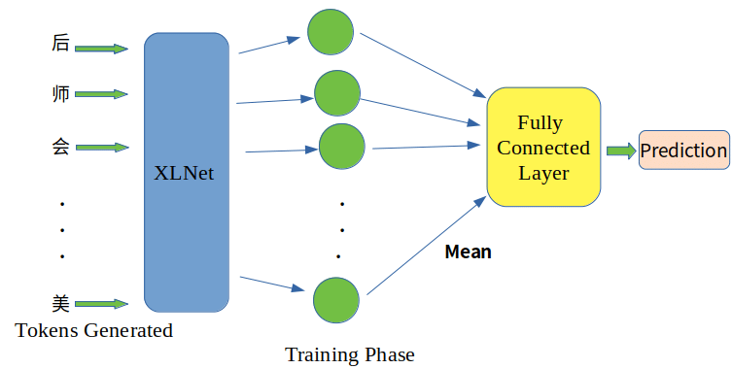
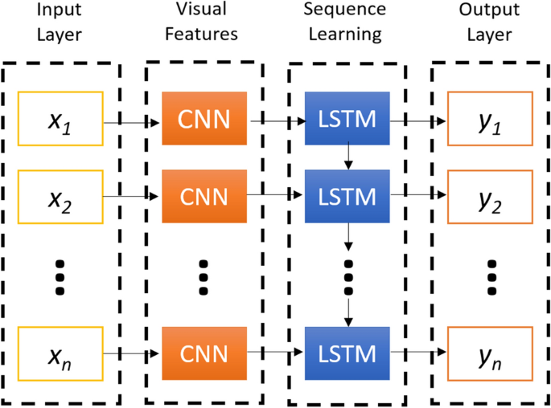
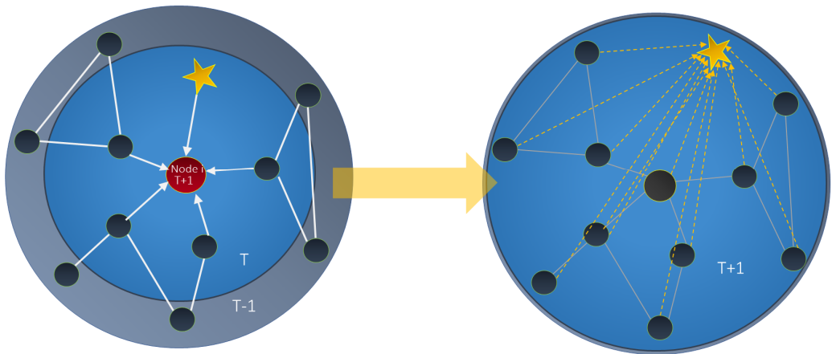
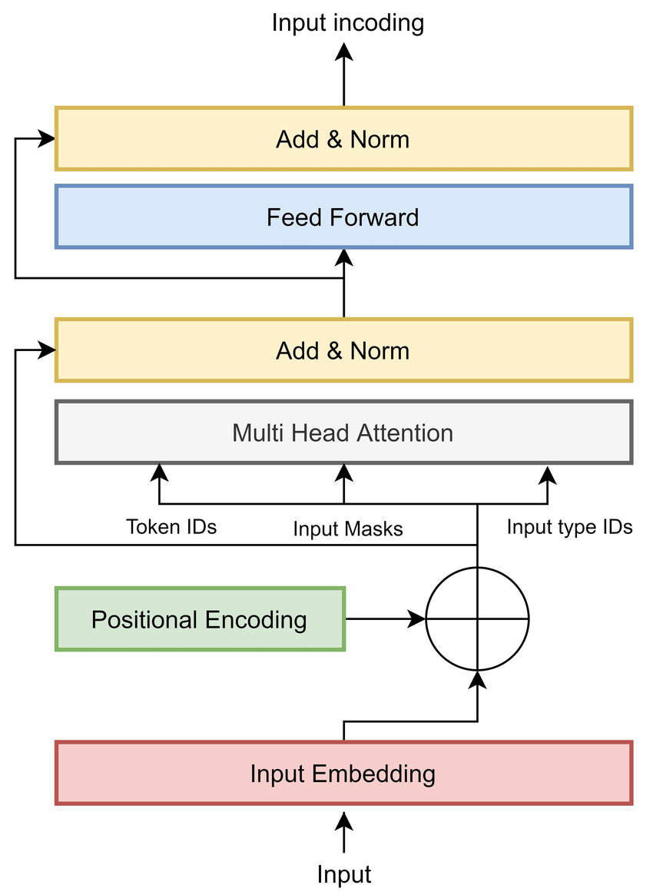
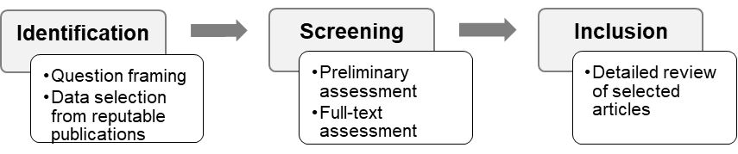
Sentiment Analysis of Online Review: A Comparison of Natural Language Processing Models
Chinedu Okonkwo, Abdelrhman Alroudi, Karla De La Cruz, Mihn Le, Ryan Gill, Kevin Desai, Ph.D.
The University of Texas at San Antonio
INTRODUCTION
RESULTS
RESULTS
CONCLUSIONS
Sentiment analysis refers to the examination of people’s opinions and feelings towards an entity or topic.
With the advent of the internet, millions of reviews are readily available making it increasingly difficult to manually examine people’s opinions expressed through online reviews.
Natural Language Processing (NLP) is a subfield of Artificial Intelligence concerned with the interactions between computers and human language, how to program computers to process and analyze large amounts of natural language data.
This study presents a comparison of 5 NLP models with accuracy as the evaluation metric
The XLNet and the GraphStar models outperformed the other models with accuracies of 96.21% and 96% respectively, while the CNN+LSTM model gave the lowest accuracy (88.9%).
It is however important to note that other factors like cost, speed, and nature of the task should be considered when selecting an appropriate model for an NLP task
A major limitation to this study is the inability to compare the speed of different speeds of the models as the models were all trained with different hardware.
XLNet Architecture (Ahmed et al, 2021)
CNN+LSTM Model Architecture (Tasdelen & Sen, 2021)
GraphStar Model: Graph data models are sets of subjects/ entities (nodes) and their inter-relationships (edges) that attempts to predict unlabeled nodes by the surrounding labeled nodes.
Modified LMU Model: LMU is a recurrent neural network that leverage the linear time-invariant (LTI) memory component of the LMU to construct a simplified variant that can be parallelized during training (and yet executed as an RNN during inference), thus overcoming a well-known limitation of training RNNs on GPUs.
RESEARCH NEED AND OBJECTIVES
To compare the performance of different NLP models on the same dataset using accuracy as the performance metric
Research objectives are to:
Review five (5) NLP models;
Compare the accuracy of the five (5) NLP models on the same dataset.
REFERENCES
Accuracy Comparison of the 5 Models
Ahmed, T., Kabir, M., Ivan, S., Mahmud, H. and Hasan, K., 2021, December. Am I Being Bullied on Social Media? An Ensemble Approach to Categorize Cyberbullying. In 2021 IEEE International Conference on Big Data (Big Data) (pp. 2442-2453). IEEE.
Camacho-Collados, J., & Pilehvar, M. T. On the Role of Text Preprocessing in Neural Network Architectures: An Evaluation Study on Text Categorization and Sentiment Analysis. arXiv 2017. arXiv preprint arXiv:1707.01780.
Chilkuri, N.R. and Eliasmith, C., 2021, July. Parallelizing legendre memory unit training. In International Conference on Machine Learning (pp. 1898-1907). PMLR.
Haonan, Lu, et al. "Graph star net for generalized multi-task learning." arXiv preprint arXiv:1906.12330 (2019).
Tasdelen, A. and Sen, B., 2021. A hybrid CNN-LSTM model for pre-miRNA classification. Scientific reports, 11(1), pp.1-9.
Xie, Q., Dai, Z., Hovy, E., Luong, T. and Le, Q., 2020. Unsupervised data augmentation for consistency training. Advances in Neural Information Processing Systems, 33, pp.6256-6268.
Yang, Z., Dai, Z., Yang, Y., Carbonell, J., Salakhutdinov, R., & Le Q, X. (1906). generalized autoregressive pretraining for language understanding. arXiv 2019; 1906.08237.
GraphStar Model Architecture (Haonan et al, 2019)
METHODOLOGY
BERT Model: Bidirectional Encoder Representations from Transformers (BERT) is a pre-trained transformer-based machine learning technique for NLP developed by Google. It uses a transformer, an attention mechanism that learns contextual relations between words in a text.
To achieve the above stated objectives, a review of electronic literature on five NLP models was conducted to identify relevant articles on them. For comparison of the models based on accuracy, only articles that implemented the models using the same dataset (IMDb dataset) are included in the study. The five models includes XLNET, GraphStar, BERT large, CNN + LSTM, and Modified LMU. The IMDb dataset consists of 50,000 reviews split between train and test datasets and two labels of positive and negative.
Research Process
BERT Model Architecture (Rahali et al, 2021)
RESULTS
CNN+LSTM Model: CNN+LSTM model combines CNN layers for feature extraction from input data with LSTM layers for sequence prediction. It is designed to solve visual time series prediction issues and generate textual annotations from image sequences.
The Five (5) NLP Models
XLNet Model: a generalized autoregressive language model that learns unsupervised representations of text sequences and incorporates modelling techniques from Autoencoder(AE) models(BERT) into Auto-regressive (AR) models while avoiding limitations of AE

