Slide 1
Headers and Includes
Lecture 8

Slide 2
Separate Compilation
Ever since we started C++, you have been incorporating external code into your programs via #include
These standard libraries organize code into modules that are useful in a variety of programs
You also have the ability break up your programs into multiple files

Slide 3
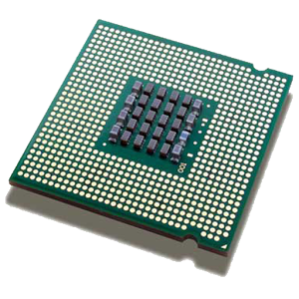
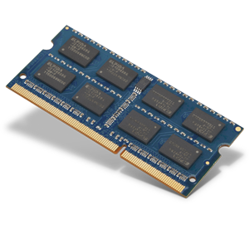
C++ Compilation Process (1)
Processor/CPU
Main Memory (RAM)
C++ Source Code
Object Code
…
Compiler

Slide 4
C++ Compilation Process (2)
Object Code
Processor/CPU
Main Memory (RAM)
C++ Source Code
Executable
Compiler
Object Code
…
Object Code
Linker

Slide 5
C++ Compilation Process (3)
Object Code
Processor/CPU
Main Memory (RAM)
Object Code
Input/Data
Executable
Linker
Output
…
Object Code

Slide 6
Why #include?
Speed. As your programs get more complex it can take a long time to compile. If you break into multiple pieces, you only need to recompile those pieces that change.
Organization. Easier to find/maintain code, easier to re-use across projects.
Modularity. Separate the interface (what a class does) from the implementation (how it does it).

Slide 7
Problem with Separate Compilation
myclass.cpp
main.cpp
class MyClass
{
public:
void foo();
};
void MyClass::foo()
{
// do stuff
}
int main()
{
MyClass a;
return 0;
}
> g++ -c -o myclass.o myclass.cpp
> g++ -c -o main.o main.cpp
main.cpp:3:2: error: unknown type name 'MyClass'
MyClass a;

Slide 8
Enter Header Files
Header files allow you to separate declaration from definition
The result is that when compiling each object file, the compiler knows that function(s)/class(es) exist, and linking brings together the implementation

Slide 9
Separate Compilation
myclass.h
myclass.cpp
main.cpp
class MyClass
{
public:
void foo();
};
#include "myclass.h"
void MyClass::foo()
{
// do stuff
}
#include "myclass.h"
int main()
{
MyClass a;
return 0;
}
> g++ -c -o myclass.o myclass.cpp
> g++ -c -o main.o main.cpp
> g++ -o prog myclass.o main.o
> g++ -o prog myclass.cpp main.cpp

Slide 10
What is #include Doing?
The #include command acts as a form of copy/paste, telling the compiler to replace the line with the entire contents of the included file
Thus, all source files that #include a header file get the full contents of that file
In general, you should not #include source files

Slide 11
File Names
Header files use a .h__ extension
.h / .hxx / .hpp are common
C++ source files use a .c__ extension
.cpp / .cxx / .cc are common
C source files use a .c extension
Some tools look for this extension, so don’t use .c unless you are programming in C

Slide 12
#include "" vs. <>
Surrounding characters indicate to the compiler where to find the header file
The angle brackets (<>) typically indicate built-in/standard that are kept in a pre-defined location
The double quotes ("") typically indicate programmer libraries that are kept in the current directory, or a list of alternatives

Slide 13
Additional Include Locations (1)
Each compiler has a way to indicate alternative search locations for header files
> g++ -c -o myclass.o myclass.cpp
myclass.cpp:1:10: fatal error: 'myclass.h' file not found
#include "myclass.h"
> g++ -c -o myclass.o -I/path/to/includes myclass.cpp

Slide 14
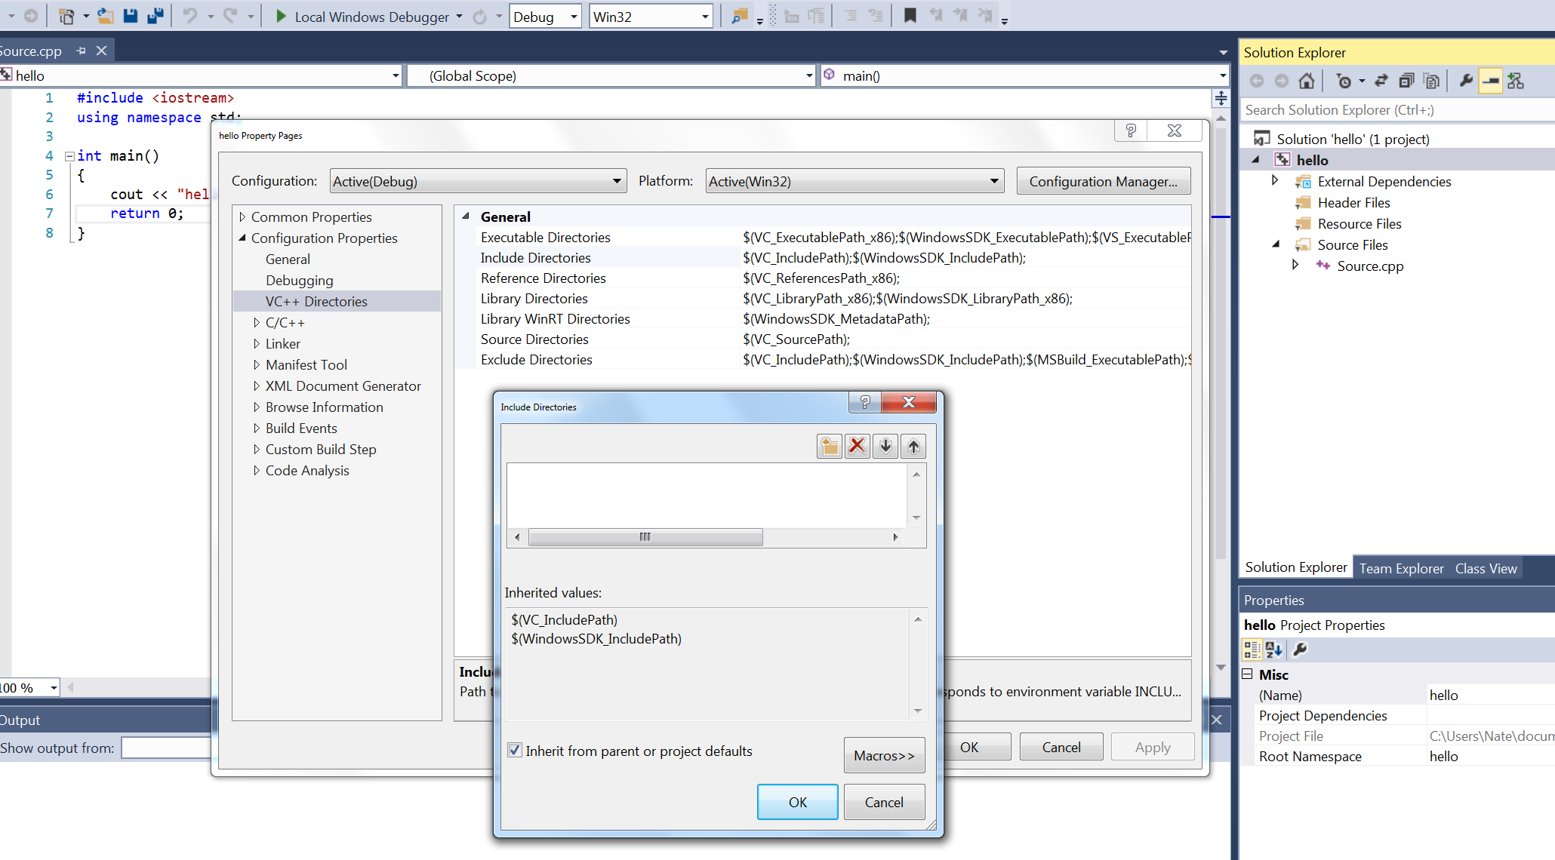
Additional Include Locations (2)
Each compiler has a way to indicate alternative search locations for header files

Slide 15
Include Guards
A best practice in C++ is to guard header files against multiple inclusion from the same file (results in already defined error)
Can occur by simple mistake
#include "myclass.h"
#include "myclass.h"
Or by including multiple header files with a common dependency

Slide 16
Unguarded Headers
x.h
a.h
b.h
main.cpp
class X
{
};
#include "x.h"
class A
{
X x;
};
#include "x.h"
class B
{
X x;
};
#include "a.h"
#include "b.h"
int main()
{
A a;
B b;
return 0;
}
> g++ -o prog main.cpp
In file included from main.cpp:2:
In file included from ./b.h:1:
./x.h:1:7: error: redefinition of 'X'
class X

Slide 17
Include Guard
Basic idea: each header gets a unique identifier, check for it before including. Headers get included at most once!
// x.h
#ifndef __X_H
#define __X_H
class X
{
};
#endif

Slide 18
Guarded Headers
x.h
a.h
b.h
main.cpp
#ifndef __X_H
#define __X_H
class X
{
};
#endif
#ifndef __A_H
#define __A_H
#include "x.h"
class A
{
X x;
};
#endif
#ifndef __B_H
#define __B_H
#include "x.h"
class B
{
X x;
};
#endif
#include "a.h"
#include "a.h"
#include "b.h"
#include "b.h"
int main()
{
A a;
B b;
return 0;
}
> g++ -o prog main.cpp

Slide 19
Forward Declaration
To avoid circular dependencies, it is best to avoid #include within header files when possible
A forward declaration is a way of stating basic information about an identifier (e.g. class, structure, function) without having the complete definition
We have been doing this with functions since COMP128!
For a class/structure:
class X;
struct Y;

Slide 20
Guidelines
If in header for class A, considering class B…
Do Nothing. A makes no references at all to B
Do Nothing. The only reference to B is in a friend declaration
Forward Declare. A contains a B pointer or reference
B* myb;
Forward Declare. One or more functions has a B object/pointer/ reference as a parameter, or as a return type
B MyFunction(B myb);
#include "b.h". B is a parent class of A (later)
#include "b.h". A contains a B object
B myb;

Slide 21
Fix This Code!
x.h
a.h
b.h
main.cpp
class X
{
};
#include "x.h"
class A
{
X foo(X x);
X *x;
};
#include "x.h"
class B
{
X x;
void foo(X& x);
};
#include "a.h"
#include "b.h"
int main()
{
A a;
B b;
return 0;
}

Slide 22
Answer
x.h
a.h
b.h
main.cpp
#ifndef __X_H
#define __X_H
class X
{
};
#endif
#ifndef __A_H
#define __A_H
class X;
class A
{
X foo(X x);
X *x;
};
#endif
#ifndef __B_H
#define __B_H
#include "x.h"
class B
{
X x;
void foo(X& x);
};
#endif
#include "a.h"
#include "b.h"
int main()
{
A a;
B b;
return 0;
}

Slide 23
Wrap Up
Header files allow you to break your code into multiple files, improving speed, organization, and code modularity
Remember to name your header/source files appropriately, and #include them using the appropriate form
Always use include guards
Try to minimize #include commands within header files to save yourself headaches later

