Slide 1
Project 0 – Heart beat LED
Ryan Adolph

Slide 2
Project Goal
The goal of this project is to refresh our knowledge of how assembly works on the MSP430FR2355 dev board by toggling 2 seperate LEDs (P1.0 - red & P6.6 – green) every one second by using a delay loop and a one second interrupt service routine (ISR)

Slide 3
Delay loop
The delay loop uses a nested loop to decrement 2 set registers (R14 & R15). We initialize our first register, R15, to 22500 then our second register, R14 to 7. We then jump to another subroutine where we decrement R14, jump to another subroutine where we decrement R15 and check if R14 == 0. If no, then keep decrementing R15 until it == 0 then reset R15 to 24000 and decrement R14 again. Repeat until R14 == 0, then toggle our red LED (P1.0)

Slide 4
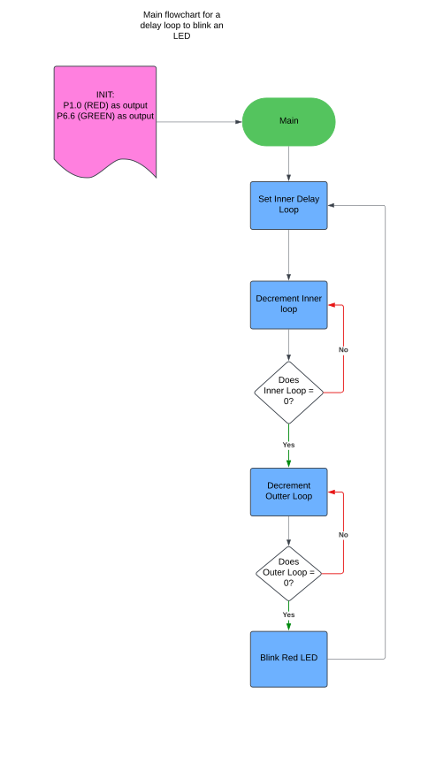
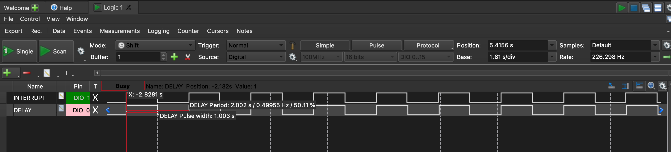
Delay loop flowchart
Delay loop comes out to a pulse of ~1.003 for being on / off

Slide 5
Interrupt service routine
We initialize timer_B0 for using continuous counting using ACLK as the timer source, using the dividers for CNTL__12 and ID__8 into TB0CTL, then enable the overflow interrupt flag on the timer_B0 register. We also have our pin P6.6 (green LED) initialized as output in order to flash it at a .5 hz or 1 second interval.
Math for interrupt
F = 32.768 / 8 = 4.096
T = (1 / 4.096) * 2^12 = 1.000

Slide 6
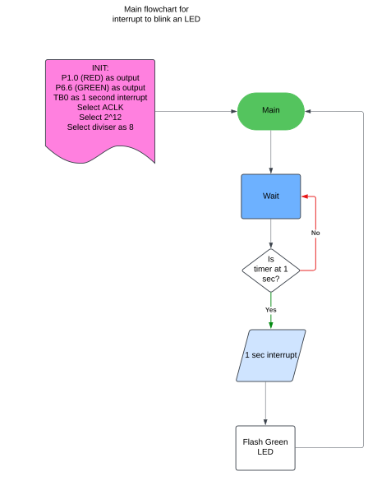
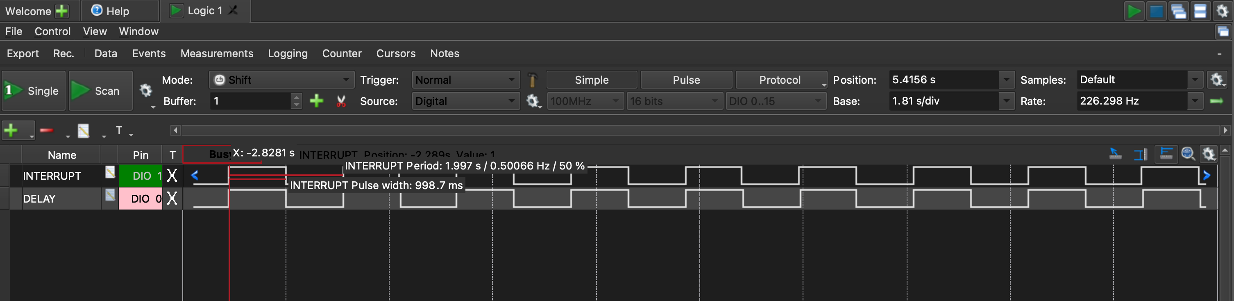
ISR flowchart
ISR timing comes to a pulse of 998.7 ms for LED being on / off

