Slide 1
Basic flight controller – Gyroscope, Accelerometer, distance sensor
EELE 465 Microcontroller applications final project
Ryan Adolph

Slide 2
Goal
The goal of this project was the be the basis for a future drone flight controller
I wanted to be able to use a gyroscope to detect my boards 3-D acceleration and change in position so my MCU will have some information of where it is in space
I also wanted to implement a distance sensor as the start of a self-landing + takeoff vehicle that is aware of how close it is to the ground or other objects
Output these values onto an LCD display so that the user is able to read the data in real time

Slide 3
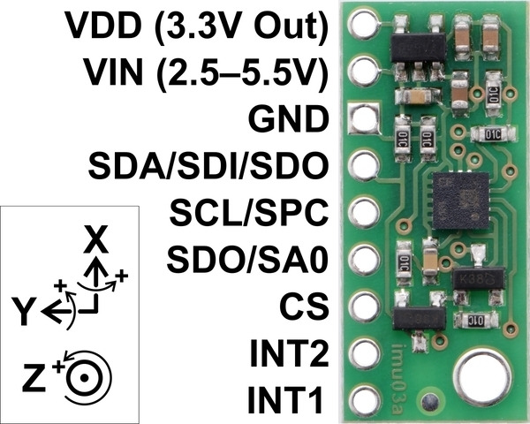
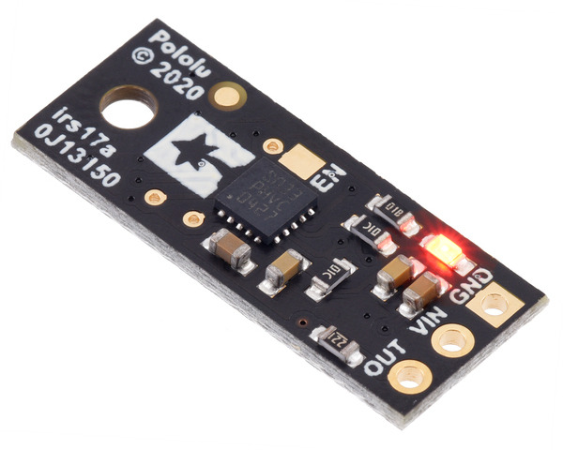
Parts implemented
Top - LSM6DS33 3D Accelerometer and Gyro Carrier
Bottom - Pololu Distance Sensor with Pulse Width Output, 130cm Max

Slide 4
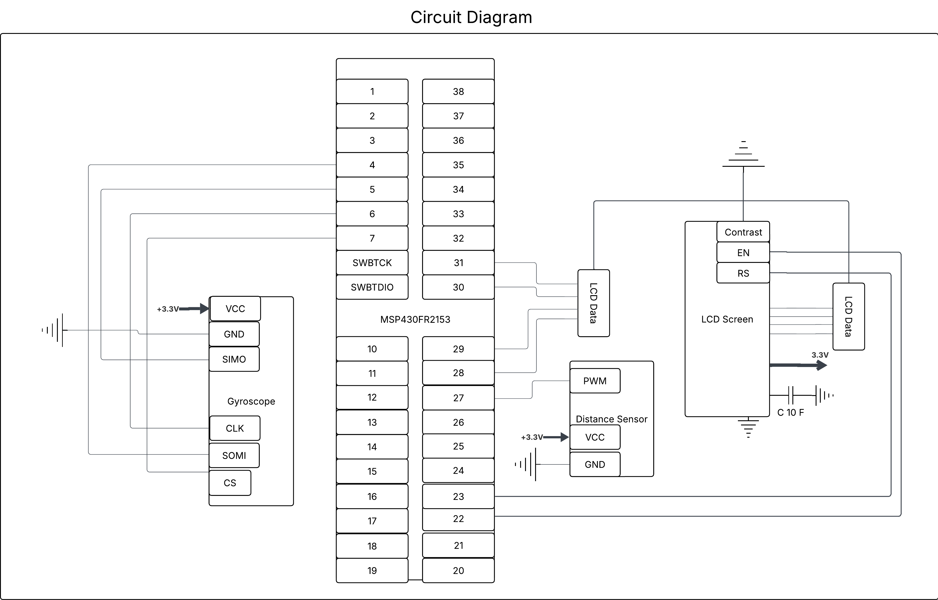
Circuit Diagram

Slide 5
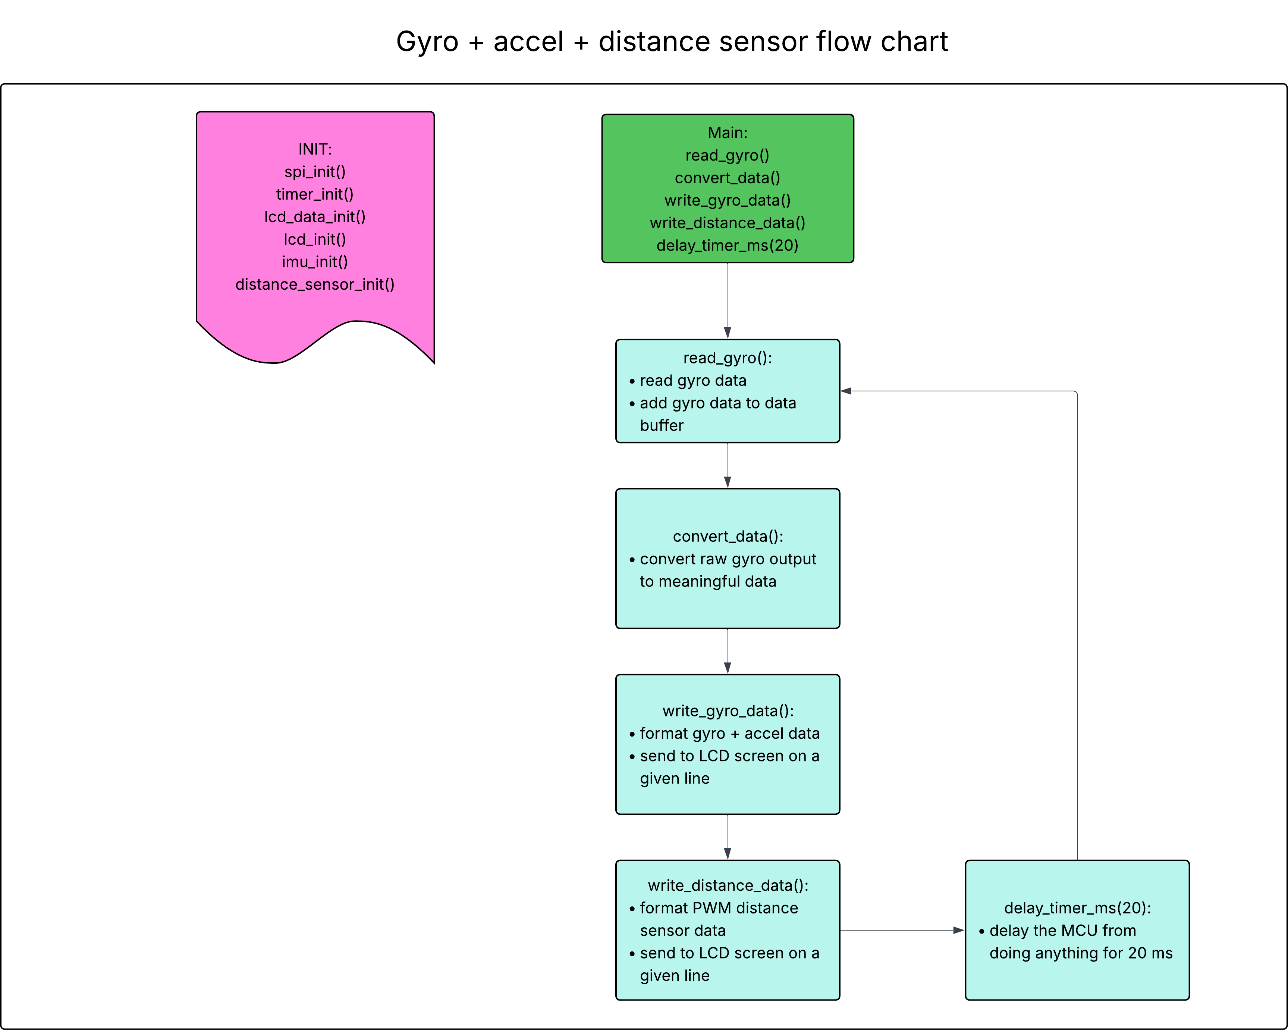
MSP430FR2153 main flowchart

Slide 6
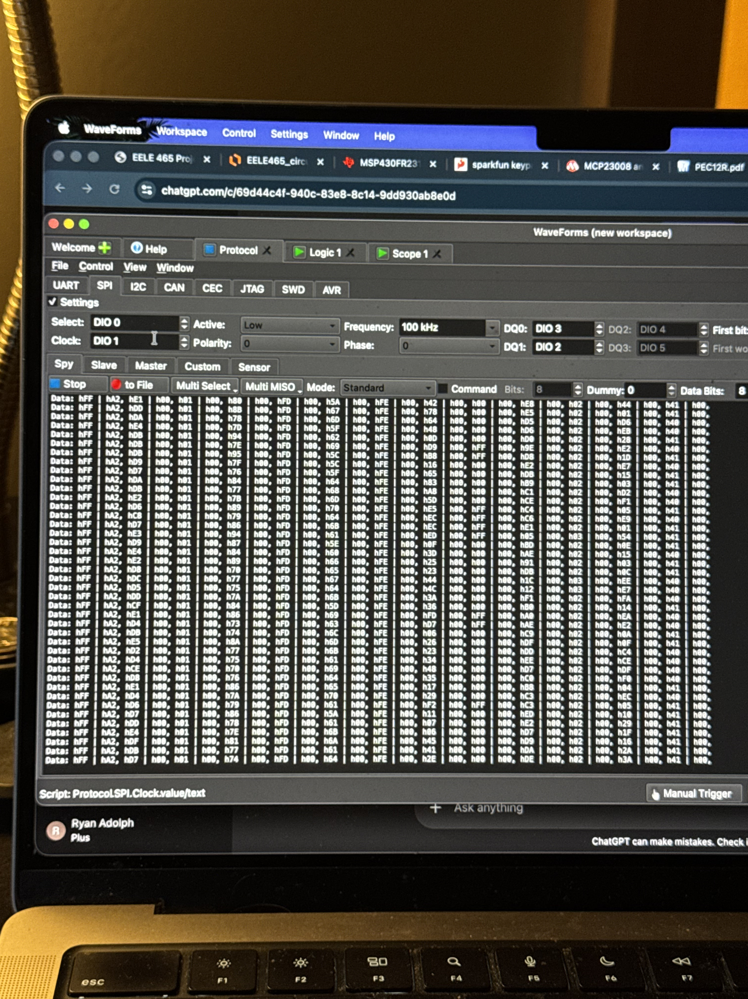
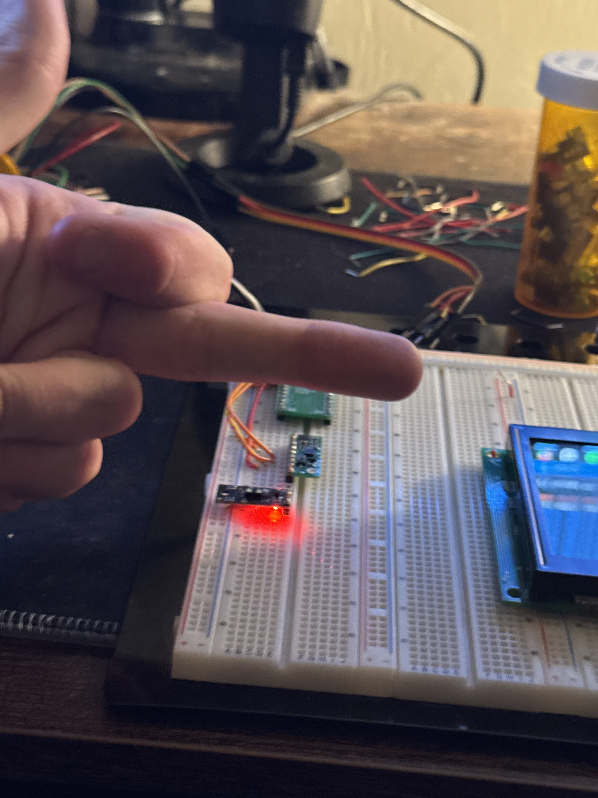
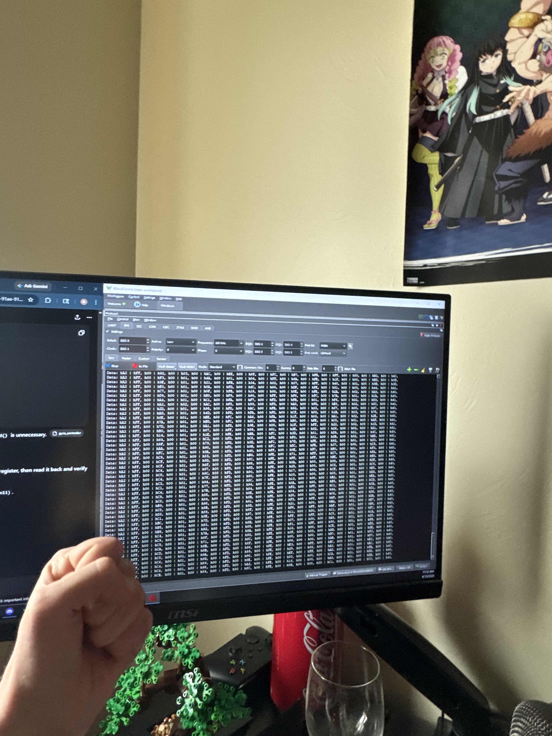
DEVELOPMENT
April 6th – April 16th
Left: April 6th – got the gyroscope initially programmed and outputting something
Right: April 10th – gyro is not outputting the correct data
Middle: April 10th – I gave up on getting it working for this week

Slide 7
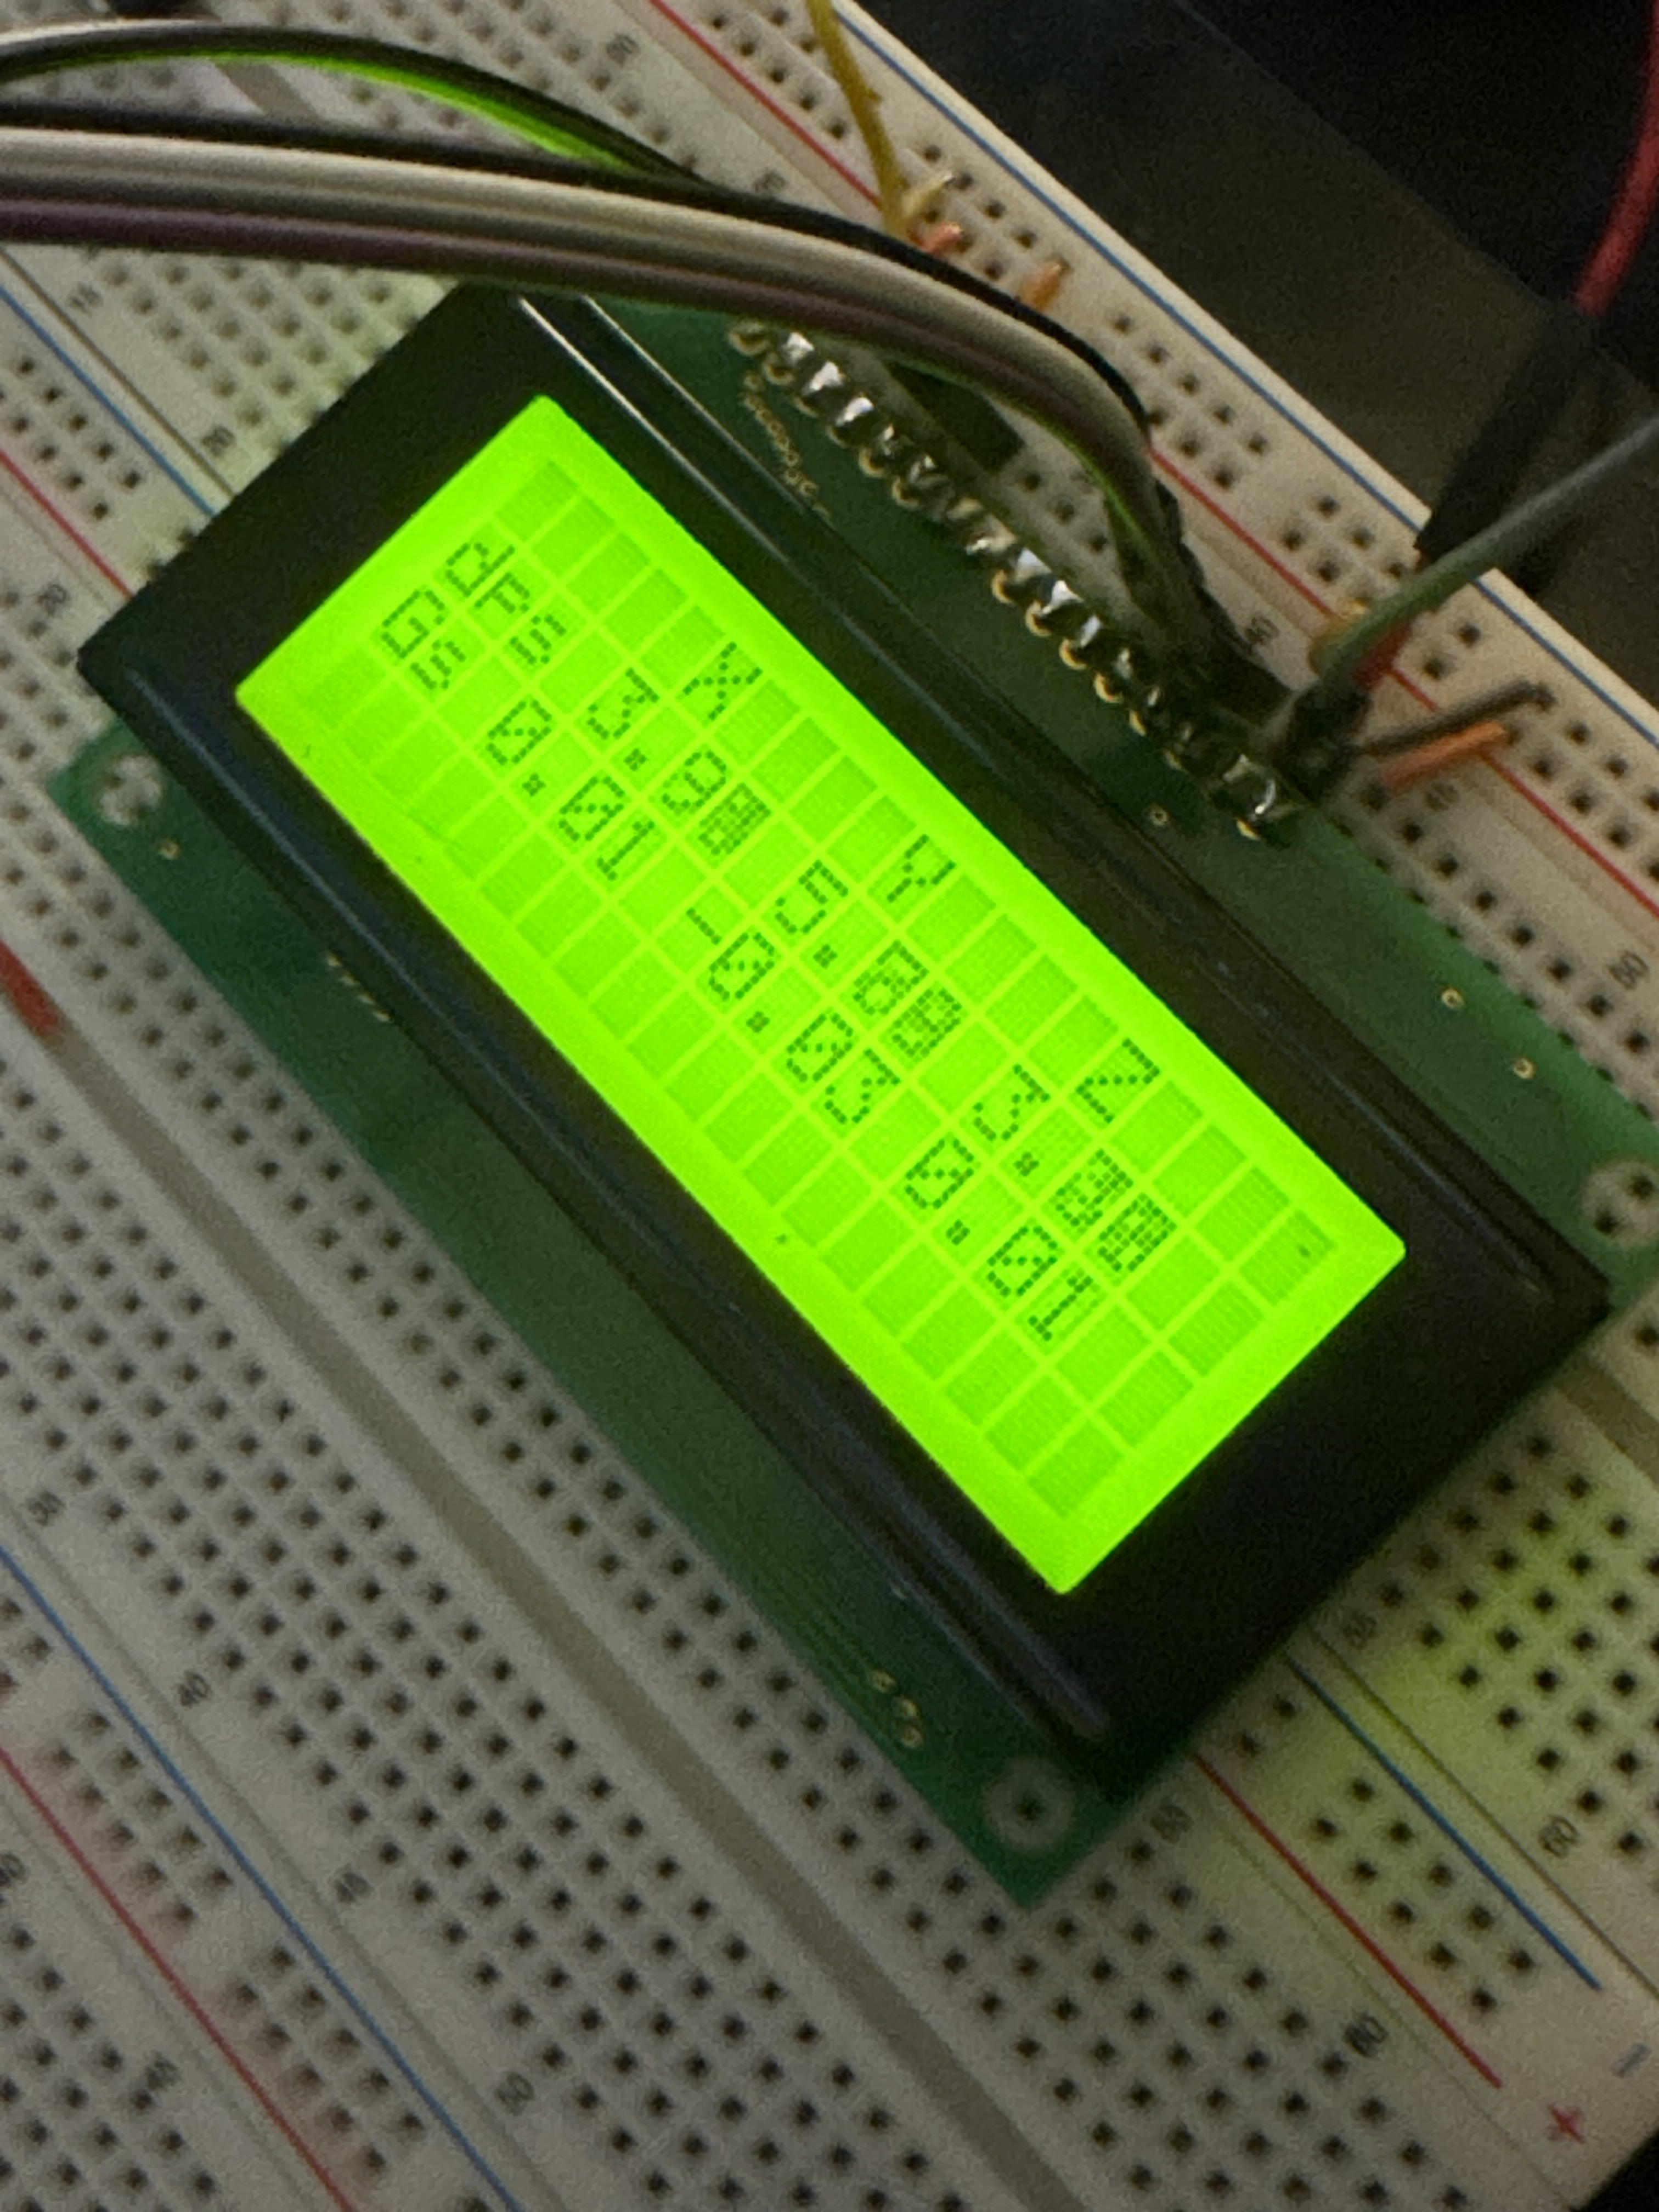
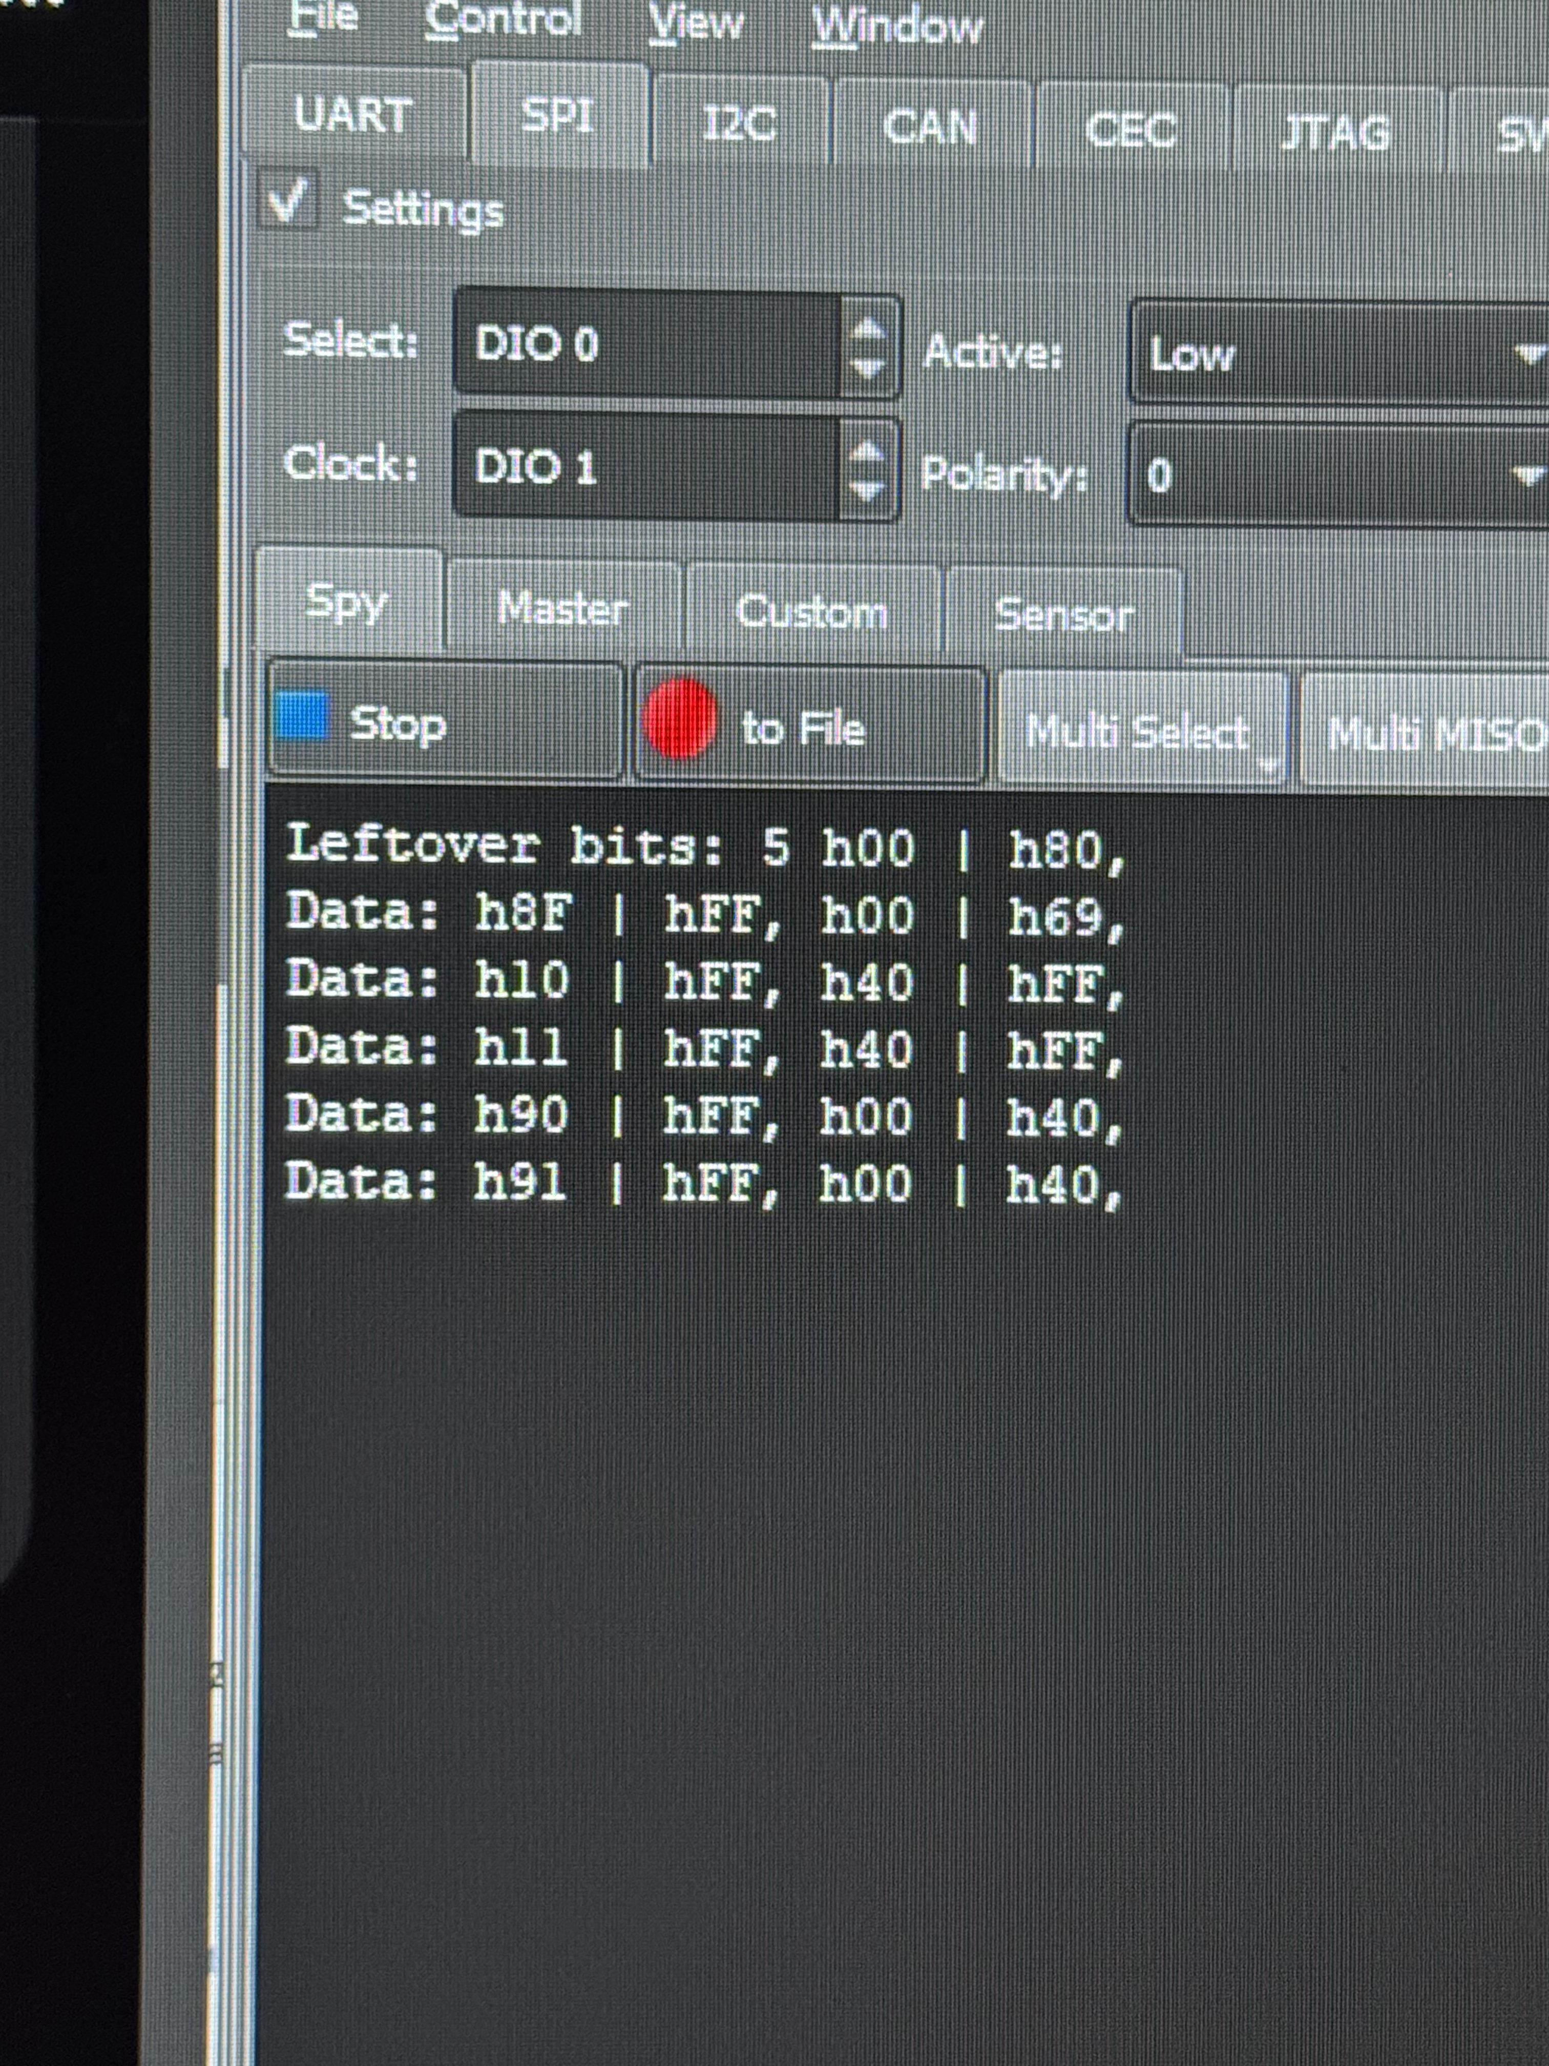
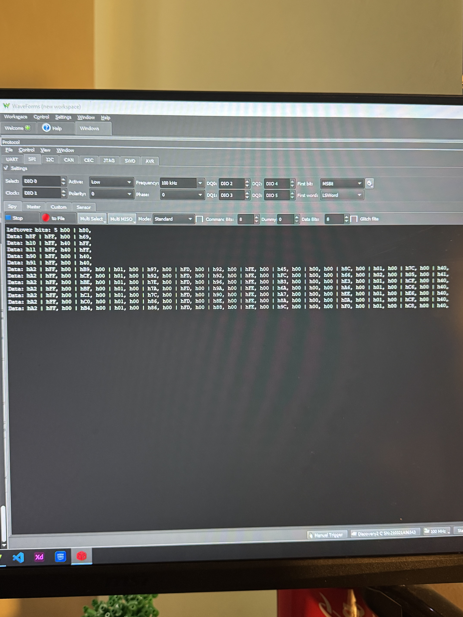
Development cont.
Left: April 14th – got the gyro working!! Also learned I soldered it upside-down
Right: April 14th – finally have the gyroscope outputting correct values from debugging + reading its data

Slide 8
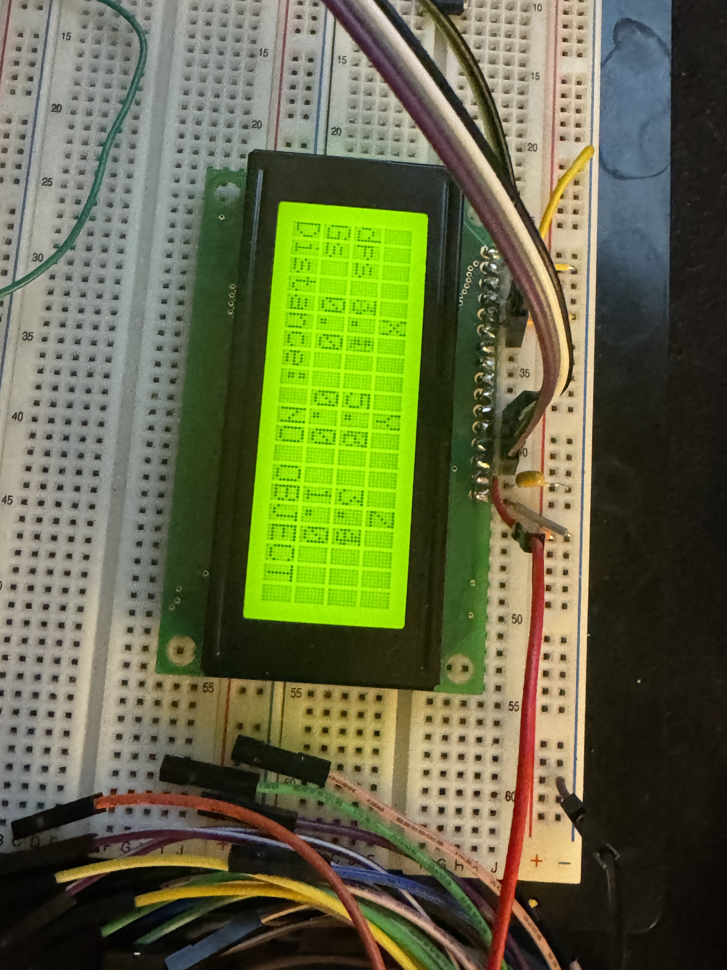
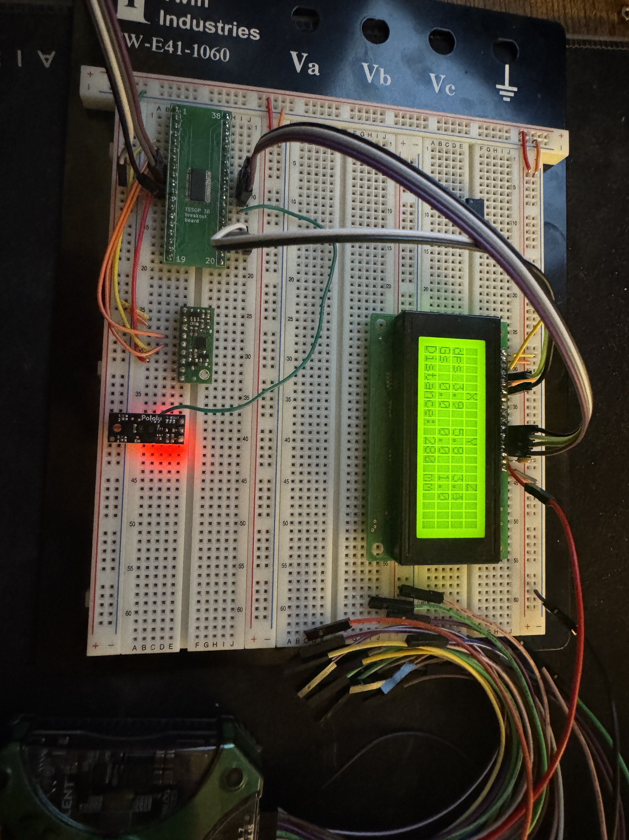
Development end
Bottom: April 16th – Got the PWM distance sensor implemented
Top: April 16th – Implemented Too-Close and Too-Far / No Object detected printing for distance sensor. Need to test its accuracy and adjust distance calculations

Slide 9
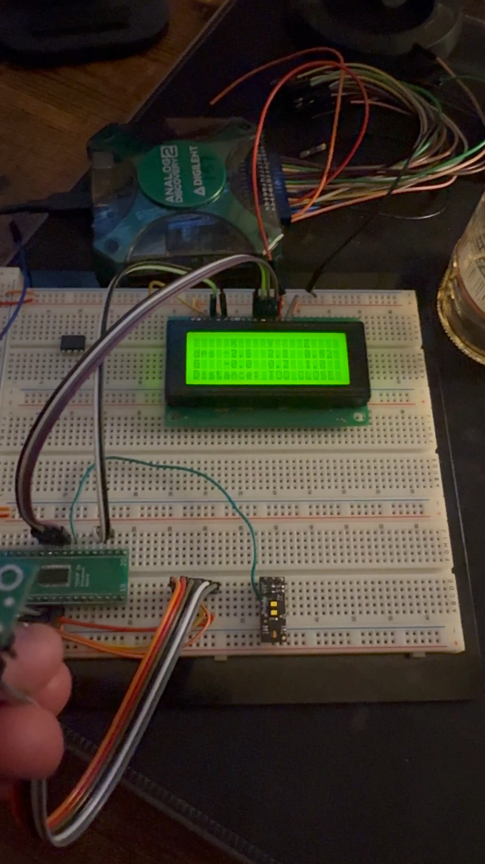
Testing
I had initially noticed that the values being calculated for my gyroscope were starting at higher values than they should when the gyro is still, so I added a loop that got the average reading for the first 500 readings and subtracted that from the current reading before printing
  I was doing research on better filtering algorithms (i.e. Kalmans Filter) but I didn’t implement that yet…
  Here is the video of me testing the gyroscope / accelerometer

