Slide 1
Goal of project 2 – I2C Bit Banging
The main goal of this project was to increase our knowledge on how the communication protocol, I2C, works by bit banging. The end goal of this project was to bit bang I2C to a real time clock, however I didn’t get this far since I was by myself so I was struggling to receive data.

Slide 2
Screenshots
Full I2C Start
Full I2C Stop
Full Address Write

Slide 3
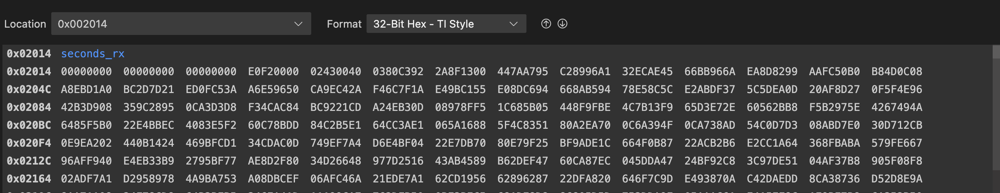
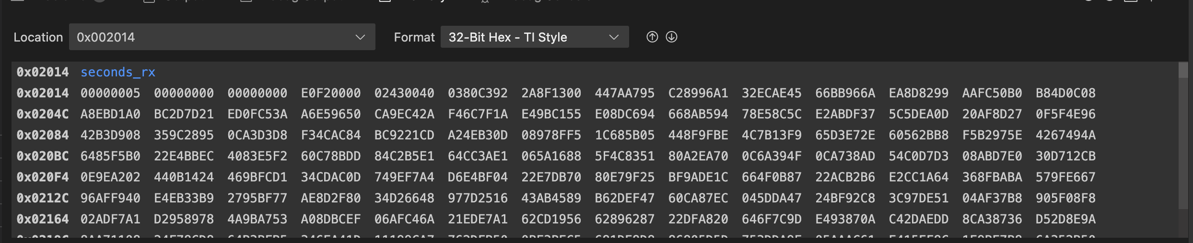
Screenshots Cont
Current Read Status – while working on this, I realized that I had some weird stuff going on with my rx_byte subroutines where I think I was clocking one extra time during this cycle. When debugging it, I was unable to find where the error was, so I think this is the best that I have…

Slide 4
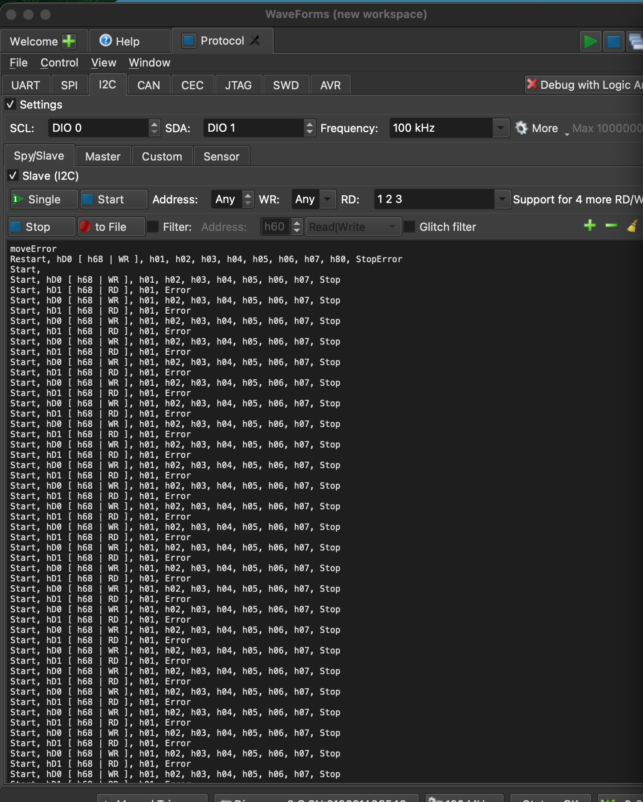
Screenshot cont
To the left depicts my full I2C write + read transactions

Slide 5
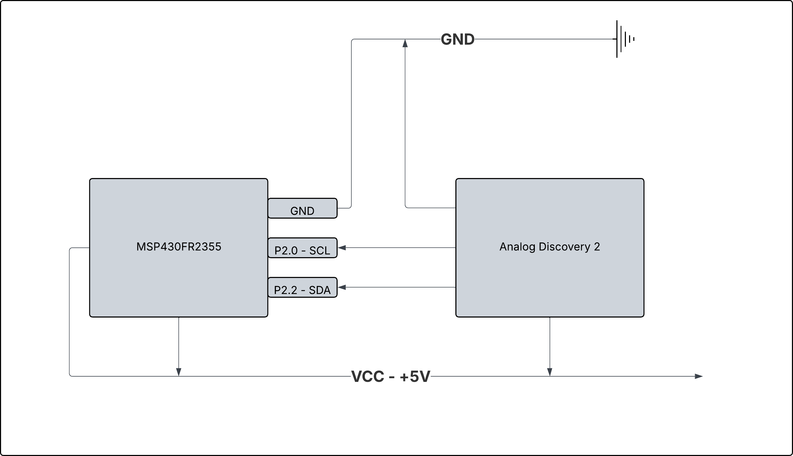
Circuit Diagram

Slide 6
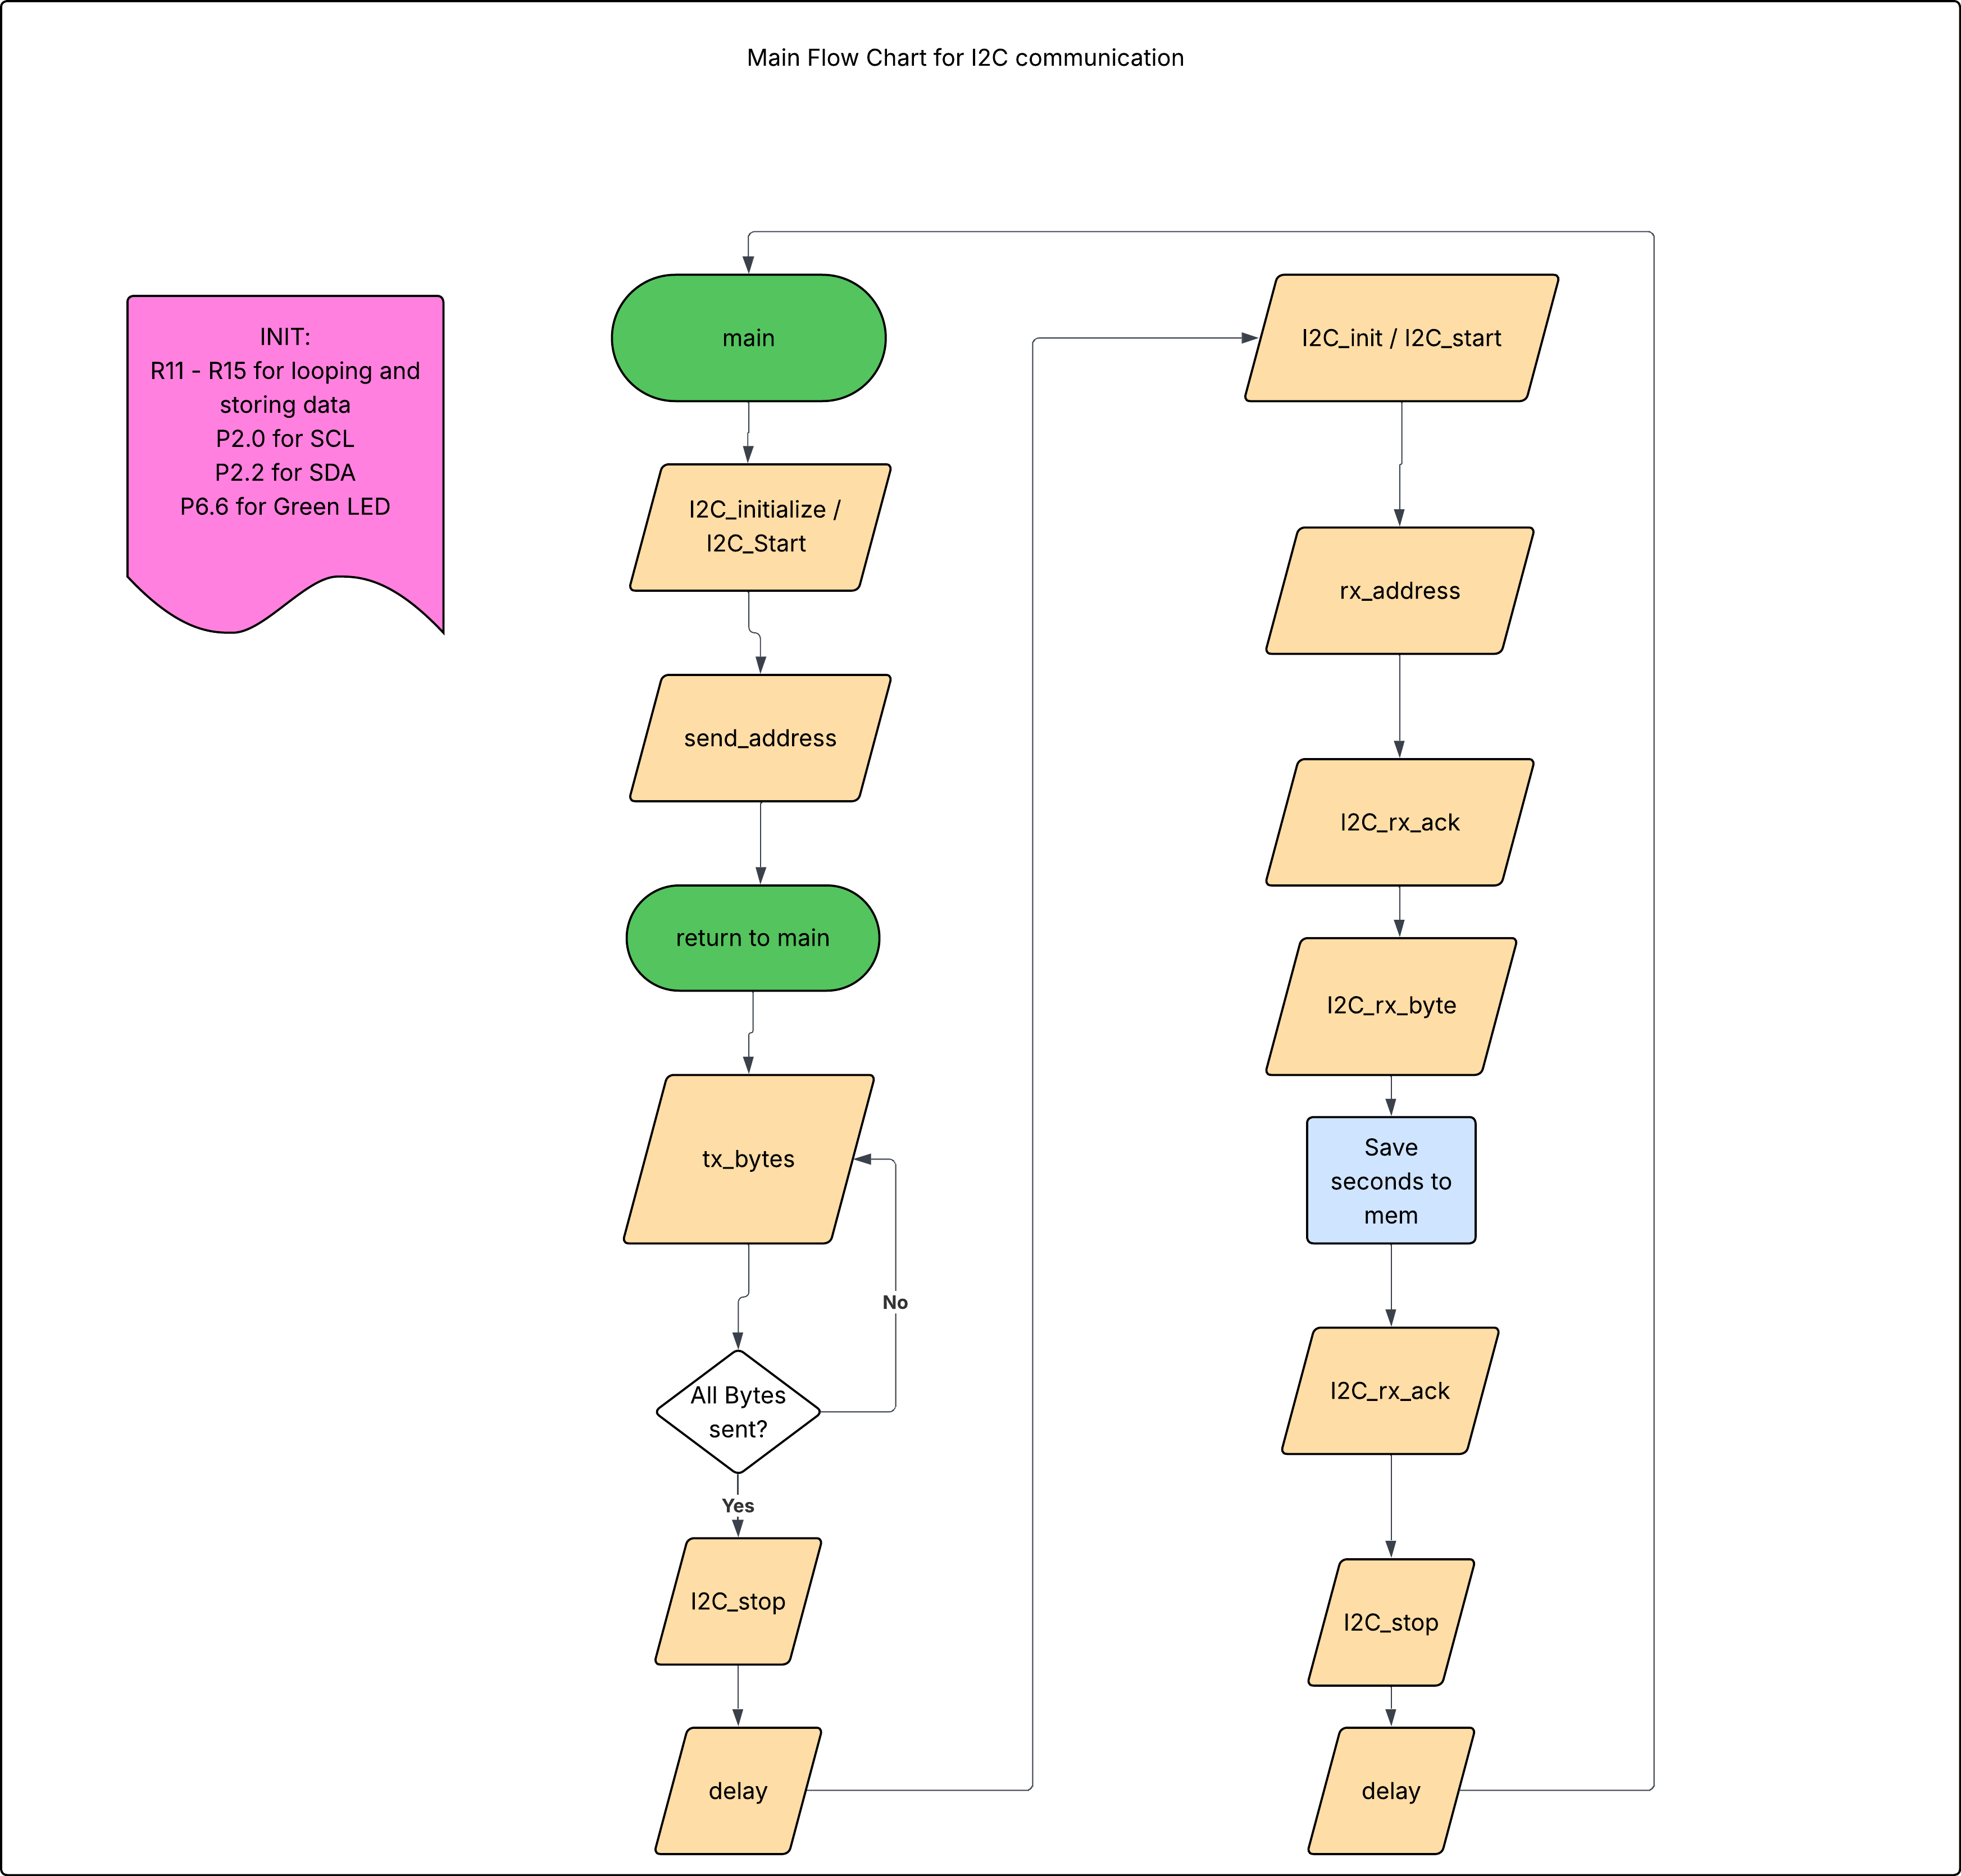
Flow Chart

Slide 7
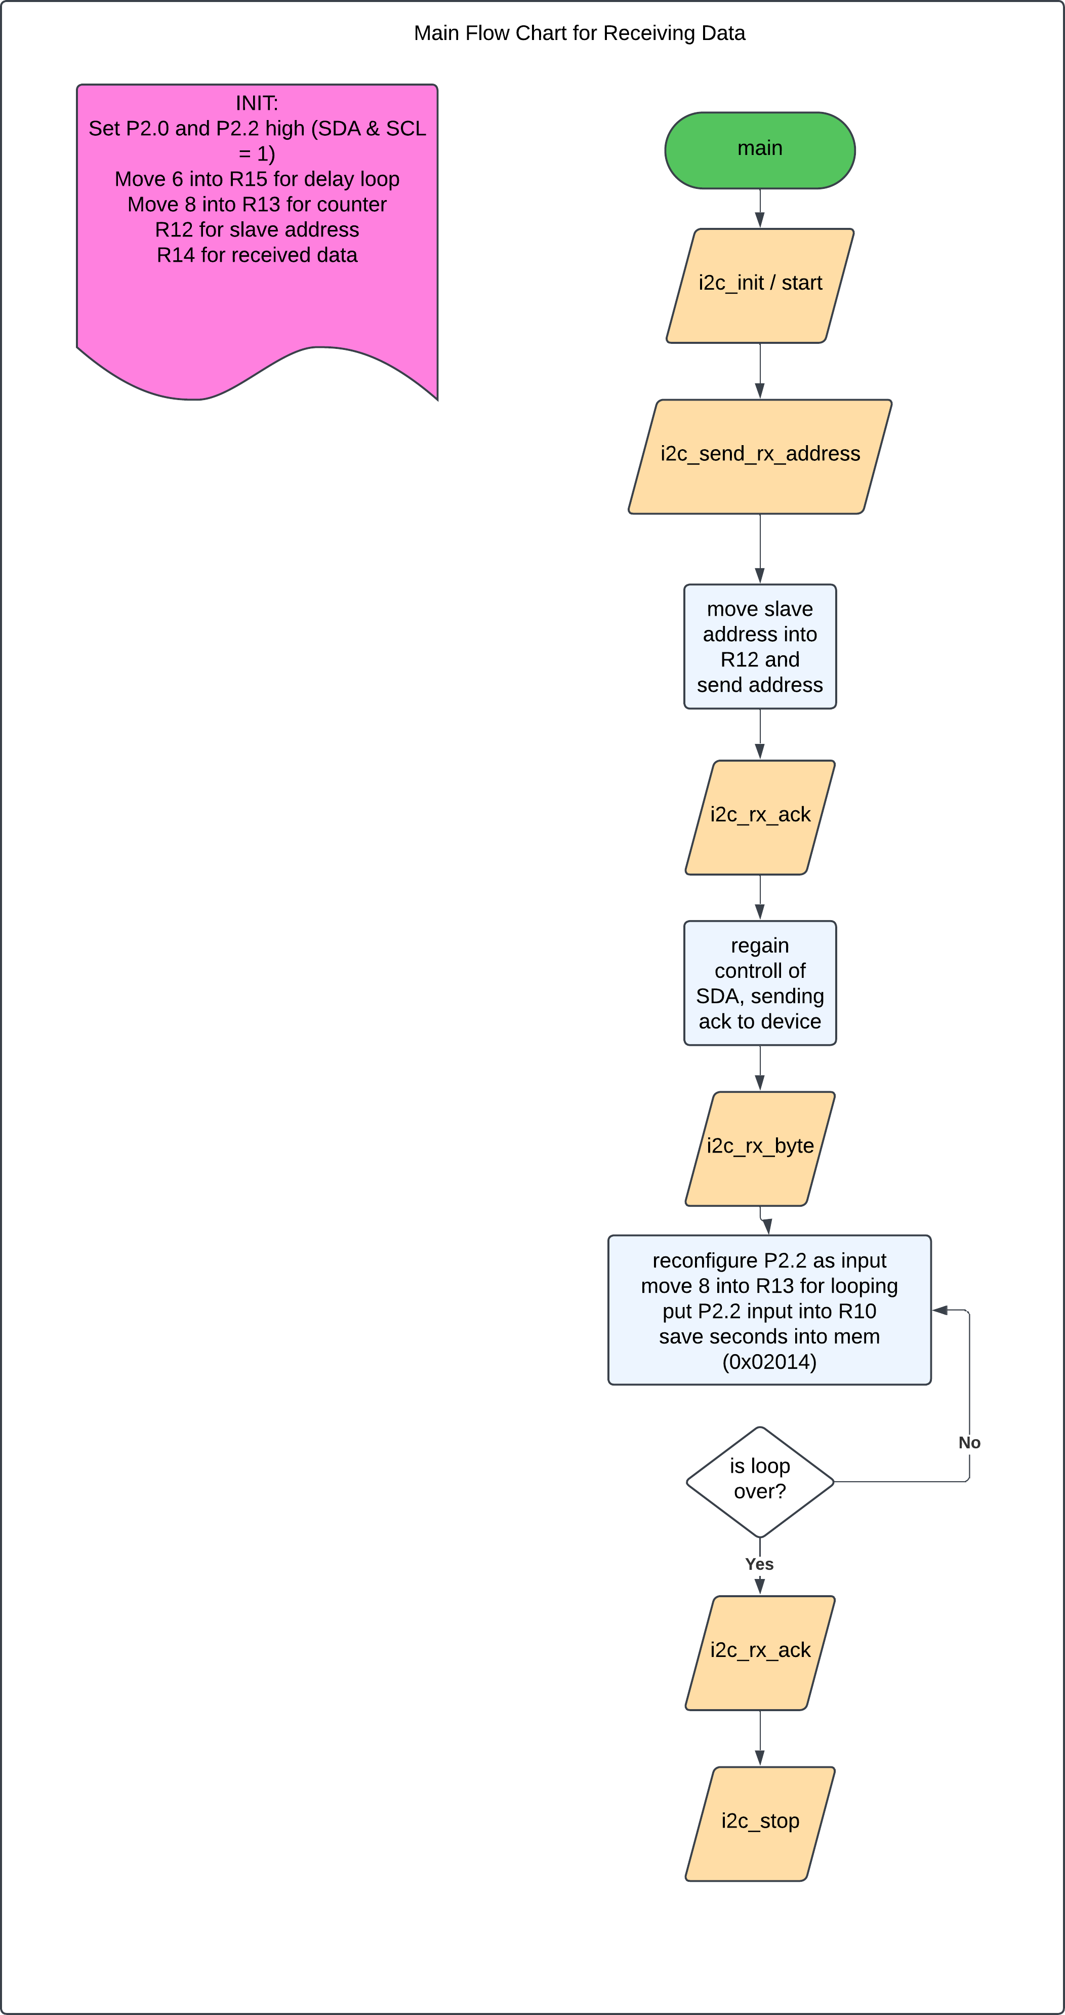
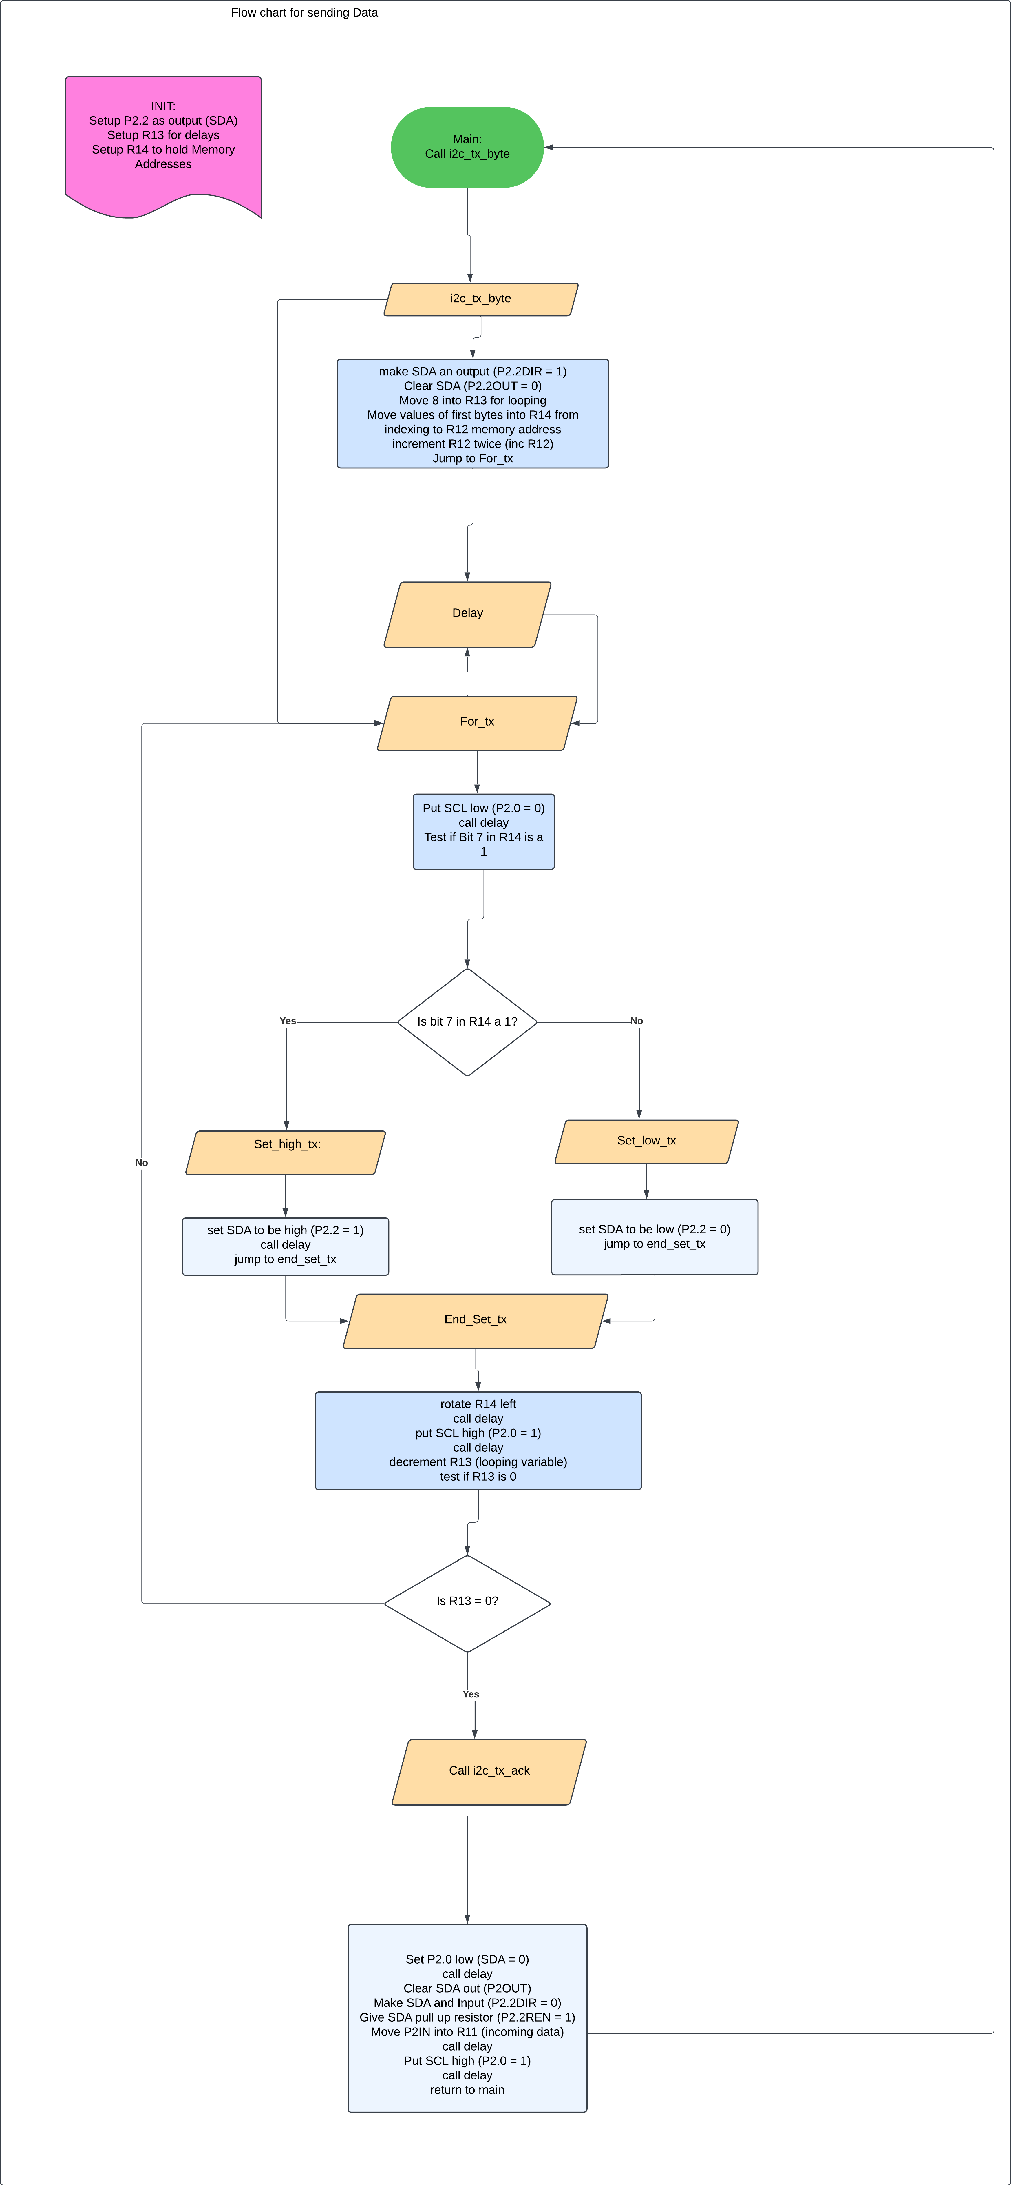
Flow chart cont

