Slide 1
Project 4 Presentation
Andrew Kernan & Ryan Adolph

Slide 2
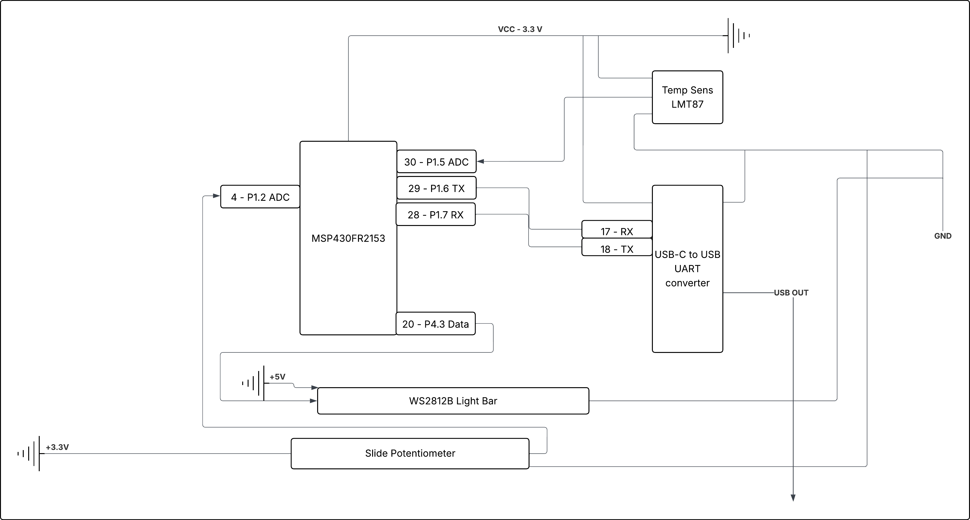
Circuit Diagram

Slide 3
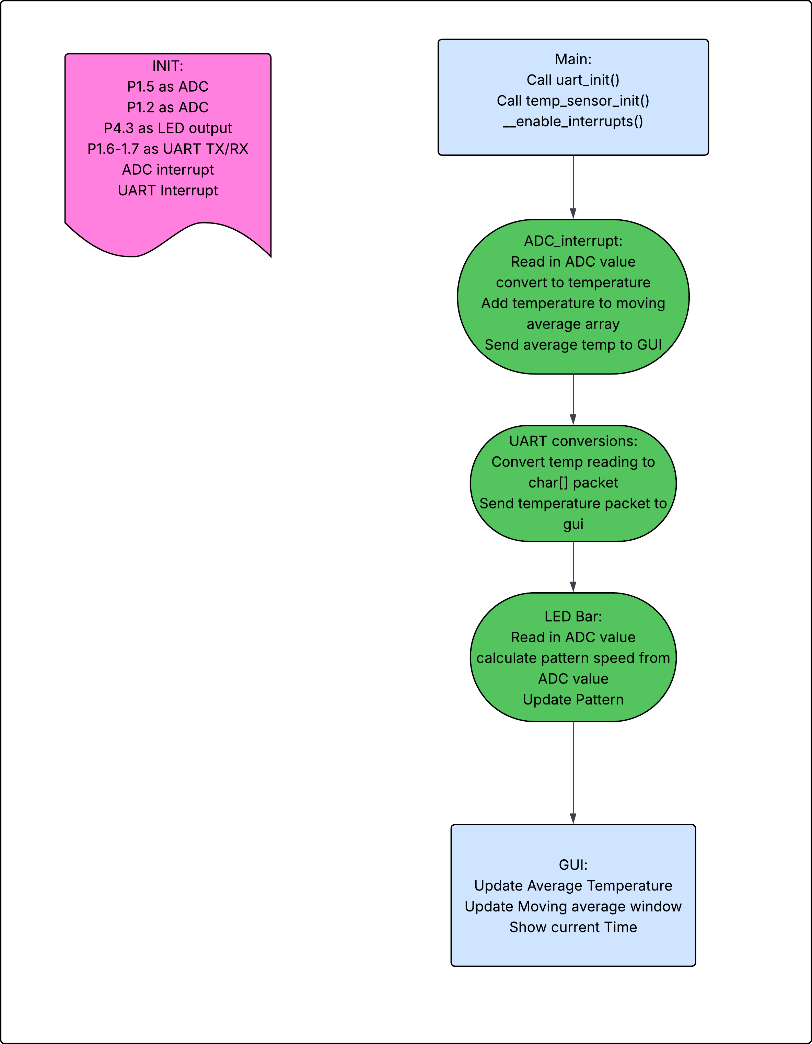
Main
FLOw chart

Slide 4
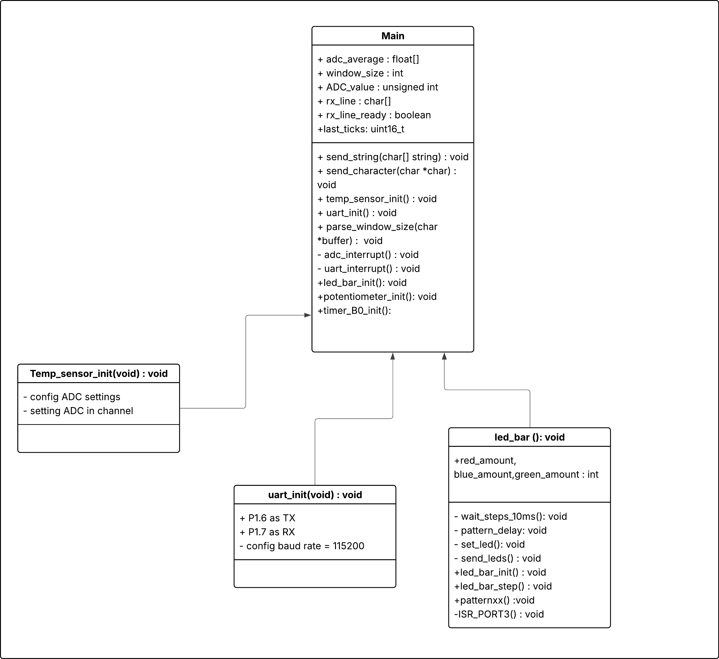
Class Diagram

