Slide 1
Credit Risk Uncovered: A Comparative Study of Classification Models for Default Prediction
Braeden Olds, Ryan Adolph, Michael Oswald

Slide 2
Overview
The goal of this project is to be able to predict whether a credit card client will default on their payments in the following months
There are several real-world applications to this project. One of the main applications would be for financial institutes or credit card vendors.
Identifying a client as low-risk when they are high-risk client could cause financial loss.
Being overly conservative and labeling every customer as medium to high-risk could also cause financial loss from minimal business opportunities.
The problem is designed as a supervised binary classification problem
Supervised binary classification problems are classic machine learning where a model is trained on data to categorize its input into one of two distinct categories or classes. Our designated classes are as follows.
Target Class 0: The client doesn’t default
Target Class 1: The client defaults

Slide 3
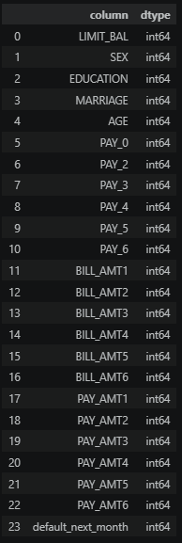
Data Overview
Consisted of financial and demographic information for credit card clients, which made this data set particularly relevant to our project
Instances: 30,000
Attributes: 23 input features + 1 target variable
Target Variable: default_next_month
Missing Values: 0
Duplicate Rows: 35
Categorical: 3 (SEX, EDUCATION, MARIAGE)
One hot encoding was done to convert these to numerical variables
Numerical: 20

Slide 4
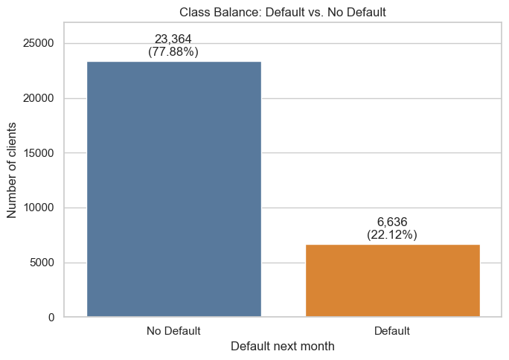
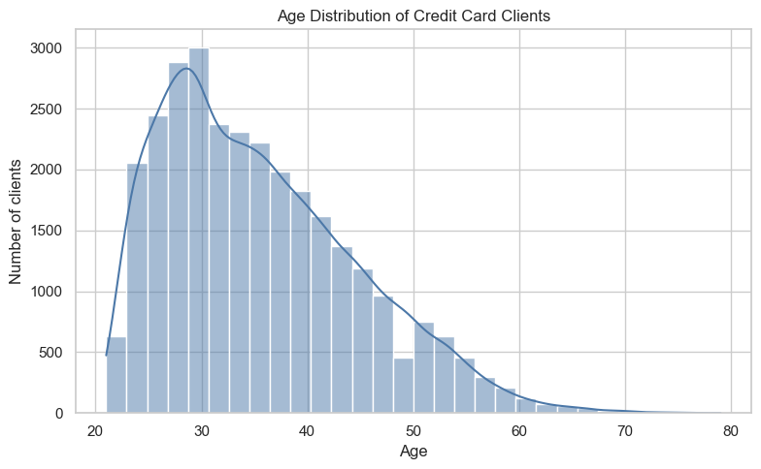
Original Class and Age Distribution
Some imbalance in our data set shows that most of our current clients are non-default clients, meaning accuracy may be skewed since predicting a majority could be easy
A large distribution of our clients are also younger clients with very few over 60

Slide 5
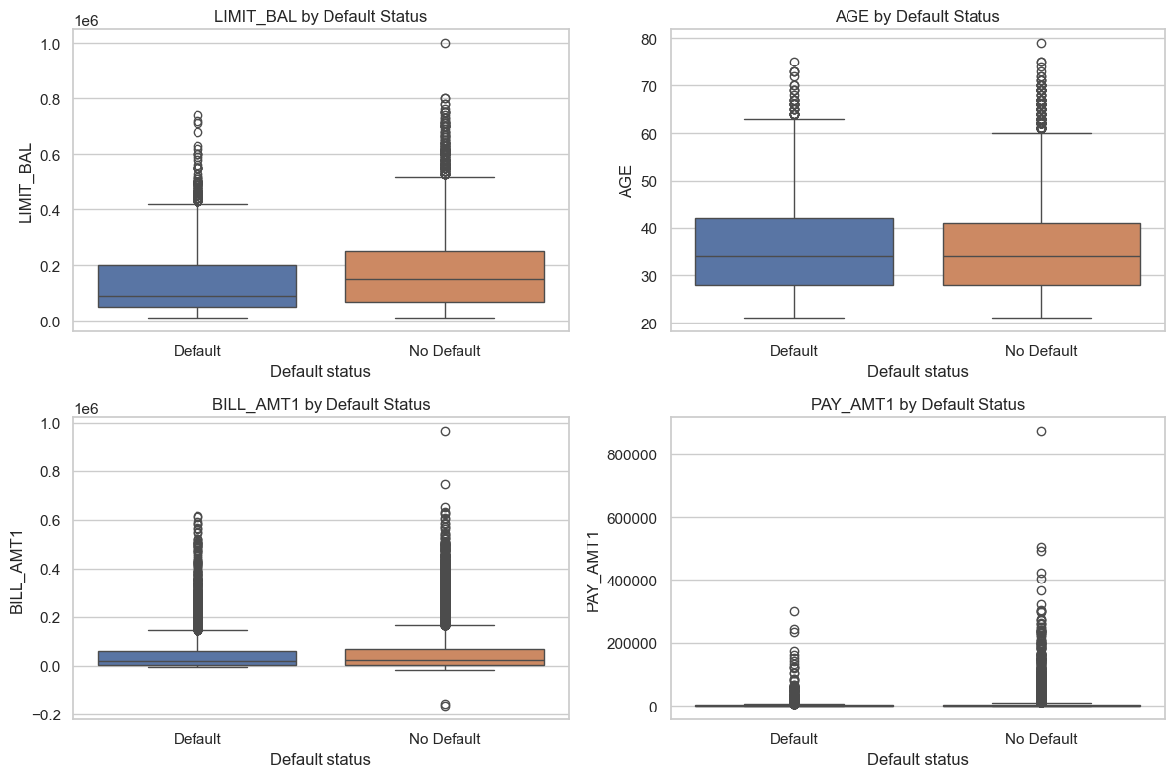
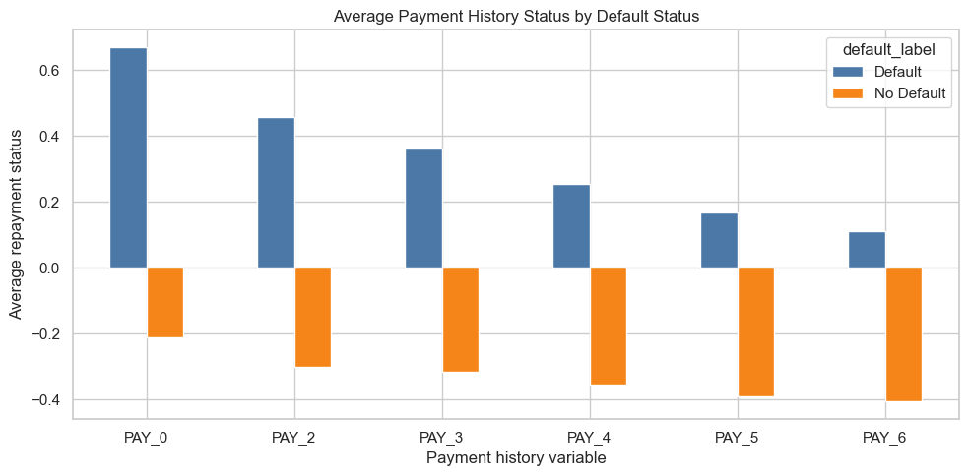
Payment History and Default Status
Selected financial variables are compared between clients who have defaulted and those who have not
The average payment history by default status is a more important graph however
Shows clients who default tend to have worse recent payment values
Supports the idea that recent payment delays are strong indicators of default risk

Slide 6
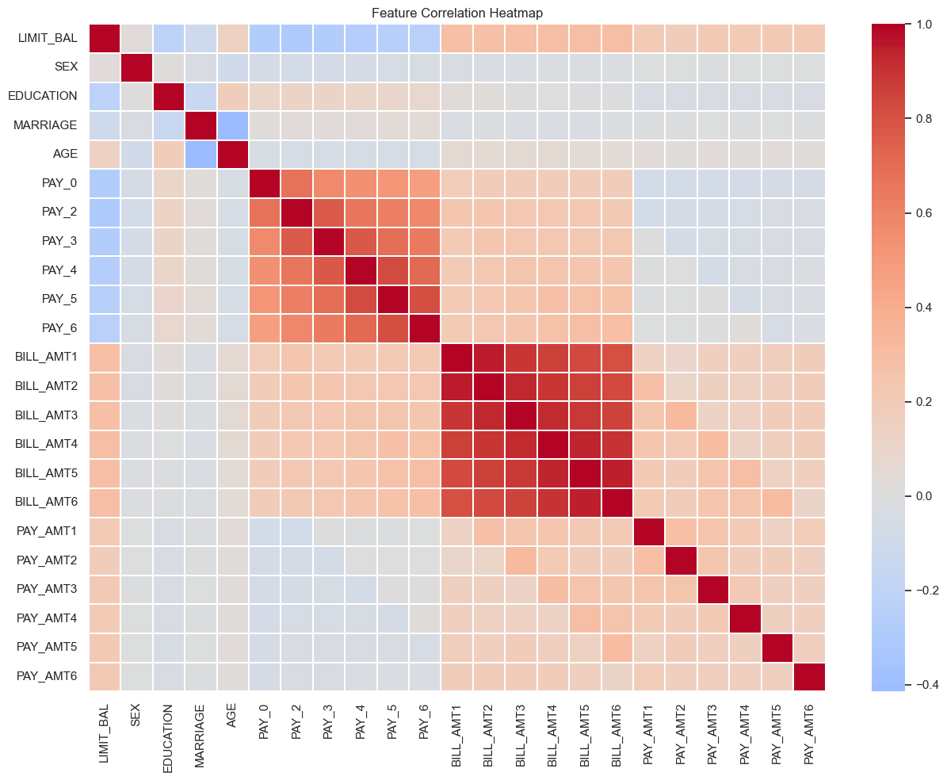
Attribute Distribution

Slide 7
Preprocessing Techniques
Categorical Variables were transformed through one-hot encoding
One-hot encoding was chosen over label encoding because variables had no inherent order, so we wanted to prevent false ranking of clients
Features were standardized using z-score standardization to ensure all features contribute equally to distance-based computations (i.e. KNN and logistic regression)
2 preprocessing pipelines were constructed for both computation models
Scaled pipeline for feature magnitude sensitive models
Non-scaled pipeline for tree-based models
Ensures that each model receives the correct preprocessed data to improve performance while preventing data leakage during cross validation

Slide 8
Techniques / Models Used
Logistic Regression
Its simplicity and interpretability can serve as a baseline model while providing insight into linear relationship between features and our target variable
Decision Trees
Capture nonlinear relationships or interactions between our variables
Random Forest
Improves upon Decision Trees by aggregating multiple trees, reducing variance and improving generalization
K-Nearest Neighbors (KNN)
Non-parametric, instance-based learning method that classifies samples based on proximity to neighbors.
Gradient Boosting
Builds models sequentially, correcting previous errors at each step. Known for strong performance on structured datasets

Slide 9
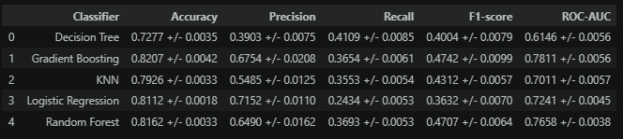
Model Performance
We evaluated our data set over all 5 of the models and calculated the cross validation scores of 5 different values: Accuracy, Precision, Recall, F1-Score, and ROC-AUC
We decided that Gradient Boosting gave us the best results, therefore that was our best model to use
Had the 1st accuracy, 2nd highest precision, 3rd highest recall, 1st highest F1-score, 1st highest ROC-AUC
To test our decision, we created a confusion matrix for the Gradient Boosting model

Slide 10
References
Data Set
Yeh, I. (2009). Default of Credit Card Clients [Dataset]. UCI Machine Learning Repository. https://doi.org/10.24432/C55S3H.

