Slide 1
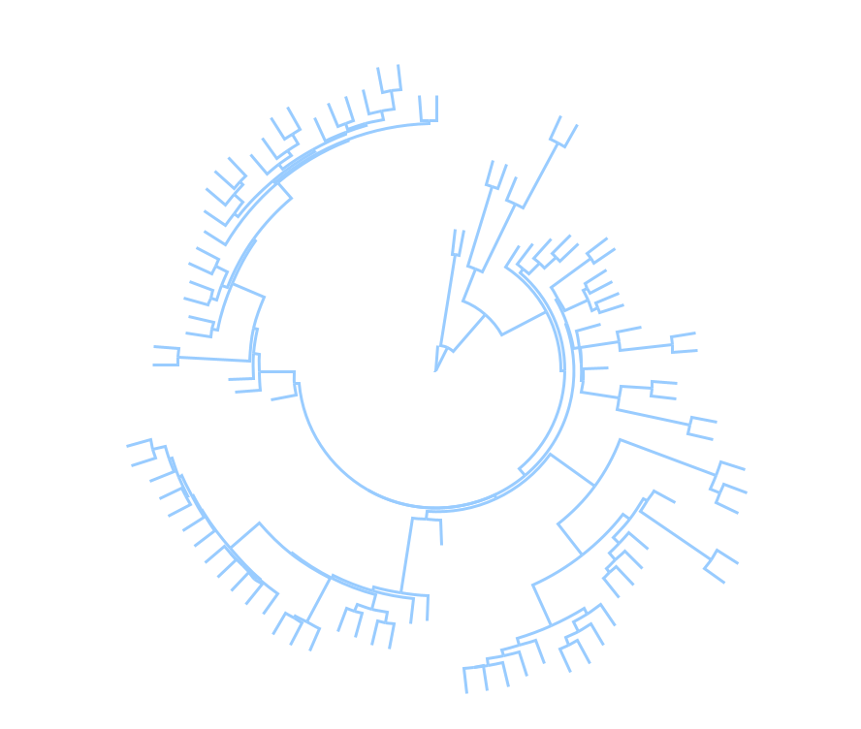
Biodiversity data wrangling: Linking large phylogenies with species traits and ecologies
Module: Phylogenetic Community Ecology
Daijiang Li
Botany 2024

Slide 2
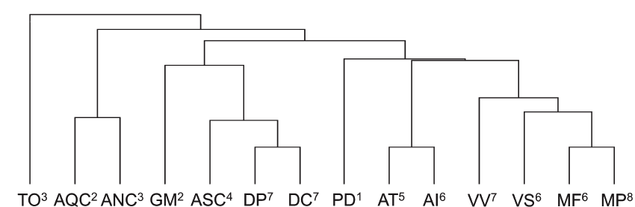














Phylogeny: evolutionary relationships among species
1. Comparative methods among species
2. Community ecology

Slide 3
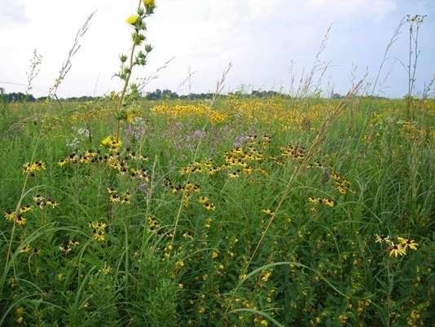
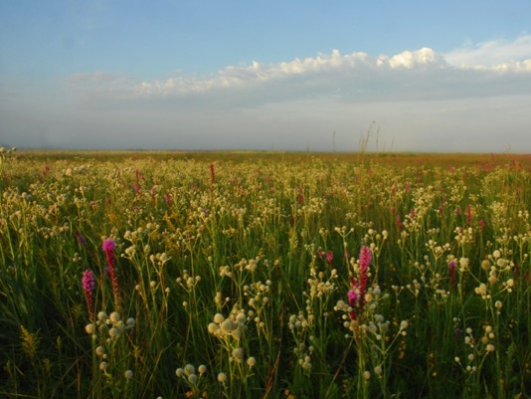
Community ecology
What species are present/absent in
different communities?

Slide 4
Why use phylogenies in community ecology?
Phylogenies can be surrogates for missing trait data
Even if relevant traits are unknown, related species should have similar trait values

Slide 5









Phylogeny tells which species will likely have similar traits
Plant Traits
wet tolerant
dry tolerant

Slide 6
Phylogeny tells which species will likely have similar traits
Species
dry site
wet site
Phylogenetically related species will occur in the same sites

Slide 7
Phylogeny tells which species will likely have similar traits
Species
dry site
wet site
Phylogeny is a surrogate for traits

Slide 8
Outline
Phylogenetic diversity
Phylogenetic Generalized Linear Mixed Models (PGLMMs)

Slide 9
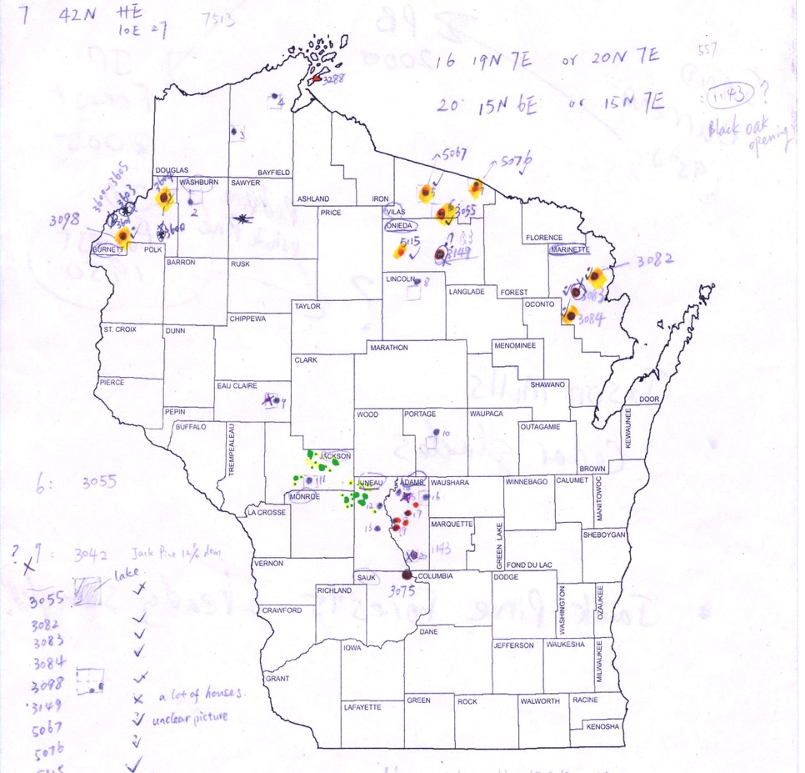
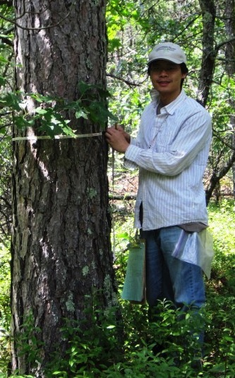
Dataset

Slide 10
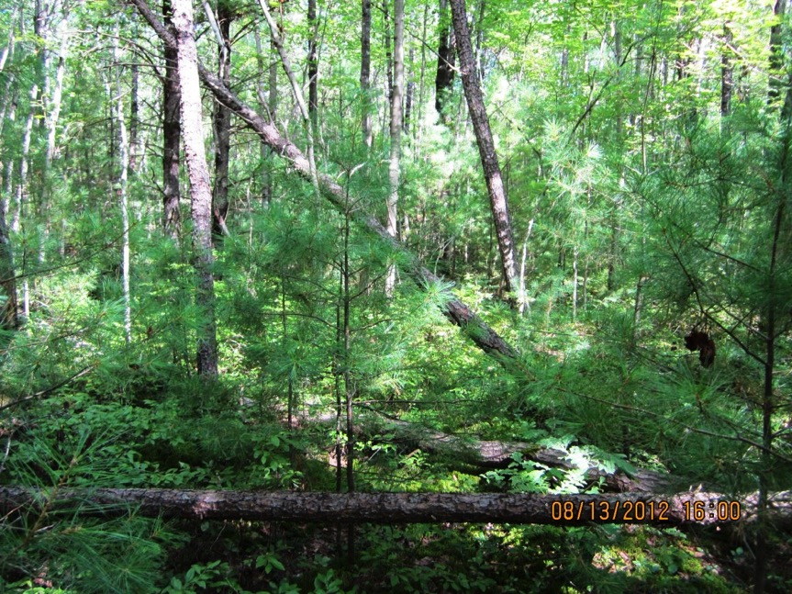
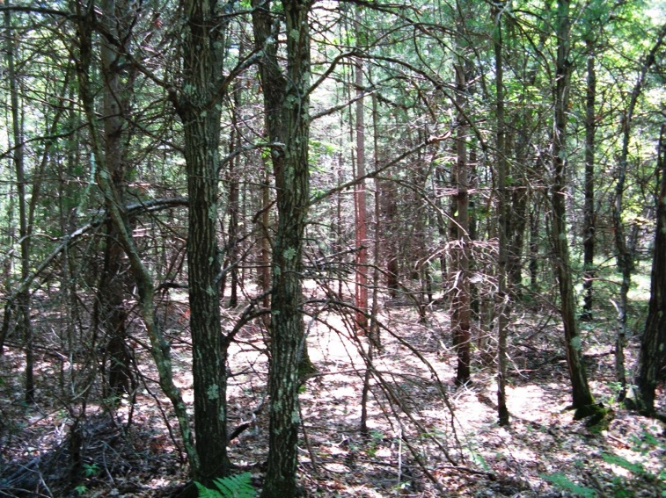
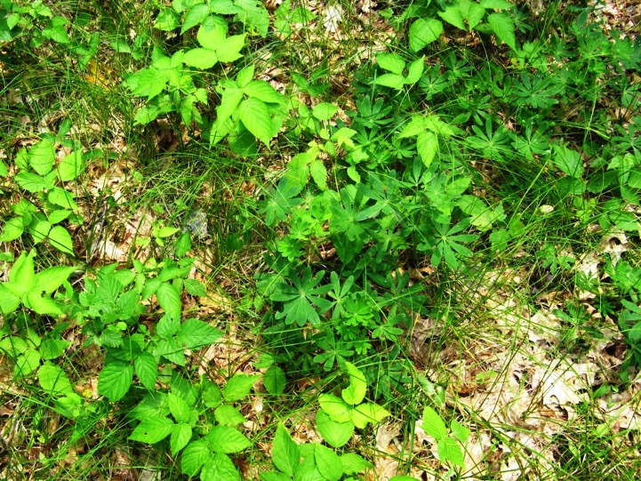
sites
Functional traits
Woody
Biotic Pollination
Shade Tolerance
Plant Height
Seed Mass
Specific Leaf Area (SLA, leaf area/dry mass)
Leaf Carbon Content (LCC)
Leaf Nitrogen Content (LNC)
Stem Dry Mass Content (SDMC)
species

Slide 11
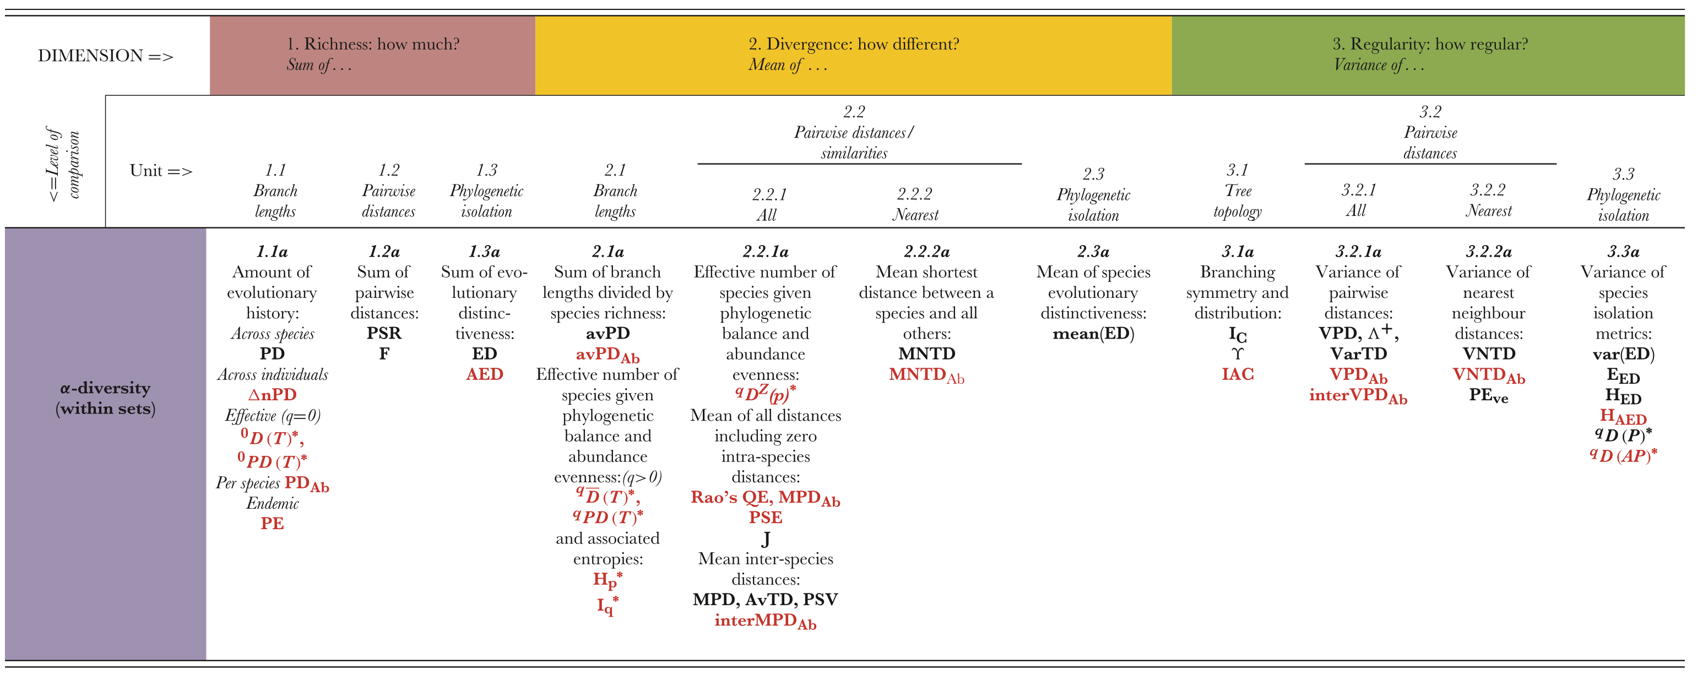
Common Phylogenetic Diversity Metrics
Tucker et al. 2016, Biological Reviews

Slide 12
Diversity
Environmental variable

Slide 13
Model-based methods
Why?
No aggregation to one value/site
Integrate multiple source of information (and their interactions)
Model validation/selection/prediction …
Deeper understanding of community dynamics

Slide 14
Warning
This section has a lot of equations in it.
I want to show how useful it is to analyze data with models.
The models look complicated only because the questions are complicated.

Slide 15
Preliminaries
Incorporating phylogenies into statistical models
Turning phylogenies into variances

Slide 16
Total variance
Shared variance
= covariance
Variance since speciation
trait

Slide 17
Brownian motion
Matrix giving phylogenetic covariances among species
Notes:
How does this related to phylogenetic signal?
Given phylogenetic tree, can give pattern of covariance among species - but can also go in opposite direction - suppose have tree with this topology - assume some other type of evolution - stabilizing selection - d measures strength of the stabilizing force - given data on trait values among species, can estimate d based on covariance in data - this tree is not the phylogeny, but instead depicts the pattern of covariance among trait values - lower covariance than predicted under Brownian motion - weaker phylogenetic signal

Slide 18
sites
1. Are related species more likely to occur in the same sites?
2. Is this because they share functional traits?
species
Li et al., 2017
New Phytologist

Slide 19
PGLMM for community composition
Y_{i} = a_{spp[i]}+ a^{p}_{spp[i]} + c_{site[i]} + d_{i} + e_{i}
a ~ Gaussian(0, σ²_{a}I_{n})
a^{p} ~ Gaussian(0, σ²_{ap}Ψ)
c ~ Gaussian(0, σ²_{site}I_{m})
d ~ Gaussian(0, kron(I_{m}, σ²_{attract}Ψ))
e ~ Gaussian(0, σ²I)

Slide 20
PGLMM for community composition
Y_{i} = a_{spp[i]}+ a^{p}_{spp[i]} + c_{site[i]} + d_{i} + e_{i}
a ~ Gaussian(0, σ²_{a}I_{n})
differences in abundance
a^{p} ~ Gaussian(0, σ²_{ap}Ψ)
…that depend on phylogeny

Slide 21
PGLMM for community composition
Y_{i} = a_{spp[i]}+ a^{p}_{spp[i]} + c_{site[i]} + d_{i} + e_{i}
c ~ Gaussian(0, σ²_{site}I_{m})
differences among sites

Slide 22
PGLMM for community composition
Y_{i} = a_{spp[i]}+ a^{p}_{spp[i]} + c_{site[i]} + d_{i} + e_{i}
d ~ Gaussian(0, kron(I_{m}, σ²_{attract}Ψ))
phylogenetic attraction within sites
Sites contain phylogenetically related species

Slide 23
attraction within sites

Slide 24
PGLMM for community composition
Y_{i} = a_{spp[i]}+ a^{p}_{spp[i]} + c_{site[i]} + d_{i} + e_{i}
e ~ Gaussian(0, σ²I)
residual variation

Slide 25
PGLMM for community composition
Y_{i} = a_{spp[i]}+ a^{p}_{spp[i]} + c_{site[i]} + d_{i} + e_{i}
a ~ Gaussian(0, σ²_{a}I_{n})
a^{p} ~ Gaussian(0, σ²_{ap}Ψ)
c ~ Gaussian(0, σ²_{site}I_{m})
d ~ Gaussian(0, kron(I_{m}, σ²_{attract}Ψ))
e ~ Gaussian(0, σ²I)

Slide 26
Y_{i} = a_{spp[i]}+ a^{p}_{spp[i]} + c_{site[i]} + d_{i} + e_{i}
σ_{a} = 0.997
σ_{ap} = 0.001
High variation among species in abundance but almost no phylogenetic signal

Slide 27
Y_{i} = a_{spp[i]}+ a^{p}_{spp[i]} + c_{site[i]} + d_{i} + e_{i}
σ_{a} = 0.997
σ_{ap} = 0.001
σ_{site} = 0.004
Little site-to-site variation in mean abundance of species

Slide 28
Y_{i} = a_{spp[i]}+ a^{p}_{spp[i]} + c_{site[i]} + d_{i} + e_{i}
σ_{a} = 0.997
σ_{ap} = 0.001
σ_{site} = 0.004
σ_{attract} = 0.096 (P < 0.001)
Significant phylogenetic attraction: related species are more likely to have high abundance in the same site

Slide 29
Phylogenetic attraction: related species occur in the same sites
Notes:
We then wanted to know why closely related plants tended to attract similar comm and numbers of poll, so we investigated whether various plant traits could explain the patterns.

Slide 30
Are there traits that explain the phylogenetic attraction?
Notes:
We then wanted to know why closely related plants tended to attract similar comm and numbers of poll, so we investigated whether various plant traits could explain the patterns. For example, we looked at whether the flowers were radially symmetrical, like phlox, or not, like horsemint, and whether the flowers had concealed nectar, like columbine, which has these long nectar spurs that could be difficult for short-tongued insects to access, or not, like these swamp milkweed flowers, where the nectar just pools in the 5 hoods.

Slide 31
Y_{i} = a_{spp[i]}+ a^{p}_{spp[i]} + c_{site[i]} + d_{i} + f_{site[i]} trait_{spp[i]} + e_{i}
f ~ Gaussian(β, σ²_{trait}I_{m}))
sites with slopes f
Abundance
Trait

Slide 32
Y_{i} = a_{spp[i]}+ a^{p}_{spp[i]} + c_{site[i]} + d_{i} + f_{site[i]} trait_{spp[i]} + e_{i}
f ~ Gaussian(β, σ²_{trait}I_{m}))
site favors species with
site favors species with
Trait

Slide 33
Y_{i} = a_{spp[i]}+ a^{p}_{spp[i]} + c_{site[i]} + d_{i} + f_{site[i]} trait_{spp[i]} + e_{i}
Do traits explain (remove) the effect of phylogeny?
site favors species with
site favors species with
Trait

Slide 34
Y_{i} = a_{spp[i]}+ a^{p}_{spp[i]} + c_{site[i]} + d_{i} + f_{site[i]} trait_{spp[i]} + e_{i}
σ_{leaf width} = 0.076
σ_{leaf circularity} = 0.29
σ_{leaf thickness} = 0.0006
σ_{dispersal} = 0.087
σ_{attract} = 0.00016
There is almost no remaining phylogenetic attraction

Slide 35
Are there traits that explain the phylogenetic attraction?
Notes:
We then wanted to know why closely related plants tended to attract similar comm and numbers of poll, so we investigated whether various plant traits could explain the patterns. For example, we looked at whether the flowers were radially symmetrical, like phlox, or not, like horsemint, and whether the flowers had concealed nectar, like columbine, which has these long nectar spurs that could be difficult for short-tongued insects to access, or not, like these swamp milkweed flowers, where the nectar just pools in the 5 hoods.

Slide 36
Are there traits that explain the phylogenetic attraction?
Yes
Notes:
We then wanted to know why closely related plants tended to attract similar comm and numbers of poll, so we investigated whether various plant traits could explain the patterns. For example, we looked at whether the flowers were radially symmetrical, like phlox, or not, like horsemint, and whether the flowers had concealed nectar, like columbine, which has these long nectar spurs that could be difficult for short-tongued insects to access, or not, like these swamp milkweed flowers, where the nectar just pools in the 5 hoods.

Slide 37
Go through R code

