Slide 1
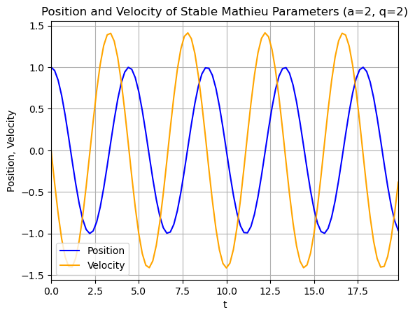
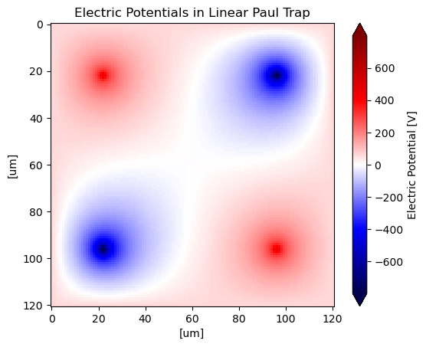
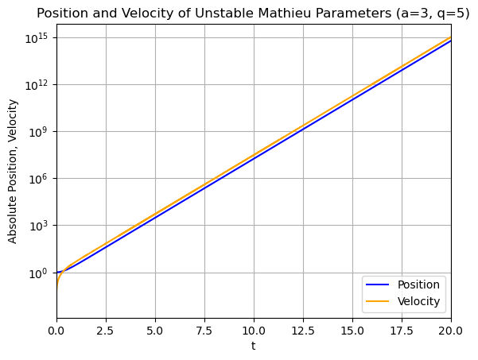
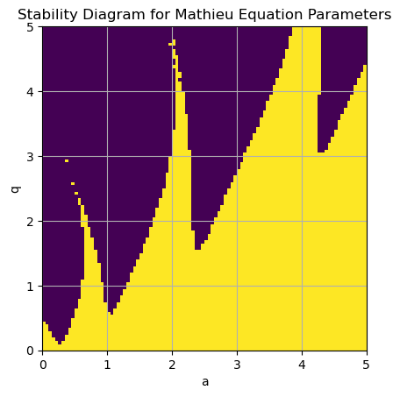



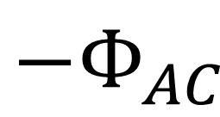
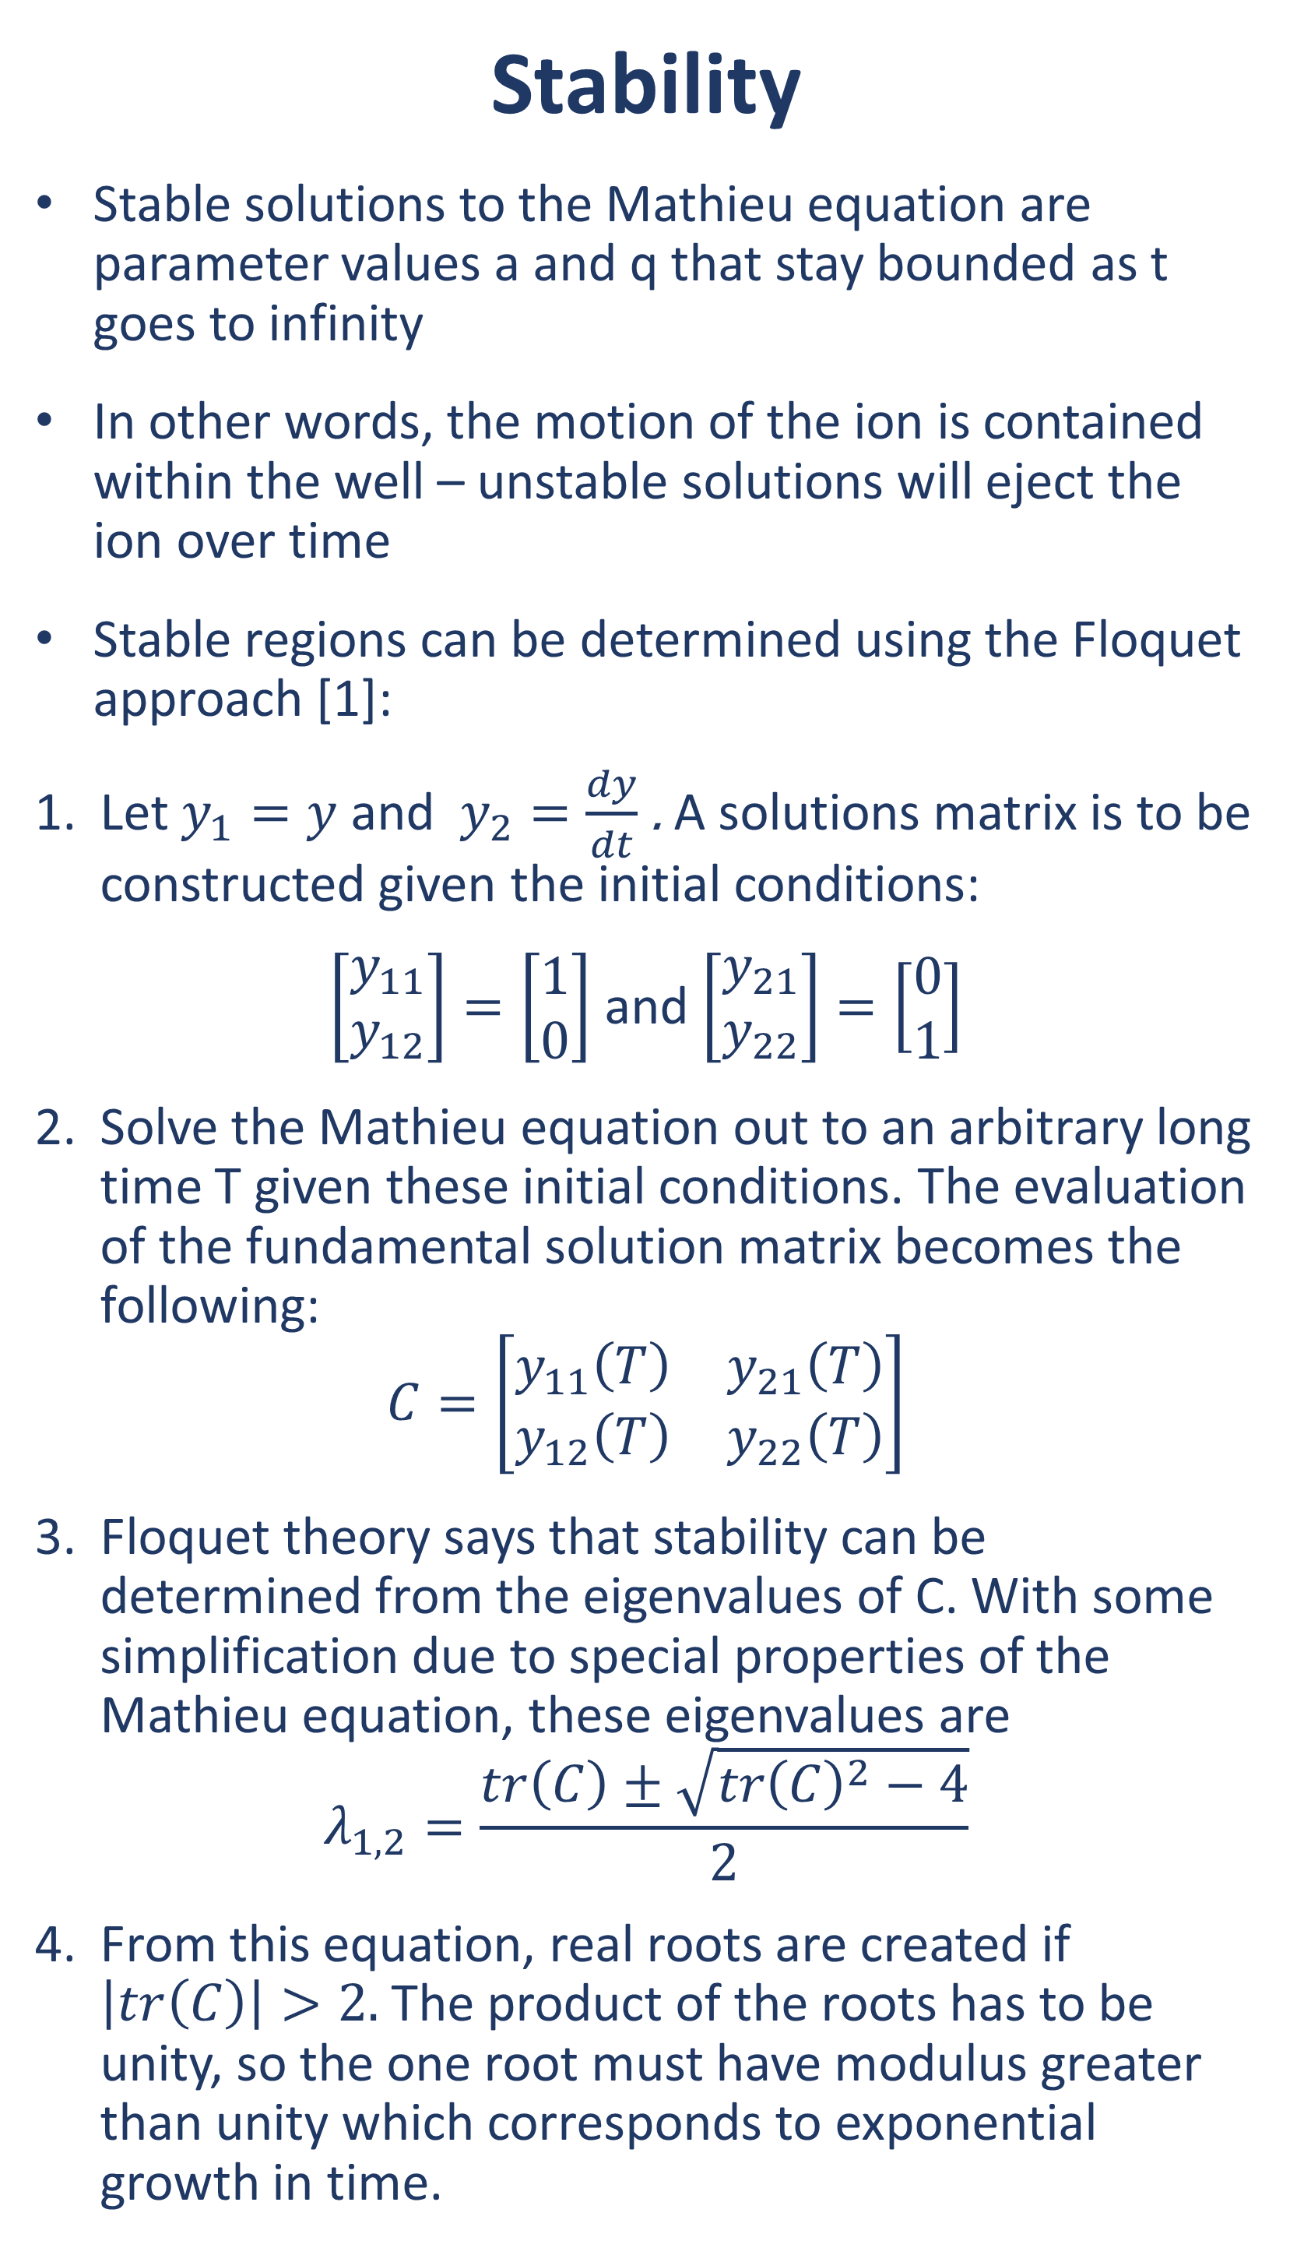
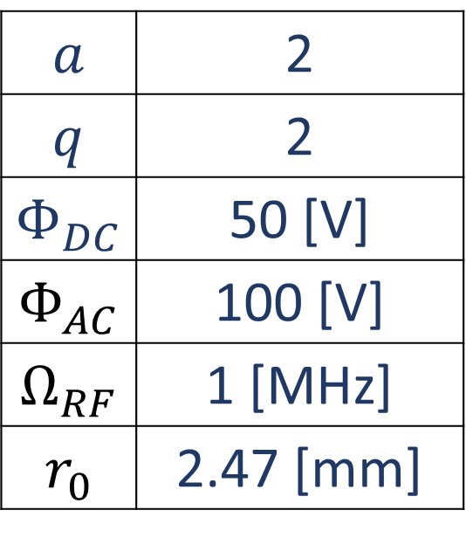

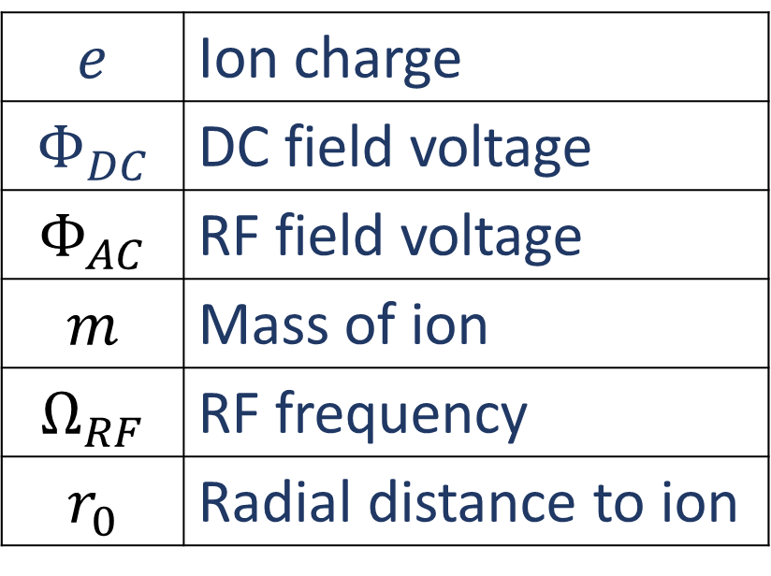
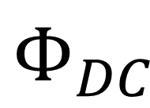
Defining an electric potential well in a linear Paul trap
Ryan A. McGill
Georgia Tech Research Institute, Atlanta, GA
Background & Motivation
Ion traps can serve as sensors, qubits in quantum computing, and as platforms to study atomic physics
Trapping requires multi-wavelength light sources to photoionize an atomic source as well as keep them cold within an electric confining potential
Earnshaw’s Theorem states that a charged particle must have an alternating and static potential together in order to contain an ion
The motion of the particle can be described by Mathieu’s equation, a second-order ordinary differential equation:
$$\frac{d^{2}y}{dt^{2}}+\left(a−2q\cos\left(2t\right)\right)y=0$$
The variables a and q are the “trapping parameters” – with a given trap geometry, the position and velocity of the ion is deterministic
Stable solutions of the Mathieu equation result in ion confinement within the potential well
Stability
Stable solutions to the Mathieu equation are parameter values a and q that stay bounded as t goes to infinity
In other words, the motion of the ion is contained within the well – unstable solutions will eject the ion over time
Stable regions can be determined using the Floquet approach [1]:
Let $y_{1}=y$ and $y_{2}=\frac{dy}{dt}$ . A solutions matrix is to be constructed given the initial conditions:
$\left[\begin{aligned}y_{11} \\ y_{12}\end{aligned}\right]=\left[\begin{aligned}1 \\ 0\end{aligned}\right]$ and $\left[\begin{aligned}y_{21} \\ y_{22}\end{aligned}\right]=\left[\begin{aligned}0 \\ 1\end{aligned}\right]$
Solve the Mathieu equation out to an arbitrary long time T given these initial conditions. The evaluation of the fundamental solution matrix becomes the following:
$$C=\left[\begin{matrix}y_{11}\left(T\right) & y_{21}\left(T\right) \\ y_{12}\left(T\right) & y_{22}\left(T\right)\end{matrix}\right]$$
Floquet theory says that stability can be determined from the eigenvalues of C. With some simplification due to special properties of the Mathieu equation, these eigenvalues are
$$λ_{1,2}=\frac{tr\left(C\right)±\sqrt{{tr\left(C\right)}^{2}−4}}{2}$$
From this equation, real roots are created if $\left|tr\left(C\right)\right|>2.$The product of the roots has to be unity, so the one root must have modulus greater than unity which corresponds to exponential growth in time.
Bounded Motion
From the stability diagram, stable Mathieu parameters can be chosen for the trap design
The bounded and unbounded motion for two parameter pairs are simulated
Electric Potentials
The Mathieu equation needs to be stable in two directions: the “x” or cross-sectional plane, and the “z” or axial direction. Assuming a=q=2, then:
x
z
$$Φ_{DC}$$
$$a$$ | 2
$$q$$ | 2
$$Φ_{DC}$$ | 50 [V]
$$Φ_{AC}$$ | 100 [V]
$$Ω_{RF}$$ | 1 [MHz]
$$r_{0}$$ | 2.47 [mm]
Simulation Setup
Using the RK4 method, the Mathieu equation can be solved for a given time period and parameters to determine the position ($y$) and velocity ($\frac{dy}{dt}$ ) of the particle in the trap
r
$$Φ_{AC}$$
$${−Φ}_{AC}$$
Simulation Setup
Poisson’s equations relate electric field to charge density. The Jacobi method is used to find the electric field across the trap at time t
At a time t, the electric field for the AC sources are calculated and ascribed a charge density based on the chosen radius for the cylindrical electrodes
$$a=\frac{4eΦ_{DC}}{mΩ_{RF}{r_{0}}^{2}}$$
$$q=\frac{2eΦ_{AC}}{mΩ_{RF}{r_{0}}^{2}}$$
$$e$$ | Ion charge
$$Φ_{DC}$$ | DC field voltage
$$Φ_{AC}$$ | RF field voltage
$$m$$ | Mass of ion
$$Ω_{RF}$$ | RF frequency
$$r_{0}$$ | Radial distance to ion
Simulation Setup
Iterate over values of a and q. Use RK4 twice per point out to a long integration time T in order to construct the solution matrix.
By finding the trace of C, the stability of the values for a and q can be determined.
The plot on the right shows stable solutions for the parameters up to 5. These “tongues” are characteristic of the stability regions for the Mathieu equation.
From here, a and q values can be chosen in the stable regions that correspond to desired trap characteristics, such as RF frequency or amplitude voltage
For both plots, the only parameter changed was a and q. It is clear that the position and velocity stay bounded for a stable solution, and that the absolute position increases exponentially for unstable parameters
While the above geometry mathematically works, it is obvious that there are more equilibrium points outside of the center of the trap. These can be alleviated with hyperbolic electrode shapes instead of cylindrical ones used here.
References
Unstable | Stable
[1] Kovacic, I. et. al. (February 14, 2018). "Mathieu's Equation and Its Generalizations: Overview of Stability Charts and Their Features." ASME. Appl. Mech. Rev. March 2018; 70(2): 020802. https://doi.org/10.1115/1.4039144

Slide 2

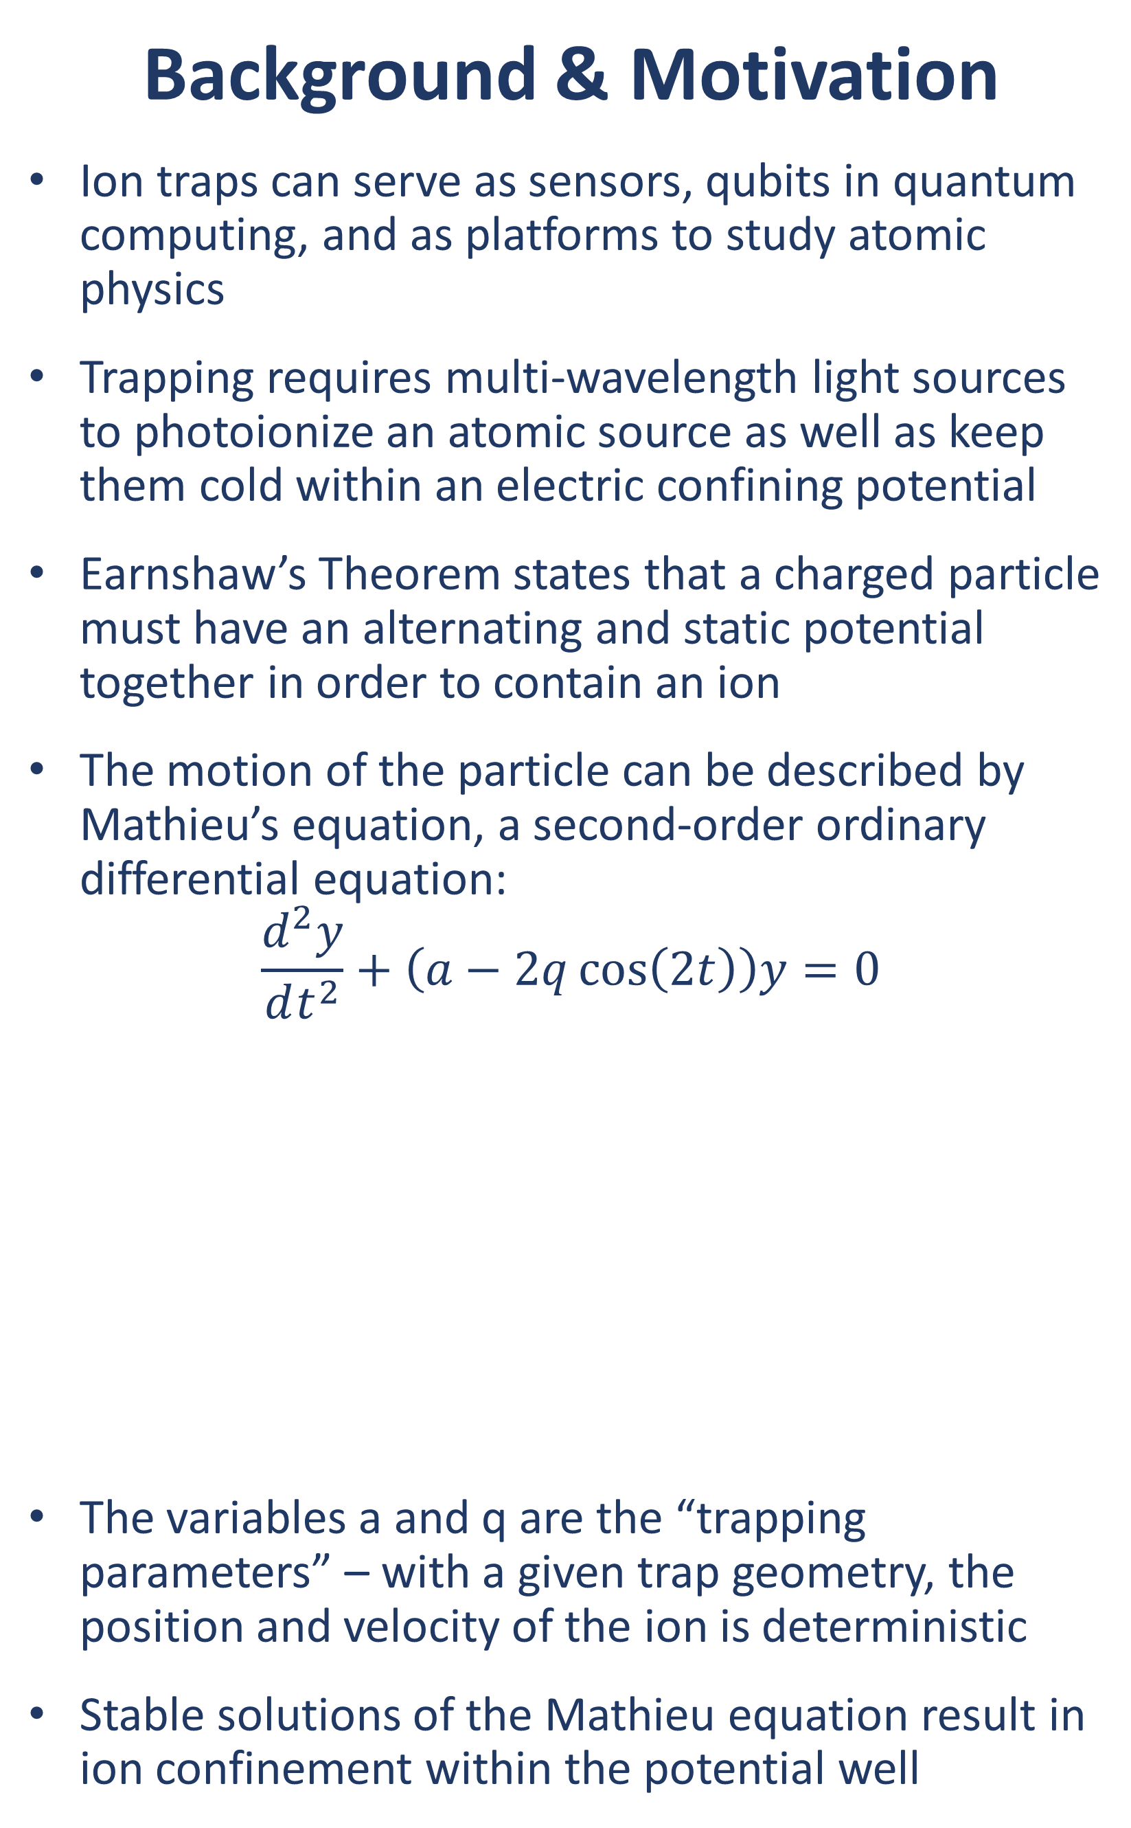
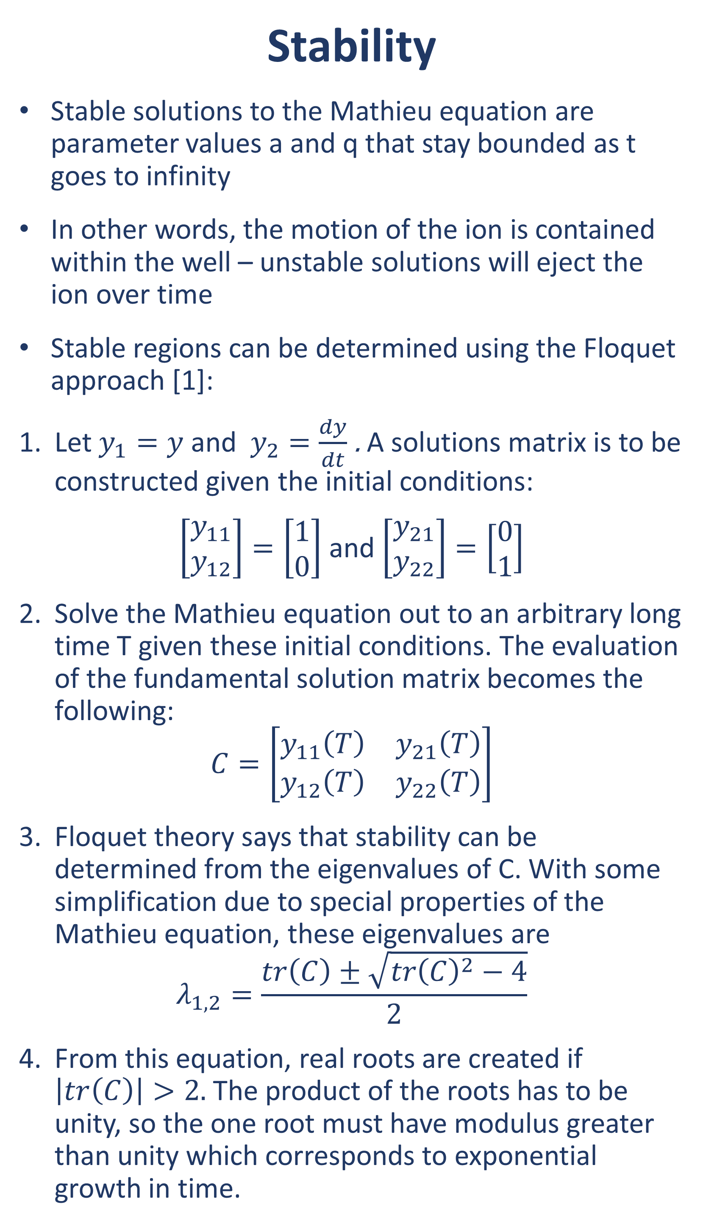
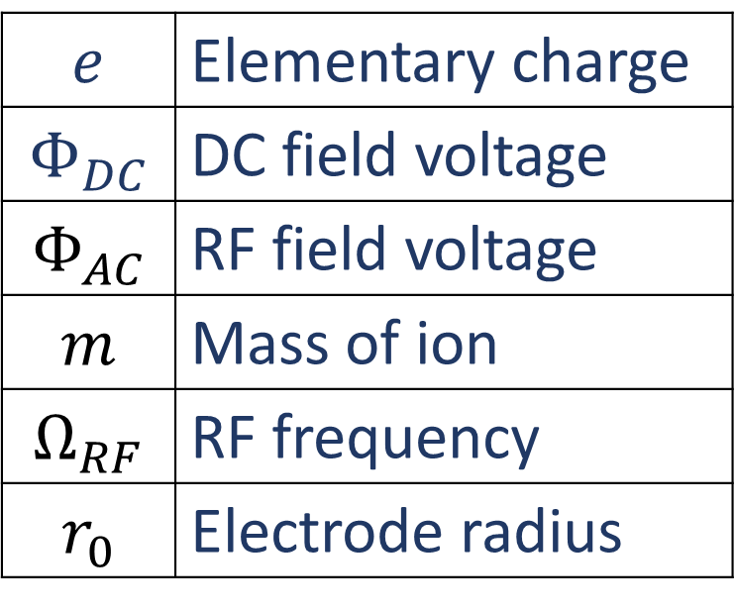
Defining an electric potential well in a linear Paul trap
Ryan A. McGill
Georgia Tech Research Institute, Atlanta, GA
Background & Motivation
Ion traps can serve as sensors, qubits in quantum computing, and as platforms to study atomic physics
Trapping requires multi-wavelength light sources to photoionize an atomic source as well as keep them cold within an electric confining potential
Earnshaw’s Theorem states that a charged particle must have an alternating and static potential together in order to contain an ion
The motion of the particle can be described by Mathieu’s equation, a second-order ordinary differential equation:
$$\frac{d^{2}y}{dt^{2}}+\left(a−2q\cos\left(2t\right)\right)y=0$$
The variables a and q are the “trapping parameters” – with a given trap geometry, the position and velocity of the ion is deterministic
Stable solutions of the Mathieu equation result in ion confinement within the potential well
Stability
Stable solutions to the Mathieu equation are parameter values a and q that stay bounded as t goes to infinity
In other words, the motion of the ion is contained within the well – unstable solutions will eject the ion over time
Stable regions can be determined using the Floquet approach [1]:
Let $y_{1}=y$ and $y_{2}=\frac{dy}{dt}$ . A solutions matrix is to be constructed given the initial conditions:
$\left[\begin{aligned}y_{11} \\ y_{12}\end{aligned}\right]=\left[\begin{aligned}1 \\ 0\end{aligned}\right]$ and $\left[\begin{aligned}y_{21} \\ y_{22}\end{aligned}\right]=\left[\begin{aligned}0 \\ 1\end{aligned}\right]$
Solve the Mathieu equation out to an arbitrary long time T given these initial conditions. The evaluation of the fundamental solution matrix becomes the following:
$$C=\left[\begin{matrix}y_{11}\left(T\right) & y_{21}\left(T\right) \\ y_{12}\left(T\right) & y_{22}\left(T\right)\end{matrix}\right]$$
Floquet theory says that stability can be determined from the eigenvalues of C. With some simplification due to special properties of the Mathieu equation, these eigenvalues are
$$λ_{1,2}=\frac{tr\left(C\right)±\sqrt{{tr\left(C\right)}^{2}−4}}{2}$$
From this equation, real roots are created if $\left|tr\left(C\right)\right|>2.$The product of the roots has to be unity, so the one root must have modulus greater than unity which corresponds to exponential growth in time.
Bounded Motion
From the stability diagram, stable Mathieu parameters can be chosen for the trap design
The bounded and unbounded motion for two parameter pairs are simulated
Simulation Setup
Using the RK4 method, the Mathieu equation can be solved for a given time period and parameters to determine the position ($y$) and velocity ($\frac{dy}{dt}$ ) of the particle in the trap
$$a=\frac{4eΦ_{DC}}{mΩ_{RF}{r_{0}}^{2}}$$
$$q=\frac{2eΦ_{AC}}{mΩ_{RF}{r_{0}}^{2}}$$
$$e$$ | Elementary charge
$$Φ_{DC}$$ | DC field voltage
$$Φ_{AC}$$ | RF field voltage
$$m$$ | Mass of ion
$$Ω_{RF}$$ | RF frequency
$$r_{0}$$ | Electrode radius
Goals
The objective for this project is to design a quadrupole linear Paul trap with ⁴⁰Ca+ using the computational physics methods from this course. For this study, there are three goals:
Stability: Form an Ince-Strutt diagram of the Mathieu parameters a and q. This will guide the decision on trap design.
Bounded Motion: Prove that with chosen parameters that the ion motion stays bounded. Further, show an unbounded case for non-stable Mathieu solutions.
Electrostatic Potentials: Now that the motion has proven to be bounded, a simulation of the electric field can be created to show the confining potential. Different geometries can be explored, from cylindrical electrodes to hyperbolic.
Simulation Setup
Iterate over values of a and q. Use RK4 twice per point out to a long integration time T in order to construct the solution matrix.
By finding the trace of C, the stability of the values for a and q can be determined.
The plot on the right shows stable solutions for the parameters up to 5. These “tongues” are characteristic of the stability regions for the Mathieu equation.
From here, a and q values can be chosen in the stable regions that correspond to desired trap characteristics, such as RF frequency or amplitude voltage
Unstable | Stable

