Slide 1
Kudu Project, Azure, & You
GIT DEPLOYMENTS IN AZURE WEB SITES
Ryan Anderson (@ryanande)

Slide 2




About me
Principal Consultant @
@ryanande
www.linkedin.com/in/ryanmanderson
www.flapstack.com
THE KUDU PROJECT
Notes:
Been working in software development for over 15 years on everything from Classic ASP => Angular. WinForms => WPF. MS Access => Sql Server 2k14. The last 2 years

Slide 3
Agenda
A walk down Memory Lane w/ CI
The Cloud
Intro to The Kudu Project
Publishing a website from Source Control
Real World! (No seriously no Northwind)
THE KUDU PROJECT

Slide 4






THE KUDU PROJECT
Notes:
Continuous Integration Continuous Delivery
Continuous Value/ Results
Continuous…. The word really dovetails nicely into what we do because software is never really “done”.
We are continuously improving, continuously driving forward.
This is a buzzword that has stuck, and is here to stay. Around 2k3 – 2k4 CrusieControl.net hit the scene. We used MSBuild, maybe NANT, was a very laborious process (IMO).
Config, config, and config some more.

Slide 5
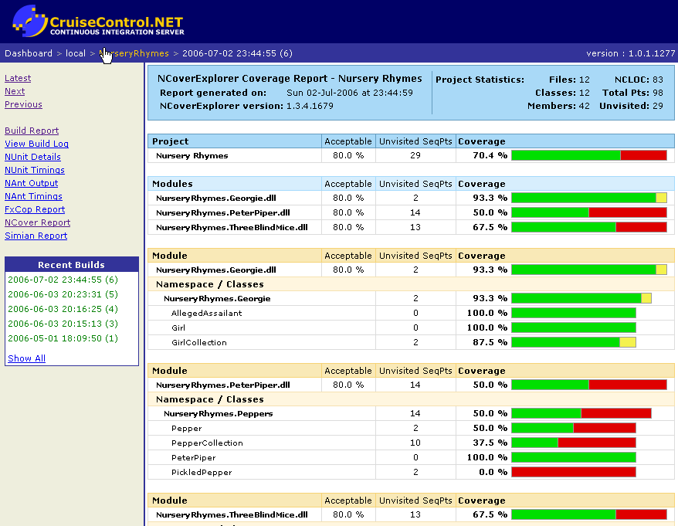
THE KUDU PROJECT

Slide 6

THE KUDU PROJECT
Notes:
And then this happened.
Rackspace, Heroku, Amazon, etc.
And then Azure.
Azure has taken a long time to mature, however, it has arrived and shows no signs of slowing down.

Slide 7
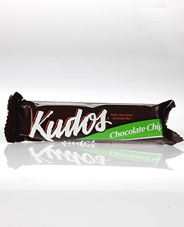
Enter the Kudu Project!
THE KUDU PROJECT
Notes:
Enter the Kudu Project! No not Kudo’s granola bars. Nor Kudo’s for a good job!
This is not what we are taking about…

Slide 8
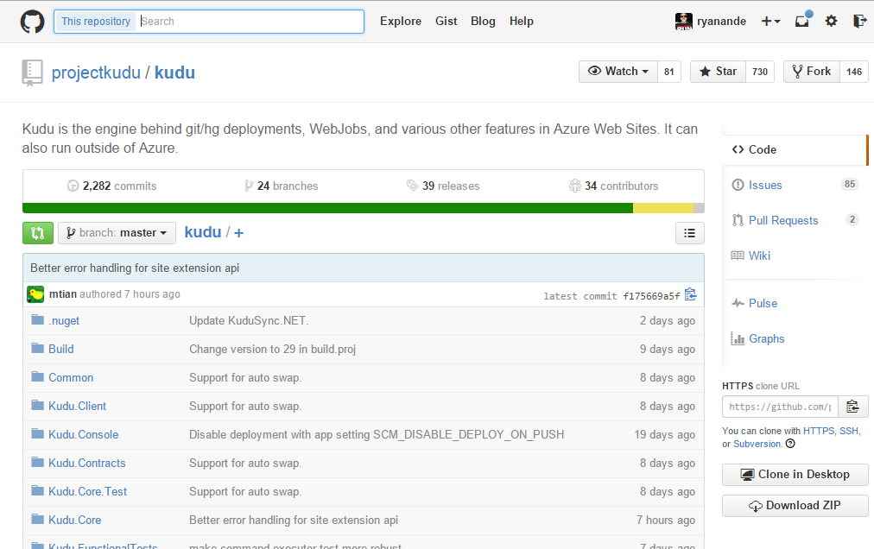
THE KUDU PROJECT
Notes:
The engine behind git and mercurial deployments.

Slide 9
What can you do?
Publishing a website from Source Control
Deployment hooks
Web Hooks
Azure Site Extensions
Post Deployment Action Hooks
Web Jobs
THE KUDU PROJECT
Notes:
Publishing a website from Source Control is a very simple interface on the management portal in Azure.
Deployment hooks: let you take over the deployment and do it yourself!
Web Hooks: external component wants to know when deployments are complete. It registers a callback url that will be called each time a deployment has finished, with the deployment information on whether the deployment was successful or not, the author, commit id and more.
Site Extensions: extensible management end point that allows you to leverage a powerful set of tools deployed as site extensions. These tools range from source code editors like Visual Studio Online to management tools for connected resources such as a MySQL database connected to a website.

Slide 10
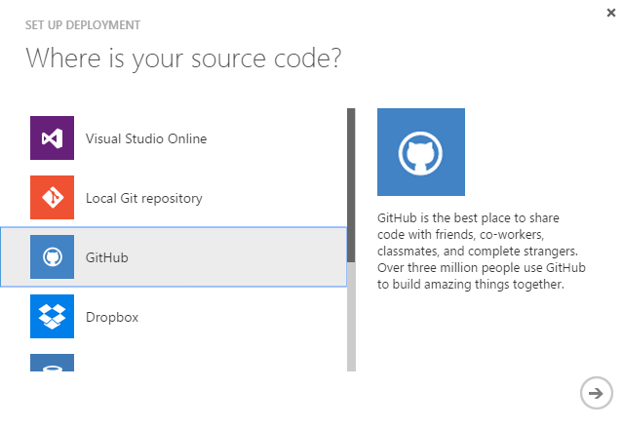
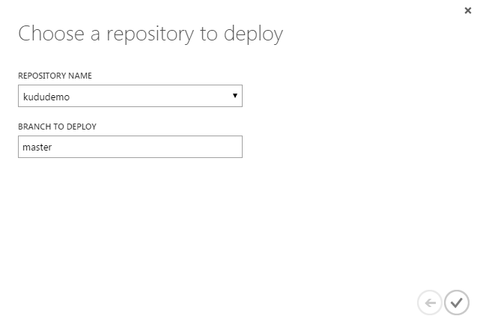
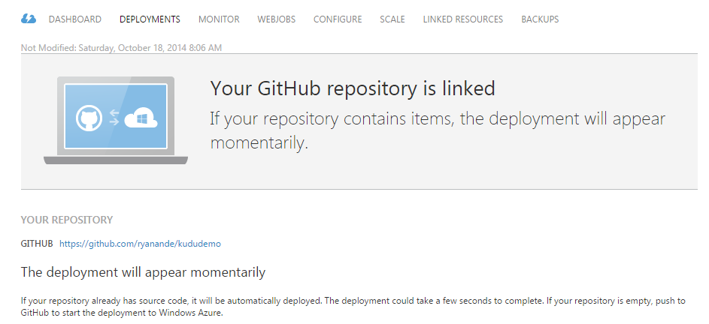
Publishing a website from Source Control
Disco!
THE KUDU PROJECT
Notes:
Azure has matured over the past two years into a solid and streamlined system to work with.
Azure can set up hooks for several repositories, even Dropbox?!? I am sure some guy in Frisco thinks that’s real cool!

Slide 11

Scenario
THE KUDU PROJECT

Slide 12
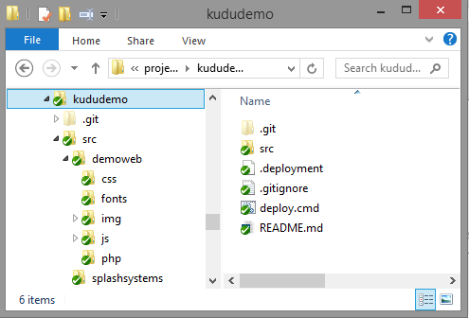
THE KUDU PROJECT

Slide 13

The .deployment file
The key to the kingdom!
THE KUDU PROJECT
Notes:
Deployment hooks!

Slide 14
.deployment – Environment Variables
DEPLOYMENT_SOURCE: this points to where the source files are, which is normally the root of the repo
DEPLOYMENT_TARGET: the target of the deployment. Typically, this is the wwwroot folder
DEPLOYMENT_TEMP: a temporary folder that can be used to store artifacts for the current build. This folder is deleted after the cmd is run.
MSBUILD_PATH: Path to msbuild executable.
THE KUDU PROJECT

Slide 15


.deployment - Example

Slide 16
WRAP!
Continuous Betterment!
Extensible!
Simple… Or not! Rope!
Who’s world is it? .deployment
THE KUDU PROJECT
Notes:
The Kudu Project is Simple, or you can go nuts with it! The give you enough rope to hang yourself! ☺

Slide 17





Thank you to our sponsors…
Austin .Net User Group
Codecamp 2014
GOLD
Happy Hour sponsor
Bronze

