Slide 1
World University Rankings
By: Griffin Clements and Ryan Baik

Slide 2
Reasoning and Presentation Plan
Our goal for this project was to show universities which factors correlate the most to overall ranking
Our original plan was to combine three datasets into one by averaging them
We ultimately decided this was not an effective way to visualize the data as the three datasets use very different metrics for ranking and could not be averaged effectively
So for each dataset, we will discuss which factors correlate the most to a university’s overall ranking

Slide 3
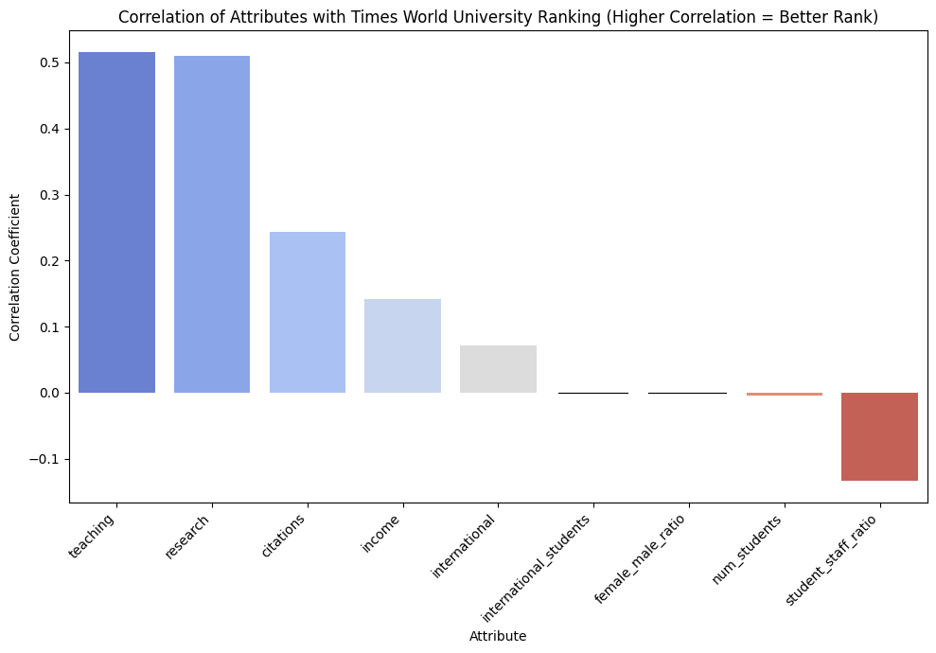
Times Higher Education World University Ranking
Scoring System
Teaching: Quality of teaching environment
Research: Productivity & reputation
Citation: Research impact
Income: Industry collaboration strength
International Outlook: Global engagement
Key Findings
Teaching & Research = Strong positive correlation
Citations = Moderate positive correlation
Industry income, international = Mild impact
Student-staff ratio = Negative correlation

Slide 4
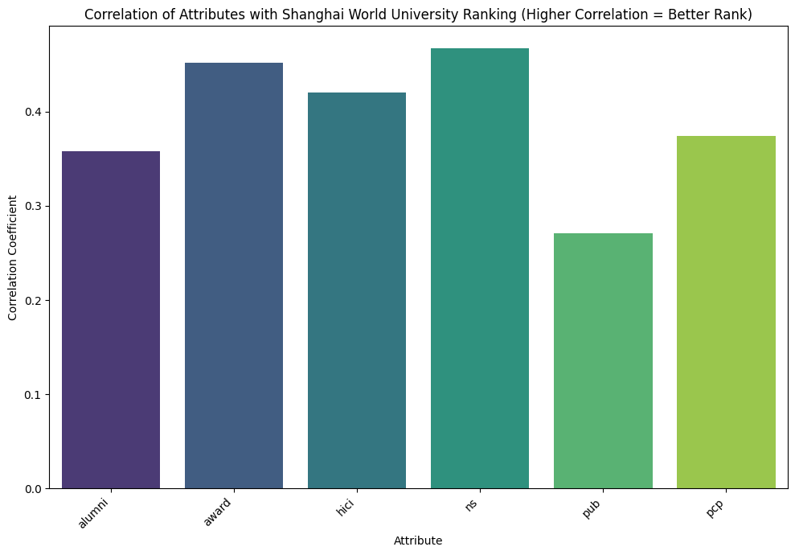
Academic Ranking of World Universities (Shanghai Ranking)
Scoring System: The top university is given a score of 100. Every other university is then scored as a percentage of the top score.
Alumni Score: Number of alumni who have won nobel prizes or fields medals
Award Score: Number of staff who have won nobel prizes or fields medals
HiCi Score: Number of Highly Cited Researchers selected by Thomson Reuters
N&S Score: Number of papers published in Nature and Science
PUB Score: Number of articles indexed in Science Citation Index - Expanded and Social Sciences Citation Index
PCP Score: A university's academic performance per capita. It is calculated by dividing the weighted sum of the other indicators by the number of full-time equivalent academic staff

Slide 5
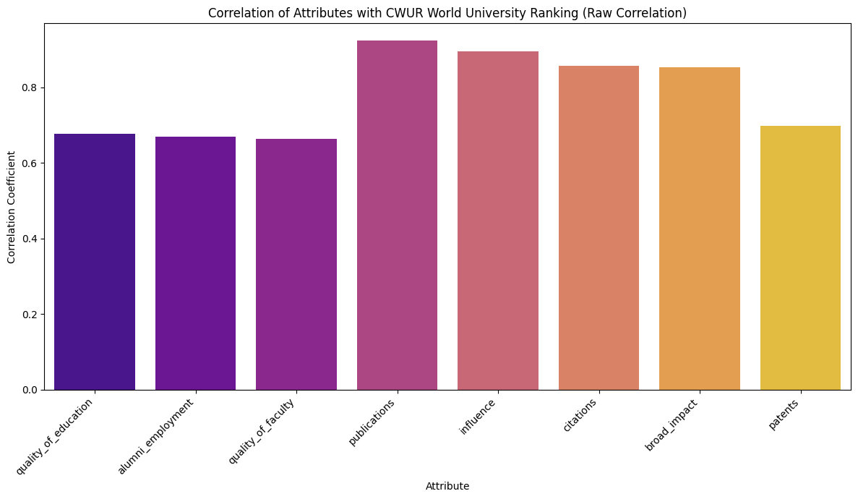
Center for World University Rankings
Scoring System
Quality of Education
Alumni Employment
Quality of Faculty
Publications
Influence
Citations
Broad Impact
Patents
Key Findings
Publications = Strongest positive correlation
Influence / citations / broad impact = High correlations
Education & Employment = Moderate Impact
Patents = Lowest but still positive impact

Slide 6
Conclusion
All of these ranking systems use an objective scoring system, but the weight/correlation to the overall ranking of universities is very subjective.
The Times Ranking System places the most emphasis on teaching quality, research performance, and citation impact, making faculty resources and academic output the strongest drivers of a higher overall ranking.
The Shanghai Ranking System puts a lot of weight on total number of awards and published papers.
The Center Ranking System focuses heavily on research productivity, citation influence, and overall academic output, with publications showing the strongest correlation to higher rankings.
Universities need to decide which ranking system is the most important to them as being the best under them all is not very feasible, and yet somehow Harvard does it.

