Slide 1
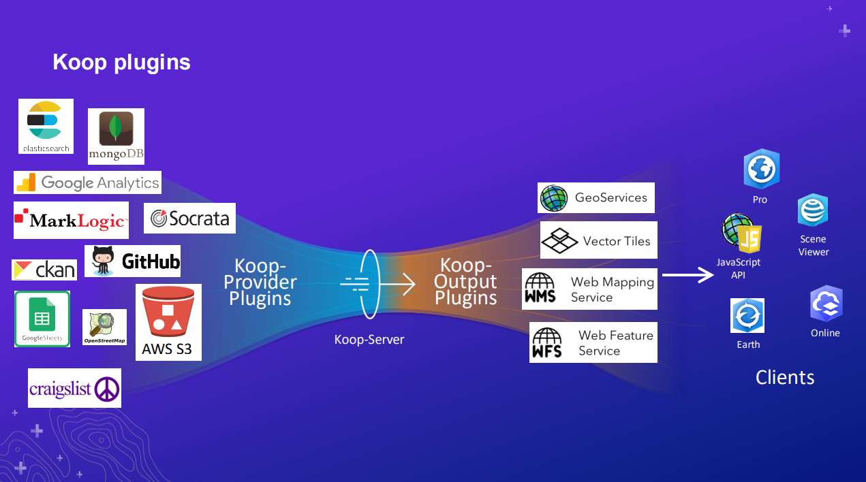



Slide 2
Koop ETL Pipeline
DATA
OpenGround
MIDAS
EM Pumps
e-Risk
BRIP
TRANSLATION
Koop Providers
REPORTING
AGOL
R/Shiny/Rmd
Qlik/Tableau/Power BI
River Gauges
Interoperable Systems

