Slide 1

Connect-4 Playing Agents
Alpha-Beta Pruning
&
Monte Carlo Tree Search

Slide 2
Problem Statement
The goal of this project is to develop intelligent agents capable of playing Connect Four optimally or near-optimally against a human opponent. We researched and implemented two approaches:
Alpha-Beta Pruning
Monte Carlo Tree Search

Slide 3
What is alpha-beta pruning?

Slide 4
What is alpha-beta pruning?
Alpha-beta pruning is a variation of the minimax algorithm

Slide 5
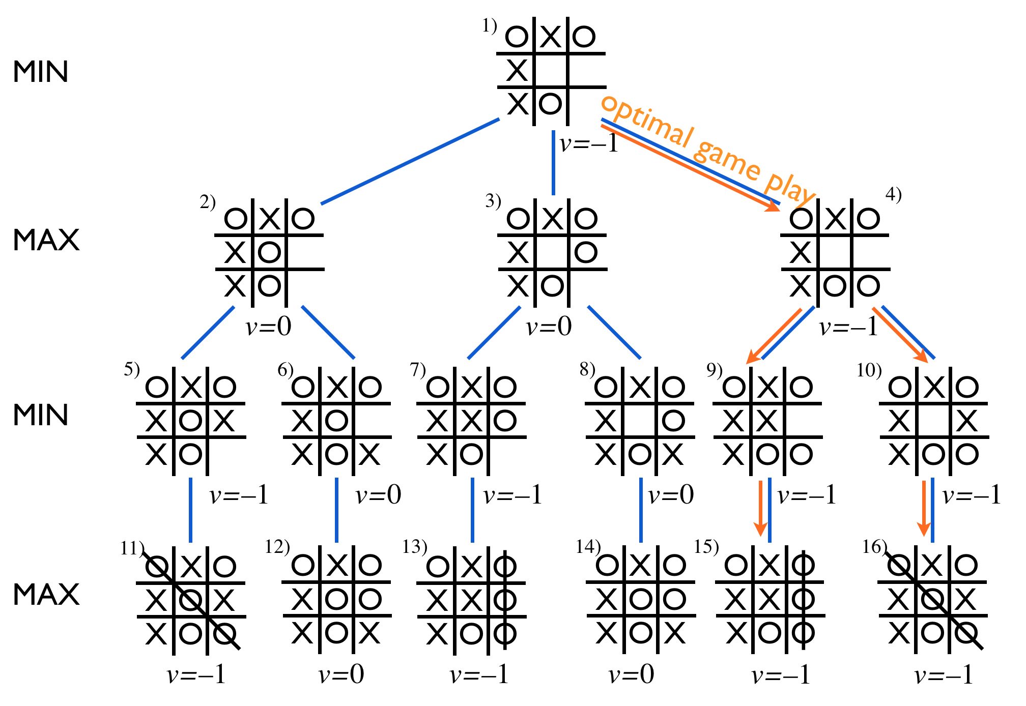
What is minimax?
Minimax is a decision-making algorithm that decides the optimal play in a game against an optimal opponent
Given a game state, it will simulate future turns in which each player makes the optimal move and return the highest score from these potential playlines
For the AI, the optimal move will maximize the score
For the opponent, the optimal move will minimize the score
Credit: https://materiaalit.github.io/intro-to-ai/part2/

Slide 6
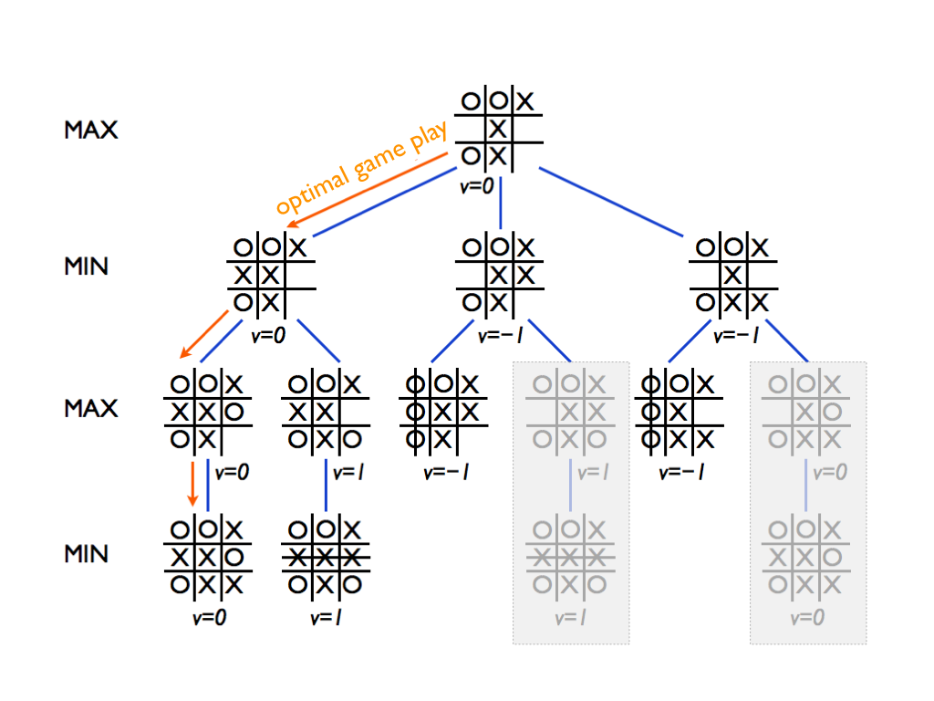
How is alpha-beta pruning different?
While searching playlines, alpha-beta pruning tracks the best possible score for both players (assuming optimal play)
Alpha is the best score for the maximizing player
Beta is the best score for the minimizing player
If it is searching a playline and finds that alpha is greater than beta for that branch, it will stop searching (“prune”) it
Credit: https://materiaalit.github.io/intro-to-ai/part2/

Slide 7
Why can we prune these branches?
When alpha is greater than beta, it means the algorithm has already found a playline that is better for one of the players
If that player plays optimally, they will pick the previously found playline instead

Slide 8
Example
Score = -1

Slide 9
Example
ɑ = -1
ꞵ = -1

Slide 10
Example
Score = 1
ɑ = 1
ꞵ = -1
ɑ > ꞵ
An optimal minimizing player will not pick this playline

Slide 11
Iterative Deepening
In addition to alpha-beta pruning, performance can be significantly improved by only checking game states up to a certain depth rather checking the entire playline. This can lead to nearsightedness in the AI if the depth is too shallow, but if set properly it can reduce a significant amount of the computation for games with high branching factors while still giving a good approximation of the optimal playline.

Slide 12
Findings
Move Time
Move Quality
Worst-Case Time Complexity: O(C^d)
where C is the number of columns in the board (by default C = 7) and d is the search depth
For d <= 5: Move time is consistently <= 1 second
For d = 6: Move time in early game is noticeably longer with some moves taking up to 4 seconds.
Move time decreases as game progresses, possibly due to pruning of suboptimal playlines
For d > 6: move time takes several seconds to minutes
Not practical for most applications
As expected, move quality increases with search depth
At low search depths, the AI is nearsighted and easily falls for long-game traps
At depths >=4, the AI begins to recognize potential threats and blocks them before they develop

Slide 13
Monte Carlo Tree Search
-probabilistic search that scales with thinking time

Slide 14
Overview
Builds a partial game tree by sampling complete games.
Repeats Selection → Expansion → Simulation → Back-propagation.
Uses the UCT score to navigate. For a child node j,
UCT(j) = Wj/Nj + C*(ln N-parent/Nj)^0.5
Exploitation (first term): empirical mean reward.
Exploration (second term): periodically trying out new actions and path
Connect-4 playout outcomes are nearly bernoulli: (win = 1, loss = -1, draw ~ 0.5), so C = 1.41 is a strong default as per Bandit-theory analysis (Auer 2002) for bernoulli rewards

Slide 15
MCTS: Four Phases
Selection – traverse the current tree from root to leaf via the UCT score, balancing exploration and exploitation.
Expansion – if the leaf isn’t terminal and has unvisited moves, create a child for one legal drop column.
Simulation (Playout) – play random or heuristic moves to the end of the game, resulting in a noisy win/loss/draw value.
Back-propagation – propagate that outcome up the path, updating each node’s visit count N and cumulative reward W.

Slide 16
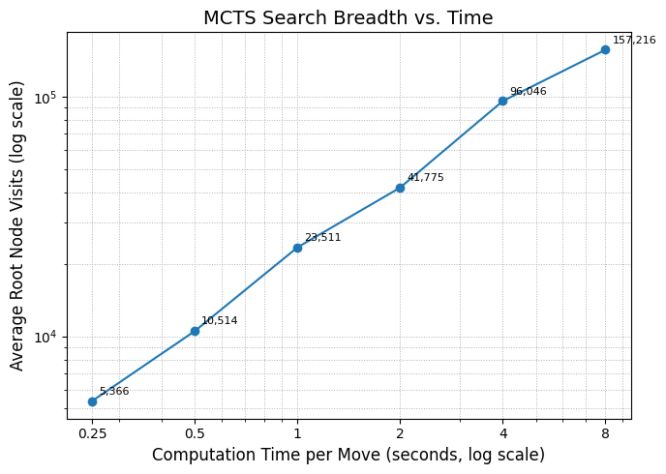
30 Simulations each. Doubling the time nearly doubles the number of roll-outs. The straight line (roughly slope ≈ 0.95 on log–log) confirms that time is a reliable difficulty parameter: if we want a stronger bot, give it more seconds

Slide 17
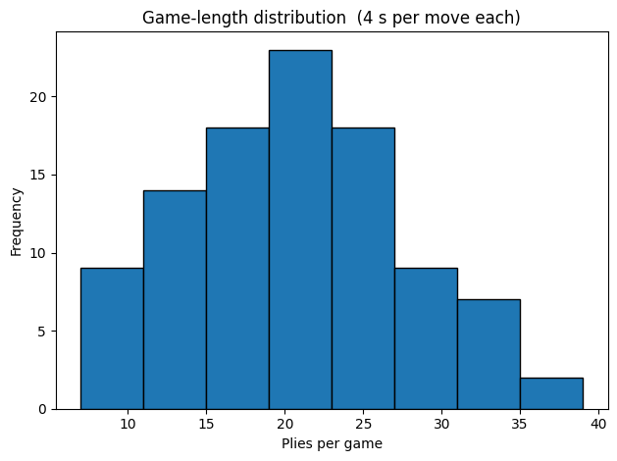
In a simulation of 100 mcts-4s vs mcts-4s, the game-length distribution looks right-skewed. As the number of seconds per move increases, the games usually take longer to resolve as the agents are stronger and the distribution becomes more and more left-skewed.

Slide 18
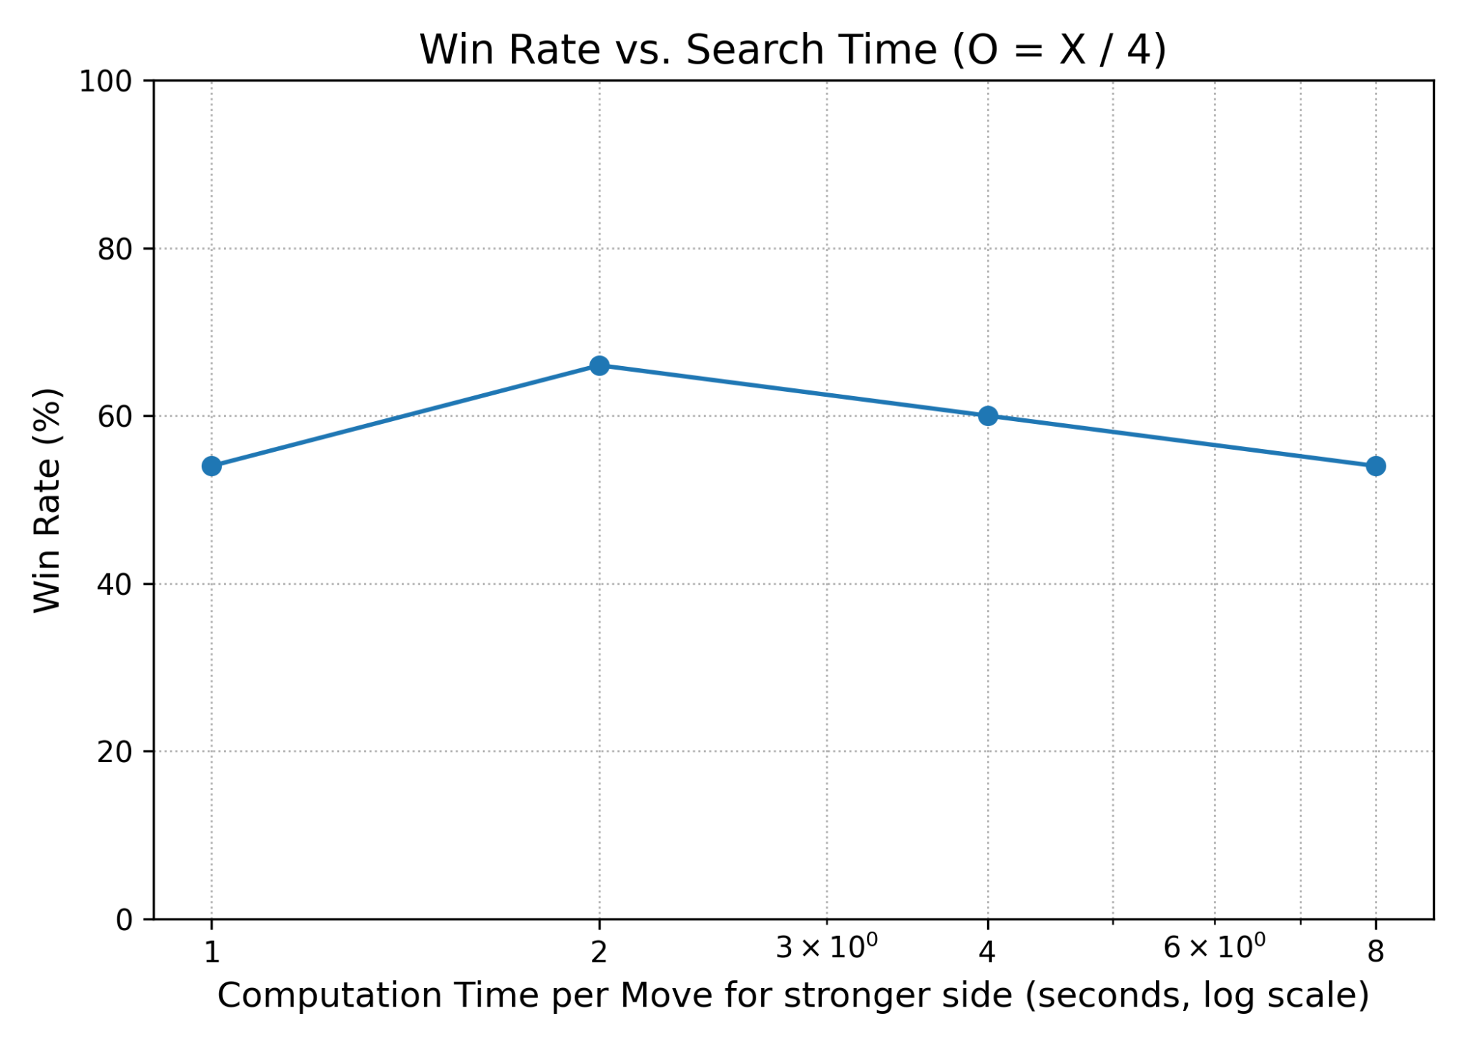
Self-play (100 games simulation):
Even though the ratio of compute (4 : 1) is constant, the absolute increase in roll-outs benefits the weaker agent disproportionately

Slide 19
Comparison with our minmax agent
MCTS (12 s) and Minmax(depth = 2) are comparable in ELO (local pc run); 50 games - MCTS W/L/D : 22/26/2
Very difficult to beat Minimax(depth > 2) with our MCTS agent even with tactics like center preference, immediate win, immediate block, 1 move ahead-block. Requires longer time per move, expensive to compute
Alpha-beta uses handcrafted evaluations, prunes moves effectively, and tactically accurate, whereas for MCTS, most of its budget is spent on thousands of noisy roll-outs that sample just one line at a time. So, difficult to achieve the same tactical sharpness
Future work: play with exploration constant, try more tactics, better processing power, combine with alpha-beta to find forced wins/losses for shallow branches and use MCTS for indecisive parts, precompute endgame database for a fixed number of empty squares <= n, etc.

