Slide 1

Heuristix Analytix
Results from analysis

Slide 2
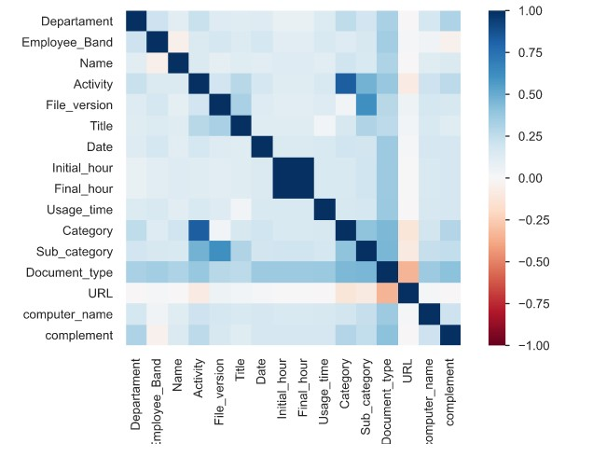
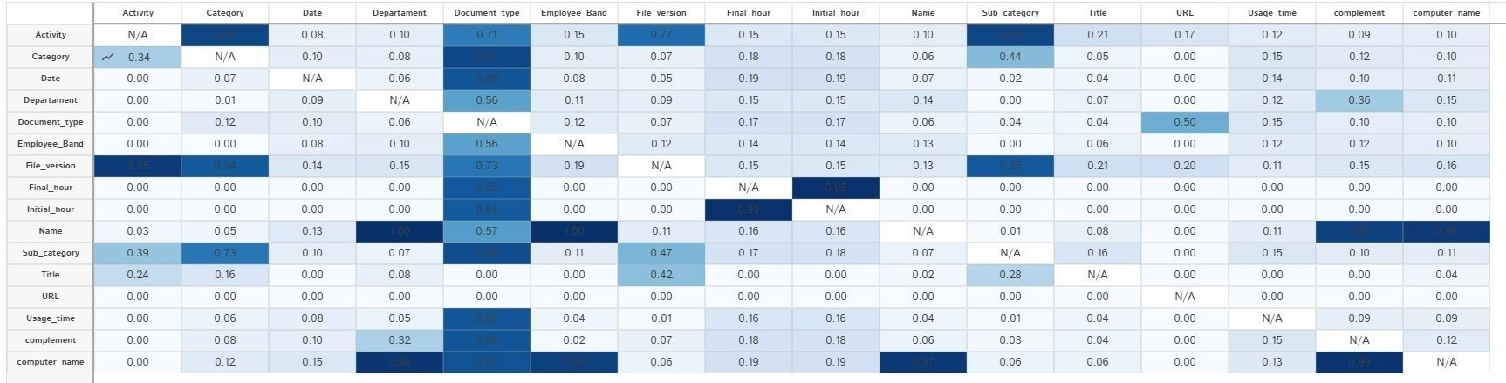
Results from Exploratory Data Analysis
Write your notes on EDA here

