Slide 1


Analytics Playground
Results from analysis

Slide 2
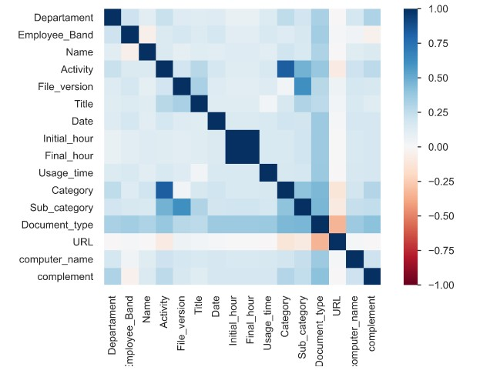
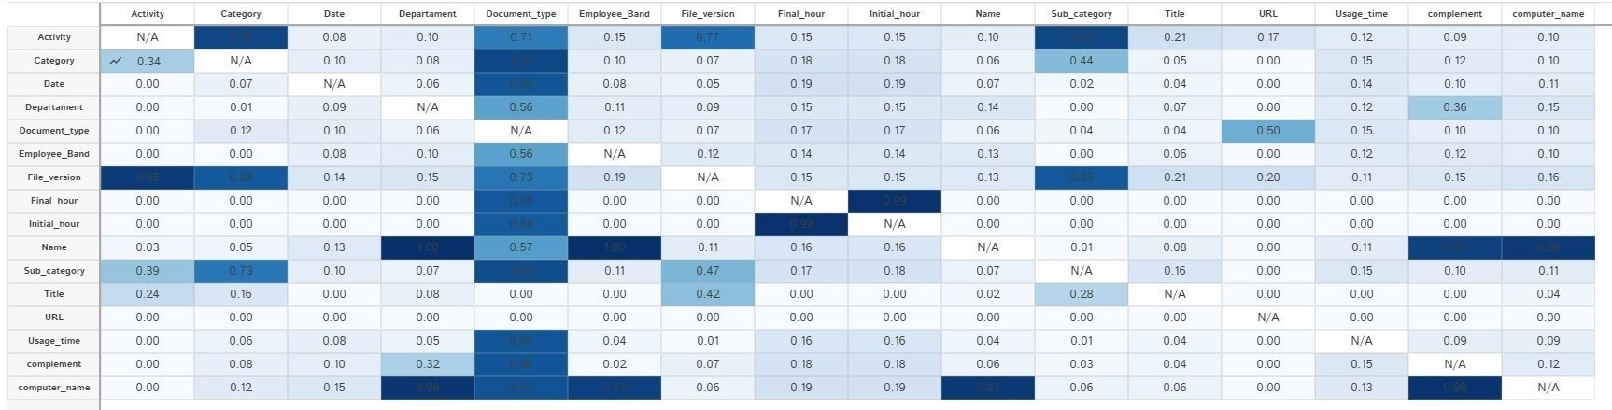
Results from custom data analysis

