Slide 1


Analytics Playground
Results from analysis

Slide 2
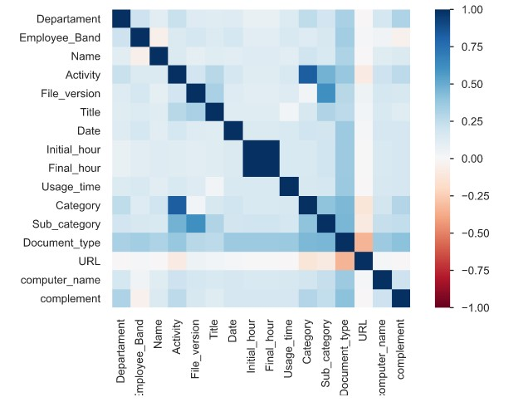
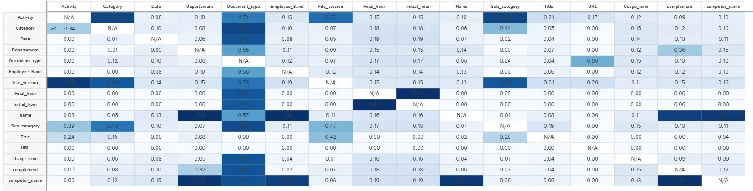
Results from Exploratory Data Analysis
3 hypotheses borne out:
We can see the correlations and PPS scores
Generally, people stick to particular activities, particularly at higher bands (consolided operations) – see e.g. activity<>sub-category
Tools are used regularly, and more innovation could be needed
However, multiple tools are occasionally used for purpose (transformation), see e.g. category<>file-version
These effects are invariant across location – strong team structure (consolidation)

Slide 3
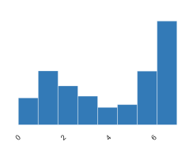
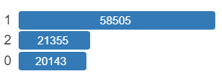
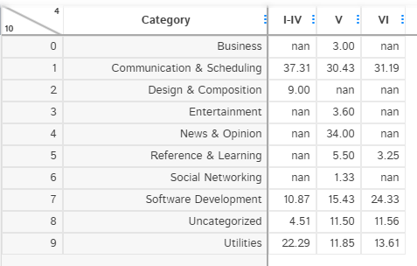
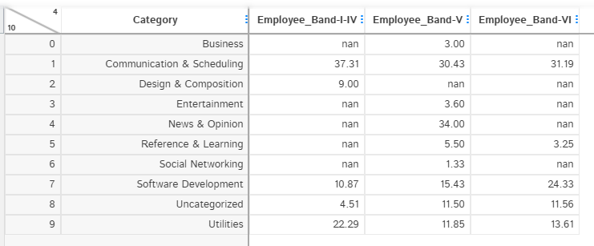
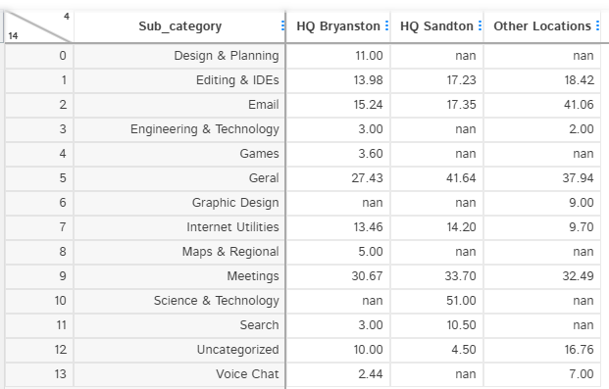
Results from Exploratory Data Analysis
Data from Bryanston swamps sample, as do lower bands
Supply comprises the largest sub-sample
A fairly rigorous structure is followed, with similar tools at similar hours (beginning and end)
Department
Band

