Slide 1

Overall

Slide 2

Agency/Region

Slide 3
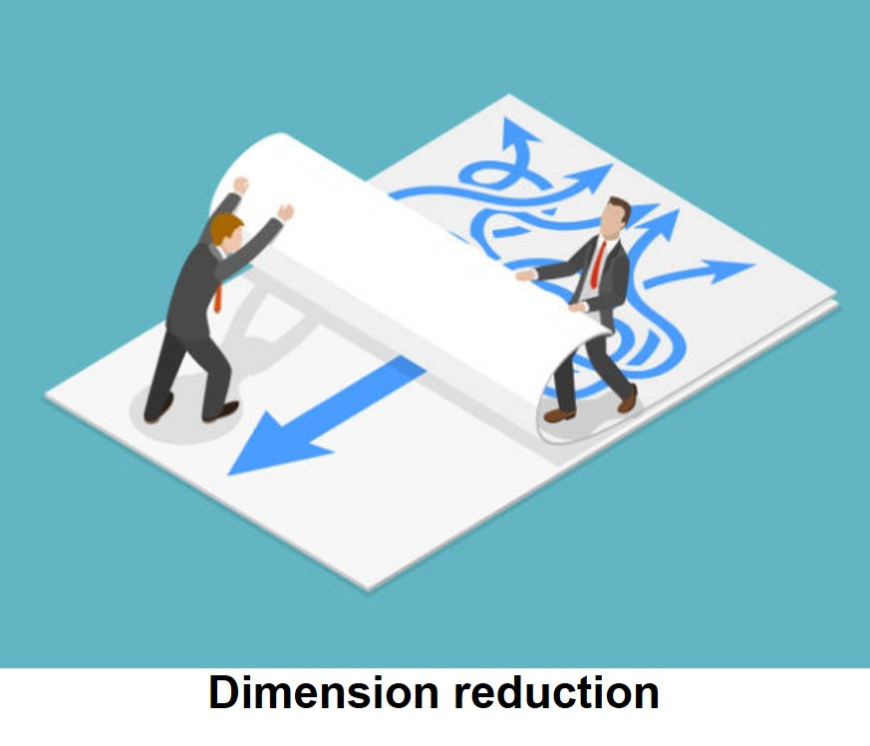
Advisor

