Slide 1
One Size Fits All? Decentralization, Corruption, and the Monitoring of Bureaucrats
Lessmann and Markwardt
Presented by Ryan Brosnahan

Slide 2
Motivation
Decentralization is often associated with less corruption, but is that the whole story?
12% of World Bank projects during 1993-97 involved decentralizing governments
As of 2006 over 19% of the World Bank budget is spent on decentralization projects
Notes:
When the iron curtain fell, many formerly communist countries become more decentralized. Why did Russia become so corrupt while satellite nations like Hungary did not?
Maybe there is a complementary relationship between decentralization and the monitoring of these bureaucrats

Slide 3
Literature
Theory:
Decentralization promotes competition between jurisdictions which gives elected officials incentive to provide better (less corrupt) service. (Arikan, 2004; Dincer, Ellis, and Waddell, 2006)
Monitoring of bureaucrats in poorer and developing countries is much weaker (Bardham and Mookherjee, 2006)
Empirical:
Majority of studies find a positive relationship between decentralization and absence of corruption (Huther and Shah, 1998; Fishman and Gatti, 2002; Arikan, 2004; Lederman, Loayza, and Soares, 2005)
Majority of studies find a positive relationship between freedom of the press and absence of corruption (Stapenhurst, 2002; Ahrend, 2002; Freille et al. 2007)
Notes:
Perhaps monitoring of the bureaucrats is the real variable to look at!

Slide 4
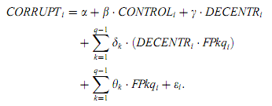
Model and Data
Decentralization indicators: Revenue, Expenditure, Employment, levels of government (tiers)
Corruption Indicators: PRS Group’s International Country Risk Guide (ICRG)
Notes:
Control includes things like population, GDP/Capita, Government Size
FPkq quintiles of freedom of the press (3)
Also did TSLS but we don’t have time to discuss in this presentation

Slide 5
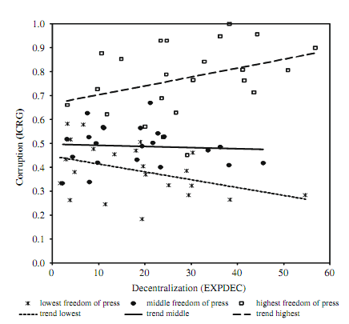
Results 1/2
Notes:
As the theory suggested.
CORRUPTION IS A MEASURE OF ABSENCE OF CORRUPTION

Slide 6
Results 2/2
Different quintile separation was explored, 3
Robustness tests were performed on various combinations of indicators, ICRG and Expenditure Decentralization
TSLS adjusting for corrupt government controlling the press still finds results consistent with OLS findings

Slide 7
Conclusions
Decentralization does impact corruption
The Effect is ambiguous without also understanding how bureaucrats are monitored

