Slide 1
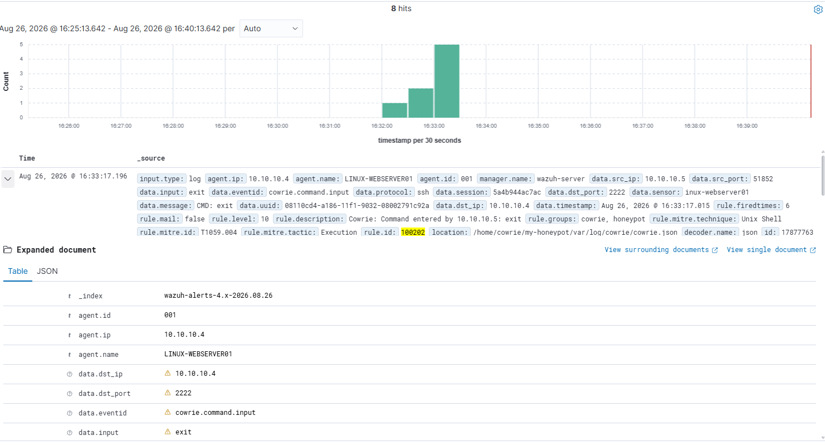
DECEPTION & SIEM VALIDATION
COMPLETED • VALIDATED
Cowrie honeypot monitoring
A non-root SSH deception service produced structured telemetry that Wazuh decoded, classified, and preserved as evidence.
DISPOSITION
End-to-end deception telemetry and three custom detections validated.
8 Wazuh alerts • 17 raw events • 1 controlled SSH session
COWRIE HONEYPOT • STAKEHOLDER RECAP • Ryan Bryant • August 26, 2026
01
Notes:
[Sources]
- User-provided lab evidence and screenshots captured August 26, 2026.
- https://docs.cowrie.org/en/latest/INSTALL.html
- https://documentation.wazuh.com/current/user-manual/capabilities/log-data-collection/monitoring-log-files.html
[/Sources]

Slide 2
EXECUTIVE OUTCOME
One controlled session exercised the full monitoring chain
The lab proved service reachability, structured collection, custom rule matching, alert severity, and evidence integrity.
17
8
3
raw Cowrie events
validated Wazuh alerts
custom detection rules
Session telemetry preserved connection, authentication, and command context.
1 failed login + 1 successful login + 6 command-input events.
Levels 7, 9, and 10 with MITRE ATT&CK context.
EXECUTIVE CONCLUSION
The interaction remained inside Cowrie’s emulated environment; no evidence showed access to the real Ubuntu filesystem or a production system.
COWRIE HONEYPOT • STAKEHOLDER RECAP • Ryan Bryant • August 26, 2026
02
Notes:
[Sources]
- User-provided lab evidence and screenshots captured August 26, 2026.
- https://docs.cowrie.org/en/latest/INSTALL.html
- https://documentation.wazuh.com/current/user-manual/reference/ossec-conf/localfile.html
[/Sources]

Slide 3
DETECTION CHAIN
Secure deployment became actionable SIEM telemetry
Each stage was validated before the next service or rule change was accepted.
Deploy & restrict
Generate telemetry
Correlate & verify
01
02
03
Cowrie ran under a locked non-root account on TCP 2222, allowed only from the private 10.10.10.0/24 lab subnet.
One failed login, one simulated success, and six shell commands created a linked session with 17 raw records.
Wazuh JSON decoding and rules 100200–100202 produced 8 alerts; all 8 evidence files passed SHA-256.
Control point: Wazuh collector and rule syntax were tested before services were restarted.
COWRIE HONEYPOT • STAKEHOLDER RECAP • Ryan Bryant • August 26, 2026
03
Notes:
[Sources]
- User-provided lab evidence and screenshots captured August 26, 2026.
- https://documentation.wazuh.com/current/user-manual/reference/ossec-conf/localfile.html
- https://documentation.wazuh.com/current/user-manual/ruleset/decoders/json-decoder.html
[/Sources]

Slide 4
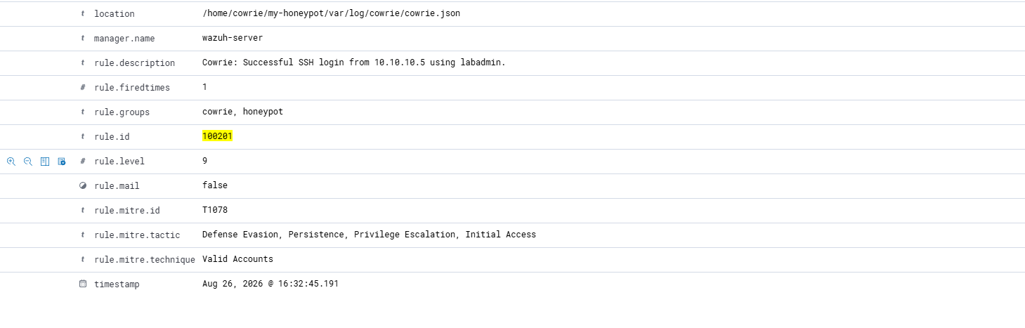
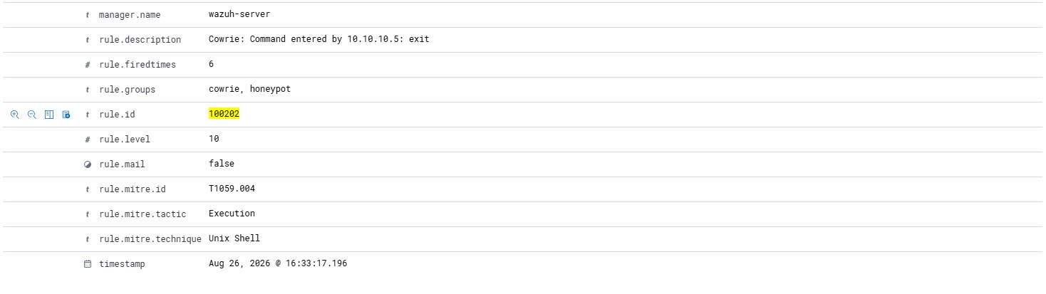
EVIDENCE
The SIEM preserved the authentication-to-command sequence
Screenshots confirm alert volume, severity, event type, source, destination, and ATT&CK mapping.
Rule 100201 • level 9 • T1078 Valid Accounts
8 hits for the controlled Cowrie session
Rule 100202 • level 10 • T1059.004 Unix Shell
COWRIE HONEYPOT • STAKEHOLDER RECAP • Ryan Bryant • August 26, 2026
04
Notes:
[Sources]
- User-provided lab evidence and screenshots captured August 26, 2026.
- https://attack.mitre.org/techniques/T1078/
- https://attack.mitre.org/techniques/T1059/004/
[/Sources]

Slide 5
RISK AND OPERATING IMPACT
The honeypot increased visibility while preserving the real host boundary
The exercise validates monitoring behavior, not internet-scale resilience or attacker attribution.
DECEPTION VALUE
SAFETY BOUNDARY
DATA HANDLING
The fake shell held the interaction
Real SSH remained unchanged
Telemetry can contain secrets
Commands returned emulated output; no evidence showed access to the real Ubuntu filesystem.
Cowrie stayed on TCP 2222 under a non-root account and was limited to the private lab subnet.
Production honeypot credentials and command logs should be treated as sensitive security data.
Limit: one scripted lab session does not establish production false-positive rates, high-volume performance, or exposure to real adversary infrastructure.
COWRIE HONEYPOT • STAKEHOLDER RECAP • Ryan Bryant • August 26, 2026
05
Notes:
[Sources]
- User-provided lab evidence and screenshots captured August 26, 2026.
- https://docs.cowrie.org/en/latest/INSTALL.html
[/Sources]

Slide 6
RECOMMENDED NEXT STEPS
Operationalize the deception capability
Priorities address segmentation, sensitive telemetry, correlation quality, and service health.
Dedicated segment
Place production honeypots in a monitored segment with strict outbound controls and clear ownership.
01
Sensitive-data controls
Restrict access, retention, and export of captured credentials, command logs, and session transcripts.
02
Behavior correlation
Link authentication success, command input, source reputation, and session identifiers into higher-confidence cases.
03
Health monitoring
Alert on process failure, port closure, agent gaps, and missing log ingestion so silence is not misread as safety.
04
Decision request: approve a small pilot with network isolation, log-access controls, and health monitoring defined before exposure.
COWRIE HONEYPOT • STAKEHOLDER RECAP • Ryan Bryant • August 26, 2026
06
Notes:
[Sources]
- User-provided lab evidence and screenshots captured August 26, 2026.
- https://docs.cowrie.org/en/latest/INSTALL.html
- https://documentation.wazuh.com/current/user-manual/capabilities/log-data-collection/monitoring-log-files.html
[/Sources]

