Slide 1
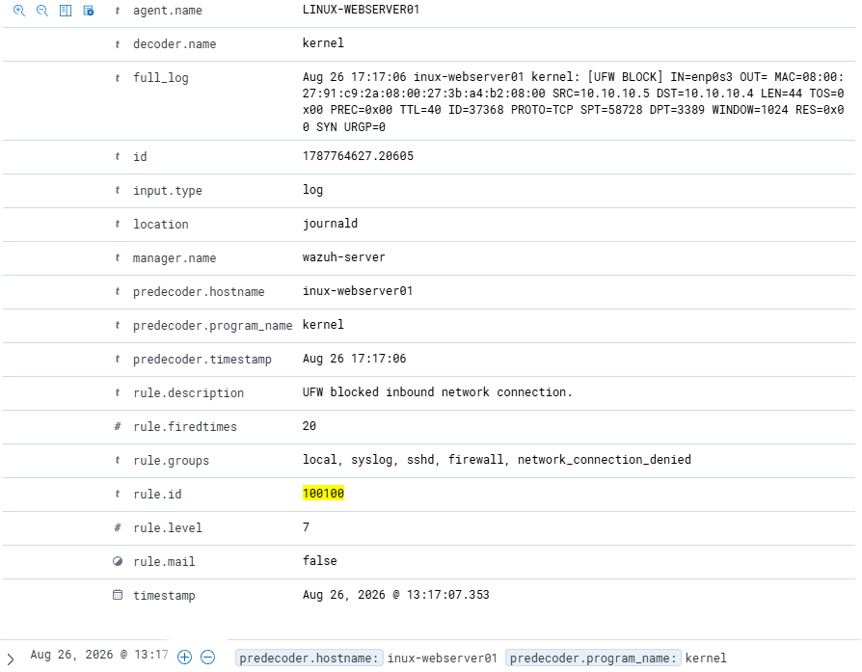
SOC RESPONSE EXERCISE
COMPLETED • VALIDATED
Targeted network isolation
A source-specific UFW containment action blocked the simulated scanner while trusted HTTP access remained available.
DISPOSITION
No compromise, outage, or data disclosure confirmed.
Wazuh rule 100100 • level 7 • source 10.10.10.5
NETWORK ISOLATION • STAKEHOLDER RECAP • Ryan Bryant • August 26, 2026
01
Notes:
[Sources]
- User-provided lab evidence and screenshots captured August 26, 2026.
- https://documentation.wazuh.com/current/user-manual/ruleset/rules/custom.html
[/Sources]

Slide 2
EXECUTIVE OUTCOME
Containment worked without interrupting trusted service
The response was narrow, reversible, and validated from both blocked and authorized network locations.
3
200
10
tested ports filtered
authorized HTTP retained
evidence files verified
TCP 22, 80, and 8080 were unreachable from 10.10.10.5 after isolation.
The Wazuh server continued to receive a successful web response.
Every collected artifact passed SHA-256 verification.
EXECUTIVE CONCLUSION
The blocked source lost access to the tested services, while an authorized system remained online. The temporary rule was then removed and normal reachability restored.
NETWORK ISOLATION • STAKEHOLDER RECAP • Ryan Bryant • August 26, 2026
02
Notes:
[Sources]
- User-provided lab evidence and screenshots captured August 26, 2026.
- https://ubuntu.com/server/docs/how-to/security/firewalls/
- https://nmap.org/book/man-port-scanning-basics.html
[/Sources]

Slide 3
ACTIVITY TIMELINE
Detect, contain, validate, recover
Each phase produced observable evidence before the analyst advanced to the next action.
Detect & triage
Isolate source
Validate & recover
01
02
03
Wazuh recorded repeated UFW blocks under rule 100100 at level 7; source and destination fields were confirmed.
A logged deny rule for 10.10.10.5 was inserted at position 1 ahead of normal SSH and Apache allowances.
Blocked-source tests, trusted HTTP 200, continued telemetry, rollback, and hash verification closed the exercise.
Control point: the analyst validated trusted service availability before declaring containment successful.
NETWORK ISOLATION • STAKEHOLDER RECAP • Ryan Bryant • August 26, 2026
03
Notes:
[Sources]
- User-provided lab evidence and screenshots captured August 26, 2026.
- https://ubuntu.com/server/docs/how-to/security/firewalls/
[/Sources]

Slide 4
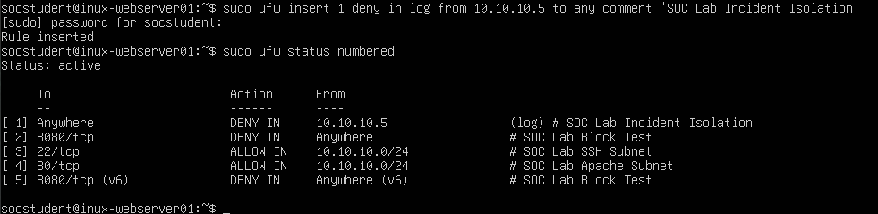
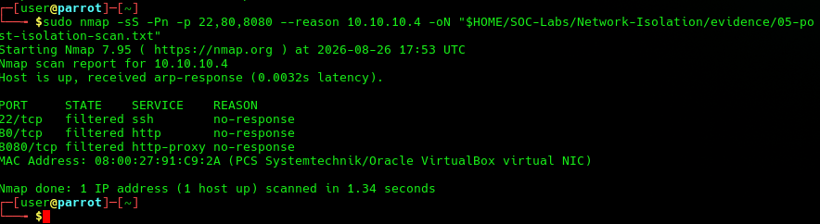
EVIDENCE
The record supports both enforcement and continuity
Key screenshots link the SIEM alert, firewall action, and independent post-isolation test.
Action: source deny rule placed first
Detection: rule 100100, level 7, SRC 10.10.10.5 → DST 10.10.10.4
Validation: TCP 22 / 80 / 8080 filtered
NETWORK ISOLATION • STAKEHOLDER RECAP • Ryan Bryant • August 26, 2026
04
Notes:
[Sources]
- User-provided lab evidence and screenshots captured August 26, 2026.
- https://documentation.wazuh.com/current/user-manual/ruleset/rules/custom.html
- https://nmap.org/book/man-port-scanning-basics.html
[/Sources]

Slide 5
BUSINESS IMPACT
Security improved without a general service outage
Observed facts are separated from conclusions the exercise did not establish.
CONTINUITY
SECURITY
LIMIT
HTTP remained available
The tested source was blocked
No compromise was proven
An authorized request from 10.10.10.3 returned status 200 during containment.
The simulated scanner saw TCP 22, 80, and 8080 as filtered after the rule change.
The lab generated reconnaissance only; it did not demonstrate exploitation, persistence, or data loss.
Residual risk: a production implementation would need time-bound rules, approvals, redundant network paths, and broader telemetry correlation.
NETWORK ISOLATION • STAKEHOLDER RECAP • Ryan Bryant • August 26, 2026
05
Notes:
[Sources]
- User-provided lab evidence and screenshots captured August 26, 2026.
- https://nmap.org/book/man-port-scanning-basics.html
[/Sources]

Slide 6
RECOMMENDED NEXT STEPS
Turn a successful lab control into a governed response pattern
Priorities focus on minimizing disruption, increasing detection confidence, and preserving auditable evidence.
Time-bound response
Use source-specific active-response rules with explicit approval, expiration, and rollback controls.
01
Stronger correlation
Join UFW blocks with authentication, endpoint, and asset-criticality telemetry before escalating severity.
02
Dual-path validation
Test every containment action from at least one blocked location and one trusted service path.
03
Evidence governance
Retain rule-change records, timestamps, and SHA-256 manifests with the incident record.
04
Decision request: adopt the workflow as a repeatable tabletop and automate evidence collection before production use.
NETWORK ISOLATION • STAKEHOLDER RECAP • Ryan Bryant • August 26, 2026
06
Notes:
[Sources]
- User-provided lab evidence and screenshots captured August 26, 2026.
- https://ubuntu.com/server/docs/how-to/security/firewalls/
- https://documentation.wazuh.com/current/user-manual/ruleset/rules/custom.html
[/Sources]

