Slide 1
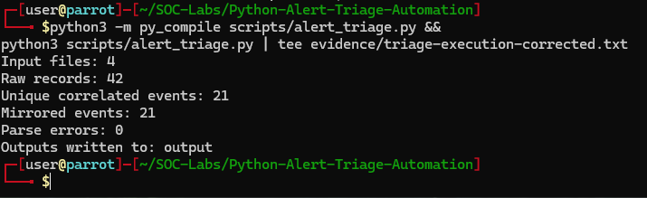
SECURITY AUTOMATION & DATA QUALITY
COMPLETED • VALIDATED
Python alert triage
A normalization and correlation pipeline converted duplicated Suricata/Wazuh records into a reconciled, analyst-ready event set.
DISPOSITION
42 raw records normalized into 21 unique events with zero parser errors.
42 raw • 21 unique • 21 mirrored • 0 parser errors
PYTHON ALERT TRIAGE • STAKEHOLDER REPORT • Ryan Bryant • August 29, 2026
01
Notes:
[Sources]
- Direct lab evidence captured by Ryan Bryant, August 29, 2026.
[/Sources]

Slide 2
EXECUTIVE OUTCOME
Normalization halved duplicate workload without data loss
The lab proved complete parsing, cross-platform field normalization, mirrored-event correlation, and multi-format reporting.
42
21
0
raw alert records
unique events
parser errors
Four JSONL inputs contained direct Suricata events and their Wazuh-ingested mirrors.
Twenty ICMP events and one custom HTTP event remained after correlation.
Every input line was accounted for; no malformed records were silently discarded.
EXECUTIVE CONCLUSION
The corrected pipeline reduced analyst-facing volume by 50% while preserving every underlying event and its source provenance.
PYTHON ALERT TRIAGE • STAKEHOLDER REPORT • Ryan Bryant • August 29, 2026
02
Notes:
[Sources]
- Counts are drawn from triage-summary.json and the corrected execution output.
[/Sources]

Slide 3
DETECTION CHAIN
A data defect became a more trustworthy correlation pipeline
The workflow exposed, diagnosed, corrected, and verified a cross-platform representation mismatch.
Parse & normalize
Diagnose & correlate
Prioritize & report
01
02
03
Read four JSONL files, mapped both source schemas, standardized types, and quarantined parsing failures explicitly.
A field comparison found integer flow_id versus a string ending in .000000; normalization restored stable identifiers.
The script produced 21 correlated events, priority counts, signature totals, six outputs, and a verified hash manifest.
Control point: raw counts, unique counts, mirrors, priorities, signatures, and parser errors were reconciled before the run was accepted.
PYTHON ALERT TRIAGE • STAKEHOLDER REPORT • Ryan Bryant • August 29, 2026
03
Notes:
[Sources]
- The defect and correction are documented in correlation-troubleshooting.txt and field diagnostic evidence.
[/Sources]

Slide 4
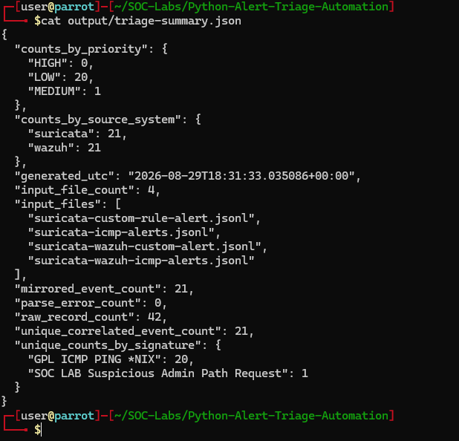
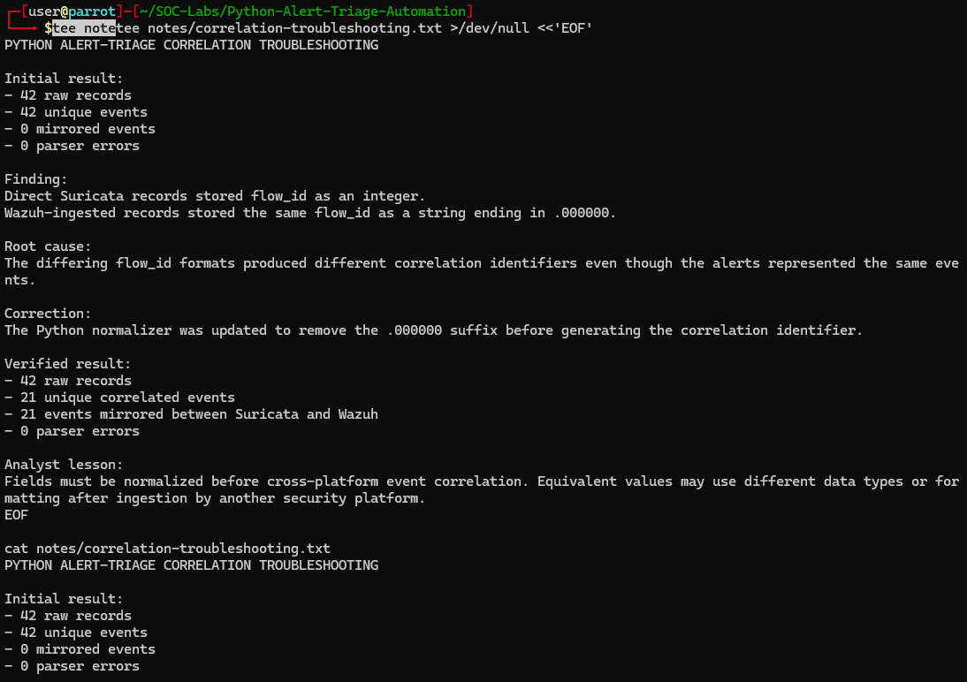
EVIDENCE
The evidence proves the defect, correction, and reconciled outcome
Execution, summary, and troubleshooting artifacts show how the result was obtained—not only the final number.
triage-summary.json • reconciled sources, priorities, signatures
Corrected run • 42 raw • 21 unique • 21 mirrors • 0 errors
Root cause • integer flow_id vs string ending .000000
PYTHON ALERT TRIAGE • STAKEHOLDER REPORT • Ryan Bryant • August 29, 2026
04
Notes:
[Sources]
- Evidence screenshots: corrected run, triage summary, and root-cause note.
[/Sources]

Slide 5
RISK AND OPERATING IMPACT
Data normalization improved signal quality and analyst efficiency
The exercise validates a controlled batch workflow, not enterprise streaming performance or production severity logic.
ANALYST VALUE
DATA QUALITY
EVIDENCE CONFIDENCE
Duplicate work was removed
Representation was standardized
No records disappeared
Mirrored records stayed traceable but no longer inflated the unique event queue.
Equivalent flow IDs became equal only after type and formatting normalization.
Explicit parser-error output, source provenance, reconciled counts, and SHA-256 checks supported trust.
Limit: the 42-record batch does not establish streaming throughput, large-scale memory behavior, production severity governance, or schema stability over time.
PYTHON ALERT TRIAGE • STAKEHOLDER REPORT • Ryan Bryant • August 29, 2026
05
Notes:
[Sources]
- Operating implications are analyst inferences from the controlled lab findings.
[/Sources]

Slide 6
RECOMMENDED NEXT STEPS
Operationalize the triage automation
Priorities strengthen regression protection, schema governance, supportability, and controlled tuning.
Regression tests
Test numeric/string equivalents, missing fields, malformed JSON, and correlation edge cases.
01
Schema versioning
Document and version the canonical field model and correlation-key definition.
02
Run telemetry
Add structured logs, run identifiers, input manifests, and health metrics for scheduled execution.
03
Govern triage rules
Move priority logic into reviewed configuration with documented owners and tuning history.
04
Decision request: advance the pipeline to a scheduled pilot after adding automated tests, schema versioning, and run-health telemetry.
PYTHON ALERT TRIAGE • STAKEHOLDER REPORT • Ryan Bryant • August 29, 2026
06
Notes:
[Sources]
- Recommendations are analyst inferences; Python JSON docs: https://docs.python.org/3/library/json.html
[/Sources]

